Slide 1
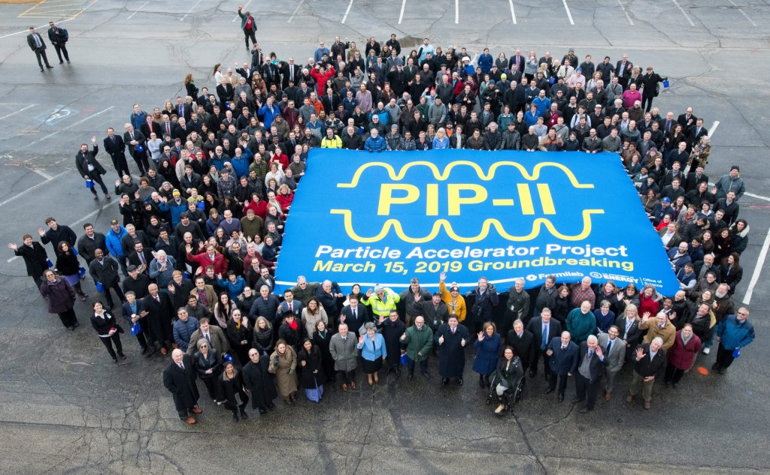

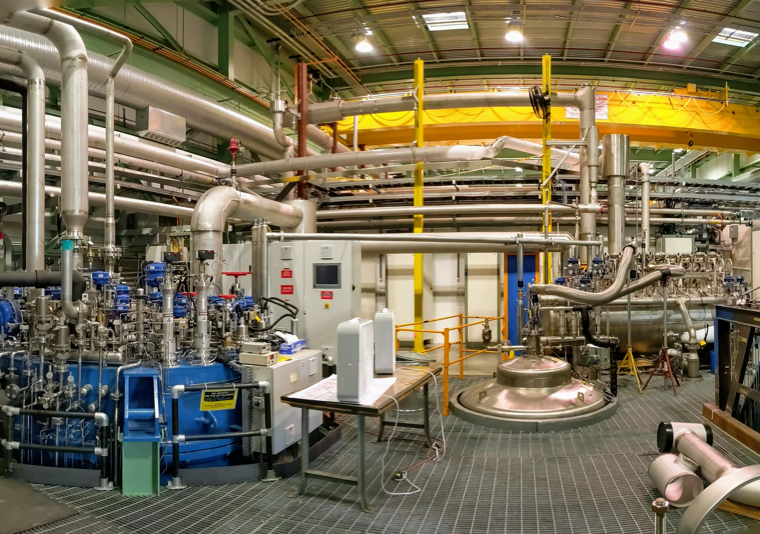
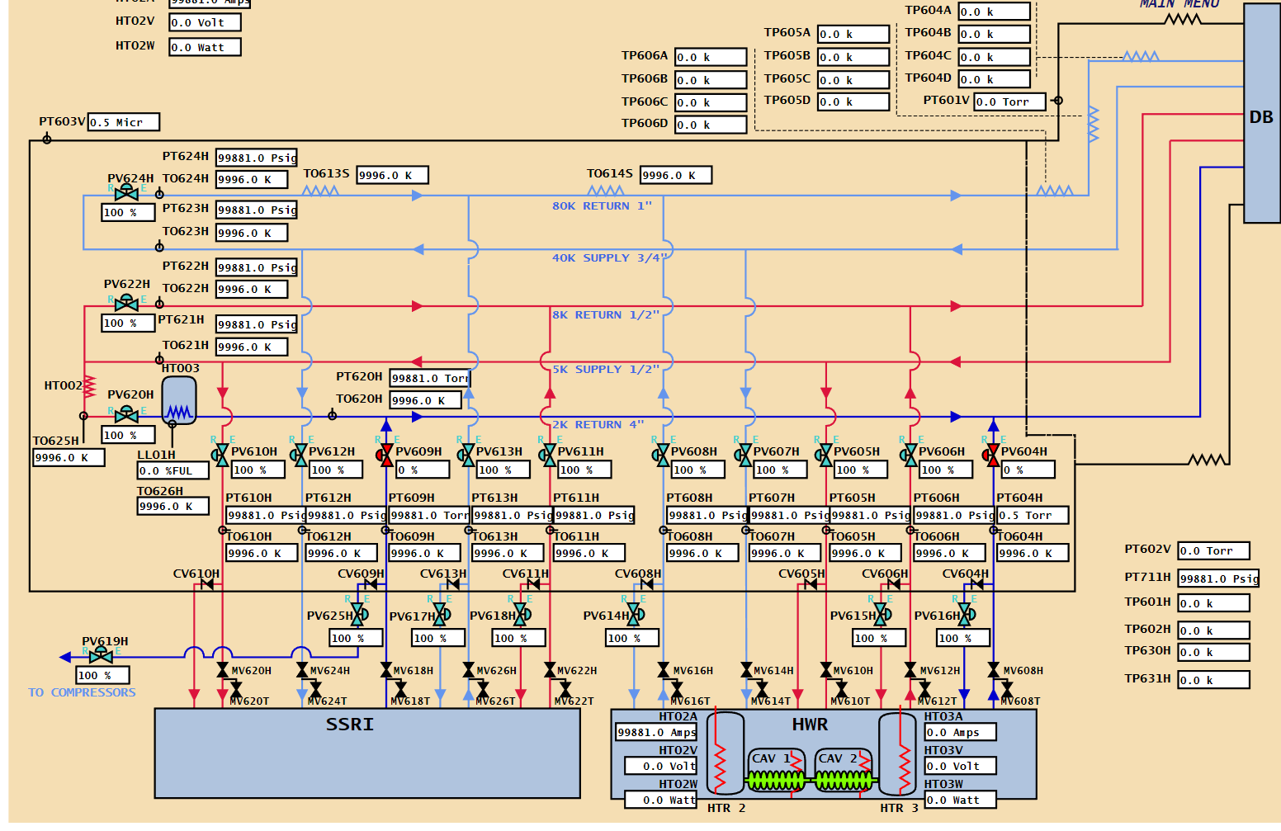
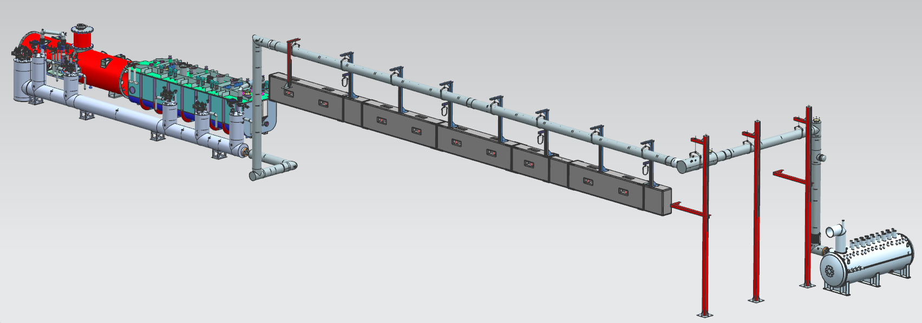
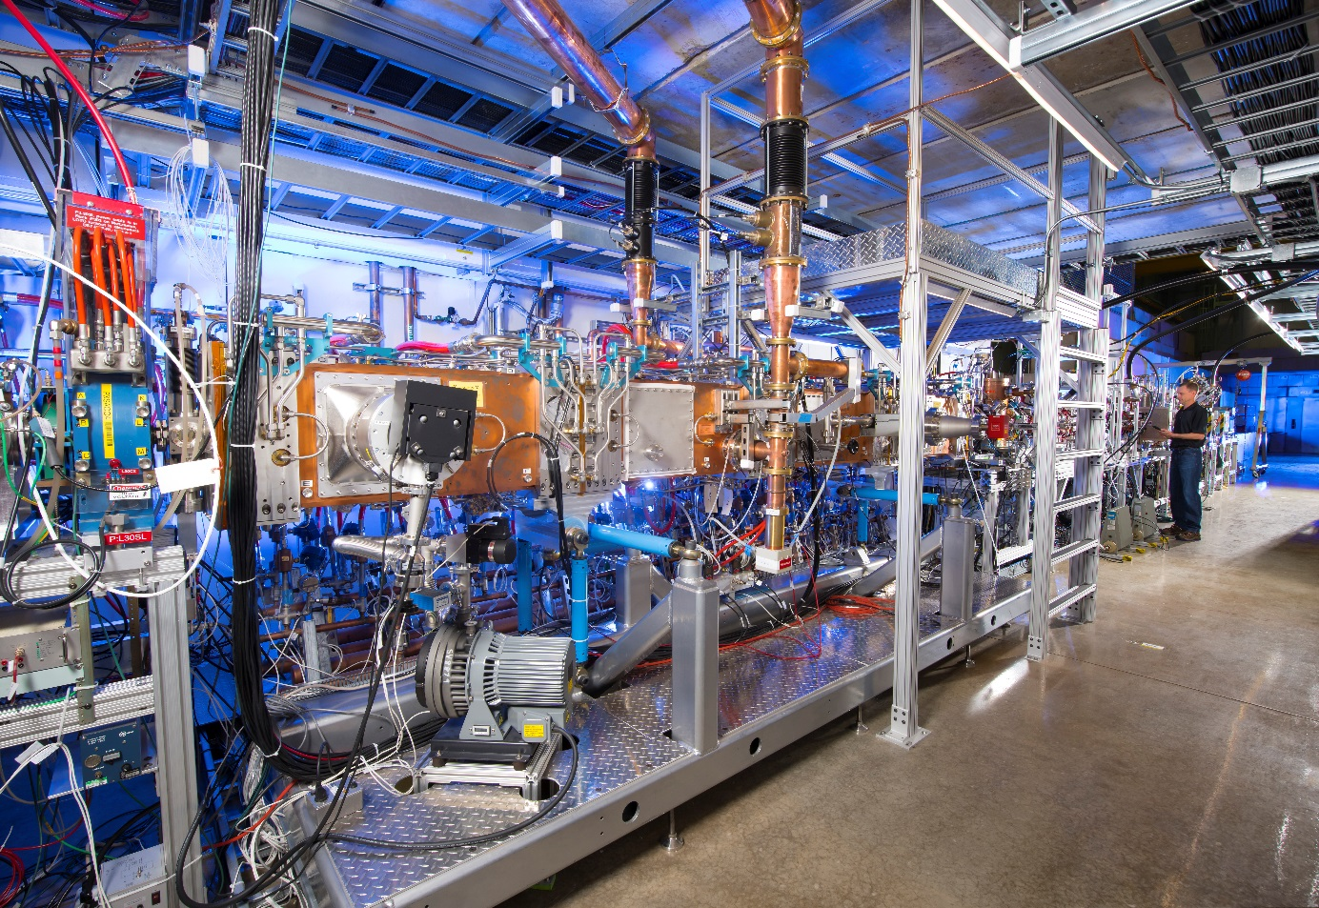
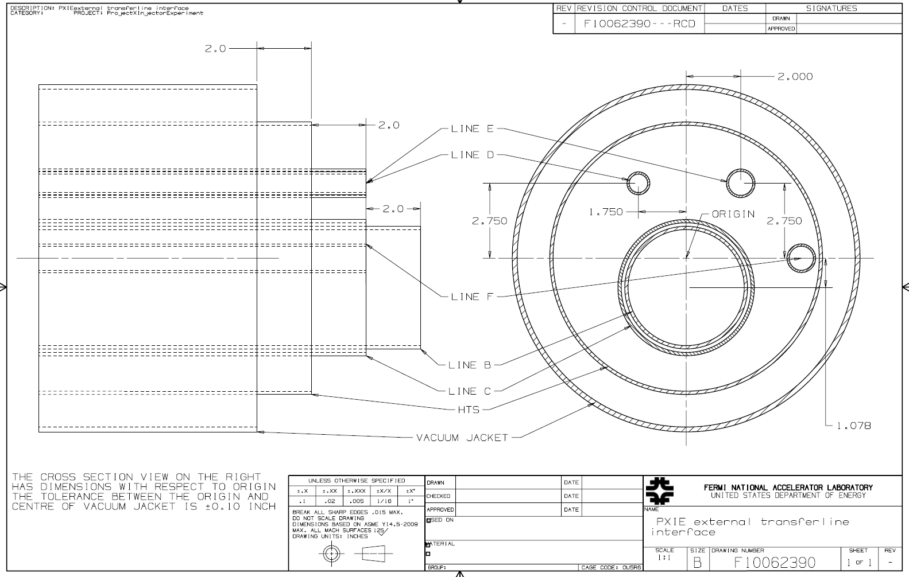
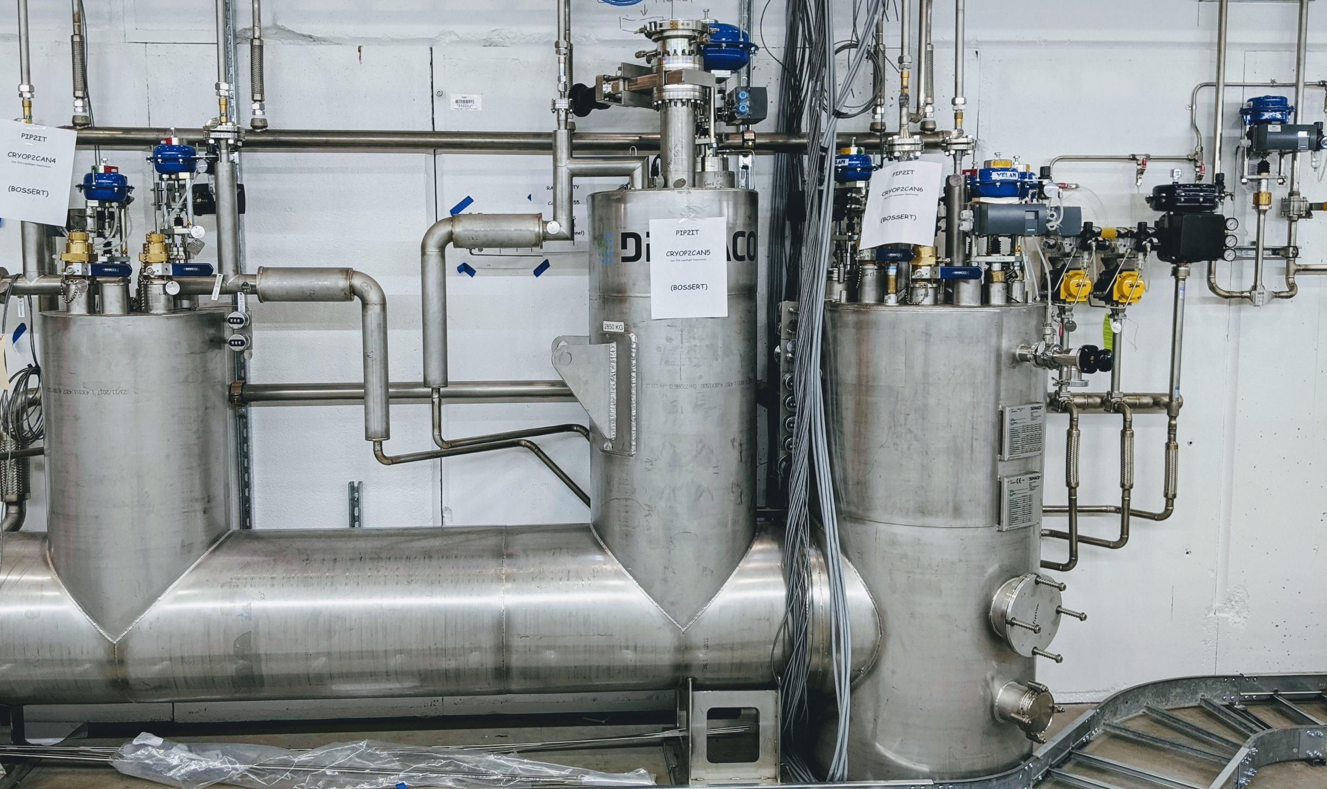
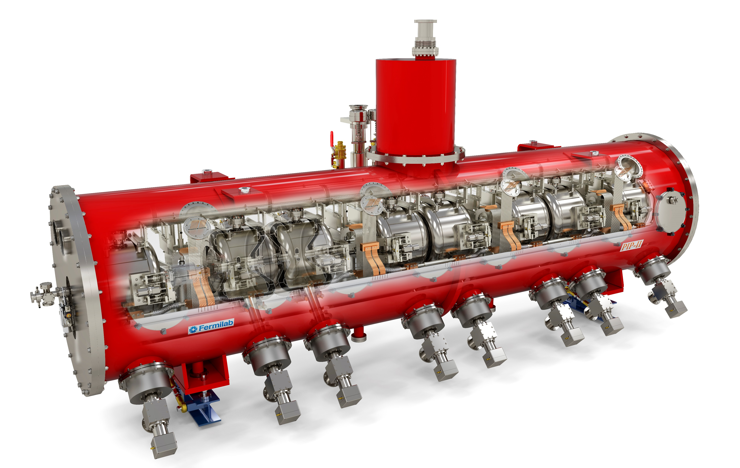
PIP-II Injector Test Cryogenic Transfer Line
C3Po1G-01 [37]
Renzhuo Wang, Benjamin Hansen, Joseph Hurd, Alexander Martinez, and Arkadiy Klebaner
Introduction
CMTF Cryogenic System
Design
Installation
Abstract. PIP-II Injector Test will test a nearly full-scale front end of PIP-II accelerator. The cryogenic transfer line will provide 2 K, 5 K and 40 K refrigeration for Half Wave Resonator and Single Spoke Resonator cryomodules. This paper will focus on design, installation and operation plan of the cryogenic transfer line.
The cave external transfer line starts at the distribution box, rises above the cave roof, follows the north wall of the PIP2IT cave, turns at the expansion box to the south along the east wall of the cave, then goes through the penetrations built in the cave wall and ends with an elbow section which will be connected to the cave internal transfer line. The expansion box houses the various pre-stressed flex hoses that moves to compensate the thermal contractions of various circuits. The external transfer line also connects to the Kinney pump near the distribution box.
The cave internal transfer line is connected to the external transfer line and has six bayonet cans that will be connected to the cryomodule via u-tubes. There are three valves in the last bayonet can to turn the flow around from Line C to Line B and D as well as Line E to F in order to allow the transfer line to be kept cold even without cryomodule in operation. A phase separator with an internal heater is downstream the turn-around valve from Line C to B. The phase separator can serve as both buffer when there is extra capacity, or to separate liquid from vapor and ensure the cold compressors run safely.
Proton Improvement Plan-II (PIP-II) project at Fermilab is building a superconducting Linac to fuel the next generation of intensity frontier experiments. Capitalizing on advances in superconducting radio frequency (SRF) technology, five families of superconducting cavities will accelerate H− ions to 800 MeV for injection into the Booster. Upgrades to the existing Booster, Main Injector, and Recycler rings will enable them to operate at a 20 Hz repetition rate and will provide a 1.2 MW proton beam for the Long Baseline Neutrino Facility.
The transfer line has five circuits in the vacuum vessel: 2 K return Line B, 5 K supply Line C, 5 K return Line D, 40 K supply Line E and 80 K return Line F. Line F is also in welded to the 40-80 K thermal shield to reduce the radiation heat load into the circuits at lower temperatures.
In order to satisfy all cooldown and warmup requirements, the 2 K return line that operates under sub-atmospheric pressure needs to be cooled down independently without affecting the normal operation of the cryoplant. A coaxial transfer line design is chosen to satisfy this requirement. The 4.5 inch Line B circuit (2 K return line) is coaxial with the 5 inch Line C circuit (5 K supply line). The coaxial design utilizes the flow through the outer Line C to cool down the inner Line B, with flow out of line C returning to compressor suction directly, therefore not disrupting the cryoplant during transfer line cooldown.
Cryogenic system in Fermilab Cryomodule Test Facility consists of a Superfluid Cryogenic Plant which provides 2 K, 5 K and 40 K helium to Cryomodule Test St=and for LCLS-II cryomodule tests and PIP2IT. The cryoplant is connected to a distribution box, which is then connected to PIP2IT and LCLS-II cryomodule on the stand. A 3000 L helium dewar is used as a pressure buffer and extra heat load for excess capacity. A warm Kinney vacuum pump is normally used for testing the cryomodules at 2 K.
Supported by the cryoplant, PIP2IT cryogenic transfer line will provide refrigeration at 2 K, 5 K and 40 K to cryomodules in PIP2IT. The transfer line is connected to the cryomodules via u-tubes to allow independent warm-up and cool-down as well as changing cryomodules individually without warming up other cryomodules. The transfer line is required to deliver 150 W at 2 K, 240 W at 5 K and 750 W at 40-80 K to the cryomodules. Because PIP2IT will operate in parallel with Cryomodule Test Stand, it is also required to keep HWR and SSR1 cold while LCLS-II cryomodule are being tested at full power.
PIP-II Injector Test (PIP2IT) is a test stand in Fermilab Cryomodule Test Facility. PIP2IT is a test cave where a nearly full-scale test of the front-end of the PIP-II accelerator is being constructed and
tested with beam. This test includes the warm front end and the first two cryomodules of the PIP-II accelerator, the half wave cryomodule (HWR) and the first single spoke cryomodule (SSR1). Following the completion of the PIP2IT, the cave will be converted into a cryomodule test stand for cold RF testing of the remaining cryomodules without beam.

