Slide 1
Overview of PRACE HLST services
Stéphane Requena
Member of the Board of Directors | PRACE aisbl

Slide 2
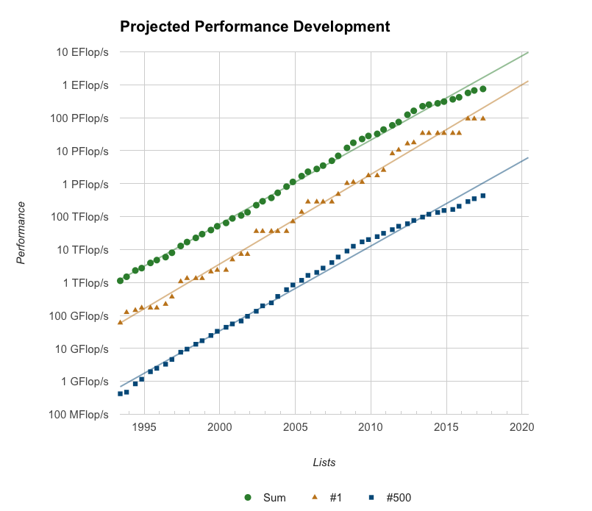
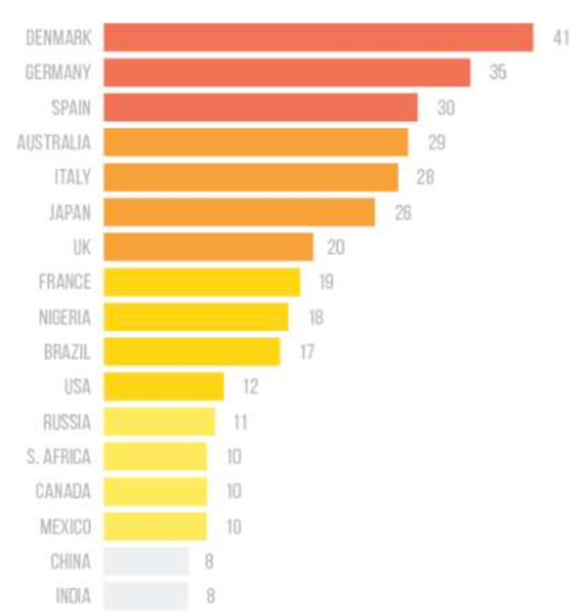
The context: the road to Exascale
Source top500.org
Expected in
  2019/20 for China
  2021/22 for US and Japan
  2022/2023 in Europe
  (EuroHPC)
BUT: No more focus
on peak performance
Systems 50 to 100x
faster than 2017
ones on real apps
Strong constraints on energy : 20 to 30MW
Free flops but moving data will cost
Strong impact on HW/SW : dense architectures, deep memory hierarchies, more //, resiliency….
Strong impact on apps / programmability !
Support to users !

Slide 3
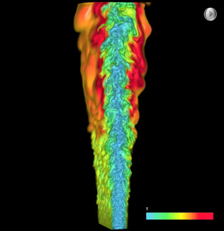
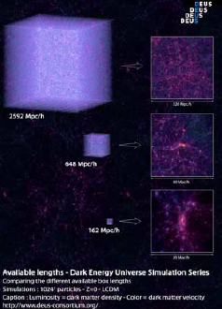
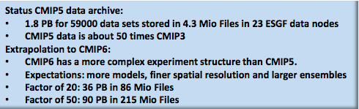
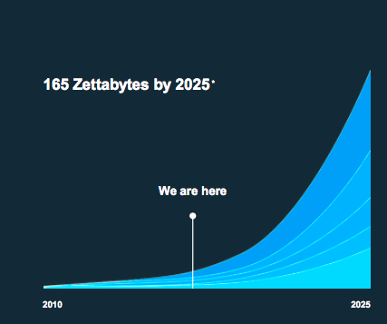
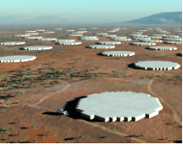
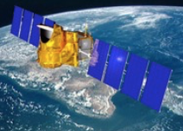
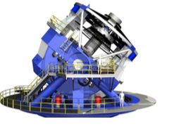
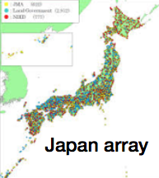
The context : Convergence between HPC, Big Data and AI
Explosion of computational data
And instrumental data
HiFi turbulent
DNS combustion
S3D : 1PB / 30mn
Cosmology
DEUS project
150 PB raw data
Climate CMIP exercices
Reservoir modeling
of gigamodels 350 TB/run
LOFAR/SKA
4 EB/yr raw
COPERNICUS/SWOT
4 PB/d raw
Network of
seismic sensors
100 TB/yr
LSST/EUCLID
20 PB/night raw
Internet & IoT

Slide 4
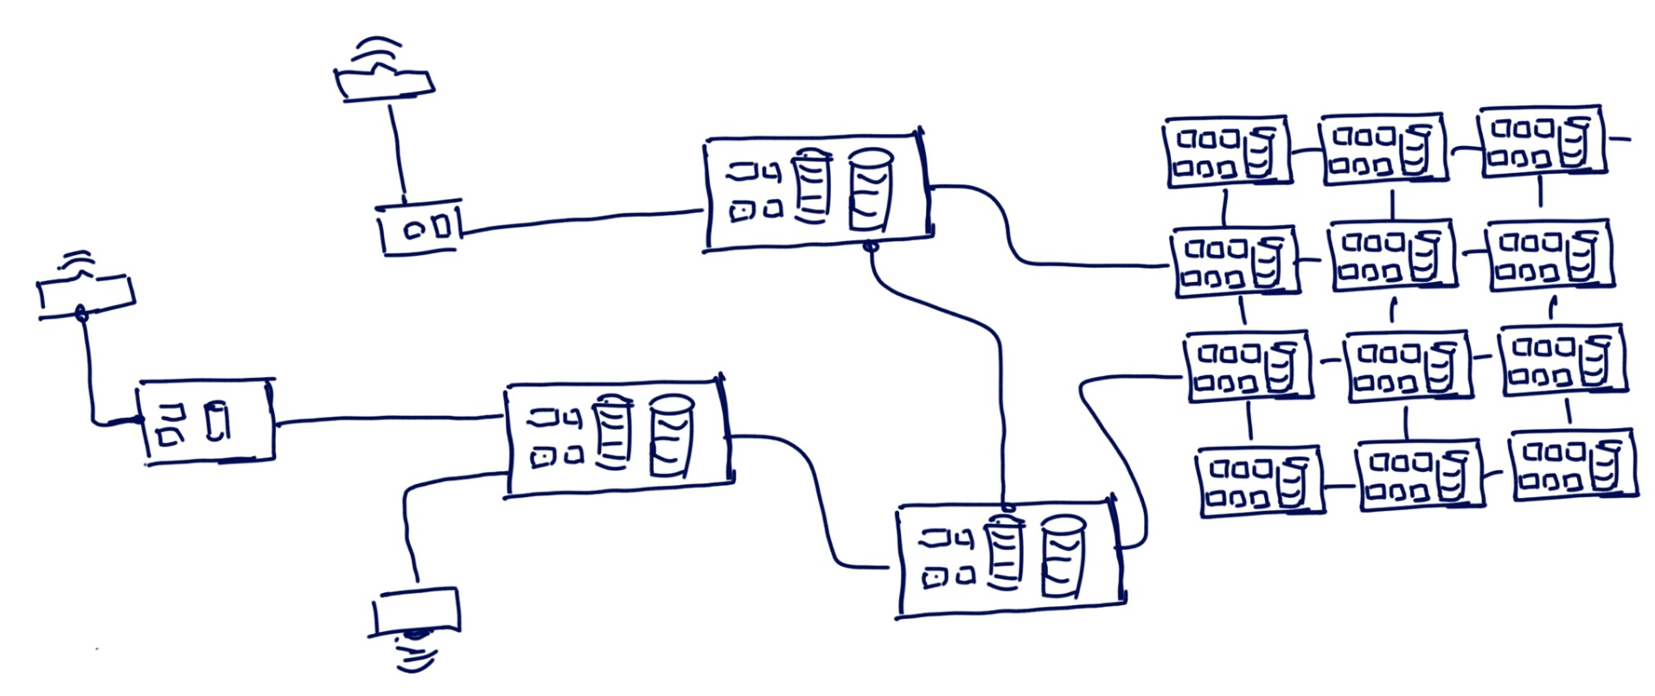


The context : Convergence between HPC, Big Data and AI
Complex workflow and data logistic to map onto the set of systems
Bottleneck frontiers
The edge
Strongly coupled node
(Supercomputers,
data centers, etc.)
Intermediate nodes
(CDN, data centers, etc.)
Challenges: cohabitation of SW stacks, containers, security, smart resource managers, elastic/interactive access, end to end workflows, edge computing (at the source), …
Development of new services, co design and user support
Sources

Slide 5
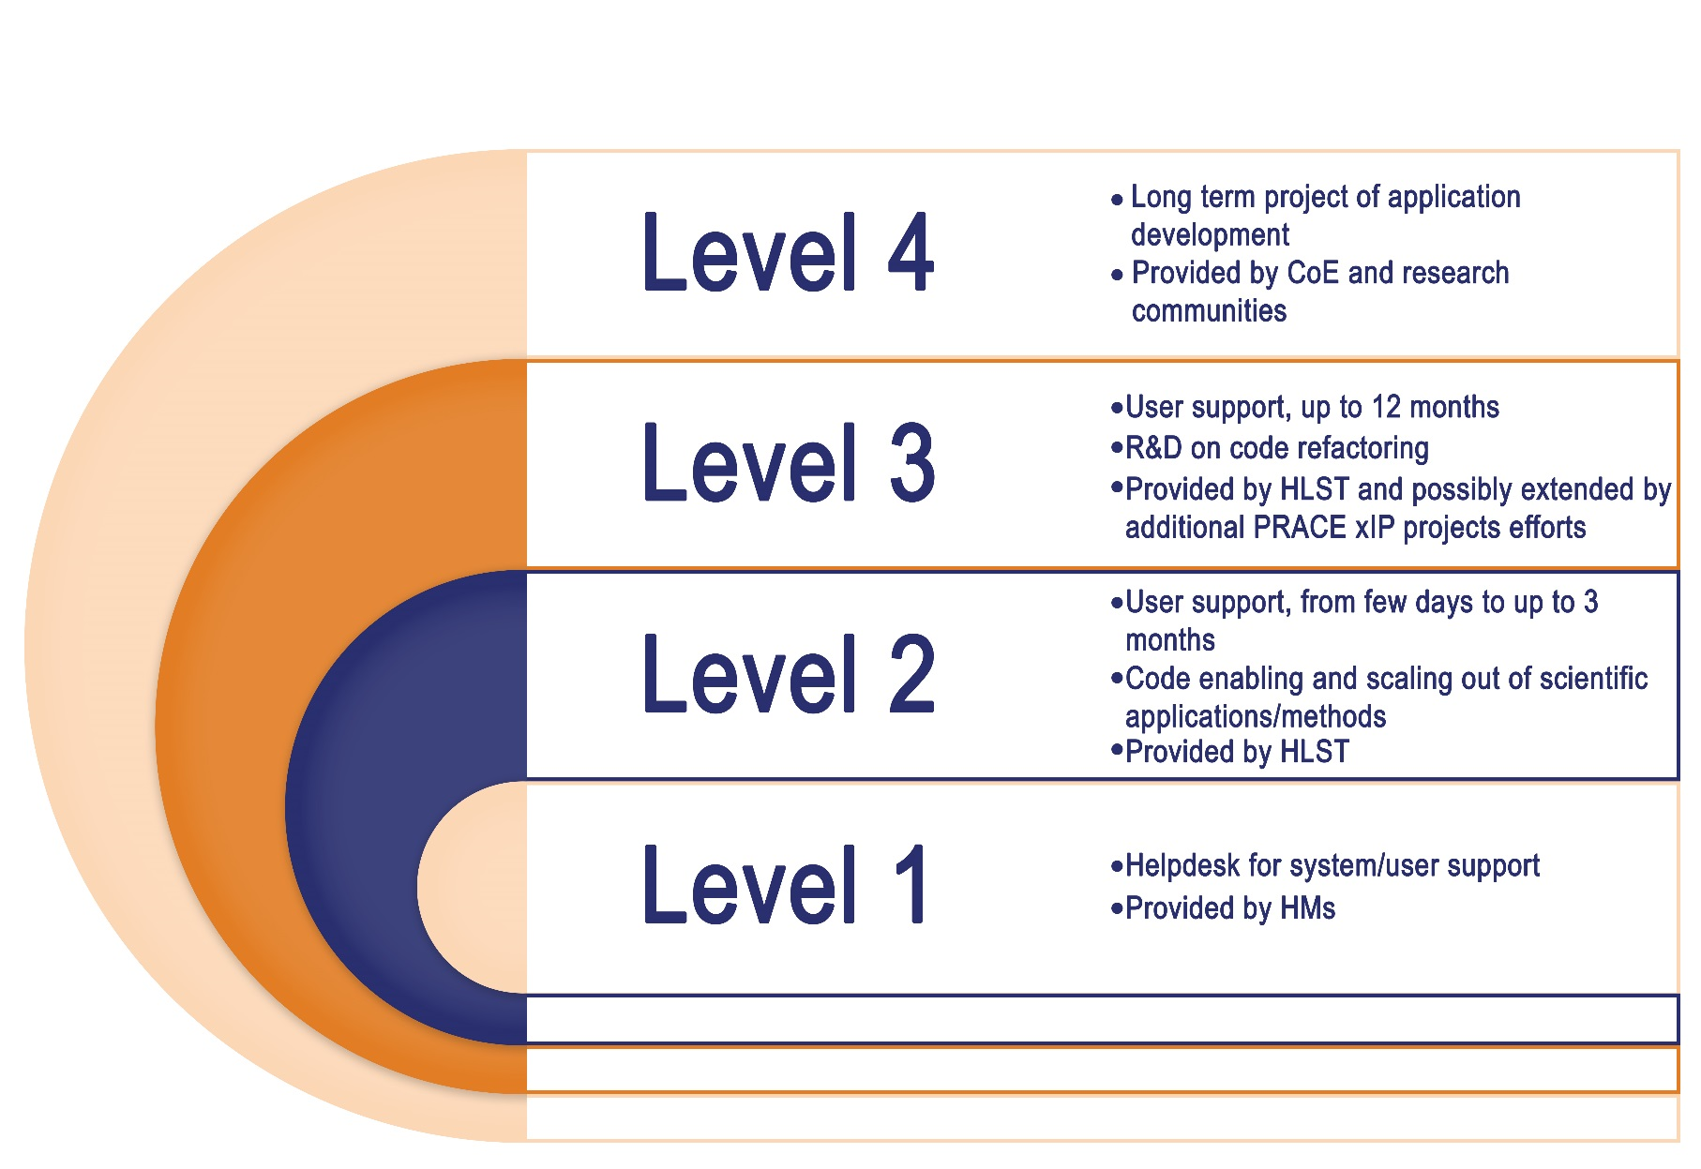
Introducing PRACE HLST | High Level Support Teams
PRACE2 firmed in 2016
  Increased contribution of HPC cycles from 5 HM (DE, FR, IT, SP and CH)
  Funding by the other PRACE partners of 5 HLST located close to HM sites
    Representing 25 FTE people working for user support level 2 and 3 operations
Code refactoring/rewriting
Code optimisation and scaling, specific to given HPC architectures

Slide 6
Introducing PRACE HLST | High Level Support Teams
On going extension of the HLST level 3 with additional resources from PRACE partners
  In the field of the PRACE-6IP projects and beyond
  Specific and new activity (WP8) coordinated by CSCS
→ Toward a fully distributed European wide level 3 taskforce
Selection process of the proposals to be supported by HLST
  For HLST level 2 : on the fly directly from the PRACE proposals running on Tier-0 centers (using either preparatory access or project access)
  For HLST level 3 :
    After each call for proposal and upon proposal of the PRACE Access Committee
    (independent experts committee in charge of the scientific ranking of projects asking for PRACE resources each call)
    → target = proposals technically rejected but with good scientific ranking
    Specific call for proposal organised by PRACE-6IP WP8

Slide 7
PRACE | HLST as one of the core services
Towards End-Users
Towards PRACE Partners
Access
Support
Communication, Dissemination, Outreach
Website
Public Relations
Scientific Communication
Summer of HPC
Events
PRACEdays
SC, ISC, ICT, ICRI, DI4R, …
Operation & Coordination of the
common PRACE Operational Services
Service Catalogue
PRACE MD-VPN network
Security
HPC Commissioning & Prototyping
Technology Watch, PCP
Infrastructure WS
Best Practices
UEABS
Tier-0 systems (open R&D)
Project Access
  1-3 years
Preparatory Access
  Type A, B, C, D
Tier-1 systems (open R&D)
DECI Programme
Application Enabling & Support
Preparatory access Type C
Preparatory access Type D
  Tier-1 for Tier-0
SHAPE
HLST support
Training
Training Portal
PTC
Seasonal Schools & on demand
International HPC Summer School
MOOC
Code Vault
Best Practice Guides
White Papers

