Slide 1
X-ray laser pulses under your feet: getting the local community to support a big RI
Joseph Piergrossi
For ARIES Outreach and Communication Workshop
Geneva, 5–6 November 2018

Slide 2
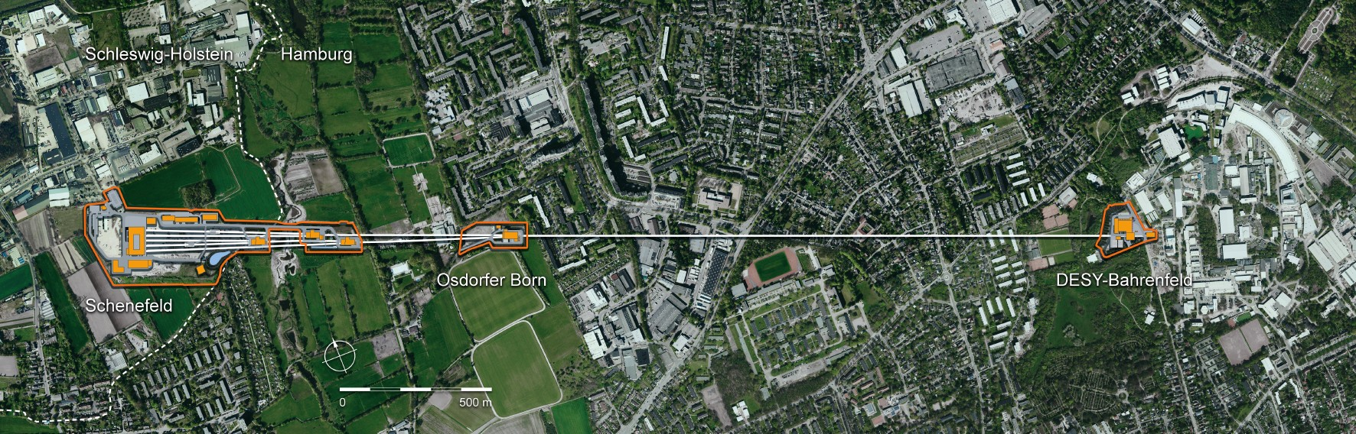
X-ray free-electron laser facility running for 3.4 km in two municipalities / states
  Starting from DESY facility in Hamburg
  Ends in Schenefeld, Schleswig-Holstein
Most of facility is underground, and in a mostly residential area
  2009 start of construction, user operation began 2017
  Early concern about public opposition and fear—now enthusiastic support

Slide 3
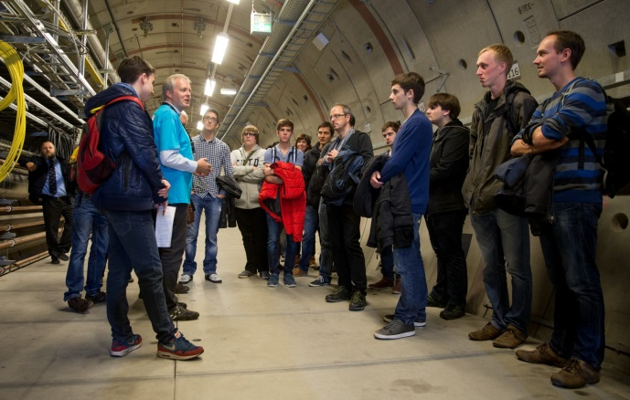
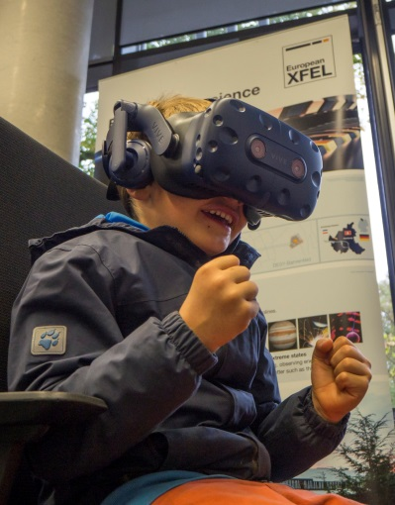
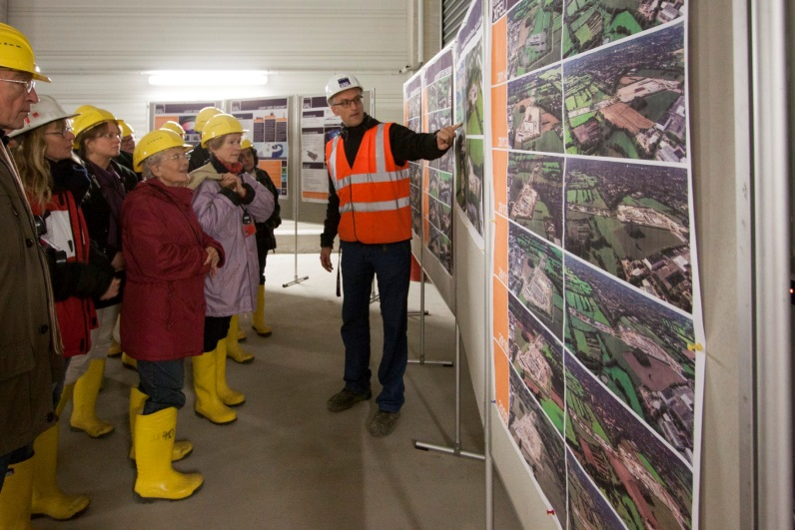

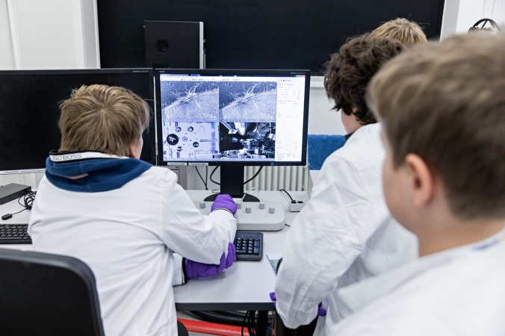
How did we get a high level of local support?
Early on: canvassing and engaging with the community
  Mapped out addresses of all neighbours and set up a 24/7 public hotline
  Regular updates on construction progress; neighbours were invited for tours
  Neighbourhood info booths (e.g., FELIX)
  Environmental restoration efforts
Public science communication events
  Hamburg Night of Science
  First Open Day on research campus in 2018
The future
  Developing a Visitor Centre with school laboratories
  Concept for public tours

