Slide 1

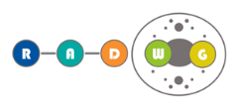

Optocoupler radiation behaviour, testing methodology and test results
Rudy Ferraro
PhD Supervisors: Salvatore Danzeca (CERN)
Luigi Dilillo (LIRMM-UM-CNRS)

Slide 2
Outlook
Optocoupler applications
Radiation effects on Optocoupler
Standard optocoupler test recommendations
Standard test protocol for space applications
CERN test protocol
Test results
Mitigation techniques: CTR degradation compensation
Conclusion

Slide 3
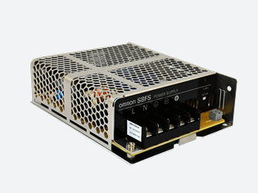
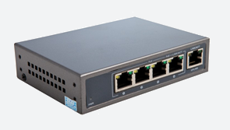
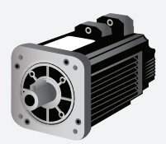
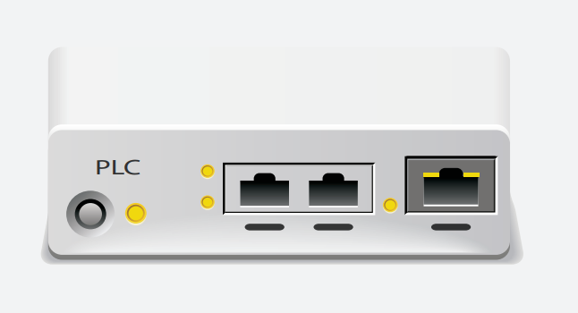
Optocoupler Applications
Power Supply
PoE (Power On Ethernet)
- DC-DC Conversion
- Feedback control circuit
- Zero Crossing circuit
- Data communication isolation
- Data communication isolation
- Coupling circuit
- DC-DC Conversion
Motor Driven and control
- Power supply isolation
- Isolation Amplifier
- DC-AC Control
- AC feedback
- Data communication isolation
PLC (Power Line Communication)
- Data communication isolation
- DC-DC Conversion
At CERN optocouplers are used for a wide range of applications:
  Quench Protection System (QPS), Power Converters (EPC), Beam Position Monitor (DOROS) etc…
Optocouplers are among the most sensitive components of a system to radiation.

Slide 4
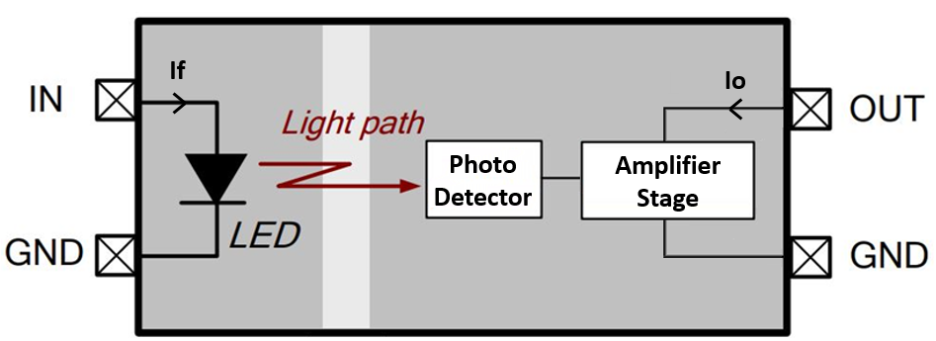

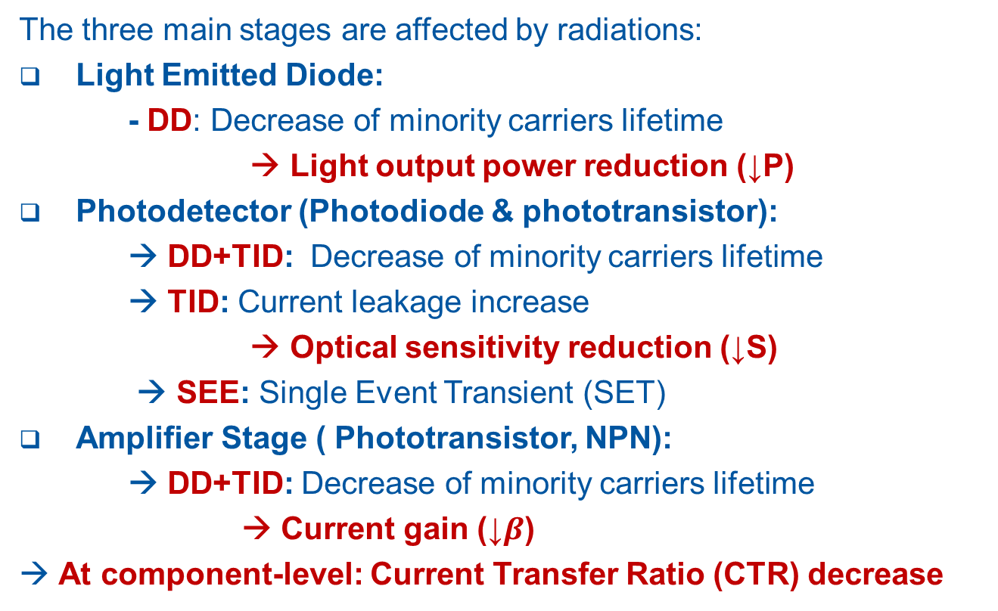
Radiation Effects on Optocoupler
The three main stages are affected by radiations:
Light Emitted Diode:
- DD: Decrease of minority carriers lifetime
→ Light output power reduction (↓P)
Photodetector (Photodiode & phototransistor):
→ DD+TID: Decrease of minority carriers lifetime
→ TID: Current leakage increase
→ Optical sensitivity reduction (↓S)
→ SEE: Single Event Transient (SET)
Amplifier Stage ( Phototransistor, NPN):
→ DD+TID: Decrease of minority carriers lifetime
→ Current gain (↓$β$)
→ At component-level: Current Transfer Ratio (CTR) decrease
- NPN
- Darlington
$$CTR=\frac{I_{o}}{I_{f}}=\frac{β∙P∙S}{I_{f}}$$
- Photodiode
- Phototransistor
- Phototriac
- PhotoSCR
Main degradation mechanism:
→ DD effect on LED [Mars-92]
- Singe/double heterojunction
- Different materials (GaAs, SiC, GaN etc…)

Slide 5
Standard optocoupler test recommendations
No international test standards exist for Displacement Damage
… But optocoupler test guidelines exist [Reed-02]
What guidelines say:
  Optocoupler are COTS hybrid, the same internal components not guaranteed
    Leads to a high lot-to-lot radiation response variability
    Part-to-part sample size should be used instead of lot-to-lot sample size.
  Input current can anneal the DD-induced degradation of LEDs [Barn84,John-99a]
    Higher is the input current, lower is the degradation
    Biasing/operating conditions will have a strong impact the degradation
  SET:
    Photodiodes sensitive to SET only when the LED is off.
    Photodiodes sensitive to proton-induced SET with a high angular dependency [Labe-97]
TID and DD are assumed to be independent in degradation [Military Handbook 814] :
  Independent TID [ASTM Standard 883] and DD tests can be performed.

Slide 6
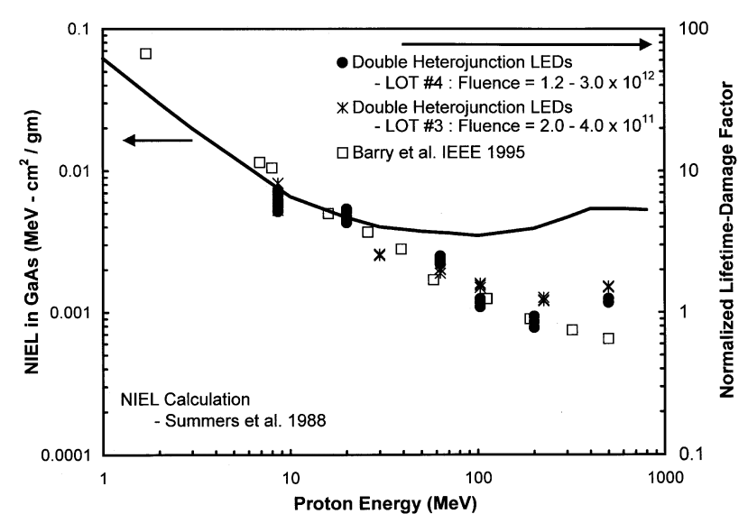

NIEL Scaling Hypothesis
Non-Ionizing Energy Loss (NIEL) scaling hypothesis:
Displacement damages induced by a particle are proportional to the NIEL in the material
Displacement damage of any kind of particles can be normalized to the same metric by scaling the damages to their respective NIELs.
Displacement Damage Equivalent Fluence (DDEF):
  Amount of 1 MeV neutron fluence necessary to induce an equivalent displacement damage to the fluence of the considered particle:
  $$Φ_{eq.}=κ_{1MeV n} \left(p,E\right)∙Φ\left(p,E\right)$$
1MeV Neutron scaling Factor:
$$κ_{1MeV n}(p,E)=\frac{NIEL\left(p,E\right)}{NIEL(1MeV neutron) }$$
With:$p$ = particle type, $E$ = particle energy
NIEL Scaling violation:
Optoelectronic devices do not follow every time the NIEL scaling theory…
Underestimation of a factor 5 on the degradation by scaling 200 MeV proton results to 10 MeV protons.
[Reed-00]

Slide 7
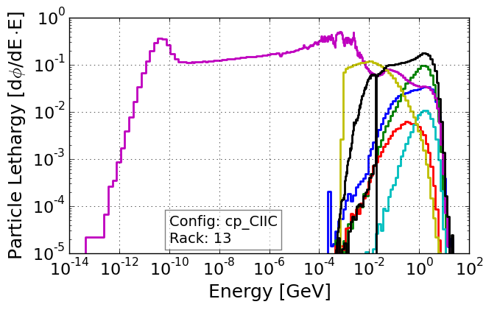
Standard Test Protocol for space applications
Not directly applicable to LHC-like environment dominated by neutrons:
Space radiation environment dominated by protons
Estimate mission equivalent proton fluence at one or several energies
Estimate mission Total Ionizing Dose
Measure proton-induced (TID+DD) CTR degradation for each energy
Measure TID-induced CTR degradation with a gamma source
Estimate proton-degradation contribution in space:
Experimental effective NIEL scaling estimation
NIEL scaling + margin of 10 if one energy
If p-induced TID<target TID:
Estimate TID degradation contribution
[Guide for Optocoupler Ground Radiation Testing and Optocoupler Usage in the Space Radiation Environment]
$${CTR^{−1}(TID+DD)}_{Mission}={{CTR }^{−1}(TID+DD)}_{Proton}+{{CTR }^{−1}(TID)}_{Gamma}$$

Slide 8
CERN Optocoupler test protocol
Estimate neutron equivalent fluence
at different energies
LHC Fluka simulation /
RadMON measurement
Estimate LHC Total Ionizing Dose
Much less convenient to find monoenergetic neutron facilities providing different energies and able to achieve high fluence compare to proton.
A solution could be to use a spallation neutron source providing a LHC-like neutron spectrum that will reduce the possible impact of NIEL scaling violation…
…Or to use the CHARM Facility of CERN.
Measure neutron-induced CTR degradation at the different energies
Measure TID-induced CTR degradation with a gamma source
Estimate the LHC n-degradation contribution:
Experimental effective NIEL scaling estimation
NIEL scaling + margin of 10 if one energy
Estimate TID degradation contribution
Estimate the degradation in the different LHC locations by combining different levels of TID and DD.
$${CTR^{−1}(DDEF,TID)}_{LHC}={{CTR }^{−1}(DDEF)}_{neutron}+{{CTR }^{−1}(TID)}_{Gamma}$$

Slide 9
CERN Optocoupler test protocol
Estimate LHC Spectrum (TID+DD) at system locations
Fluka simulation /
RadMON measurement
Estimate Total Ionizing Dose
CHARM mixed-field Facility can reproduce LHC radiation environments.
Allows to minimize possible NIEL scaling violations
Measure LHC Spectra-like (TID+DD) CTR degradation in CHARM Facility
Measure TID CTR degradation with a gamma source
Estimate the degradation in the different LHC locations by combining different levels of TID and DD.
Estimate the LHC n-degradation contribution:
Extract neutron equivalent-induced (DD) degradation by removing TID contribution
Estimate TID degradation contribution
$${CTR^{−1}(DDEF,TID)}_{LHC}={{CTR }^{−1}(DDEF)}_{CHARM}+{{CTR }^{−1}(TID)}_{Gamma}$$

Slide 10
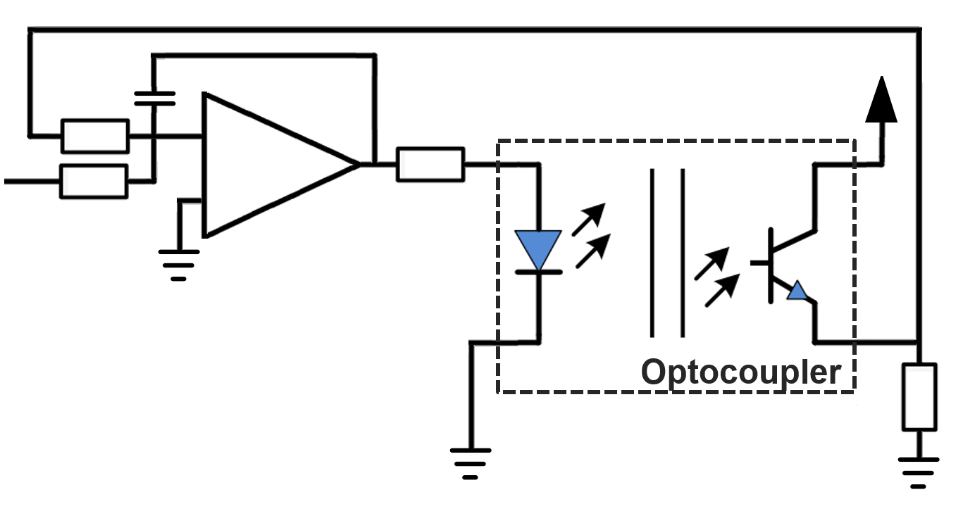

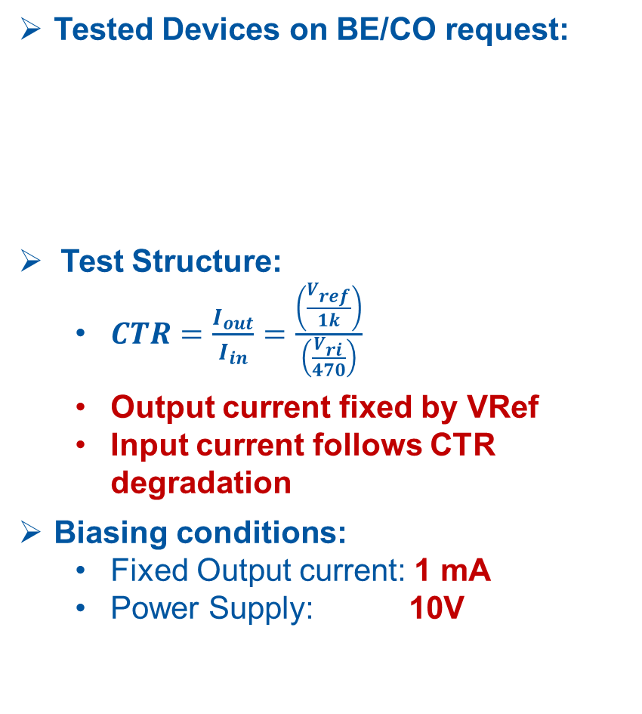



Test devices and conditions
Tested Devices on BE/CO request:
Test Structure:
  $CTR=\frac{I_{out}}{I_{in}}=\frac{\left(\frac{V_{ref}}{1k}\right)}{\left(\frac{V_{ri}}{470}\right)}$
  Output current fixed by VRef
  Input current follows CTR degradation
Biasing conditions:
  Fixed Output current: 1 mA
  Power Supply: 10V
Identify the best optocoupler candidates for CERN applications
Device | TLP383 | TLP385 | TLP785 | PS2505 | 4N49U | HCPL-5501 | 6N138* | ACPL-247*
Type | InGaAs (COTS) | GaAs (COTS) | GaAs (COTS) | GaAs (COTS) | GaN or SiC (COTS) | GaAsP (Radhard) | GaN or SiC (COTS) | GaN or SiC (COTS)
CTR (1mA) | 1.25 | 1.45 | 1.47 | 7.96 | 2.80 | 0.65 | 0.32 | 1.35
* Not requested
100k
$$V_{ri}$$
$$V_{CC}$$
-
+
Ri = 470
100k
$$V_{ref}$$
Opamp OP2177ARZ
Radtol up to 1kGy
EDMS: 1387205
Ro = 1k
$$V_{ref}$$

Slide 11
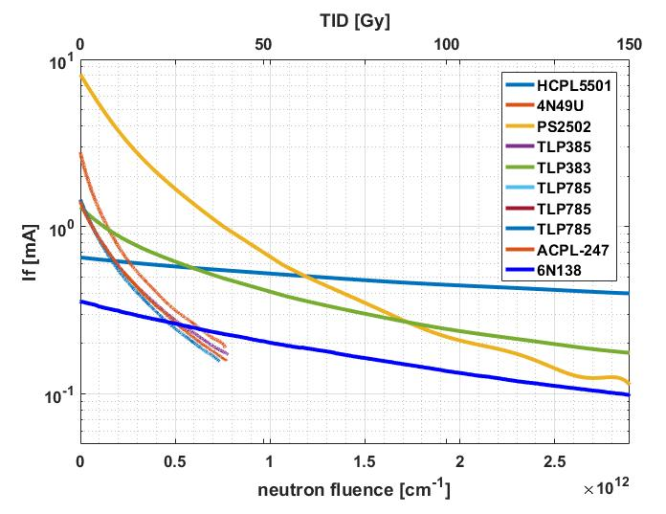
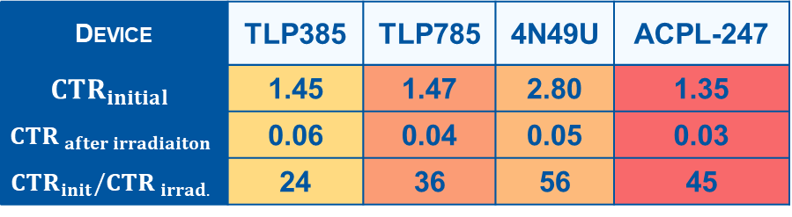

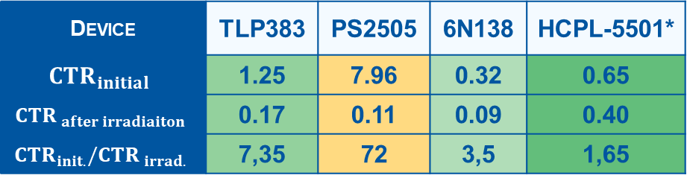
Test Results: CTR degradation
First Run: CHARM Position 16 CuOOOO
  Radiation levels: 150 Gy & 2.2 x 10¹² n. cm⁻²
$${CTR}_{init}$$
Device | TLP385 | TLP785 | 4N49U | ACPL-247
$${CTR}_{initial}$$ | 1.45 | 1.47 | 2.80 | 1.35
$${CTR}_{ after irradiaiton}$$ | 0.06 | 0.04 | 0.05 | 0.03
$${CTR}_{init}/{CTR}_{ irrad.}$$ | 24 | 36 | 56 | 45
VCC = 10V
Io = 1mA
Second Run: CHARM Position 16 CuOOOO
  Radiation levels: 170 Gy & 3.2 x 10¹² n. cm⁻²
Device | TLP383 | PS2505 | 6N138 | HCPL-5501*
$${CTR}_{initial}$$ | 1.25 | 7.96 | 0.32 | 0.65
$${CTR}_{ after irradiaiton}$$ | 0.17 | 0.11 | 0.09 | 0.40
$${CTR}_{init.}/{CTR}_{ irrad.}$$ | 7,35 | 72 | 3,5 | 1,65
* Radhard device
EDMS Report: 2002403

Slide 12
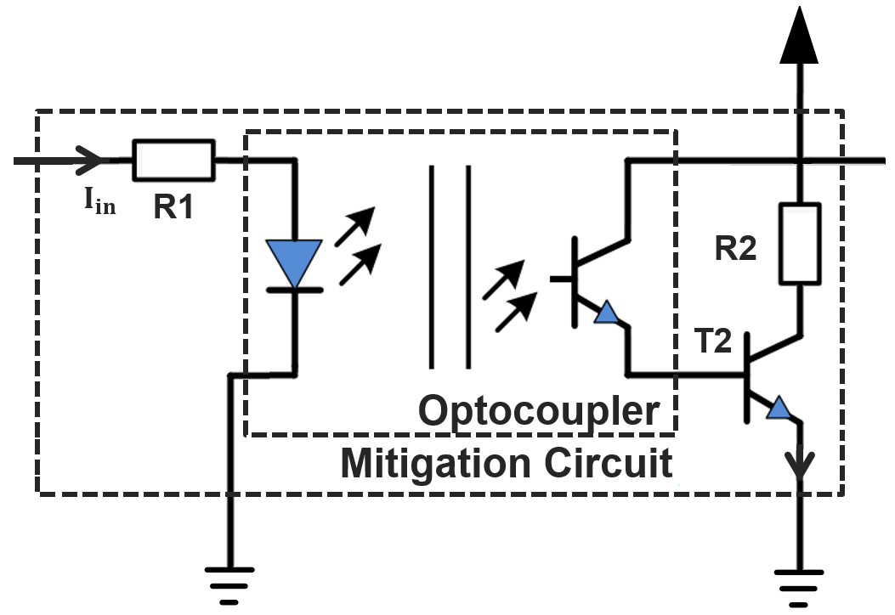
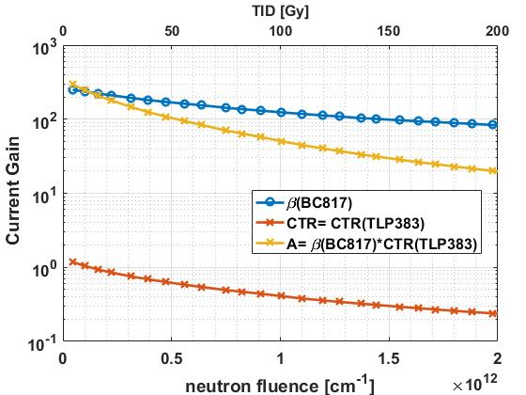
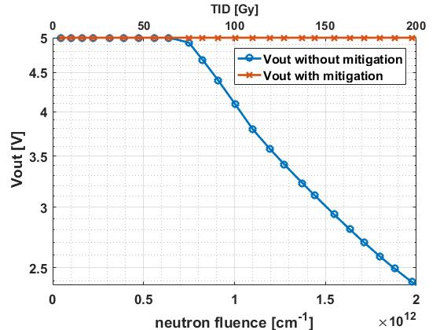



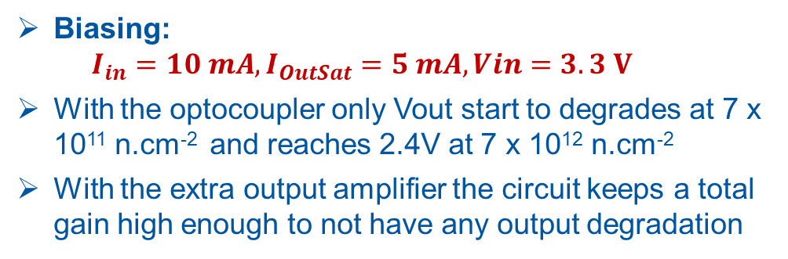







Mitigation techniques: ↓CTR compensation
$$V_{CC}$$
Application:
  Digital Signal Transmission
Extra Output Amplifier Stage:
  NPN BJT in Emitter follower mode
Example: BC817 (1759520) + TLP383
$$5V$$
$$V_{in}$$
$$V_{out}$$
$$330Ω$$
$$5V$$
$$3,3V$$
$$1k Ω$$
$$I_{out}$$
$$A_{total}=\frac{I_{out}}{I_{in}}= β∙CTR$$
Biasing:
  $$I_{in}=10 mA,I_{OutSat}=5 mA, Vin=3.3 V$$
With the optocoupler only Vout start to degrades at 7 x 10¹¹ n.cm⁻² and reaches 2.4V at 7 x 10¹² n.cm⁻²
With the extra output amplifier the circuit keeps a total gain high enough to not have any output degradation

Slide 13
Conclusions
Optocouplers are simple components but their qualification can be complex.
Optoelectronic components can exhibit NIEL scaling violation
Neutron-based test protocols adapted to the LHC environment must be performed to ensure realistic radiation responses
The CHARM facility represents the best option to minimize NIEL scaling errors but spallation neutron sources are also good candidates.
A first screening radiation campaign at CHARM allowed to identify promising optocoupler components for LHC equipment: TLP383 (COTS) & HCPL-5501 (Radhard) commercially available
Further qualification tests will be performed on the selected candidates.

Slide 14
Backup slides
Notes:
The CHARM mixed-field facility can reproduce the LHC radiation environments, which allows to minimize possible NIEL scaling violations.
Then the method consist to test the device in CHARM and in a gamma facility.
Then by removing the TID response to the CHARM ones which induce both TID and DD, we can isolate the DD response.
And then the final degradation estimation is performed by combining different ratio of DDEF and TID corresponding to the different ratios of the LHC.
But unfortunately, there is another problem:
It has been show recently in the literature that TID and DD are not always independent in damage for optoelectronic and bipolar technology.
We can see on this figure a study we publish this year at RADECS where a bipolar component was degrading 3 times faster when exposed to both TID and DD compare to the separated response.
We have shown in this paper that the level of dependence depends on the DDEF and TID ratio, which means that for each conditions.

Slide 15
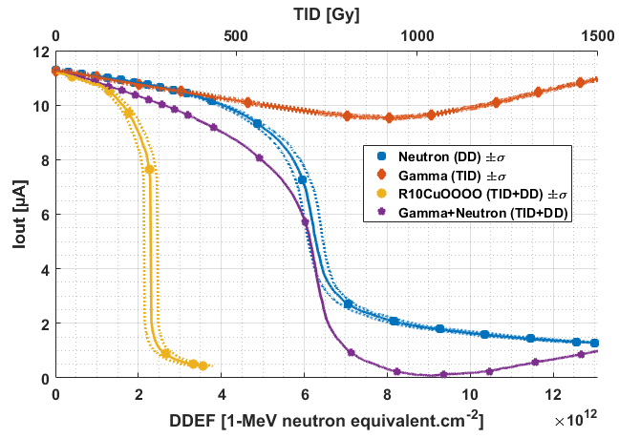
CERN Optocoupler test protocol
Estimate LHC Spectrum (TID+DD) at system locations
Fluka simulation /
RadMON measurement
Estimate Total Ionizing Dose
CHARM mixed-field Facility can reproduce LHC radiation environments.
Allows to minimize possible NIEL scaling violations
TID and DD are not always independent in damage for optoelectronic and bipolar technology [Barnaby 2002]
[Gorelick 2005]
Level of dependence depends on DDEF/TID
Measure LHC Spectra-like (TID+DD) CTR degradation in CHARM Facility
Measure gamma-induced CTR degradation
Degradation estimation in operation performed by combining different ratio of DDEF and TID corresponding to the different ratios of the LHC.
  Degrades ~3 times faster than expected !
Extract neutron equivalent-induced (DD) degradation by removing TID contribution
Estimate TID degradation contribution
[Ferraro et al 2018]
$${CTR^{−1}(DDEF,TID)}_{LHC}={{CTR }^{−1}(DDEF)}_{CHARM}+{{CTR }^{−1}(TID)}_{Gamma}$$

Slide 16
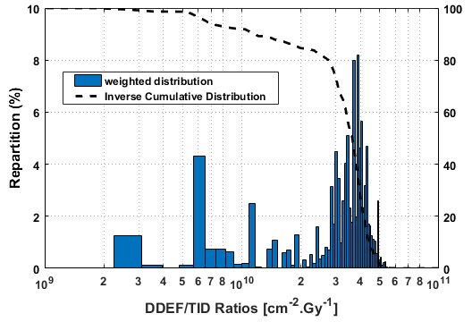
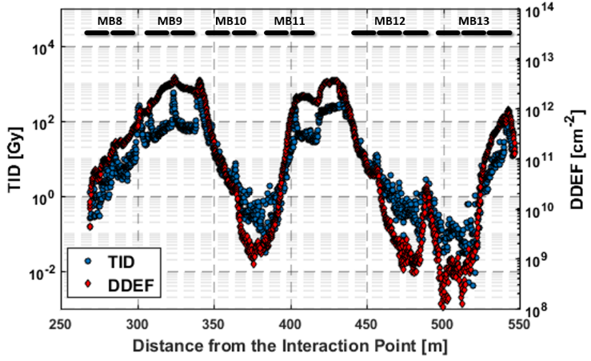
LHC Radiation environments
Systems can be highly distributed in the LHC and exposed to a wide variety of ionizing and non-ionizing dose levels
Example: dispersion Area 5 (Hi-lumi 250 fb⁻¹.y⁻¹)
  TID from 10 mGy up to 1kGy per year
  DDEF from 10⁸ up to 10¹³ 1 MeV neq. per year
  Below MB10 for 5 years:
    TID: 350 Gy
    DDEF: 5 x10¹¹ neq. cm⁻²
  Below MB11 for 5 years:
    TID: 350 Gy
    DDEF: 1x10¹³ neq. cm⁻²
~1.510⁹ neq. cm⁻².Gy⁻¹
  X20 !
~3x10¹¹ neq.cm⁻².Gy⁻¹
[Ruben et al 2018]
→ The same device will be exposed to 20 times more DD for the same absorbed dose !
Wide variety of DDEF/TID Ratio: From 10⁹ up to 10¹¹ 1MeV neq.cm⁻².Gy⁻¹
The objective is to have assess the radiation response of optocouplers in this wide range of conditions.

Slide 17
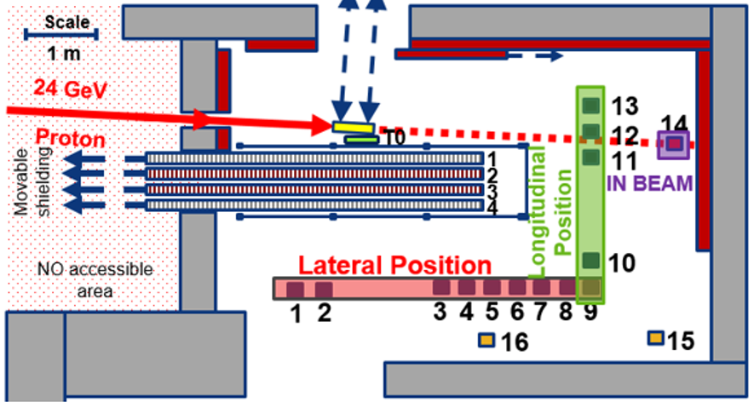
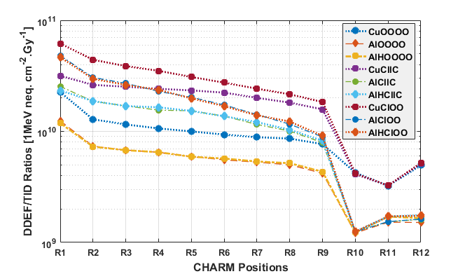
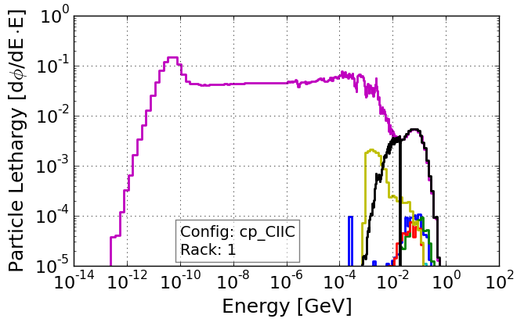
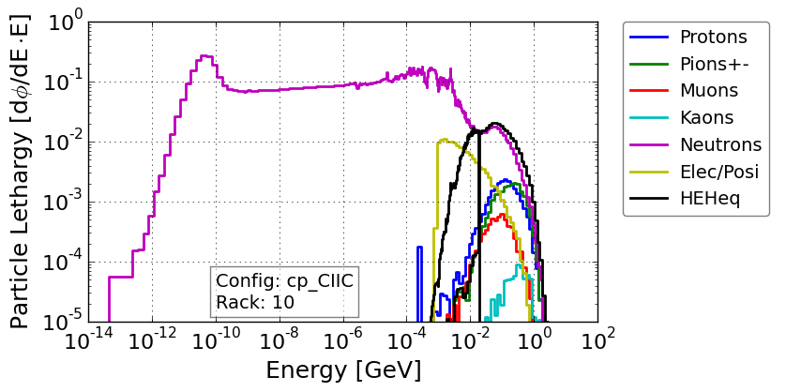
CHARM Mixed Field Facility
Primary 23 GeV proton beam impinge a target
Secondary radiation fields similar to the LHC radiation fields.
Radiation field can be modulated with:
Target:
Shielding:
Positions:
AlH - Aluminium Hole
Al - Aluminium
Cu - Copper
C – Concrete (1,4)
I – Iron (2,3)
1-16
Lateral Positions
R13
R1
R10
Strong neutron domination on lateral positions
→ High DDEF/TID ratios (up to 6 x 10¹⁰ cm⁻².Gy⁻¹)
Stronger TID domination on longitudinal positions
  → Low DDEF/TID ratios (down to ~10⁹ cm⁻².Gy⁻¹)
In the facility, as in the LHC, a same component can be exposed to 60 times more DD for the same TID level.
Longitudinal Positions
    TID: 92 Gy/ Day
    DDEF: 4.8 x10¹¹ cm⁻².day⁻¹ DDEF/TID: 5.4 x10⁹ cm⁻².Gy⁻¹
    TID: 23 Gy.day⁻¹
    DDEF: 6.4 x10¹¹ cm⁻².day⁻¹
    DDEF/TID: 2.8 x10¹⁰ cm⁻².Gy⁻¹
    TID: 46.2 Gy/ Day
    DDEF: 4.5 x10¹¹ cm⁻².day⁻¹
    DDEF/TID: 4 x10¹¹ cm⁻².Gy⁻¹
99% of the LHC ratios covered by the facility.

Slide 18
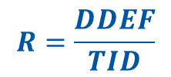
CERN Optocoupler test protocol
Estimate LHC Spectrum (TID+DD) at system locations
Fluka simulation /
RadMON measurement
Estimate Total Ionizing Dose
Allows to minimize possible NIEL scaling violations
Allows to assess eventual TID-DD dependencies
Example of application for an IC bipolar component in [Ferraro et al 2018]
Measure LHC Spectra-like (TID+DD) CTR degradation in CHARM Facility with different configurations
Measure gamma-induced CTR degradation
Extract neutron eq.-degradation (DD) for each DD/TID ratio, calculate the TID-DD dependency for each tested ratios and extrapolate to the non tested ones.
Estimate TID degradation contribution
$$R=\frac{DDEF}{TID}$$
$${CTR^{−1}(DDEF(R),TID)}_{LHC}={{CTR }^{−1}(DDEF(R))}_{CHARM}+{{CTR }^{−1}(TID)}_{Gamma}$$

Slide 19
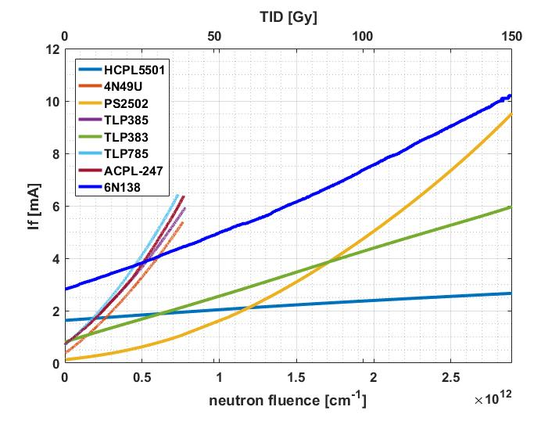
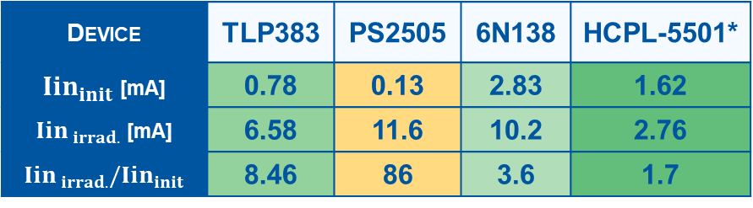
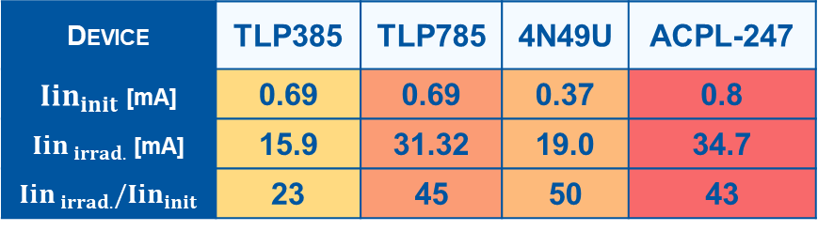
Test Results: excess input currents
First Run: CHARM Position 16 CuOOOO
  Radiation levels: 150 Gy & 2.2 x 10¹² n. cm⁻²
$${CTR}_{init}$$
Device | TLP385 | TLP785 | 4N49U | ACPL-247
${Iin}_{init}$ [mA] | 0.69 | 0.69 | 0.37 | 0.8
${Iin}_{ irrad.}$ [mA] | 15.9 | 31.32 | 19.0 | 34.7
${Iin}_{ irrad.}/{Iin}_{init}$ | 23 | 45 | 50 | 43
VCC=10V
Iout = 1mA
Second Run: CHARM Position 16 CuOOOO
  Radiation levels: 170 Gy & 3.2 x 10¹² n. cm⁻²
Device | TLP383 | PS2505 | 6N138 | HCPL-5501*
${Iin}_{init}$ [mA] | 0.78 | 0.13 | 2.83 | 1.62
${Iin}_{ irrad.}$ [mA] | 6.58 | 11.6 | 10.2 | 2.76
${Iin}_{ irrad.}/{Iin}_{init}$ | 8.46 | 86 | 3.6 | 1.7
* Radhard device
EDMS Report: 2002403

Slide 20
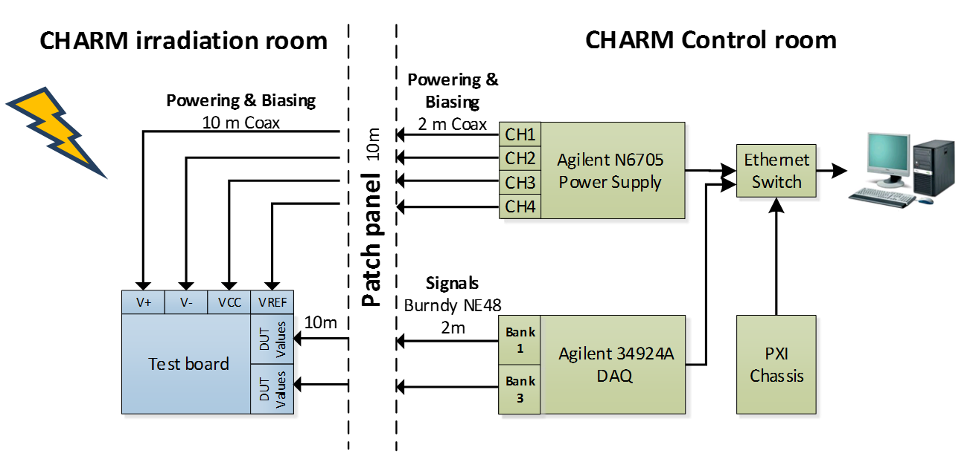
Test devices and conditions
Objective: Identify the best optocoupler candidates for CERN applications
  Two irradiation sessions:
Location | Configuration | DDEF [n. cm⁻²] | TID [Gy]
16 | CuOOOO | 2.2 x 10¹² | 150
Location | Configuration | DDEF [n. cm⁻²] | TID [Gy]
16 | CuOOOO | 3.2 x 10¹² | 170
Test Board:
  Optocoupler test board
  Up to 20 devices under test

Slide 21
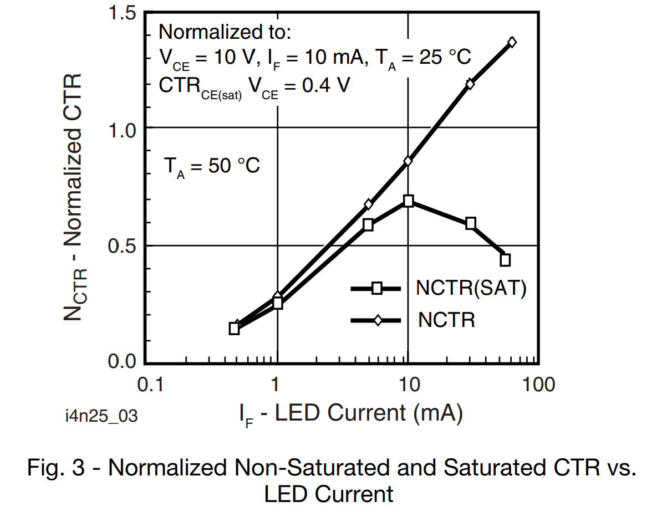
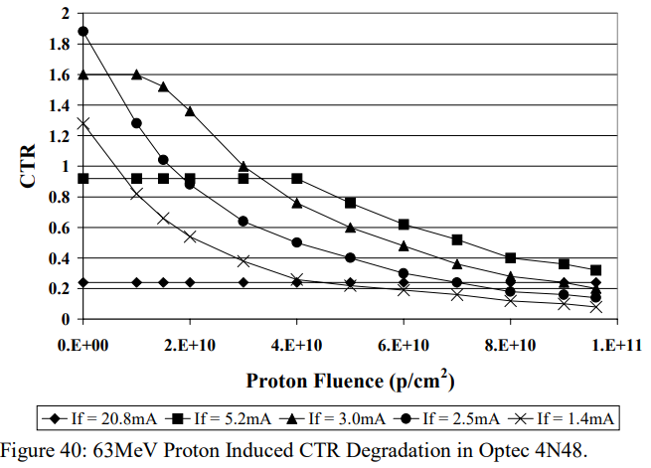
Mitigation techniques: ↓CTR attenuation
Use in saturation mode leads to a lower apparent degradation
Higher current → higher annealing → Lower ↓CTR
↓CTR
  Without
  NPN
  saturation
  With NPN
  saturation

