Slide 1
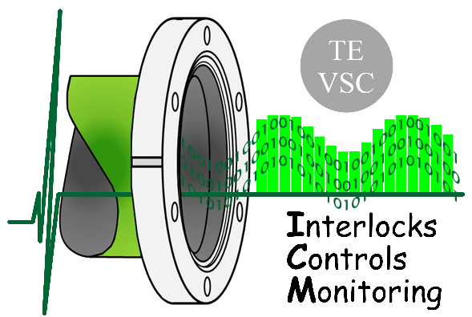
Vacuum developments and radiation tests
RADWG 22 October 18
Nikolaos Chatzigeorgiou
Gregory Pigny
Vilde Rieker
TE-VSC-ICM

Slide 2
Outline
Vacuum electronics developments in 2018
COTS PSI status and LOT procurement
Controls to tackle all radiation campaigns
Characterization of electronics at CHARM
  Penning
  Pirani
  Piezo
  Power Supply
  Conclusions
  Future work

Slide 3
Vacuum electronics developments in 2018
Sub-WP1: R2E
Task 1: Gauge electronics in the LHC ARCs and DS
  Active Parts: Penning, Pirani, Piezo and Power supply
  Passive parts: backplane, crate design, system architecture
TWEPP18 poster: “Radiation tolerant conditioning electronics for vacuum measurements”
https://indico.cern.ch/event/697988/contributions/3056160/

Slide 4
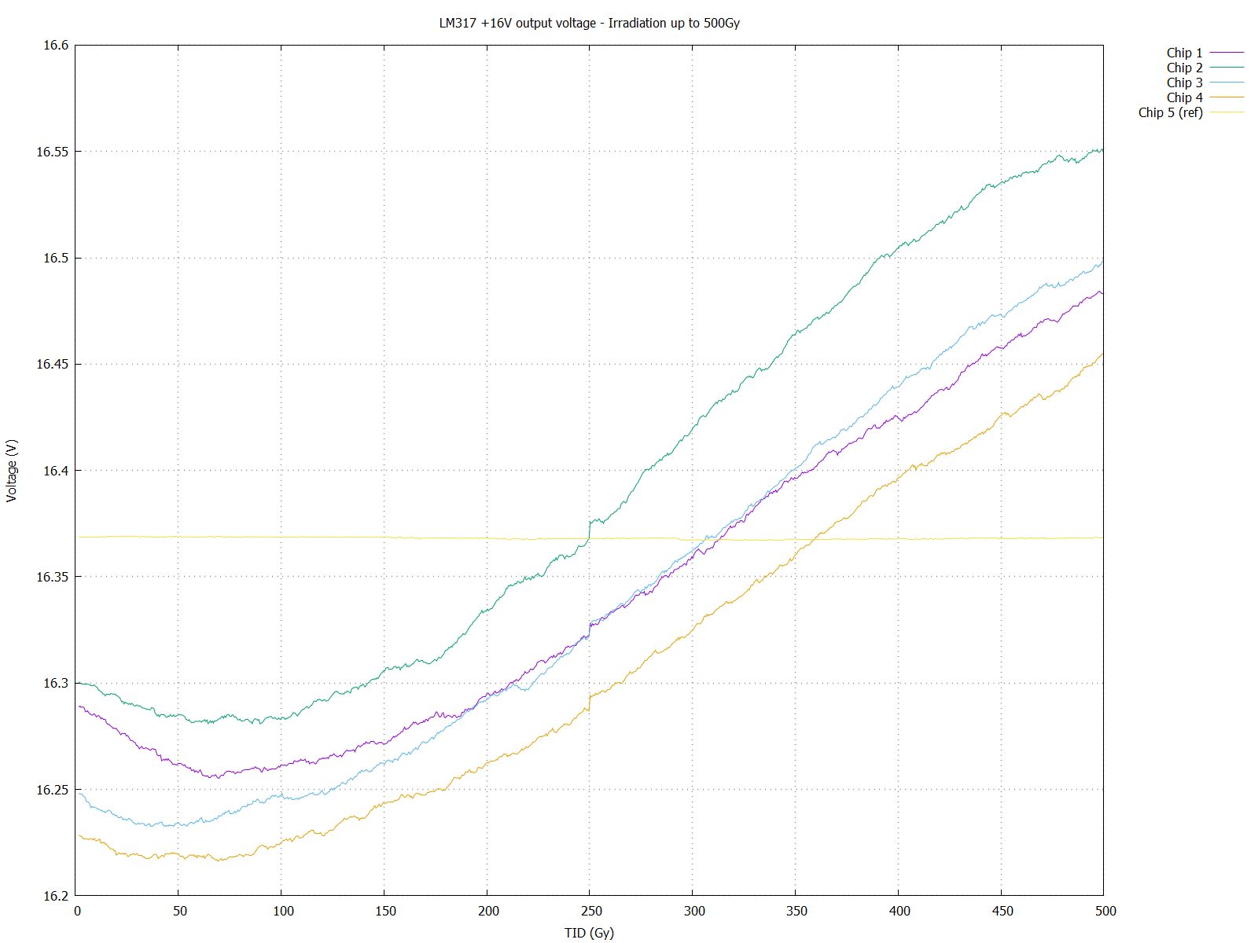
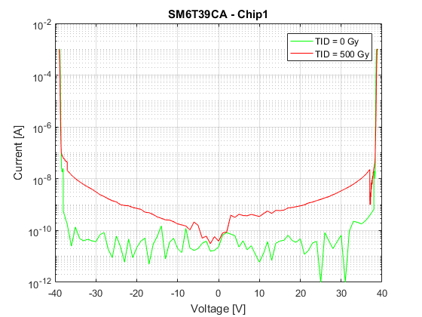
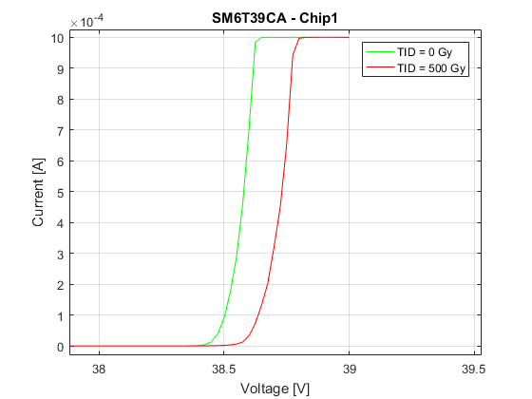
COTS PSI campaigns in Q1/Q2 2018
SM6T39CA
ST
LOT: GP5060CV VU GP
Bi-directional TVS
Output protection of 4-20mA stage
IV curve at 500Gy
8 DUTs – within specs at 500Gy
LM317AT/NOPB
TI
LOT: 7AAE1JUE3
Adjustable regulator
Penning HV converter
Output voltage stability
4 DUTs – 30mV drift

Slide 5
COTS Procurement
COTS for LS2 production
  DS production and spares:
    16+4 Penning
    16+4 Pirani
    48+10 Piezo
    96+20 Power Supply
  Covered 10 Test cards of each design
  Same batch as the PSI samples when was feasible
  New batches for the rest; minimizing risk through Date Code and factory shorting
Need PSI batch verification for full LS3 production

Slide 6
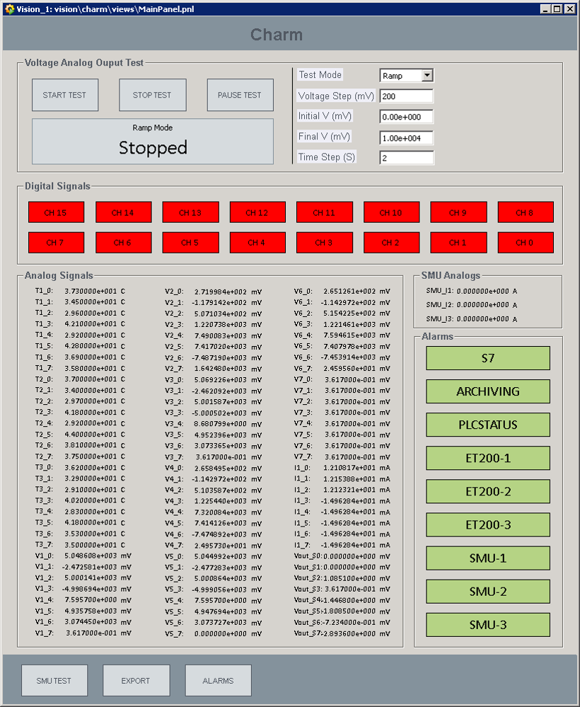
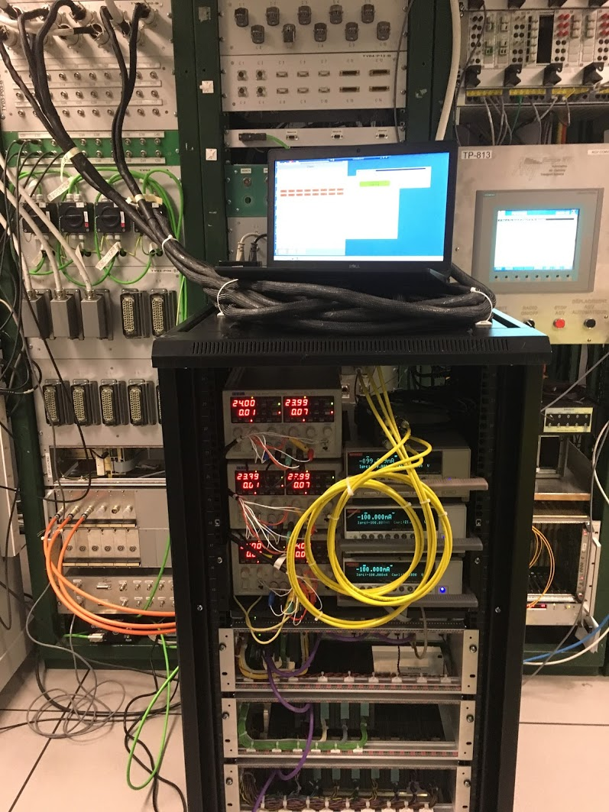
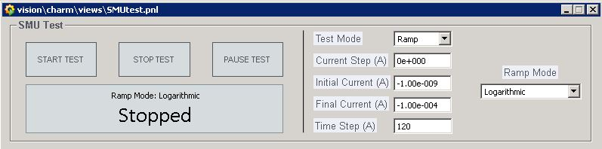
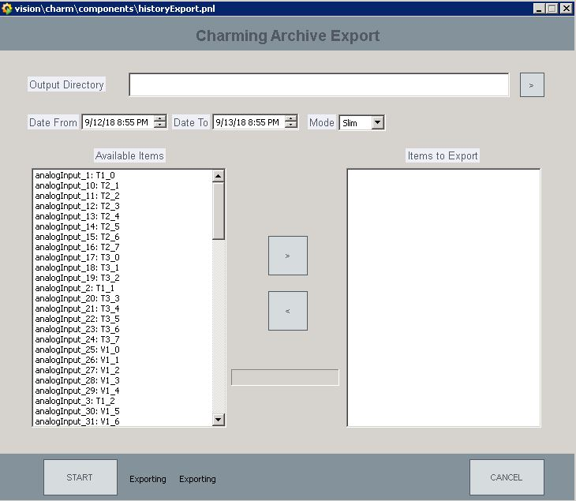
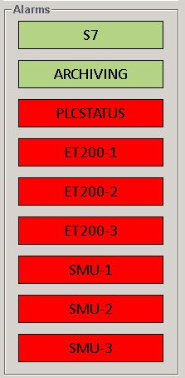
Control system
Designed to tackle all irradiation campaigns
Based on Siemens PLC and WinCCOA
Can sample up to 100 analog channels and provides 16 DOs
Controls external SMU instruments
Programmable Linear/Logarithmic sequences
Archives data in a database
Sends notification alarms in case of system failure
SMU panel
Voltage Source
DO
Export panel
Alarms

Slide 7
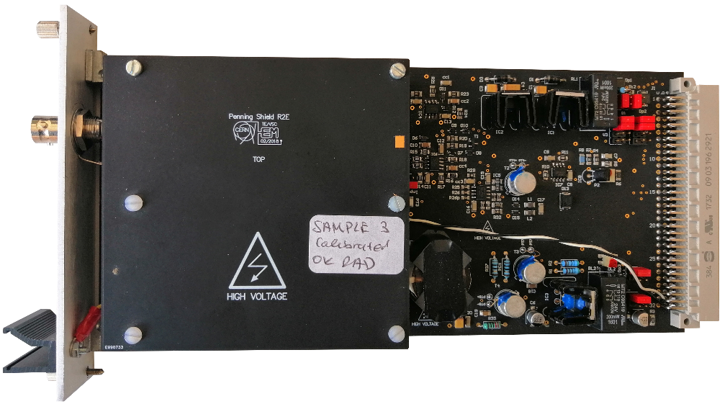
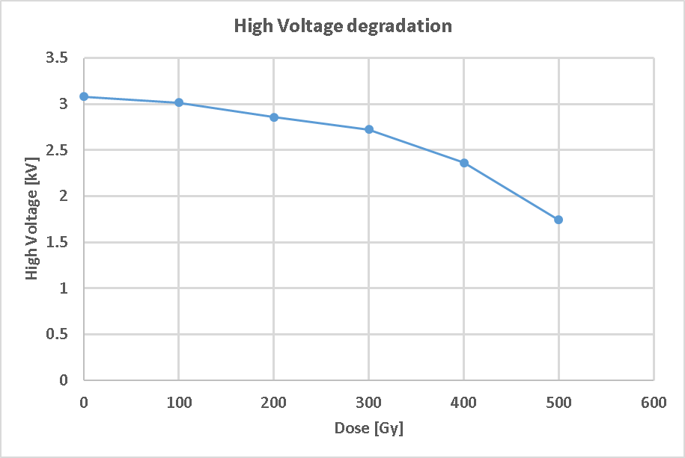
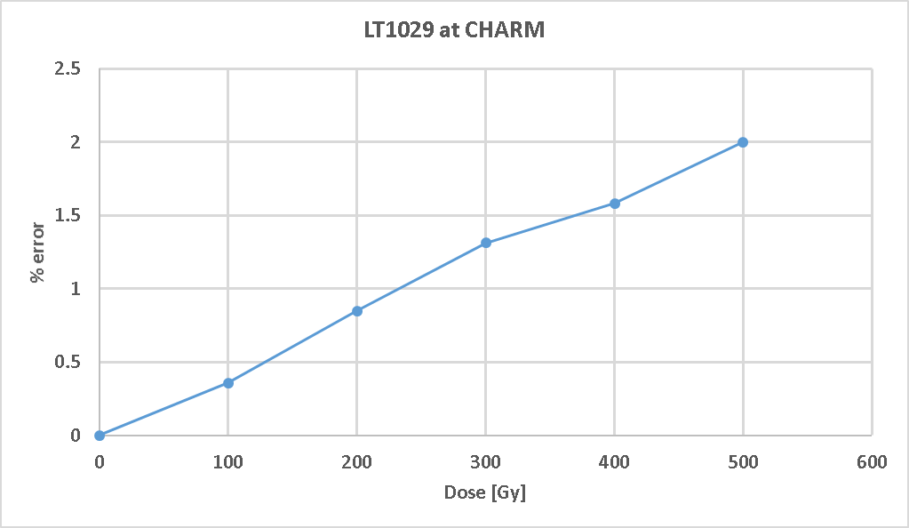
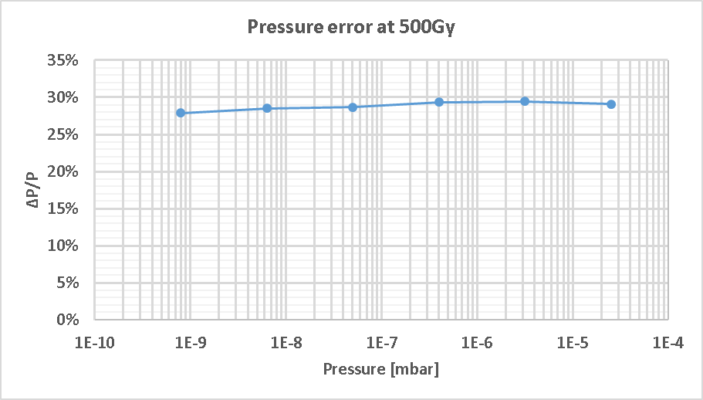
Penning Conditioning Electronics v1
Campaign started May 2 for 2 weeks
Input sweep from 1nA to 100uA (1 point/decade)
Strong deviation of the LM317
HV dropped from 3kV to 1.7kV
2% deviation of the Vref (LT1029)
Introduced 30% relative error on output reading due to the non-linear transfer function

Slide 8
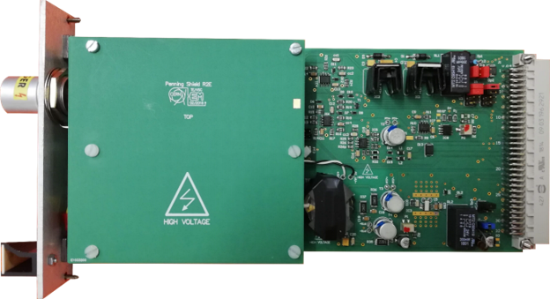
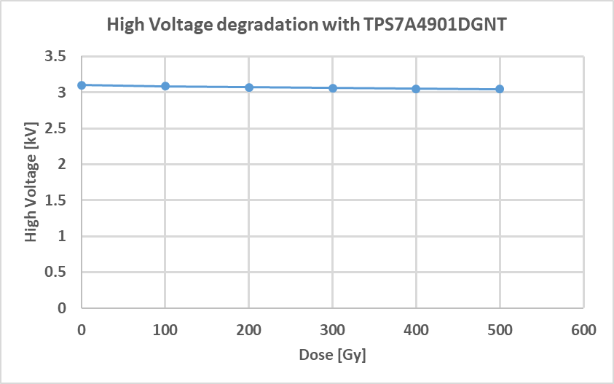
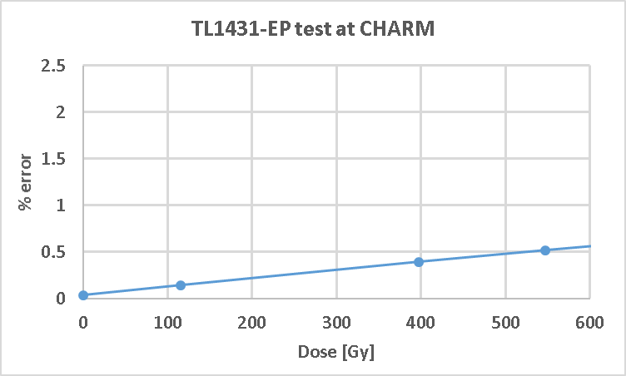
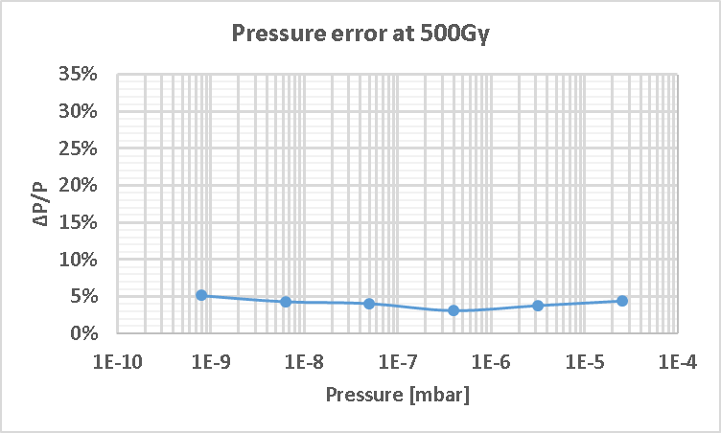
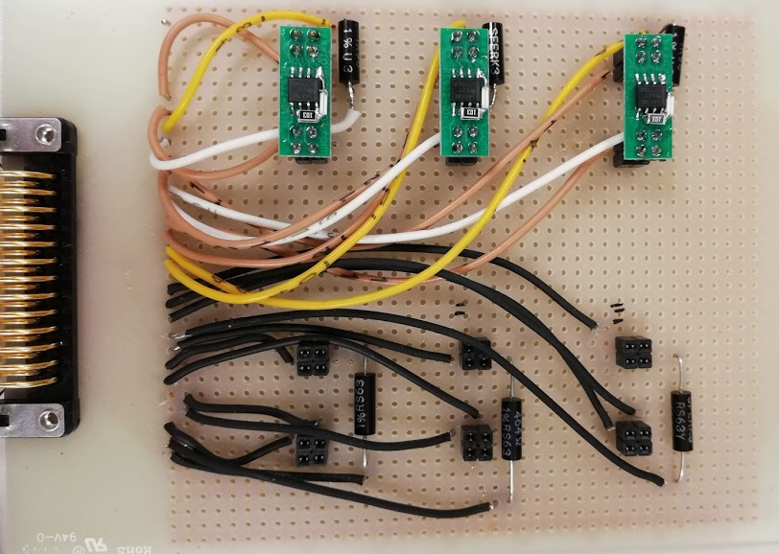
Penning Conditioning Electronics v2
Campaign started AUG 1 for 2 weeks
Input sweep from 1nA to 100uA (1 point/decade)
New Regulator for HV generation
(TPS7A4901DGNT)
HV stable within 2%
55V drop at 500Gy
New Vref; component level test at CHARM (with N. Trikoupis)
0.5% @ 500Gy deviation of the Vref
6% full-scale error at 500Gy
TL1431-EP
LOT:6167839TW6

Slide 9
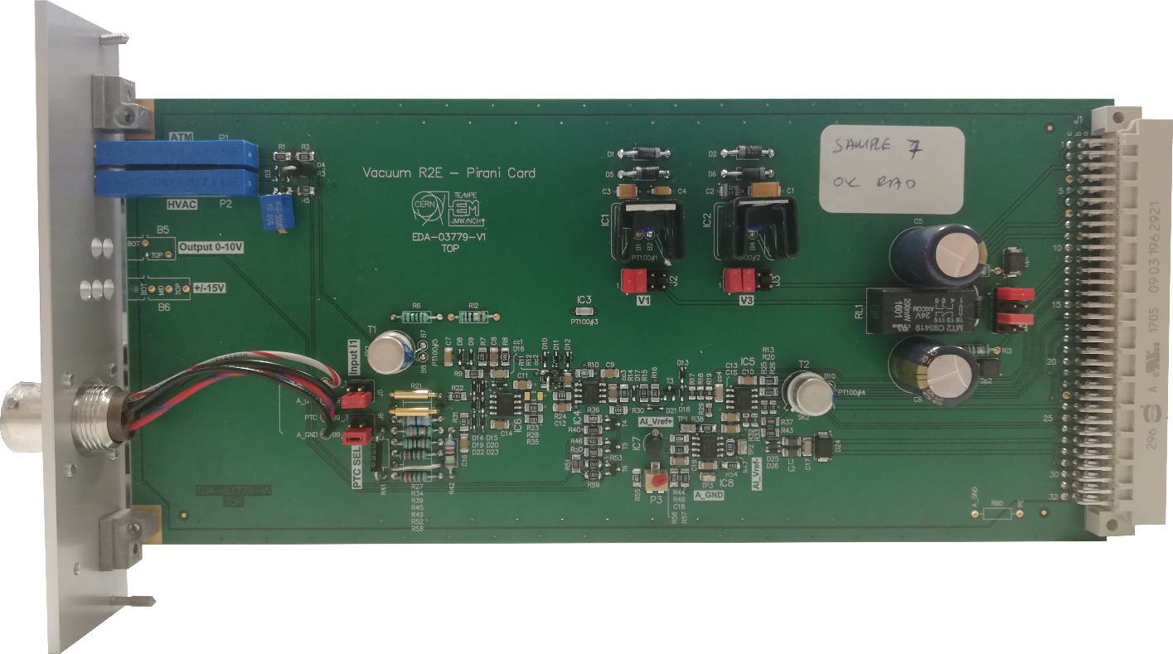
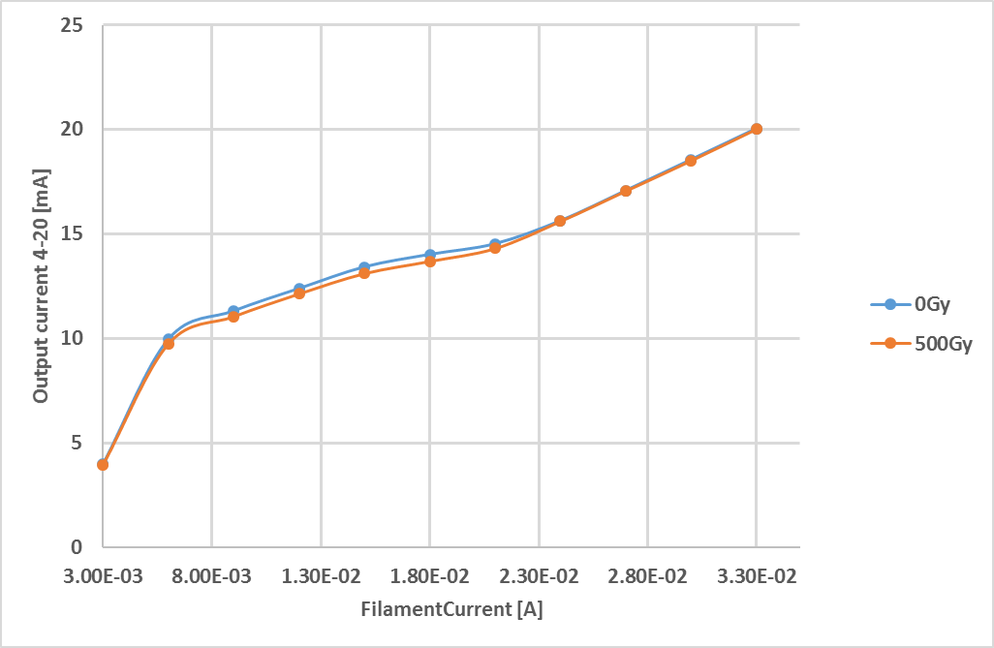
Pirani Conditioning Electronics
Campaign started May 16 for 2 weeks
Pressure simulation with SMU
Sweep from 3mA to 33mA, 3mA step
2.5% maximum readout error
On-going analysis

Slide 10
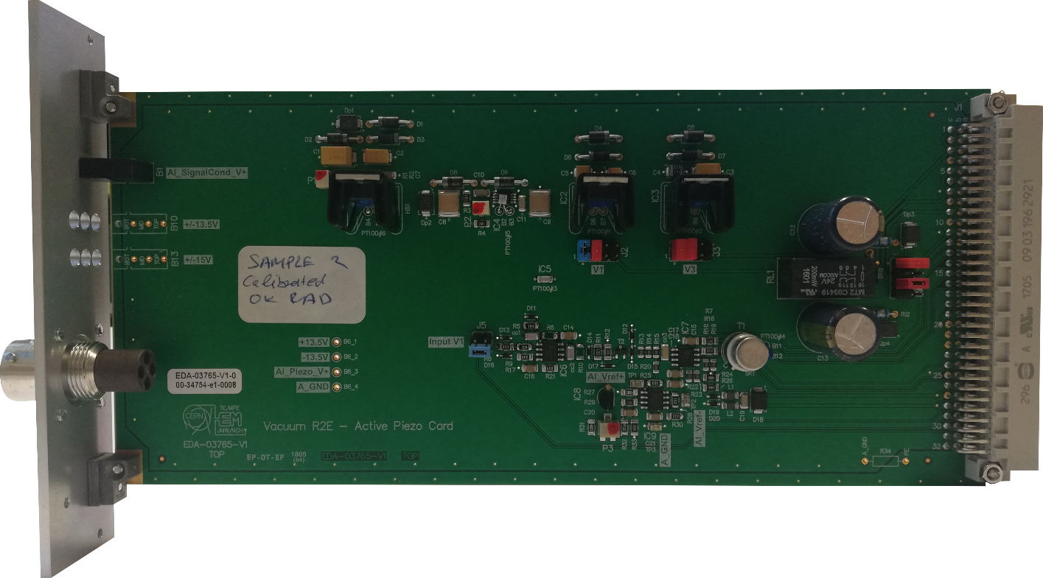
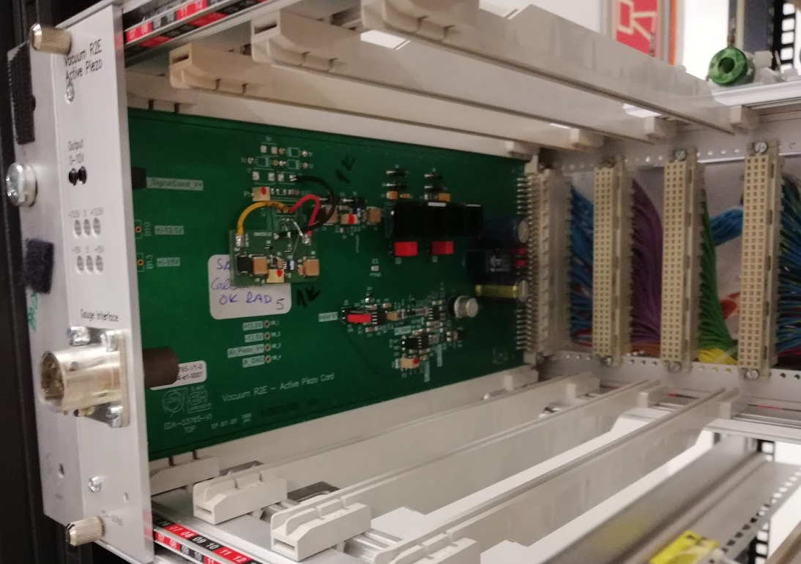
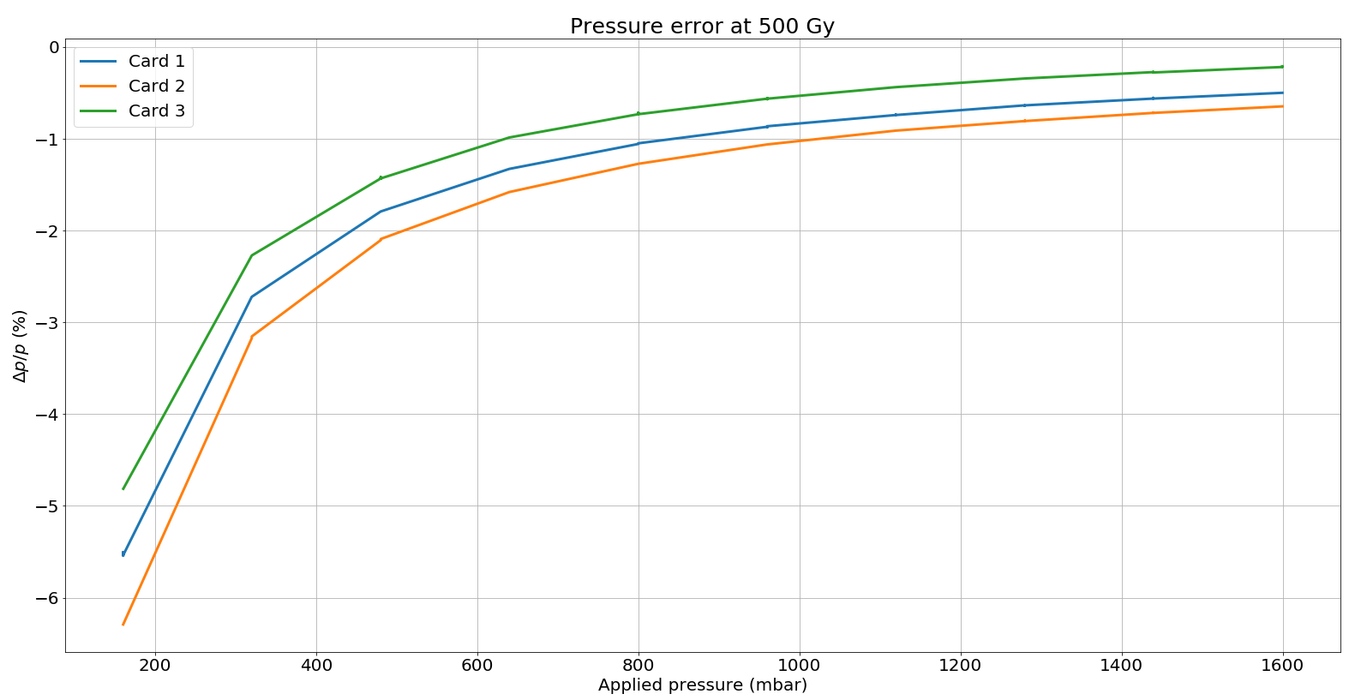
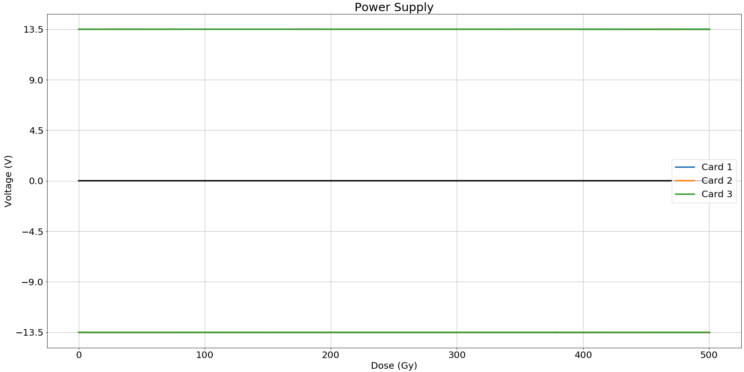
Piezo Conditioning Electronics
Campaign started JUL 4 for 2 weeks (same campaign with PS)
Pressure simulation with voltage source. Sweep 0-10V, 1V step
Exchange of the LM317 with TPS7A4901DGNT
Relative error below 2% for most of the range
±13.5V supply stability within 0.1%

Slide 11
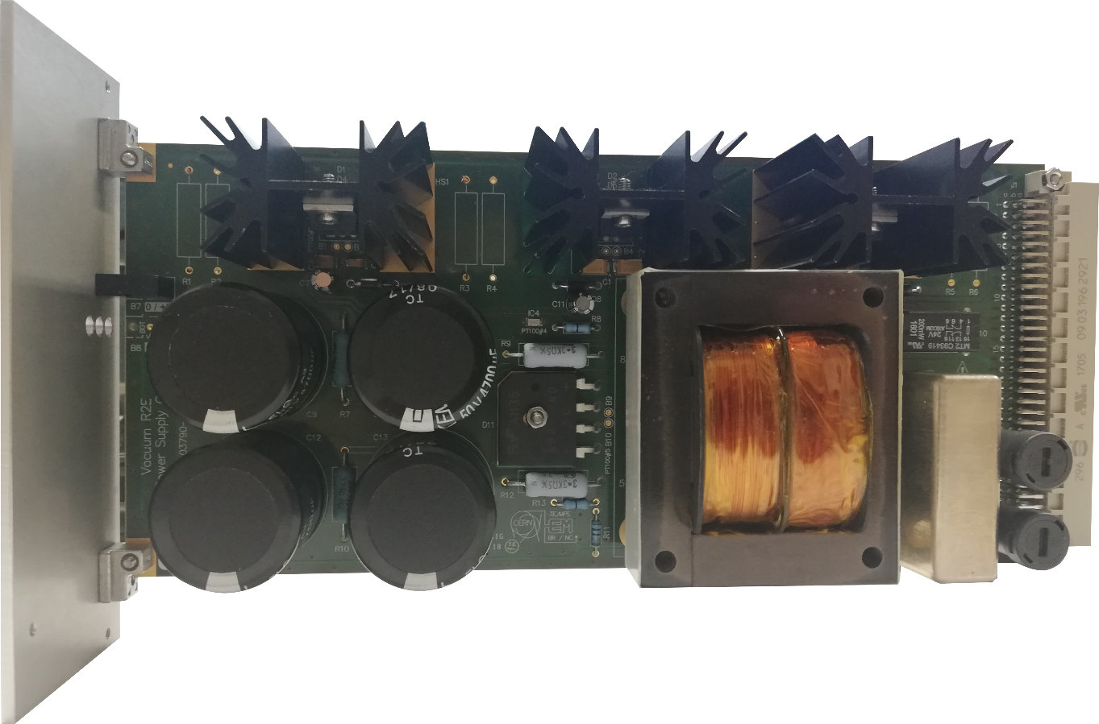
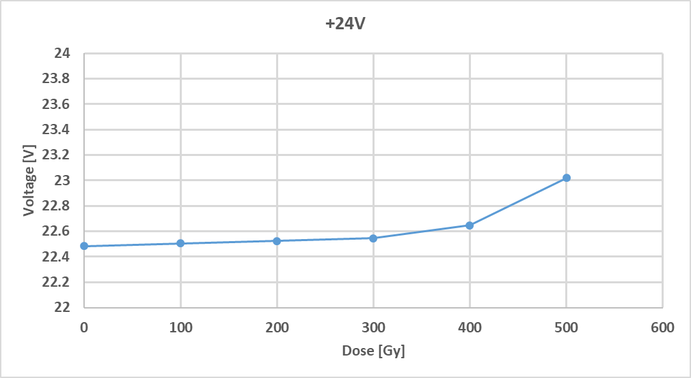
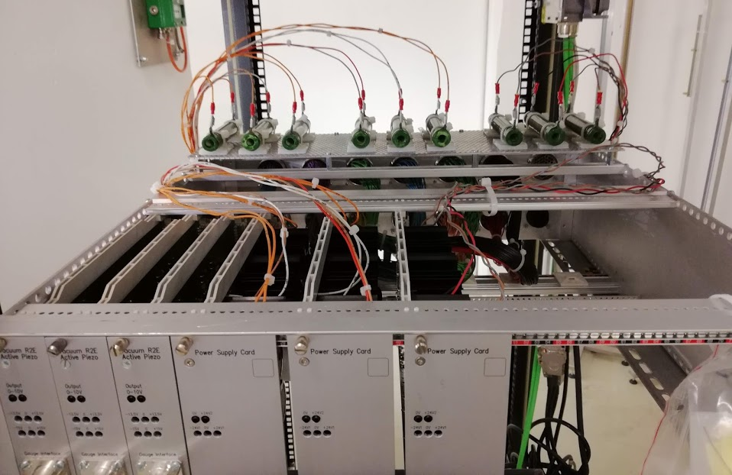
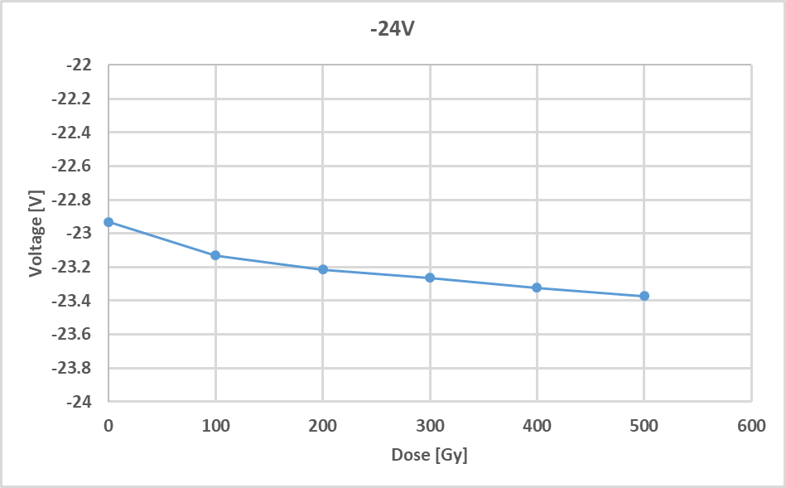
Power Supply
Campaign started JUL 4 for 2 weeks
(same campaign with Piezo)
Dummy loads to simulate nominal consumption
    120mA each positive rail
    120mA the negative rail
  Accumulated 730Gy
  All power cycles successful

Slide 12
Summing up
All designs accumulated 500Gy with tolerable degradation of performance
Dynamic mitigations:
TPS7A4901DGNT replaced the LM317 for Penning and Piezo cards
New voltage reference TL1431-EP replaced LT1029 and tested with Penning card
The LM7915 ON, LOT:X001323576
13 samples in total at CHARM through the system level tests
fails to provide nominal output voltage (-4V) suddenly or after power cycle
  6 accumulated more than 700Gy successfully (including power cycle at the end)
  4 failed at 640Gy / 2 at 750Gy / 1 at 470Gy
8 samples sent to PSI for test up to 1kGy with power cycles every 100Gy
Similar behavior: fails to provide nominal output voltage (-4v) but recovers after some minutes (while at CHARM the effect was permanent)
  1 successfully passed the 1kGy power cycle
  6 failed at 1kGy / 1 at 500Gy
We are in the process of studying the Dose to displacement damage ratio between CHARM and PSI data (with S. Danzeca and Rudy R. Ferrano)

Slide 13
Future Work
Finish the RHA document (for ECR)
Finishing the pre-series production and assembly the first prototype crate
Testing and verifying the pre-series in the lab and under real pressure measurement in vacuum chamber
Start production for LS2
Special Thanks
Group VSC
Gregory Pigny, Paulo Gomes, Andre Rocha, Rodrigo Ferreira, Jose de la Gama, Vilde Rieker
R2E
Ruben Garcia Alia
EN-SMM-RME
Salvatore Danzeca, Chiara Cangialosi, Georgios Tsiligiannis, Gilles Foucard
TE-CRG-CI
Nikolaos Trikoupis
EN-SMM-MRO
Jerome Lendaro

