Slide 1
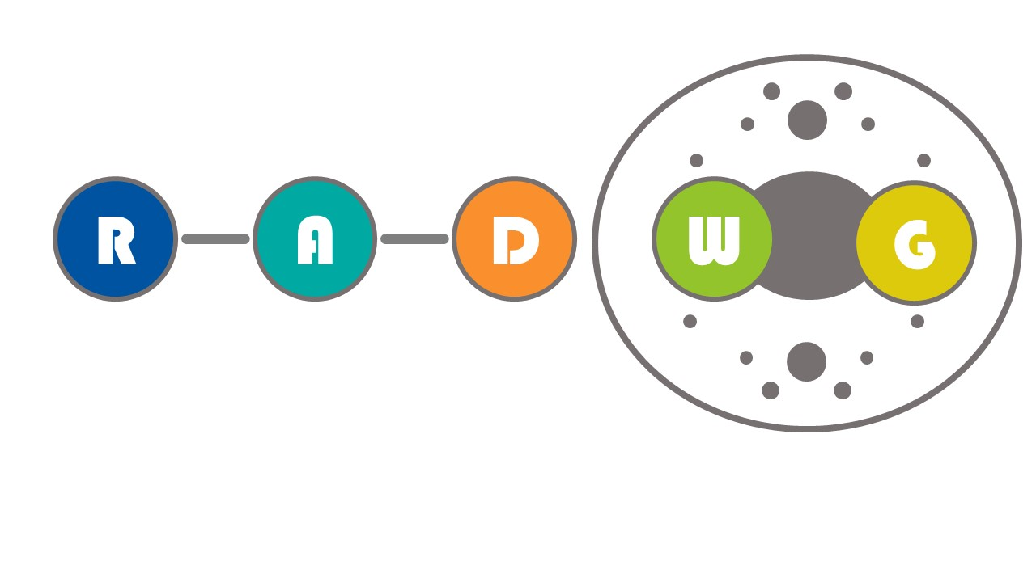
RADWG Meeting November 2018
Salvatore Danzeca EN/SMM/RME on behalf of the RADWG

Slide 2
AGENDA
Activities Overview by Salvatore Danzeca
Vacuum development and radiation tests by Nikolaos Chatzigeorgiou
ELMB ++ development and radiation test result by Kamil Szymon Nicpon
NanoExplore FPGA radiation test results by Georgios Tsiligiannis
Optocoupler radiation tests results and suggested selection process by Rudy Ferraro

Slide 3

RADWG Mandate
It provides support to the accelerator sector equipment groups for the assessment of radiation tolerance of electronic equipment to be installed in radiation exposed areas.
It is as a forum for electronic engineers to discuss
  design practices
  radiation tests
  radiation induced failures in the accelerators.
It coordinates radiation test campaigns inside and outside CERN
The RADWG assists the R2E Project leader for the evaluation of the technical aspects of the proposed mitigation actions with the representatives of the equipment groups

Slide 4
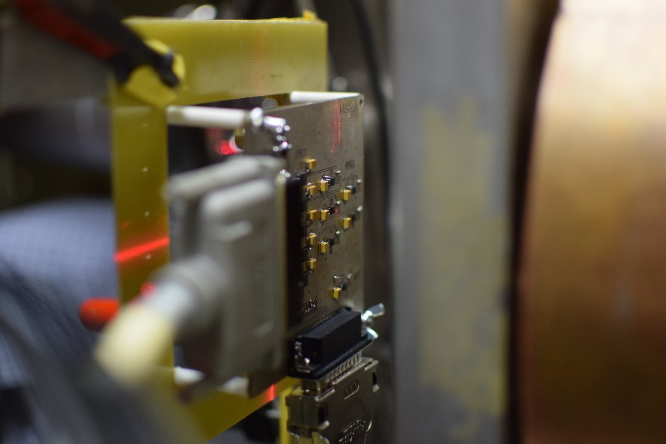
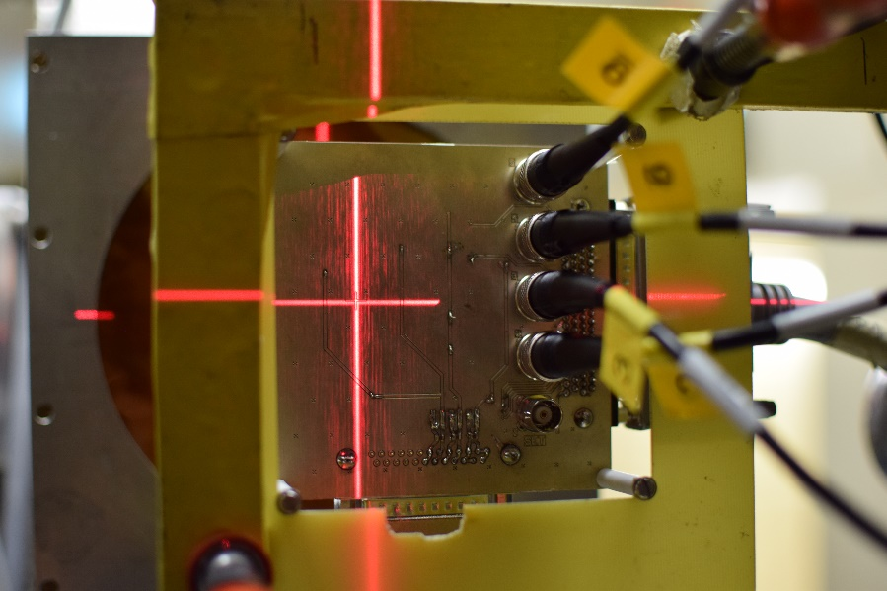
Radiation Tests
71 components tested under irradiation in the 2018 requested by TE/VSC, TE/EPC, BE/BI, TE/MPE
8 PSI-PIF proton test campaigns
5 years collaboration with PSI to ensure continuity of the radiation tests also during the LS2
Radiation test database available online: https://radwg-table.web.cern.ch/public/

Slide 5
Radiation test campaigns
PSI Facility Updates
  2019 Requests open
Test date | Components | Test group | Equipment owner
January | Sensor calibration, Vacuum components, DCDC Converter from Atlas | EN/SMM | TE/VSC – EN/SMM
April | Voltage regulators, transistors, misc | EN/SMM | TE/VSC , TE/MPE
May | Timer, Logic | EN/SMM | BE/BI – TE/VSC – TE/MPE – BE/CO
June | Zener Diodes, DAC, FLASH, misc | EN/SMM | BE/BI – TE/VSC – TE/MPE – BE/CO
July | Logic, Diodes, I2C buffer from Atlas | EN/SMM | BE/BI – TE/VSC – TE/MPE – BE/CO
August | Voltage regulators, RFMos, OpAmp | EN/SMM | BE/BI – TE/VSC – TE/MPE – BE/CO
October | Sensor calibration, Diodes, FPGA misc, | EN/SMM | BE/BI – TE/VSC – TE/MPE – BE/CO
November | Lot qualification, ADC, DC-DC converters, | EN/SMM | BE/BI – TE/VSC – TE/MPE – BE/CO

Slide 6
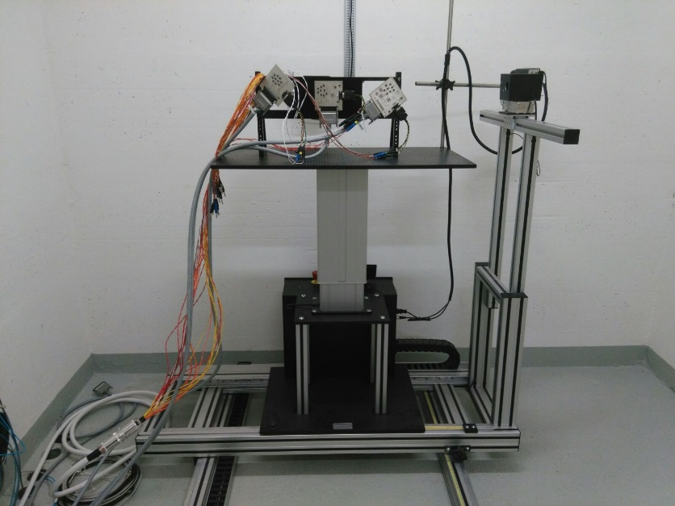
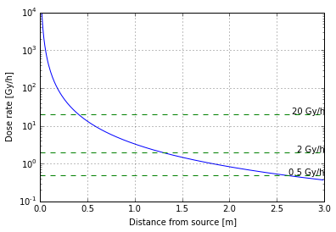
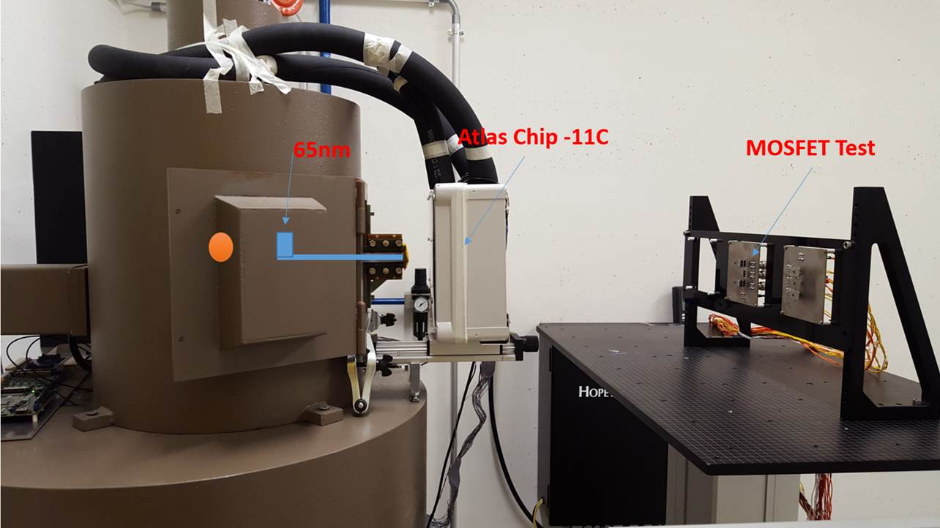
⁶⁰Co facility @ CERN
Reminder: dose rates from 20Gy/h up to 0.36Gy/h
Inside the irradiator setup: 300Gy/h to 100Gy/h on a small surface
Past Users:
  Kurtis Johnson (31 May to 16 Aug)
  Rudy Ferraro (16 Aug to 10 Sept)
  Joan Cesari (multiple tests)
  Matteo Brucoli (15 June to 22 June)
On-going : Atlas FPGA TID testing
Call for tender for the new source of 100TBq completed.
Installation next year
  Modification of the irradiator might be necessary
The new source can allow us to reach 1MGy in 20 days on 4x4 cm. Larger sample size will require more time.

Slide 7

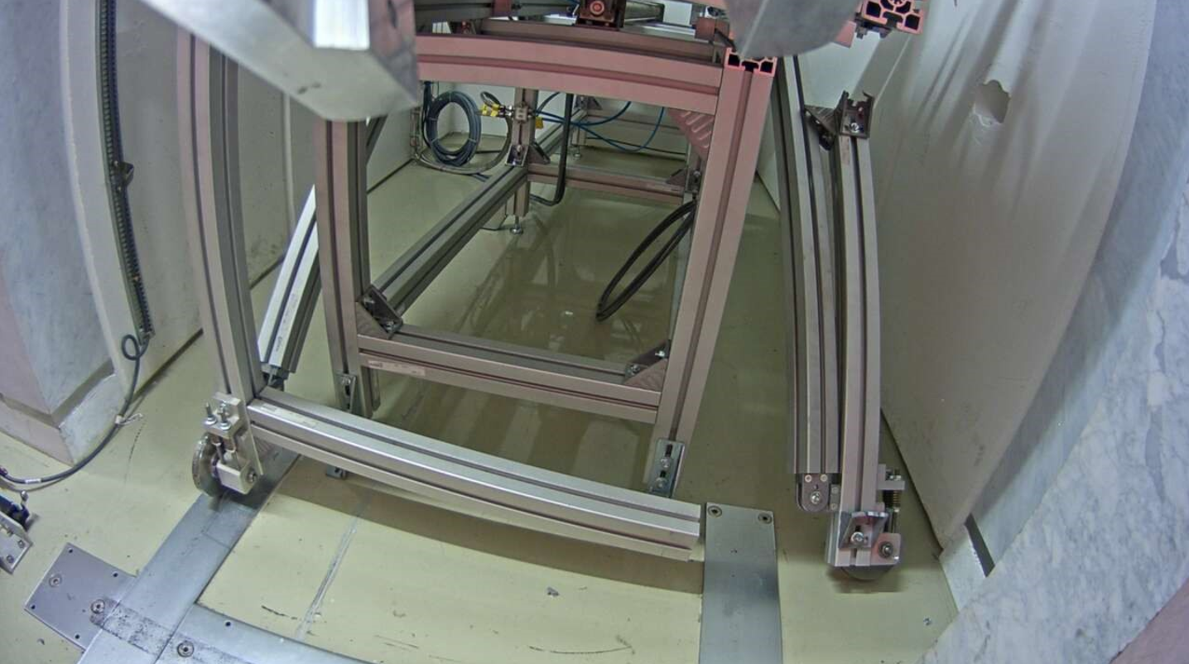
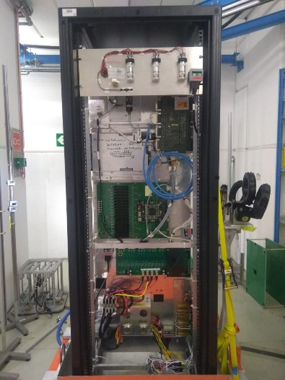
CHARM Facility
Fully booked for the 2018
Last day with protons 11/11/2018
More than 50 users (2x 2017) from CERN and external institutes
  Reports available online : http://charm.web.cern.ch/content/radiation-test-report
Problem on the target solved in two weeks with the help of the EN-STI and Robotics intervention
  All the users have been re-scheduled and no beam lost
Up to 8 users running in parallel in different positions (last year was 6)
New configuration: In-beam testing for component screening
  8 Optocoupler screened
  2 DC-DC converter
Online dosimetry using the RadMon system
Second ion beam (Lead) in CHARM during the 2018 starting on the 12/11/2018

