Slide 1
WP7 Organisation
Regina Rochow
Vidyo Meeting, 04 October 2018

Slide 2
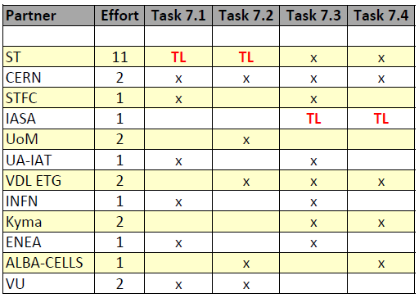
WP7 Tasks and involved Partners
Task 7.1 - Gerardo D’Auria, ST
Global integration of CompactLight for new Research Infrastructures
running
Task 7.2 - Regina Rochow, ST
Services to be provided
to be started soon …
Task 7.3 - Evangelos Gazis, IASA
Preliminary estimation of construction and operation costs
starting
Task 7.4 - Evangelos Gazis, IASA
Technology Transfer
to be started soon ...
Proposed WP7 Partner Involvement:
New!!
D7.1: Midterm report with CompactLight global integration and cost analysis (M24)
D7.2: Final report with CompactLight global integration analysis, services and cost (M36)

