Slide 1

PROPOSAL FOR A COST MODEL FOR THE X-FEL of the
COMPACT LIGHT COLLABORATION
Evangelos Gazis
IASA @ Compact Light
Many Thanks to: R Rochow, J. Clarke, D. Schulte, W. Wuench

Slide 2
CONTENTS
COMPACT LIGHT XFEL
OTHER XFEL SYSTEMS COST
COST of other systems breakdown
XFEL@DESY
ESS@LUND
COST MODEL for LARGE systems
COST MODEL PROPOSAL for XLS
======================================
TIME Schedule
RISK Analysis
Commissioning – Operation

Slide 3
XLS Performance (Gerardo D’ Auria, XLS Kick-off meeting)
Parameter | Value | Unit
Minimum Wavelength | 0.1 | nm
Photons per pulse | >10¹²
Pulse bandwidth | <<0.1 | %
Repetition rate | 100 to 1000 | Hz
Pulse duration | <1 to 50 | fs
Undulator Period | 10 | mm
K value | 1.13
Electron Energy | 4.6 | GeV
Bunch Charge | <250 | pC
Normalised Emittance | <0.5 | mrad
Preliminary Parameters and Layout of XLS hard X-ray FEL facility

Slide 4
Basic Parameters (D. Schulte et al, Trieste Meeting)
 | unit | CLIC_502 |  | CLIC_L |  | Swiss
Structures per RF unit |  | 12 | 16 | 12 | 16 | 4
Klystrons per RF unit |  | 2 | 2 | 2 | 2 | 1
Structure length | m | 0.23 | 0.23 | 0.48 | 0.48 | 1.98
a/lambda |  | 0.145 | 0.145 | 0.14 | 0.14
Allowed gradient | MV/m | 100 |  | 80
Operating gradient | MV/m | 77 | 67.5 | 59 | 51 | 27.5
Energy gain per RF unit | MV | 213 | 248 | 339 | 391 | 203
RF units needed |  | 27 | 23 | 17 | 15 | 26
Total klystrons |  | 54 | 46 | 34 | 30 | 26
Linac active length | m | 74 | 85 | 98 | 115 | 206
Cost estimate | a.u. | 76.2 | 71.5 | 63.4 | 64.5
Preliminary estimates based on CLIC cost indicate:
cost of one RF unit C_{RF} (no accelerating structures) is approximately the same as 4m (estimate 1) to 8m (estimate 2) of active length, used 6.67m
Needs to be reviewed
Assume cost of RF unit is 2 cost units (cu)
Thanks to Ph. Lebrun
and I. Syratchev

Slide 5
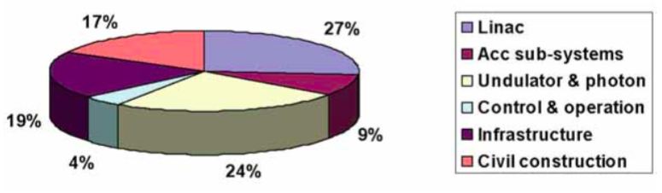
COST of other systems Breakdown
XFEL@DESY
TASK DISTRIBUTION
Electron Gun + Linac 27%
Accelerator sub-systems 9%
Undulator and photon 24%
Controls and operation 4%
Infrastructure 19%
Site and civil work 17%
COST M€
Project preparation 38.8
Project construction, capital investment 736.3
Project construction, personnel 250.1
Total construction cost 986.4
Beam commissioning 56.4
Total project construction cost 1,081.6

Slide 6
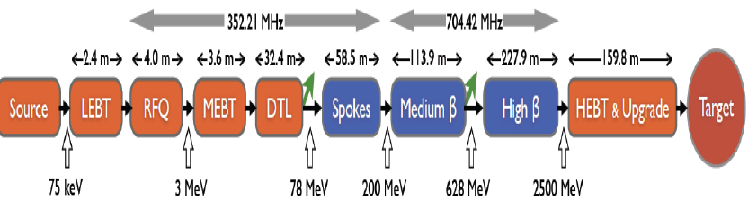
COST of other systems Breakdown
ESS (Dave McGinnis/Accelerator Division)
The European Spallation Source (ESS) will house the most powerful proton linac ever built.
    – Average beam power of 5 MW.
    – Peak beam power of 125 MW
    – Acceleration to 2 GeV
    – Peak proton beam current of 62.5 mA
    – Pulse length of 2.86 ms at a rate of 14 Hz (4% duty factor)
• 97% of the acceleration is provided by superconducting cavities
• The linac will require over 150 individual high power RF sources
    – with 80% of the RF power sources requiring over 1.1 MW of peak RF
    power
    – We expect to spend over 200 M€ on the RF system alone

Slide 7
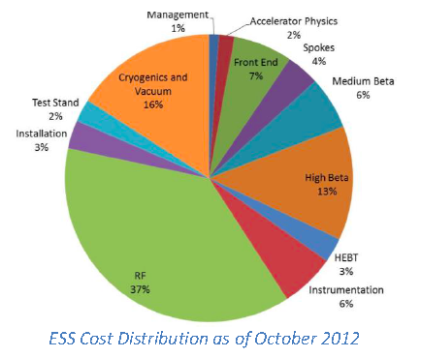
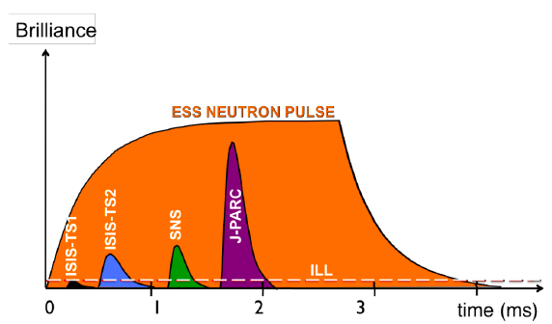
COST of other systems Breakdown
ESS (Dave McGinnis/Accelerator Division)
RF 37%
INSTRUMENTATION 6%
HIGH BETA 13%
MEDIUM BETA 6%
SPOKES 4%
FRONT END 7%
ACCELERATOR PHYSICS 2%
MANAGEMENT 1%
CRYOGENICS-VACUUM 16%
TEST STAND 2%
INSTALLATION 3%

Slide 8
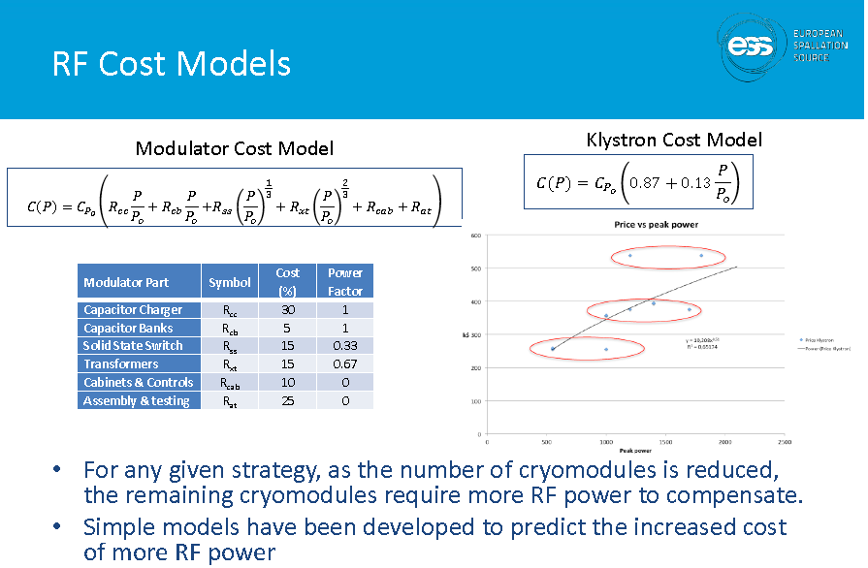
COST of other systems Breakdown
ESS (Dave McGinnis/Accelerator Division)

Slide 9

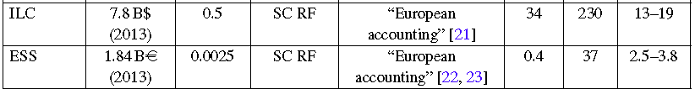

COST of LARGE systems
An example by V. Schiltsev
Total Project Cost = TPC
L = Length of the tunnel, E = cm Energy, P = total site AC power for the facility
α, β, γ = coefficients, but β varies with the accelerator technology

Slide 10
A draft COST MODEL for XLS
Sub-Systems
RF-Gun
Injector
LINACS
Klystrons
Bunch Compressors
Magnets
Undulator
Controls & Operation
Rough Distribution %
      6
      9
      16
      25
      10
      5
      25
      4
WP Leaders should start providing rough estimation of the cost/item-system, to be frequently updated!

Slide 11
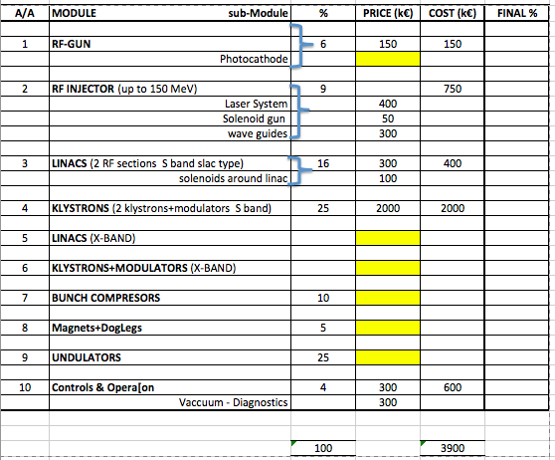
A draft COST MODEL for XLS (thanks to Massimo Ferrario)
The yellow slots are missing costs PLUS any other missed item

