Slide 1
CompactLight
WP7 Cost Model for the Undulator System
Raffaella Geometrante

Slide 2
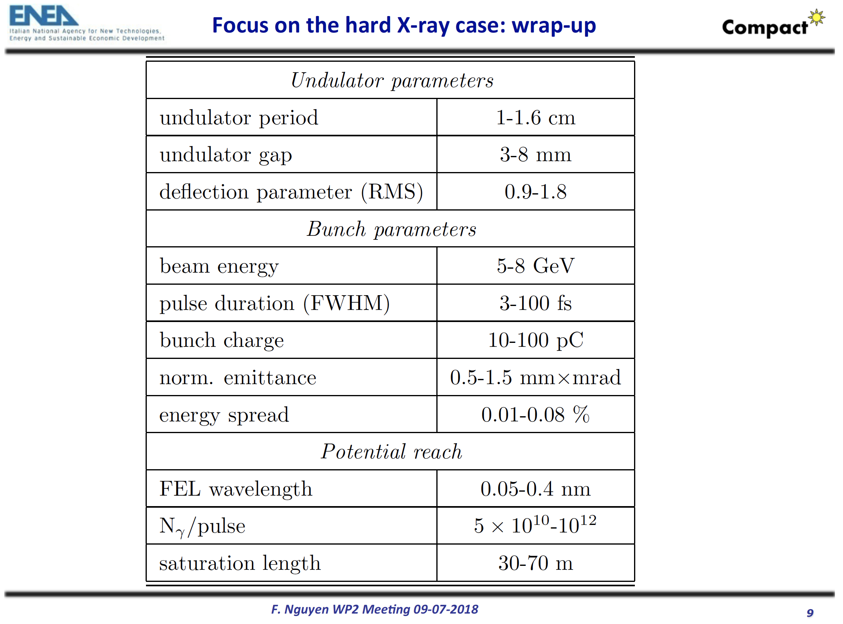
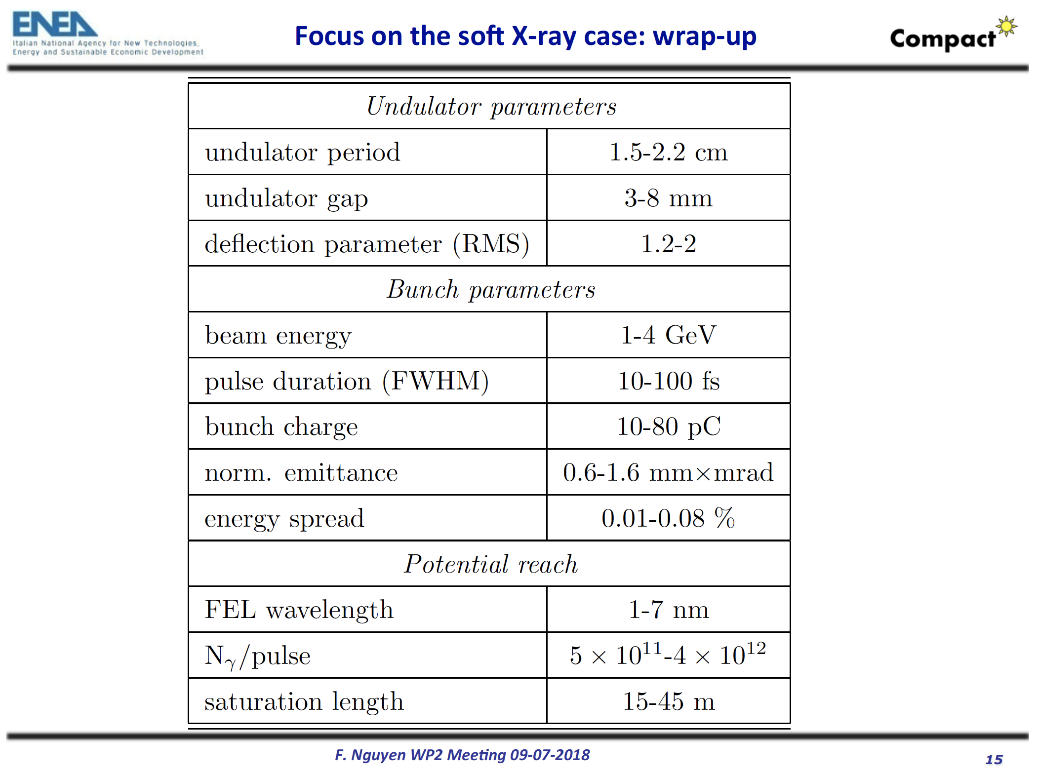

Slide 3
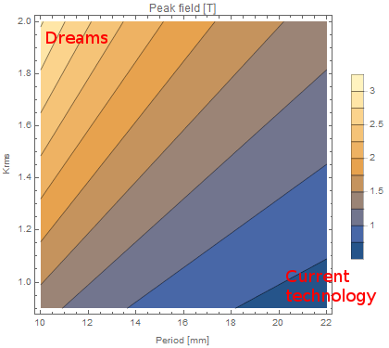
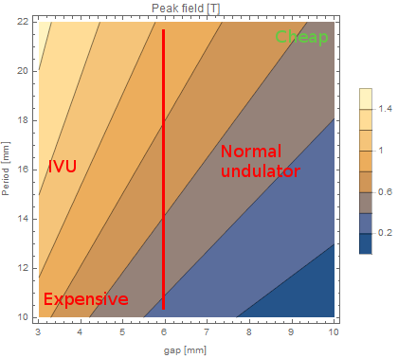
Mirko Kokole

Slide 4
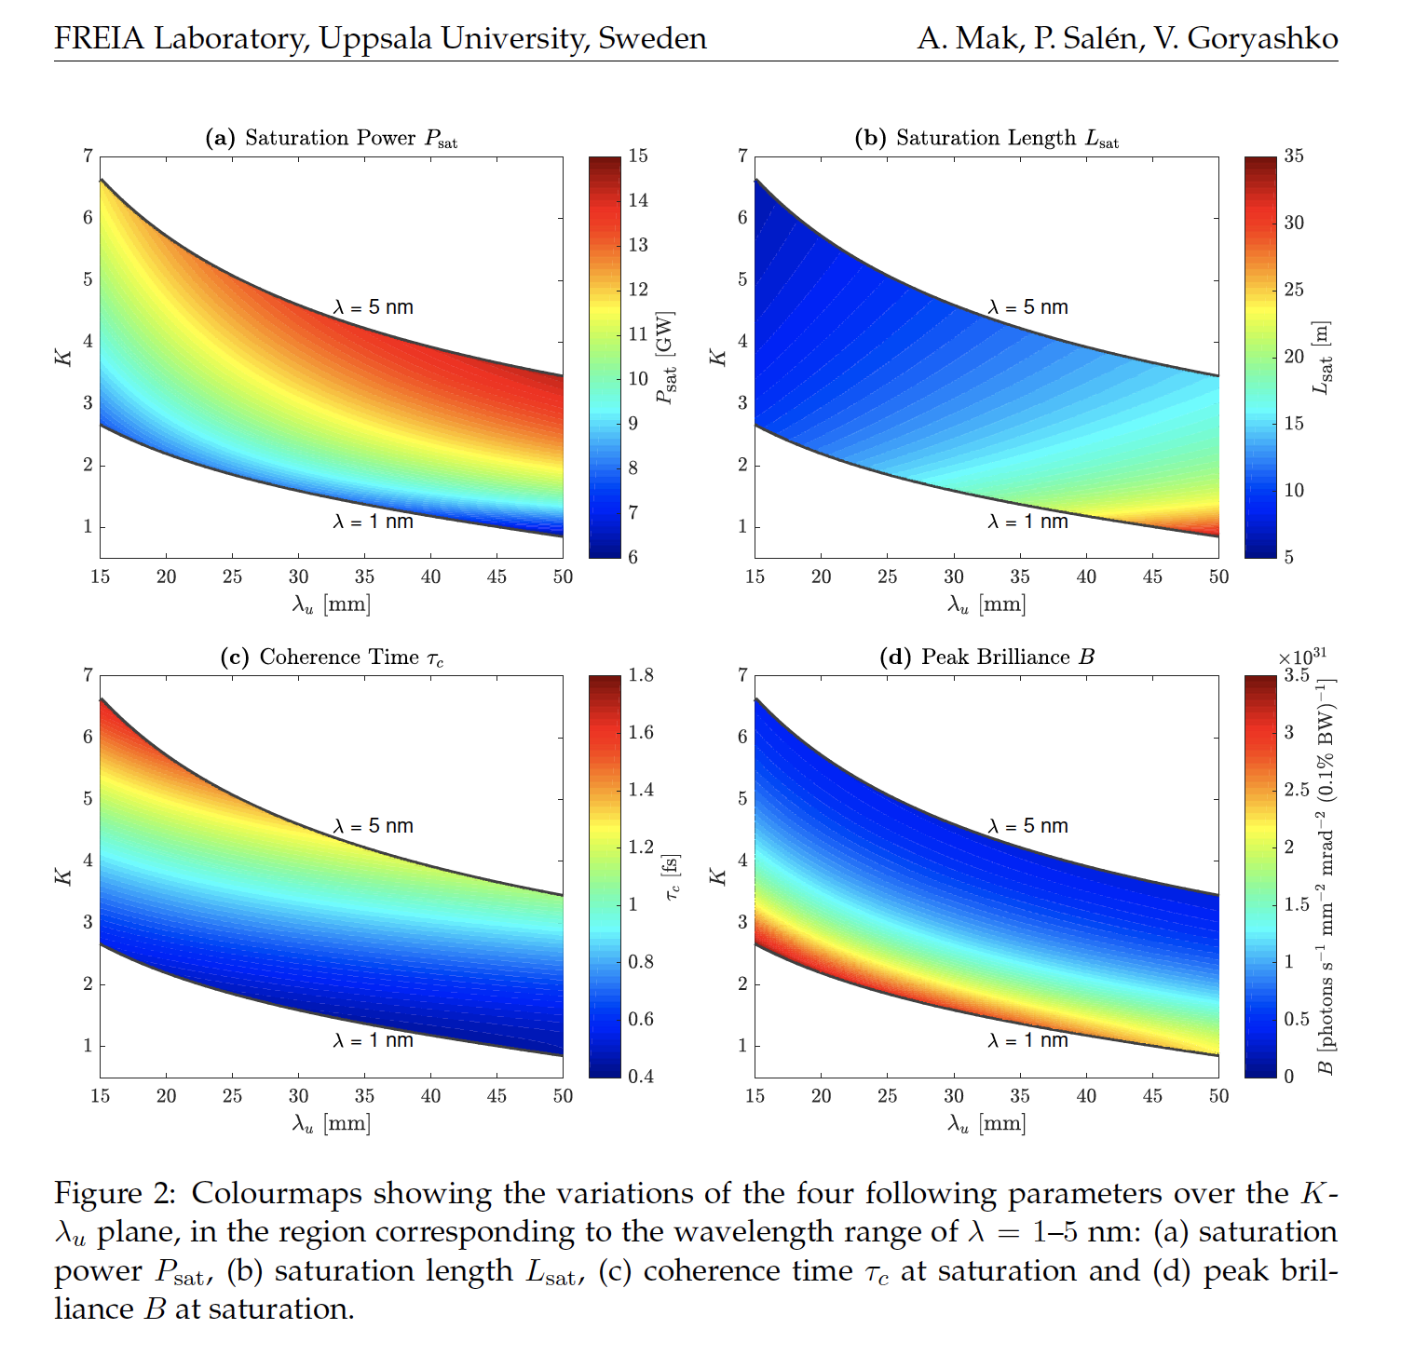
A. Mak, P. Salen, V. Goryashko, Undulator Considerations in the Baseline Design of the MAX IV Soft X-Ray Laser, Paper in the FREIA Report Series are published on internet in PDF-formats. Download from http://uu.diva-portal.org

Slide 5
Questions
What are the driving conditions – CLEAR GUIDELINES
Compactness
Feasibility
Cost
State of the art
Aggressive solutions
Mak, P. Salen, V. Goryashko, Undulator Considerations in the Baseline Design of the MAX IV Soft X-Ray Laser, Paper in the FREIA Report Series are published on internet in PDF-formats. Download from http://uu.diva-portal.org
What are the steps forward?

Slide 6
Cost Model for the Undulator System
Cost Evaluation for different undulator technologies (cost per m)
It depends on the number of modules, total length, operation modes etc.
What about ancillary services?
What about Maintanance, repair, reuse, remanufacturing, refurbishing, recycling, and upcycling (circular economy)?
REPORT FROM THE COMMISSION TO THE EUROPEAN PARLIAMENT, THE COUNCIL, THE EUROPEAN ECONOMIC AND SOCIAL COMMITTEE AND THE COMMITTEE OF THE REGIONS on the implementation of the Circular Economy Action Plan
Circular economy: regenerative system in which resource input, waste, emission and energy leakage are minimized by closing and narrowing energy and material loops
Eco-design ←→ waste management

Slide 7
Cost Model for the Undulator System
Variable/fix gap
Holders/magnets
CS
...
→ Thomas Schmidt WP5

