Slide 1
Progress of DLC Resistive Electrode
You LV
On behalf of resistive DLC collaboration
State Key Laboratory of Particle Detection and Electronics
University of Science and Technology of China
RD51 mini week, 05-12-2018

Slide 2
Outline
R&D on thick-DLC
Application of thick-DLC
Copper coating on DLC

Slide 3
Motivation
  Current thin-DLC sample
  Thick-DLC sample
Thickness : ~ 50 nm
Surface resistivity: 1 MΩ/□ to 100 MΩ/□
Resistivity uniformity: ~13% @15cm×15cm DLC
Thickness : > 100 nm
Surface resistivity: ~MΩ/□ to ~TΩ/□
Resistivity uniformity: ~23% @25cm×25cm DLC
The current thin-DLC sample have been successfully applied in μRWELL detector as resistive electrode.
Thick-DLC can be applied in many MPGDs due to the thicker DLC coating with a wide range of adjustable surface resistivity.
  The longer of the deposition time, the DLC is thicker and has a lower resistivity.
  Add hydrogen into the DLC can increase the surface resistivity significantly.
  Add hydrogen into the DLC by using the Ar/iC₄H₁₀ gas mixture.
  The higher isobutene flow, the higher surface resistivity.
More detail of the deposition process can be found in Y.Zhou, RD51 Collaboration Meeting, 28-09-2017

Slide 4
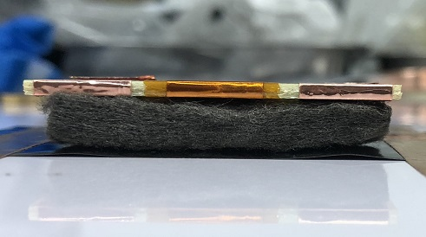
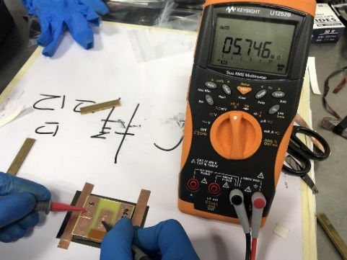
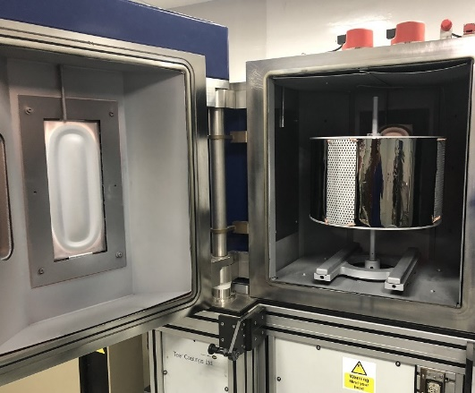
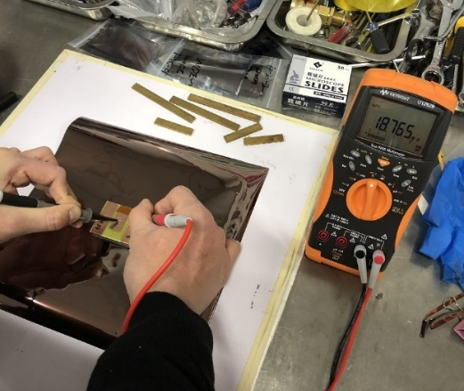
Sample of thick-DLC
  The value measured by the tool have a scale factor of 10 relative to the absolute surface resistivity.
  Deposition parameters for 25cm × 25cm DLC sample:
Deposition time: 30 min
Target current: 2.8 A
Initial vacuum degree: 1.4×10⁻⁵ Torr
Bias voltage: 30V
Thickness: ~210 nm
Tool for surface resistivity measurement
  The typical resistivity uniformity:
32
32
32
23% (sigma/mean) @25cm×25cm
The height of the carbon target is about 30cm almost the same as our sample size. It results a larger surface resistivity at the edge of the target and lower at the central area.
19
18
17
27
26
27
25cm × 25cm DLC sample (Sigma/mean=23%)
Surface resistivity (MΩ/□)

Slide 5
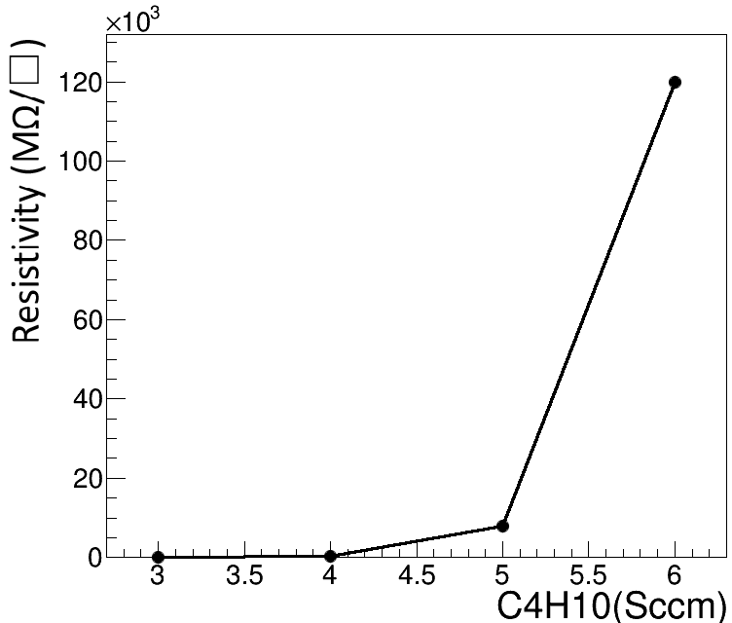
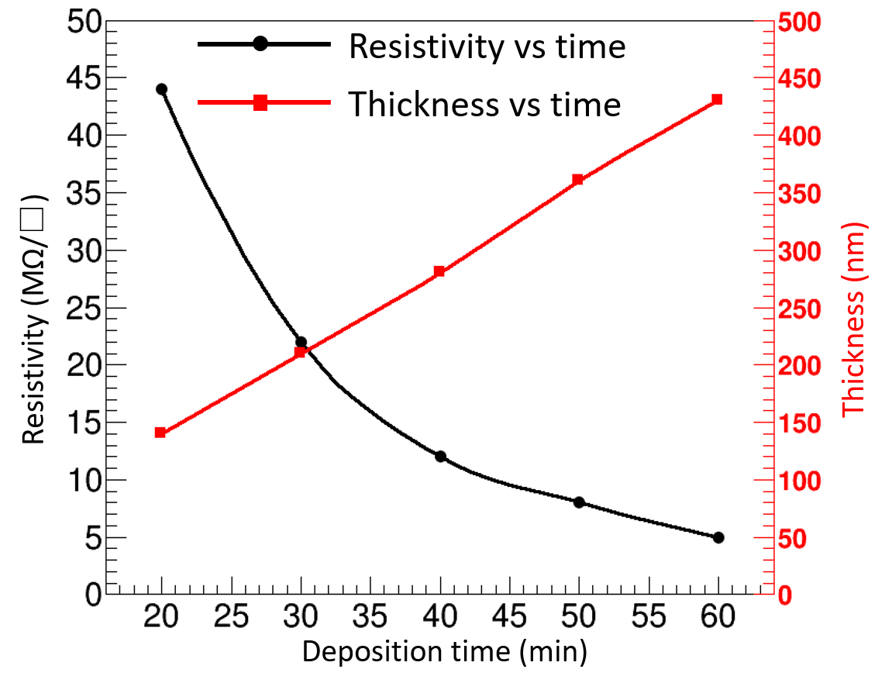
Resistivity & thickness
  Surface resistivity is sensitive to the hydrogen, it can be adjusted in wide range by changing the gas flow of iC₄H₁₀ .
  It can be adjusted more precise by controlling deposition time (DLC thickness ∝ deposition time).
Time: 30 min
Current: 2.8A
C₄H₁₀: 3 sccm
Thickness: 210 nm
Current: 2.8A
iC₄H₁₀ (sccm)
Fig. 3. Resistivity vs iC₄H₁₀ gas flow

Slide 6
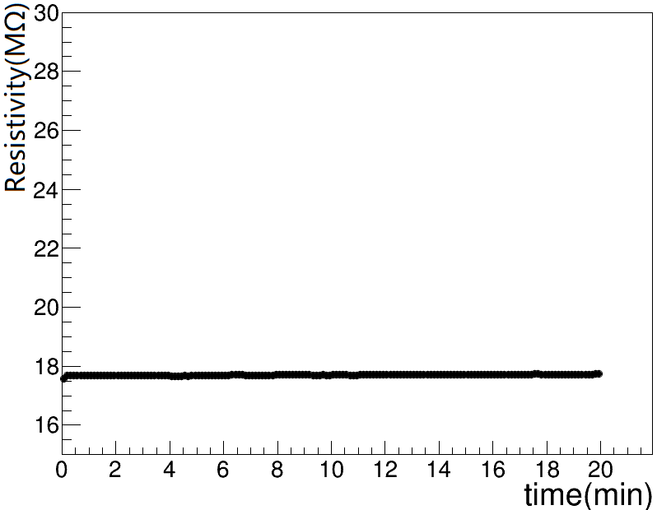
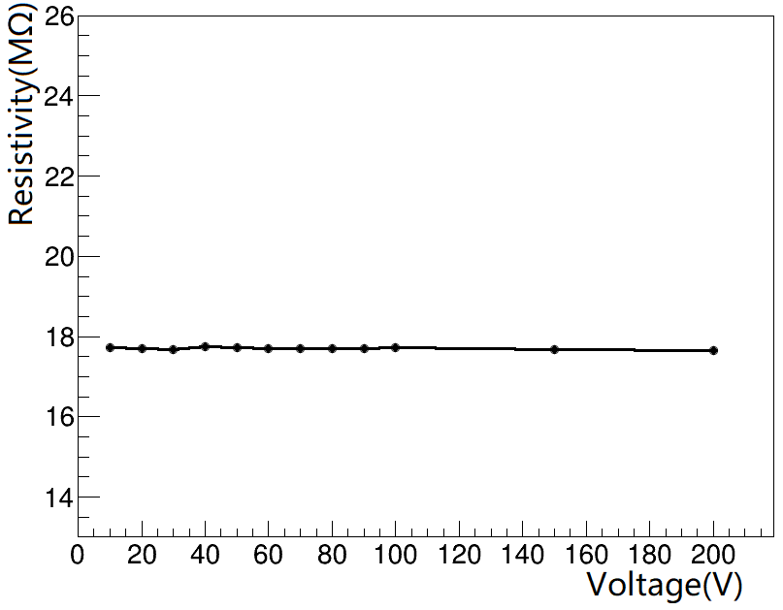
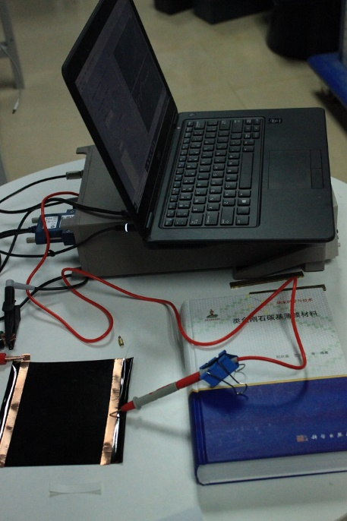
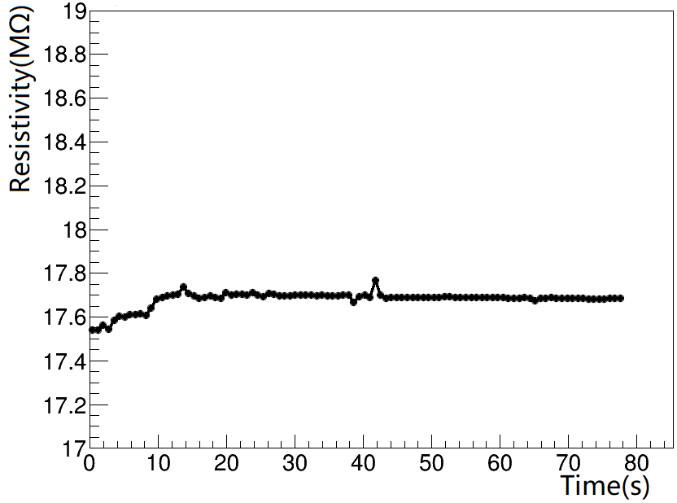
Resistivity vs voltage
  Dependence test of resistivity with voltage applied on the DLC sample.
The resistivity became stable immediately(～10s).
Resistivity is independent with the voltage, showing the ohmic behavior.
Hydrogen: 3.2 Sccm
Thickness:～1 μm
Test system (Keithley 6487)
Resistivity vs time
Resistivity vs voltage

Slide 7
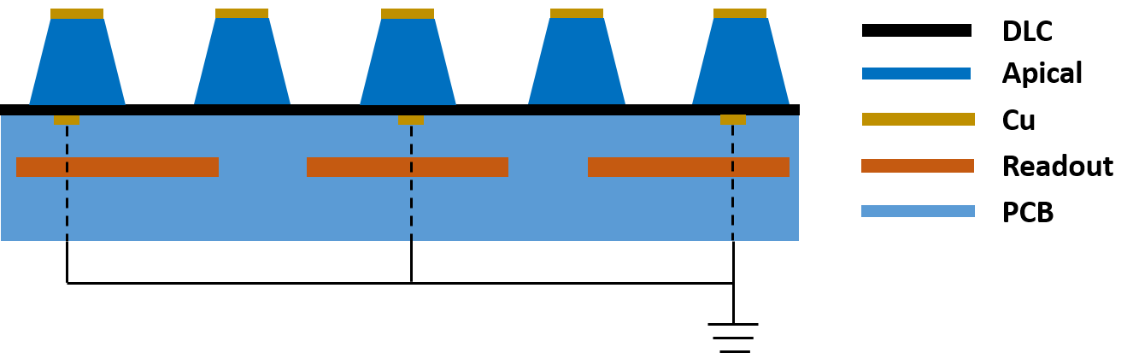

New combined structure (Cu/DLC/APICAL/Cu)
New combined structure (Cu/DLC/APICAL/Cu) is required to make high-rate μRWELL PCB.
Combined structure (Cu/DLC/APICAL/Cu)
High rate μRWELL PCB
The copper clad on the DLC is etched to dash strips and grounded at every a few mm.
The charges collected on the DLC can be quickly released via the grounded copper strips.
Technique of depositing copper on DLC needs to be developed.
This work was supported by a RD51 common project: DLC based electrodes for future resistive MPGDs.

Slide 8
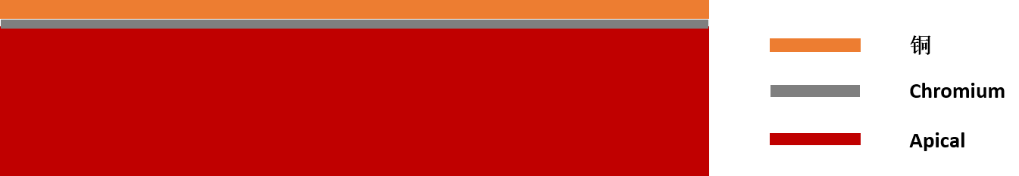
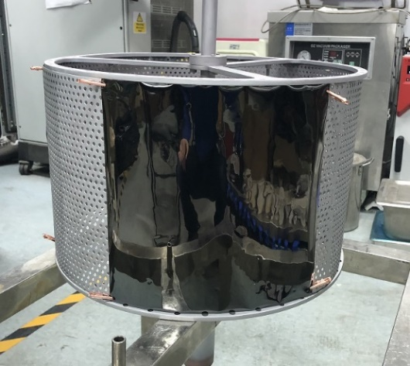
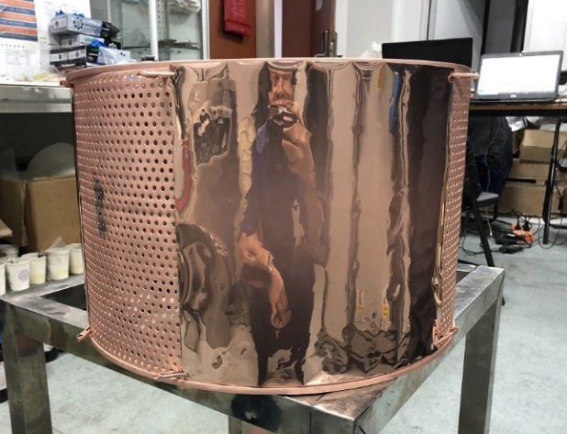
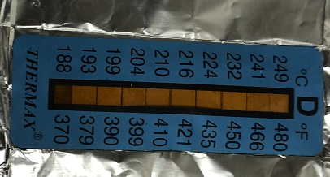
Copper coating on DLC
Coating procedures:
Coat Chrome (~50nm) on DLC
1 min “Chrome + Cu” coating
300 min Cu coating
Structure of APICAL substrate
Before copper deposition (left). After copper deposition (right).
The temperature in the chamber after 300min copper deposition is 188 centigrade.
The surface resistivity would change after deposition of the copper due to the high temperature.
More detail about the change of resistivity with the temperature will be studied.

Slide 9
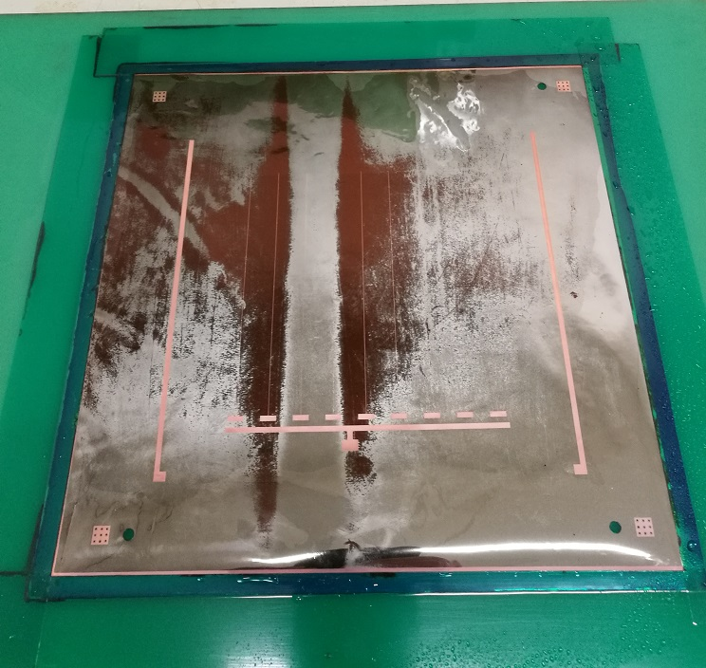
Problem of copper deposition
Problem of the current copper deposition DLC
Chrome is too thick, need a very long etching time.
“Chrome + Cu” co-deposition layer can not be etched.
Optimization of the copper deposition
Adjust the thickness of chrome
Adjust the thickness of “Chrome + Cu” co-deposition layer
Change the transition layer (Titanium?)
Etching chromium of the μRWELL PCB

Slide 10
THANKS

