Slide 1


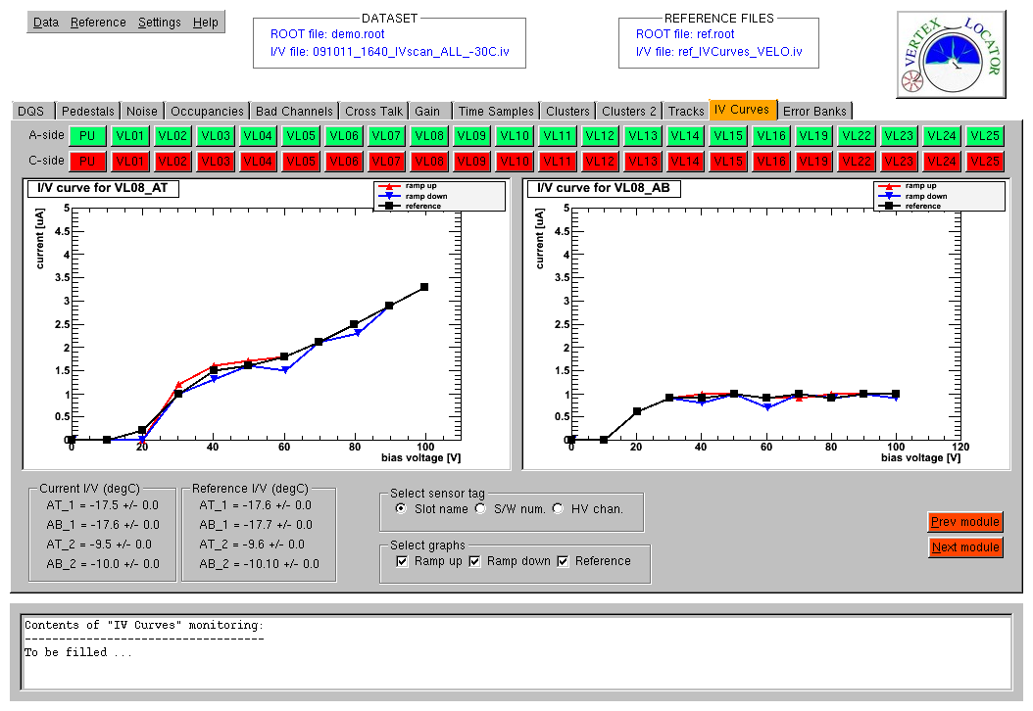

VELO Data Quality
Eduardo Rodrigues
University of Glasgow
LHCb Data Quality Meeting, CERN, 10 December 2009

Slide 2
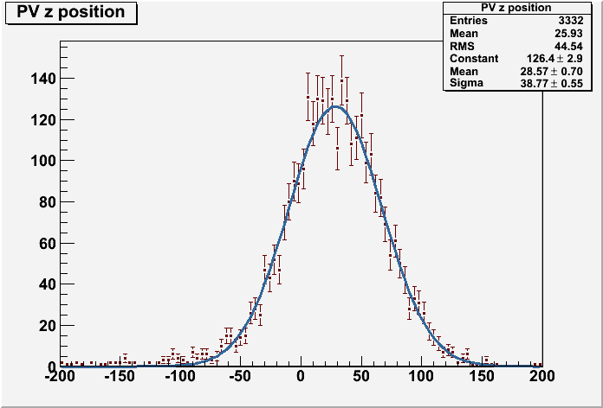
VELO – the LHCb vertex detector ;-)
A beautiful set of primary vertices from *the* run 63567

Slide 3
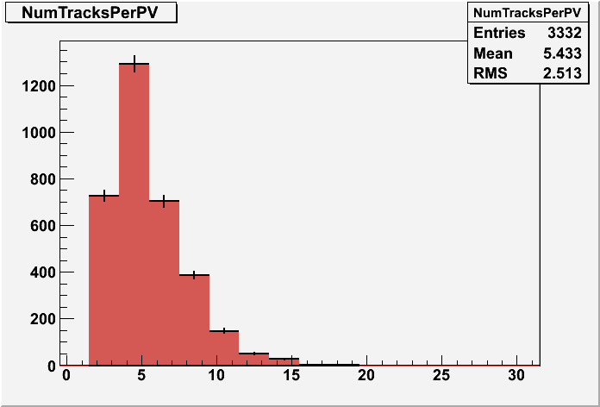
VELO – the LHCb vertex detector ;-)

Slide 4
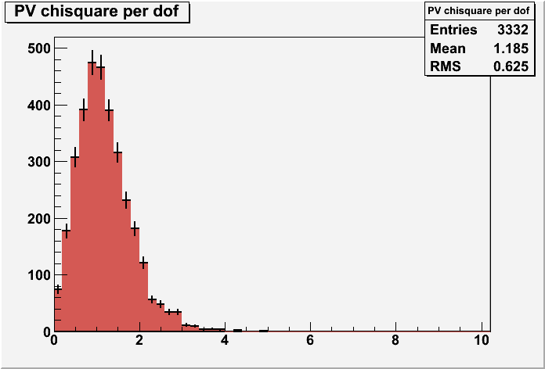
VELO – the LHCb vertex detector ;-)

Slide 5
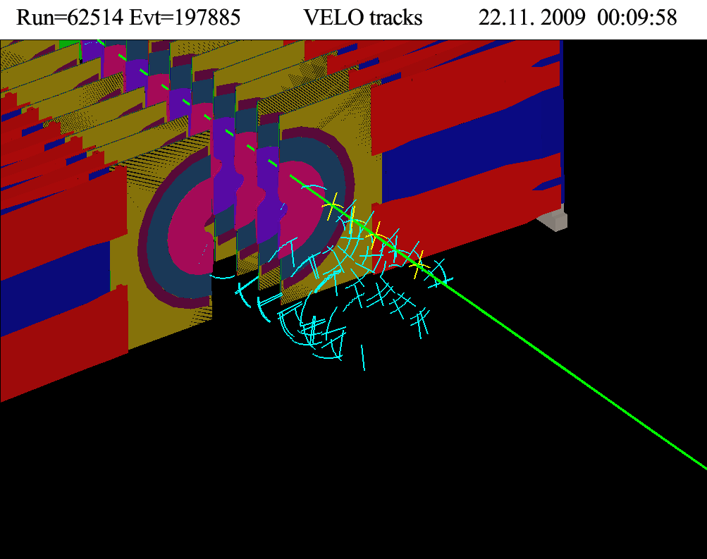
Events with VELO tracks

Slide 6
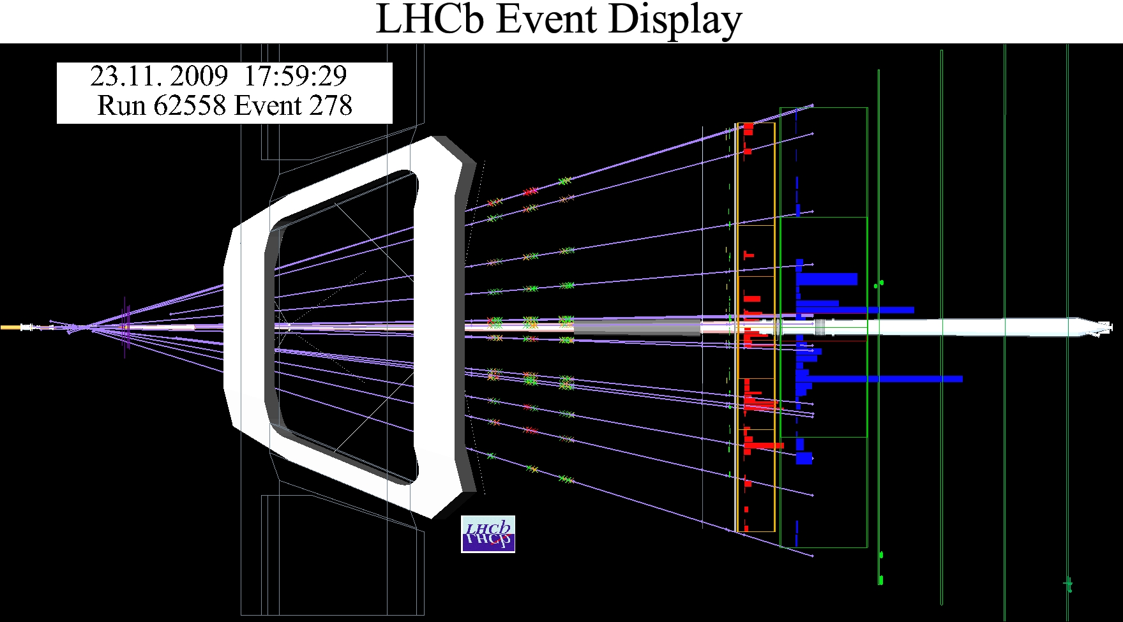
First collisions at 450 GeV (VELO off)

Slide 7
Overview of VELO DQ&M activities
Online presenter & monitoring : Kurt
Data Quality coordination : Eduardo
Monitoring contributions – contact person(s):
Monitoring of occupancy in HLT
TELL1 algorithm & pedestals
Error banks
Timing monitoring
IV monitoring
Noisy & dead strips
Noise vs voltage
Gain monitoring
Occupancies
Cluster monitoring
Track and vertex monitoring
Alignment monitoring
IP resolution monitoring
Pile-up system monitoring
Monitoring GUI
Landau fitting
Other contributors
: Malcolm
: Tomasz
: Chiara
: Kazu, Ivan
: Lars
: James K.
: Abdi
: Grant
: James K.
: Eduardo, James M.-S.
: Silvia
: Silvia
: Michael
: Serena
: Eduardo
: James M.-S.
: Chris, Karol, Kurt, Paula

Slide 8
Web documentation
Web / Twiki pages:
https://lbtwiki.cern.ch/bin/view/VELO/VELODataQuality
https://lbtwiki.cern.ch/bin/view/VELO/VELODQMShifters
https://lbtwiki.cern.ch/bin/view/VELO/VELODQMAlgorithms
https://lbtwiki.cern.ch/bin/view/VELO/VetraScripts
https://lbtwiki.cern.ch/bin/view/VELO/VeloOnlinePresenter
http://lhcb-release-area.web.cern.ch/LHCb-release-area/DOC/vetra/
https://lbtwiki.cern.ch/bin/view/VELO/VETRAHowTo
CVS repository:
http://isscvs.cern.ch/cgi-bin/cvsweb.cgi/Velo/VeloDataMonitor/?cvsroot=lhcb
http://isscvs.cern.ch/cgi-bin/cvsweb.cgi/Velo/VeloRecMonitors/?cvsroot=lhcb
http://isscvs.cern.ch/cgi-bin/cvsweb.cgi/Velo/VetraScripts/?cvsroot=lhcb
http://isscvs.cern.ch/cgi-bin/cvsweb.cgi/Tell1/Vetra/?cvsroot=lhcb

Slide 9
VELO DQM framework – the GUI
Why a GUI ?
Because it provides by construction a friendly interface to the shifter
And it also provides a common framework on which to « plug » monitoring tasks,
with basic functionality shared among the latter
DQM software suite
NZS and ZS data monitoring algorithms are packaged in Velo/VeloDataMonitor
and Velo/VeloRecMonitors, respectively
The corresponding analysis scripts (ROOT macros, Python modules/scripts) are collected in Velo/VetraScripts
The VELO monitoring GUI is the main user interface, the one shifters will be dealing with 99% of the time
But all the analysis scripts can also be run in standalone, i.e. not via the GUI. This may be useful in « expert mode »

Slide 10
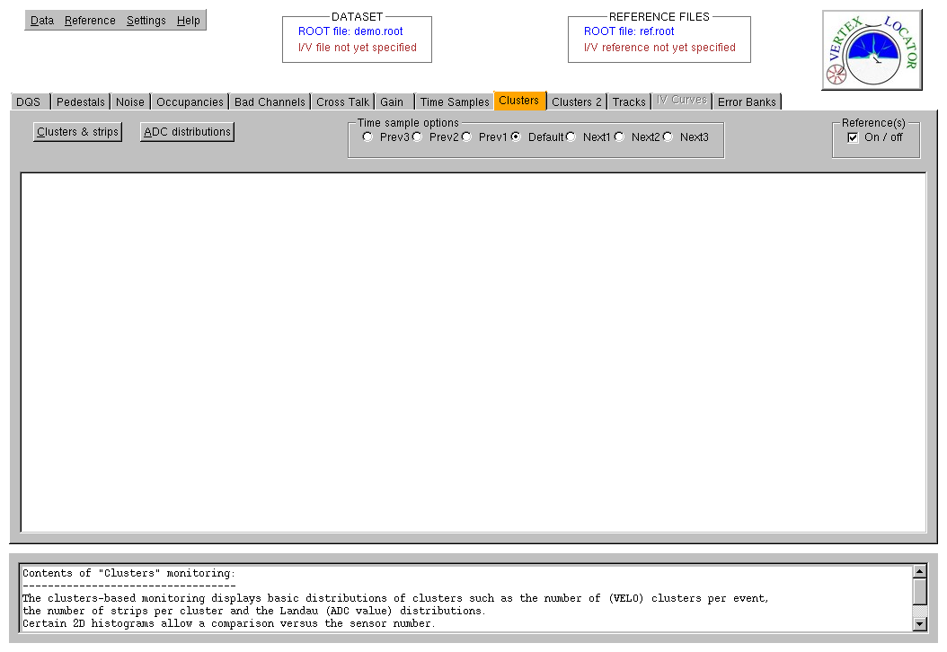
VeloMoniGUI
1 tab per monitoring “task”
Top-level menu for basics
Indicators of open ROOT/IV curve files
1 tab per “monitoring task”
Documentation window (per tab)

Slide 12
On procedures
DQM
The data quality & monitoring procedures for VELO shifters are explained in
https://lbtwiki.cern.ch/bin/view/VELO/VELODQMShifters
- meant to be the most up-to-date reference on procedures and practical details
During these few days of data taking, procedures have been, in general,
followed by the VELO shifters
- though the DQ checks have not always been done fully :S
- things will for sure improve with experience and user feedback
Tomorrow’s VELO meeting aiming at a discussion based on users
experience, report of problems & next steps, etc,
Bug reports
To be done via the LHCb Data Quality Savannah portal
https://savannah.cern.ch/projects/lhcbdataquality/
Shifters are starting to get into this “habit” …

Slide 13
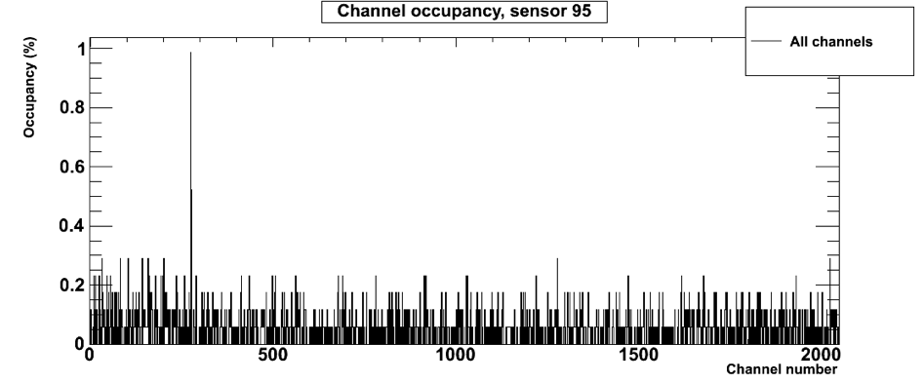
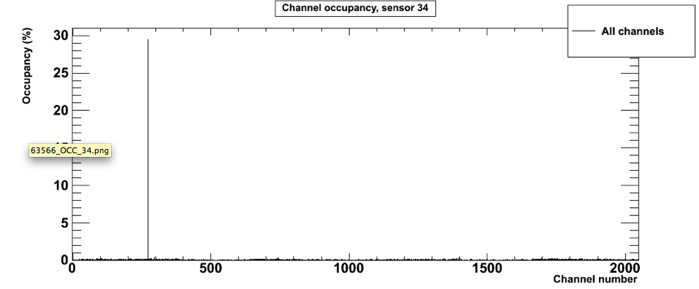
DQM – does it fit its purpose?
Example: occupancies moni. Finding “hot channels”
run 63566
Mostly intermittent problems.
Static problem on sensor 34, channel 273
from run 63496 onwards

Slide 14
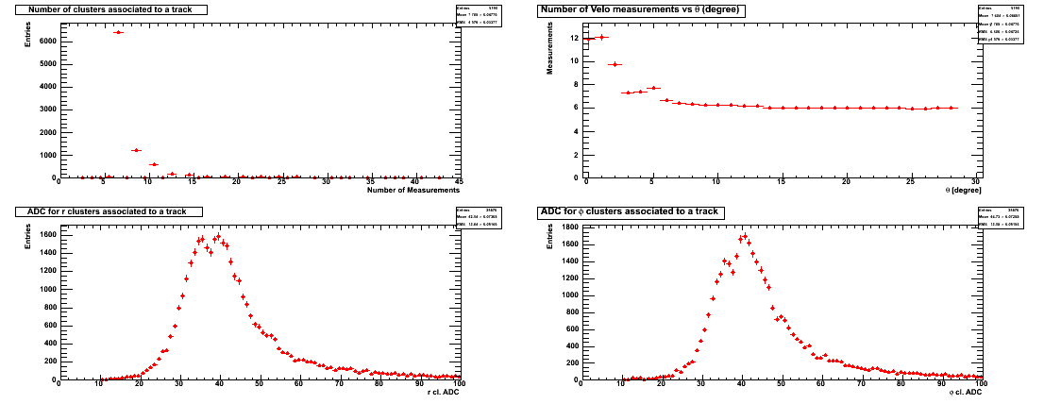
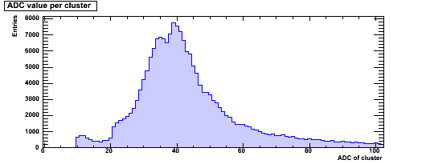
Clusters on tracks
run 63497
Clusters NOT on tracks

Slide 15
What have we learned so far ?
A lot !
Procedures have shown hick-ups
Addressing these will eventually result in improvements
Most runs have been analysed with our DQM tools
- the results are stored under /group/velo/dqm
Some have been summarised in the ELOG
- this is an area where we need to improve
DQM allowed to quickly spot hot or noisy channels, high occupancies, etc.
We now need to digest the data, log everything, mask hot channels, etc.
*then* we will be in a much better position for the 2010 data to come !

Slide 16
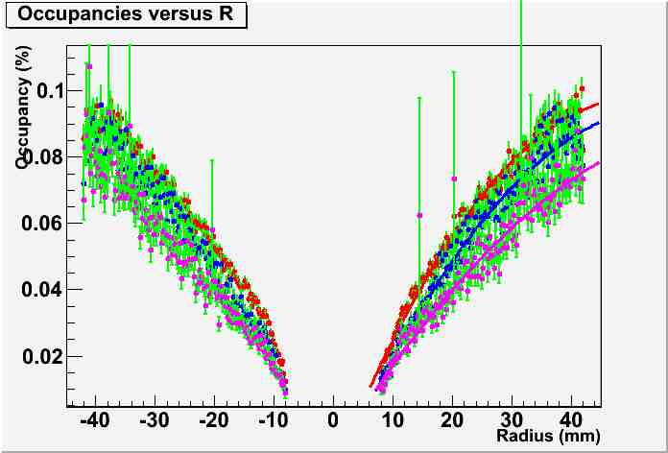
DQM is good. But further analysis is better !
Opening 20mm
Opening 25mm
Opening 29mm
how this dependence
changes as we close

Slide 17
Miscellaneous
Tutorial
A VELO DQ&M tutorial has been set up
- comprehensive: some 85 slides in the first version
- will for sure evolve a lot based on experience and user feedback
References
Quite a few references are implemented in our GUI
But based on Monte Carlo ;-)
Careful analysis of the 2009 data will hopefully contribute to
a better understanding and will provide relevant references …

Slide 18
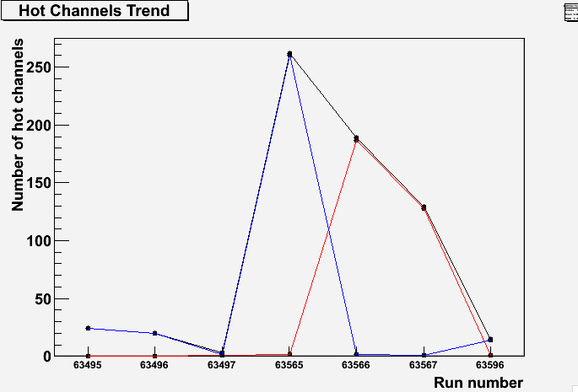
DQM « snapshots » are nice. What about trending?
Example of “trending”, monitoring hot channels versus run number …
Trending of the intermittent, persistent and total # of “hot” channels

Slide 19

Conclusions
- VELO DQ & M is looking good !
- First results are rather encouraging
- We want more data. Just bring it on … !

