Slide 1
LINAC4 source tunnel and test stand
Alessandra Lombardi
Jean –Baptiste Lallement
Daniel Noll

Slide 2
Source in the tunnel – same as the 2017-18 run
Performance achieved (at 160mA) :
  Current : 24 mA
  Emittance : 0.3 mm mrad rms /
  Useful Pulse length (5%flatness) : 600 µsec
  Pulse-to-pulse : 2%

Slide 3
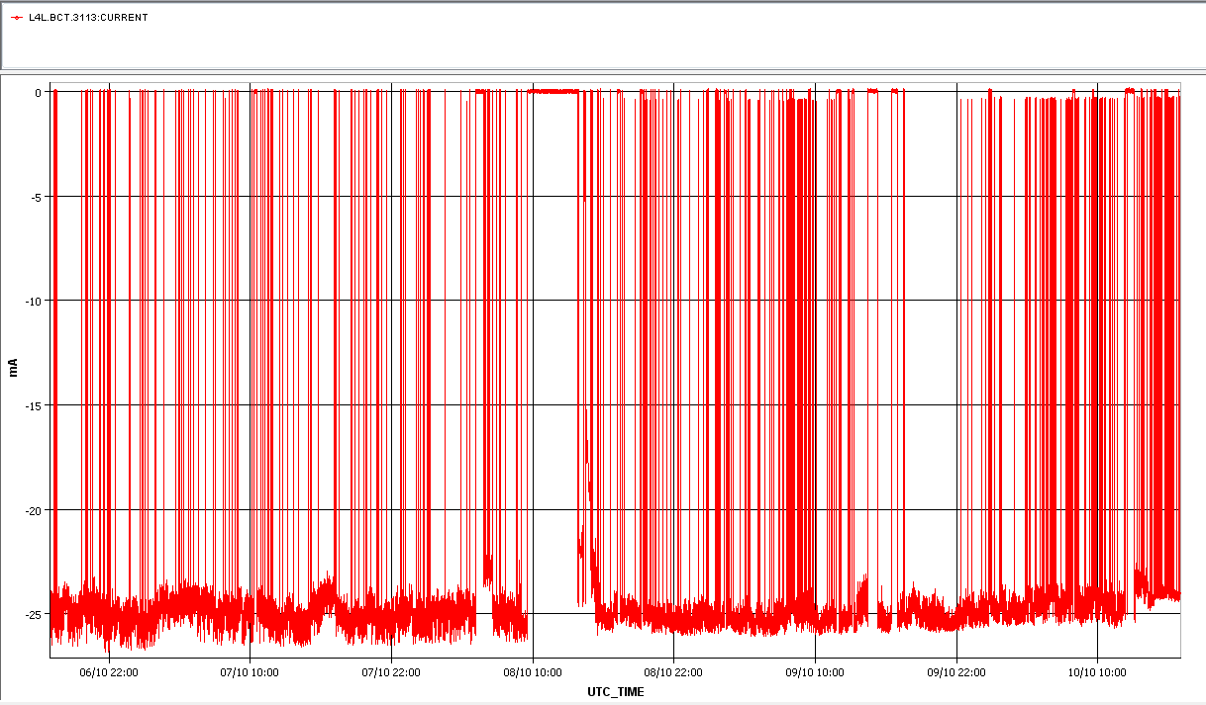
current

Slide 4
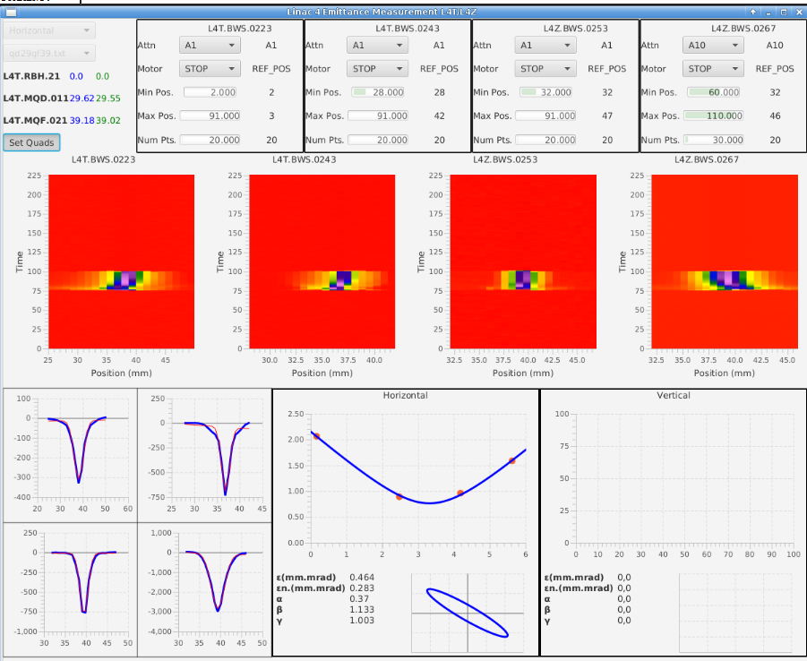
emittance

Slide 5
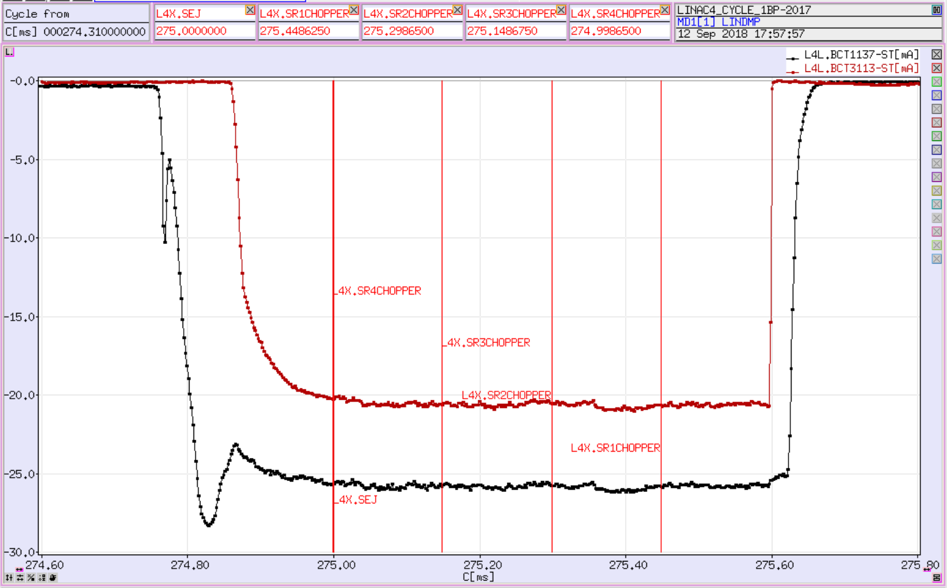
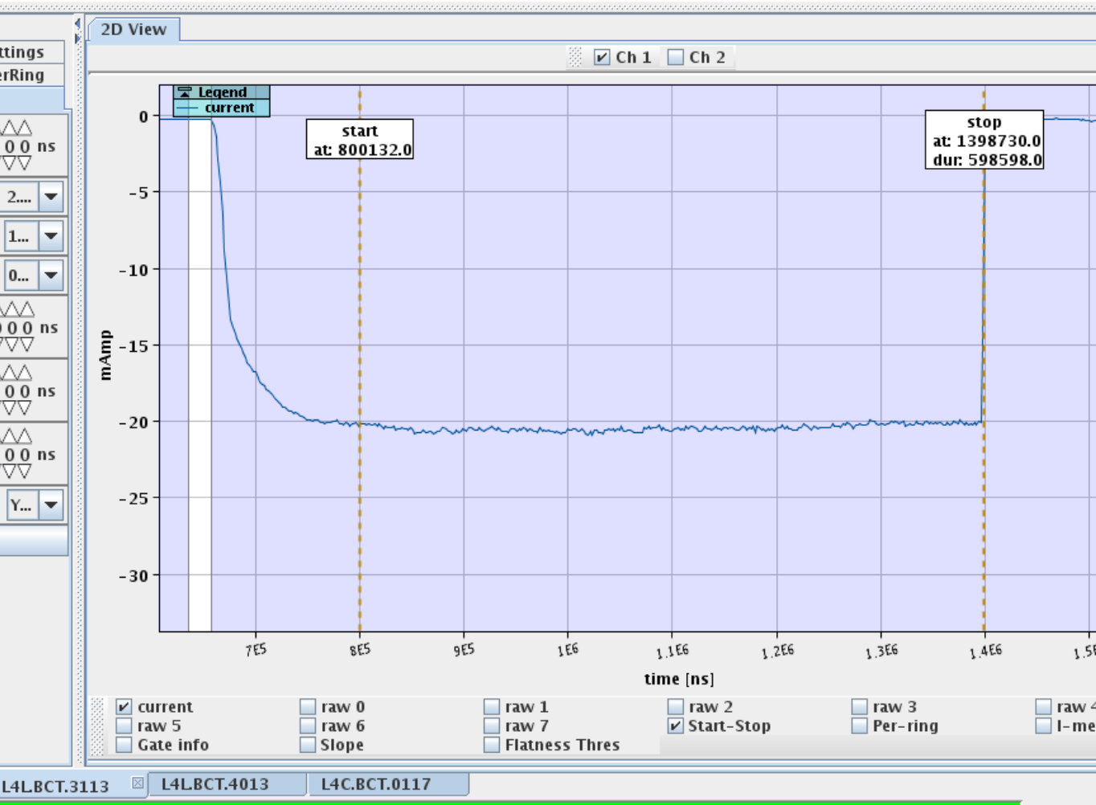
600µsec good pulse length
after RFQ (before chopper)
Extensive pre-chopper and chopper tests to minimise the effect of neutralisation.
Final solution
  850µs from the source
  50µs chopper by the pre-chopper (min)
  200µs chopped by the chopper

Slide 6
Pulse-to-pulse jitter (25 mA after the RFQ for 35 mA into the RFQ)
Filtering action of the RFQ is beneficial to pulse stability
BCT at 45 keV
Sigma=3%

Slide 7
2. Pulse-to-pulse jitter correlation with RF stability
Running average over six hours
Rf power
Current in the LEBT

Slide 8
Longer term drift (II)
At ~41.3 kW RF power:
~0.05 mA/hour
~ 1.12 mA/day

Slide 9
Solutions to long term drift
Automatic tuning
Continous cesiation
Achieve the desired current and stability in volume mode i.e. without the necessity of cesiation (this is within the reach, tests august 2018)

Slide 10
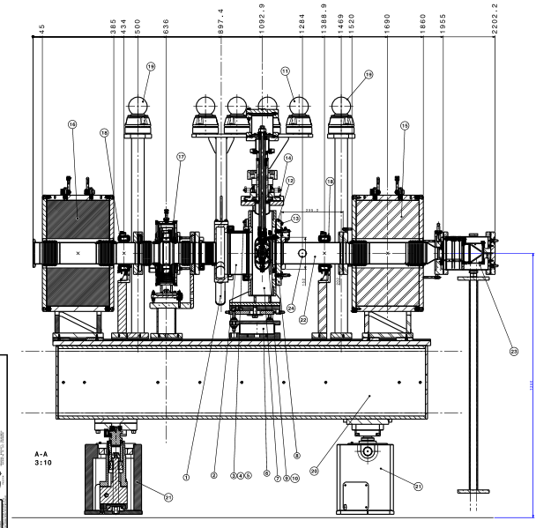
To the test stand
Test stand is equipped with a delicate yet functional emittance meter and an rfq “mask”.
The volume mode source has been tested at the test stand for intensity in the RFQ acceptance

Slide 11
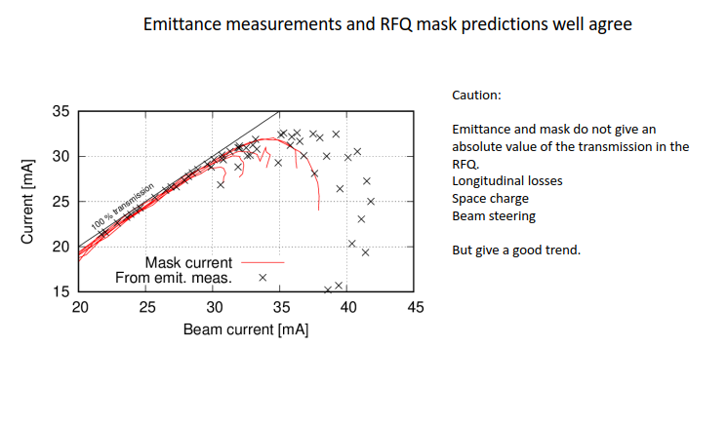
Mask is a quick way to characterise a source

Slide 12
Test stand plan – next 2 months
week | linac4 test stand | comments test stand | visitors test stand | tunnel | comments tunnell
8-12 october | cesiated,bore 8mm cusp free |  | Keio uni | cesiated ,bore 6.5 , cusp | reliability run
15-19 october | cesiated,bore 8mm cusp free |  | Ausburg | cesiated ,bore 6.5 , cusp | reliability run
22-26 otober | 21/10 :installation volume 7.5 mm cusp | regain performance |  | cesiated ,bore 6.5 , cusp | reliability run
29 october-2Nov | volume 7.5 mm cusp | emittance stability and mask |  | cesiated ,bore 6.5 , cusp | reliability run
5-9 Nov | volume 7.5 mm cusp | emittance stability and mask |  | cesiated ,bore 6.5 , cusp | reliability run
decision point : if the volume 7.5mm cusp gives at least 30mA in the mask and the stability is acceptable then we will follow the program below
12-16 Nov | clean and install the one from the tunnell with a bore 8.0 eletrode fitted |  |  | 12 Nov Install in tunnell volume 7.5 mm cusp | reliability run
19-23 Nov | volume ,bore 8.0 , cusp | emittance stability and mask |  | volume 7.5 mm cusp | reliability run
26-30 Nov | cesiated ,bore 8.0 , cusp | emittance stability and mask |  | volume 7.5 mm cusp | reliability run
3-7 Dec | volume ,bore 9.0 , cusp | emittance stability and mask |  | volume 7.5 mm cusp | reliability run
10-14 Dec | cesiated ,bore 9.0 , cusp | emittance stability and mask |  | volume 7.5 mm cusp | reliability run

Slide 13
Upcoming review
We will present the reviewer with the two options for 25 mA (cesiate or non-cesiated)
We will present the plans for the continous cesiation and for autopilot
We will present the roadmap to 45mA out of the RFQ

Slide 14
Spare RFQ
At the moment there are no firm plans for a full spare RFQ. Baseline plan is to buy the copper (done) and manufacture 1 section.
A working group (chaired by E. Mahner) is investigating whether we can increase the field in the RFQ to 50MV/m (presently 36MV/M). The answer should be there by the end of the year.
After the working group has finilised the report we can compare the advantage of a spare RFQ with increased acceptance vs an RFQ which is a copy of the existing one

