Slide 1
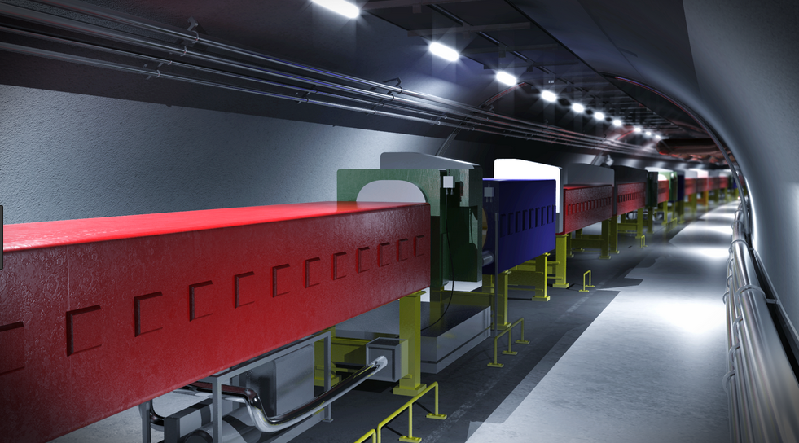
BLMSPS – Design Overview
E. Calvo, E. Effinger, M. Saccani, V. Schramm, W. Viganò, C. Zamantzas
12 October 2018

Slide 2




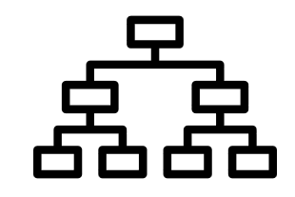

Agenda
Introduction
Objectives
System names and acronyms
Tunnel Crate design
Distribution of functions
Parts description

Slide 3

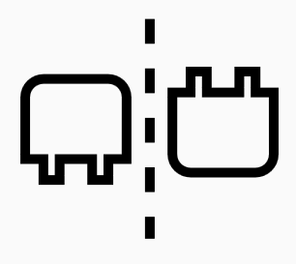


Objectives
Keep the SPS BLM architecture as much similar as the LHC BLM.
Acquisition card and Power Supply Unit pin to pin compatible with the LHC BLM chassis.
Increase the acquisition performance:
  Radiation tolerant up to 1KGy (Current solution is up to 500Gy).
  Min integration period = 5µs (Current solution is = 40µs).
Improve the safety
  Protection against direct contacts to HV or 230VAC.
  Grounding improvements.

Slide 4


Objectives
Improve the reliability:
  Reduce number of interconnections.
  Simplify manufacture.
  Simplify optical transceiver interconnection.
Improve maintainability:
  Reduce repair time .
  Additional diagnostics.

Slide 5
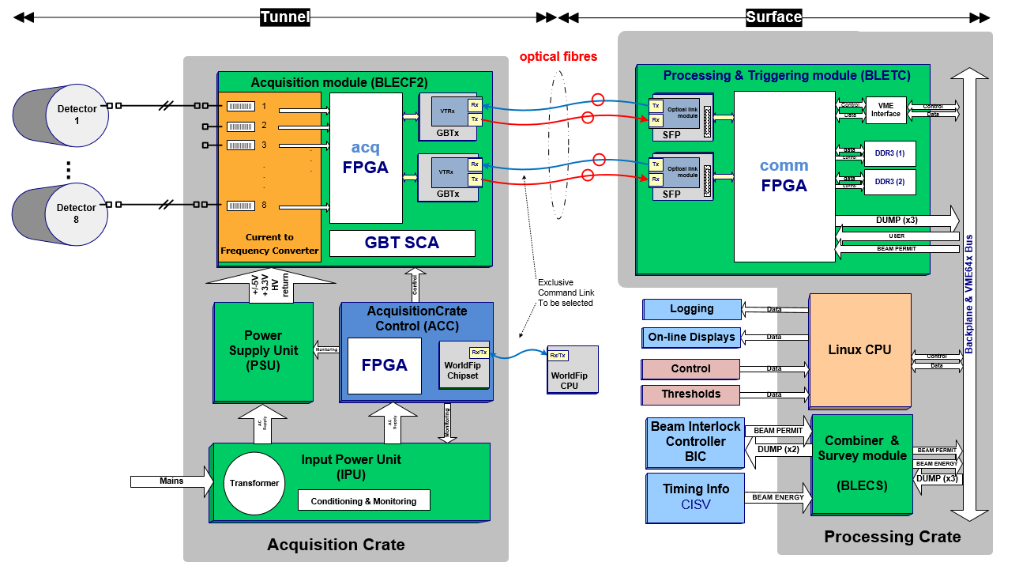
System Overview

Slide 6
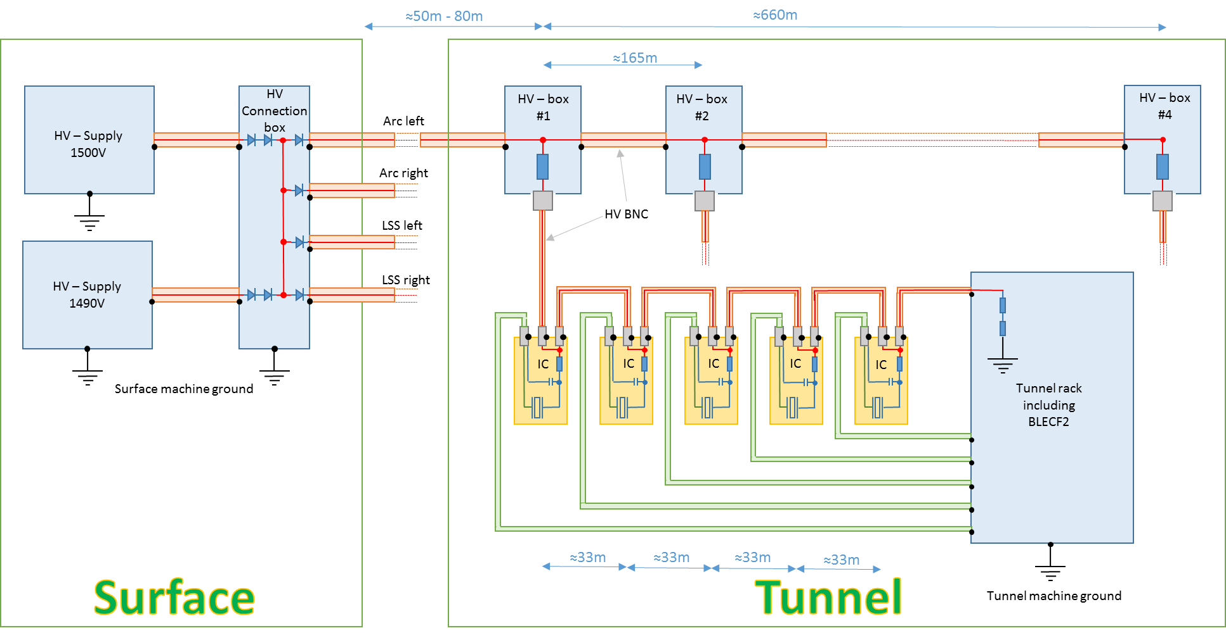
Connections architecture

Slide 7
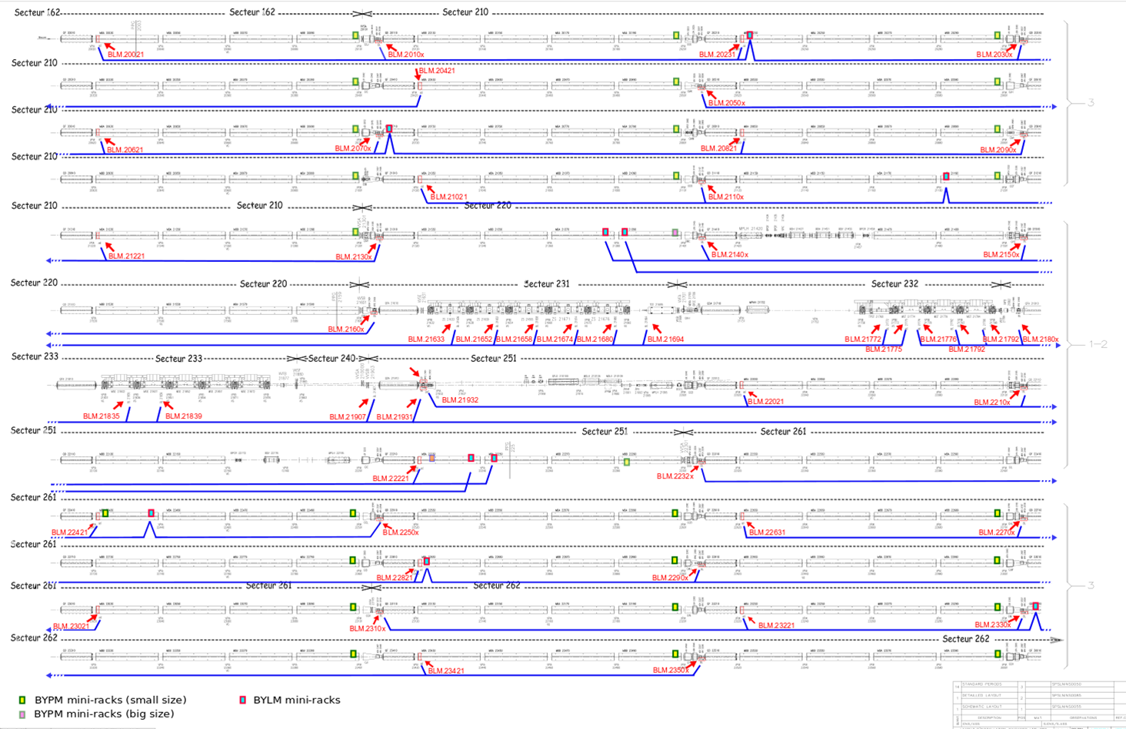
Tunnel installation architecture

Slide 8
Tunnel installation architecture
With the current number of BLM channels we would have about 10 mini-crates per sextants (in total 60 mini-crates will be installed).
Each mini-crates will acquire 5 monitors + 3 spares.
The position of BLM mini-crates will close to the BPM mini-crates.
In the LSS we will not have any mini-crates, they will be located at the end of the arc.
The longer cable to connect the monitor to the mini-rack will be about 100m.
This a proposal which has to be approved by the Integration Team.

Slide 9
System names and acronyms
Beam Loss Electronic Acquisition Crate for the Tunnel (BLEACT) EDA-03916-V1-0
Beam Loss Electronic Backplane for the Tunnel (BLEBPT) EDA-03917-V1-0
Beam Loss Electronic Input Power Unit (BLEIPU) EDA-03918-V1-0
Beam Loss Electronic Power Supply Unit (BLEPSU) EDA-03919-V1-0
Beam Loss Electronic Acquisition Crate Control (BLEACC) T.B.D.
Beam Loss Electronic Current to Frequency version 2 (BLECF2) EDA-03704-V1-0
Beam Loss Electronic LED plug (BLELED) EDA-03920-V1-0

Slide 10
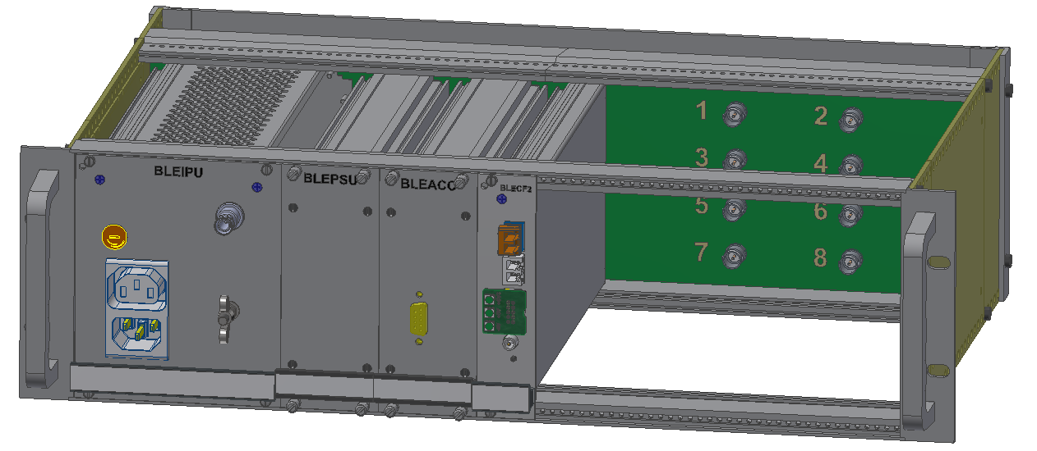
Acquisition Crate 3D - Update
3U
280mm
Height = 3U
Depth = 280mm
Fully shielded
No HV or 230V_{AC} inside the chassis
Maintenance and repairing actions from the front side

Slide 11

Acquisition Crate – distribution of functions
Backplane
Boards interconnection
Test points
Input signal connectors
Input Power Unit
Power Supply Unit
Crate Control
Acquisition Card
230V_{AC} Protection and filtering
7V_{AC} (winding2) conversion to generate all required voltages.
All functions of BLECF
2 x 7V_{AC} (winding1 and winding 2) conversion for BLECF2
Inputs for EEPROM reprogramming (from both front panel and backplane)
230V_{AC} output bridge connection
Reprogramming of BLECF2
Power output voltages:
±5V_{DC} , +3.3V_{DC} and +1.5V_{DC} for BLECF2
Power input transformer 230V_{AC} to 2 x 7V_{AC}
Direct commands for BLECF2
Input for direct commands
Power cycle function
Transformer status signal conditioning
On/Off functions
On/Off function for the BLECF2 through the PSU
Transformer status diagnostic
High Voltage feedback conditioning
Transformer status diagnostic
Front panel LEDs
1-Wire diagnostic

Slide 12
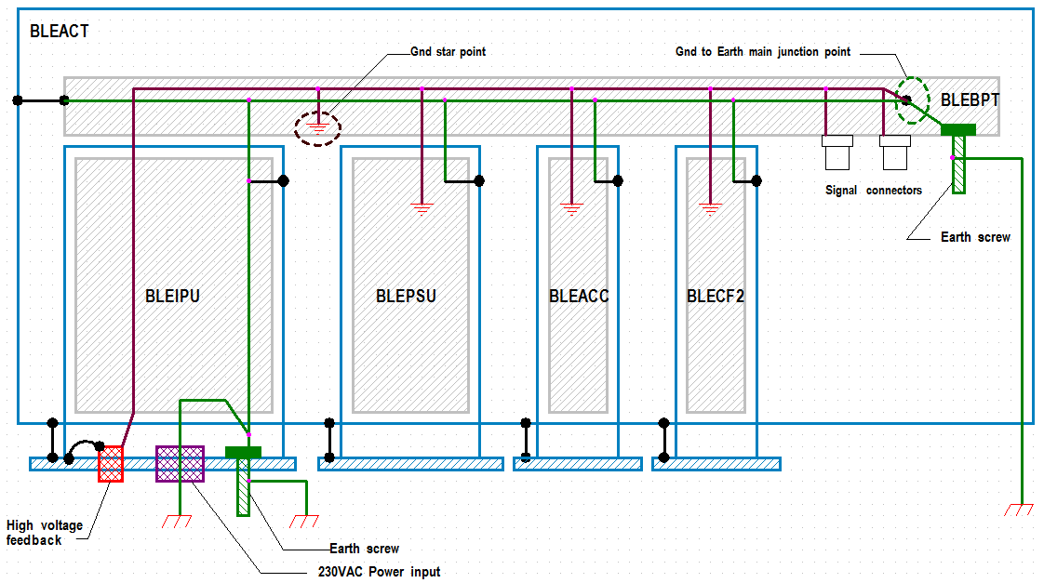
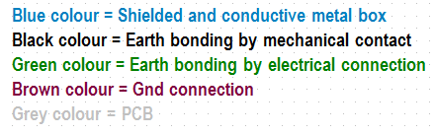
Acquisition Crate – Grounding and Bonding

Slide 13
Acquisition Crate – Grounding and Bonding
If the BLEIPU is unplugged with the HV cable plugged in, and the HV power on, the grounding screw on the front panel prevents electrical shock from the discharge of the Ionization chamber HV capacitor.
At the same time, if the BLEIPU module is not inserted, and the HV is power on, the chassis grounding screw prevents the electrical shock that could result from touching the chassis (because the signal cables are plugged).

Slide 14
Acquisition Crate – Grounding and Bonding
As a result of the safety precautions a ground loop is created.
Dedicated tests will be done to check the noise immunity.

Slide 15
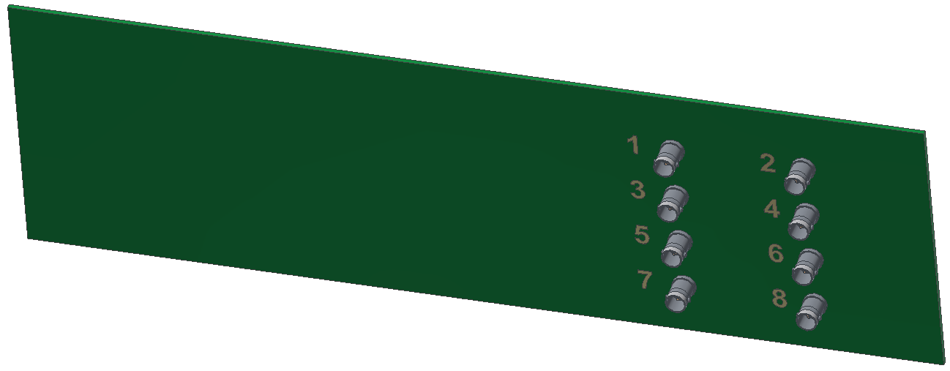
Backplane - Characteristics
PCB thickness = 2.2mm
PCB materials = FR4
Copper thickness = 35µm
The draft schematics of the backplane is ready, and with the layout designers support it will be used to optimize the interconnections.
The design of the BLEACT including all boards will be done with the CADENCE tool.

Slide 16
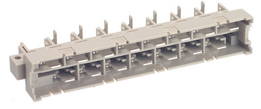
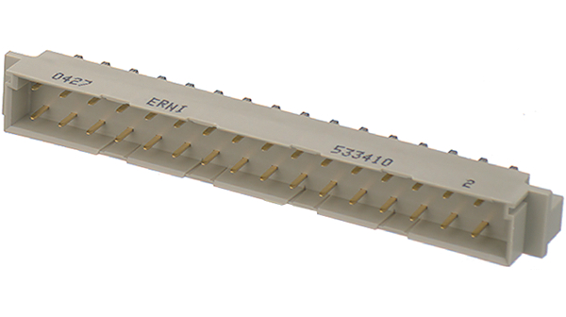
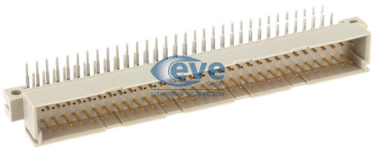
Cards connectors
BLEIPU connector
Harting: 09 06 115 2911
No problem if connectors for BLEIPU and BLEPSU are the same, because due to the electronic boxes size, it is impossible to swap them.
BLEPSU connector
Harting: 09 06 115 2911
BLEACC connector
(SCEM: 09.61.36.015.4
Harting: 09 04 132 2921)
BLECF2 connector
(Harting: 09 03 164 2921)

Slide 17
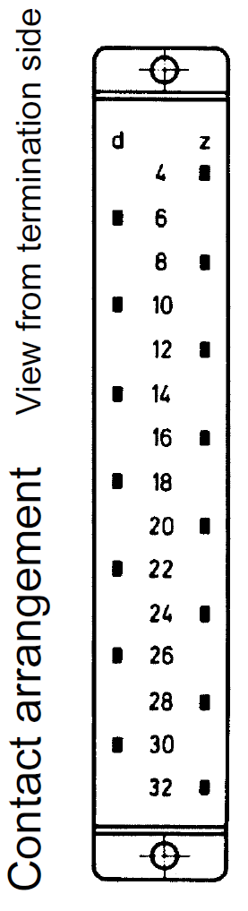
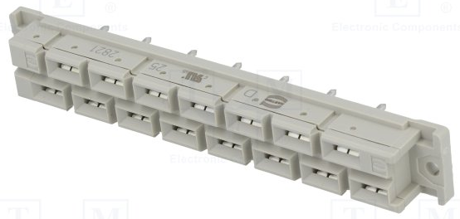
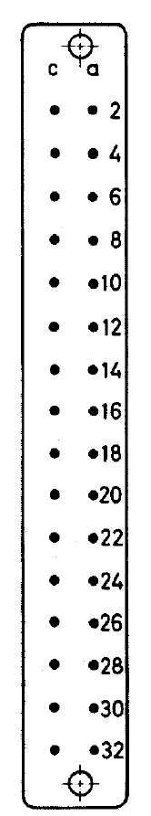
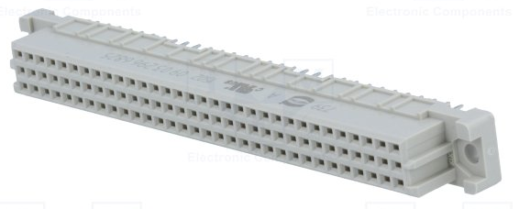
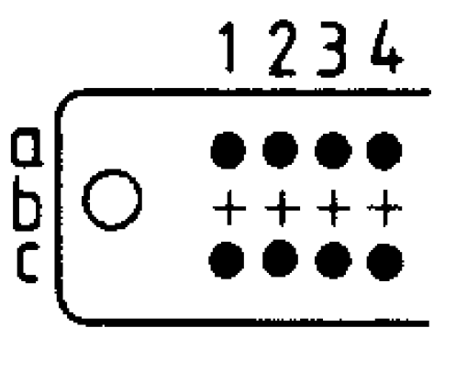
Backplane connectors
Female for BLEIPU connector
(SCEM: 09.61.41.565.4
Harting: 09 06 215 2821)
Female for BLEPSU connector
(SCEM: 09.61.41.565.4
Harting: 09 06 215 2821)
Female for BLEACC connector
(Harting: 09 04 232 2831)
Female for BLECF2 connector
(Harting: 09 03 264 2825)
2 x 32 Contacts

Slide 18
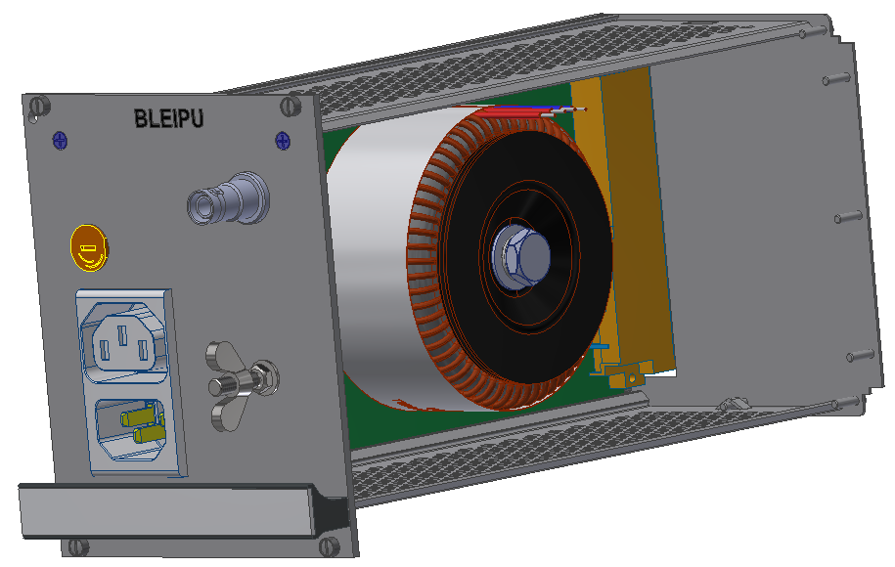
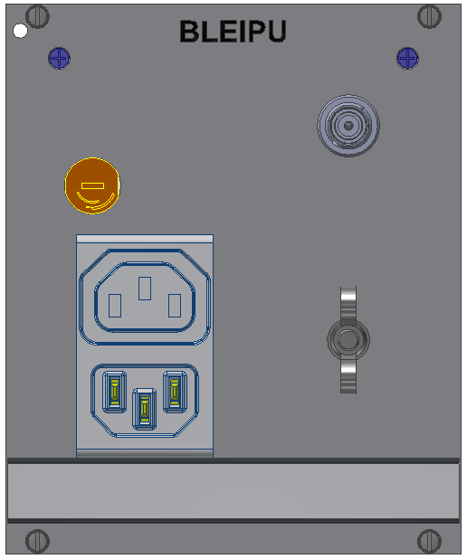
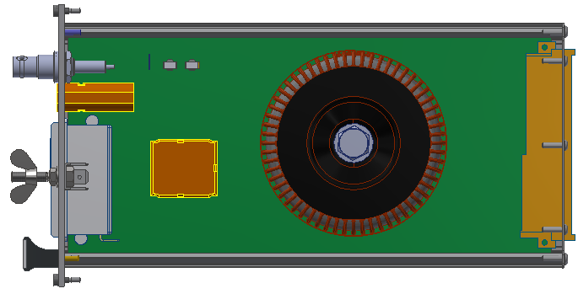
Input Power Unit (BLEIPU) - 3D modelling
HV input connector
230 V_{AC} Inlet/Outlet
Fuse
Earth screw
HV divider
Power transformer
Input filter

Slide 19
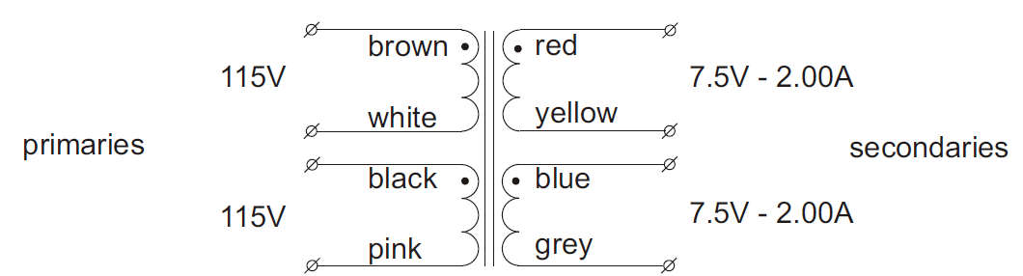
Input Power Unit (BLEIPU) pinout
Pin | Connection name | Type
4Z | Transformer winding 1 – output A (7 V_{AC}) | PWR output
8Z | Transformer winding 2 – output A (7 V_{AC}) | PWR output
6D | Transformer winding 1 – output B (7 V_{AC}) | PWR output
10D | Transformer winding 2 – output B (7 V_{AC}) | PWR output
12Z | Chassis ground | Earth
26D | HV divider output | Output
28Z | GND ref | Gnd
30D | Winding 1 status signal | Output
32Z | Winding 2 status signal | Output
HV divider
Power transformer
Input filter
5.00A

Slide 20
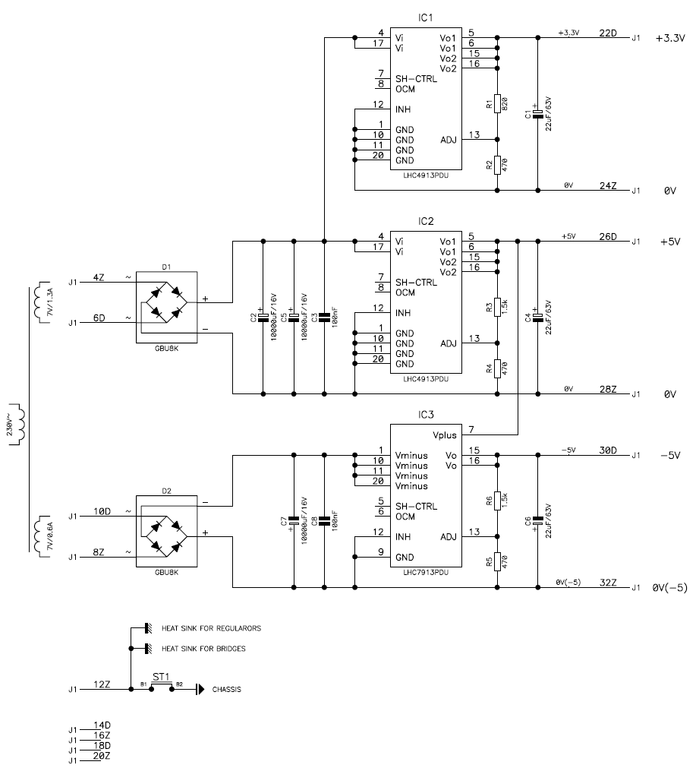
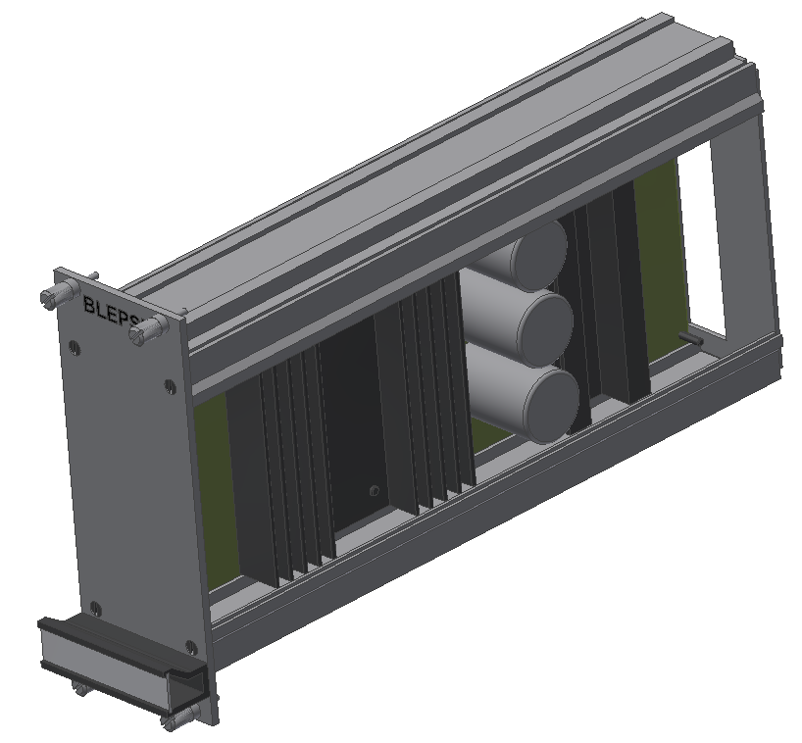
Power Supply Unit (BLEPSU) - Update
Schematic will be based on the EDA-00691 with the following additional functions:
On/Off power supplies.
Replacement of the 3.3V_{DC} linear voltage regulator with a DC/DC converter.
Generation of the +1.5V_{DC.}

Slide 21
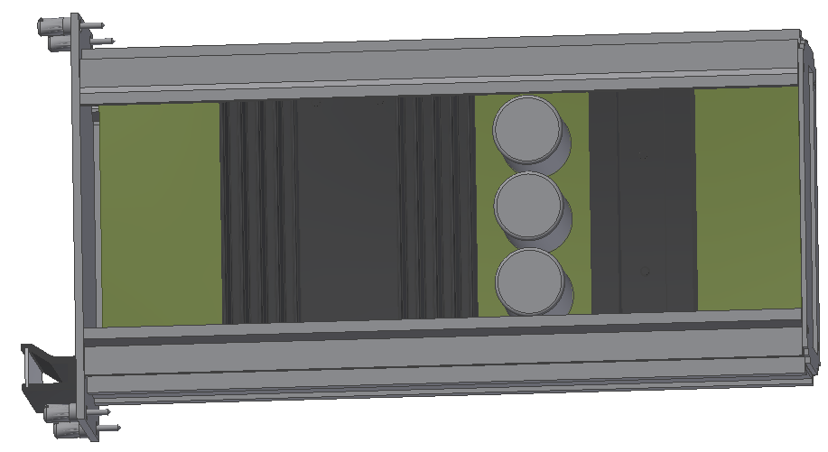
Power Supply Unit (BLEPSU) - pinout
Pin | Connection name | Type
4Z | V_{AC} Input 1 – A | PWR input
8Z | V_{AC} Input 2 – A | PWR Input
12Z | Chassis ground | Earth
16Z | On/Off - Digital (in) | Input
20Z | +1.5V_{DC}_ref | Gnd
24Z | +3.3V_{DC}_ref | Gnd
28Z | +5V_{DC}_ref | Gnd
32Z | -5V_{DC}_ref | Gnd
6D | V_{AC} Input 1 – B | PWR input
10D | V_{AC} Input 2 – B | PWR input
14D | On/Off - Analog (in) | Input
18D | +1.5V_{DC} | PWR output
22D | +3.3V_{DC} | PWR output
26D | +5V_{DC} | PWR output
30D | -5V_{DC} | PWR output
The BLEPSU pinout is the same as for EDA-00691 (LHC BLM power supply, with additional signals)
New! -> On/Off function for the Digital part from the BLEACC or BLECF2 cards
New! -> Generation of the +1.5V_{DC}
New! -> On/Off function for the analog part from the BLEACC or BLECF2 cards
New! -> Generation of the +1.5V_{DC}

Slide 22
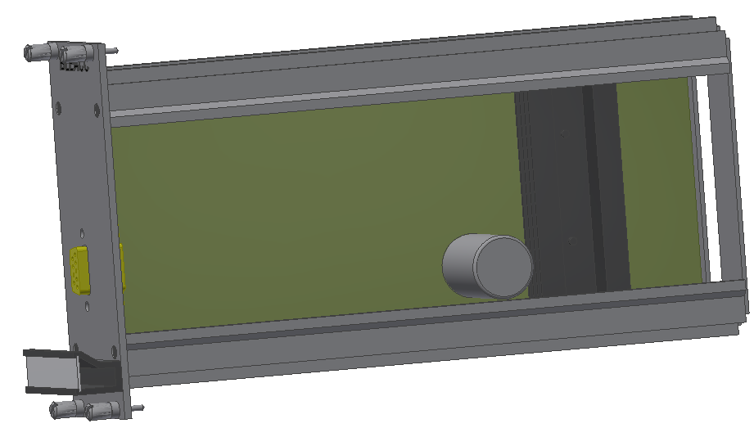
Acquisition Crate Control (BLEACC) - pinout
Pin | Connection Name | Type
A8/A10 | V_{AC} Input 2 – A | PWR Input
C8/C10 | V_{AC} Input 2 – B | PWR Input
A16 | Transformer winding 1 status | Input
C18 | Transformer winding 2 status | Input
C2 | On/Off - Digital (Out) | Output
A2 | On/Off - Analog (Out) | Output
A18 | BLECF2_cmd_0 (To BLECF2 – A21) | Output
A20 | BLECF2_cmd_1 (To BLECF2 – C21) | Output
C20 | BLECF2_cmd_2(To BLECF2 – A22) | Output
A22 | JTAG (TMS) | Output
C22 | JTAG (TCK) | Output
A24 | JTAG (TDI) | Output
C24 | JTAG (TDO) | Input
A26 | JTAG (TRST) | Output
C12 | Chassis ground | Earth
A4, A6,.. | GND ref | Gnd
A28 | Spare A (Only on the backplane BLEBPT) | t.b.a.
C26 | Spare B (Only on the backplane BLEBPT) | t.b.a.
Power input
Transformer power monitoring
BLECF2 On/Off function
Outputs for direct commands to BLECF2
BLECF2 EEPROM reprogramming
Spare interconnection between BLECF2 and BLEACC (only present on the backplane BLEBPT)

Slide 23
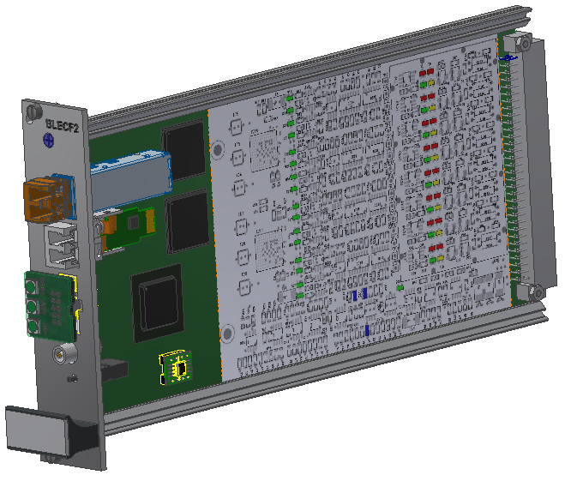
Acquisition Card (BLECF2) - pinout
Pin | Connection name | Type
A19 | Transformer winding 1 status | Input
C19 | Transformer winding 2 status | Input
C1 | On/Off - Digital part (Out) | Output
A1 | On/Off - Analog part (Out) | Output
A20 | BLECF2_cmd_0 (To BLECF2 – A21) | Input
A21 | BLECF2_cmd_1 (To BLECF2 – C21) | Input
C21 | BLECF2_cmd_2 (To BLECF2 – A22) | Input
A22 | JTAG (TMS) | Input
C22 | JTAG (TCK) | Input
A23 | JTAG (TDI) | Input
C23 | JTAG (TDO) | Output
A24 | JTAG (TRST) | Input
A27 | Chassis ground | Earth
A32, C32, … | GND ref | Gnd
2 x tbd | +1.5V_{DC} | PWR Input
C24 | Spare A (from to BLEACC) | t.b.a.
A25 | Spare B (from to BLEACC) | t.b.a.
Transformer power monitoring
Power cycle function
Input for direct commands
EEPROM reprogramming
19 free pin in the BLECF1 (EDA-00593) connector
Spare interconnection between BLECF2 and BLEACC

Slide 24
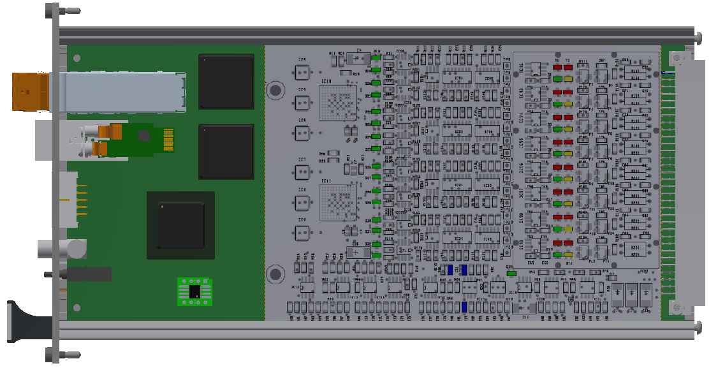
Acquisition Card (BLECF2) - 3D preview
SFP
GBTx
VTRx
GBTx
JTAG + LEDs connector
NanoXplore NG-Medium
Lemo
Reset PB
EEPROM

Slide 25
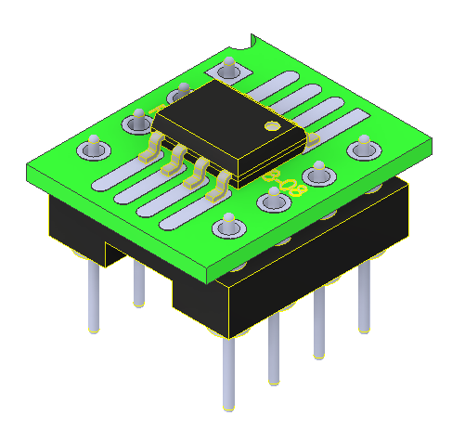
Acquisition Card (BLECF2) – EEPROM
The new FPGA RAM based requires an external EEPROM from which to boot.
External EEPROMs are not very radiation tolerant (only up to 300Gy).
By locating the EEPROM on a socket allows the EEPROM to be programmed on a separate bench.

Slide 26
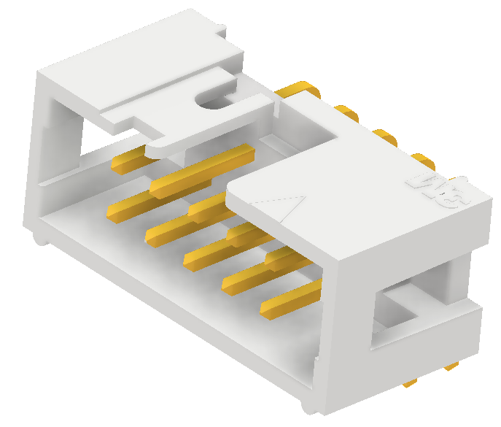
Acquisition Card (BLECF2) – Front connector
The front panel connector has 10 pins which could be used as follows:
TRST-
TMS
TCK
TDI
TDO
2V5
GND
+5V
-5V
1-Wire interface for diagnostic
FPGA JTAG
Diagnostic LEDs

Slide 27
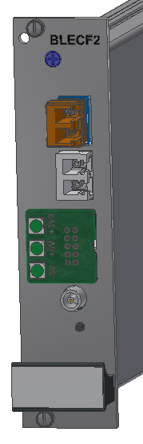
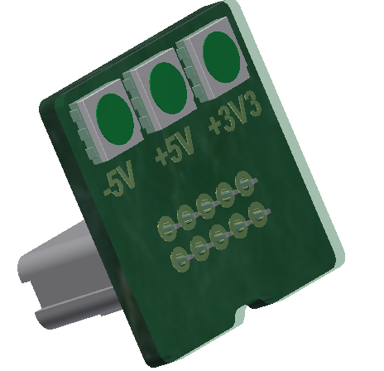
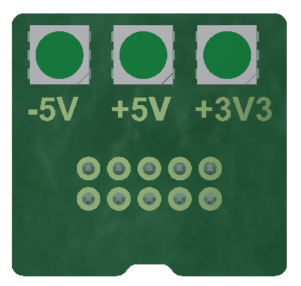
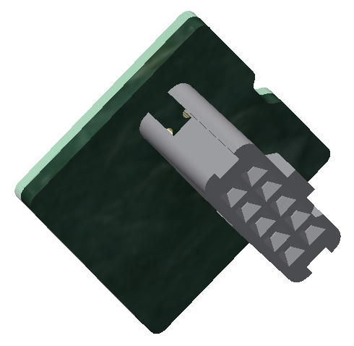
Acquisition Card (BLECF2) – LED CAP
An active BLECF2 front panel connector cap will be used to protect the BLECF2 front panel connector and to display the status of the main internal voltages.
Protective and insulating coating

Slide 28
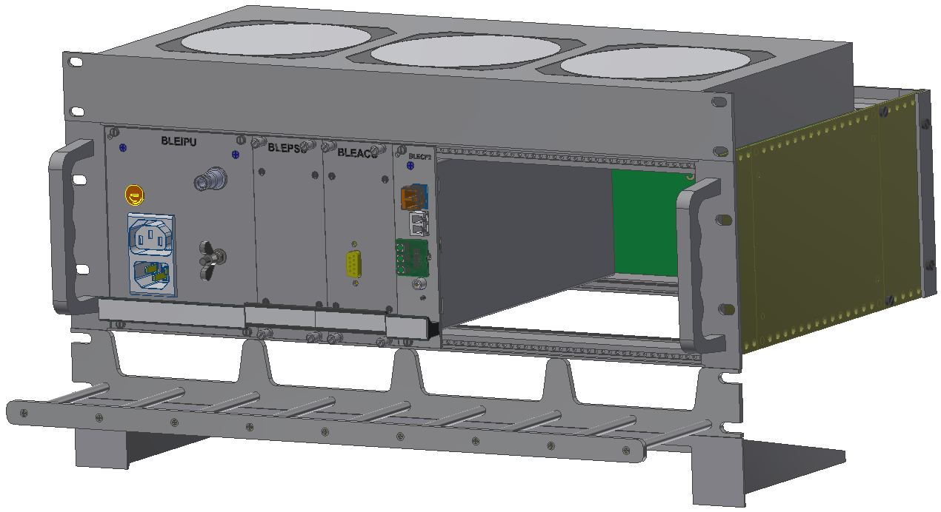
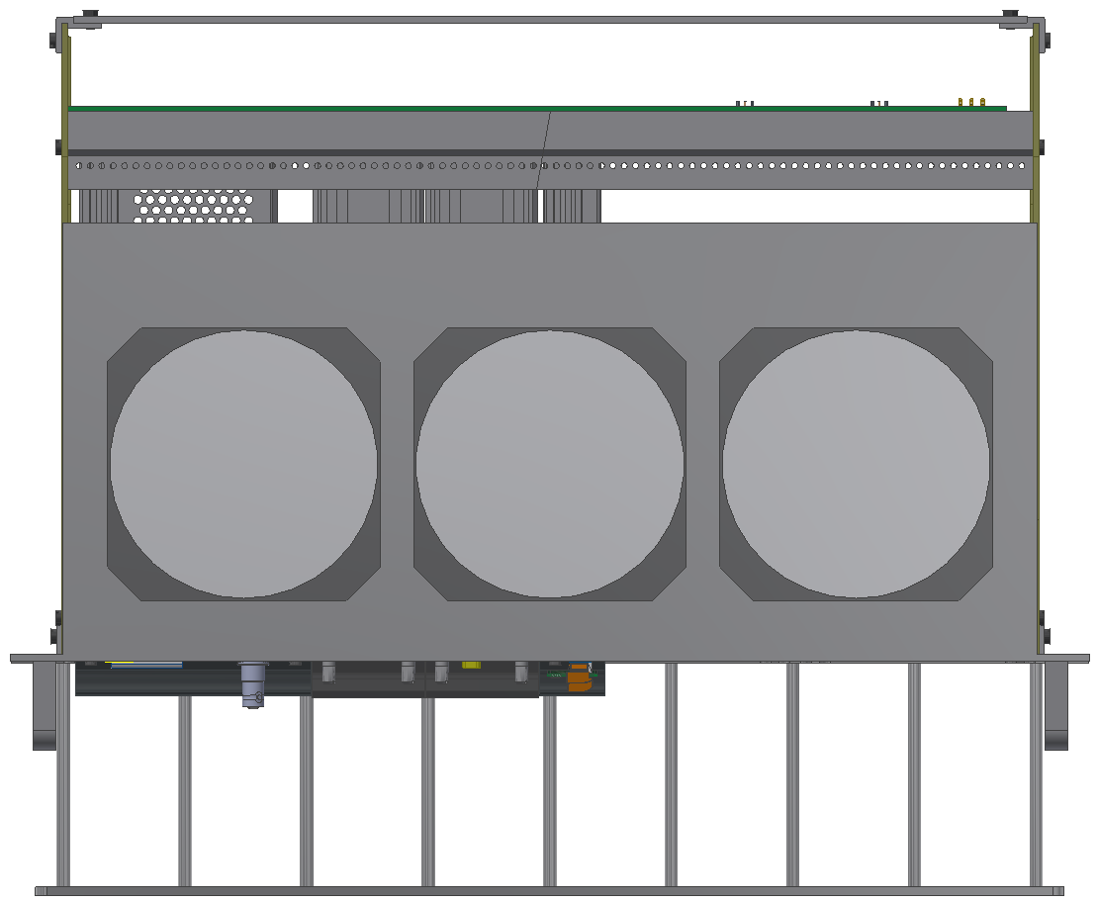
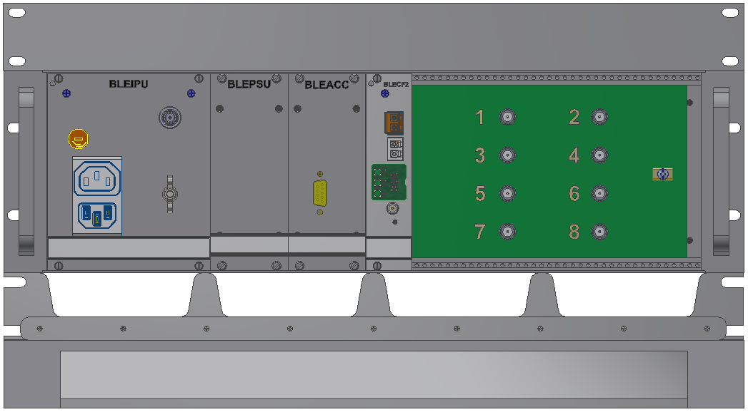
BLMSPS – 3D chassis ventilation
The crate cooling will be guaranteed by a fan tray + an air deflector.
Air will be blown from the top to the bottom to limit the amount of dust blown onto the electronics.

Slide 29
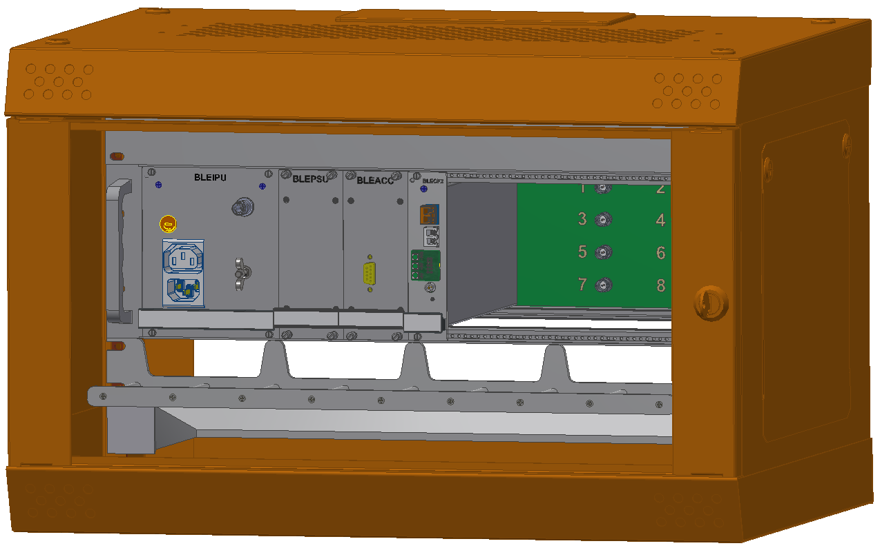
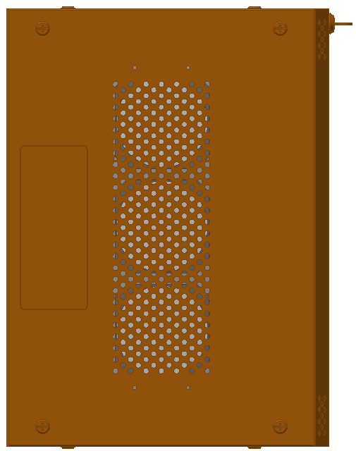
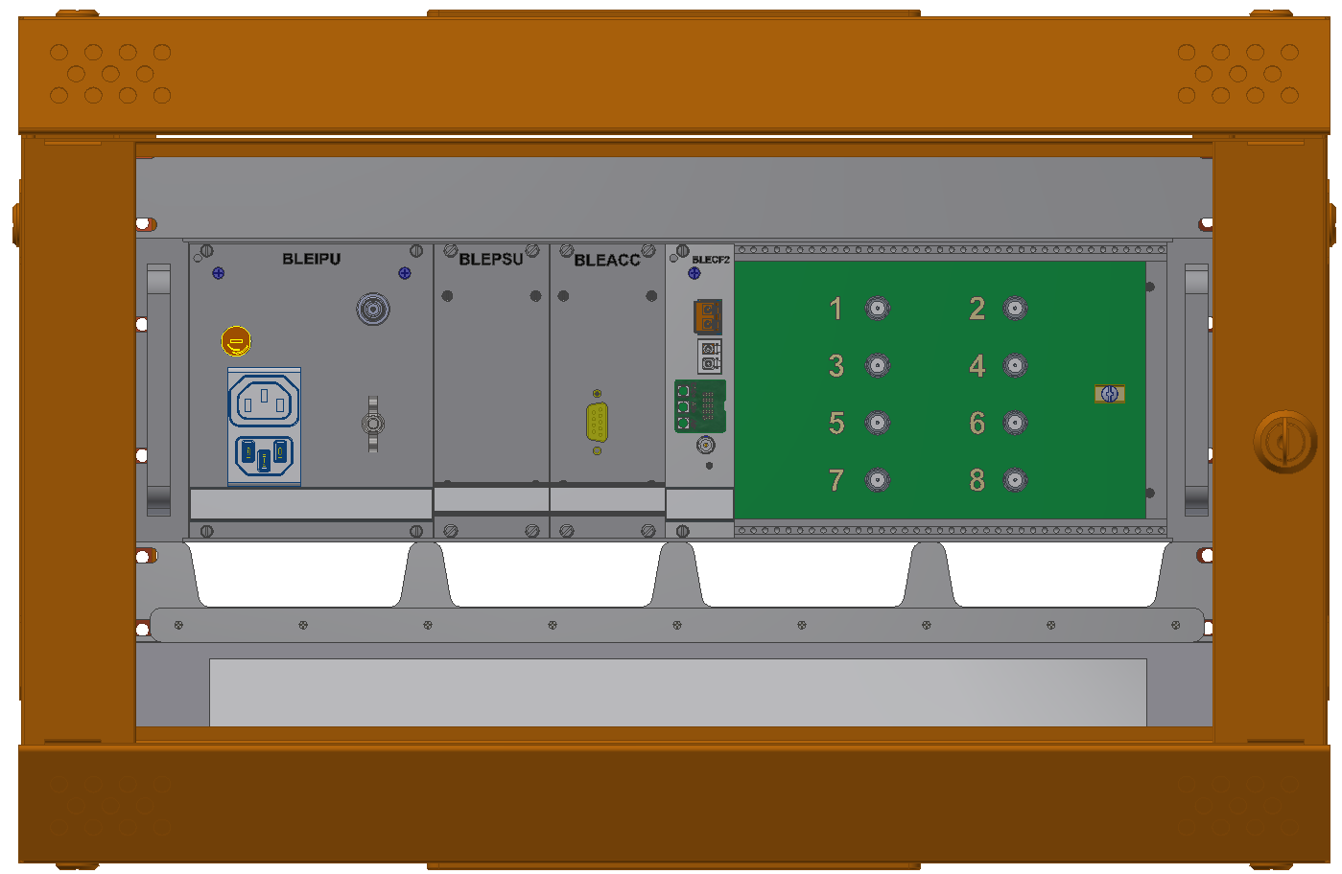
BLMSPS – 3D cabinet integration
Earth screws
Fan tray
BLEACT
Cables holder
Air deflector

Slide 30
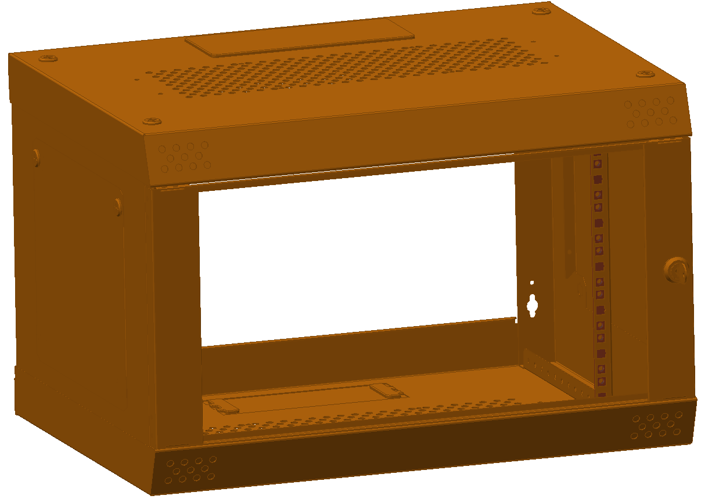
BLMSPS – Cabinet characteristics
Model: 19" Camrack QX
Height unit: 6U
Height: 384 mm
Width: 580 mm
Depth: 421 mm
P.N.: CQX064211
Color: Red, blue, orange, white, black
Distributors: Farnell, RS, Distrelec
Copper bar

Slide 31
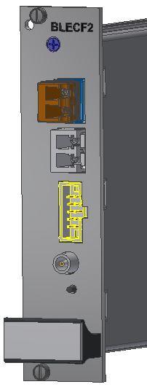

FPGA programming and local diagnostics
An interconnecting board will allow the EEPROM reprogramming and also the connection to the 1-Wire diagnostic interface.
NanoXplore
USB JTAG interface
USB1
Connector
1-Wire to USB interface
USB2
A very simple diagnostic function can be given with a direct connection to the local PC to guarantee an easy diagnostic even in case of issues with 4G connection, virtual machines, etc…
KO
Test mode
+5V
-5V
+2V5
HV
GBTx1
GBTx2
VTRx1
VTRx2
Temp
DAC level
ADC status
Integrator levels
TBD
TBD
TBD

Slide 32
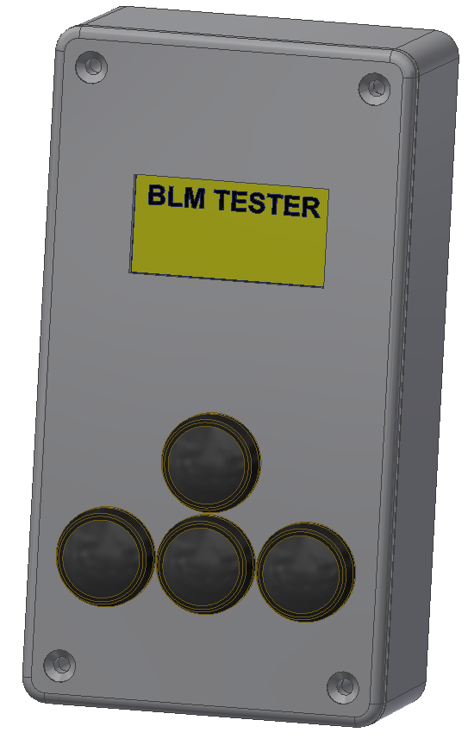
Tunnel tester
The PC + the external board can be replaced by a simpler custom made “tester”
Advantages of this solution:
Lighter than a PC.
User friendly.
Power supplied by either BLEACT or battery.
Maintenance can be easily assigned to technicians.
1-Wire interface

Slide 33
Conclusions
The architecture of the BLMSPS system has been fully defined.
  Backward compatibility with the LHC system.
  Optimized for quicker maintenance actions.
The need of the Acquisition Crate Controller card depends on the availability of a bidirectional optical link; will be kept as optional controller because it guarantees redundancy.
Input Power Unit (BLEIPU), Power Supply Unit (BLEPSU) and Backplane (BLEBPT) are at an advanced design phase.
Many of the components for the acquisition card (BLECF2) have been selected with the help of Salvatore Danzeca and the Radiation Tolerant electronics team (EN-SMM-RME).

Slide 34
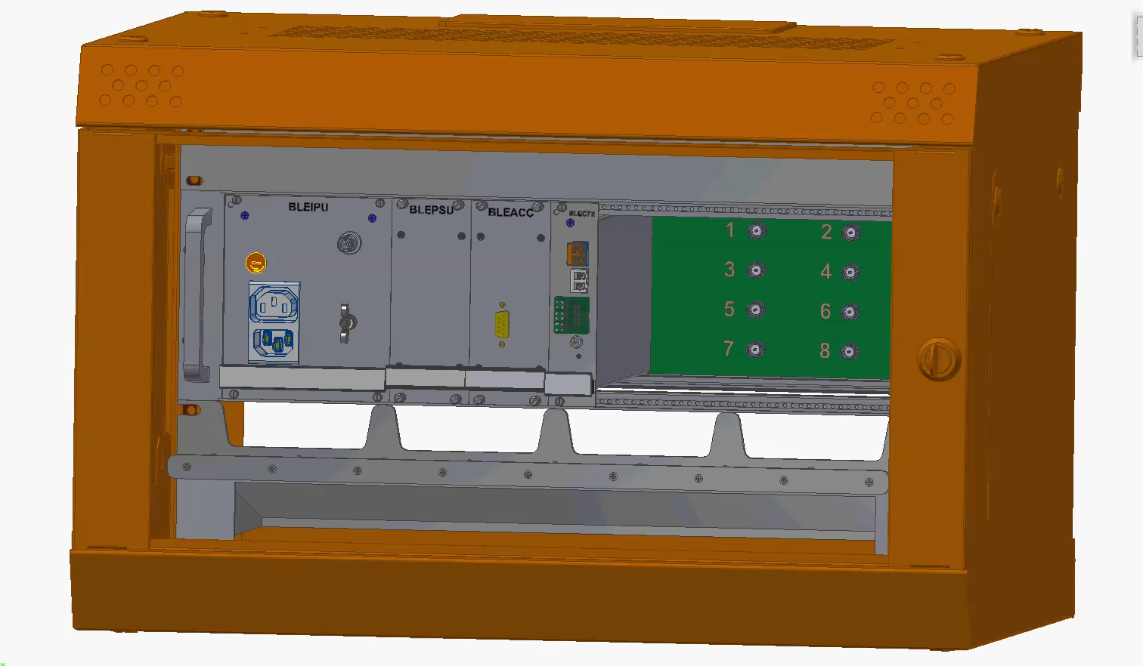
BLMSPS – 3D animation
Thank you very much for your attention!

Slide 35
Additional Slides

Slide 36
Power budget
Current supplied by Transformer winding 1 in case of Linear voltage regulators use
= 3751mA
Current from Transformer winding 2
(The BLEACC current consumption has to be added)

Slide 37
Power budget
If the current architecture (LHC type) of the power supply based on linear voltage regulators, we would have the following power loss on the power supplies:
Digital = 1601mA * (9.87V - 3.3V) = 10.5W
GBTx = 1750mA * (9.87V - 1.5V = 14.6W
Analog (+) = 400mA * (9.87V – 5V) = 1.95W
Analog (+) = 300mA * (9.87V – 5V) = 1.46W
--------------------------------------------------------------------------------------
Total = 28.5W (we can cook eggs on the BLEPSU)
Dropout voltage
By using DC/DC converters on the Digital and transceiver parts would have the following new scenario on the power supplies:
Digital = 1601mA * 3.3V ((3.3V / 9.87V)/0.8) = 2.41W
GBTx = 1750mA * 1.5V ((1.5V / 9.87V)/0.8) = 0.5W
Analog (+) = 400mA * (9.87V – 5V) = 1.95W
Analog (+) = 300mA * (9.87V – 5V) = 1.46W
----------------------------------------------------------------------------------------------------
Total = 6.31W
DC/DC efficiency

Slide 38
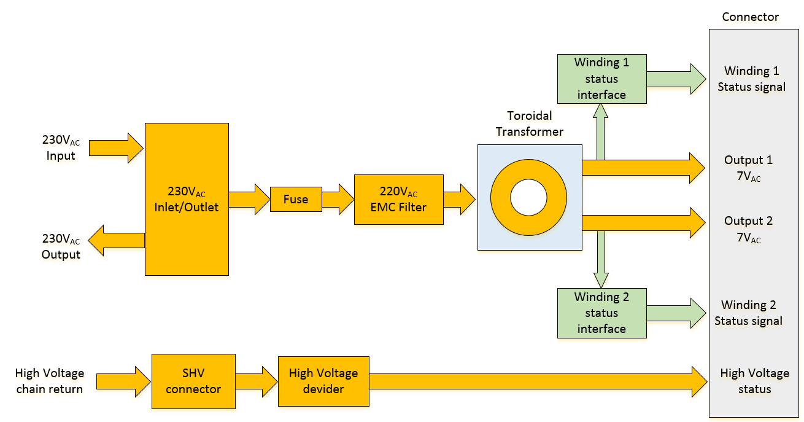
Input power unit (BLEIPU) – Block diagram

Slide 39
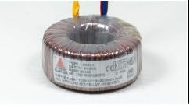
Input power unit - BLEIPU
A custom transformer built with radiation tolerant materials and CERN tunnel approved materials is going to be produced and delivered to us in a couple of weeks
5.00A

Slide 40
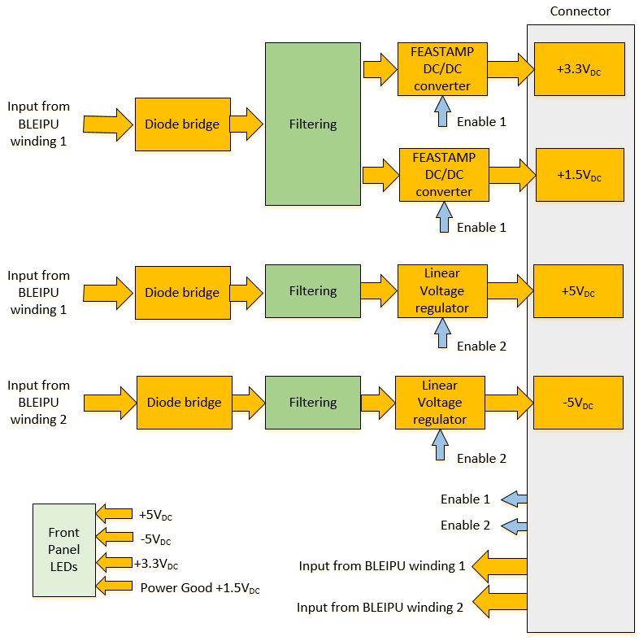
Power supply unit (BLEPSU) – Block diagram

Slide 41
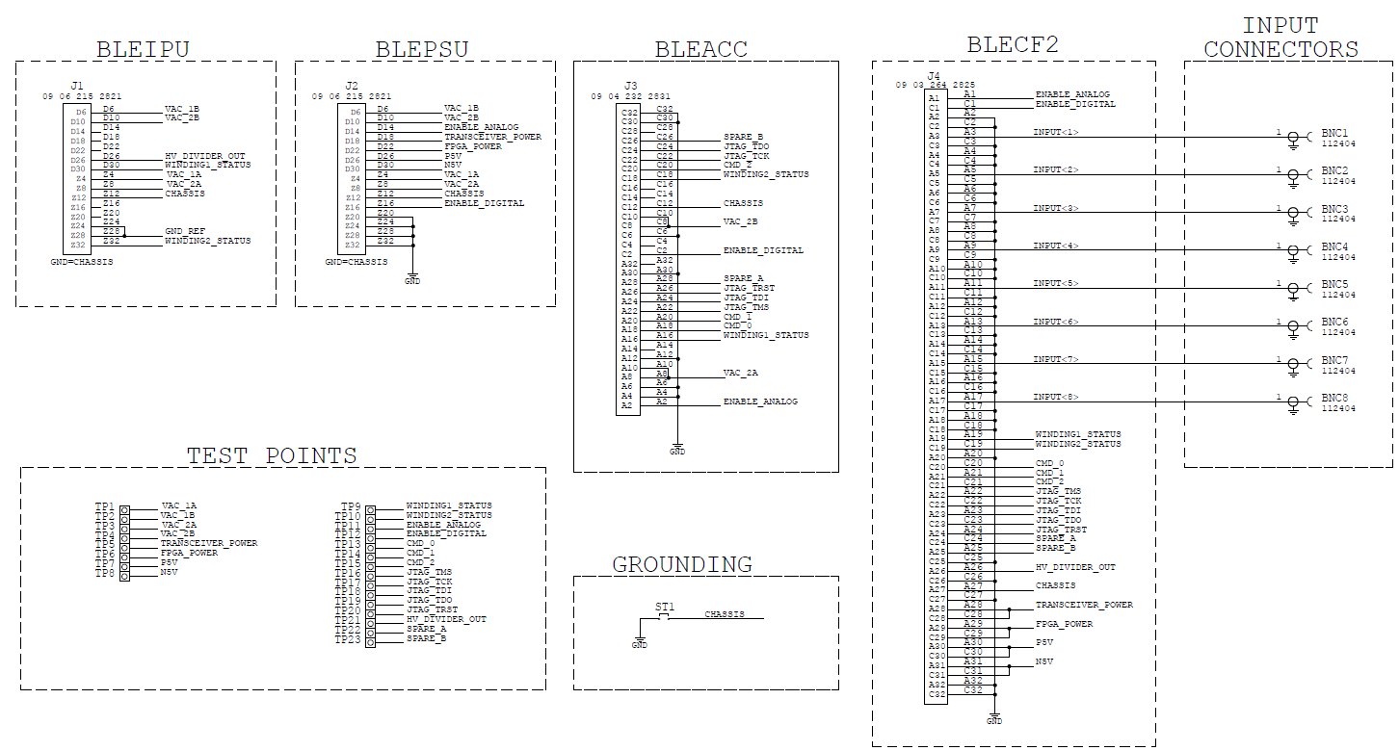
BLMSPS – Backplane schematics

Slide 42
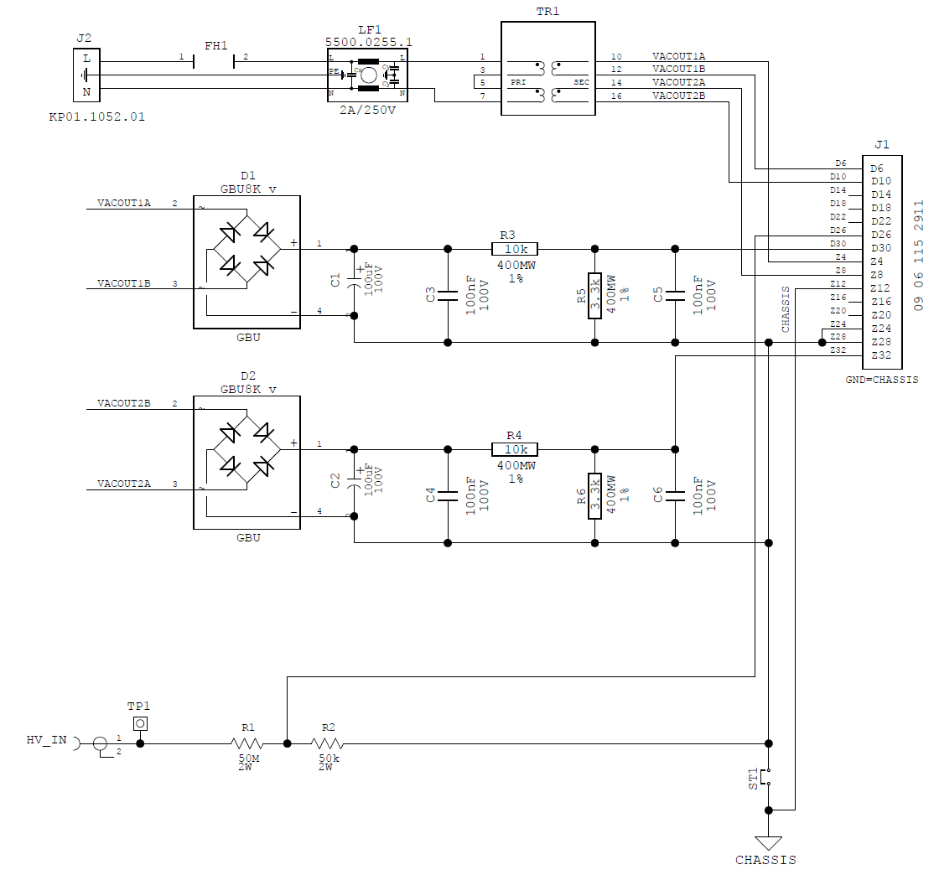
BLMSPS – Input power unit schematics

Slide 43
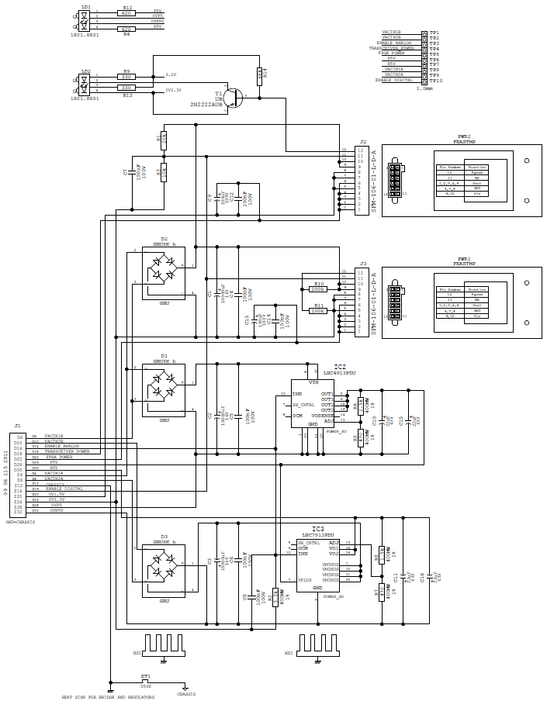
BLMSPS – Power supply unit schematics

Slide 44

BLMSPS – Power supply unit layout design

