Slide 1
BI-BP future needs for rad-hard tunnel crates
12/10/2018 BI Technical Board
A. Boccardi, M. Barros Marin, M. Krupa, M. Wendt

Slide 2
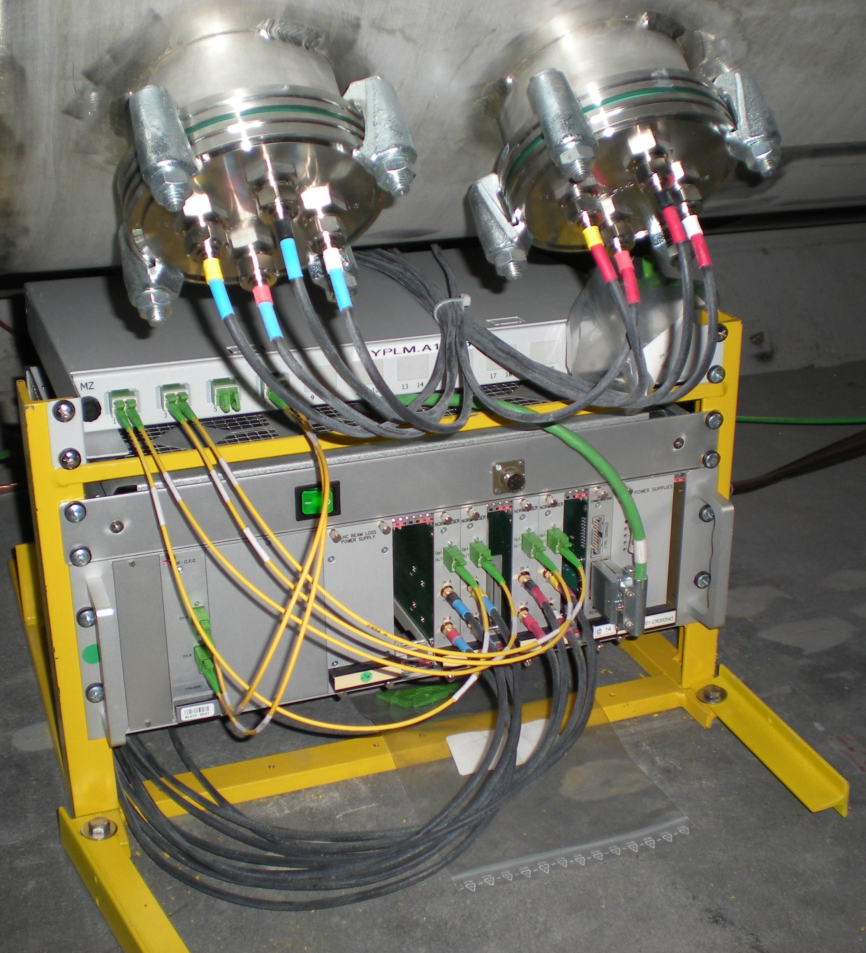
LHC arc BPM tunnel infrastructure
Tunnel crate shared with BLMs
Cryostat feedthroughs
(2 x 4 SMA)
SMA cables (2 x 4)
Optical fibres (2 x 2)
Infrastructure maintained for LHC BPM upgrade

Slide 3
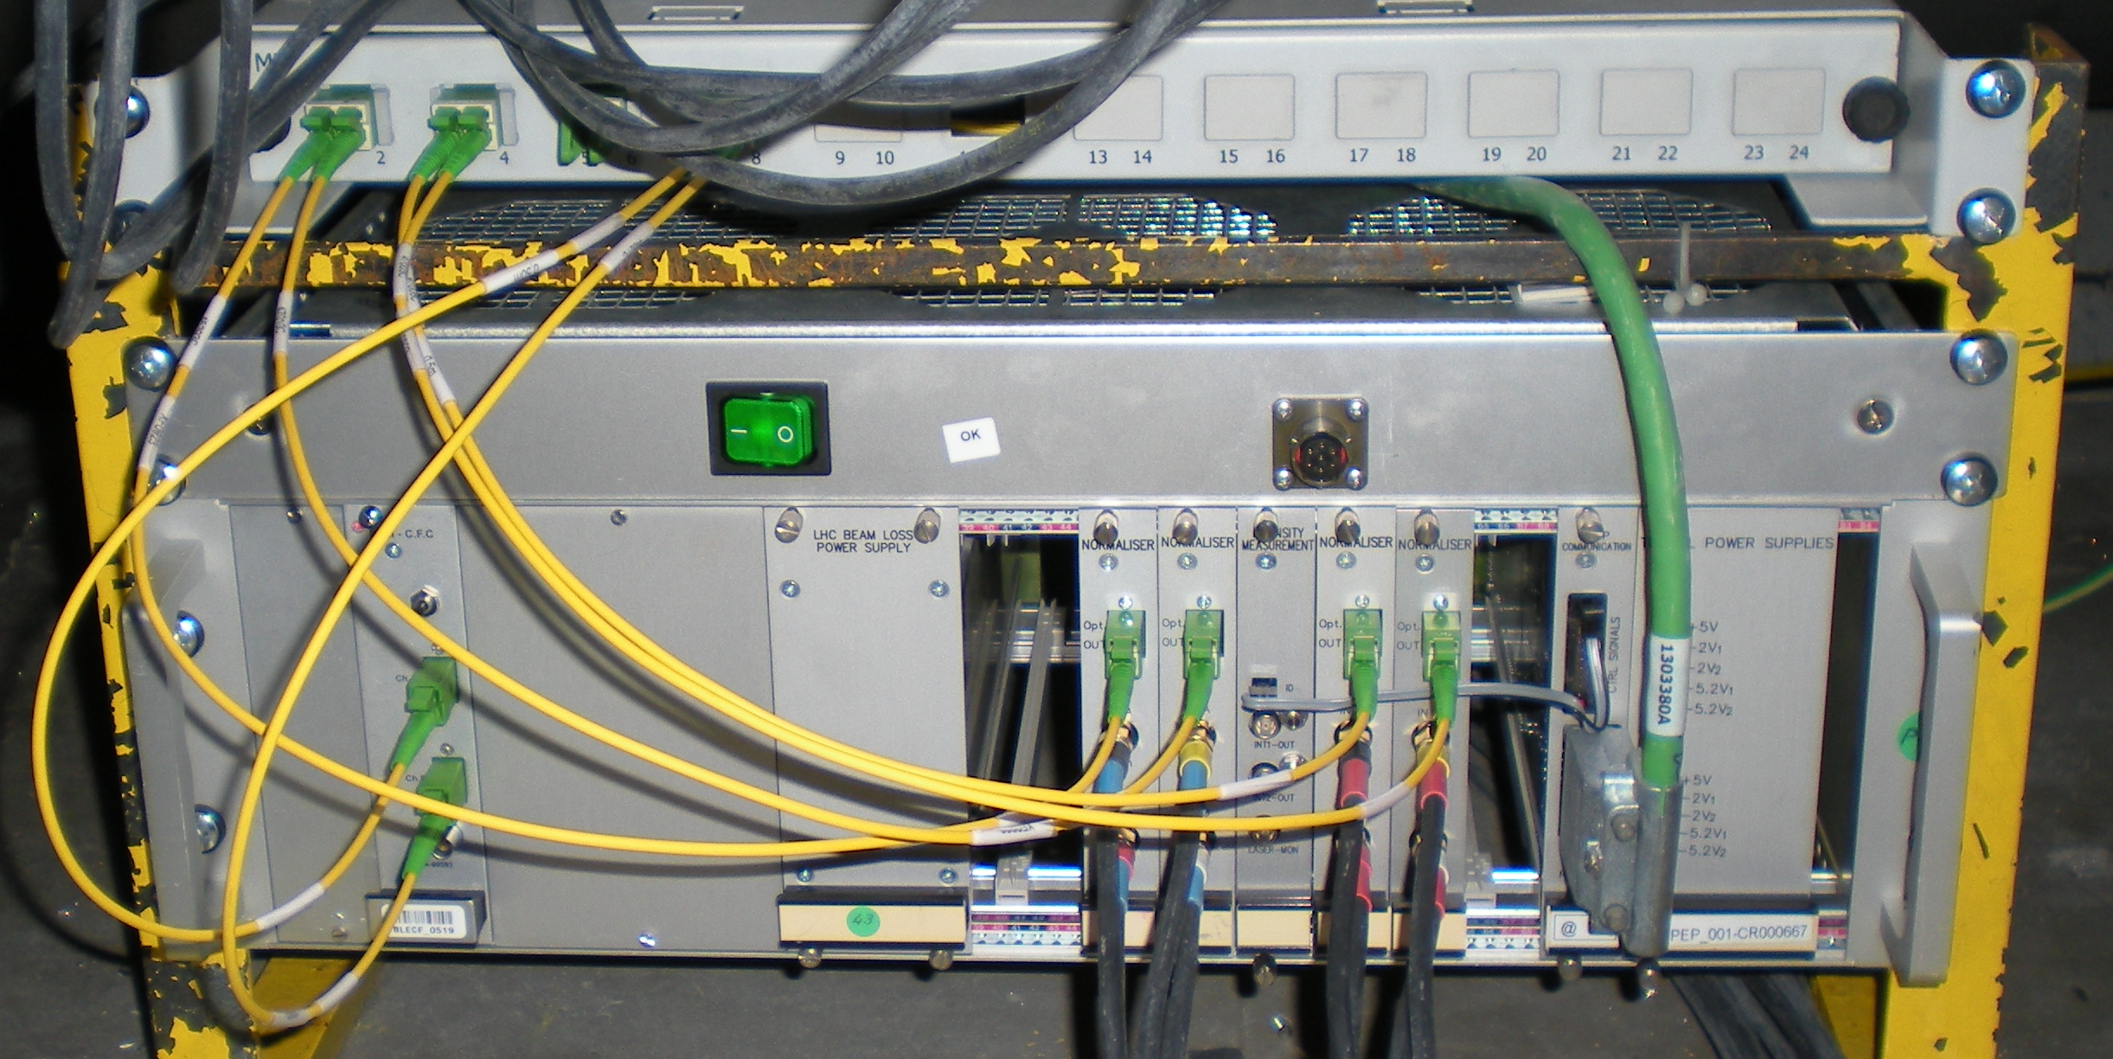
Typical LHC arc installation
BLM card
BLM PSU
2 x BPM card
comms
PSU

Slide 4
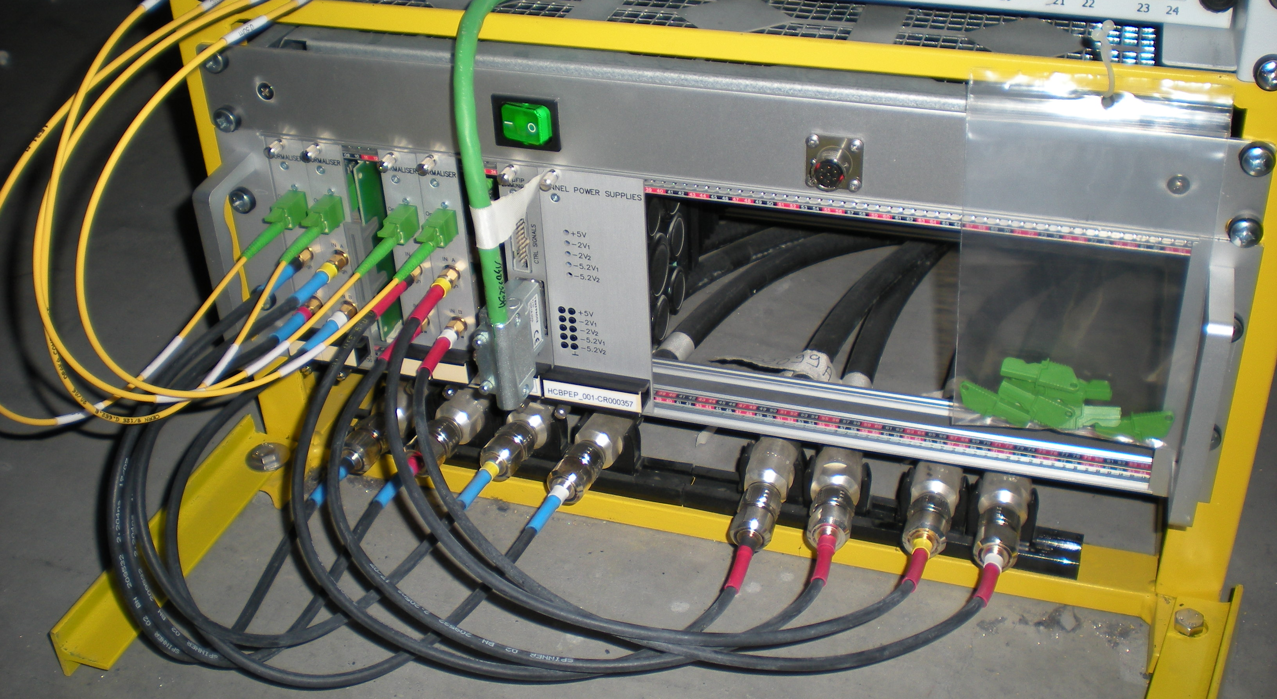
Unusual cases
Long cables

Slide 5
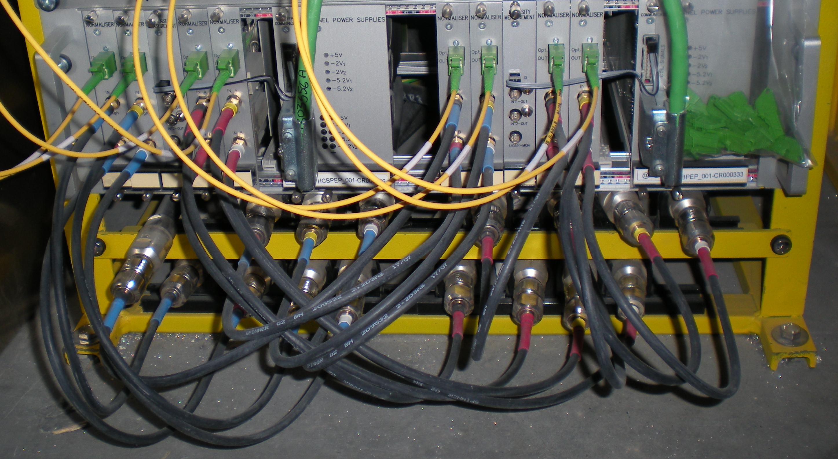
Unusual cases
2 x 2 BPMs

Slide 6
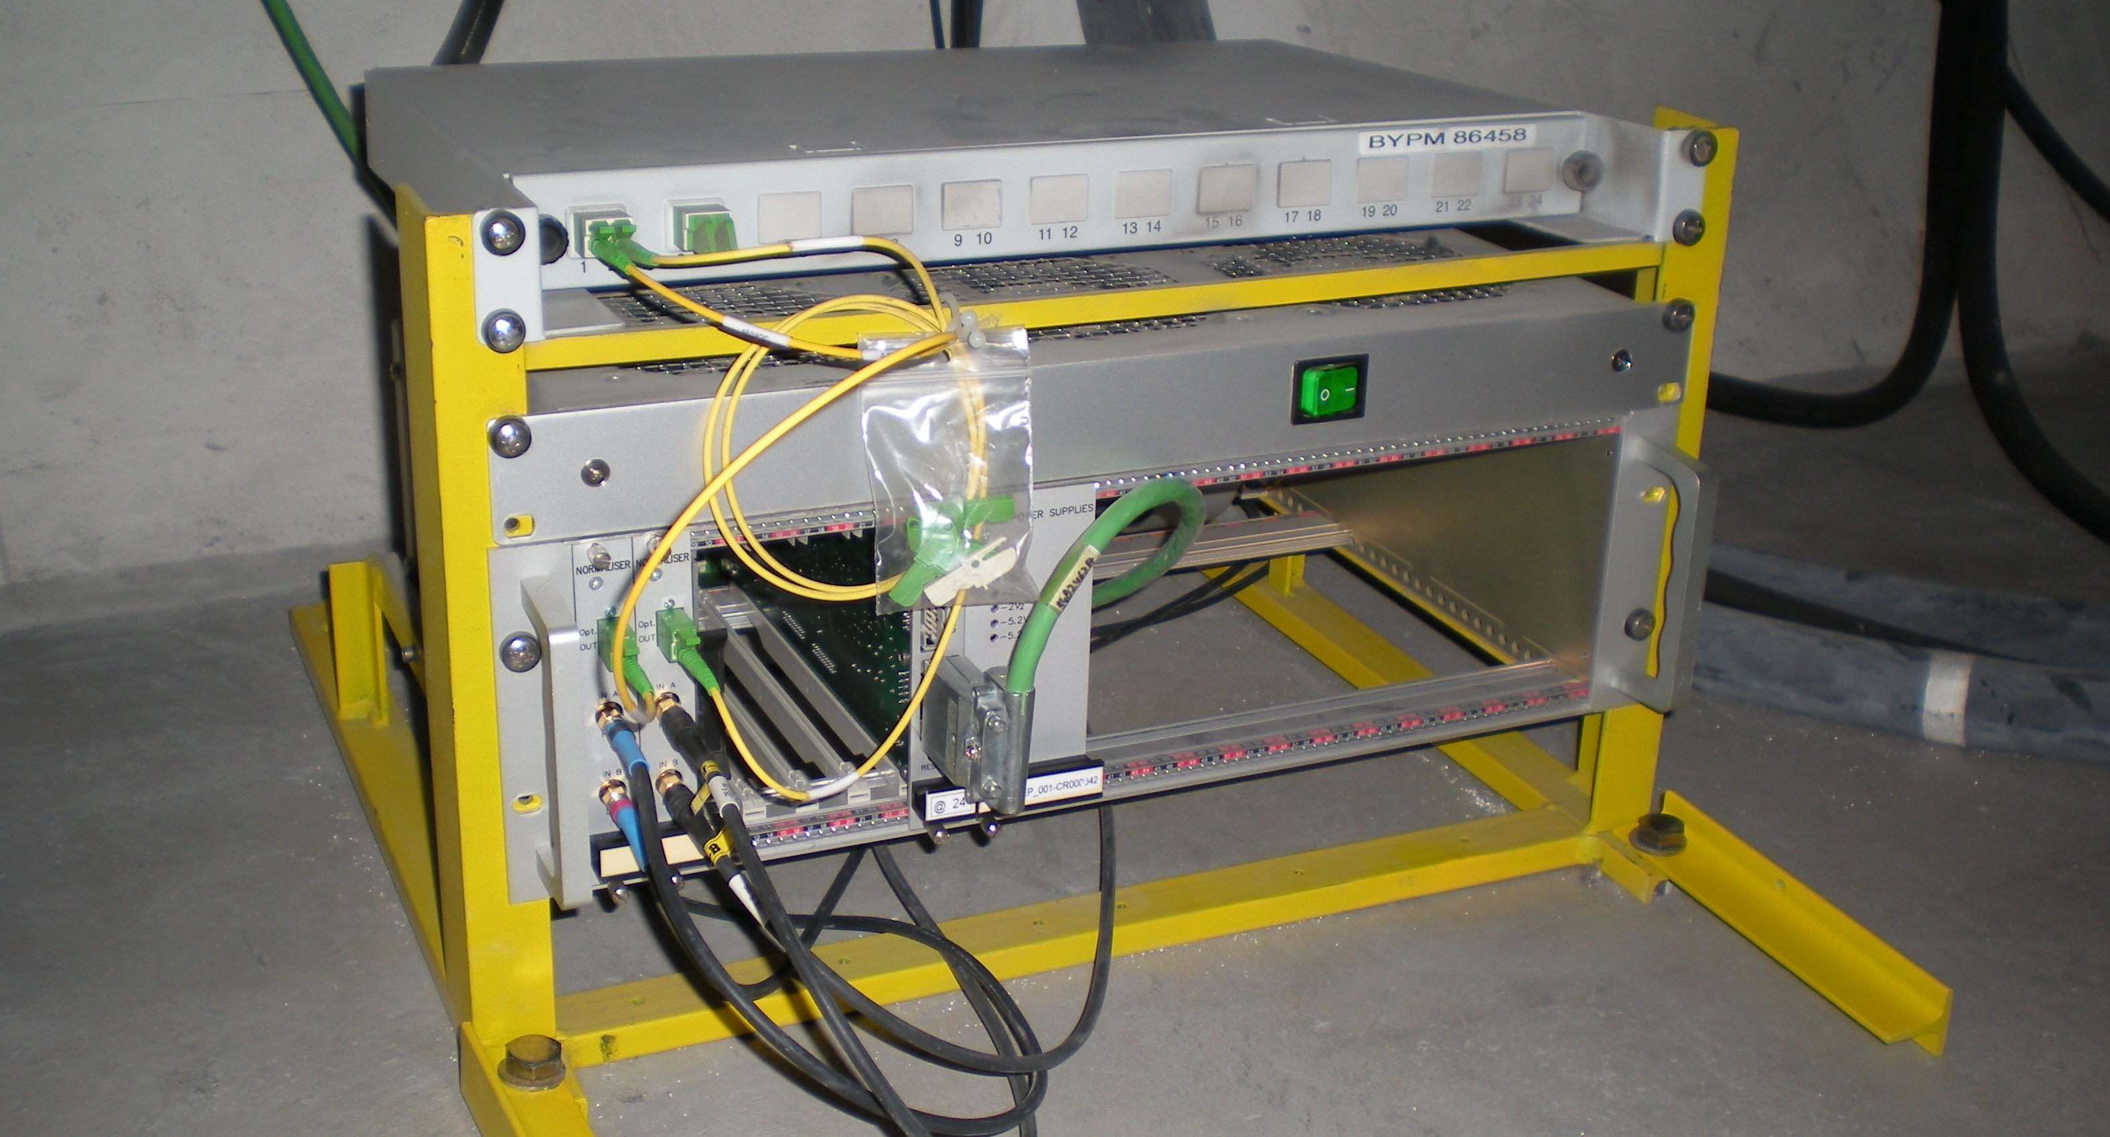
Unusual cases
Transfer lines

Slide 7
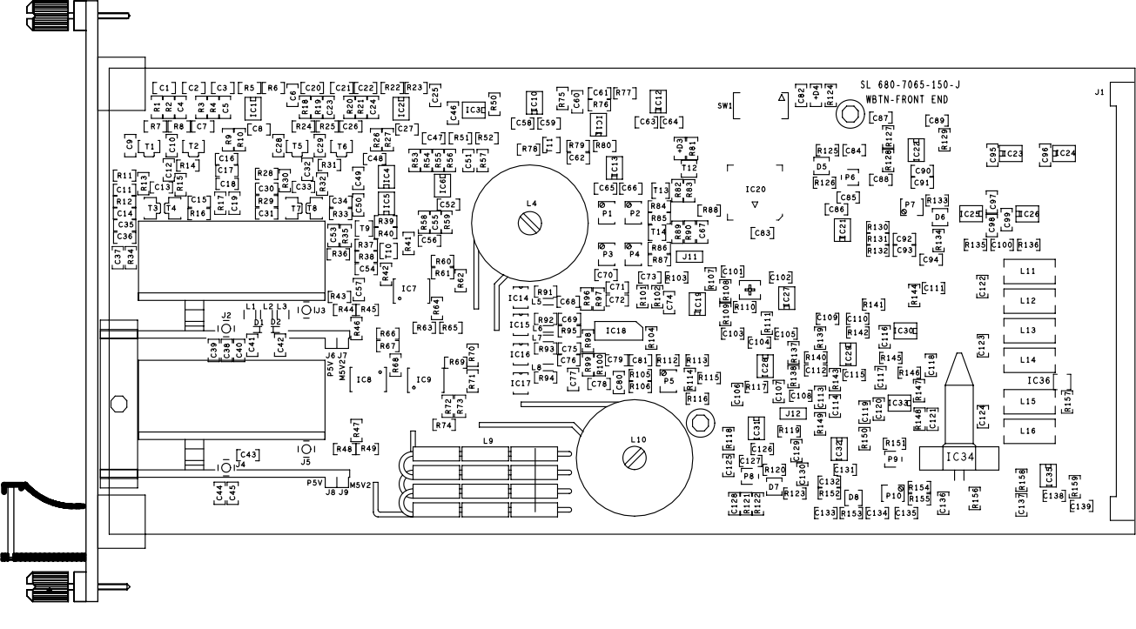
LHC BPM card
Analogue electronics
100 mm
222 mm

Slide 8

LHC BPM upgrade architecture
Maintain LHC fibres and cabling
Similar to LHC BPM interlock upgrade
Mixed analogue and digital installation in the tunnel crates:
  A passive analogue RF board for signal conditioning
  A digital board for signal digitising, pre-processing and transmission
Both boards installed as a single unit
Exact implementation details under discussion

Slide 9
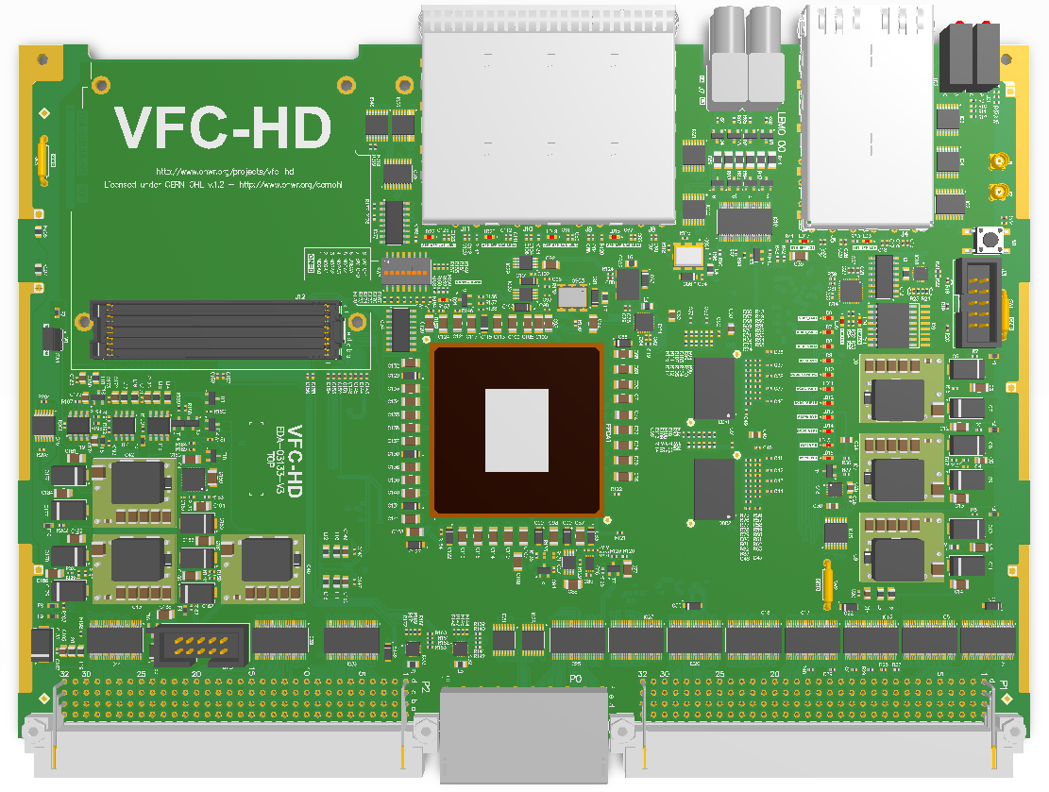
Digital board real estate
LHC BPM
upgrade
Not needed
160 mm
Possibly
needed
Needed
233 mm

Slide 10
Maintain format of the digital board?
?
Might be
possible
but looks
challenging
?

Slide 11
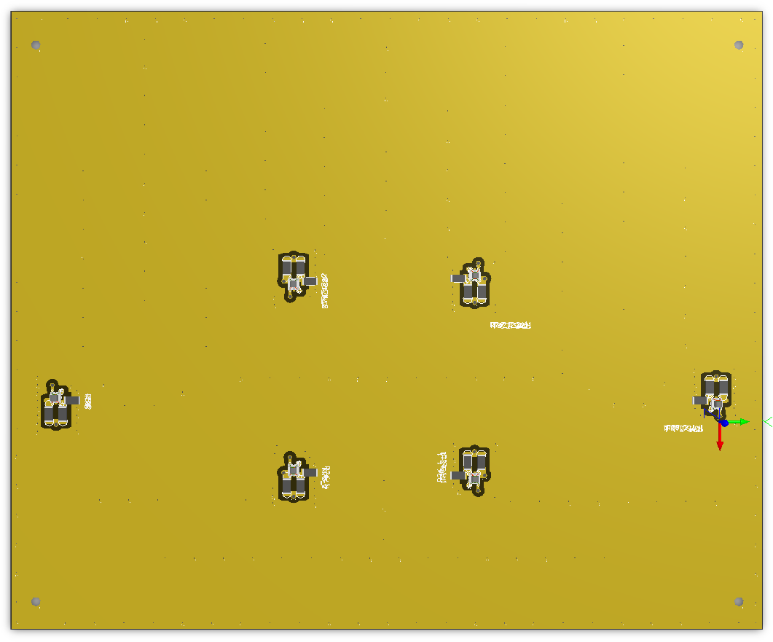
RF analogue board real estate
LHC BPM
upgrade
220 mm
Needed
Distributed elements.
Board dimensions
dictated by physics
but compact designs
could be investigated.
256 mm

Slide 12
Compact analogue RF board
63% size reduction
required
Two options:
Very high ε dielectric
Multilayer design
Finding the right
solution requires R&D

Slide 13
LHC BPM upgrade preliminary spec
Real Estate:
  1 unit = 1 digital board + 1 passive analogue RF board
  Unit size: 3U might be possible. Is 4U an option?
  Typically 2 units per crate
Electrical:
  2 x < 50 W power consumption
  Passive cooling
  Independent power management per unit
  Backwards compatibility with FIP
  No “intelligent” backplane required:
    All communication: optical links
    BPM signals: RF SMA connectors
    Support of a BPM FE unit ID handling?
Mechanical:
  Fast and secure installation
  Simple, easy exchange of BPM FE units

