Slide 1
BE-BI ‘readiness’ for LS2
Ray VENESS

Slide 2
BI ‘readiness’ for the LS2 Days
CERN-wide ‘LS2 Days’ meeting
  Next week, 9&10 October
  15-minute talk from BI on readiness for LS2
  General introduction and overview, but cover only large projects and potential issues
I propose to cover:
  LIU project
    BWS, BGI vertical, MOPOS, internal beam dump (SBDS),
  CONS
    ALPS, Booster BTVs,
  HL-LHC
    BGC, BPW,

Slide 3
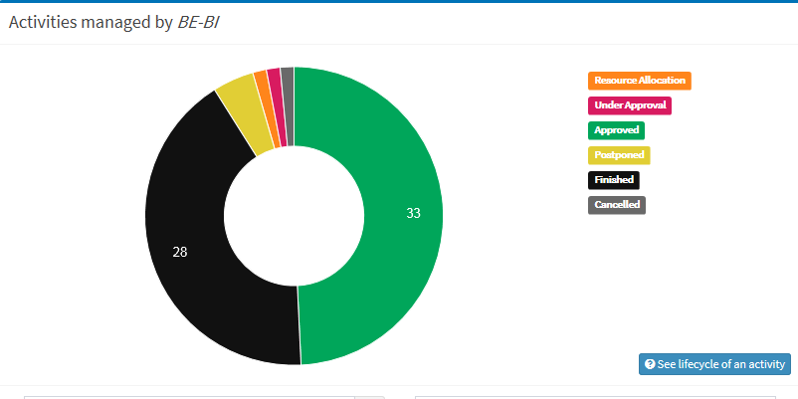
BI-run activities in PLAN

Slide 4
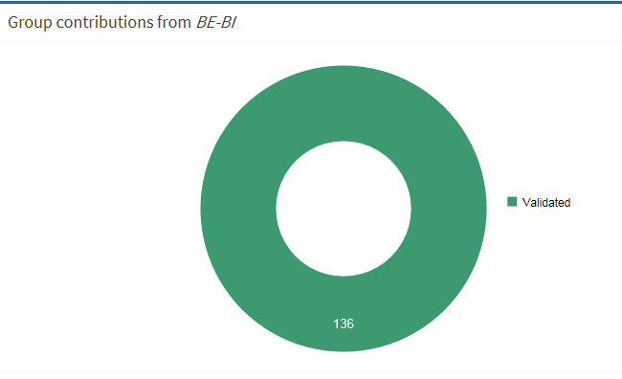
BI contributions to activities in PLAN

Slide 5
Main lessons learned from LS1
Equipment readiness for installation
  We need to track progress and inform early of any issues
    Regular follow-up during the shutdown, including production, test, mechanics, electronics and software
    Agreed in principle for 50% of a PJAS integrated in the planning team to help us follow-up our equipment readiness
Conflicts between the different machine schedules
  BI have limited ‘expert’ resources who can only be in one place at a time
    Planning team will (soon) give us a schedule for all BI activities across all machines, which we can analyse for conflicts and adjust if necessary
Conflicts between installation and commissioning
  Injectors will be commissioned while the LHC is still open
    Re-commissioning coordinators will need to work with shutdown coordinators
Follow-up of maintenance activities
  Need to start maintenance early and spread over the whole shutdown to avoid last-minute issues
    Use multiple IMPACT requests distributed both by sector (for SPS and LHC) and in time to ensure we can follow-up the progress of our maintenance activities – as tested in the intermediate shutdowns
Unplanned activities
  Late requests for new instrumentation, maintenance and performance issues uncovered during shutdown. Could be an issue in LS2, due to the removal and re-installation of many old instruments in PSB and PS. Several FTE of additional work arrived during LS1.
  Additional reinforcement planned for LS2.

Slide 6
Who is responsible for…
Cable identification for SPS1, 2 and old MCR
  Who is doing this for BI?
North area renovation
  Are BI requesting any work in LS2 here? Who is coordinating this?
Electrical lockout procedures for BI
  Who is coordinating this?
Beam interlock system – 3 different requests
  SPS injection, PSB ring, LINAC4 transfer lines
Controls conformity – FESA2, GM, RDA2… 9 in total
AD target area consolidation

