Slide 1
BIM FORUM #2

Slide 2
BIM FORUM #2
AGENDA
Présentation
Utilisation du BIM pour les projets de futur
Retour gestion des réservations cv aujourd’hui et demain
BIM development. Ongoing topics in SMB-SE
Tips for work with Revit & Catia

Slide 3
BIM FORUM #2
PRESENTATION
EDMS:

Slide 4
BIM FORUM #2 PRESENTATION
In the previous meeting:
Civil engineering design office activity in Revit
SFA18 - Pré-étude détaillée et coordination de l’intégration
Preliminary procedure to export models from Revit to CATIA
Revit & Catia conversion experience in HL-LHC
Example of interaction with consultants on the 3579-SXA5 new building project
Example of interaction with consultants on the High Luminosity project
Tips for work with Revit & Catia

Slide 5
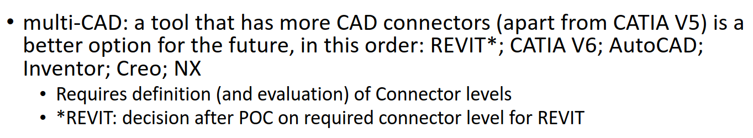
BIM FORUM #2 PRESENTATION
New sections and groups participating in the forum
CAEC (Computer Aided Engineering Committee)
SMB-SE-CEB
EN-HE
CAD 2021 Project

