Slide 1
BIM FORUM
BIM FORUM #2
Example of REVIT usage
in the projects for futur

Slide 2
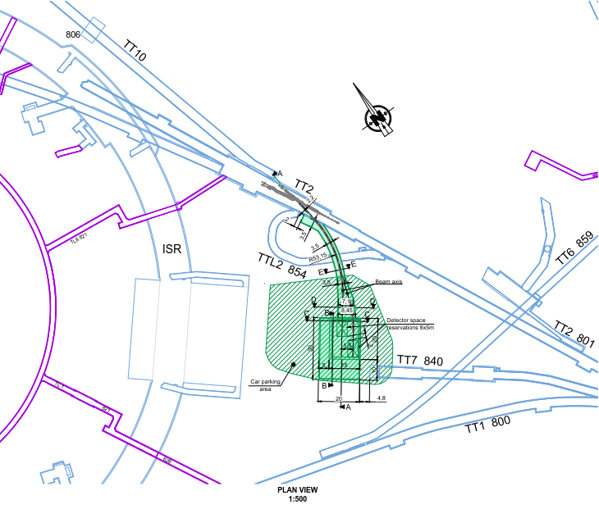
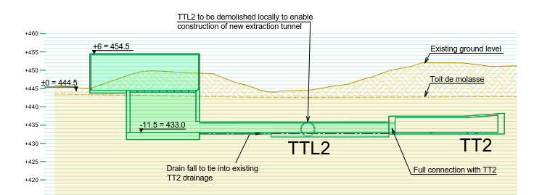
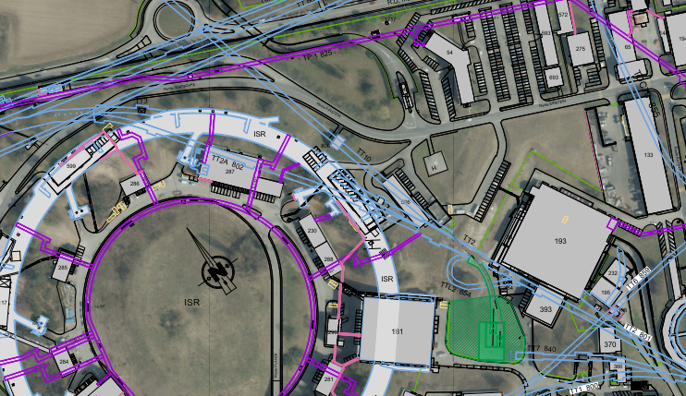
e-SPS
New electron beam facility on SPS in MEYRIN
Interaction with tunnels, buildings and ground
Existing 3D tunnels from CATIA
Existing ground/molasse points from GIS and modeling in REVIT
New structures made in 3D in CATIA
Proposal’s drawing made in AUTOCAD
Existing buildings from GIS and AUTOCAD

Slide 3
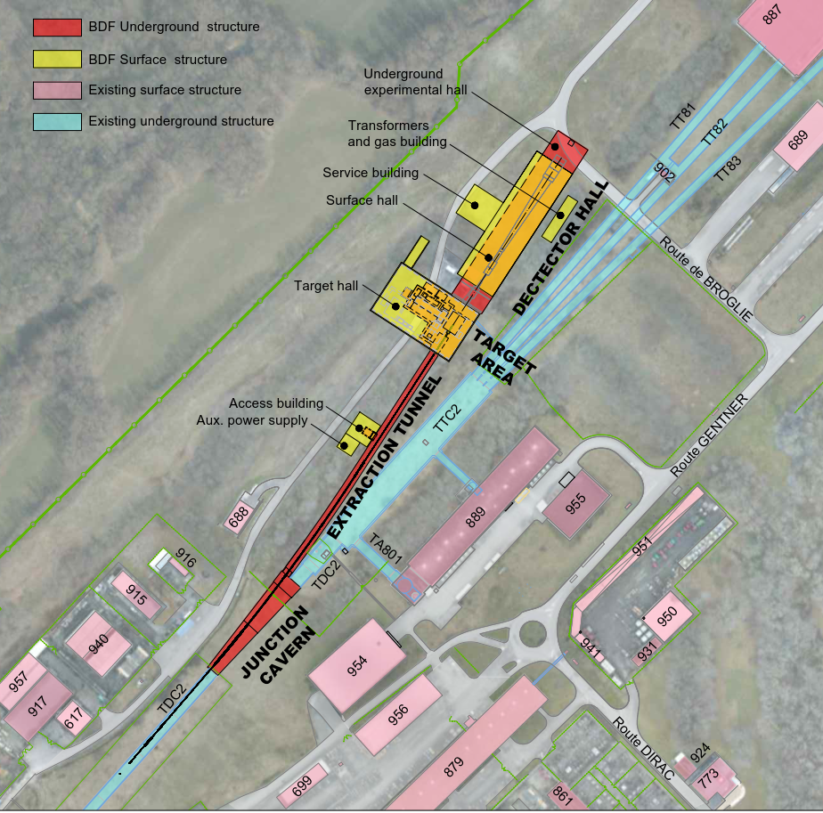
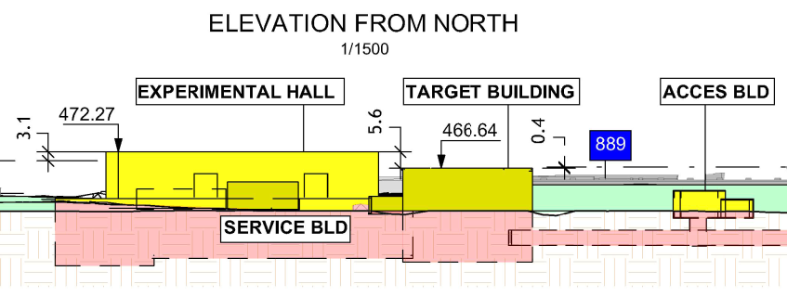
BDF
New beam dump facility on SPS in PREVESSIN
Interaction with tunnels, buildings and ground
Junction on the existing tunnels
General integration on the site with other buidlings
Integration with existing ground levels
Exchange of REVIT model with external consultant for calculation/metrics

Slide 4
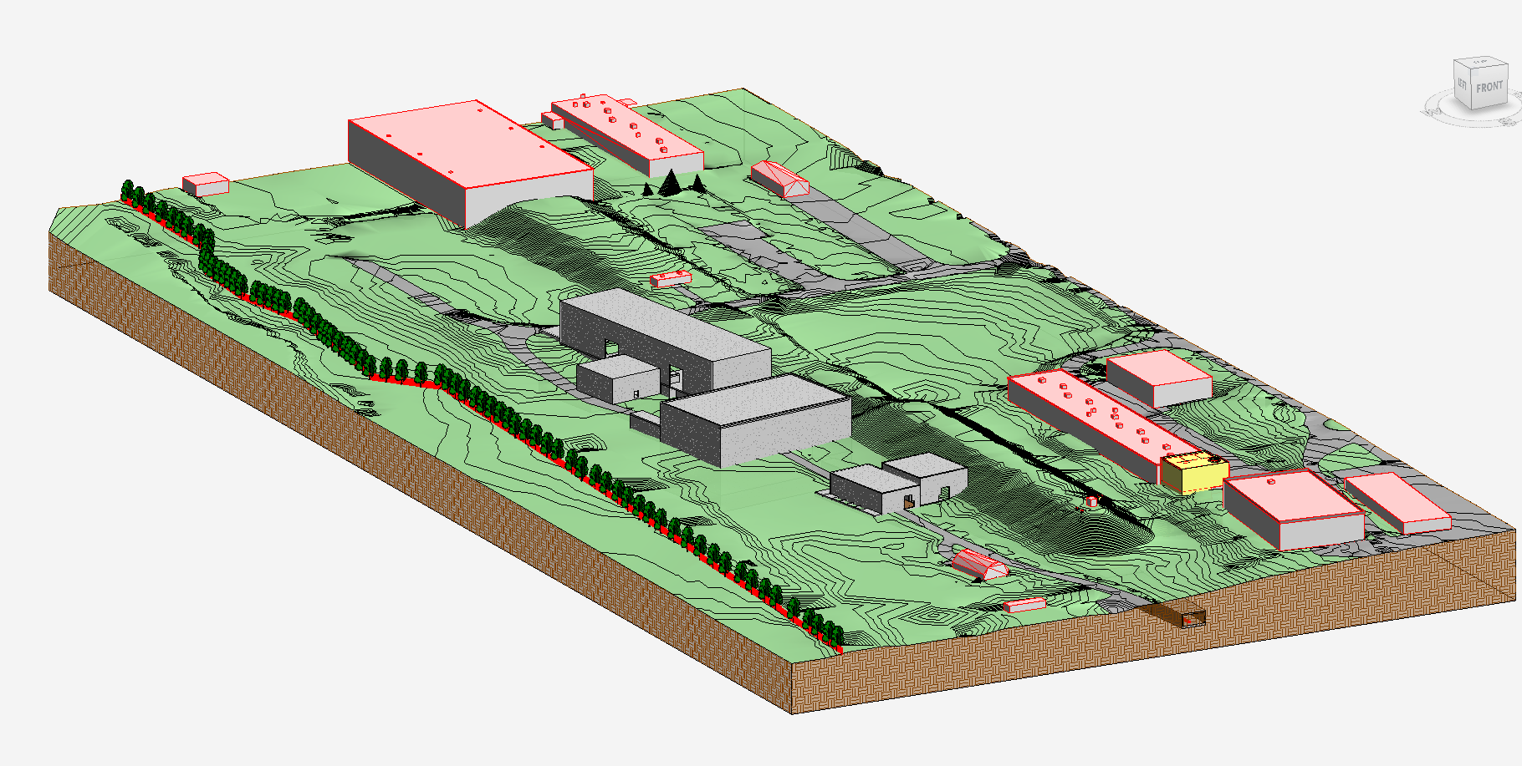
BDF
Existing buildings from SITG and Autocad
Existing ground points from GIS and modeling in CIVIL 3D and REVIT
New tunnels and buildings made in REVIT from integration CATIA model
And some drawings made in AUTOCAD
And other drawings made in REVIT
Existing 3D tunnels from CATIA

Slide 5
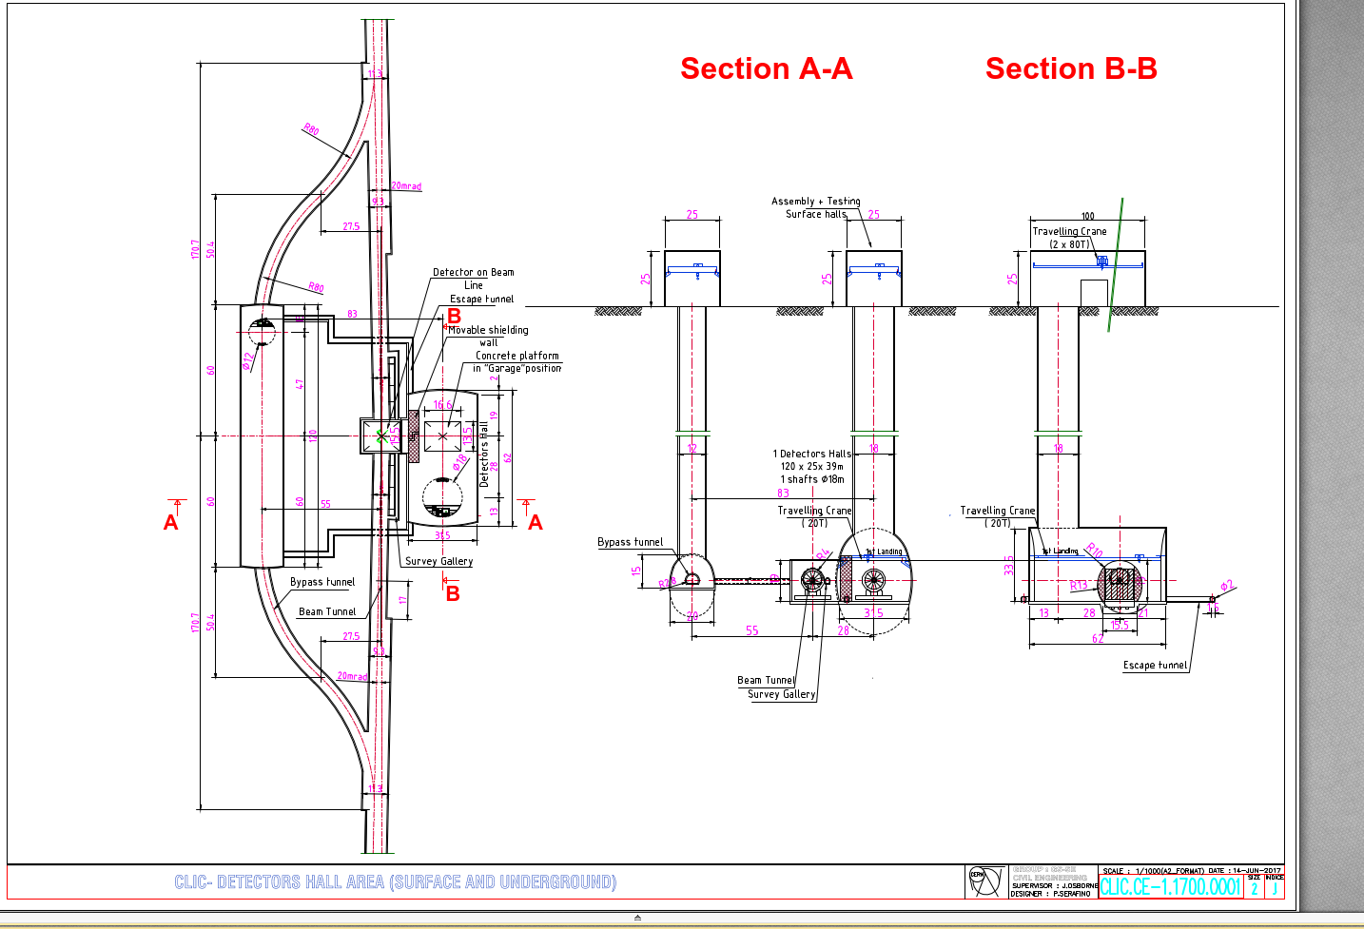
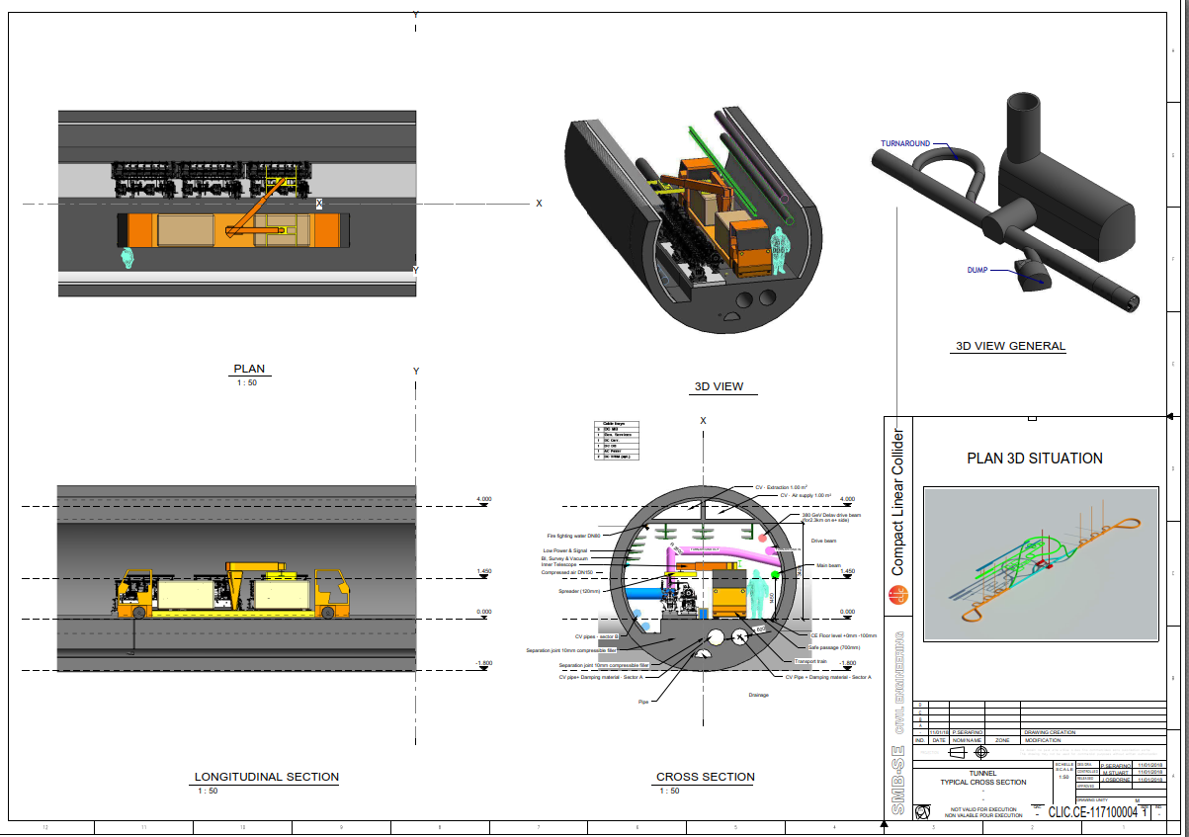
CLIC
New compact linear collider
Drawings initially made in AUTOCAD in the past years => conversion in 3D to REVIT
From AUTOCAD to REVIT

Slide 6
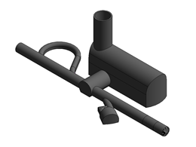
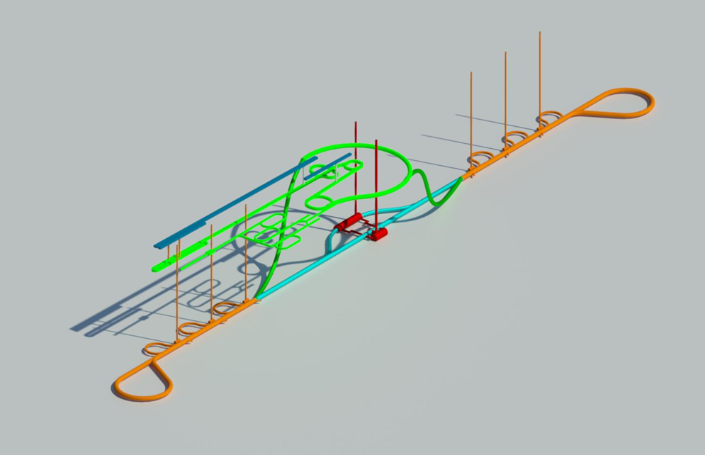
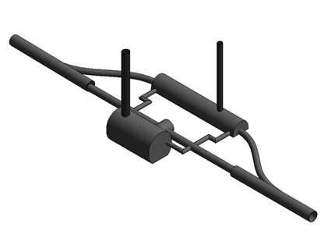
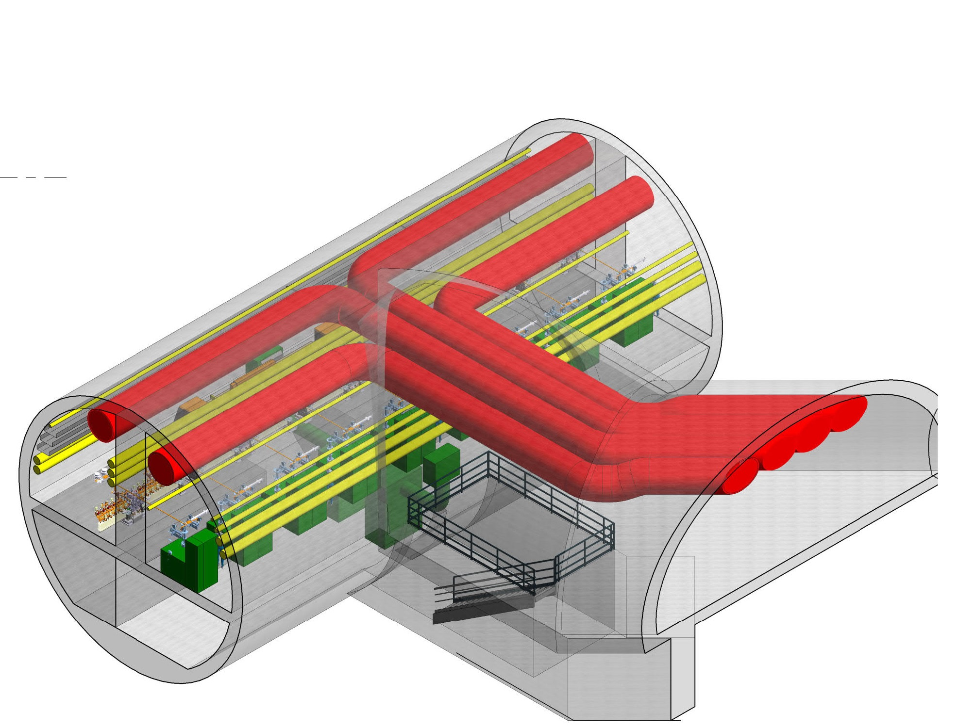
CLIC
Differents parts (families) and different models for the tunnels
Integration of CV pipes for ventilation (schematic by SMB)

