Slide 1
BIM FORUM #2
Ongoing BIM activities. SMB-SE-DOP
EDMS:

Slide 2
Ongoing Activities SMB-SE-DOP
Some elements in development:
  Folder BIM for the collaborative projects
  3D scan for buildings
  Connection with the calculation software
  Integration with the GIS

Slide 3
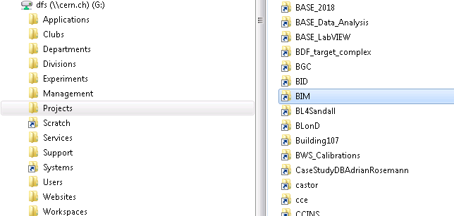
Ongoing Activities SMB-SE-DOP
  Folder BIM for the collaborative projects

Slide 4
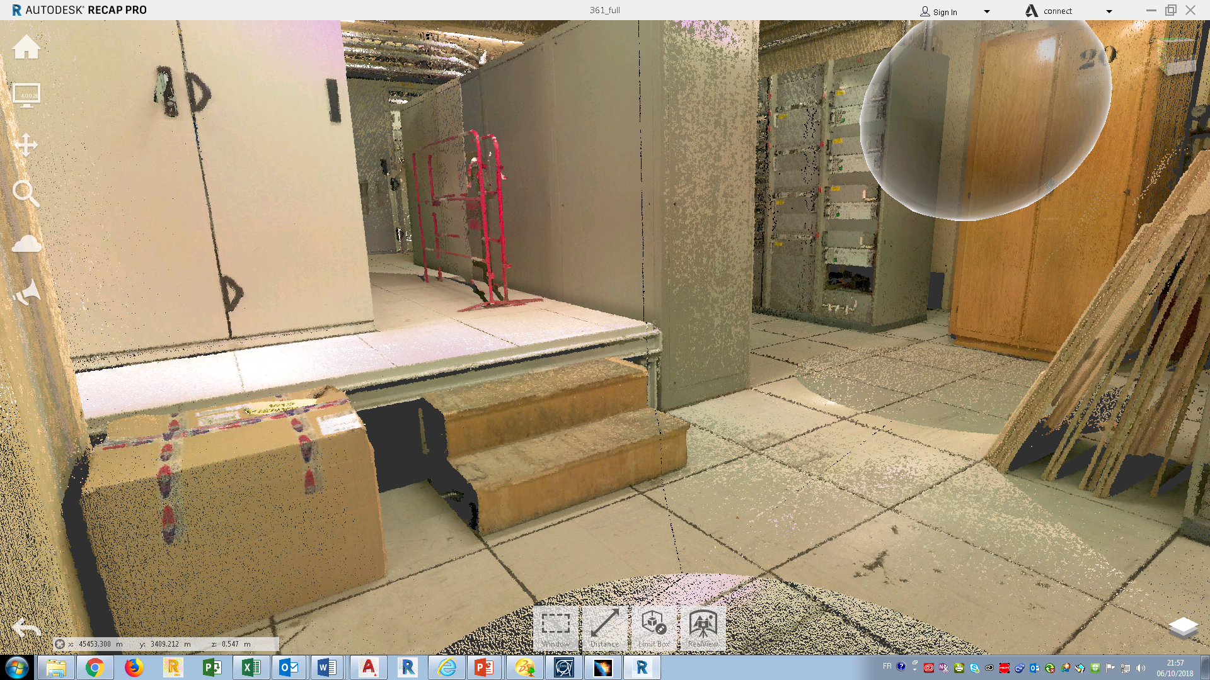
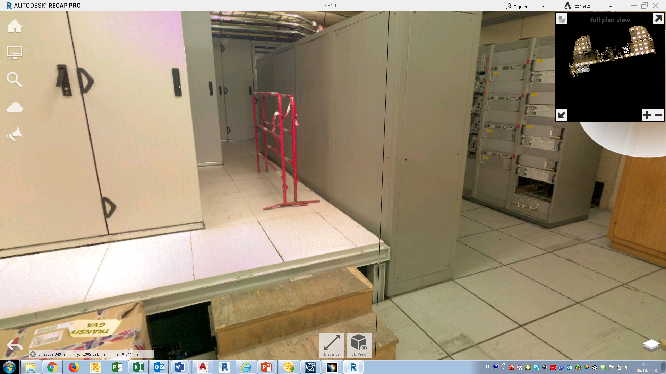
Ongoing Activities SMB-SE-DOP
  3D scan for buildings
Images 360° and scan connected
Possible se in Revit and Catia
Implantation – Coordinates

Slide 5
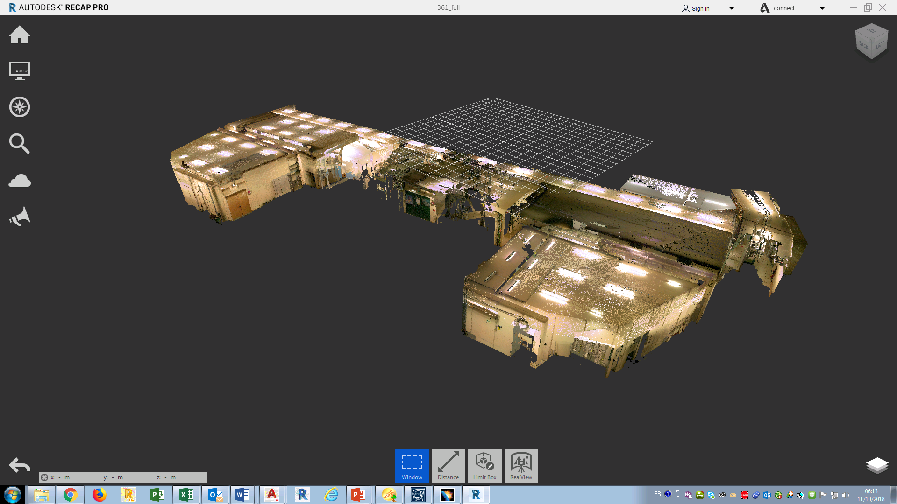
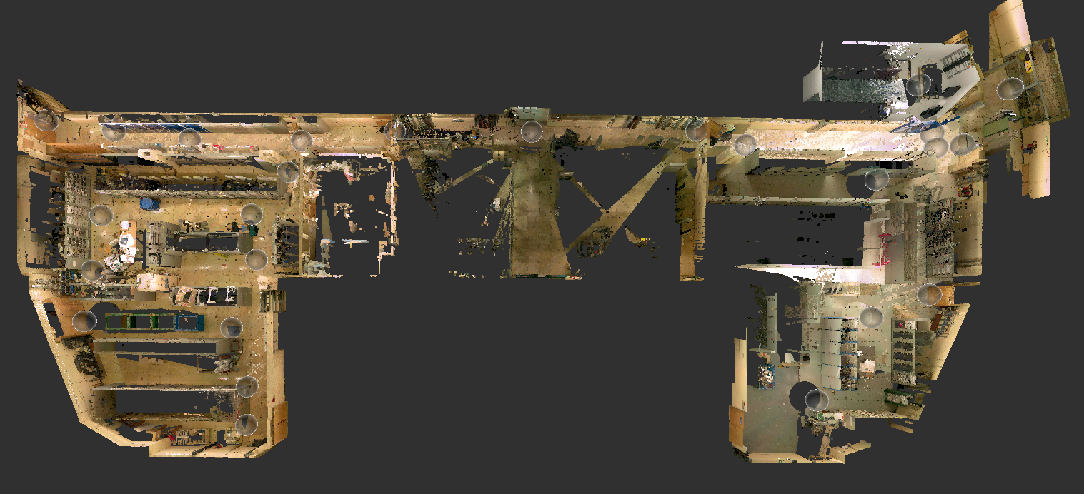
Ongoing Activities SMB-SE-DOP

Slide 6
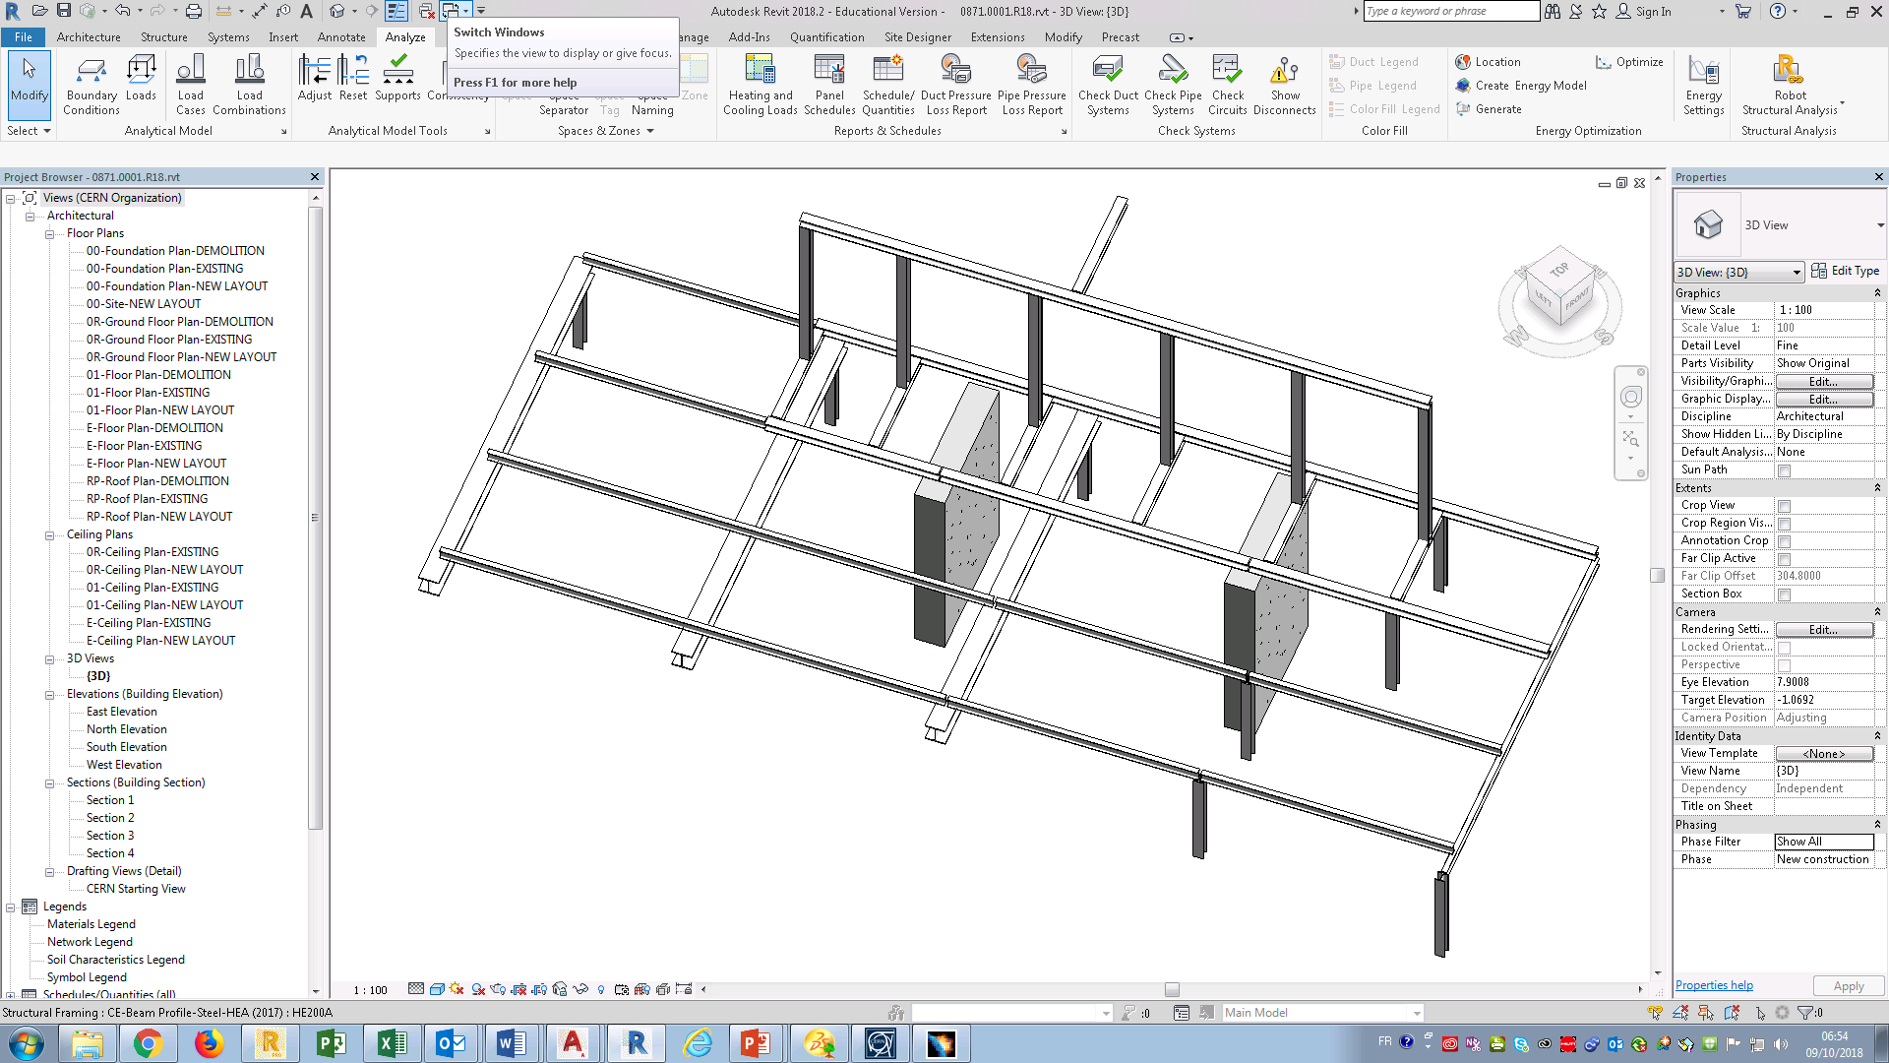
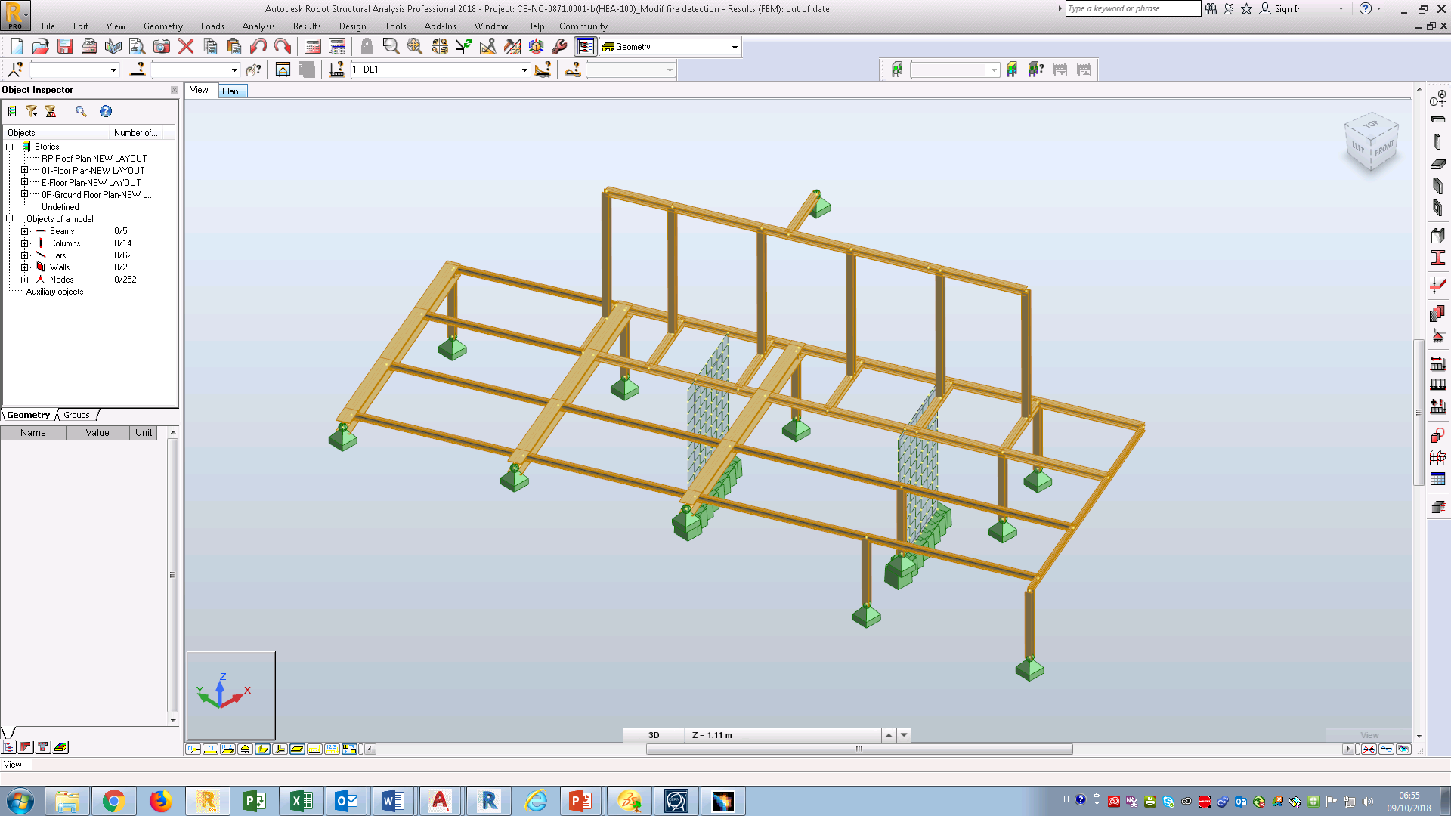
Ongoing Activities SMB-SE-DOP
  Integration with the
  Calculation software

Slide 7
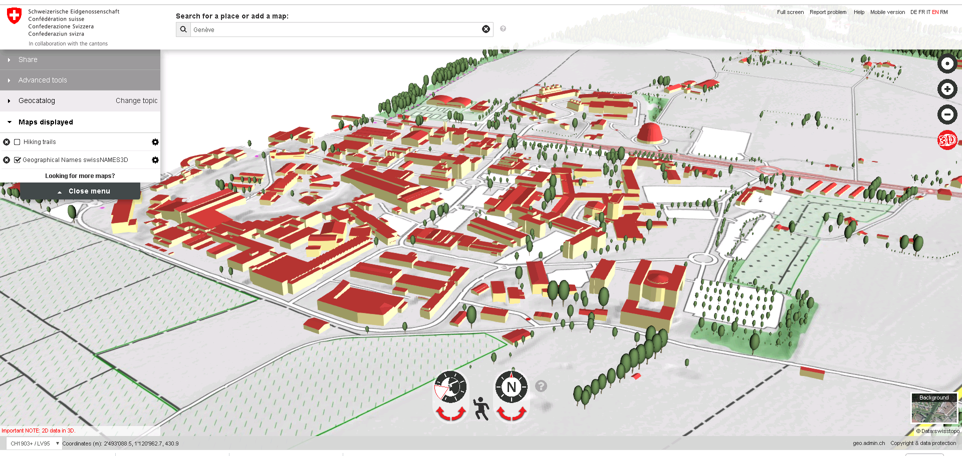
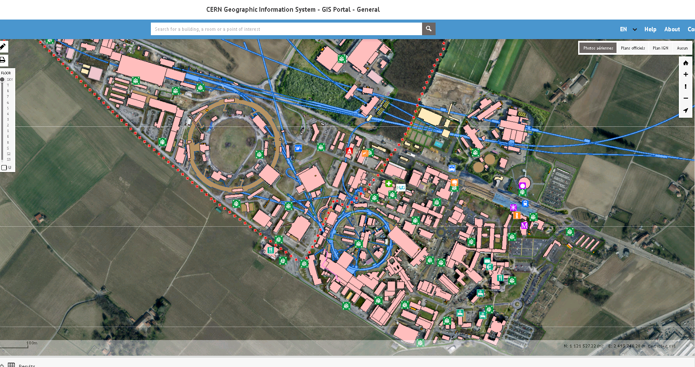
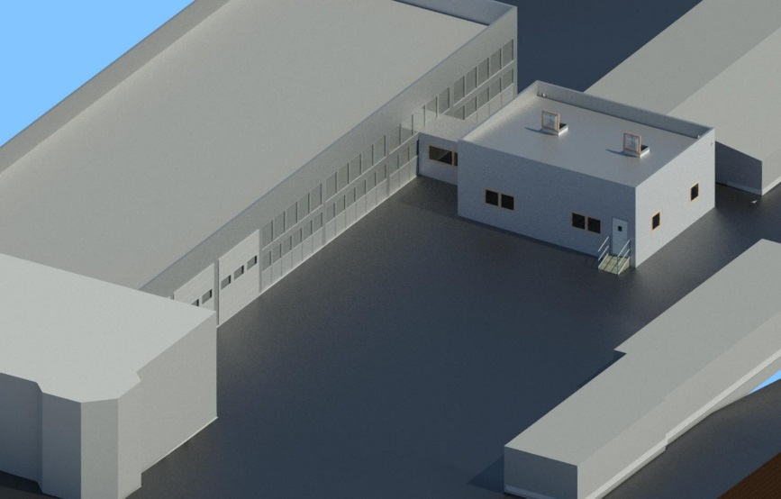
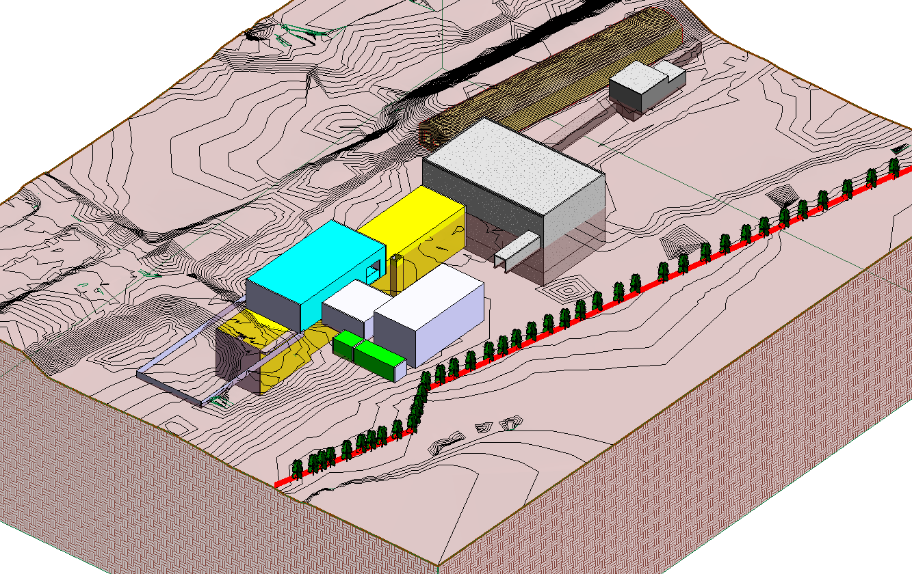
Ongoing Activities SMB-SE-DOP
  Integration with the GIS

