Slide 1
Eliminations
Clearance (CH)
TFA (FR)
Milestone planned
Period Planned
2018 S1 | 2018 S2 | 2019 S1 | 2019 S2 | 2020 S1 | 2020 S2 | 2021 S1 | 2021 S2 | 2022 S1 | 2022 S2
LS2 – RW Reception & Storage
INCA
50 m³
50 m³
50 m³
50 m³
ISR-2
ELFI – Vent. Filters
38 m³
38 m³
38 m³
SHERPA
800 m³
(+341 small magnets)
1000 m³
ISR-4
SHERPA LS2
Containment enclosure
300 m³
SHERPA
«with containment enclosure»
400 m³
110 m³
LEP vacuum chambers (Pb)
ISR-7 left
LEP (dipoles +ISR7)
«Asbestos»
after treatment SMB
ISR-2
Concrete+ rubble
ELICA LS2
400 m³
ELMA- Magnets
Not in ISR
Crane CL
Tritiated water
50 m³
100 m³
50 m³
= production

Slide 2
Storage tunnel - Periods of availability
The ISR will be available by ½ octants for one semester.
Within the semester, the floor would be available by ¼ octant.
Walls/ceiling will be available for the whole semester.
Confirmed for S1 2020
o n - g o i n g
2018 S2
2021 S1
2022 S2
2022 S1
2017 S1
2016 S2
2020 S1
2015 S2
2015 S2
Availability
ISR 2R
ISR 3L
ISR 3R
ISR 5L
ISR 5R
ISR 6L
ISR 6R
ISR 7L
ISR 7R

Slide 3
Conditions for the availability
Confirmed for S1 2020
S2 2018
S1 2021
S2 2022
S1 2022
o n - g o i n g
S1 2020
S1 2017
S2 2016
2015
2015
ISR 2R
ISR 3L
ISR 3R
ISR 5L
ISR 5R
ISR 6L
ISR6R
ISR 7L
ISR 7R
Storage of LS2 rad. Waste.
Move of
- tritiated water to B.573
- Magnets >8t to ISR 5.
- Comb. RW to B.225
Cont.enclosure by S1 2019.
Elimination of cables and combustible RW.
Move of residual combustible RW to B.225
No floor access
(shielded areas for highly rad. waste).
Storage of
not-stackable RW (pallets).
Dismantling of old shielded area.
Elimin. of
. LEP Cavities,
. Pb chamb.
. asbest. RW
HSE-RP
Conditions
B.573 refurb. by S2 2017
Contain. enclosure by S2 2018
B.225 refurb. by S1 2018
Evaporation in B.573 by end of S2 2017
B.225 refurb. with sprinkler by S1 2018 (to be discussed).
Floor waterpr. compatible with the existing sh. area.
Possibility to keep racks in place to be studied.
Floor waterproof. before sh. area extension
Asbestos facility avail. By S1 2018
SMB
Civil eng. work and HVAC
possible before S2 2022.
Waterprof. in S1 2018.
Elec., fire det., access ctrl,
waterproof. & painting in
S1 & S2 2022.
Waterpr. partially possible after ISR6 sh. extension.
Elec., IT & painting ongoing.
All other work in 2017.
HVAC in 2018.
Civil eng. work and HVAC possible before S2 2018.
Elec., fire det., access ctrl, waterproof.
painting in S2 2018.
Floor waterpr.
and all remaining
work possible in 2017.
HVAC in 2018.
Civil eng. work possible in 2017. HVAC in 2018.
CE work
possible in 2017.
HVAC in 2018.
Remaining works in S1
2020.
.
Remarks
INFRASTR.
EDMS 2037144

Slide 4
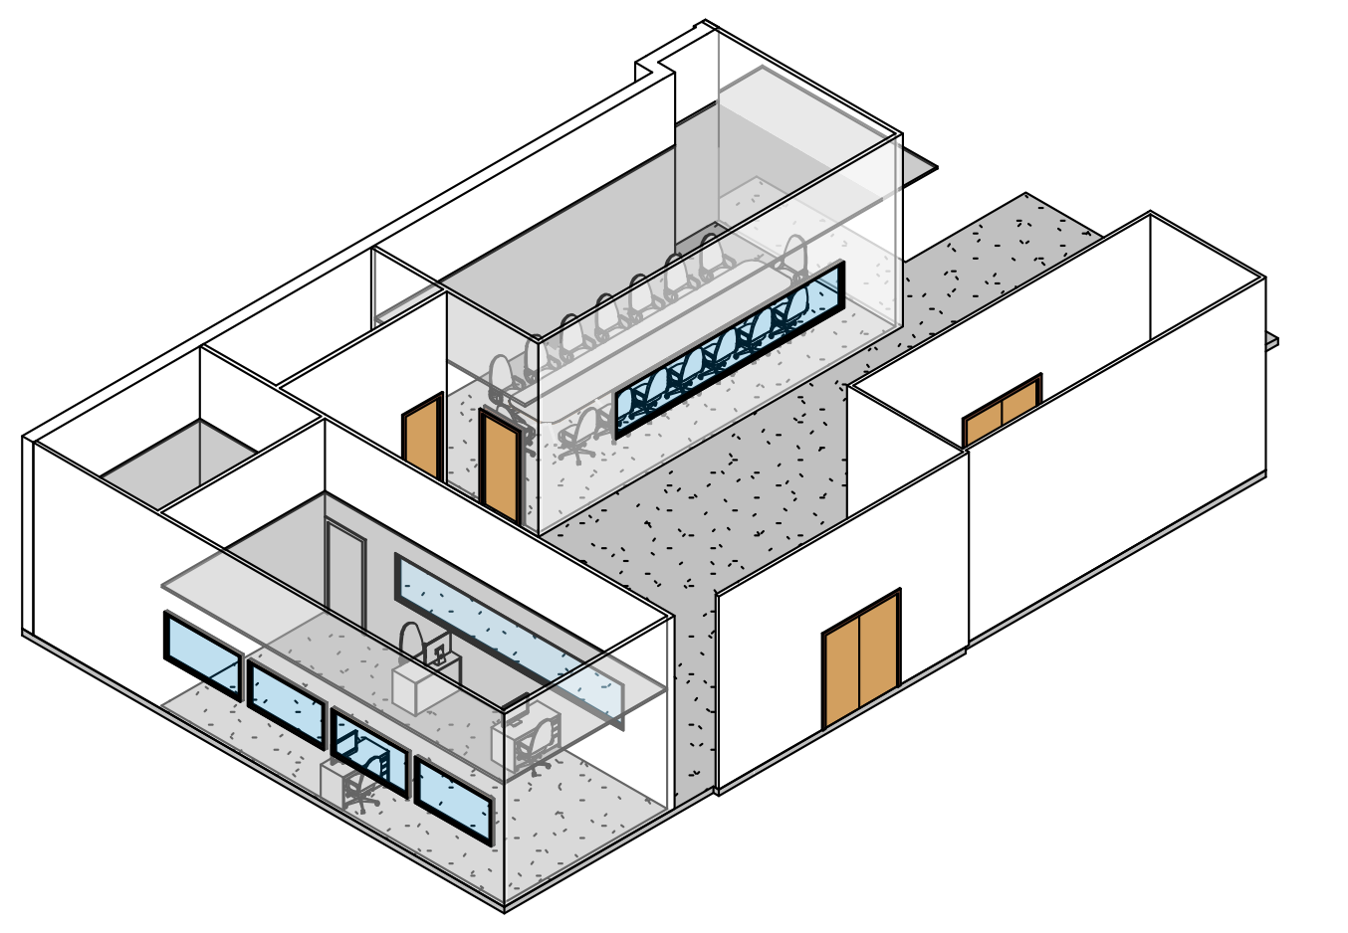
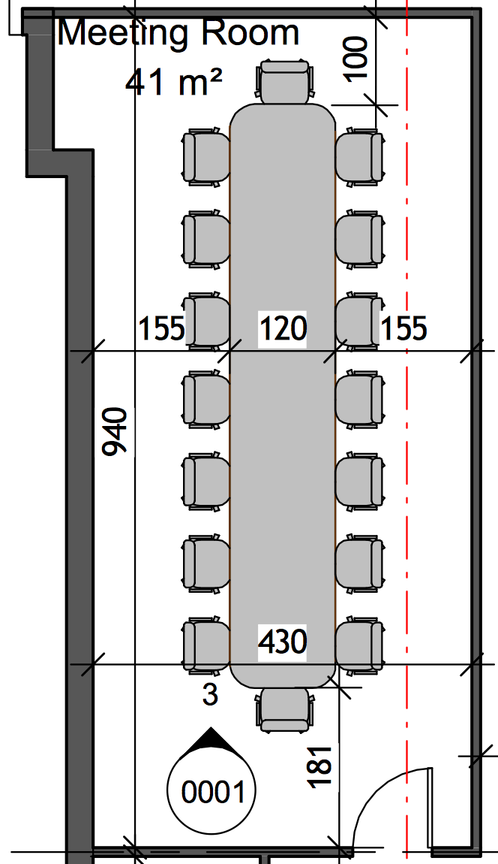
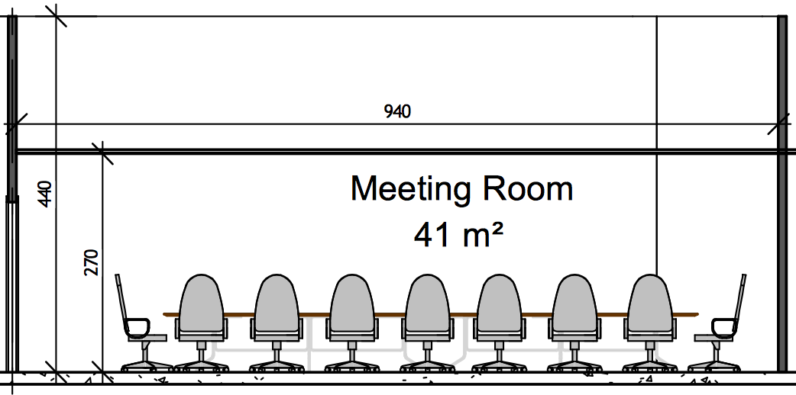
Meeting room B.184 - Overview

Slide 5
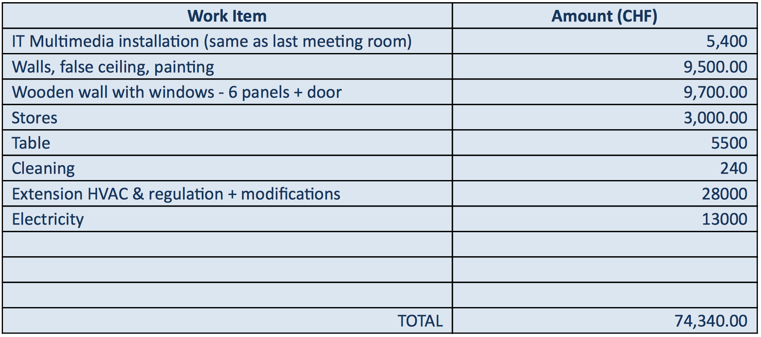
Meeting room B.184 - Costs

