Slide 1
Status and outlook of the refurbishment of BLDG.574
C. Colloca
RWTCS Steering Commitee

Slide 2
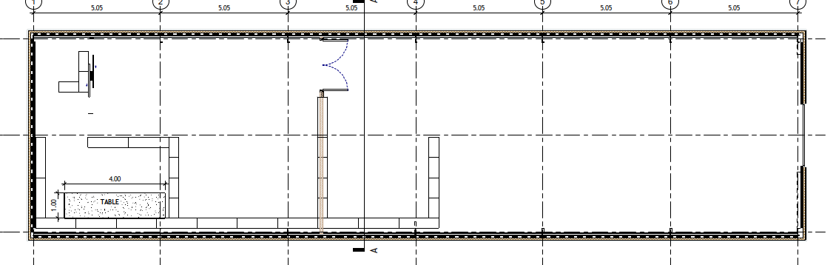
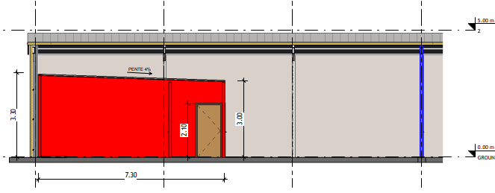
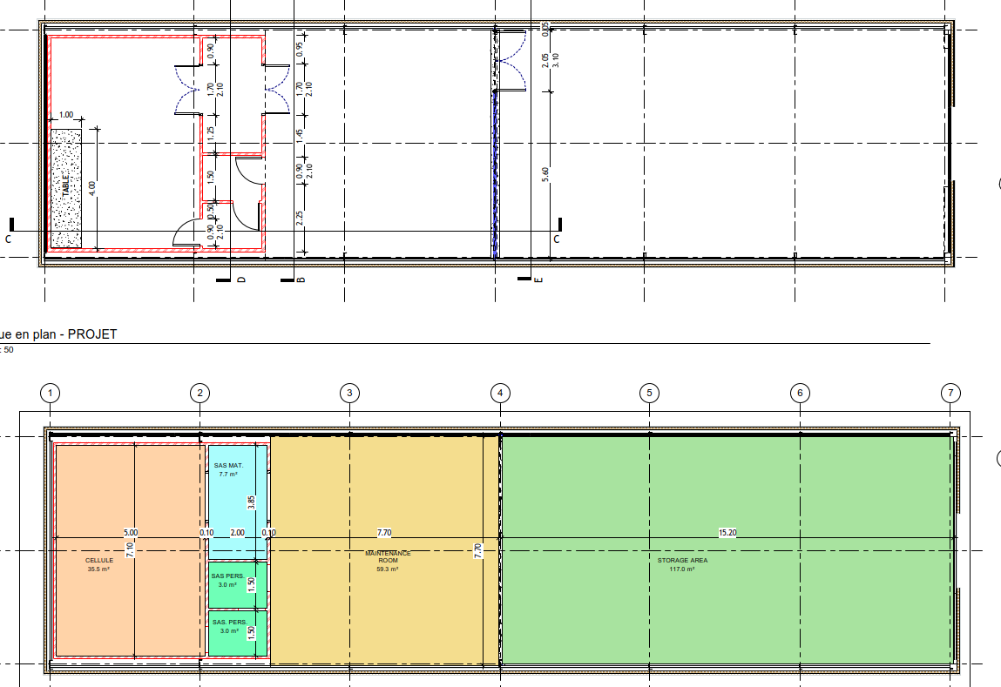
BLDG. 574 Layout
236 m2

Slide 3
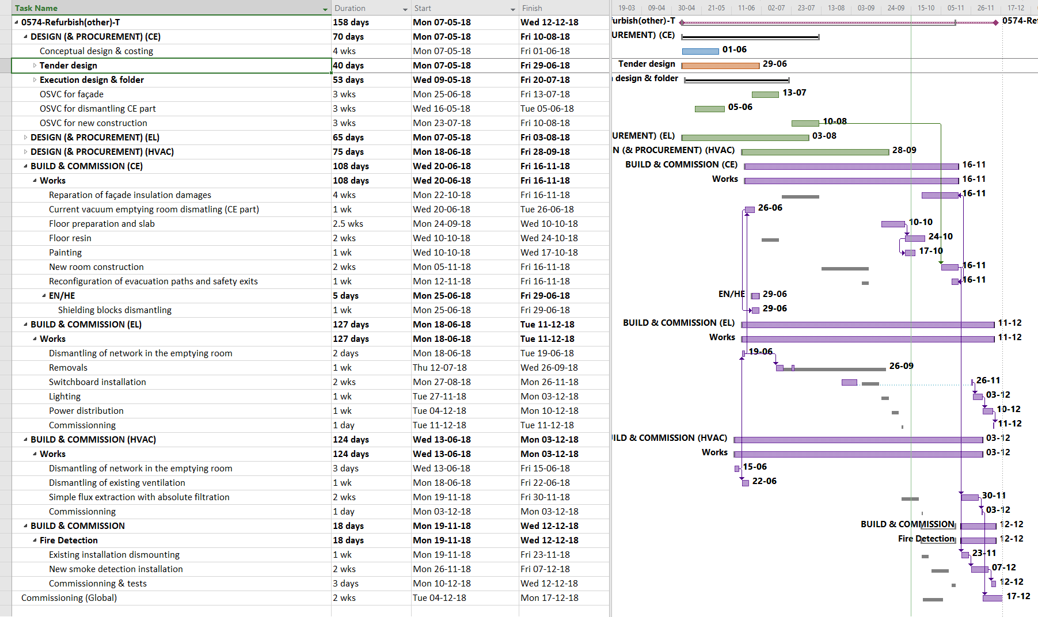
BLDG. 574 Planning

Slide 4
BLDG. 574 Cost

Slide 5
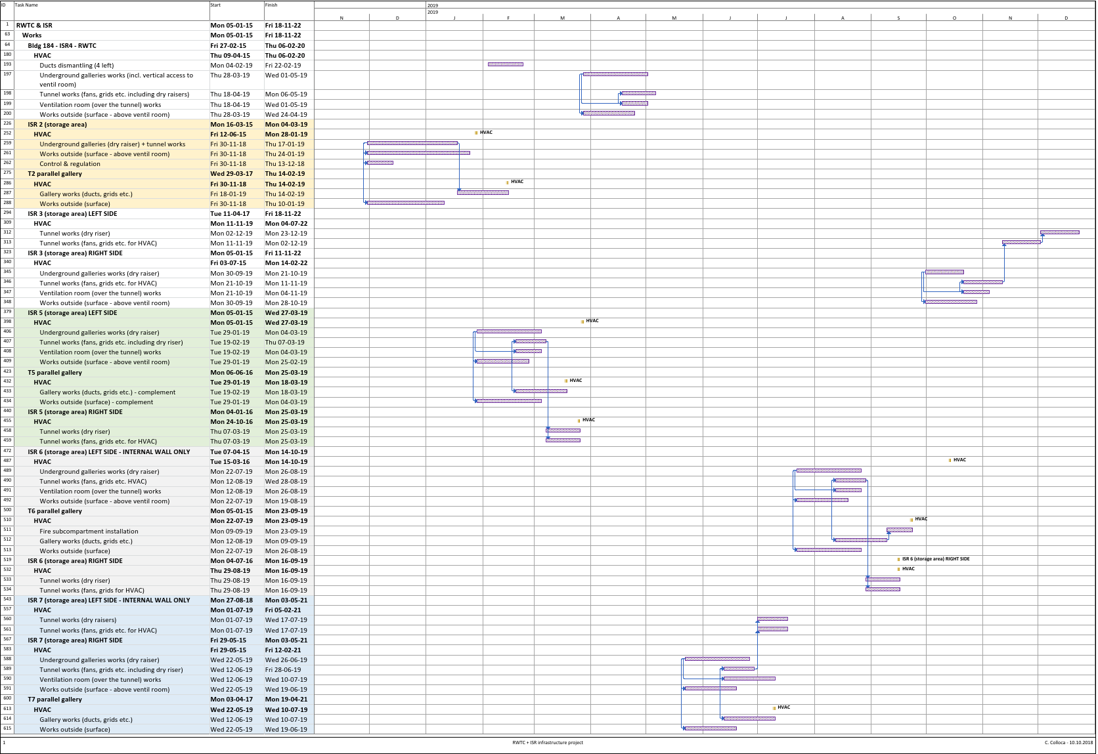
Planning of the HVAC installation

Slide 6
  Technical problems with the new installed doors :
  - max under guarantee period
  - to be ready for the future
  Difficult purchasing of new doors:
  Wrong companies?
  Heavy process?
  Dosimetry?
  Too high level of requirements (size & fire safety)?
  Non compliant material /supply - > energy wasting & shifting dates
RWTCS Steering Commitee
Supply of vent.doors & stairs

Slide 7
  Possible improvements for general safety aspects:
  - anticipation / suggestions (active presence) of HSE CO
  - re-set (or respect) SLA
  - clarify MSI (yes or no, and where)
RWTCS Steering Commitee
Contribution/collaboration with HSE-OHS

Slide 8
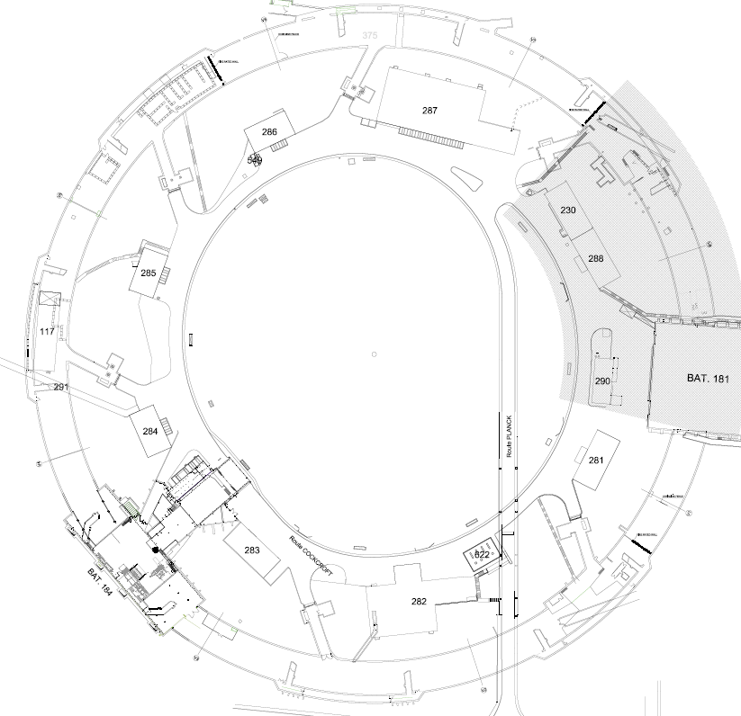
Work progress vs. expenditures
RWTCS Steering Commitee

Slide 9
INFRASTRUCTURE WORK
WORK PACKAGES | WORK PACKAGE OWNER | WORK PACKAGE TEAM
Civil engineering & building work | C. Colloca SMB/SE | L. Maricalva, R. Ortega, T. Moro SMB/SE
Electricity | J. Gomez SMB/SE | F. Vincent SMB/SE
HVAC | G. Rouge SMB/SE
Cranes & handling/lifting equipment | O. Boettcher EN/HE | Y. Seraphin EN/HE
IT networks | L. Borakiewicz IT/CS
Access control | R. Nunes BE/ICS | N. Rama BE/ICS
Fire detection | D. Raffourt BE/ICS | P. Thome BE/ICS

Slide 10
- Old electrical network dismounting ISR2
- Old telephone & IT network dismounting ISR2
- New electrical installation ISR2
- Floor sealing (hatches, underground connections & passages, holes, water channels) and local floor repairs ISR2
- Floor grids installation ISR2
- Tunnel painting (walls ceiling) ISR2
- Crane corbels repair ISR2
- Crane rail alignment ISR2
- V1 (ventilation unit) dismantling ISR1-2
- Fire wall ISR2 entrance basin & basin small wall
FINISHED WORK (MARCH – OCT 18)
ISR2 sector

Slide 11
- Fire doors finishing works ISR3, ISR4, ISR5, ISR6, ISR7
- Replacement of safety stairs ISR2, ISR4, ISR8 and exterior
FINISHED WORK (MARCH – OCT 18)
Bldg 574:
- dismounting & demolition
- plateform preparation
    - concrete slab

Slide 12
- Fire wall ISR2-ISR3
- Fire detection installation ISR2
- Rails repairs & replacement ISR2
- New meeting room bldg. 184
- Foundation & cover structures for HVAC (all sectors)
- BLDG 574:
- separation wall
On going/starting WORK

Slide 13
- Foundations & cover structures for HVAC (all sectors)
- Execution file for HVAC installation
- BLDG 547: class C cell
- BLDG 573: design finalized
- BLDG 225: waiting for HSE/OHS input
On going/starting STUDIES

Slide 14
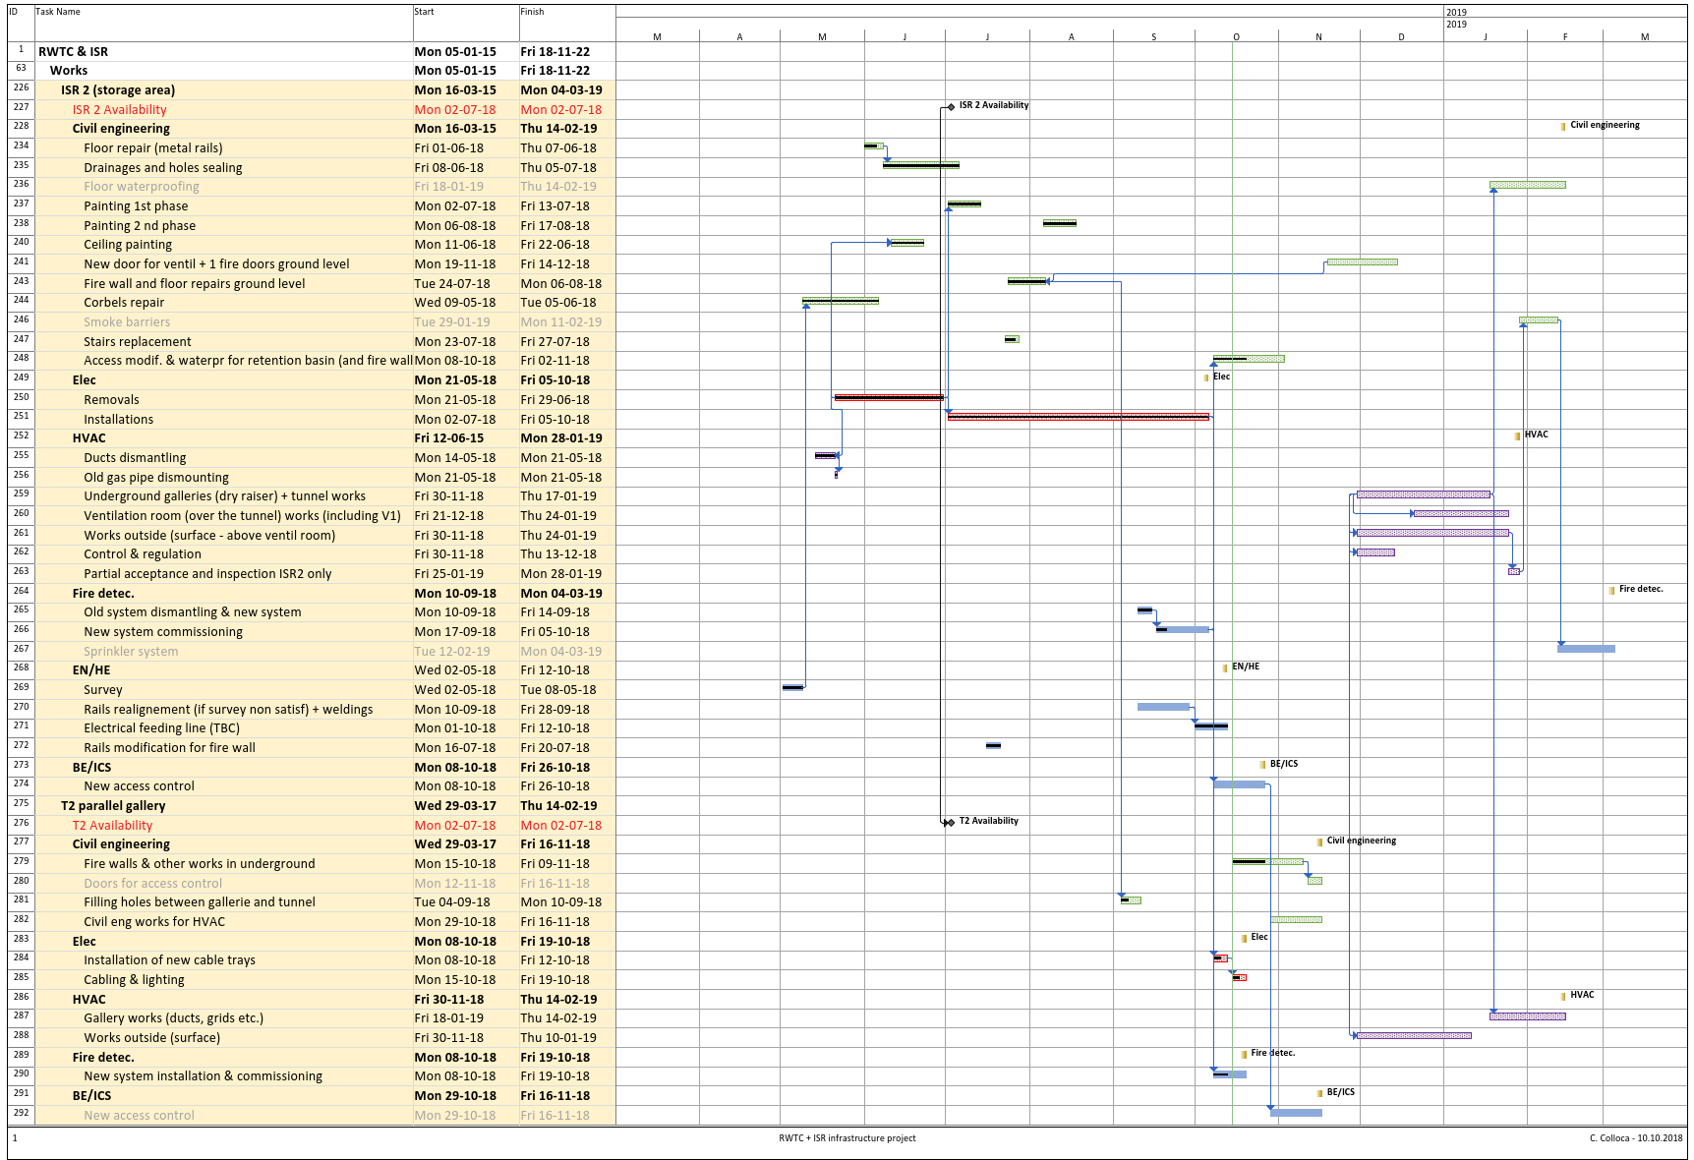
PLANNING

Slide 15
SPENDING PROFILE
EXPENDITURES (FOR TUNNEL WORK ONLY – NO SECURITY) | 2018 | 2019 | 2020 | 2021 | 2022 | 2023
GLOBAL BUDGET* (kCHF) | 890 | 2’750 | 500 | 260 | 300 | 45
TOTAL | 4’745
Includes:
New estimate for dry raisers
Finalization of civil eng. works for HVAC
Floor reparation included (out of the waterproofing)
Planning v 62
*Without ‘Access control’, ‘Human resources’

Slide 16

THANK YOU
FOR THE ATTENTION!

