Slide 2
Official Entice Meeting
Konstantinos Platis
Acintya Rao
Web redevelopment project
11-10-2018

Slide 3
Until today
D8 Migration
Creation of D8 themes
Implementation of CERN Web Components

Slide 4
Coming Up…
Webtools website (Documentation + Maintenance)
Web Team Packages
Entice Forum
Drupal Websites’ profiles
Web Team Git

Slide 5
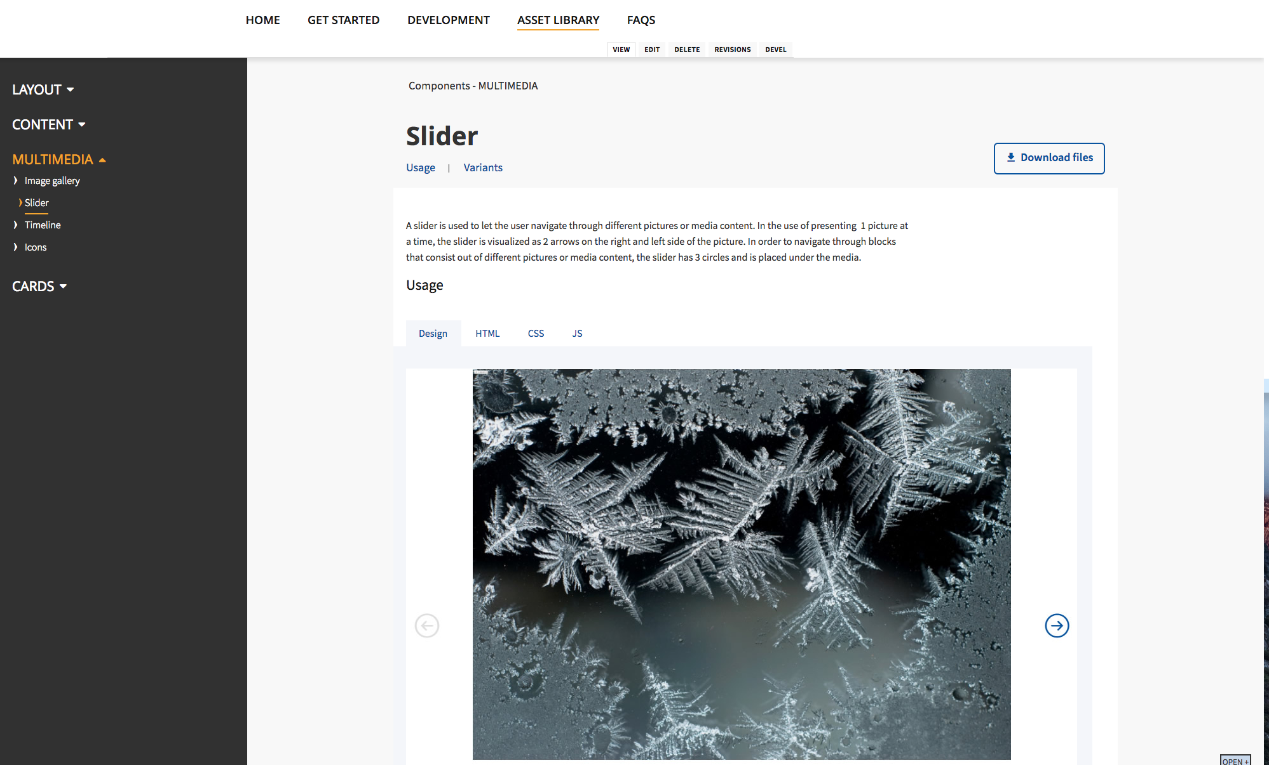
Webtools Website
Drupal Get-Started guide
Documentation
Update announcements

Slide 6
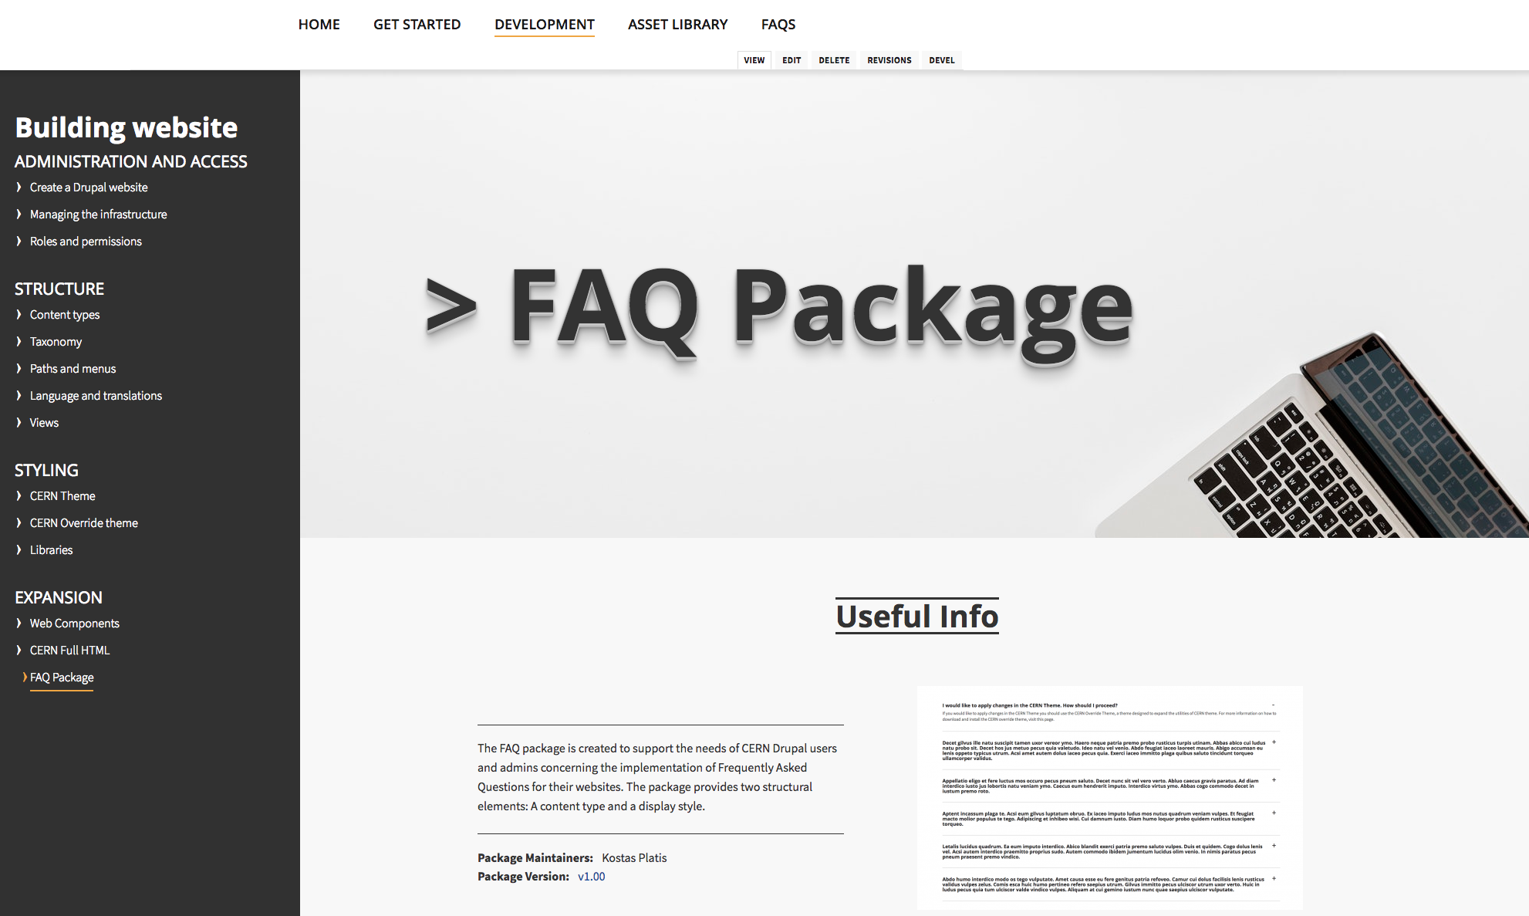
Web Team Packages
Out-of-the box CTs
Encapsulated in modules
Predefined render types

Slide 7
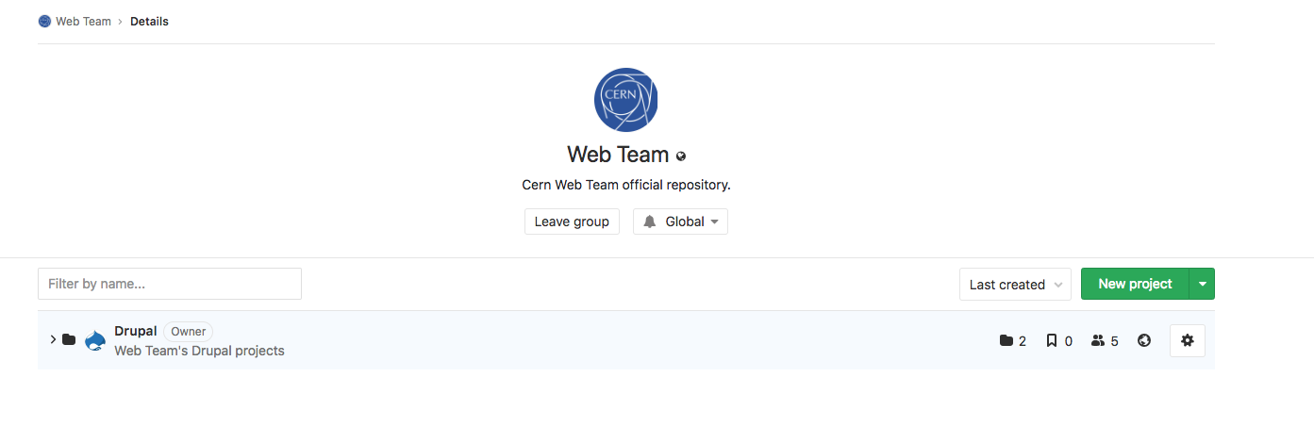
New WT Gitlab
https://gitlab.cern.ch/web-team
Drupal D7/D8 modules
CERN Override theme
it-dep-entice e-group for access

Slide 8
D8 profiles
Predefined profiles for Drupal websites

Slide 9
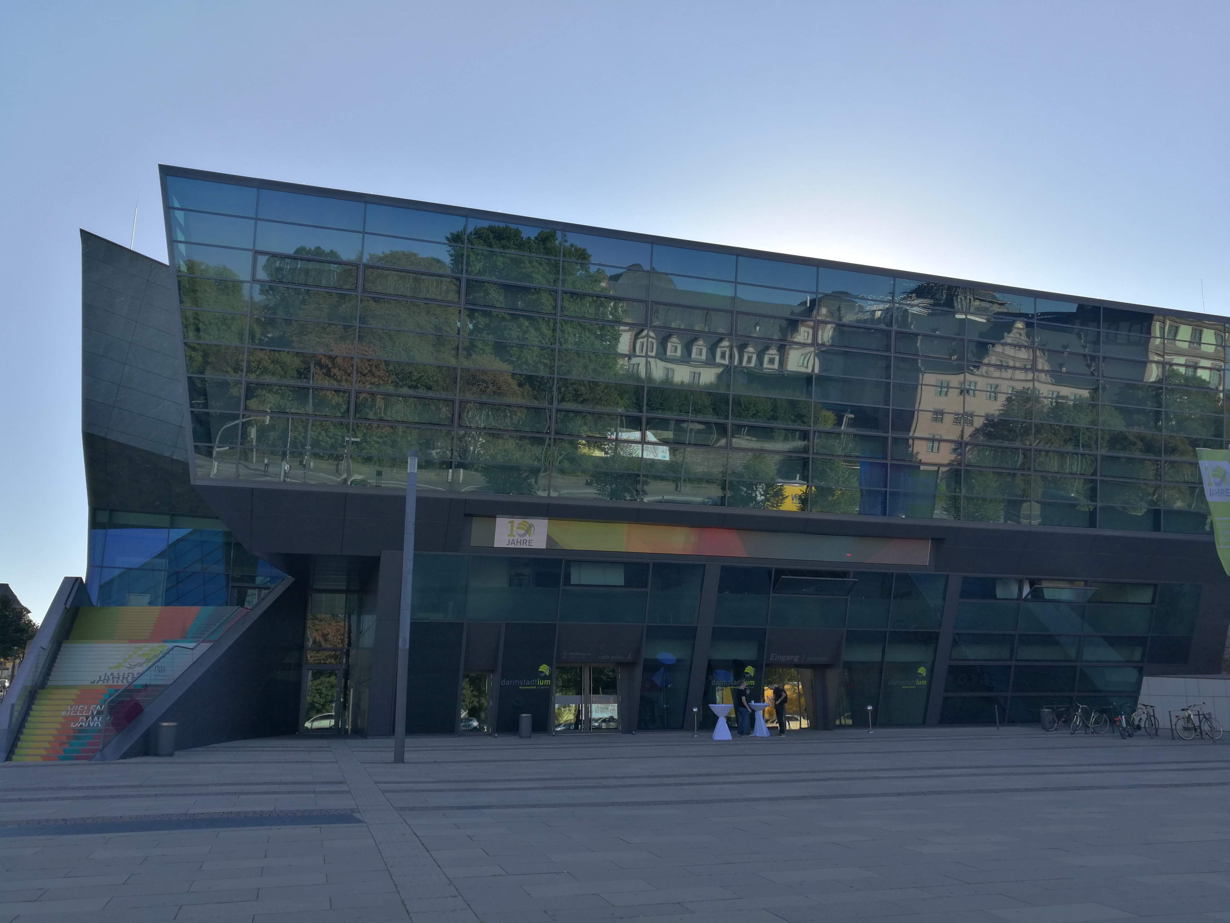
Drupal Europe 2018 (Darmstadt)
Decoupled Drupal
Single Page Apps
Rules
Editor experience when using paragraphs

Slide 10
Thank you!
Q&A

