Slide 1


Controllable Critical Current Degradation of ReBCO CC by Post-Manufacturing Deoxygenation
Griffin Bradford, Xinbo (Paul) Hu, D. Abraimov, D.C. Larbalestier
Many thanks for discussions with Tom Painter who has pursued similar ideas and to Bill Starch for essential laboratory support
A portion of this work was performed at the National High Magnetic Field Laboratory which is supported by NSF cooperative agreement DMR-1644779 and the State of Florida.
Notes:
Note for Slide:

Slide 2
Outline
Motivations for controllable degradation of coated conductors
Methods
Results
Implications for future magnet designs
Notes:
Note for Slide:

Slide 3
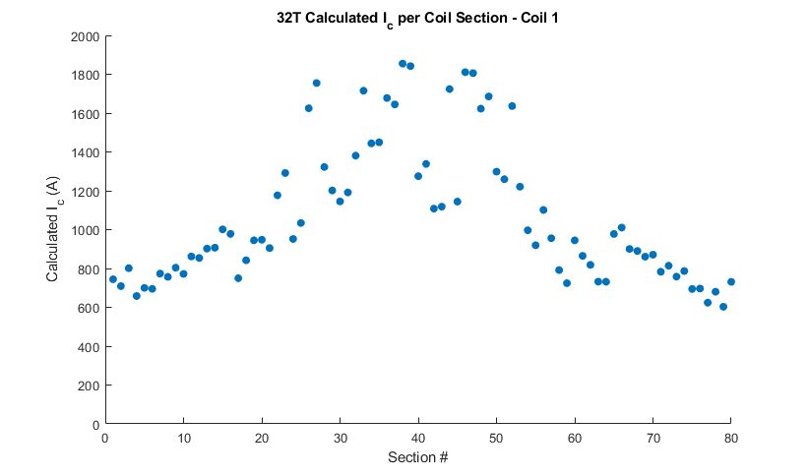
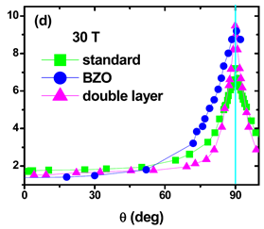
The large anisotropy of REBCO makes many regions of a solenoid far too stable (Weijers: 32 T experience)
REBCO solenoids quench in the end windings where I_{c} ~20% of central windings due to the large I_{c} anisotropy
~35-40 K margin
(T_{cs} = 40-45 K)
~ 25-30 K margin
256 A = ~10 K margin
174 A = 0 K margin
Operating current
Angular Dependence of ReBCO at 30T
In 32 T, I_{c} for central pancakes was up to 1800 A when the end pancakes had I_{c} ~700 A and I_{operating} was 174 A
Notes:
Note for Slide:

Slide 4
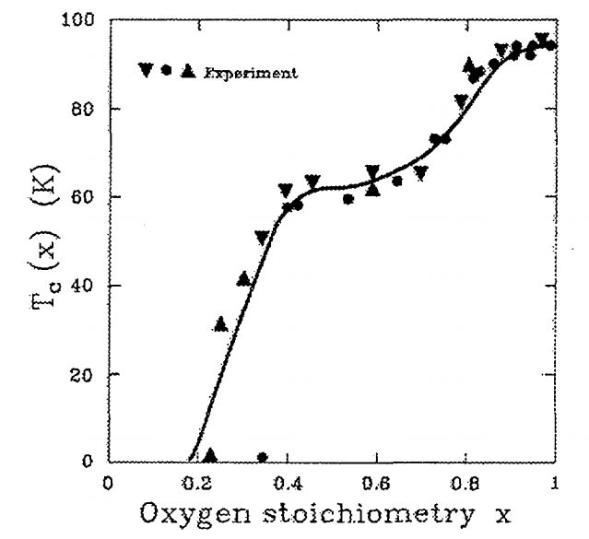
How best to address highly a variable stability margin?
O_{6.9}: T_{c} 92K
Mix and match conductors from various companies with natural variation of I_{c}
Ask one or more particular conductor manufacturers to deliver low I_{c}, not just high I_{c} conductors?
Develop a post-delivery HT to controllably degrade the I_{c} so that conductor bought to one specification can be repurposed as best needed
O_{6.5} T_{c} ~ 60 K
Structural and Superconducting Properties of High-Tc Superconductors, 1999, Page 25, https://inis.iaea.org/collection/NCLCollectionStore/_Public/31/009/31009747.pdf
Notes:
Note for slide: Easiest way to degrade I_c is by degrading T_c by withdrawing O from Cu-O chain sites
Note for slide: Removing oxygen and degrading Tc and thus Ic is our chosen route

Slide 5
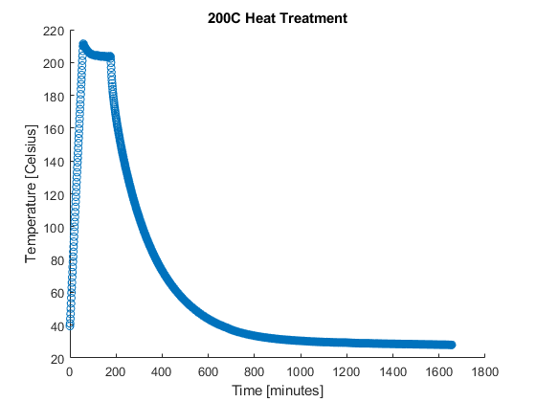
Methodology
We chose 32 T REBCO tapes made by SuperPower with thick Cu (50 μm on each side)
HT in Ar to avoid surface oxidation in range 200-240 C to be compatible with subsequent solder treatments
Measured T_{c}, I_{c} (77 K(SF) and 4.2 K (15 T)
Typical Heat Treatment Profile
Heat Treatment Profile
Treatments done in batch mode with 0.2 m long samples
Notes:
Note for Slide:

Slide 6
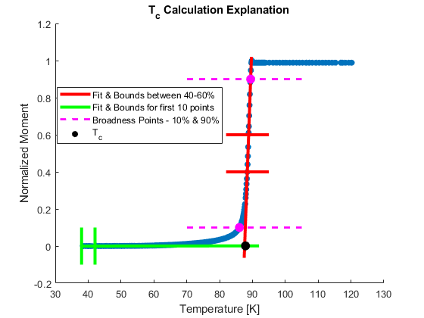
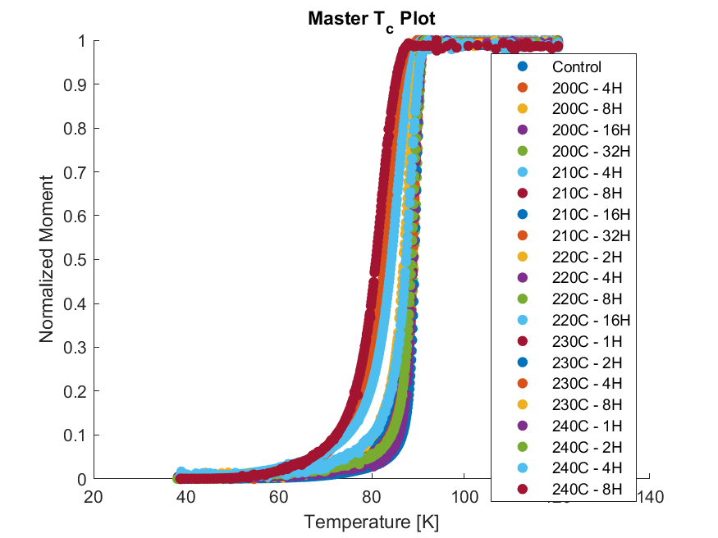
T_{c} can be reproducibly degraded but is not yet uniform, especially for longer HT
T_{c} fitting done by:
  Linear Fit between 40% & 60% of maximum moment
  Linear Fit of first 10 points
  Intersection of these fits at 0 and 1
  Breadth defined as ΔT at 10% & 90% of maximum moment
Longer and higher temperatures give broader transitions
Lowest T_{c} reached was ~72 K, with a spread of ~13 K
  Still retained an I_{c} of 14 A at 77K (SF), originally was 119 A
  Originally, T_{c} was ~86 K with a spread of ~3 K
Greater deoxygenation
T_{c} Changes with Treatments
Notes:
Note for Slide: Ar treatment can predictably lower Tc, cannot equilibrate given zero partial oxygen pressure in environment, leaves behind a distribution of T_c (see breadth) and I_c(see T_c~72K but still SC)
Note for Slide: Fitting method gives T_c < 90K, people would find it unexpected, just explain that it is due to your fitting method, make comment that T_C is usually ~90

Slide 7
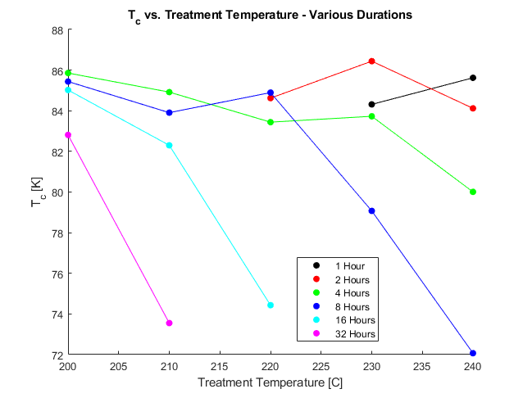
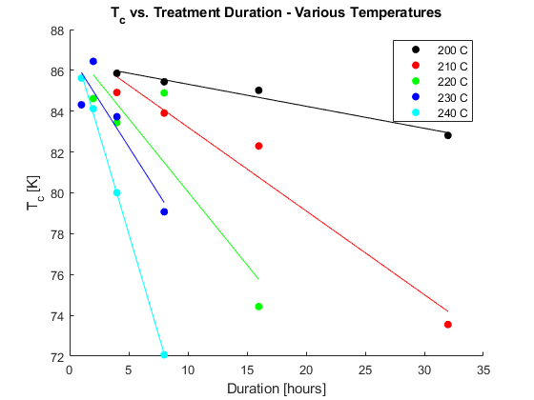
T_{c} is degraded controllably by HT at 200-240 C
1 hour
2 hours
200 C
4 hours
230 C
220 C
210 C
8 hours
32 hours
16 hours
240 C
Notes:
Note for Slide:

Slide 8
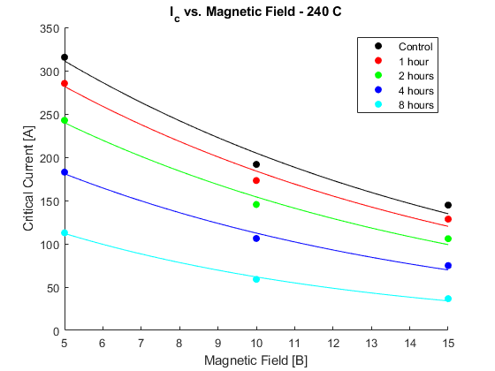
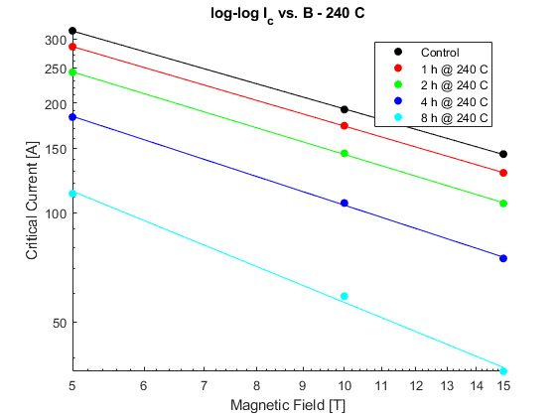
After deoxygenation I_{c}(H,4K, H‖c) was systematically degraded
α = 0.7106
α = 0.7255
Control
α = 0.7530
1 h
2 h
α = 0.8104
4 h
8 h
α = 1.014
4.2 K, 15 T | Control | 8 h @ 200 C | 8 h @ 210 C | 8 h @ 220 C | 8 h @ 230 C | 8 h @ 240 C
I_{c} | 145 A | 125 A | 111 A | 87 A | 65 A | 37 A
α | 0.7106 | 0.7244 | 0.7446 | 0.7796 | 0.8311 | 1.014
Notes:
Note for Slide:

Slide 9
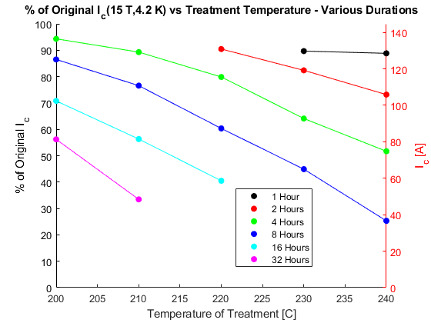
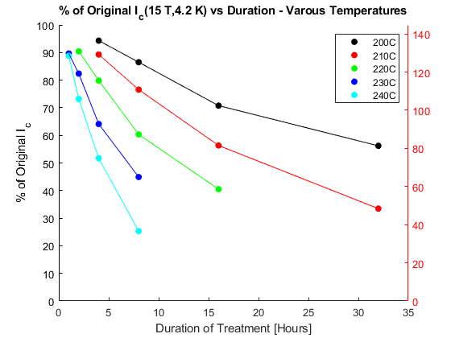
I_{c}(4.2 K,15 T) can be reduced to 25% very easily
1 hour
2 hours
200 C
4 hours
210 C
230 C
16 hours
220 C
32 hours
8 hours
240 C
I_{c} (4.2K,15T) originally was 145 A
8H @ 240C ➔ I_{c} = 36 A, 80% decrease!

Slide 10
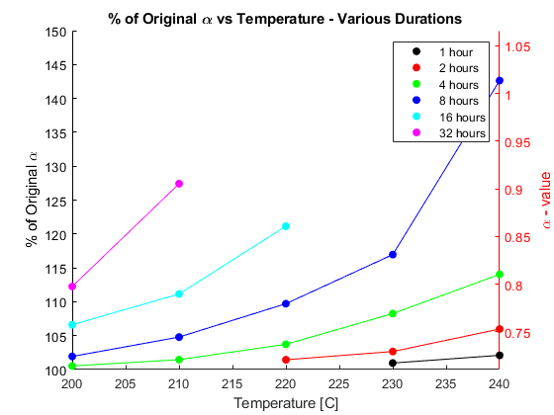
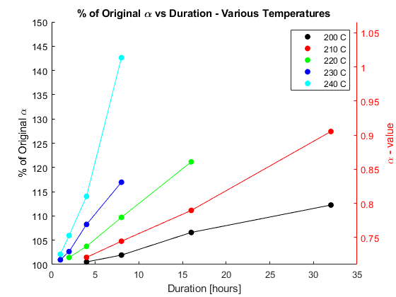
α Increases with Longer and Hotter Treatments
Original α = 0.7106
240 C
32 hours
8 hours
16 hours
220 C
230 C
210 C
4 hours
2 hours
200 C
1 hour
Notes:
Note for Slide: Alpha changing in 4.2K show contributions from O pin defects and nano-pin defects, 77K would only show nano-pin defects as O defects are thermally disordered at 77K. David: Not clear to me now what the 77 K is pointing to – I cannot believe the BZO NR have changed – but their effect certainly has changed
Note for Slide: A large alpha means rapid loss of Jc(H) due progressively weaker vortex pinning – this is thus a direct and important conclusion of your work. The implication of the 77 K changes is that the loss is NOT just due to point pinning loss but also to BZO NR loss too – this is interesting. I do not understand it and it deserves more study.

Slide 11
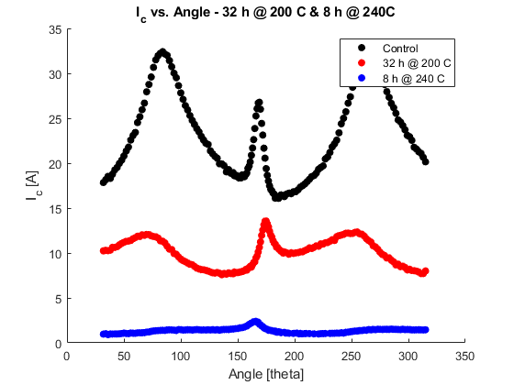
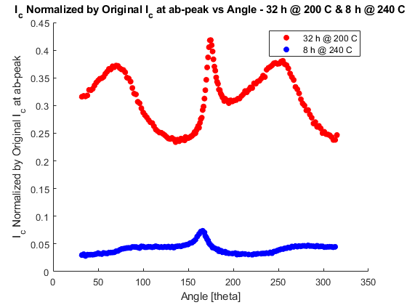
Deoxygenation causes marked vortex pinning changes: 77 K, 1 T
Untreated
32 h @ 200C
32 h @ 200C
8 h @ 240C
8 h @ 240C
Notes:
Note for Slide: you can say that TEM is planned but we do not expect the BZO-NR to have disappeared. We do know that the O-defect landscape has changed greatly as a result of pulling out O and also that Hc has dropped significantly so changing the pinning landscape significantly
Note for Slide: There is a marked loss of the c-axis pinning peak normally associated with alignment of vortices with the BaZrO₃ nanorods (BZO-NR)

Slide 12
YateStar: Degradation of properties over 50 cm seems to be quite uniform
Hall Array Plot of I_{c}(x,y) of tape subjected to 2H @ 250C
Initial defects are not exacerbated but do remain
c-axis I_{c}(77K,0.6T) is more affected than ab- plane I_{c}
Notes:
Note from David: I find the 2nd bullet to be very interesting. I think that c-axis of BZO is about 7% more than optimally doped YBCO – c-axis INCREASES as O is taken out, reducing the mismatch – can you find out by how much? The intriguing possibility s that point defect distribution changes after more O is withdrawn – also that the thermodynamic Hc goes down strongly, reducing the pinning potential scale (0.5 muzeroHcsquared)

Slide 13
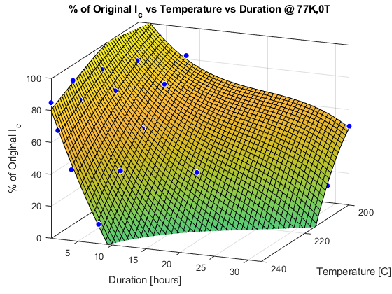
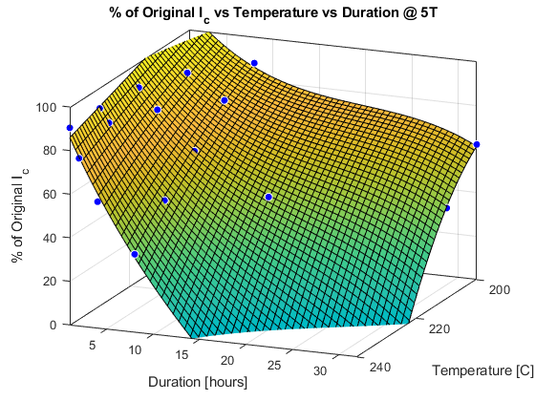
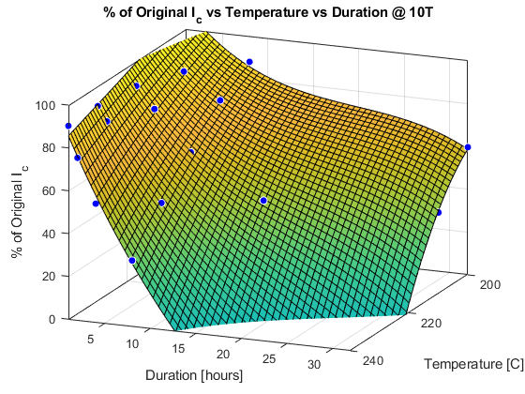
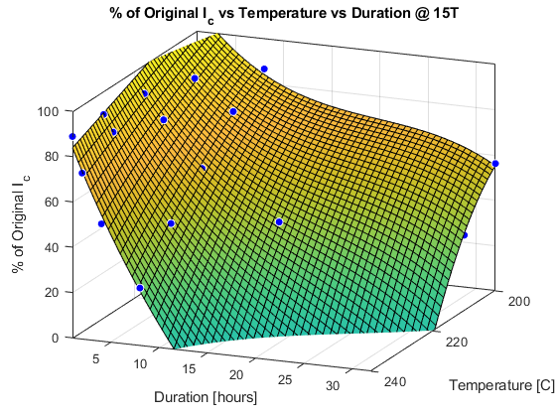
I_{c} Surface Plots show smooth, progressive nature of the changes
I_{c} (4.2K,15T) originally was 145 A
8H @ 240C ➔ I_{c} = 36 A, 80% decrease!
% of Original I_{c} vs B shows near linear dependence on B
Notes:
Note for Slide:

Slide 14
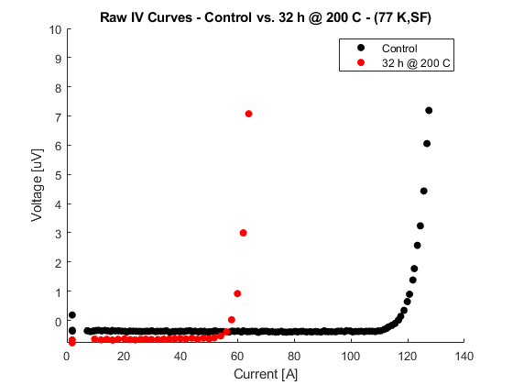
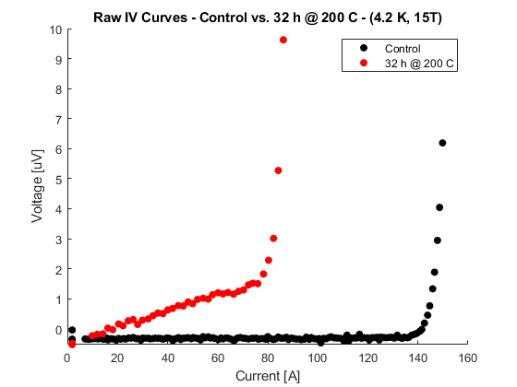
Observed Current Transfer Resistance @ 4K
No resistance seen at 77 K but all thick Cu 32 T samples showed it at 4.2 K
A thin Cu samples did NOT show R – so what?
  We presently interpret this as being caused by a more resistive REBCO-Ag interface.
  We do not believe this is inherent and it may even be useful in enhancing the quench propagation velocity
Levin, G A, et al. “The Effects of Superconductor–Stabilizer Interfacial Resistance on the Quench of a Current-Carrying Coated Conductor.” Superconductor Science and Technology, vol. 23, no. 1, 2009, p. 014021., doi:10.1088/0953-2048/23/1/014021.
Notes:
Note for Slide:

Slide 15
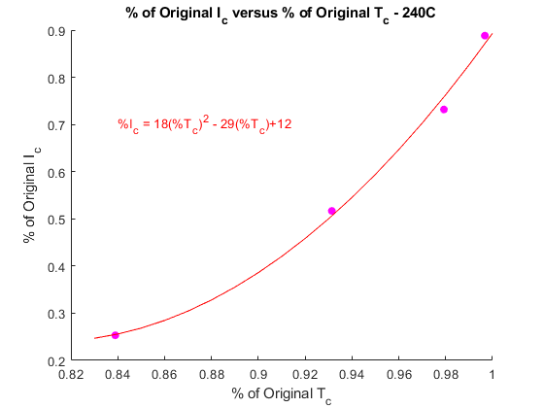
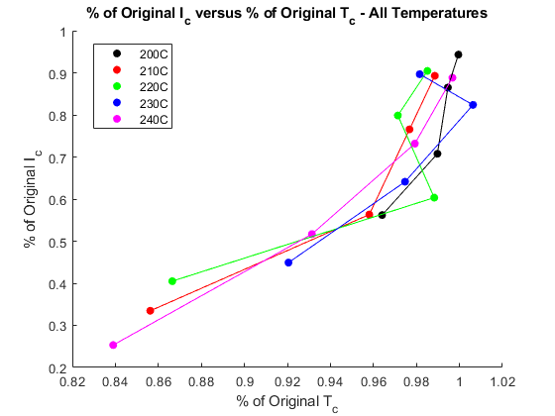
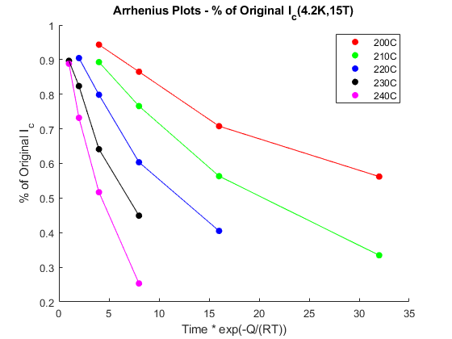
I_{c} loss is clearly by outward diffusion of oxygen
I_{c} loss is pretty well predicted by an Arrhenius plot with Q = 0.9 eV/atom
I_{c} loss correlates well to T_{c} loss
Notes:
Note for slide:

Slide 16
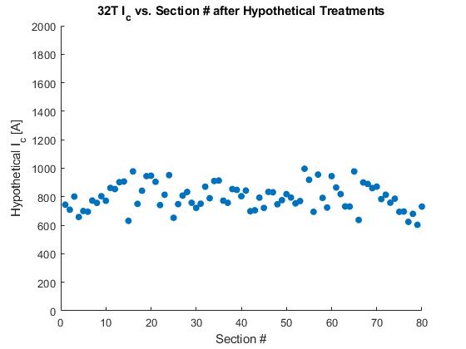
So what? 32 T could have had a uniform I_{c} across all pancakes, simplifying quench protection
With this method, a controllable degradation treatment for a given tape can be developed, allowing for I_{c} reduction in various parts of a magnet
The increased resistance could prove to be beneficial
More control over ReBCO in possession, not limited to its manufactured I_{c}
Simple and easily reproducible
Suppose we treat at 200 C for 36 hours
And treat this at 200 C for 30 hours
Standard Deviation of I_{c} ~ 354 A
Standard Deviation of I_{c} ~ 92 A
Notes:
Note for Slide:

Slide 17
Additional Thanks
Huub Weijers for the helpful plots of the 32T
All ASC members and graduate students for all their support
Notes:
Note for Slide:

Slide 18
END
Notes:
Note for Slide:

Slide 19
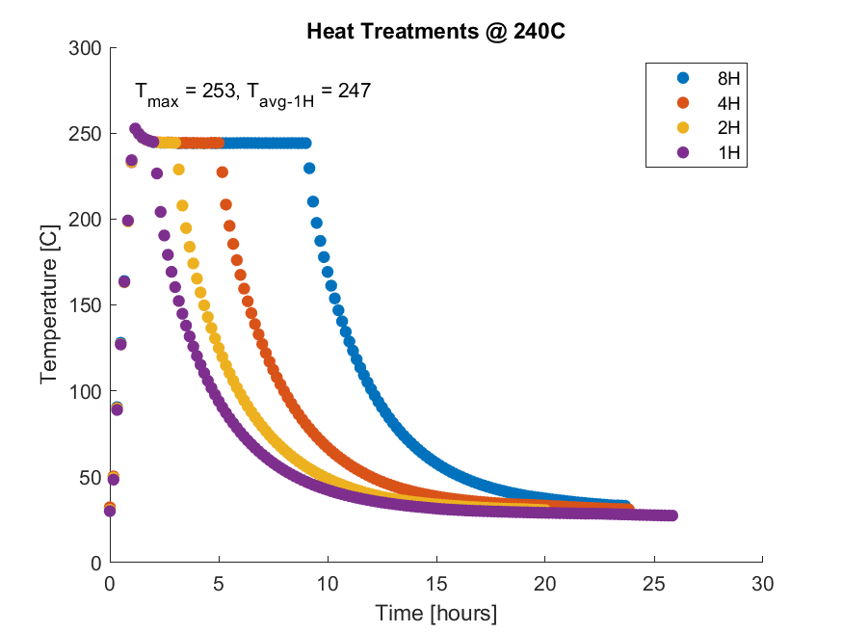
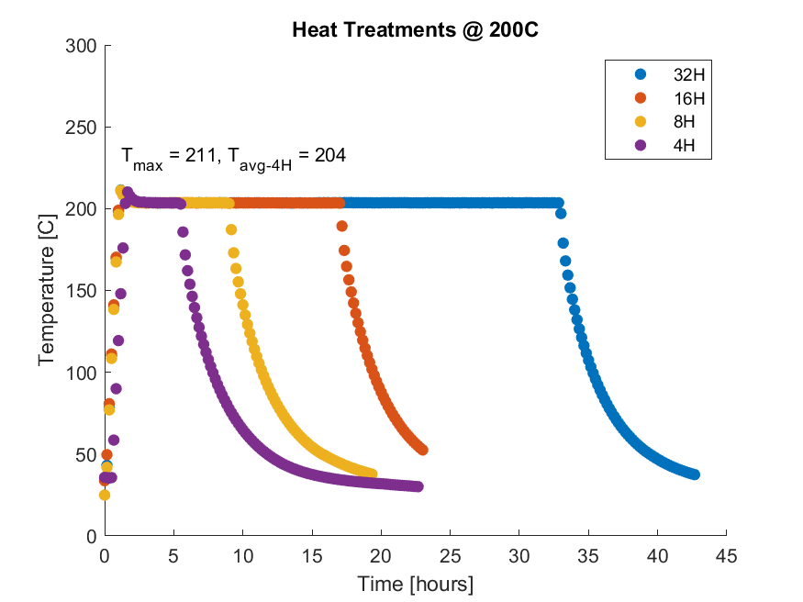
20 Samples with varying HT from 4 h/200 C to 8h/240 C
20 samples were treated:
  4,8,16,32 h @ 200 C
  4,8,16,32 h @ 210 C
  2,4,8,16 h @ 220 C
  1,2,4,8 h @ 230 C
  1,2,4,8 h @ 240 C
  All vacuum-pumped, backfilled with Argon, and treated in flowing Argon
Temperature reached in ~ 1 hour
  All treatments follow this profile
  Allowed to cool-down to ~30 C in Argon before removing from furnace
All samples had T_{c} and I_{c} characterization
Treatment Profiles – 240 C
Treatment Profiles – 200 C
Notes:
Note for Slide:

Slide 20
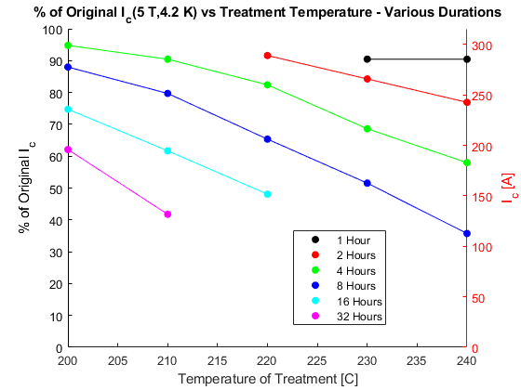
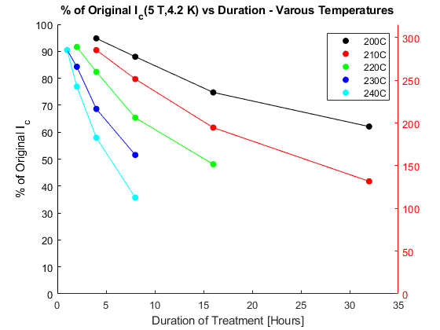
I_{c}(4.2 K,5 T) versus Temperature and Duration

Slide 21
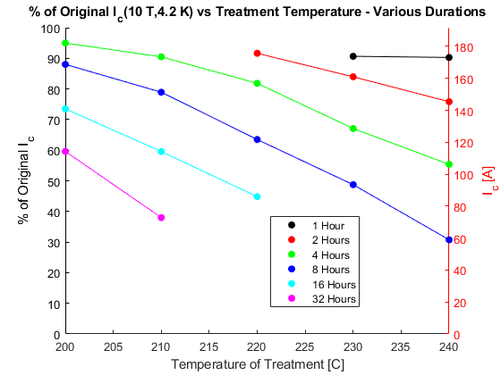
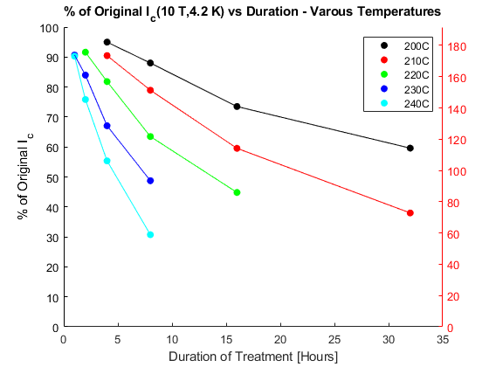
I_{c}(4.2 K,10 T) versus Temperature and Duration

