Slide 1
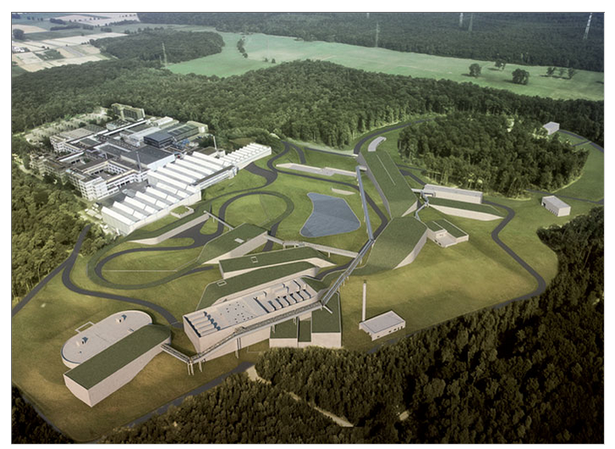
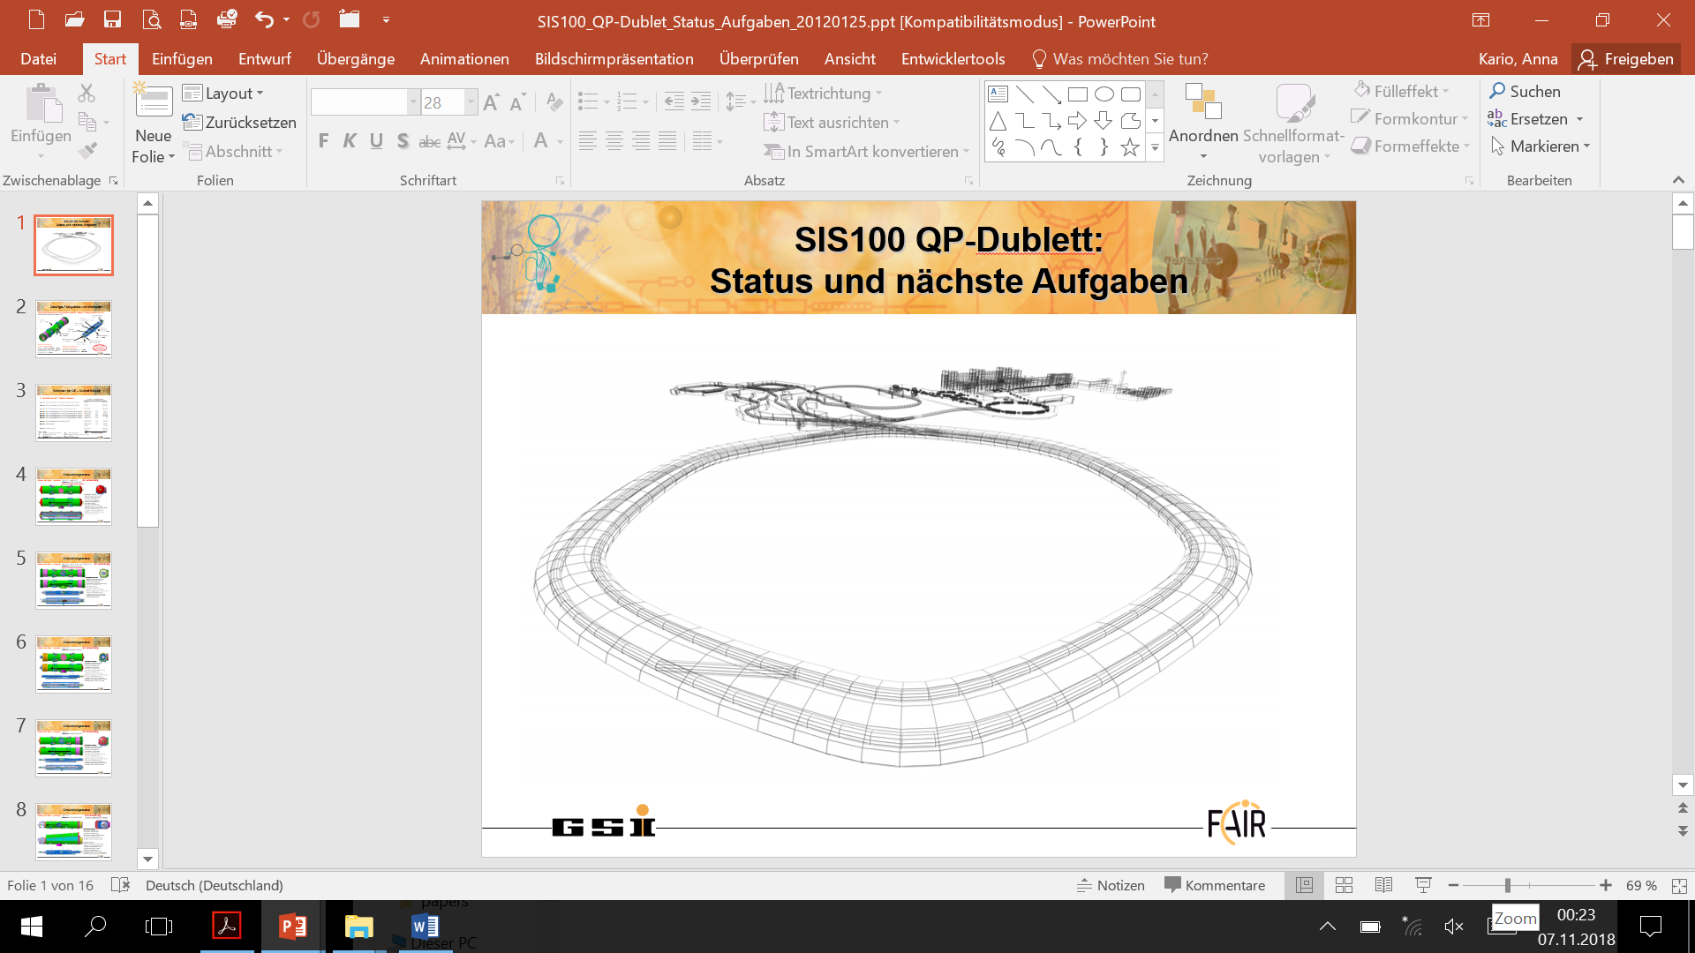
FAIR’s first SIS 100 Accelerator Quadrupole Doublet Module – Manufacturing update and Test
Anna Kario,
A. Szwangruber, A. Bleile, K. Sugita, J.P. Meier, J. Ketter,
A. Waldt, E. Fischer, C. Roux, P. Spiller, S. Lindner,
R. Blümel, T. Winkler, J. Macavei, F. Garnica-Buenaver,
T. Eberl, L. Bozyk, P. Kowina, S. Wilfert, I. Pongrac,
H. Kollmus, C. Schroeder, B. Streicher @ GSI
M. Breitenbach, J. Amend, A. Kramer, S. Curelli, K. Heyn
@ Bilfinger Noell

Slide 2
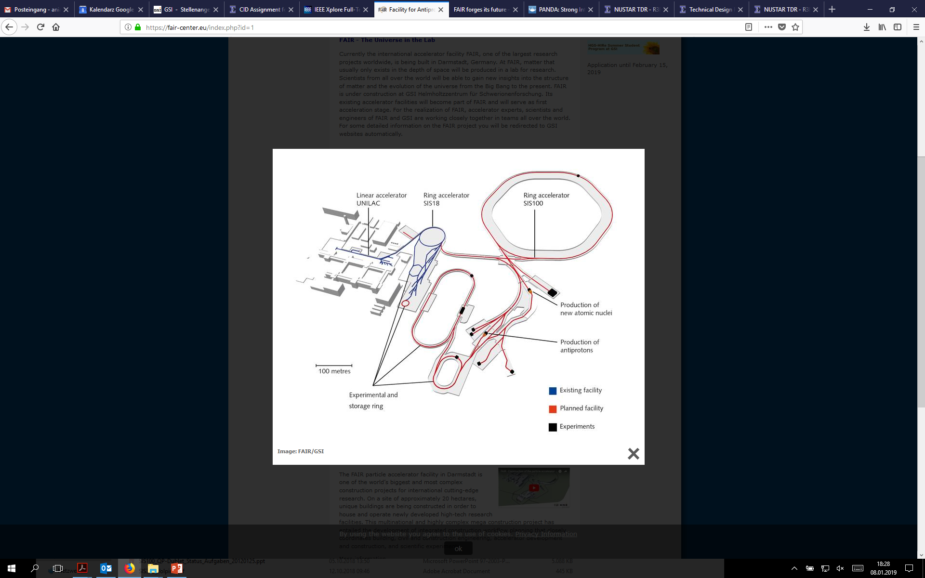
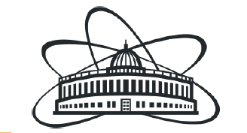
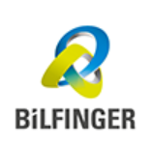

Superconductivity at FAIR - Facility for Antiproton and Ion Research
108 dipoles
303 quadrupoles, sextupole and corrector magnets assembled with UHV and beam diagnostic into Quadrupole Doublet Modules
CBM
JINR Dubna:
quadrupole and corrector magnets production and testing
Bilfinger Noell:
integration of magnet units, UHV system and beam diagnostic into QDM
INFN Salerno:
QDM testing
PANDA
APPA
4 quadrupoles
HESR
SuperFRS
CR
R³B-GLAD
NuSTAR

Slide 3
SIS100 Quadruple Doublet Module configurations
Straight section modules
  types 2.123 and 2.13s
  17 modules
  Stand-alone module
  types are in between two
  warm sections
  Cryogenic supply through
  attached by-pass line
Arc section modules
  types 2.5 to 2.9D
  54 modules
  Arc section module type
  incline of the arc-section
  Cryogenic supply in
  line of the arc section
Special modules
  types 2.4x and 1.Ei
  2 modules
  US- and DS-terminations of
  sector 5 in SIS100
  Additional Injection-
  and extraction QP-doublets
  separately supported
  Cryogenic supply by
  attached by-pass line
Arc termination modules
  types 2.4 and 1.E
  10 modules
  US- and DS-termination of
  the arc section of SIS100
  Cryogenic supply by
  attached by-pass line
  Additional support for vacuum forces

Slide 4
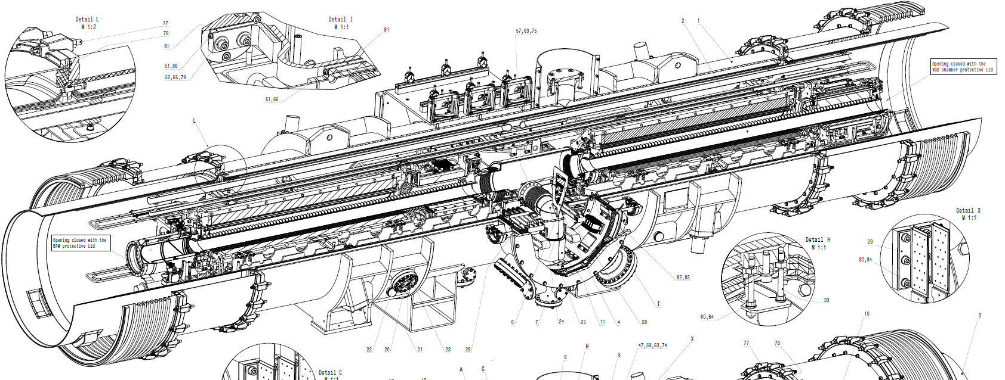
First of Series Quadrupole Doublet Module - 2.5
Cryocatcher
Defocusing QD
Beam direction
Beam Position Monitor
Vertical Focusing Chromaticity Sextupole Magnet - CV
Vacuum Chamber
Focusing quadrupole F2
Steering
Magnet - ST
Downstream unit SF2B (F2 + steerer)
Upstream unit VQD (QD + sextupole)

Slide 5
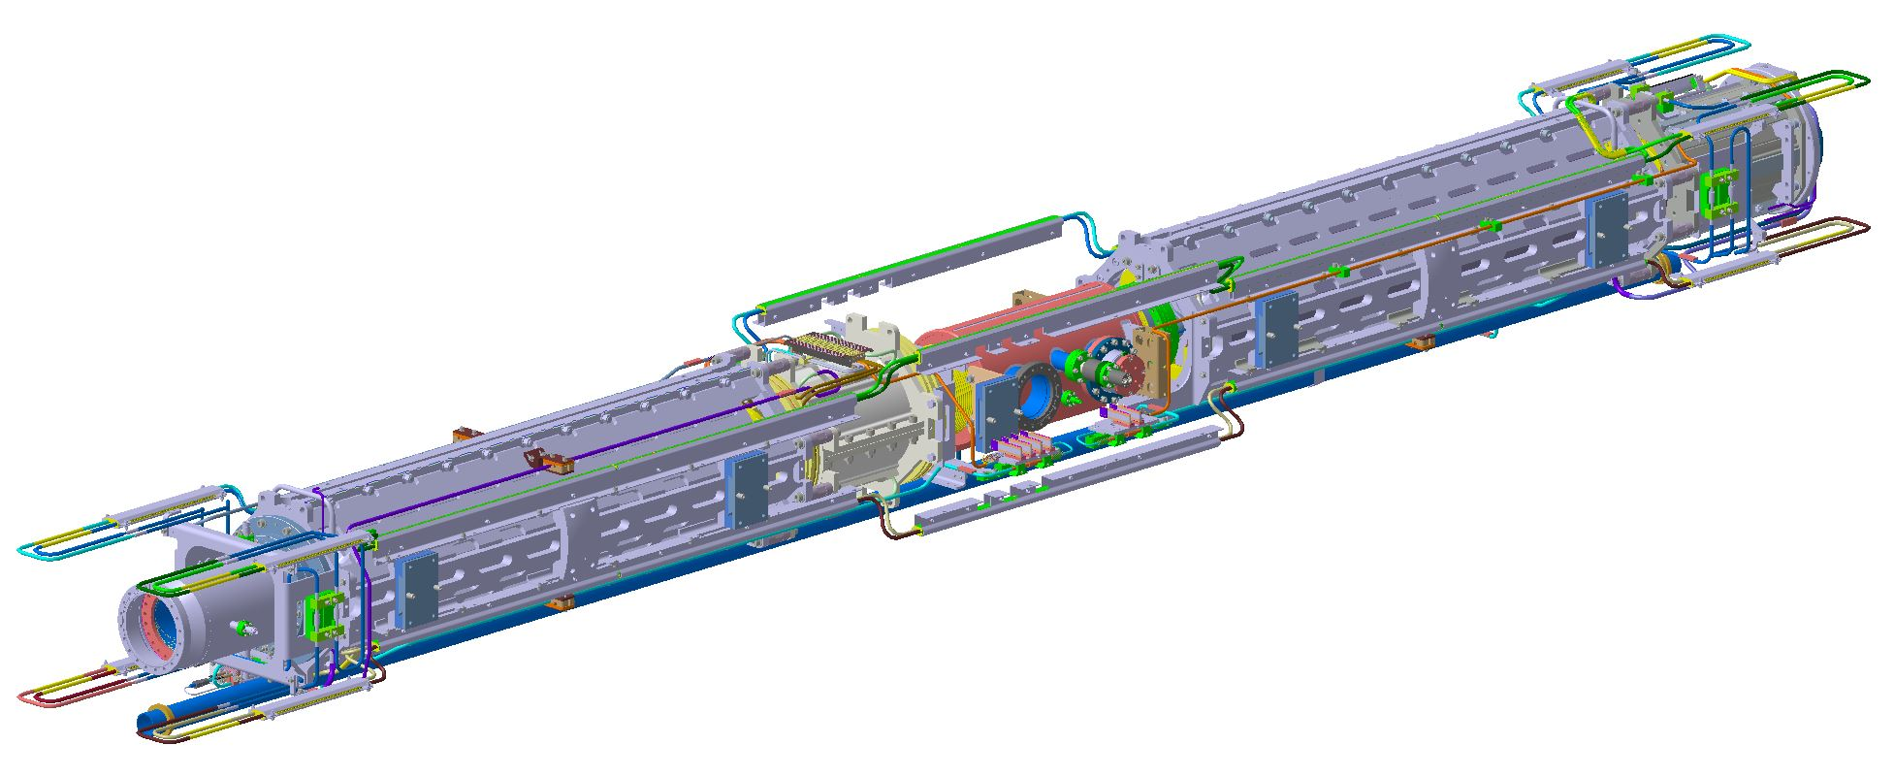
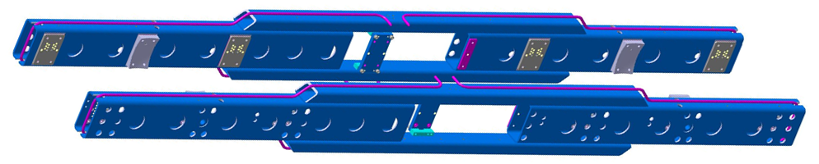
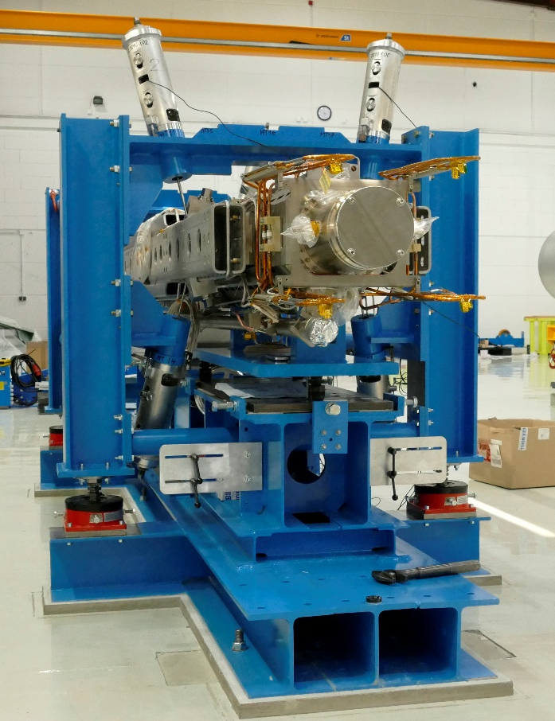
Quadrupole module mechanical correction of the magnetic field:
unit SF2B
unit VQD
yaw
J6
J4
J2
J6
J4
J2
Z
roll
X
pitch
Y
J5
J3
J1
J5
J3
J1
existing system of plates with variable shape, thickness and pin connection system allows for correction of the magnetic axis mechanically.

Slide 6
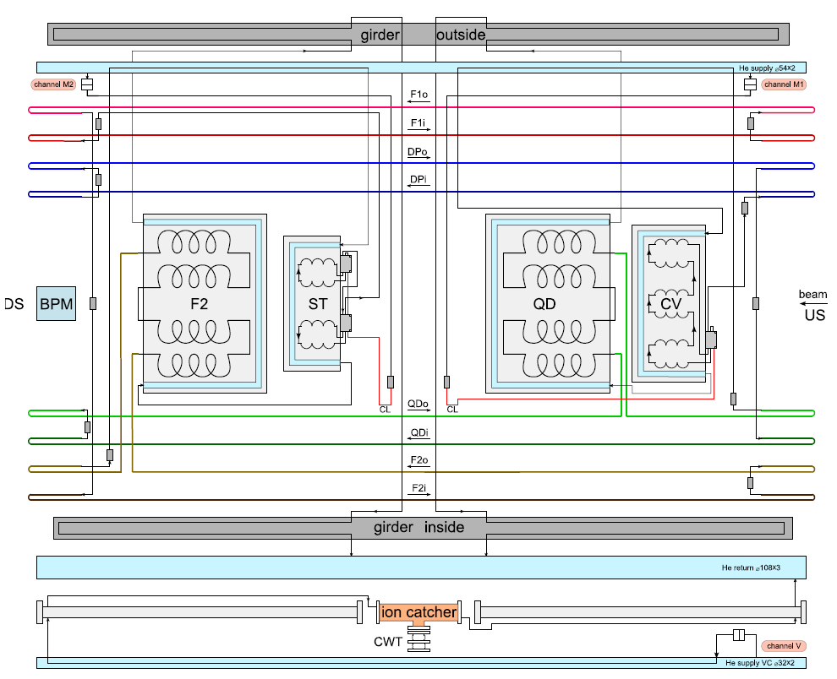
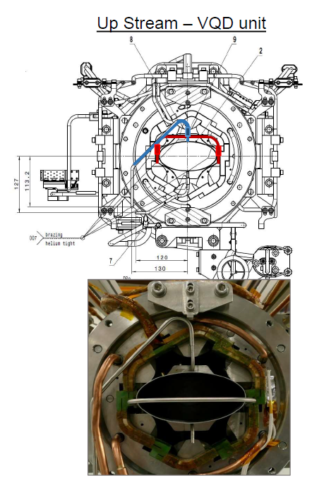
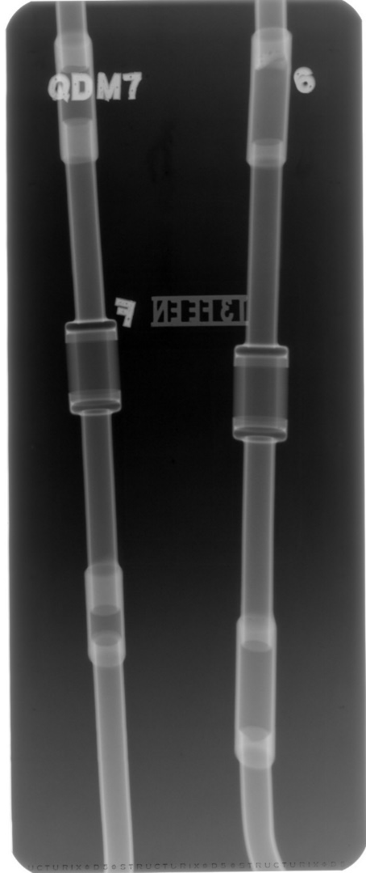
Qualification of the hydraulic connections:
2.9E-09
mbar*L/s
1.1E-08
mbar*L/s

Slide 7
Process lines leak level in cold mass and flow rates
q _{L} (mbar*L/s)
criterion
cold mass
VQD and SF2B
vacuum chamber
JINR
Noell
JINR
Noell
JINR Dubna
Entire Cold Mass Leak level:
@ 15 bar 1.80E-06 mbar*L/s
@ 20 bar 1.10E-06 mbar*L/s
Noell
results should be compared with calculations (20% agreement)

Slide 8




Ultra High Vacuum Residual Gas Analysis
unit SF2B
integrated UHV system
$$\sum_{n=41}^{100}{In−I44}$$
$$\sum_{n=41}^{100}{In−I44}$$
p = 5.04*10⁻⁴
t = 22°C
≤
0.62
p = 1*10⁻³
t = 22°C
≤
0.03
$$\sum_{n=1}^{40}{In+I44}$$
$$\sum_{n=1}^{40}{In+I44}$$
(required ≤ 0.15)

Slide 9
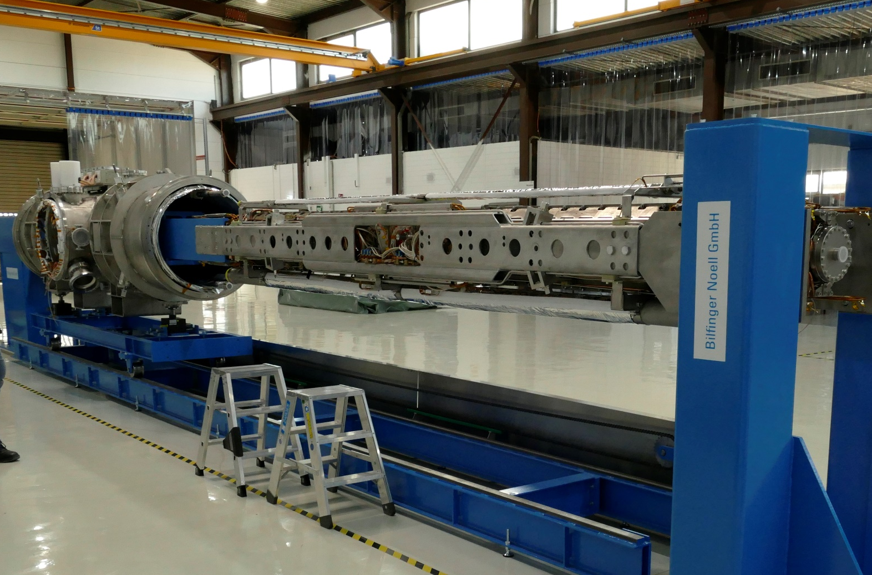
Integration of the cold mass into cryostat
mechanical connections
Beam Position Monitor and cryocatcher installation
hydraulic connections for process lines
Ultra High Vacuum connections
extended prototype instrumentation
(temperature sensors, heaters, voltage taps, quench detection, strain gauges)

Slide 10
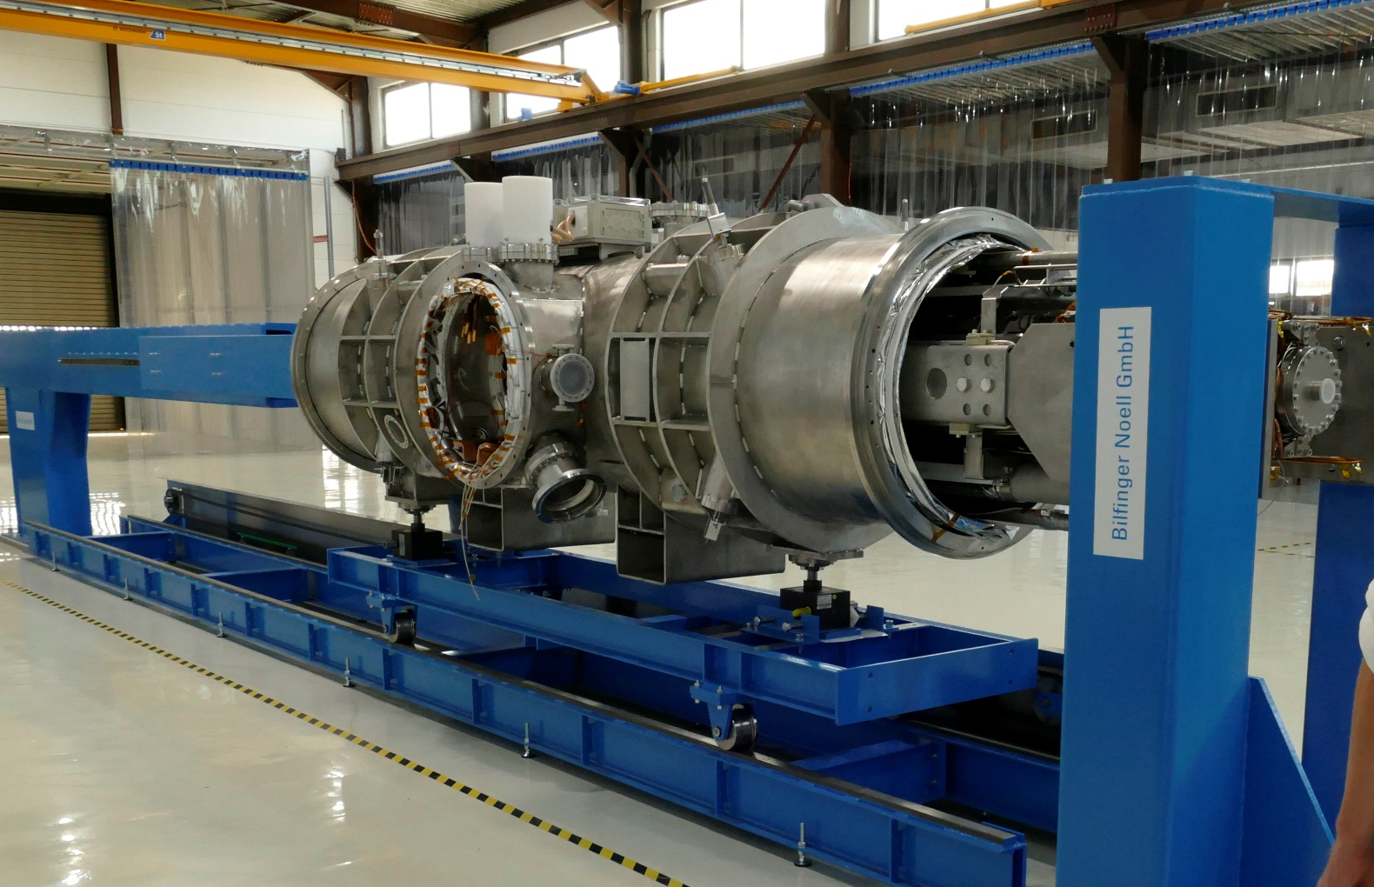
Successful integration of the cold mass into cryostat
cryostat leak free
merging cryostat with thermal shield (MLI, thermal connections, Aluminium body)
thermal shield with thermalisation connections and MLI
collisions between thermalisation and suspension system
successful merging of cold mass and cryostat system

Slide 11
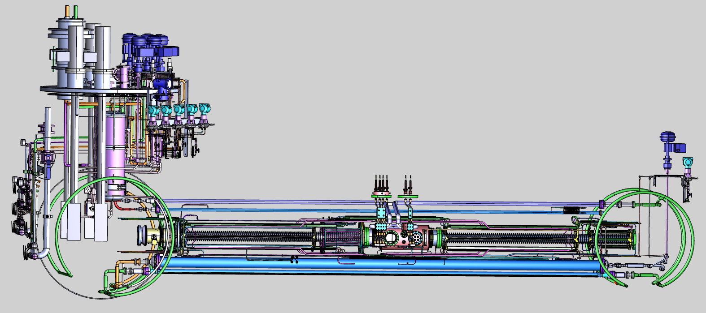
Prototype module testing at GSI
Mechanical template for mechanical measurement
Preparation of cables for instrumentation and powering of corrector magnets, quench detection system
Nuclotron cable assembly for powering in series of quadrupole magnets
He adapters for cooling system are procured
Measurement software in progress
Cables for instrumentation and powering of corrector magnets, quench detection system
Nuclotron cable assembly adapter for powering quadrupole magnets in series
He adapters for cooling system
Measurement software
Template for mechanical measurement
Mounting scheme at Series Test Facility station

Slide 12
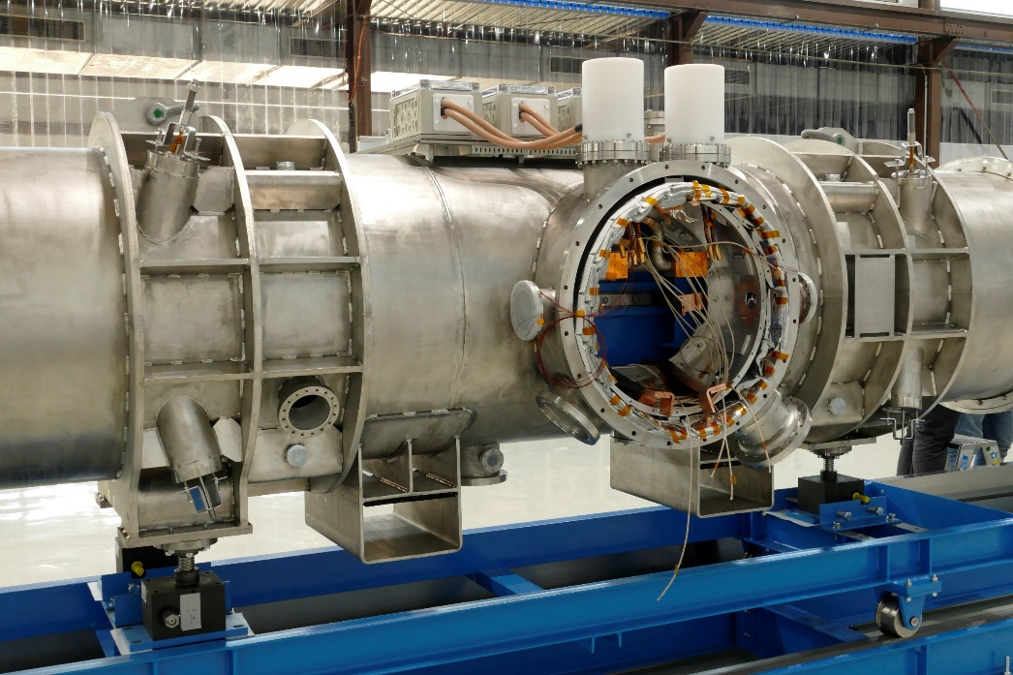
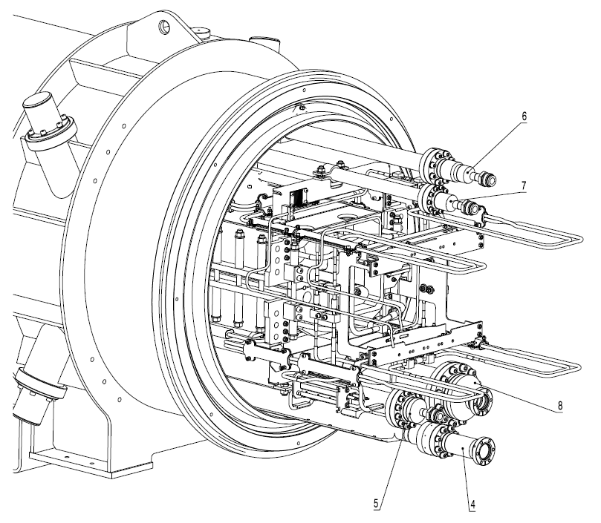
Prototype module testing at GSI at warm
Measurement of the cold mass and cryostat by laser tracker
Functional tests of sensors, insulation tests for low and high voltage circuits
Leak tests of the process lines
Leak tests of the ultra high vacuum system
Instrumentation tests: temperature sensors with calibration curves
Checking the power circuits for electrical integrity (voltage taps)
Leak tests of the cryostat vessel
Integral leak test of the process lines during pump and purge process
Functional tests of instrumentation

Slide 13
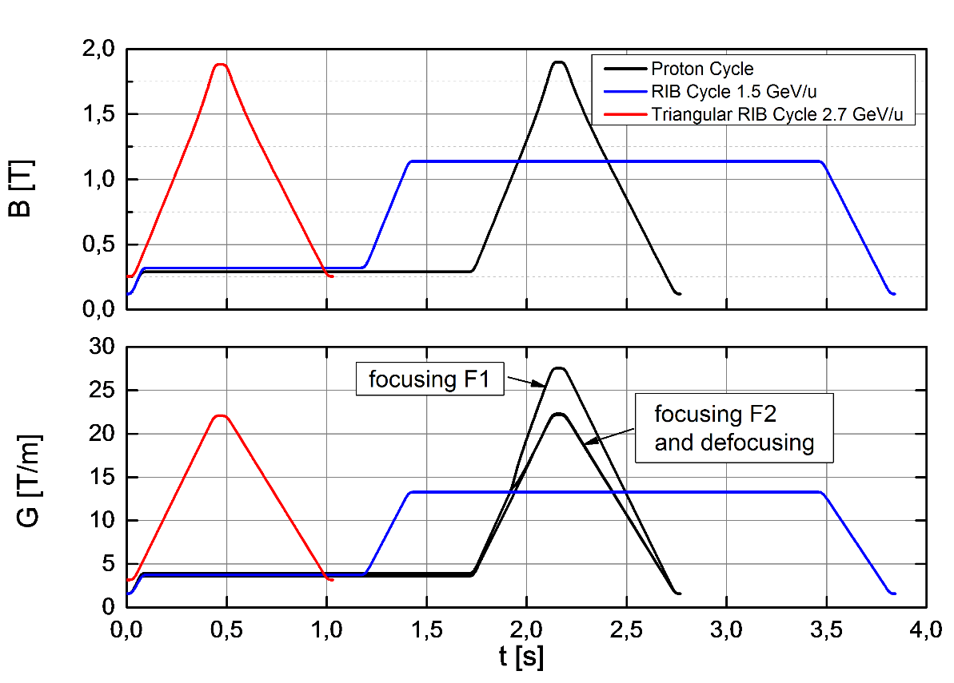
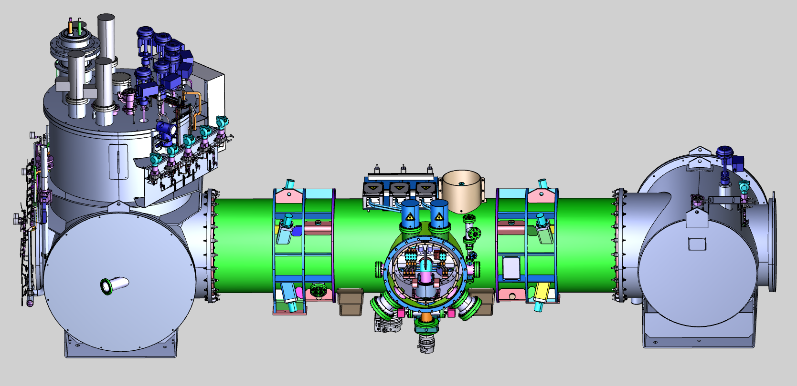
Prototype module testing at GSI at 4.5 K
Measurement of the helium mass flow rates of the
static heat load
High and low voltage tests at cold conditions
Validation of the voltage taps over cool down
Measurement of cold mass position via. laser tracker
Test of the quench detection system for corrector magnets
Powering of the main quadrupole magnets
Powering of the corrector magnets and testing the
functionality of the Local Current Leads
Measurement of the helium mass flow rates of the dynamic heat load
Measurement of the Ultra High Vacuum system
Functional test of the Beam Position Monitor and cryocatcher

Slide 14
Summary:
1. Magnet units, vacuum chambers, beam diagnostic and other
module components available at Bilfinger Noell for prototype
assembly.
2. Integration of QDM prototype advanced, module will be delivered
in October 2019 to GSI.
3. Testing campaign of the magnet module is planned and will start
in November 2019 at GSI series test facility.

