Slide 1
High Temperature Superconductors and
Medical Devices: Ultra-compact MRI and LFEIT
Dr. Boyang Shen and Dr Tim Coombs
Department of Engineering
University of Cambridge, UK
2019 Magnet Technology Conference
MT26
September 2019

Slide 2
Outline
1. Ultra-compact MRI
2. Superconducting Lorentz Force Electrical Impedance Tomography (LFEIT)

Slide 3
1. Ultra-compact MRI

Slide 4


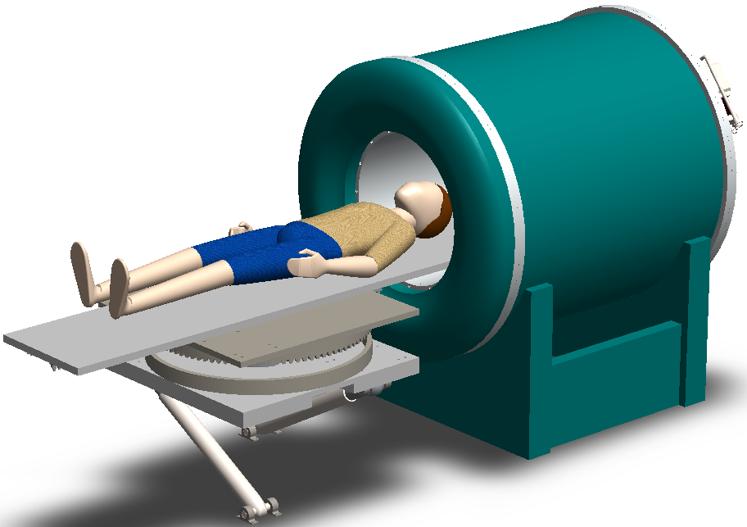
Ultra-compact MRI
Mobile MRI
Pre-surgery Room
Ultra-small MRI
Ultra-compact MRI system is for the rapid diagnosis of the brain syndrome and some other urgent diseases, which can be potentially equipped into the pre-surgery room and ambulance.

Slide 5
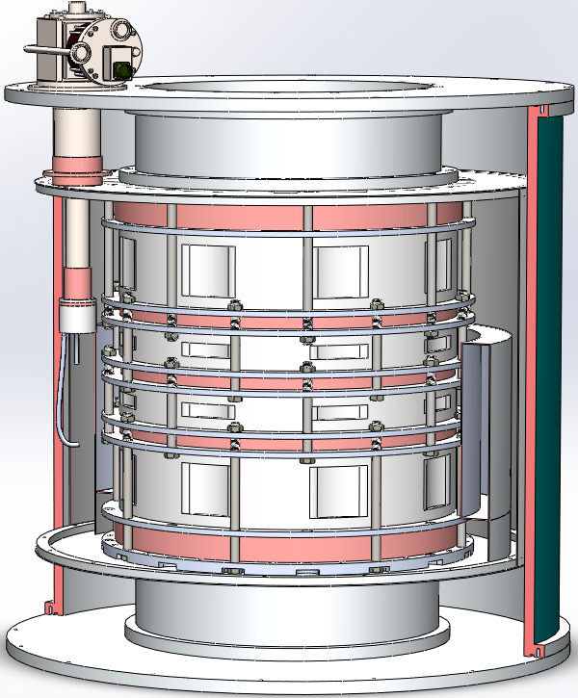
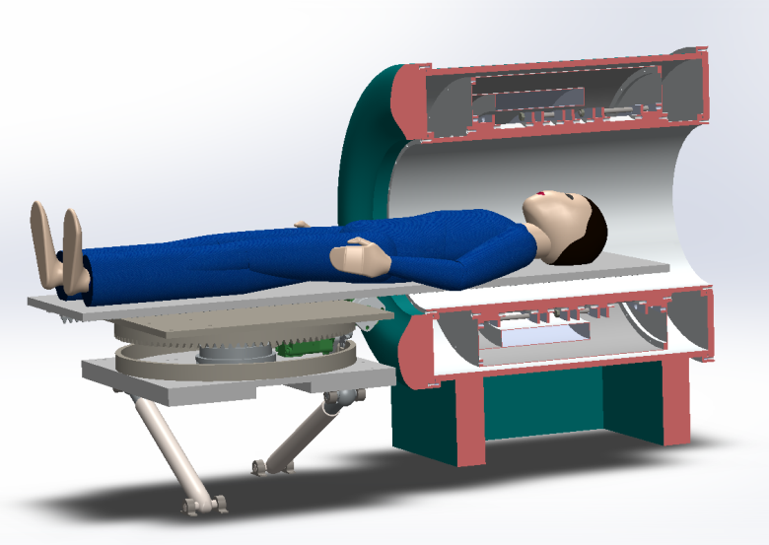
HTS magnet for Ultra-compact MRI
Key component: HTS magnet
Compact Geometry
Strong Magnetic Field
High Uniformity

Slide 6
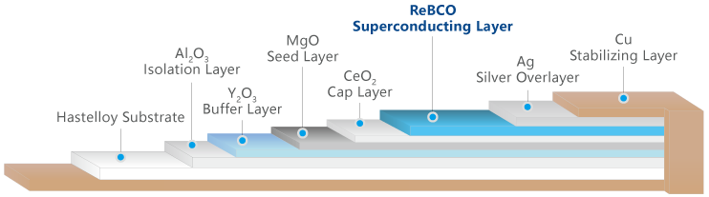
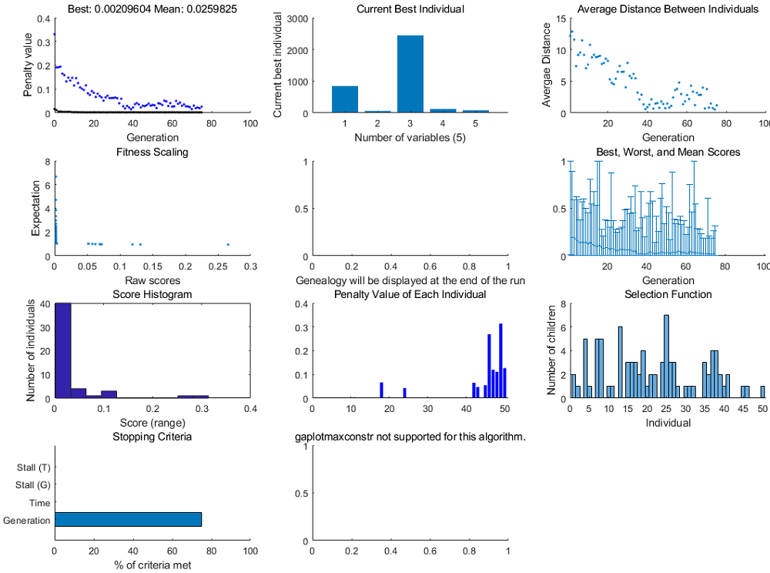
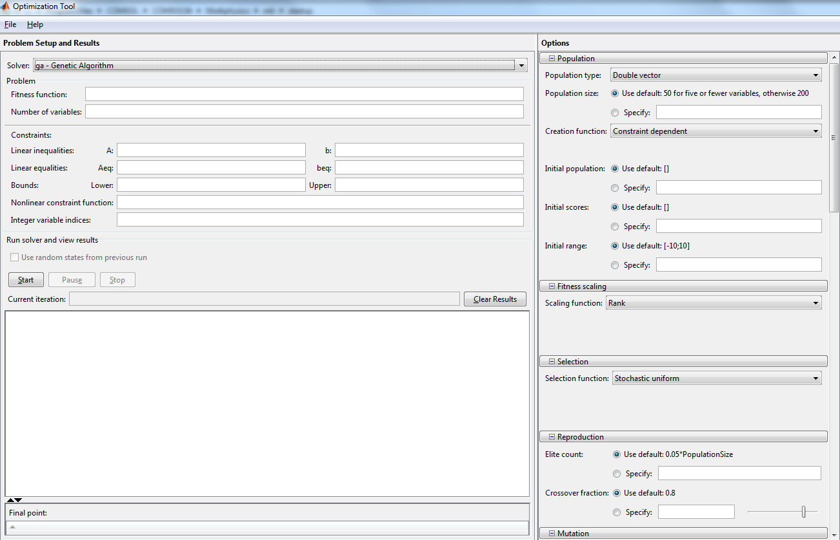

Strong and Uniform HTS Magnet
Second Generation (2G) HTS
e.g. ReBCO HTS tape
High aspect-ratio dimension
Challenges:
uniformity optimization
Powerful optimization tool needed
Shanghai Superconductor Technology®
Genetic Algorithm (GA) optimization were based on the FEM package COMSOL Multiphysics with the LiveLink for MATLAB.

Slide 7
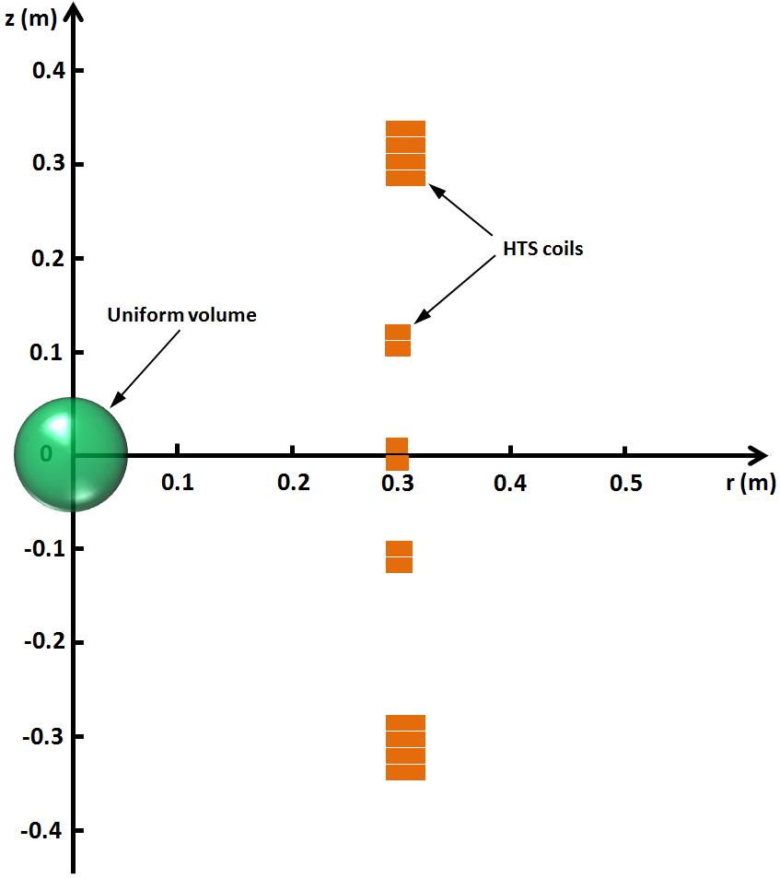
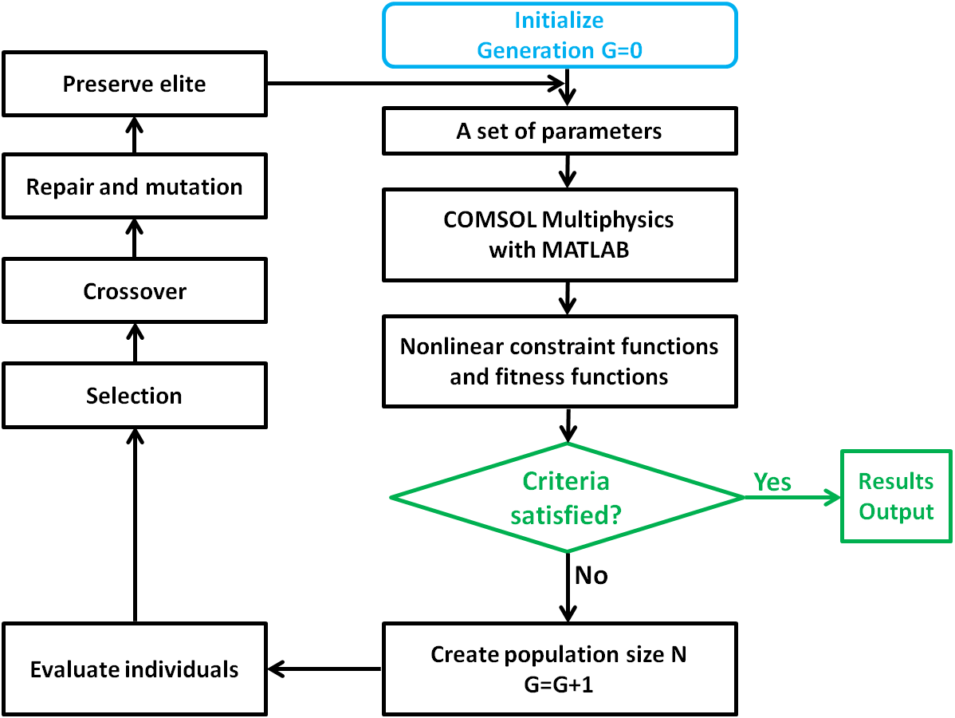
Optimisation Strategy
5-set of double-pancake HTS coils. If the criteria achieved, the optimization iterations stopped; otherwise, the iterations continued to reach the targets through repetitive selection, crossover, mutation, and elite preservation, until targets achieved.

Slide 8
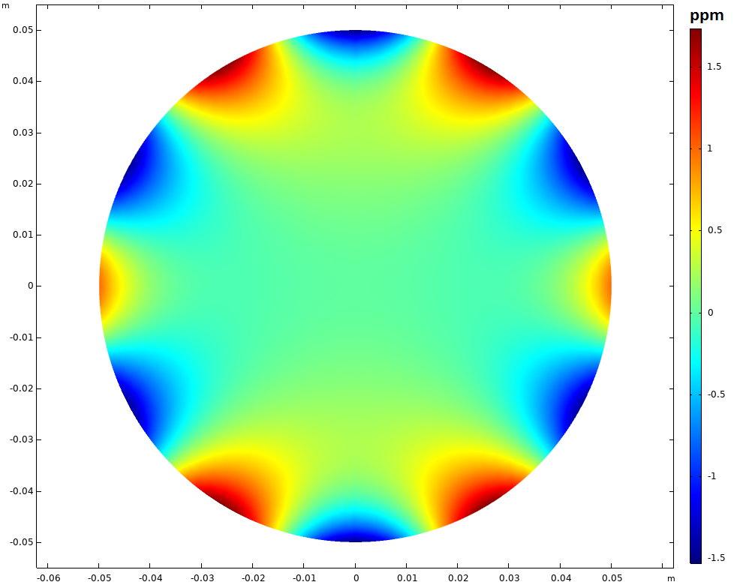
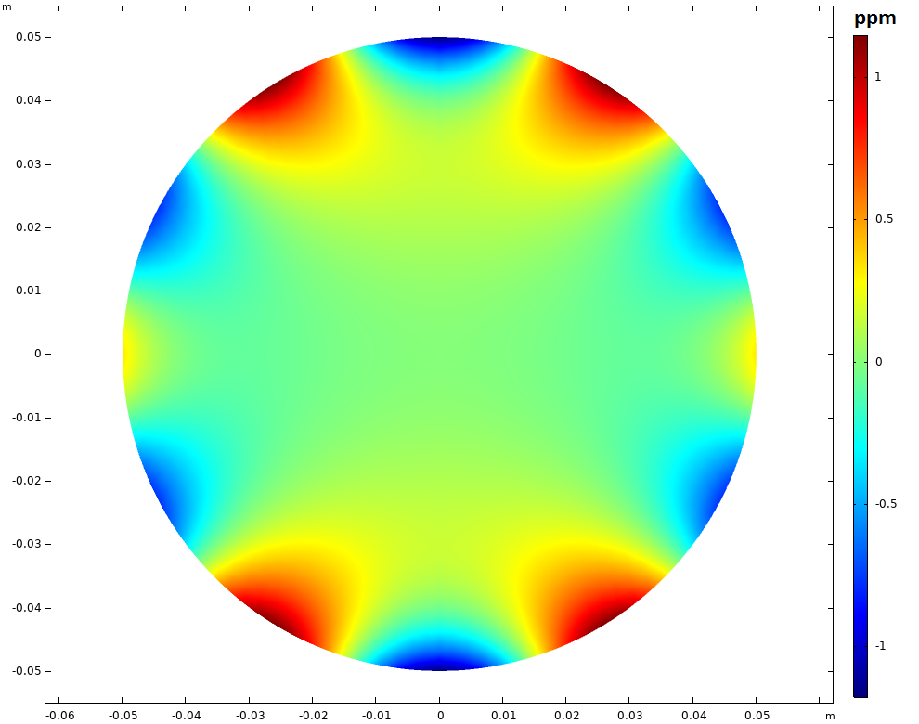
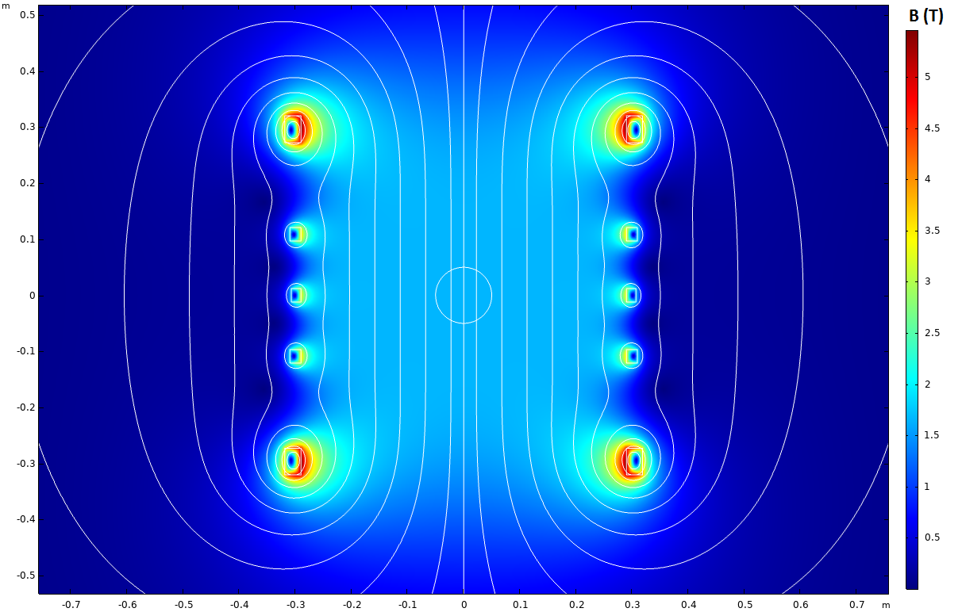
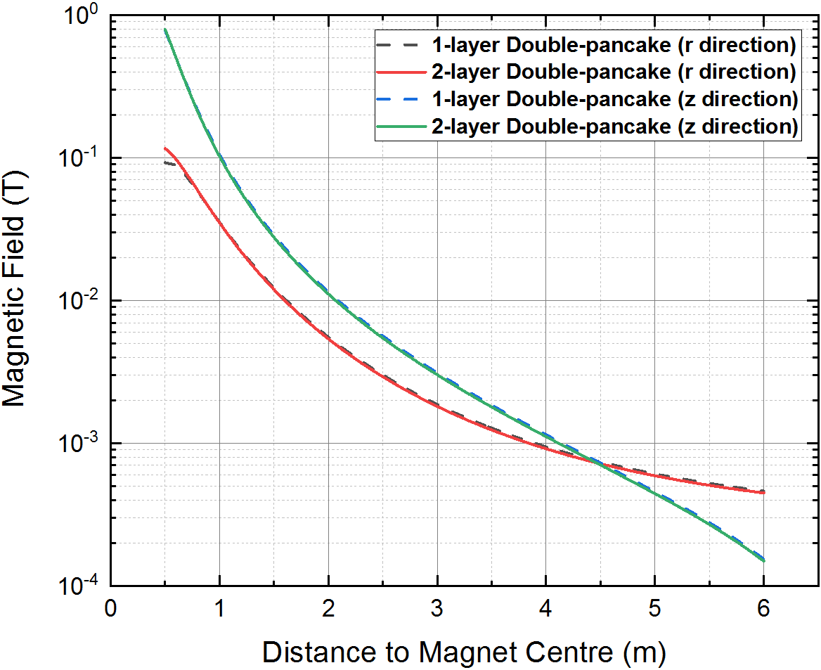
Magnetic Profile
Inhomogeneity in a 10 cm DSV (1-layer end double-pancake case)
Inhomogeneity in a 10 cm DSV (2-layer end double-pancake case)

Slide 9
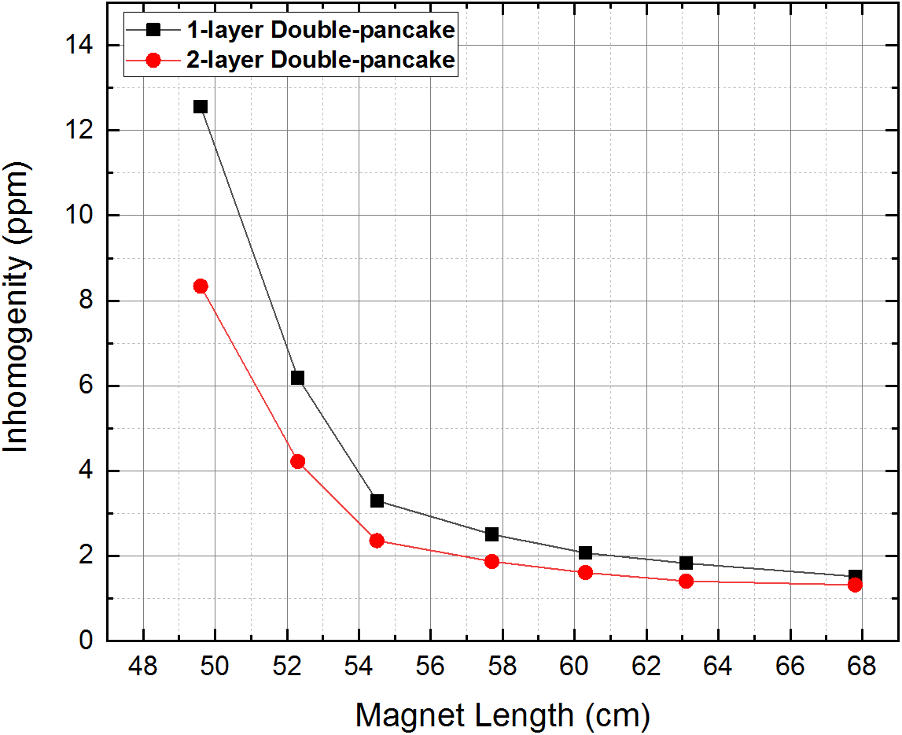
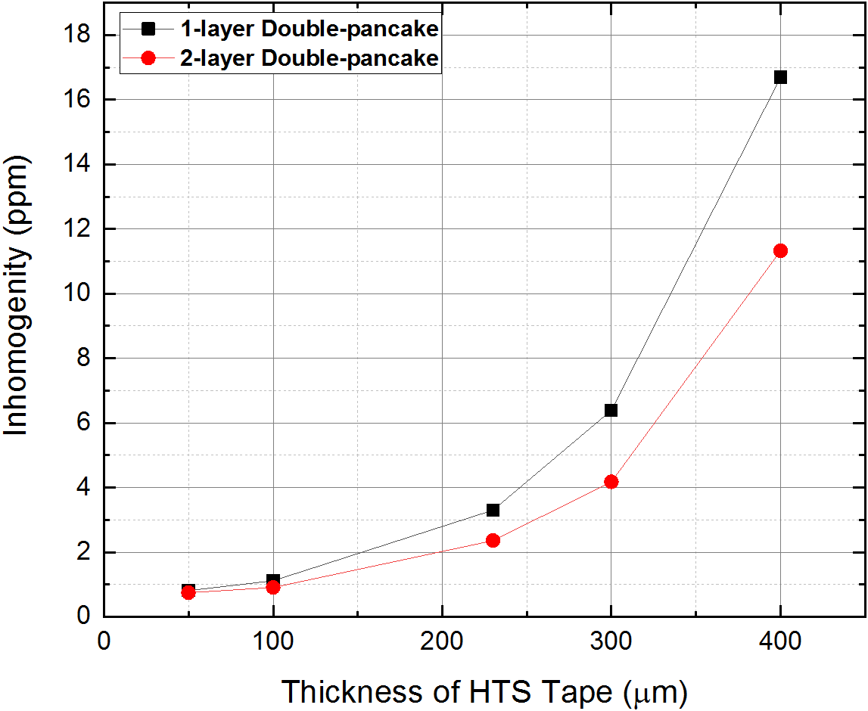
Sensitivity Study
The sensitivity studies were carried out, for the relationship between the homogeneity in a 10 cm DSV and (1) magnet length, and (2) thickness of HTS tape.

Slide 10
2. Superconducting Lorentz Force Electrical Impedance Tomography (LFEIT)

Slide 11
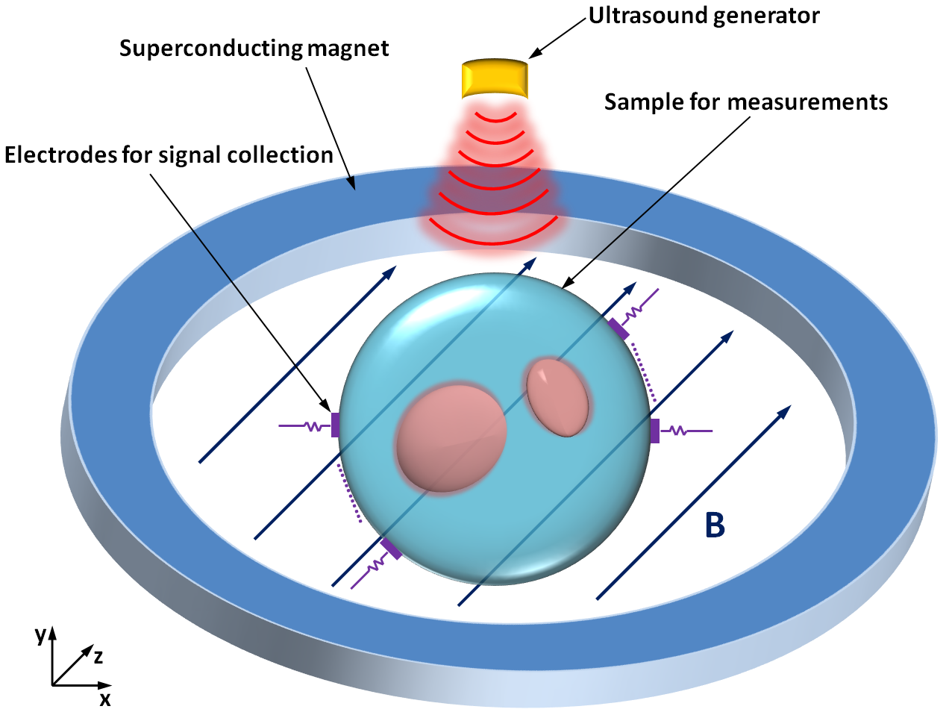
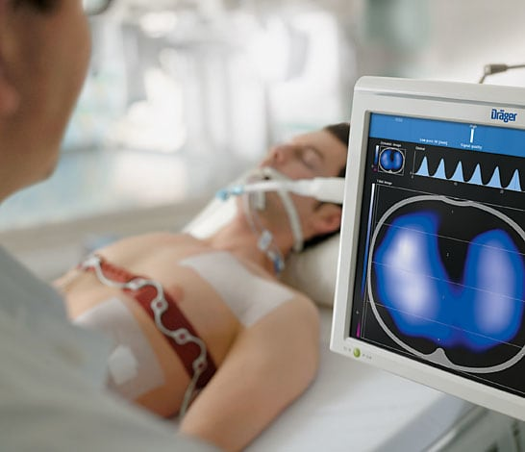
Design of Superconducting Lorentz Force Electrical Impedance Tomography (LFEIT)
Superconducting LFEIT
Conventional Electrical Impedance Tomography (EIT)
LFEIT is a novel diagnostic scanner which is able to achieve the 3D high resolution imaging of tissue impedance based on ultrasonically induced Lorentz force

Slide 12

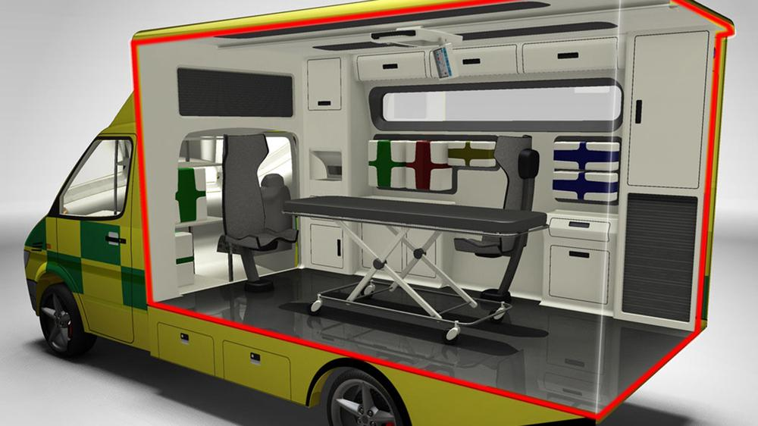

Advantages of LFEIT
1. Excellent bio-detection
2. High resolution
3. Portability
4. Low cost

Slide 13
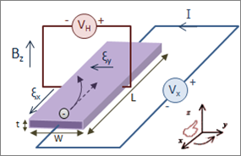
Working Principle
c
Hall effect
Ultrasound transducer
(1.1)
The measured signal is proportional to the magnitude of magnetic field, the momentum of ultrasound and the gradient of electrical conductivity.

Slide 14
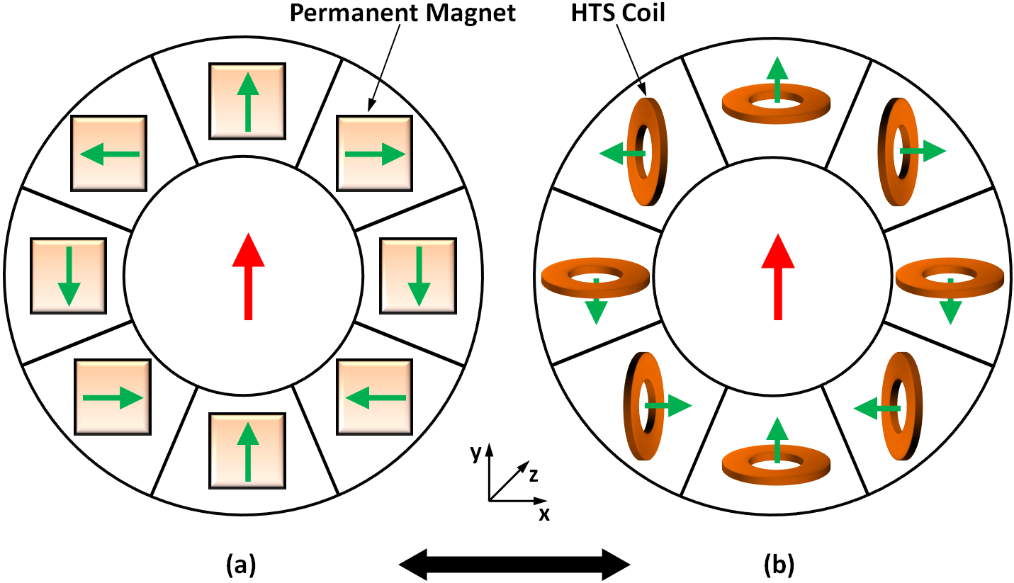
Superconducting Magnet Design
(a) Configuration of permanent magnet (PM) based Halbach Array magnet.
(b) Configuration of high temperature superconducting (HTS) coils based Halbach Array magnet.
Halbach Array is an effective arrangement of magnets that is able to generate a homogenous magnetic field, whose geometry has thin depth in z direction.
B. Shen et al, “Design of a Superconducting Magnet for Lorentz Force Electrical Impedance Tomography”, IEEE Trans. Appl. Supercond., 2016.

Slide 15
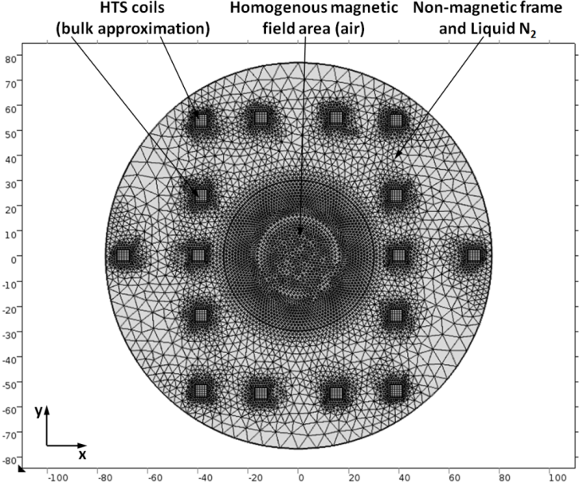
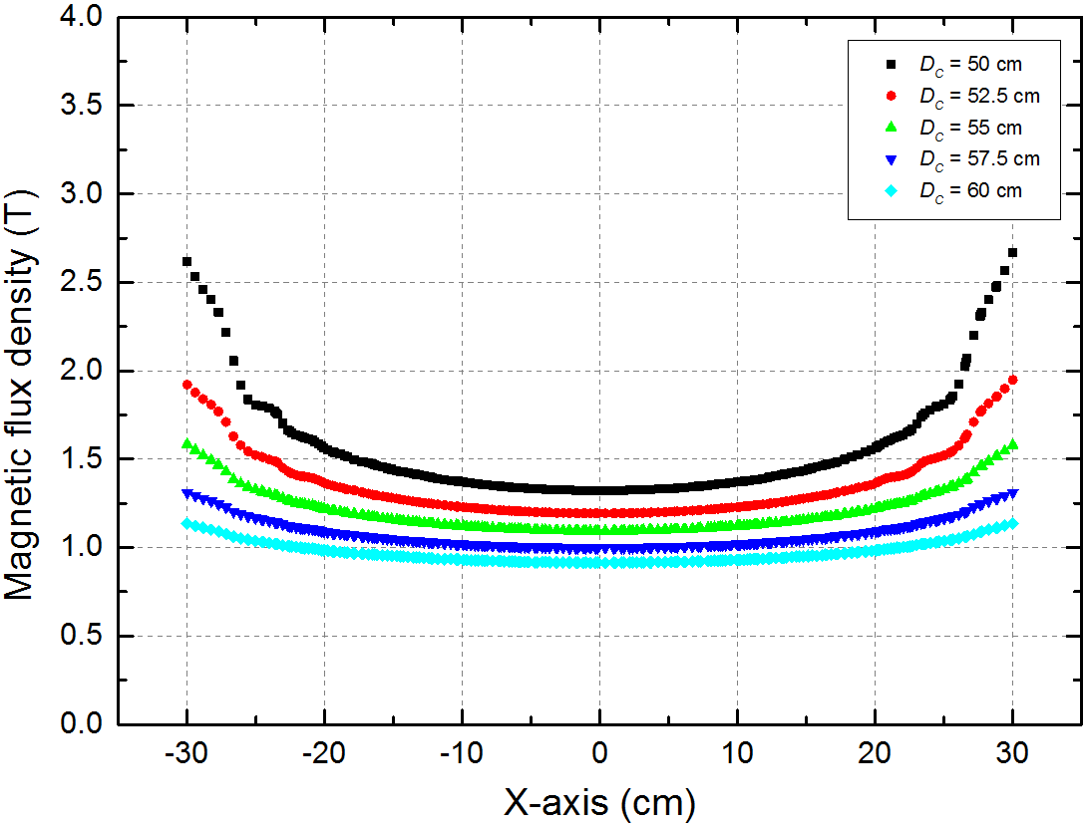
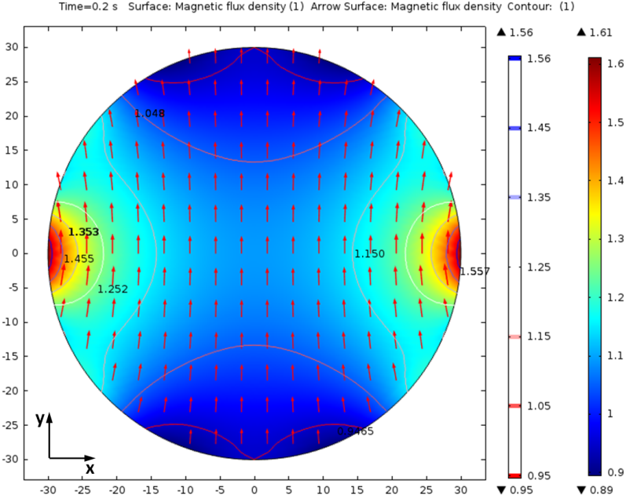
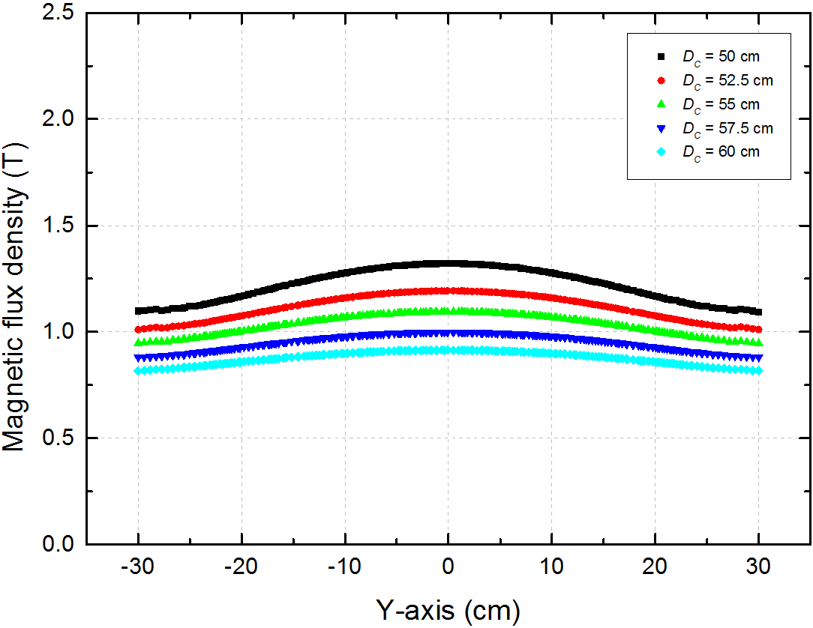
Superconducting Magnet Design
B. Shen et al, “Design of a Superconducting Magnet for Lorentz Force Electrical Impedance Tomography”, IEEE Trans. Appl. Supercond., 2016.

Slide 16
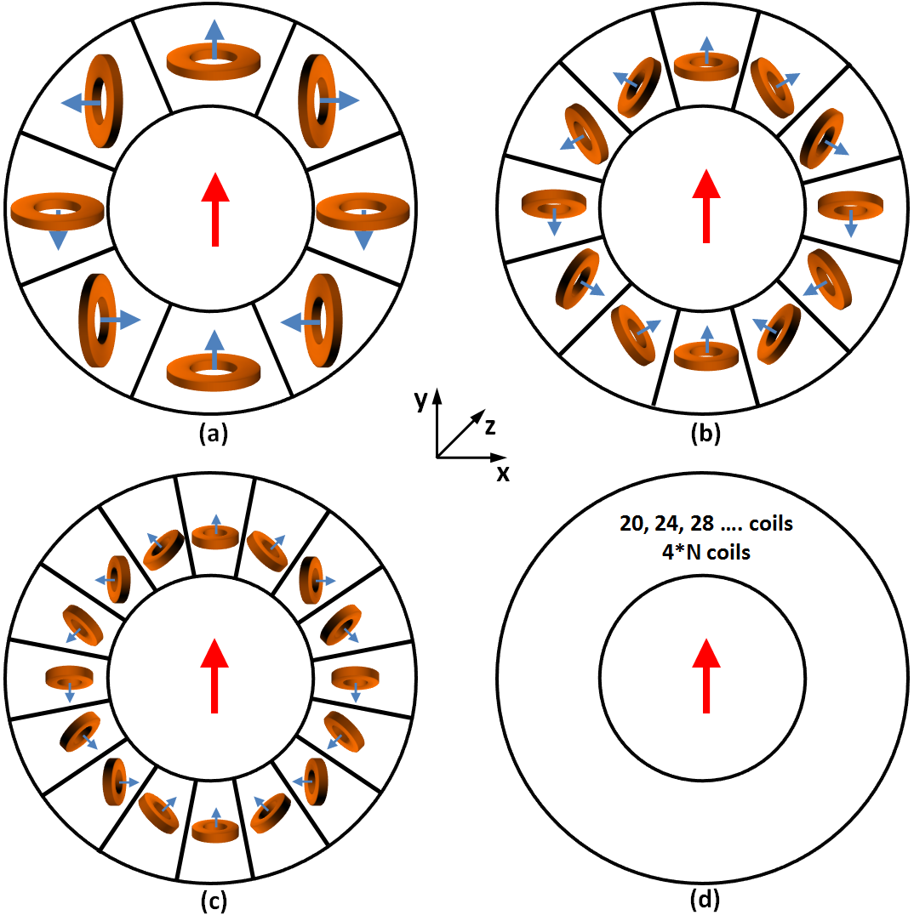
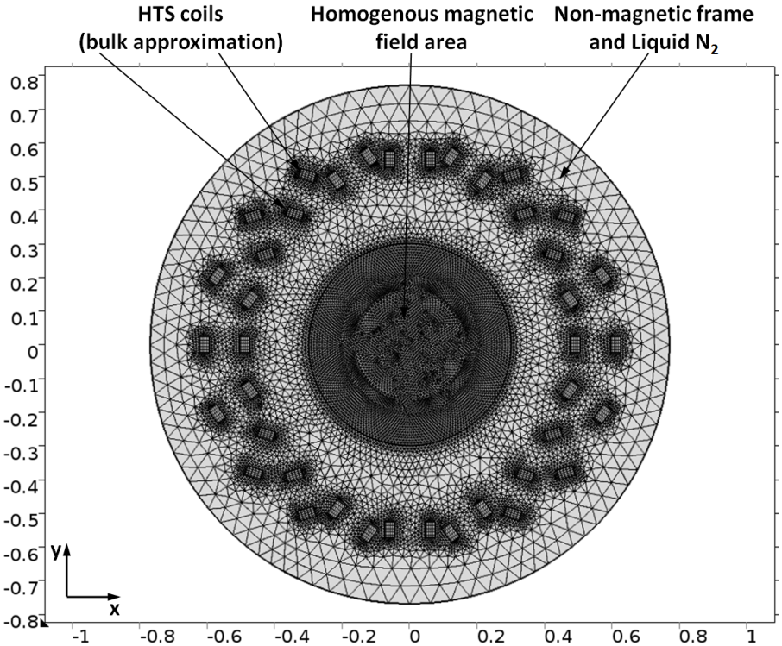
Superconducting Magnet Optimisation
Without changing the total amount of superconductor, optimisation on using increasing numbers of coils can be done by shrinking each coil’s size with increasing number of coils.
B. Shen et al, “Optimization Study on the Magnetic Field of Superconducting Halbach Array Magnet”, Physica C, 2017.

Slide 17
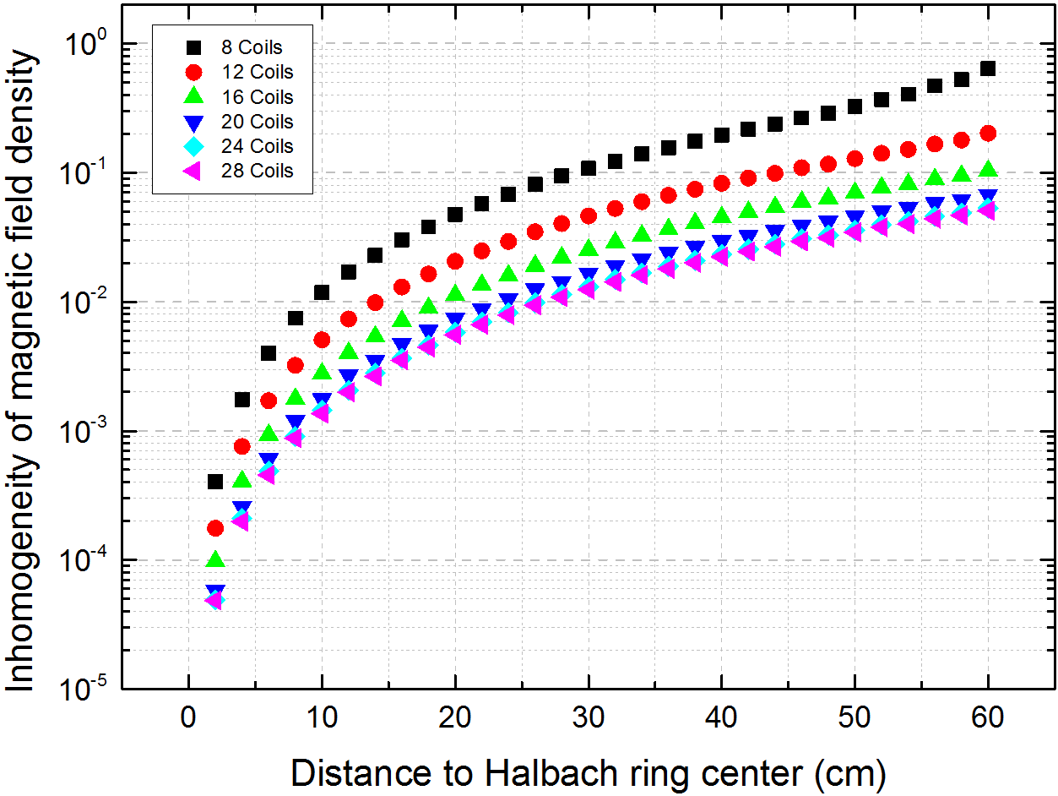
Superconducting Magnet Optimisation
(2.1)
(2.2)
(2.3)
Some equations have been derived from this investigation. α and β are the variables for power law which is related to the n (numbers of coils) in equation (2.2) and (2.3). Both α and β have exponential relation with n and adding a constant, where a = 1.408E-4, b = -0.1556, c = 1.188E-05, e = 43.32, f = ‑0.5279, g = 2.022.
B. Shen et al, “Optimization Study on the Magnetic Field of Superconducting Halbach Array Magnet”, Physica C, 2017.

Slide 18
LFEIT System simulation
According to the formula of Lorentz force:
Where q is charge of particle move with velocity v, and B is magnetic flux density. This Lorentz force is also equivalent to the force caused by the induced electric field :
Meanwhile, the relation of electrical conductivity is :
Combining Equation (2.4), (2.5) and (2.6), the equation for transient current density can be derived:
Assuming the ultrasound wave propagating along z direction, the ultrasound bean width is W and ultrasound path is L, the voltage measurement can be described as:
Where a is a percentage constant representing the efficiency current collected by the electrodes, B₀ is the static magnetic field and R is the total impedance of measurement circuit. According the formula for relation of sound pressure and particle movement velocity, z direction term can be:
The ultrasound momentum M can be expressed by using the time integration of ultrasound pressure with regard to time t:
Therefore, that the governing equation for final output signal of LFEIT can be determined by combining Equation (4.5), (4.6) and (2.10):
Equation (2.11) reveals that magnitude of final output signal is proportional to the strength of magnetic field and the ultrasound pressure. More importantly, output signal is nonzero only at the interface where the gradient of electrical conductivity over mass density ∇(σ/r) is not zero. The mathematical MATLAB model of LFEIT system was built based on governing equations (2.11).
(2.4)
(2.5)
(2.6)
(2.7)
(2.8)
(2.9)
(2.10)
(2.11)
B. Shen et al, “Design and Simulation of Superconducting Lorentz Force Electrical Impedance Tomography (LFEIT)”, Physica C, 2016.

Slide 19
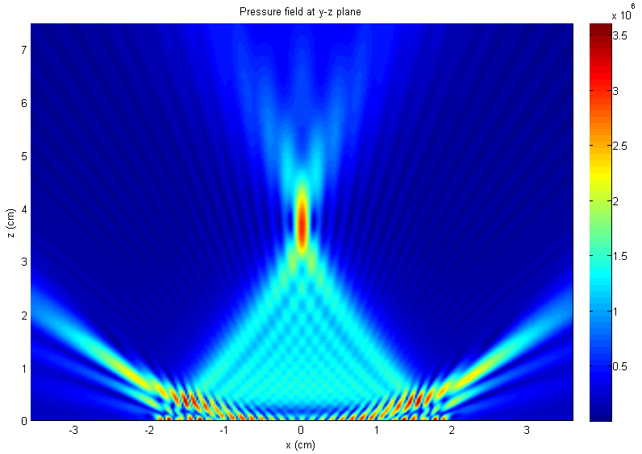
Ultrasound Module Design
This acoustic module used ultrasound phase array structure, which consisted of 32 transducer elements with each generating 1 MHz ultrasound signal.
B. Shen et al, “Design and Simulation of Superconducting Lorentz Force Electrical Impedance Tomography (LFEIT)”, Physica C, 2016.

Slide 20
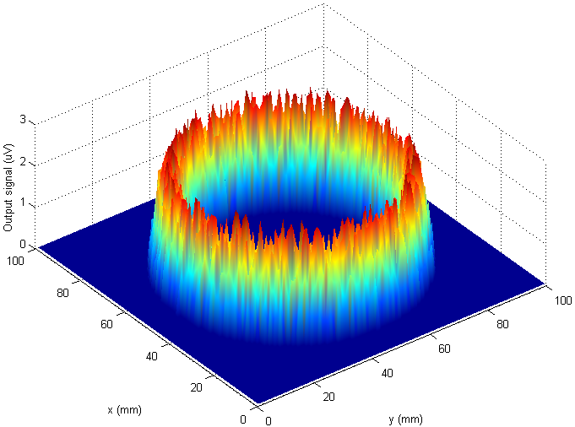
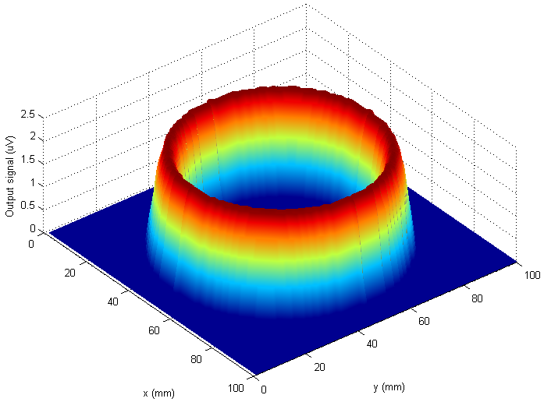
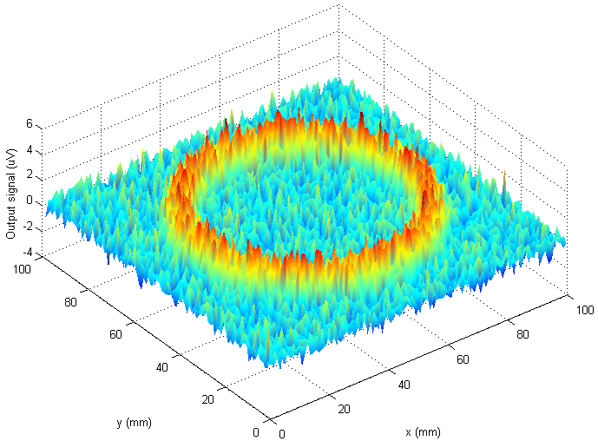
Modelling of Electrical Signal
Output signal detected from sample located in inhomogeneous magnetic field.
Ideal output signal (absolute value) detected from sample with absolute uniform magnetic field and zero noise.
Output signal detected from sample located in inhomogeneous magnetic field with noise condition.
B. Shen et al, “Design and Simulation of Superconducting Lorentz Force Electrical Impedance Tomography (LFEIT)”, Physica C, 2016.

Slide 21
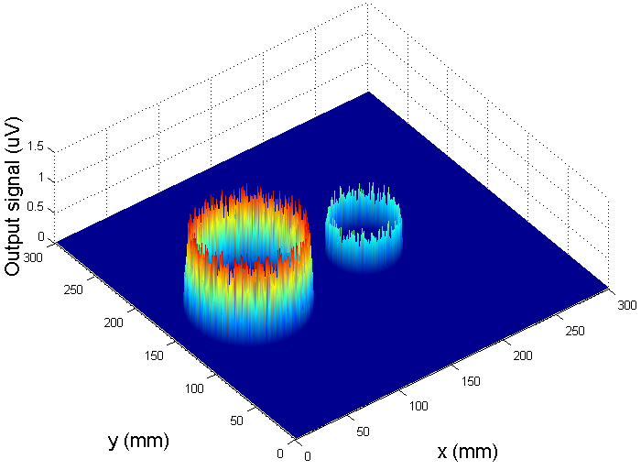
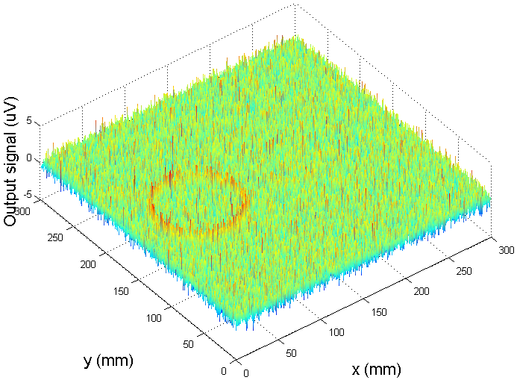
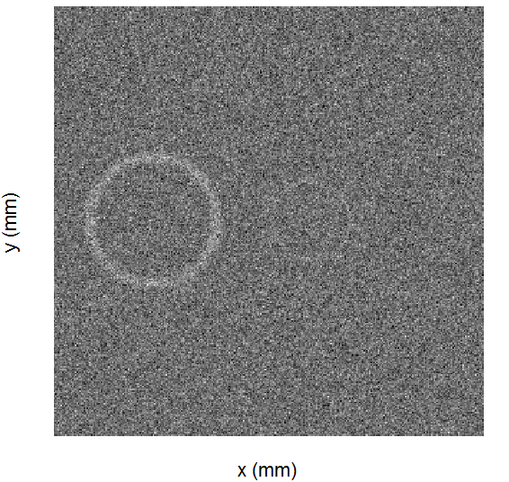
Final Signals and Basic Imaging –
Normal Iron Magnet
(a) (b) (c)
(a) voltage output (absolute value) without noise, (b) with noise, (c) electrical signal imaging: from the sample.
The imaging of electrical signal is faint and it is very difficult to find the edge and location of second sample.
B. Shen et al, “Design and Simulation of Superconducting Lorentz Force Electrical Impedance Tomography (LFEIT)”, Physica C, 2016.

Slide 22
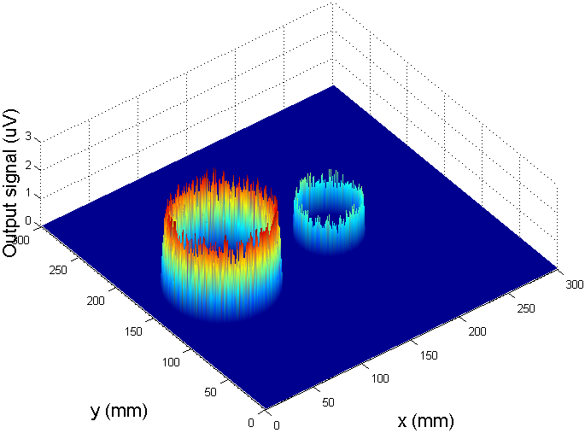
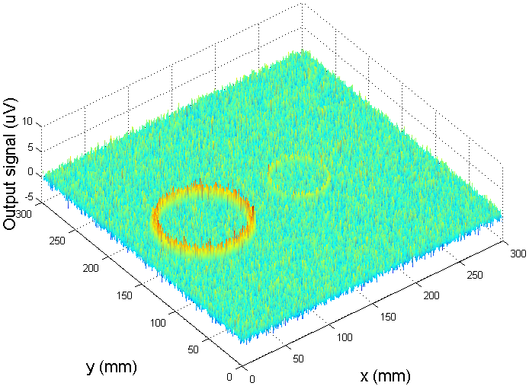
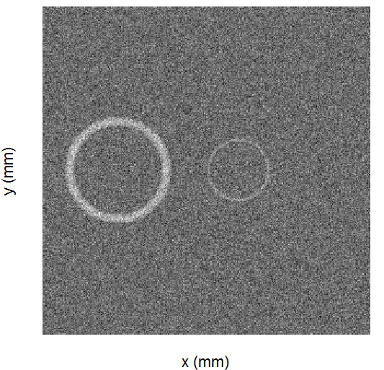
Final Signals and Basic Imaging –
Superconducting Magnet
(a) (b) (c)
(a) voltage output (absolute value) without noise, (b) with noise, (c) electrical signal imaging: from the sample.
The edge and shape of both samples can be discovered
B. Shen et al, “Design and Simulation of Superconducting Lorentz Force Electrical Impedance Tomography (LFEIT)”, Physica C, 2016.

Slide 23

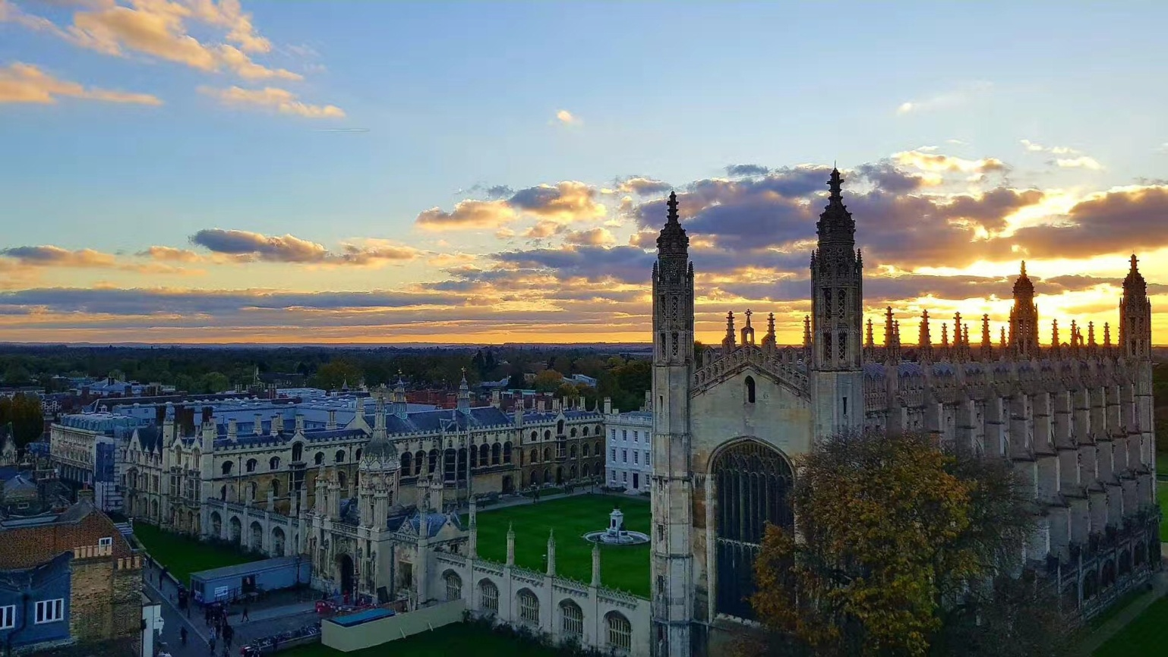
Thank you! Questions?
Boyang Shen, bs506@cam.ac.uk
Tim Coombs, tac1000@cam.ac.uk

