Slide 1


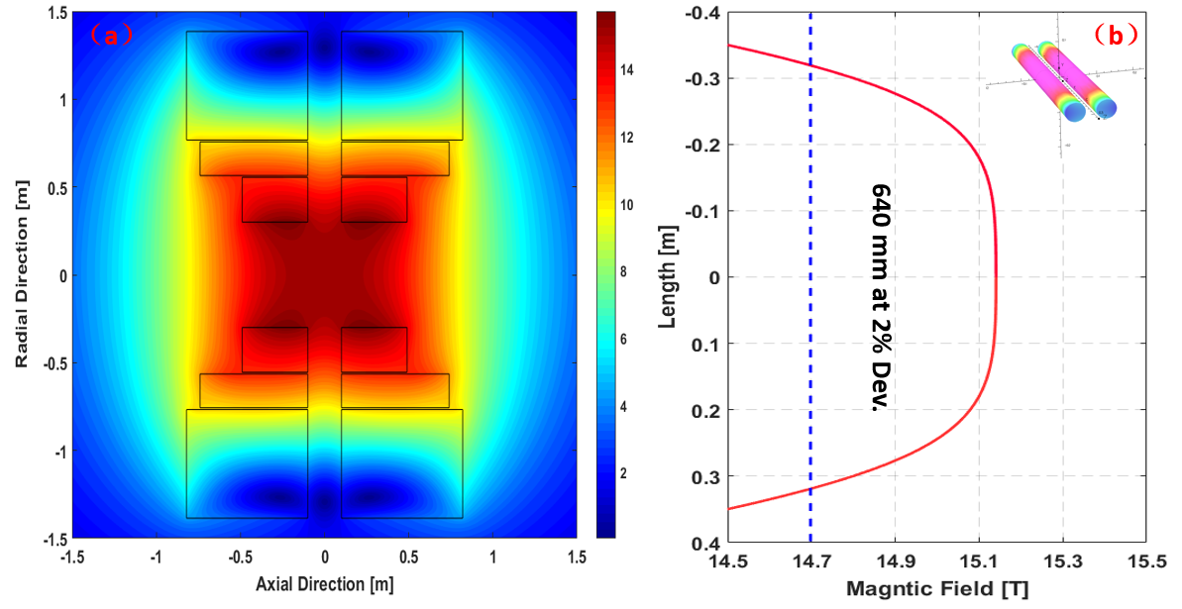
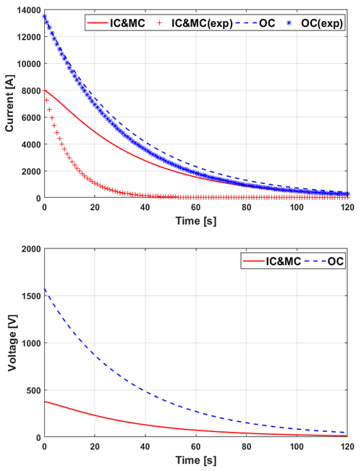
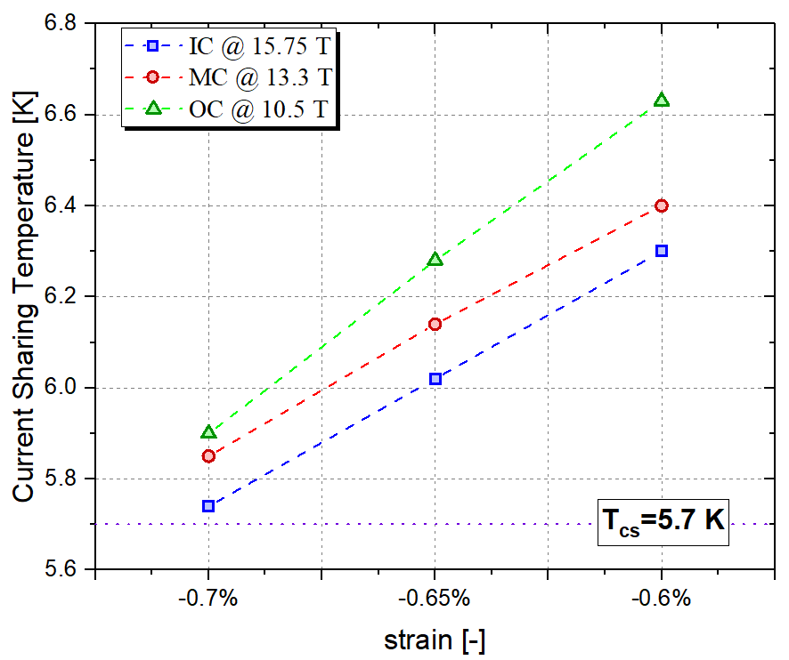
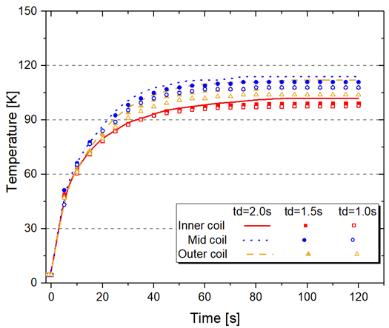
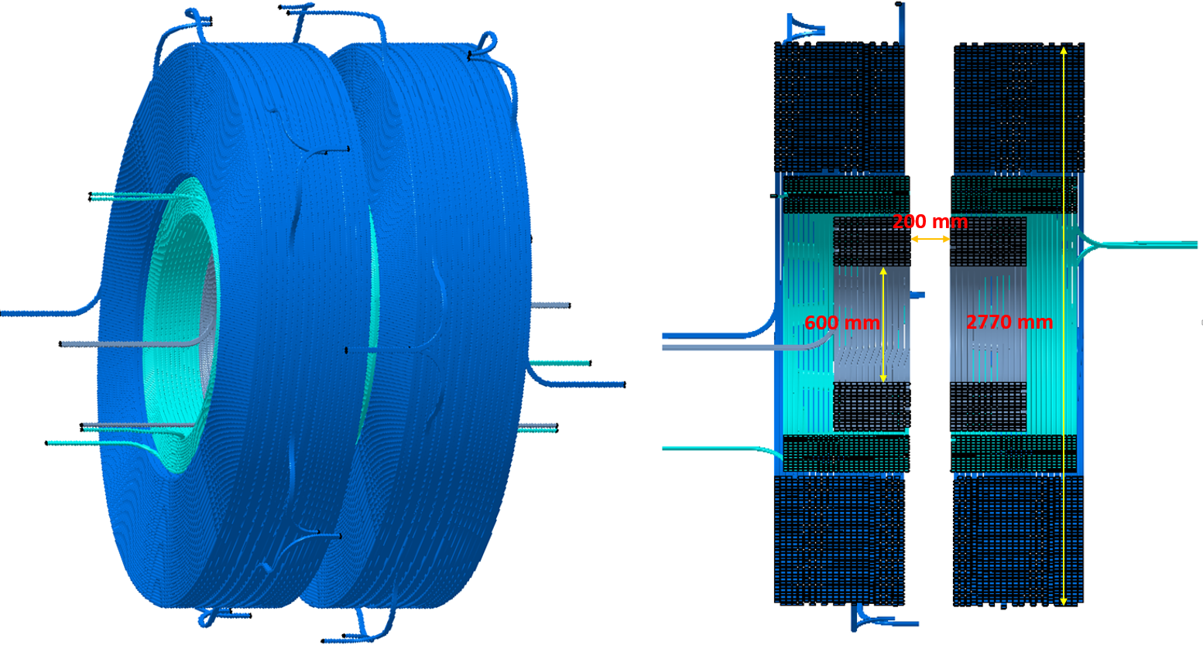
Poster No.: Thu-Mo-Po4.02-05 [10]
Conceptual Design of 15 Tesla Conductor Test Facility for Future Fusion Reactor
Chao Dai¹, Yu Wu¹, Jinggang Qin¹, Arend Nijuis³, Yi Shi¹, Kaihong Wu^{1,2}, Yongliang Zhang^{1,2}, Xiaopeng Yu¹, Qiangwang Hao¹
1 - Institute of Plasma Physics, Chinese Academy of Sciences, PO Box 1126, Hefei, Anhui 230031, China
2 - University of Science and Technology of China,No.96,JinZhai Road Baohe District, Hefei, Anhui 230026, China
3 - Energy, Materials and Systems, Faculty of Science and Technology, University of Twente, Enschede 7500AE, Netherlands.
ASIPP
1. Introduction
3. Superconducting wire & conductor
The China Fusion Engineering Test Reactor (CFETR) is the next device in the roadmap for the realization of fusion energy in China, which aims to bridge the gaps between the fusion experimental reactor ITER and the demonstration reactor (DEMO). On the way to CFETR, several key issues should be preliminarily studied, one of them is the large scale and high-performance cable-in-conduit conductor (CICC). For example, according to the current design, CFETR TF coil would be a big challenge, the maximum magnetic field is 14.5 Tesla, and the operating current is 95.6 kA. That means the Lorentz force on the conductor will be ~1400 kN/m, 1.5 times to ITER TF coil. Huge Lorentz force not only brings challenges to structural materials but also lead to another critical issue: conductor performance degradation.
A new project which aims to build a SULTAN-like test facility with the maximum background field up to 15 Tesla, the mission of this facility will be the performance study of future high field CICC for CFETR and DEMOs worldwide. In addition, this test facility will provide a large space, high magnetic field environment for other researches.
the maximum field of the HF coils is higher than 15 Tesla, the high-performance Nb₃Sn strand should be taken into consideration. For MF coils, their maximum field is about 13 Tesla, that means high-performance Nb₃Sn strand and ITER-grade Nb₃Sn strand are both adaptable. But using high-performance Nb₃Sn strand can reduce the number of superconducting strand and meanwhile increase the number of cooper strand in the cable, which can reduce the hot spot temperature when the quench happens the ITER-grade Nb₃Sn strand is chosen for LF coils
Based on the strand performance and magnet operating parameters, the preliminary designed conductor parameters are listed in Table II.
Table II. The operating parameters of the magnet
 | Inner coil | Middle coil | Outer coil
Strand | OST M-grade Nb₃Sn (d=0.81 mm with Cr plated) |  | Nb₃Sn strand for CFETR CSMC (d=0.82 mm with Cr plated)
Cu: Non-Cu | 1.0 | 1.0 | 1.0
RRR | 100 | 100 | 100
Cable Pattern | 3sc×4×5×6 | (1sc+2cu)×4×4×5 | (1sc+2cu)×4×5×6
Number of SC | 360 | 80 | 120
Number of Cu | 0 | 160 | 240
Void Fraction (%) | ~32 | ~32 | ~32
Jacket thickness (mm) | 2.2 | 2.2 | 2.2
Insulation | 1.0mm S-glass fiber tape
Fig. 1. (a) Magnetic field distribution of the magnet; (b) Magnetic field distribution in longiFig. 1. (a) Magnetic field distribution of the magnet; (b) Magnetic field distribution in longitude direction on the test pletude direction on the test sample
2. Magnet Design overview
The magnet system is the key component of the test facility, which consists of three split pairs of the solenoid coil, and they are named to be inner coil (IC), middle coil (MC), outer coil (OC) based on their positions respectively. The operating parameters are listed in Table I,
The quench protection resistors should be optimized to reduce the induced current caused by the inter-coil coupling.
The hot spot temperatures with various protecting delay time are calculation with the optimized current discharging curve, which is shown in fig.4. results show that all the conductor layouts at all situations can meet the hot spot temperature criterion (fig.5).
Table I. The operating parameters of the magnet
 | IC1&IC2 | MC1&MC2 | OC1&OC2
Operating current [kA] | 8.0 | 8.0 | 13.5
Maximum field [T] | 15.75 | 13.3 | 10.5
Operating temperature [K] | 4.5 | 4.5 | 4.5
The current sharing temperatures of three types of conductor were assessed and shown in fig.3
The design criterion requires that the magnetic field deviation on the test sample should be below 2% within the length of 550 mm.
The magnetic field distribution of the magnet is shown in Figure 1 (a), and Figure 1 (b) shows the field distribution on the 550 mm length test sample.
Figure 2 shows the structure of the magnet. The winding method for inner and middle coils is layer wound, and the winding method for outer coils is a double pancake. The minimum distance of the gap between the split coils is 200 mm. Take the volume of the structural components into consideration, the dimension of the room temperature aperture for a SULTAN-like U-shaped conductor test sample is 160×100 mm. The maximum field on the sample will be ~16.5 Tesla if the self-field is considered. The inner diameter of the magnet is 600 mm, which could provide a high magnetic field environment for other experiments in the future.
Fig. 1. (a) Magnetic field distribution of the magnet; (b) Magnetic field distribution in longitude direction on the test sample
Fig. 3. Tcs assessment of the conductors
Fig. 5. hot spot temperatures calculated by GANDALF
Fig. 4. discharging current curve
4. Results and Conclusions
The 15 Tesla conductor test facility is a fundamental facility for the CFETR program. The main mission of this facility is providing the various test conditions for future high-performance, large-scale superconductors. At present, the conceptual design of its magnet system is completed, which consists of three concentric split pairs of Nb3Sn coil. In parallel with the magnet system design, preliminary work of other auxiliary systems, such as power supplier system, cryogenic system, and quench protection system have been carried on. As the most significant component of the magnet, the parameters of the prototype conductors will be solidified and the conductor short samples will be manufactured and tested in the next stage of work.
Fig. 2. coil structure of the magnet system

