Slide 1

Co-Authors:
Boris Bellesia, Jordi Amoros, Piergiorgio Aprili,
Alessandro Bonito-Oliva, Eva Boter, Paz Casas,
Marc Cornelis, Charalampos Kostopoulos,
Ken Libens, Robert Harrison,
Angela Hernandez, Alessandro LoBue,
Guim Pallas, Narcis Pellicer, Eduardo Pozuelo,
Eduard Viladiu - Fusion for Energy
Emma Gautheron - CERN
Edoardo Pompa - SETIS
Lionel Poncet - ITER Organization
Santiago Tarrago - EPFL
Marc Ferrater - ISQ
Current Centre Line integration in the manufacturing process of the ITER Toroidal Field Coils
Marc Jimenez
MT-26 Vancouver
27 September 2019
This publication reflects the views only of the author, and Fusion for Energy cannot be held responsible for any use which may be made of the information contained therein.
The views and opinions expressed herein do not necessarily reflect those of the ITER Organization.

Slide 2
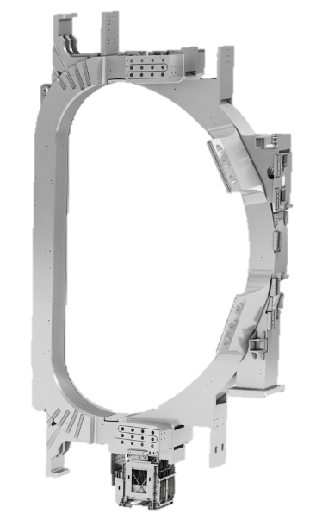
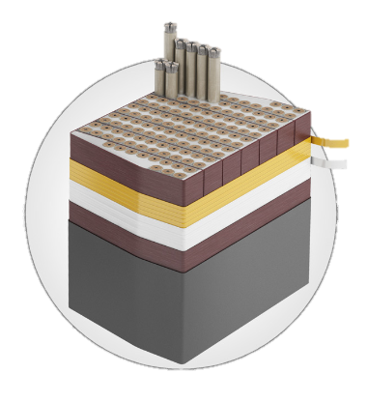
CCL integration in the manufacturing of the ITER TFC
Contents of the presentation
Introduction
Process overview
CCL calculation
WP Optimum Positioning
Virtual Assembly
CCL during Insertion
CCL after Welding
Conclusions

Slide 3
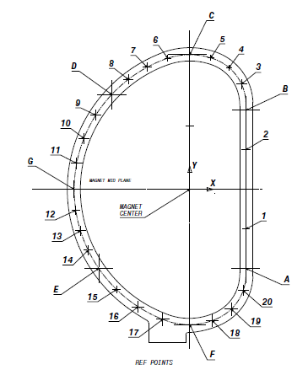
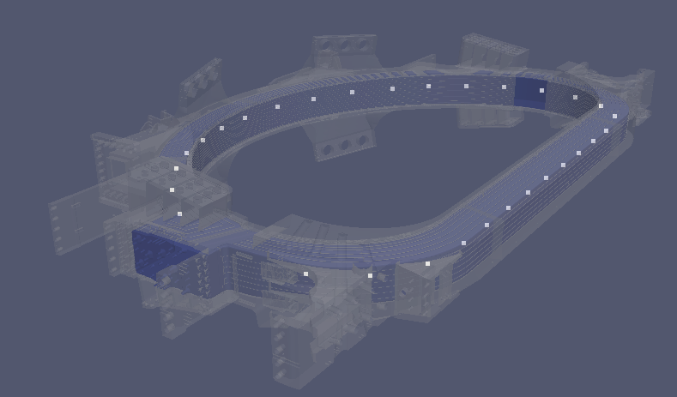
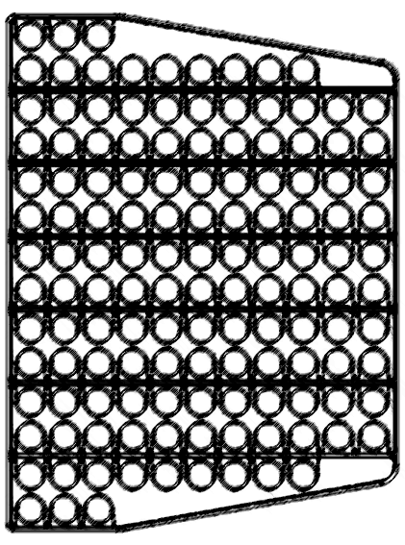
1. Introduction
What is the Current Centre Line?
Defined as the barycenter of the 134 turns of conductors
‘As-built’ information can be represented in the CCL
To be calculated in 27 sections of the TFC
Section 1
Section 1

Slide 4
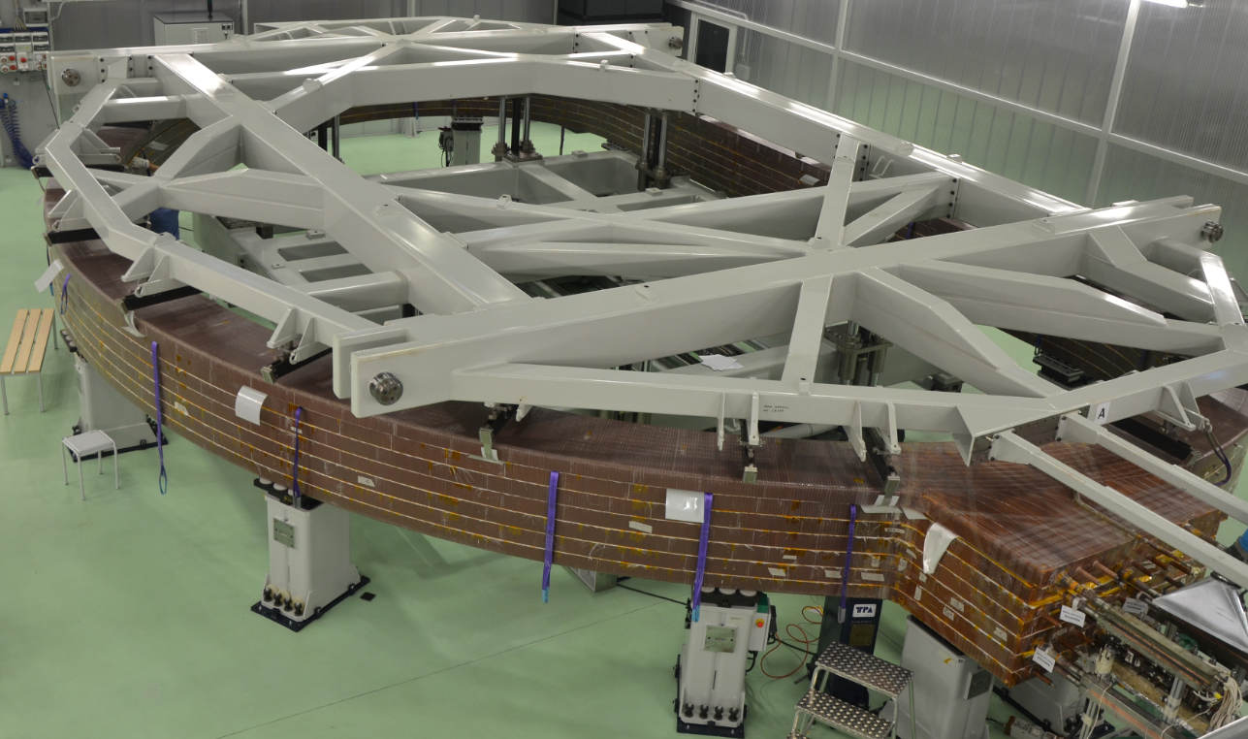
1. Introduction
Why is it useful?
Characterizes the magnetic field of the ‘as-built’ magnet
Manufacturing can be optimized to recover deviations
Proper CCL positioning is key to minimize Error Field
4

Slide 5
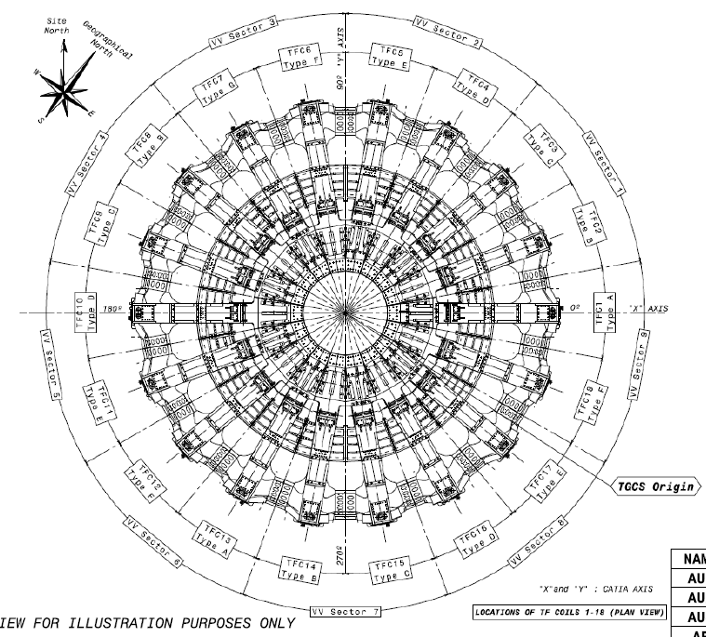
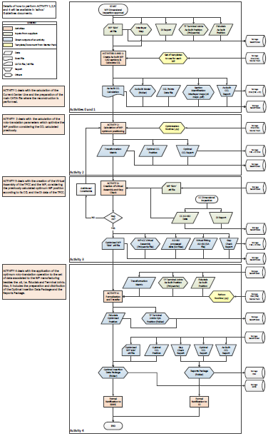
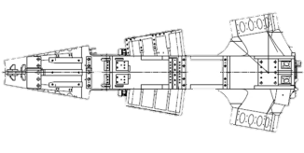
1. Introduction
Many actors, joint effort
18 TFCs to be assembled by the ITER Organization
Fabrication managed by F4E and QST, with 5 main suppliers
Harmonization effort to define insertion and final machining
Procedure stablished at F4E level to maintain Quality Assurance, Configuration and Control of the Data

Slide 6
2. Process Overview
Supplier’s manufacturing data is feed into PIRAMID
WP Data
TFCC Data
Insertion Data
CCL Calculation
WP Optimum Positioning
Virtual Assembly
CCL Update for Machining
Process for Integrating and Registering As-built Magnet data for Insertion Definition
Configuration Management maintained though ENOVIA Smarteam® PLM software

Slide 7
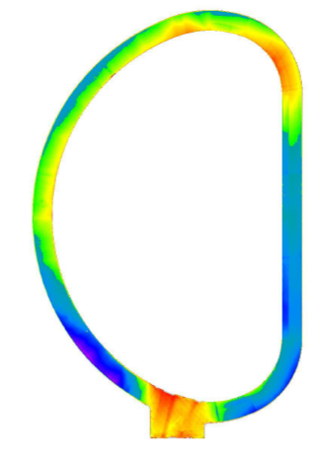
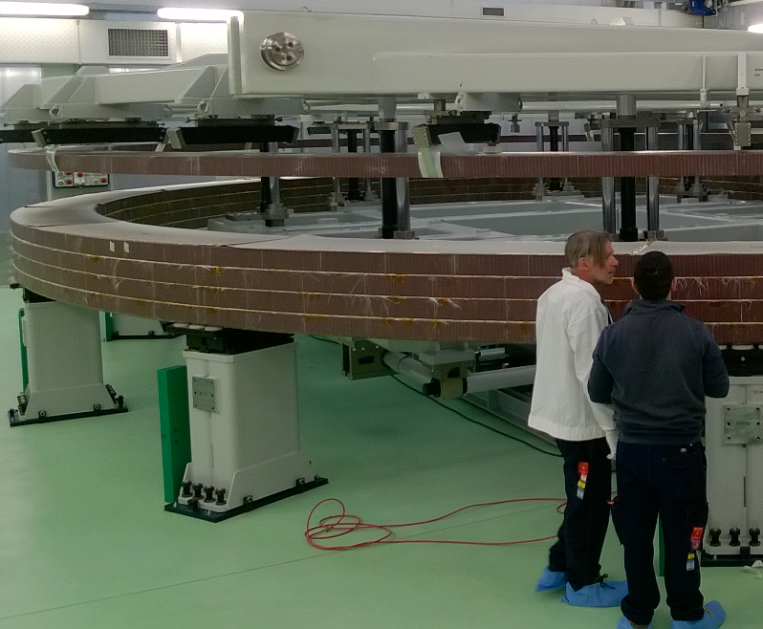
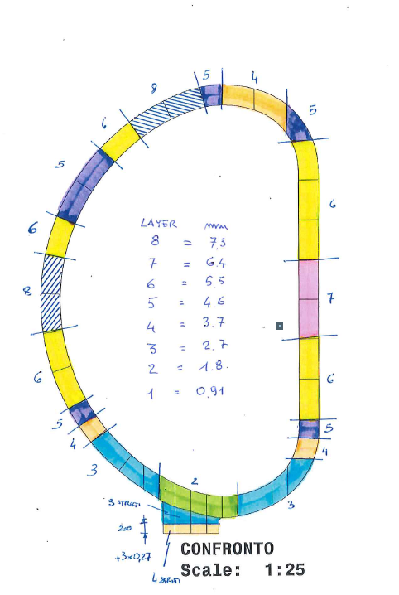
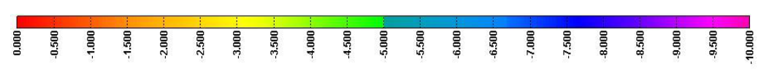
3. CCL Calculation
External surface shape analysis
Data from WP manufacturing
Interlayer map
during DPs stacking

Slide 8
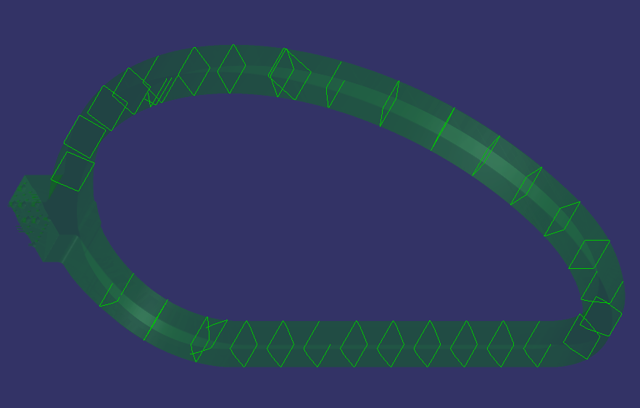
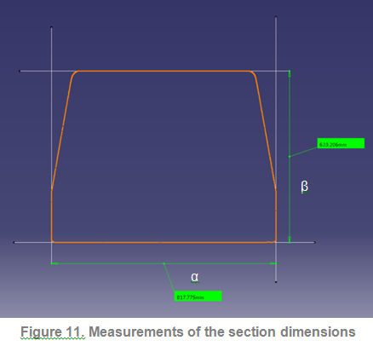
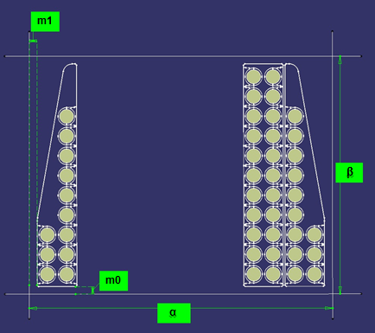
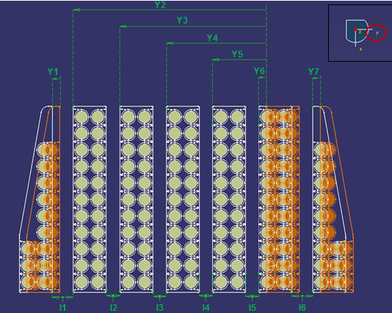
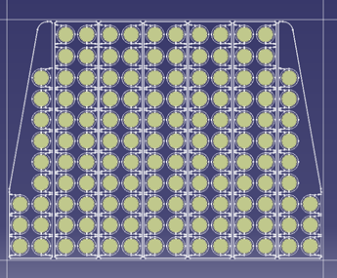
3. CCL Calculation
DP positioning
Construction of CAD model
1
2
3
4
Sections on WP external surface
Tolerance of conductor position inside RP groove, ground insulation and RP dimensions, considered in the uncertainty budget of the method.
Notes:
Section 3D scan of the WP at a relevant section
Calculate the thickness of the ground insulation*
Calculate interleaving thickness
Using the ground insulation and interleaving find the position for each DP
Locate conductors in DP
Calculate CCL as the barycenter of the conductors
*HYP: ground insulation is nominally homogeneous in specific section. Variations inside section taken into account in the uncertainty budget.

Slide 9
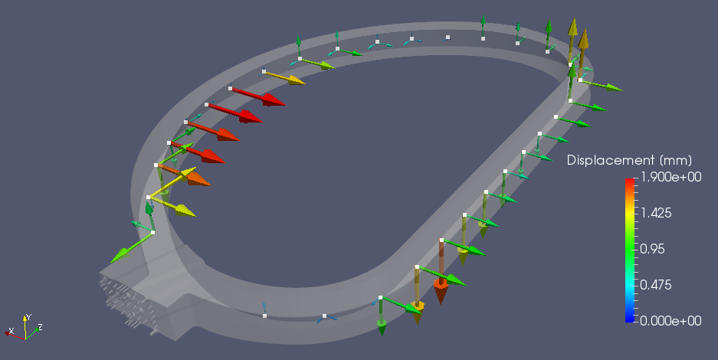
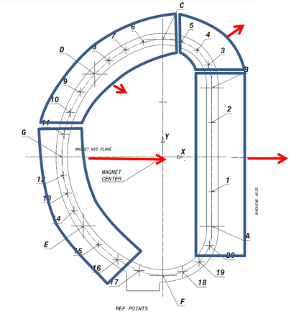
3. CCL Calculation
 | CCL Deviations
Sections | ΔX | ΔY | ΔZ | VECTOR
A | 0.20 | 0.00 | -1.52 | 1.53
B | 0.15 | 0.00 | 1.11 | 1.12
C | -0.84 | 0.64 | 0.72 | 1.28
D | -0.29 | -0.51 | 0.33 | 0.67
E | 0.85 | 1.16 | -1.15 | 1.84
F | NA | NA | NA | NA
G | 1.05 | 0.00 | 0.19 | 1.07
1 | -0.06 | 0.00 | -1.36 | 1.36
2 | -0.08 | 0.00 | -0.68 | 0.68
3 | 0.35 | 0.55 | 1.50 | 1.64
4 | -0.12 | 0.84 | 1.42 | 1.65
5 | -0.62 | 0.73 | 1.03 | 1.41
6 | -0.86 | 0.05 | 0.79 | 1.17
7 | -0.68 | -0.30 | -0.07 | 0.75
8 | -0.47 | -0.48 | 0.23 | 0.71
9 | 0.03 | -0.55 | 0.62 | 0.83
10 | 0.42 | -0.50 | 0.77 | 1.01
11 | 0.64 | -0.28 | 0.22 | 0.73
12 | 1.06 | 0.29 | -0.08 | 1.10
13 | 0.95 | 0.56 | 0.16 | 1.11
14 | 0.98 | 0.88 | -0.73 | 1.51
15 | 0.53 | 1.41 | -0.33 | 1.54
16 | -1.57 | -1.14 | 0.78 | 2.09
17
18 | -0.82 | -0.05 | 0.31 | 0.88
19 | -0.59 | -0.26 | 0.01 | 0.64
20 | 0.02 | -0.30 | -0.99 | 1.03
CCL deviation calculated in sections
Average ΔX = 0.9 mm, ΔY = 0.5 mm, ΔZ = 0.7 mm
Total average deviation = 1.38 mm (1.39 mm in the SL)
Notes:
Similar behaviour for all the 5 WP calculated so far

Slide 10
4. WP Optimum Positioning
Optimization to reduce deviations
Y translation (SL focus)
Specific step by step alignment focused to minimize SL deviations
Rotation around X (SL focus)
Optimization finally defined as a 3D roto-translation:
  ty = 0.80 mm
  tx = -0.84 mm
  Rx= 0.02°
  Rz = -0.007°
Rotation around Z (SL unvaried)
X translation
(SL focus)

Slide 11

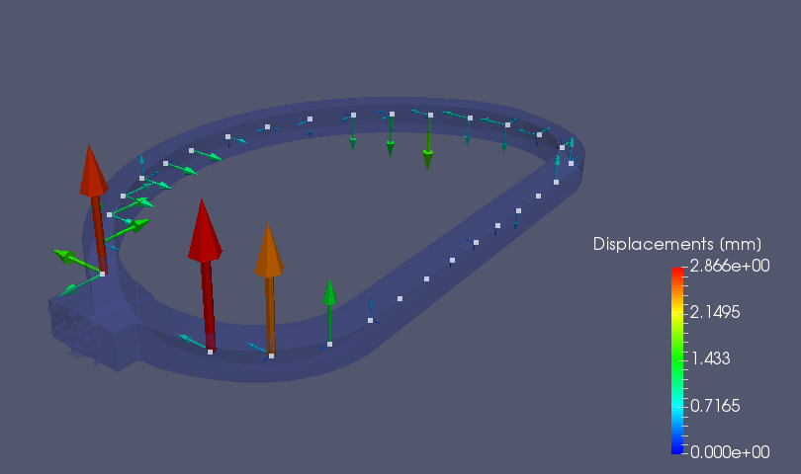
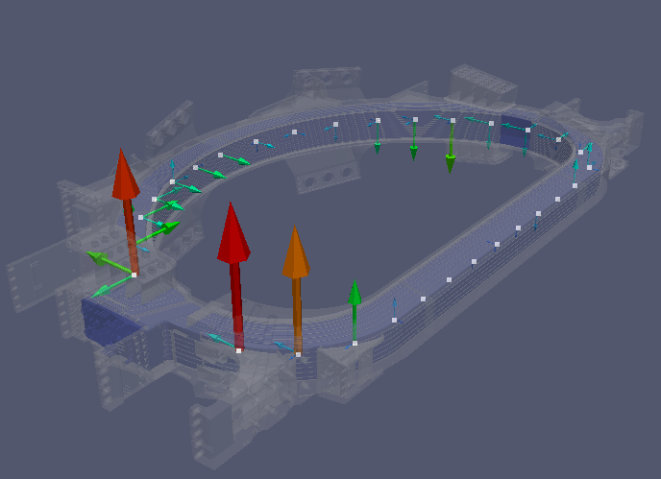
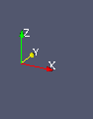
4. WP Optimum Positioning
Optimal position of the WP with new CCL associated
Vertical Deviations:
SL differences zeroed in average
(max dev. = 0.73 mm)
In all WP, average is 0.72mm
(max. 2.9 mm)
Horizontal deviations:
SL differences zeroed in average
(max dev. = 0.25 mm)
In all WP, average is 0.5mm
(max. 1.6mm)
WILL IT FIT?

Slide 12
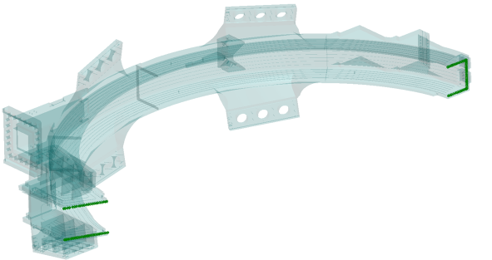
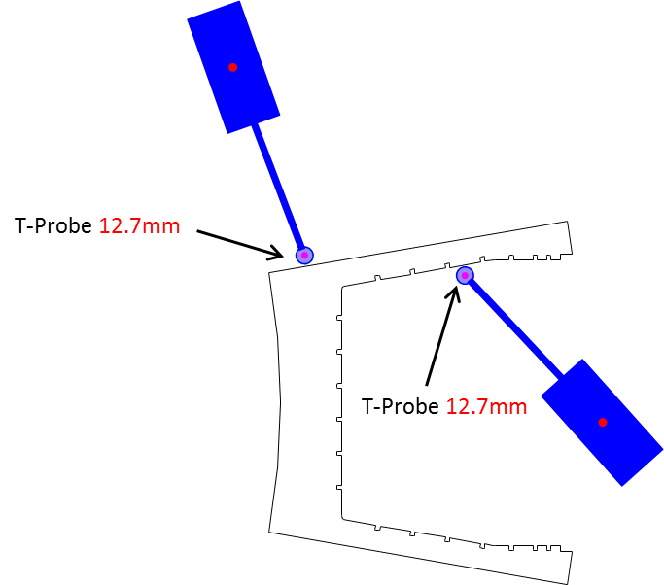
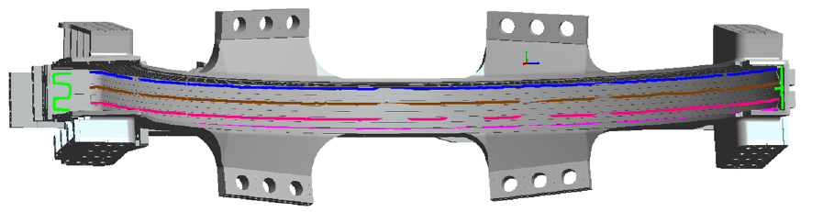
5. Virtual Assembly
Data from the TFCC manufacturing
Dimensional data in several digital formats are received from Japanese Suppliers
This is used for Virtual Fitting AU+BU cases
The WP in optimum position is also introduced in the Virtual Assembly

Slide 13
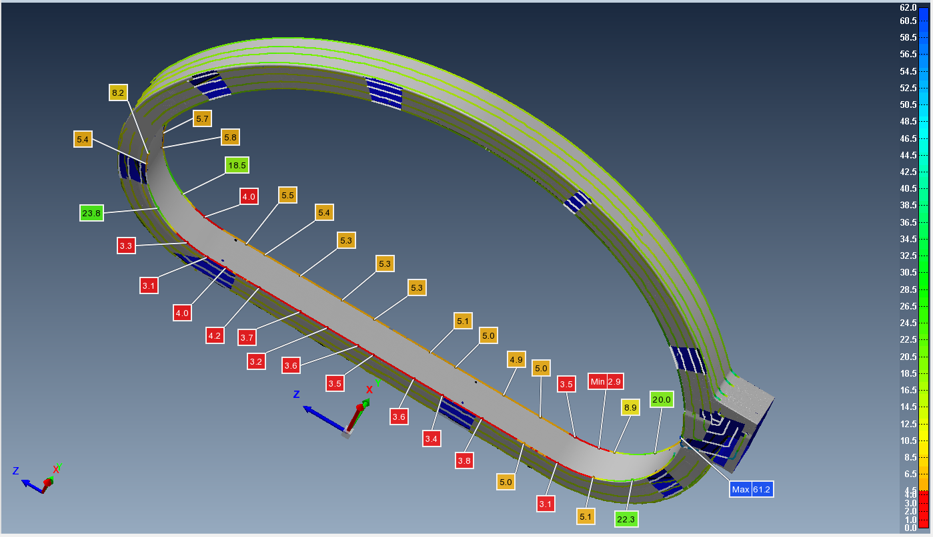
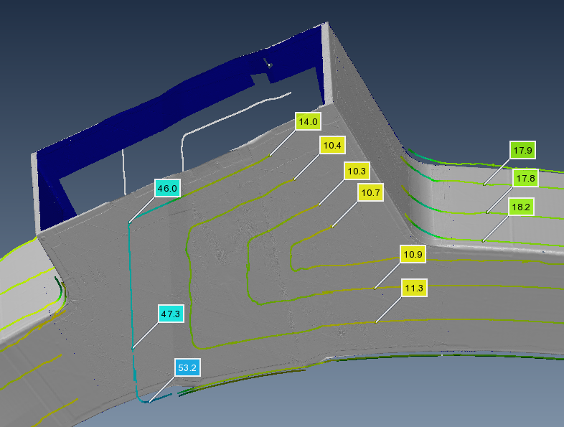
5. Virtual Assembly
Gap verification
No-Clashes and gap requirements are verified in all 3D WP volume
Experimental gap check confirmed Virtual Assembly results
Notes:
Gap values range from 11 to 23 mm. Avg. between model and measure is difference is ~1mm

Slide 14
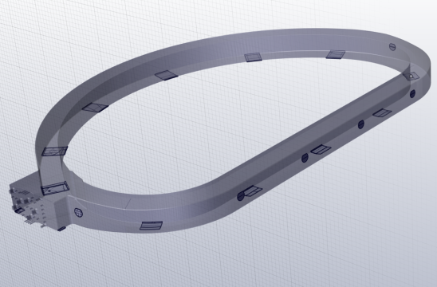
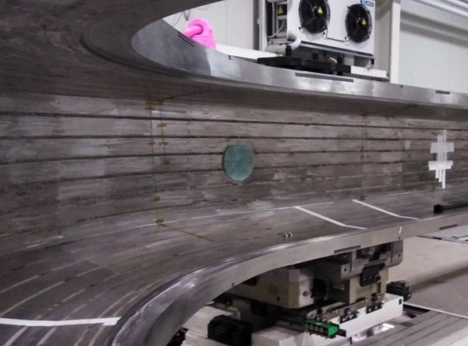
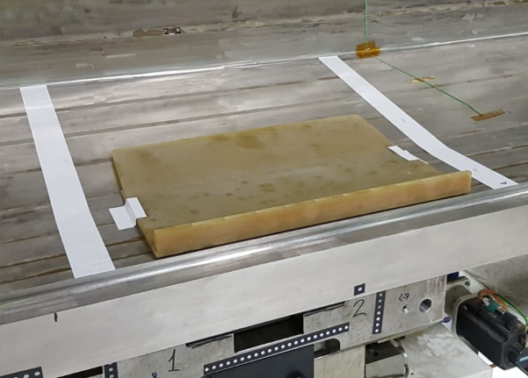
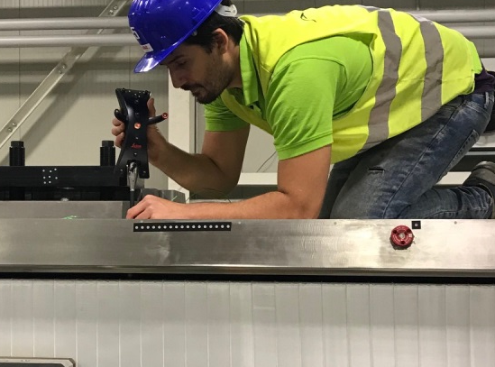
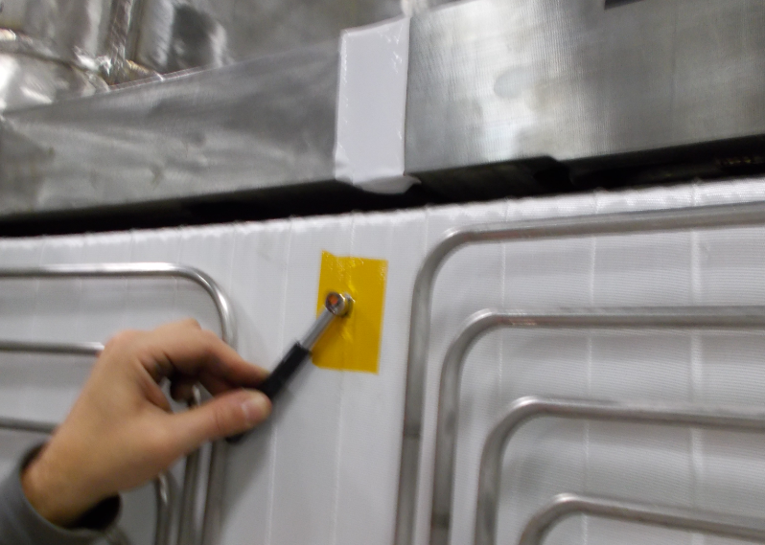
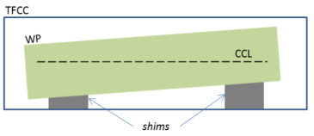
6. CCL during Insertion
Shimming between WP and TFCCs is defined
Reverse engineered shims implement WP position

Slide 15
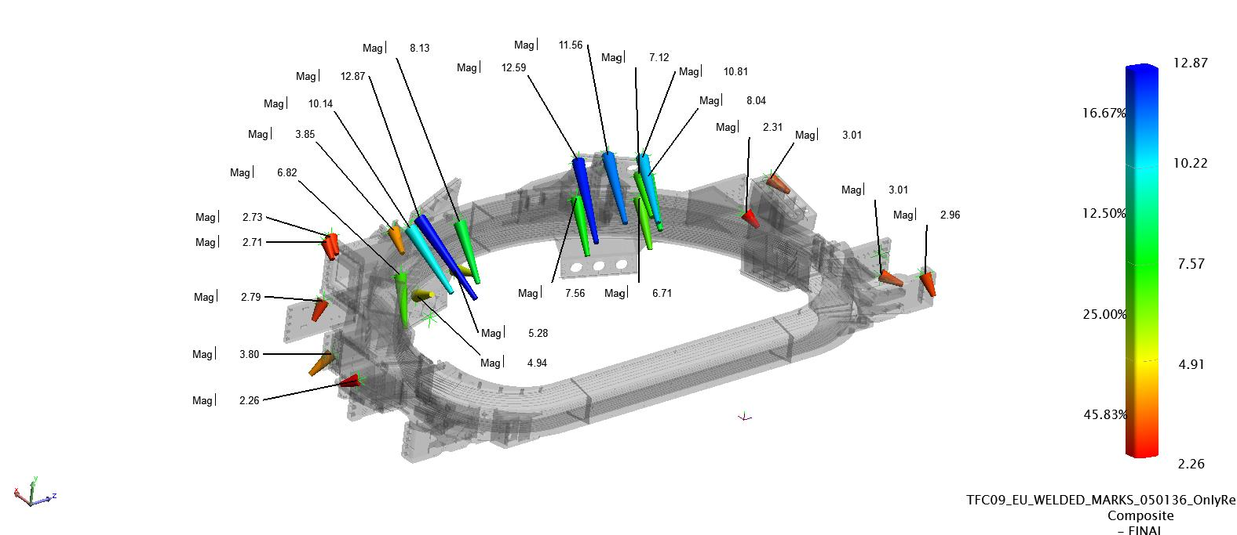
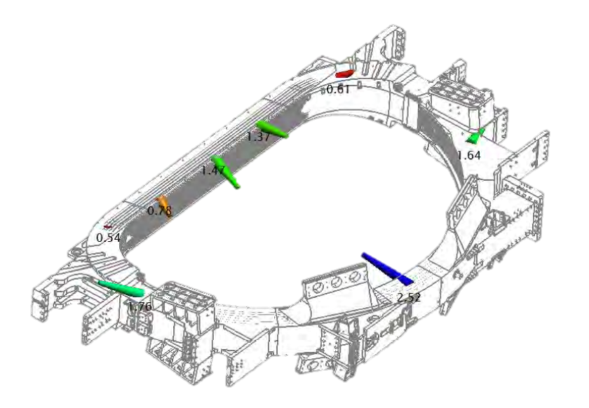
7. CCL after Closure Welding
Dimensional Inspection After welding TFC
WP position is measured with T-probe through VPI holes in the cases, to evaluate WP movement and position deviation.
TFC Fiducials and Interface areas are measured in detail with Laser Tracker and Scan

Slide 16
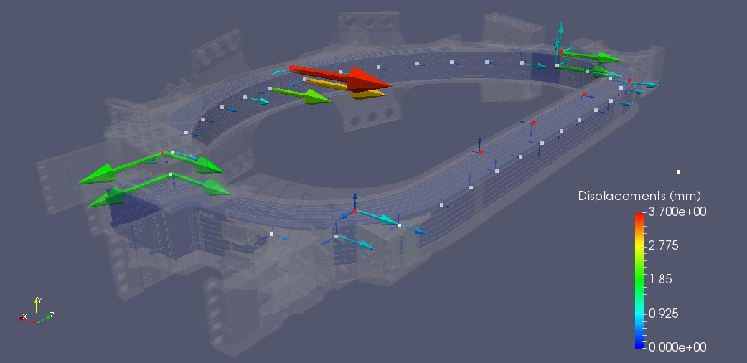
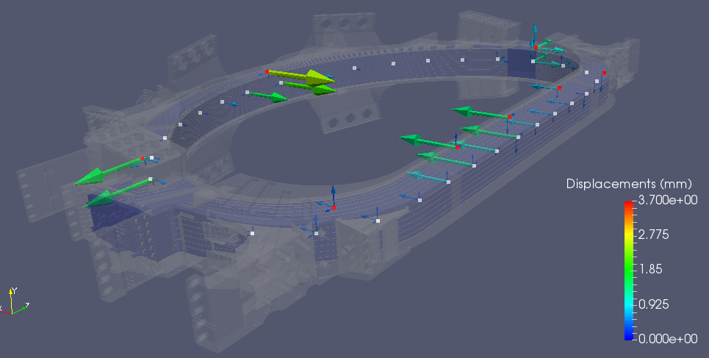
7. CCL after Closure Welding
WP deviation is interpolated to the CCL fiducials to obtain final CCL deviation w.r.t its optimum position
Final CCL Position
WP Fiducials
CCL Points
Results can be optimized considering different priorities for the TFC features.
After machining harmonization:
Negligible deviation of the CCL in the SL
Minimal deviation out-of-plane
Deviation in central D-shape due to case weld deformation

Slide 17
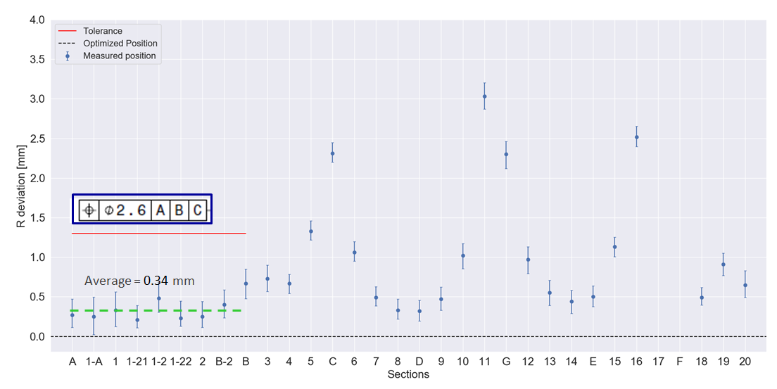
7. CCL after Closure Welding
Final CCL Position

Slide 18
8. Conclusions
F4E created CAE models to manage the CCL position throughout the TF manufacturing, using dimensional and other data from European and Japanese suppliers.
Standardized procedure set up to collect, process and store all the technical data.
All six WPs CCL calculation performed so far provide similar deviation results.
Great results on first EU TF#09, final average error 0.34 mm, well below required tolerance (ϕ 2.6 mm)
TF#09 data will be used by the IO in the assembly of the ITER machine.

Slide 19





Thanks for your attention!
Follow us on:
www.f4e.europa.eu
www.twitter.com/fusionforenergy
www.youtube.com/fusionforenergy
www.linkedin.com/company/fusion-for-energy www.flickr.com/photos/fusionforenergy
This publication reflects the views only of the author, and Fusion for Energy cannot be held responsible for any use which may be made of the information contained therein.
The views and opinions expressed herein do not necessarily reflect those of the ITER Organization.

