Slide 1






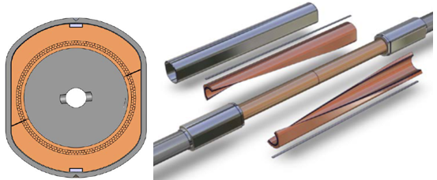
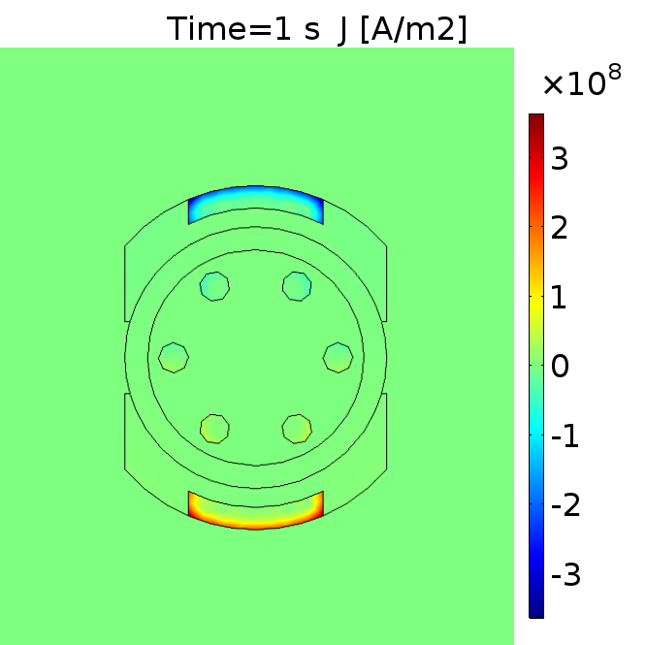
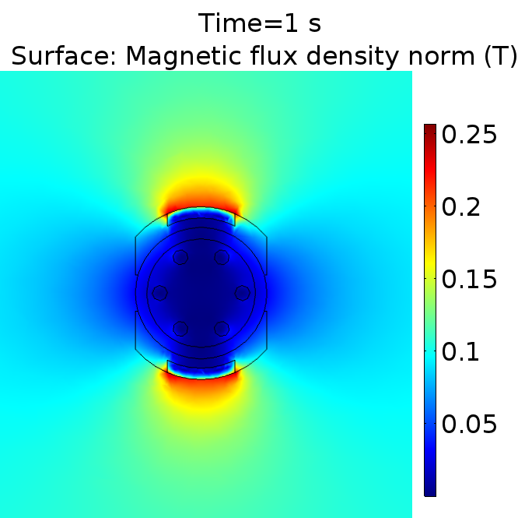
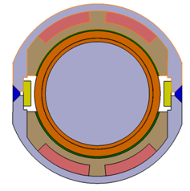
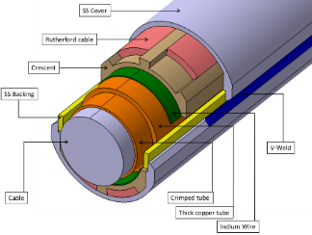
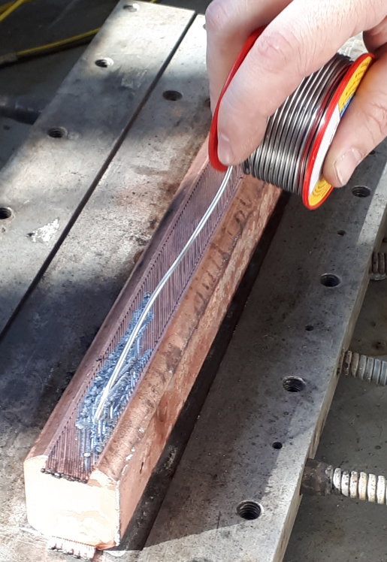
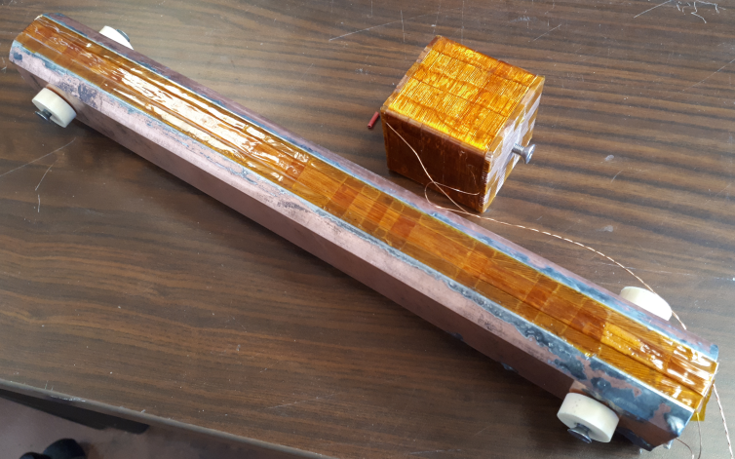


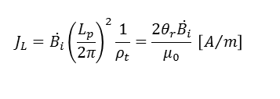

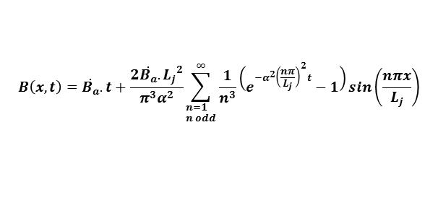
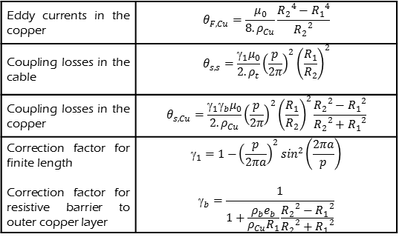


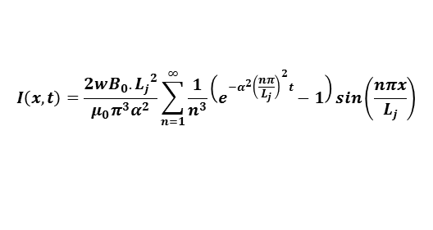
INDUCED CURRENTS AND AC LOSSES MODELS FOR A BUTT-JOINT WITH RUTHERFORDS SHUNTS
Torre, P. Decool, G. Jiolat
CEA, IRFM, F-13108 Saint Paul-lez-Durance France
T. Schild, E. Gaxiola
ITER Organization
The ITER Central Solenoid (CS) has terminal butt-type joints called Coaxial joints. It was decided to study a design of this joint with rutherford shunts, and to build models for its resistive and inductive behaviors. In particular, the behavior of the joint under magnetic field transients is investigated with various analytical models that are compared with a FEM model. The key point of the study was to verify that the induced currents were reasonable and would not induce flux jumps in the rutherfords. A prototype with simplified geometry was tested in the CEA Josefa facility under various field ramps. The results are presented and discussed.
JOINT DESIGNS & MAIN PARAMETERS DC RESISTANCE EVALUATION
Design parameters | Value | Unit
Joint total length | 355 | [mm]
Cable compacted diameter | 29 | [mm]
Residual void fraction | 20 | [%]
Cable last twist pitch | 450 | [mm]
Max background operating field | 3,9 | [T]
Operating current | 45 | [kA]
dB/dt transverse | 0,1 | [T/s]
dB/dt axial | 0,1 | [T/s]
Resistance of the material layers for each configuration was estimated using the geometrical parameters and material resistivities.
The materials layers themselves contribute to about 0,3 nΩ of DC resistance (PRD and LUD). The rest is mainly contact resistances, which can be modelled by addition of a resistive layer:
AC LOSSES MODEL - PRD
Between 1D model and 3D real geometry, a demagnetization factor 2 is applied (relevant to rod-slab equivalence).
FEM MODEL
A COMSOL fem model was also developed to cross-check the values computed by the analytical model. Current and field distributions are shown below. It was also used to compute axial field variation reaction.
Laced Union Design (LUD)
$$ρ_{b}e_{b}=R_{ctc}∗S_{ctc}$$
R_{ctc} | $$ρ_{b}e_{b}$$
1 nΩ | 8.14e-12 Ω.m²
AC LOSSES MODEL - PRD
Baseline
For a partial screening by parallel rutherfords, the usual composite model (see below) is not applicable. A model based on 1D magnetic diffusion is developed:
Eigenfunction expansion:
External Sc shells (soldered)
2 layers of twisted strands [1200mm]
$$∆B−\frac{μ_{0}}{ρ}\frac{∂B}{∂t}=0$$
w
Iz(x,t)
z
ρ=0
D
It(x,t)
y
ρt
x
MOCKUP & TEST
Parrallel Rutherfords Design (PRD)
$$B\left(0,t\right)=B\left(L_{j},t\right)=\dot{B_{a}}t$$
Ba=By(t)=0.1*t
Lj
A simplified mockup was manufactured using rutherfords cables soldered to a copper block with similar geometry.
$$B\left(x,t\right)=\dot{B_{a}}.t+\frac{2\dot{B_{a}}.{L_{j}}^{2}}{π^{3}α^{2}}\sum_{\begin{aligned}&n=1 \\ &n odd\end{aligned}}^{∞}{\frac{1}{n^{3}}\left(e^{−α^{2}{\left(\frac{nπ}{L_{j}}\right)}^{2}t}−1\right)sin\left(\frac{nπx}{L_{j}}\right)}$$
Straight copper shells
Parrallel rutherfords
Untested
$$I\left(x,t\right)=\frac{2wB_{0}.{L_{j}}^{2}}{μ_{0}π^{3}α^{2}}\sum_{n=1}^{∞}{\frac{1}{n^{3}}\left(e^{−α^{2}{\left(\frac{nπ}{L_{j}}\right)}^{2}t}−1\right)sin\left(\frac{nπx}{L_{j}}\right)}$$
AC LOSSES - LUD
The LUD design has a complete outer superconducting cylindrical shell. This implies a very good shielding of the perpendicular field variation.
The composite (strand) model for AC losses* can be applied:
ρ_{Cu}
The mockup was tested in the Josefa Facility (CEA / up to 1T/s). Model (dashed) is confronted to the experimental measurements (plain) in these induced voltage curves..
R₂
Eddy currents in the copper | $$θ_{F,Cu}=\frac{μ_{0}}{8.ρ_{Cu}}\frac{{R_{2}}^{4}−{R_{1}}^{4}}{{R_{2}}^{2}}$$
Coupling losses in the cable | $$θ_{s,s}=\frac{γ_{1}μ_{0}}{2.ρ_{t}}{\left(\frac{p}{2π}\right)}^{2}{\left(\frac{R_{1}}{R_{2}}\right)}^{2}$$
Coupling losses in the copper | $$θ_{s,Cu}=\frac{γ_{1}γ_{b}μ_{0}}{2.ρ_{Cu}}{\left(\frac{p}{2π}\right)}^{2}{\left(\frac{R_{1}}{R_{2}}\right)}^{2}\frac{{R_{2}}^{2}−{R_{1}}^{2}}{{R_{2}}^{2}+{R_{1}}^{2}}$$
Correction factor for finite length Correction factor for resistive barrier to outer copper layer | $$_{1}=1{−\left(\frac{p}{2πa}\right)}^{2}\sin^{2}\left(\frac{2πa}{p}\right)$$ $$_{b}=\frac{1}{1+\frac{ρ_{b}e_{b}}{ρ_{Cu}R_{1}}\frac{{R_{2}}^{2}−{R_{1}}^{2}}{{R_{2}}^{2}+{R_{1}}^{2}}}$$
R₁
Model Losses Calculation for T=1s runs
Runs | I_{ruth} [kA] | P_{tot max} [W] | E_{tot 1s} [J] | E_{tot 20s} [J] | T_{max 1s} [K] | T_{max 20s} [K]
B_{e} = 0.1 T | 3.19 | 0.084 | 0.037 | 0.50 | 5.65 | 8.13
B_{e} = 0.4 T | 12.8 | 1.35 | 0.61 | 8.00 | 12.4 | 18.1
B_{e} = 0.6 T | 19.9 | 3.26 | 1.52 | 19.4 | 15.9 | 22.3
B_{e} = 0.8 T | 25.6 | 5.40 | 2.51 | 32.1 | 18.1 | 25.0
ρ_{t}
ρ_{b}e_{b}
Field transient : 0,1T/s during 1s + plateau
Computed power and induced currents
Onset of instabilities is found at around 0,6T field variation :
CONCLUSION
$$P=\frac{2θ_{tot}{\dot{B_{i}}}^{2}}{μ_{0}} [\frac{W}{m3}]$$
$$J_{L}=\dot{B_{i}}{\left(\frac{L_{p}}{2π}\right)}^{2}\frac{1}{ρ_{t}}=\frac{2θ_{r}\dot{B_{i}}}{μ_{0}} \left[A/m\right]$$
Two coaxial joint designs are still being investigated. For both designs, an AC losses and induced currents assessment was necessary, For the PRD, the model is based on magnetic diffusion equation, and was confronted with experiment. For both designs, 0,1T/s field variation, axial and transverse, are acceptable.
* J.L. Duchateau et. al, “Coupling-current losses in composites and cables: analytical calculations”, Handbook of Applied Supercon-ductivity, Volume 2, IoP, 1998.

