Slide 1

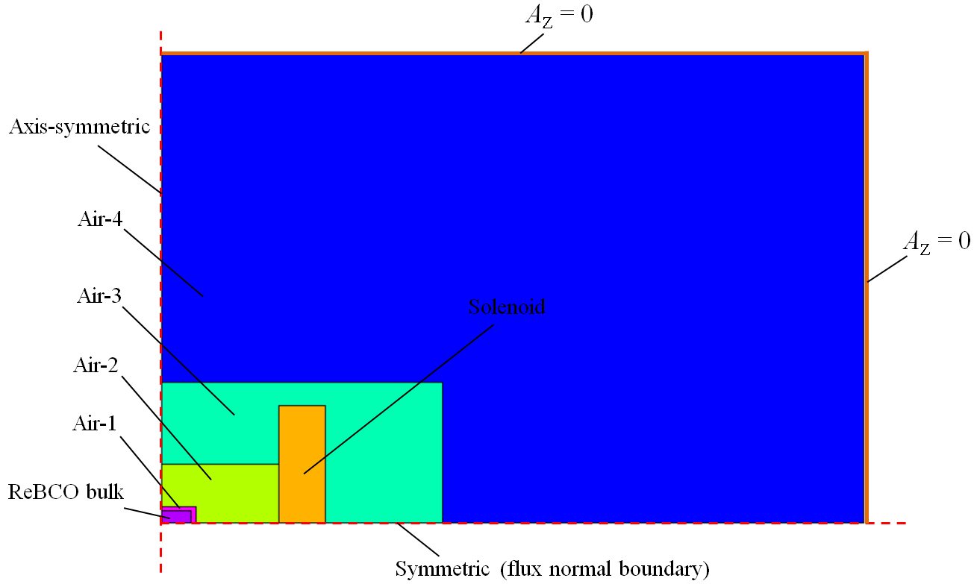
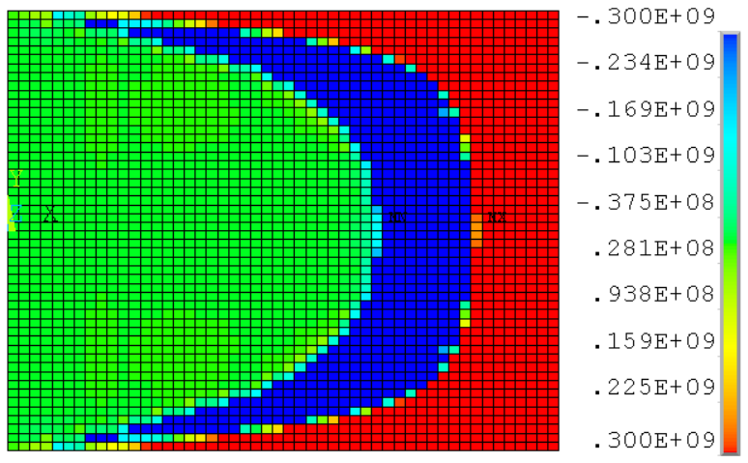
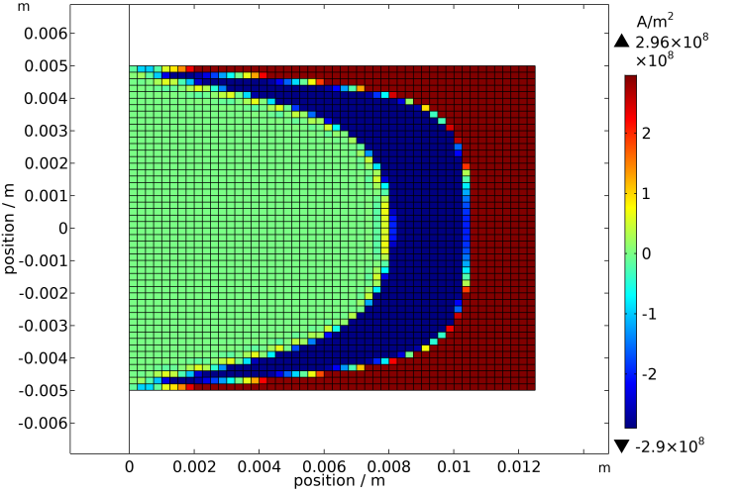
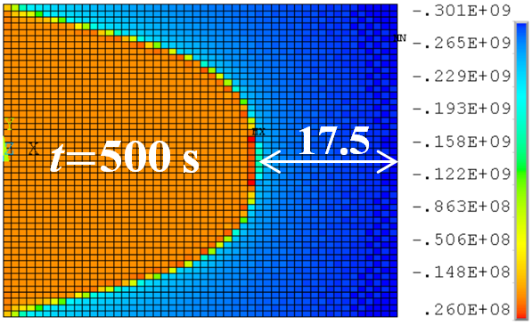
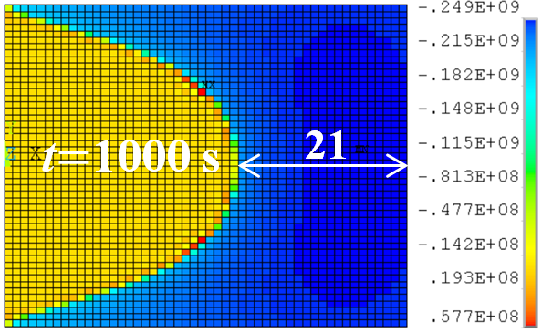
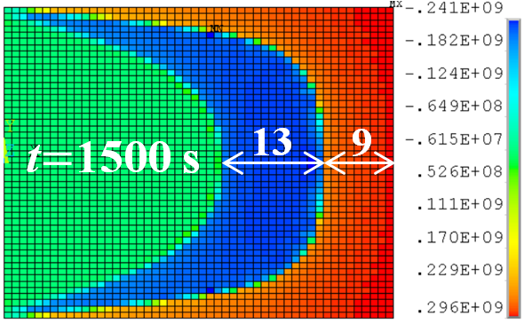
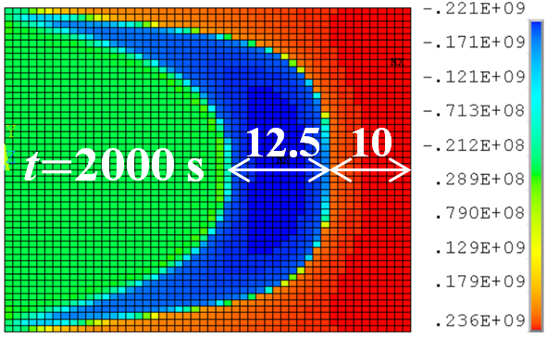
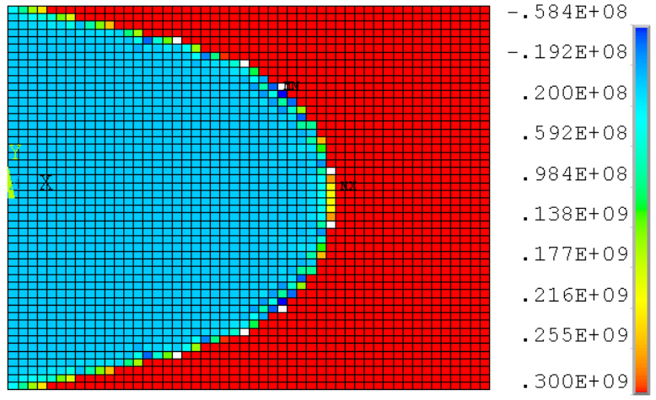
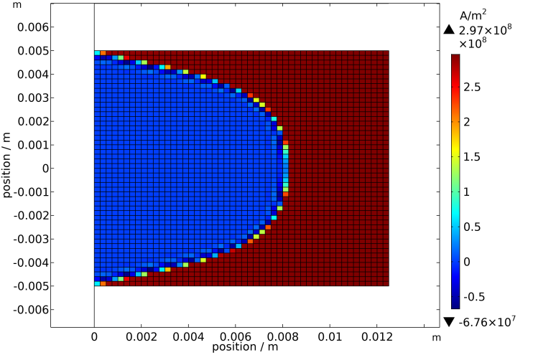
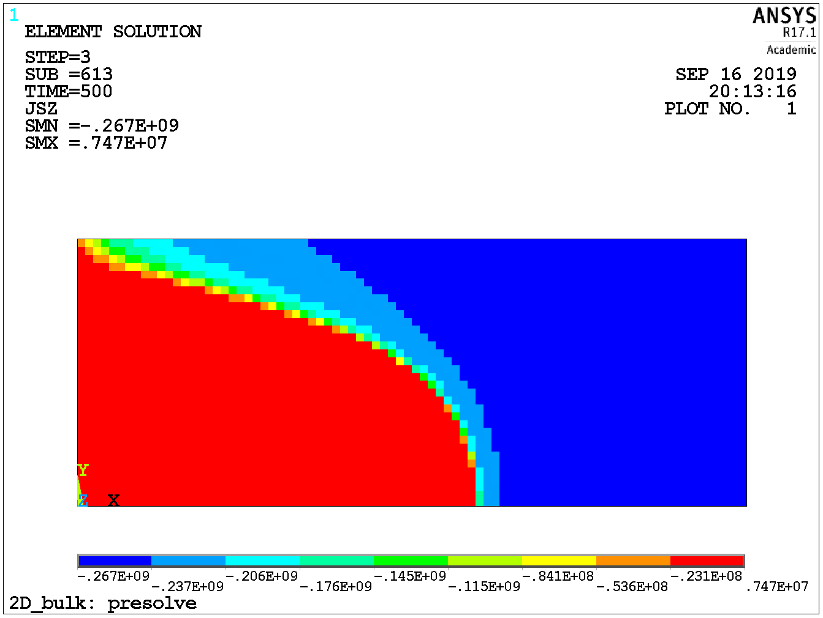
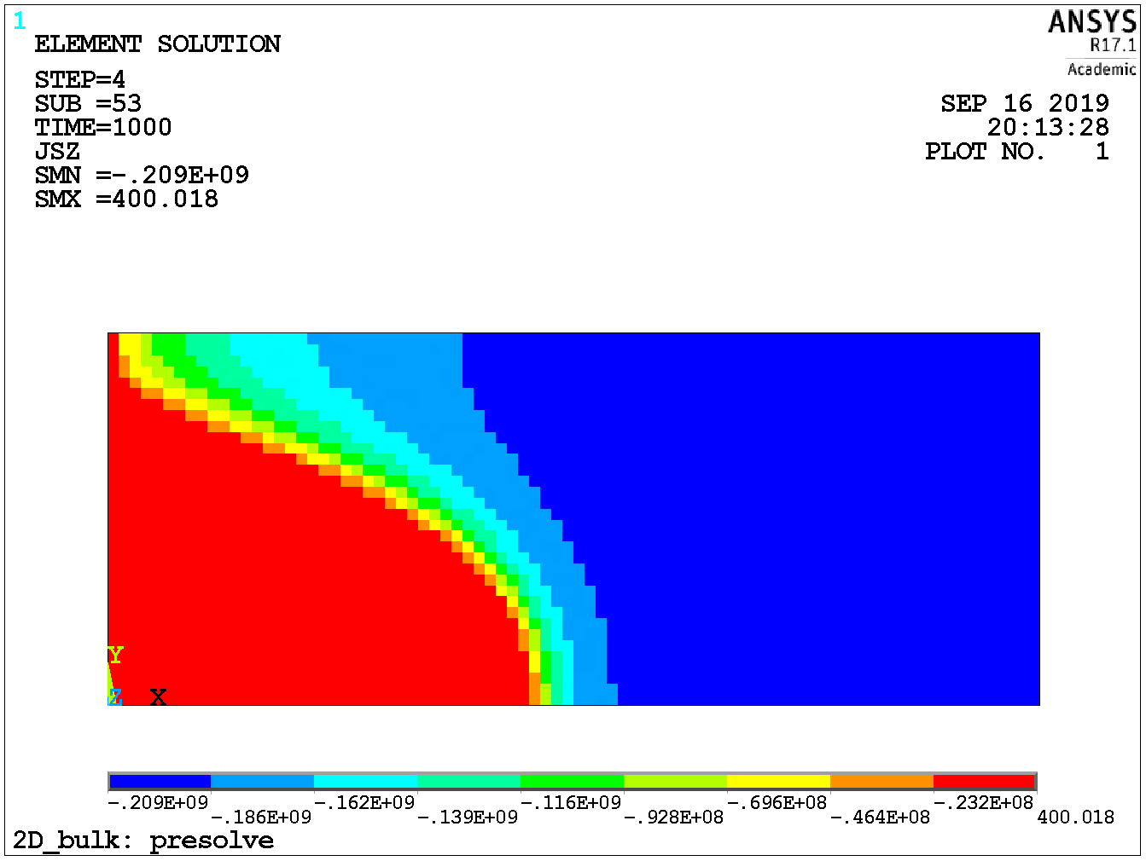
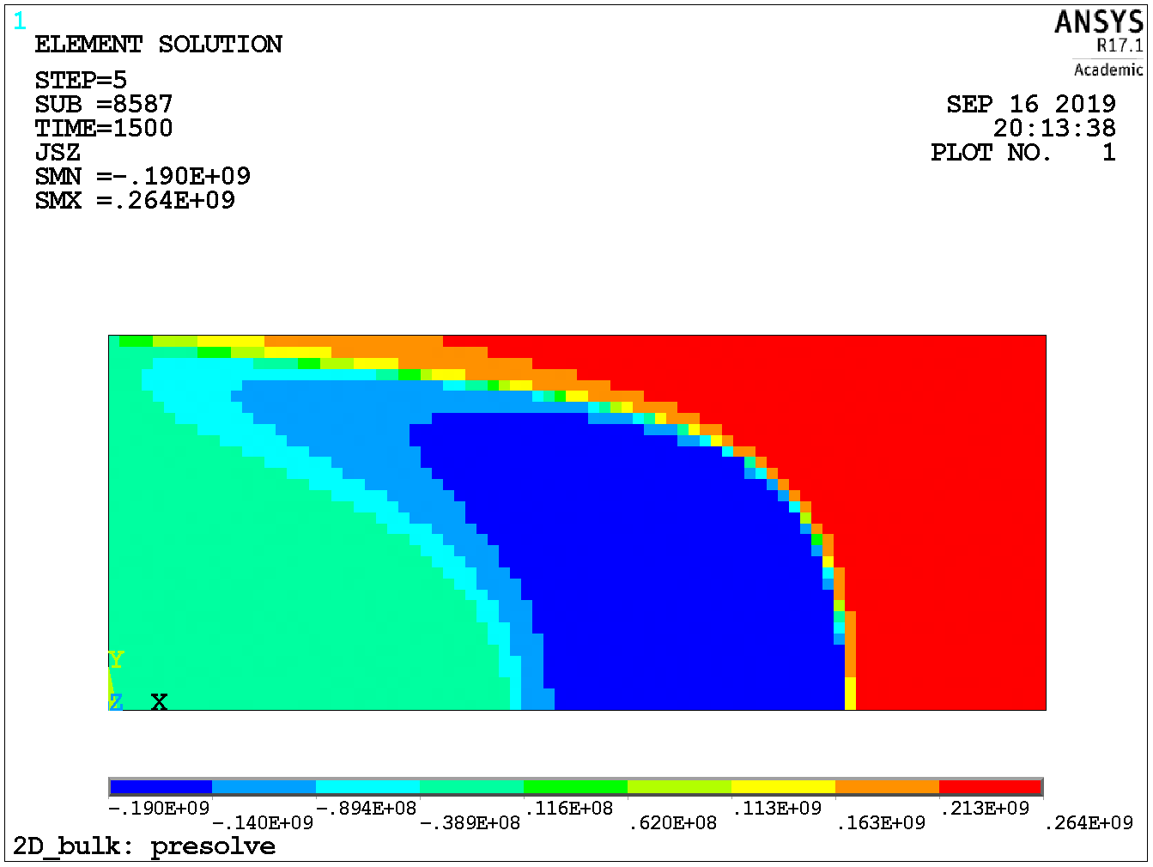
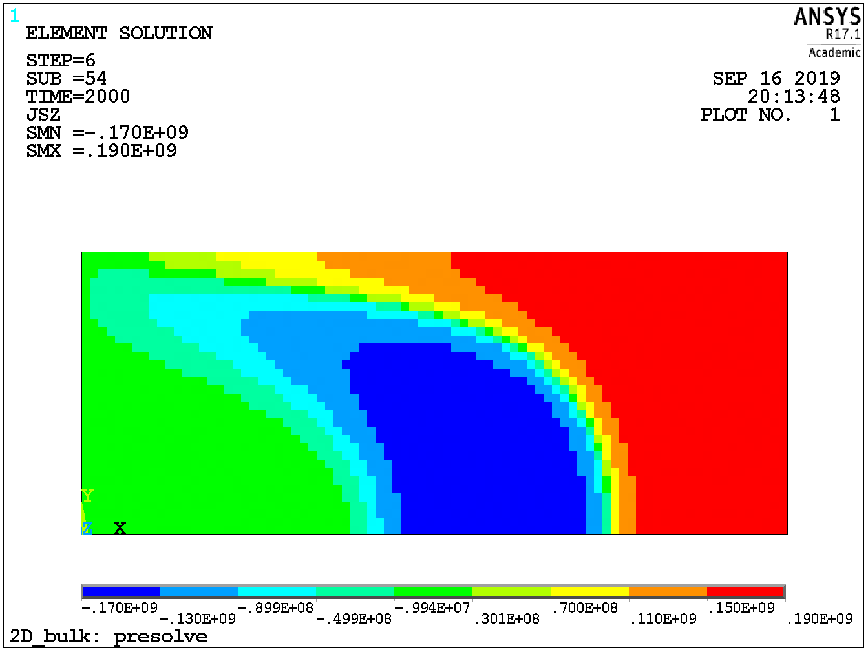
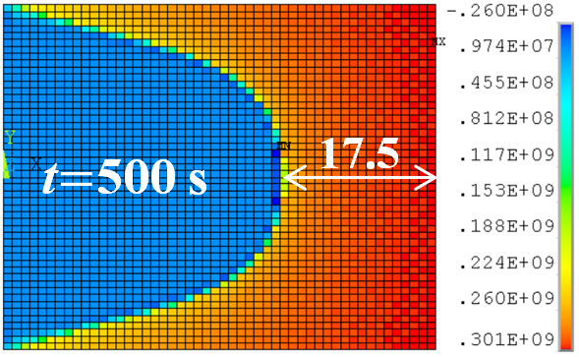
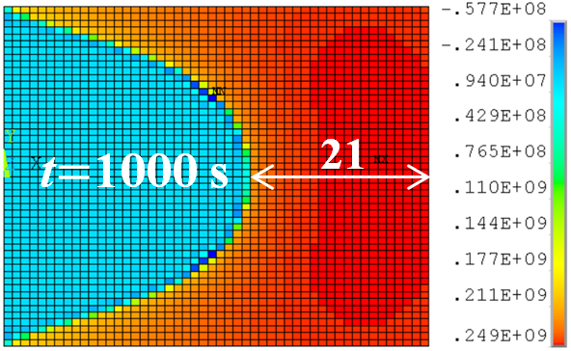
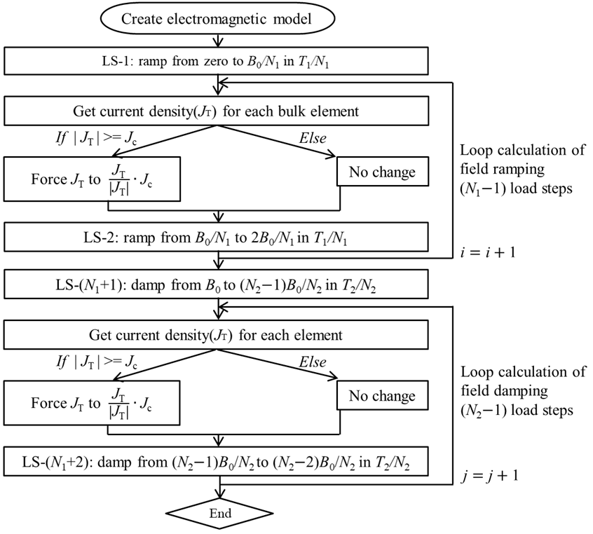
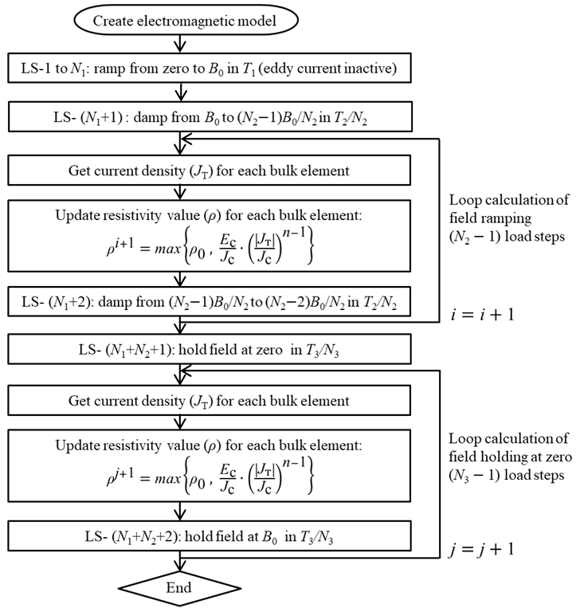
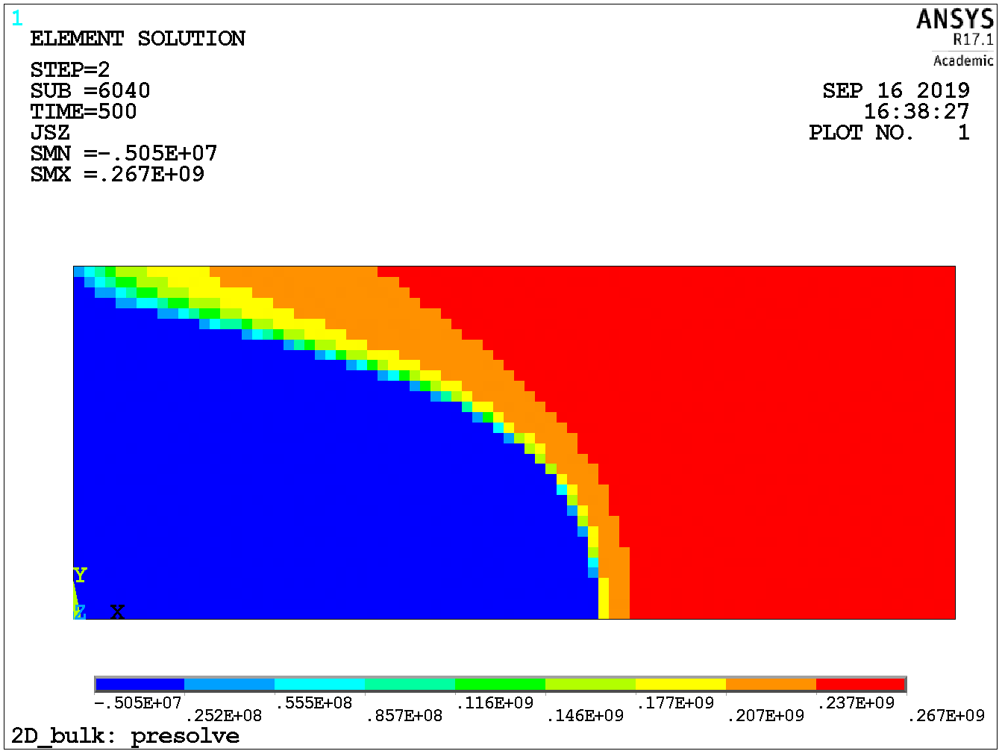
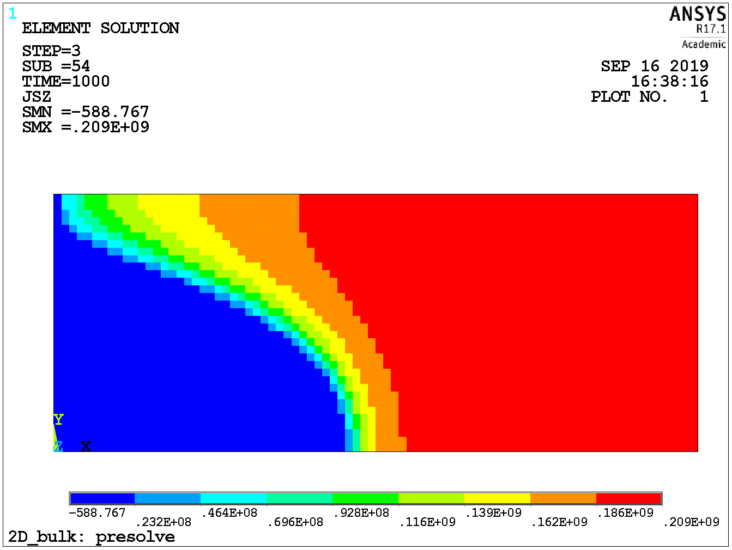
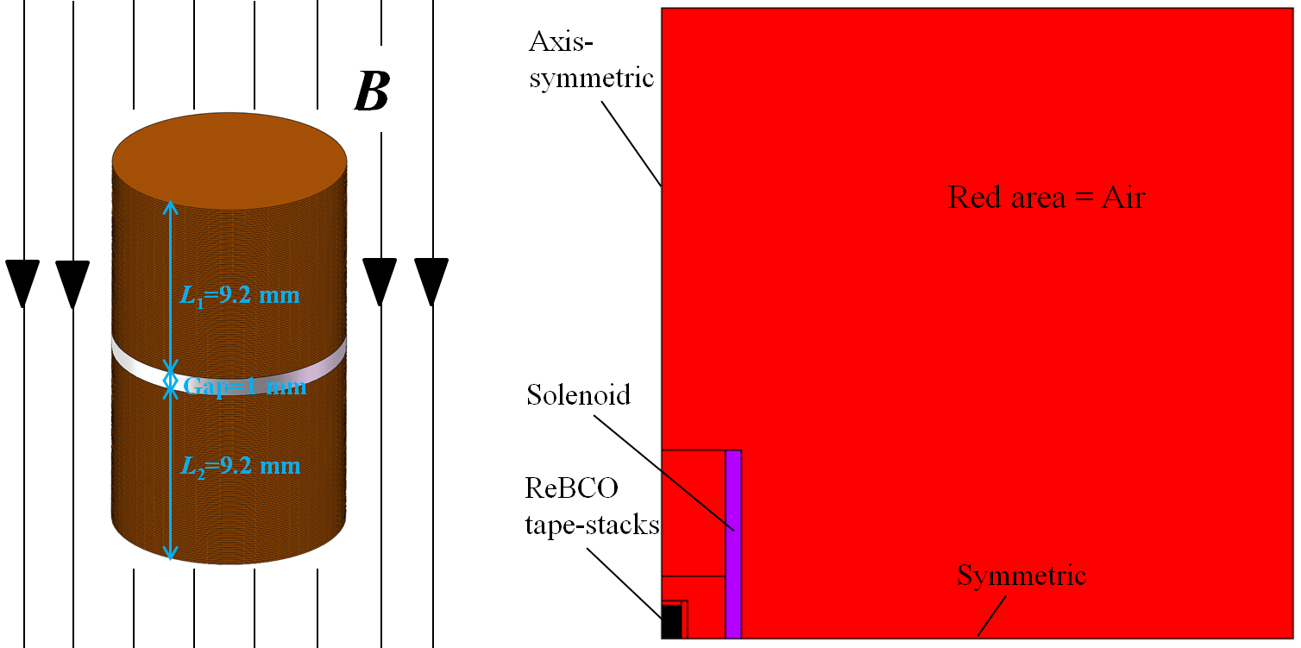
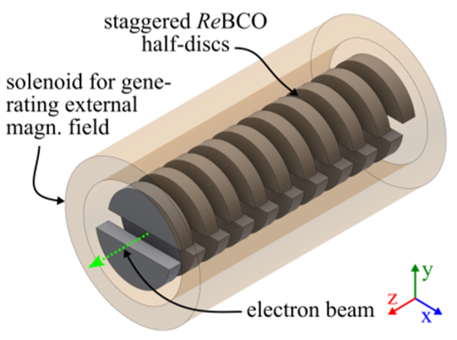
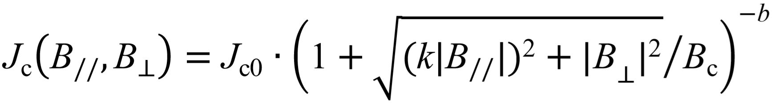
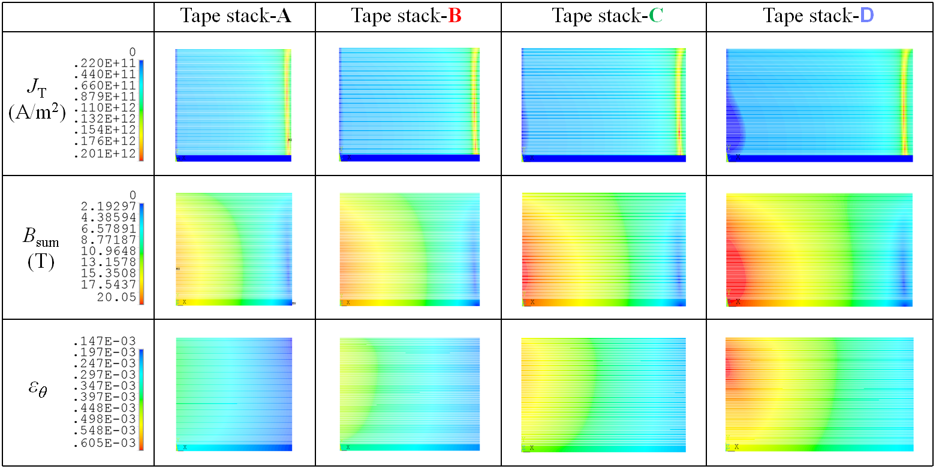
Magnetization simulation of ReBCO bulk and tape stack using ANSYS A-V-A formula based iterative algorithm method (IAM) and user-defined element (UDE)
Kai Zhang¹, Lucas Brouwer², Sebastian Hellmann¹, Marco Calvi¹, Thomas Schmidt¹
¹ Paul Scherrer Institute, Villigen, Switzerland (e-mail: kai.zhang@psi.ch; sebastian.hellmann@psi.ch; marco.calvi@psi.ch; thomas.schmidt@psi.ch)
² Lawrence Berkeley National Laboratory, CA, USA (e-mail: LNBrouwer@lbl.gov)
Presentation ID
Mon-Mo-Po1.02-09
Abstract: The A-V-A formula based iterative algorithm method (IAM) is for the first time developed and implemented in ANSYS to simulate the critical state model and the flux creep model based magnetization problems of ReBCO bulks. The benchmark simulation results agree well with the results from using the H-formula in COMSOL. The computation time is saved by using A-V formula in superconductor areas and A-formula in non-superconductor areas. Further studies prove this new method fits well in solving more complex magnetization models, like the ReBCO tape stack and the ReBCO bulks staggered array undulator for hard X-ray free electron laser (FEL). Second we explored the feasibility of modeling the magnetization of HTS by creating a user-defined element (UDE) in ANSYS. Like the easiness of defining PDEs in COMSOL, the features like E-J power and the Kim model can be pre-installed in the UDE. Preliminary benchmark simulation results from using this new UDE in ANSYS are given in this poster.
ReBCO bulk
(Φ25 mm, 10 mm thick)
Figure 1. 2D axis-symmetric half FEA model for the ReBCO bulk’s magnetization
Solve the critical state model magnetization of ReBCO bulk by using IAM
Solve the flux creep model magnetization of ReBCO bulk by using IAM and UDE
ZFC
ZFC
J_{c}=3e8 A/m²,
n=20
(a)
(b)
(c)
by using IAM
More details of the UDE can be found from
FC
Figure 3. ZFC magnetization. External field rises linearly from zero to 1 T in 500 s and then holds at 1 T for 500 s and then drops linearly to zero in 500 s and then holds at zero for 500 s
[2] L. Brouwer, D. Arbelaze, B. Auchmann, L. Bortot and E. Stubberud, Supercond. Sci. Technol. 32, 095011, 2019
[3] K. Edwards, L. Brouwer, J. F. Troitino, D. Arbelaez and S. Prestemon, User Defined ANSYS Elements for 3D Multiphysics Modeling of Superconducting Magnets, to be presented in this conference, Mon-Mo-Po1.02-07, 2019.
(d)
(e)
(f)
More details of the A-V-A formula based IAM can be found from
t=500 s
t=1000 s
[1] K. Zhang, S. Hellmann, M. Calvi, T. Schmidt and L. Brouwer, Magnetization current simulation of high temperature bulk superconductors using A-V-A formula based iterative algorithm method, arXiv:1908.04640, 2019
t=1500 s
t=2000 s
by using UDE
Figure 2. Trapped current density in ReBCO bulk after (a) zero field cooling (ZFC) magnetization by using (b) A-V-A formula in ANSYS and (c) H-formula in COMSOL. Trapped current density in ReBCO bulk after (d) field cooling (FC) magnetization by using (e) A-V-A formula in ANSYS and (f) H-formula in COMSOL. (J_{c}=3e8 A/m², set n=200 in COMSOL to approach the CSM)
FC
by using IAM
J_{c}=3e8 A/m²,
n=20
Figure 4. FC magnetization. External field drops linearly to zero in 500 s and then holds at zero for 500 s.
t=500 s
t=1000 s
by using UDE
Model the FC magnetization of ReBCO tape stack
(a)
(b)
(c)
(d)
Figure 5. Left: Iterative algorithm method for simulating critical state model based ZFC magnetization in Figure 2 (a); Right: Iterative algorithm method for simulating flux creep model based FC magnetization in Figure 4.
Model the FC magnetization of ReBCO bulks staggered array undulator
Figure 6. (a) FC magnetization of the ReBCO tape stack; (b) 2D axis-symmetric half FEA model created in ANSYS; (c) Critical current density of the SuperOx tape at 4.2 K as a function of magnetic field and field angle; (d) Trapped B_{y} at the gap center during FC magnetization.
(1)
Tape stack-A: Φ20 mm
400 layers
46 μm tape
L₁=L₂=9.2 mm
Tape stack-B: Φ24 mm;
400 layers
46 μm tape
L₁=L₂=9.2 mm
Tape stack-C: Φ28 mm;
400 layers
46 μm tape
L₁=L₂=9.2 mm
Tape stack-D: Φ32 mm
400 layers
46 μm tape
L₁=L₂=9.2 mm
Figure 8. ReBCO bulks staggered array undulator [4]
Figure 9. Trapped undulator field during magnetization [5]
More details can be found from
[4] S. Hellmann, M. Calvi, T. Schmidt and K. Zhang, Numerical Design Optimization of Short-Period HTS Staggered Array Undulators, to be presented in this conference, Wed-Af-Po3.16-06, 2019.
[5] M. Calvi, M. D. Ainslie, A. Dennis, J. H. Durrell, S. Hellmann, T. Schmidt1, Y. Shi, K. Zhang, A GdBCO bulk staggered array undulator, presented in the 11th International Workshop on Processing and Applications of Superconducting Bulk Materials and presented in EUCAS2019.
Figure 7. Trapped current density J_{T} ,magnetic field B_{sum} and hoop strain ε_{θ} in different tape stacks after FC magnetization from 20 T to zero.
Conclusions – Compared to COMSOL or other FEM tools, ANSYS-IAM shows its unique advantages in manageable computation time, multi-frame restart analysis, easily used A-V-A formula and easy-convergence. The computation time by using A-V-A formula based IAM in ANSYS is competitive with the computation time by using H-formula in COMSOL, especially when the critical state model is preferred. More complex magnetization models, like the ReBCO tape stack and the HTS staggered array undulator are worked out by using this new method. Some preliminary simulation results, generated by using the newly developed UDE in ANSYS, are also given in this poster. But further work remains to be done to tell the advantages or disadvantages of using ANSYS-UDE compared to the H-formula in COMSOL.

