Slide 1

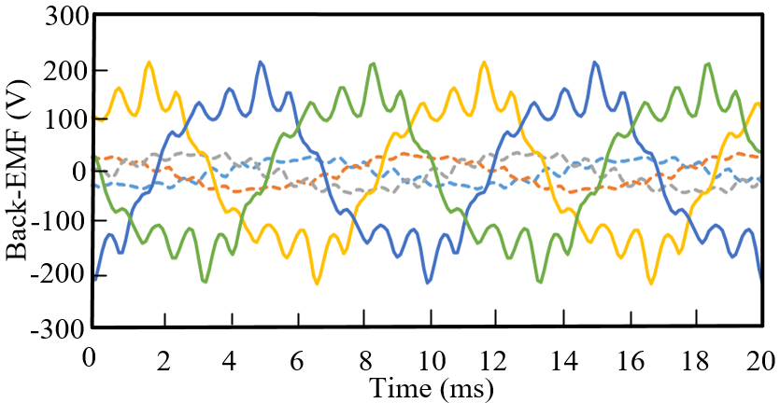
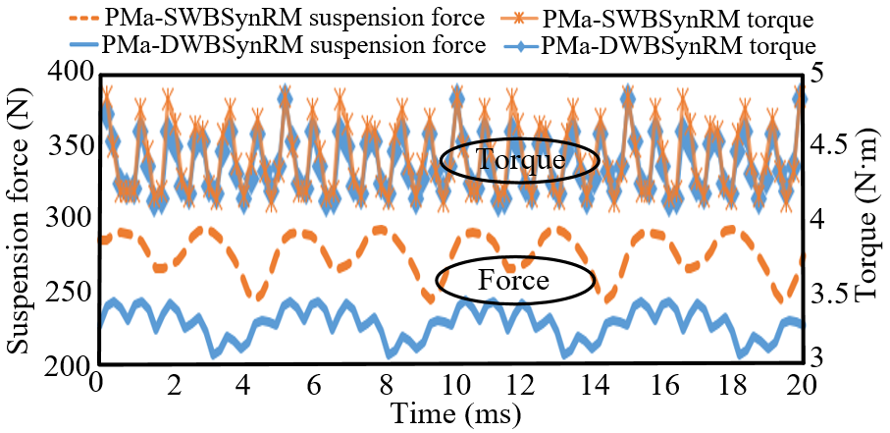
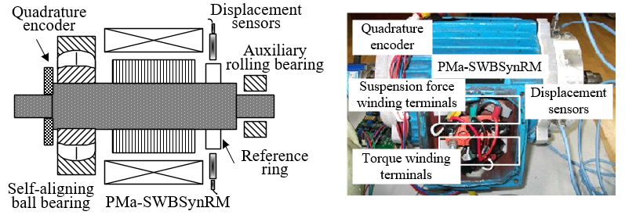
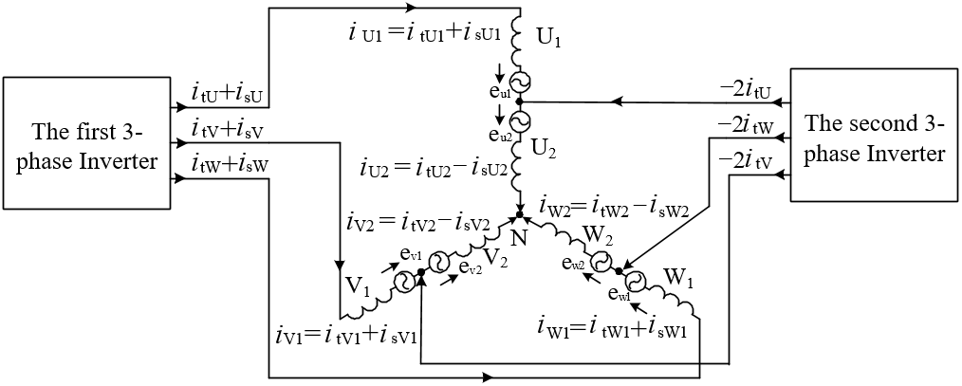
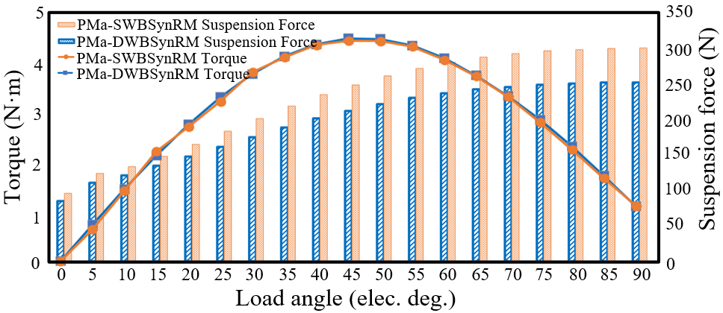
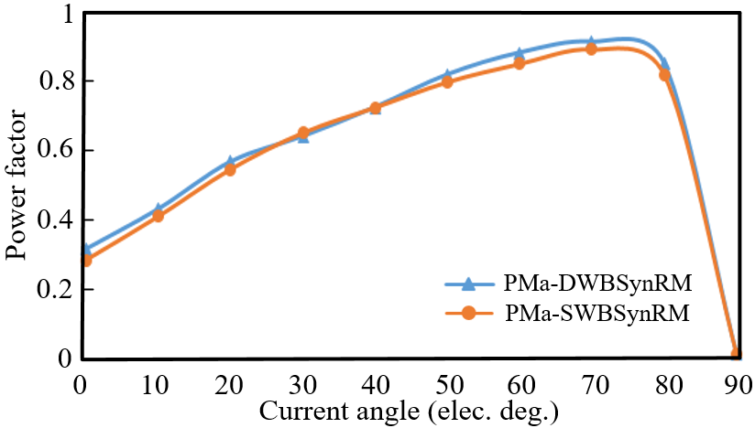
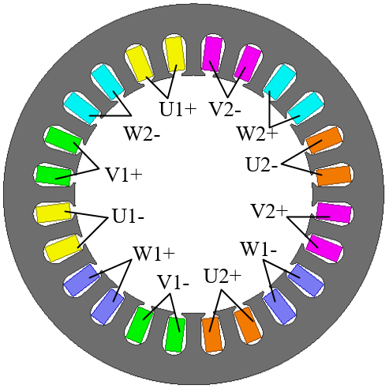
Optimization Design of Permanent Magnet Assisted Single Winding Bearingless Synchronous Reluctance Motor
Zongyou Ji, Huangqiu Zhu and Ying Xu
26th International Conference on Magnet Technology
Poster ID :Tue-Mo-Po2.12-02(Poster Session)
School of Electrical and Information Engineering, Jiangsu University, Zhenjiang 212013, Jiangsu, China
Background
Finite Element Analysis
In the past two decades, a bearingless synchronous reluctance motor (BSynRM) was proposed and developed. The BSynRMs have broad application prospects in vacuum, high speed, high precision and many other industrial fields. The permanent magnet assisted bearingless synchronous reluctance motor (PMa-BSynRM) has higher torque and power factor than BSynRM, which has multi-flux barriers rotors with permanent magnet. However, conventional PMa-BSynRMs have suspension force windings and torque windings in the stator, and their reliability may be restricted by the complexity of stator windings and lack of the compactness of the motor structure. To balance the contradictions mentioned above, a novel permanent magnet assisted single winding bearingless synchronous reluctance motor (PMa-SWBSynRM) is proposed.
The FEA has been done by Ansys/Maxwell. The solid line and the dashed line respectively repre-sent the no-load back-EMF generated by the torque current and the suspension force current, the magnitude of which is about 205 V and 32 V, respectively. As a result, the first inverter terminal voltage amplitude only accounts for 14.3% of the terminal voltage of the second inverter.
The torque ripple of the PMa-SWBSynRM is 13.92%, which lightly lower than the PMa-DWBSynRM of 14.11%. However, the suspension force ripple of the PMa-SWBSynRM is 16.07% worce than that of PMa-DWBSynRM, 14.34%.
Motor Topology
The rotor of PMa-SWBSynRM s is supported by a self-aligning ball bearing, which makes the left end of rotating shaft be fixed in axial direction and the radial 2-degree-of-freedom is flexible. At right end of rotating shaft is equipped with auxiliary rolling bearing, and there is a certain gap between rotating shaft and auxiliary rolling bearing for suspension operation. When appropriate suspension force current is given, rotor can be suspended steadily from the auxiliary bearing. In addition, the eddy current sensors and photoelectric encoder are installed at both ends of rotating shaft and they are used to measure displacement and velocity respectively.
The details of machine design parameters are presented the paper. In order to verify the performance of the proposed motor, the load angle from 0 to 90 step 5 are selected to calculate the average torques and suspension forces of the PMa-DWBSynRM and PMa-SWBSynRM. The maximum torques of the two motors are around the angle of 45°. Meanwhile, the maximum torque of the PMa-SWBSynRM is 4.21 N·m smaller than 4.25 N·m, the maximum torque of the PMa-DWBSynRM. Furthermore, the average suspension force of the PMa-SWBSynRM is 268.1 N, bigger than 226.7 N, the suspension force of the PMa-DWBSynRM.
The power factor of the PMa-SWBSynRM is 0.91 at the optimum current angle, little lower than the PMa-DWBSynRM, 0.94. And then in the range of 0-90°current angle, the power factors of both two motors are similar.
Operation Principle of the PMa-SWBSynRM
Each phase winding account for 4 grooves, and the adjacent two stator grooves are the same phase windings. Moreover, the spatial angle of the adjacent phase of each group of three-phase winding units is 2π/3, and each phase windings is arranged in turn. Fig. 3 shows that two 3-phase windings are connected at the end of the corresponding phase windings and the connection is drawn out of the middle line to form a T-shaped winding structure. The bad consequence of high induced electromotive force on current of suspension force in windings can be reduced by the T-shaped single winding structure.
The torque generation principle of the PMa-SWBSynRM is the same as that of the traditional synchronous reluctance motor. The PMa-SWBSynRM is enabled to operate at syn-chronous speed, owing to the difference between d- and q-axis magnetic reluctance making flux lines follow through the given paths. Because of permanent magnet installed into the rotor, the permanent magnet torque is also included in the total torque.
Two different sequences of currents are introduced into two three-phase windings at the same time to produce torque and suspension force. One current is the torque current, which is used to generate torque caused by the interaction of 4-polar magnetic fields owing to the permanent magnet in the rotor. The other current is the suspension force current, which is used to generate 2-polar magnetic fields to break the equilibrium magnetic field in the air gap, thus generating controllable radi-al suspension force.
Conclusion
A novel PMa-SWBSynRM with T-shaped winding structure is proposed in this paper. The two 3-phase inverters are used for introducing two groups current into the windings to realize the electromagnetic torque and the radial suspension force. The back-EMF in the corresponding winding can be eliminated by the T-shaped winding structure. The PMa-SWBSynRM not only has the advantages of the traditional PMa-DWBSynRM, but also makes the internal structure of the motor simpler, and the stator-side power losses is reduced. In order to confirm the performance of the PMa-SWBSynRM, based on the FEA, the PMa-SWBSynRM and PMa-DWBSynRM are compared. The experiment results indicate that the power factor and torque of the PMa-SWBSynRM is similar to PMa-DWBSynRM. what's more, the suspension force of PMa-SWBSynRM increases about 18.27% with the optimized structure. It can be confirmed that the control system of the PMa-SWBSynRM can enable the stable suspension operation at 5000 r/min.

