Slide 1



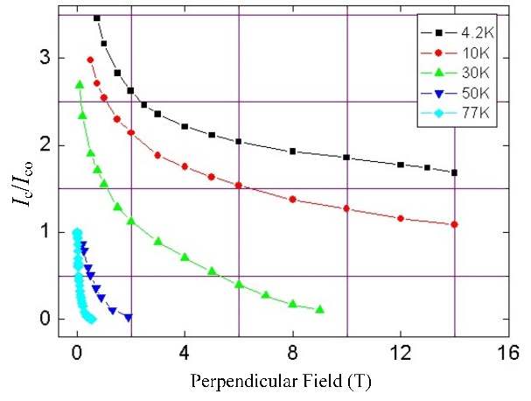
Investigation of High Temperature Superconducting Linear Flux-Switching Motors with Different Secondary Structures
Ruiwu Cao，Minghang Lu
Department of Electrical Engineering，Nanjing University of Aeronautics and Astronautics
I. Abstract
III. Design of the HTSLFSMs
In this paper, HTSLFSMs with slotted and segmented secondaries for railway transit system are investigated. The topologies and working principle of the two motors are introduced. To guarantee the comparison of the motors is fair, several principles are proposed. Based on the principles, two HTSLFSMs with different secondary structures are designed. And the two motors are optimized to improve their thrust force and power density. The comparison between the two motors shows that, HTSLFSM with slotted secondary has higher thrust density and smaller thrust force ripple, while HTSLFSM with segmented secondary has higher power factor and need less secondary materials.
Refrigeration device:
The refrigeration device adopted is shown in Fig.3. The cover of the container is omitted to show inner structures. Double-layered Dewar structure is adopted to refrigerate every HTS coil. The function of outer Dewar is to house the inner Dewar and realize heat insulation. The inner Dewar is sus-pended in the outer Dewar using poly tetra fluoroethylene. And it is evacuated between the outer Dewar and inner Dewar to prevent heat transfer.
Table I. Key Parameters of Motor I & Motor II
HTS coil:
The working temperature is determined around 30K. To estimate the critical HTS current, FEM calculation is conducted in advance.
Based on Fig.5, I_{c}/I_{c0} is about 1.5. Considering fault tolerance, the HTS current is finally determined 45A. The detail Parameters are in Table II.
Motor parameters:
The motor parameters are designed and optimized according to the practical need of railway transit system. The parameters are shown in Fig.4 and the values are shown in Table I.
II. Topology and Operation Principle
Name and Unit | M I | M II
Primary height [cm] | 10 | 10
Primary pole pitch [cm] | 10.3 | 14.9
Primary tooth width[cm] | 5.0 | 3.7/5.0
Primary yoke height [cm] | 3.5 | 3.5
Primary length [cm] | 372 | 372
Primary tooth width [cm] | 5 | 5/4.5
Secondary height [cm] | 3.9 | 9.0
Secondary pole pitch [cm] | 17.7 | 25.2
Secondary yoke height [cm] | 4.5 | -
Air gap length [cm] | 1 | 1
Rate armature current [A] | 210 | 210
Armature current density[A/mm²] | 4.68 | 4.68
Turns of armature coil | 35 | 17
Stack length [cm] | 28 | 28
Speed [m/s] | 15.68 | 15.68
Topology:
Fig.1(a) shows the structure of a HTSLFSM with slotted secondary, named as Motor I. Both armature windings and HTS coils are wounded around two adjacent primary teeth. Adjacent HTS coils are placed at the interval of one primary slot, while adjacent armature windings are placed next to each other in one slot. All the HTS coils have the same magnetization direction.
Fig.1 (b) shows the structure of a HTSLFSM with segmented secondary, named as Motor II. The armature windings and HTS coils are placed alternatively. Every armature winding and HTS coil is wounded around one primary tooth. Adjacent the HTS coils have the same magnetization direction. And the secondary of Motor II is segmented iron cores.
Fig.3 Structures of refrigeration device for HTS coils (cover omitted)
(a)
Table II. Parameters of HTS coil
Name and Unit | Value
Rated HTS current [A] | 45
Turns of HTS coil | 480
Temperature [K] | 30
Material | Bi-2223/Ag
(a)
(b)
Working Principle:
For Motor I, Fig.2 (a) shows the positive maximum flux linkage of Phase A when the secondary tooth is right under the left primary tooth wounded by phase A. The red dotted lines indicate the magnet circuit. Fig.2 (b) shows the negative maximum flux linkage of Phase A. During one mechanical period of secondary tooth, the flux linkage of Phase A experiences its positive peak and negative peak, forming a sinusoidal wave.
For Motor II, Fig.2 (c) shows the positive maximum flux linkage of Phase A and Fig.2 (d) shows the negative maximum flux linkage of Phase A. Similarly, during one mechanical period of secondary segment, the flux linkage of Phase A forms a sinusoidal wave.
Fig.5 Characteristic curves of HTS field winding.
Fig.4. Structure parameters
(a) Motor I. (b) Motor II.
(b)
IV. Electromagnetic Performance Comparison
Fig.1 Structure of the HTSLFSMs
Slotted secondary (M1).
Segmented secondary (M2).
Magnetic Field:
As Fig.6 suggests, the flux density of Motor I and Motor II is high in some part of primary teeth and yoke, and especially the primary tooth tips. While the flux density in the secondary is much weaker than that in primary.
Table III. Electromagnetic Performance
Conclusions:
The electromagnetic performance of Motor I and Motor II are shown in Table III. And the conclusions are summarized as follows:
Thrust force: Slotted type offers 12.4% higher thrust force than segmented type does.
Power factor: Segmented type offers 10.0% higher power factor than slotted type does.
Material cost: Segmented type needs 58% less material for secondary than slotted type to obtain its best performance.
Name and Unit | M I | M II
Rated speed [m/s] | 15.68 | 15.68
Current frequency [Hz] | 88.5 | 61.4
Thrust force [kN] | 18.1 | 16.1
Thrust force ripple [N] | 2.5 | 3.5
Frequency [Hz] | 88.5 | 61.4
Copper loss [W] | 860 | 927
Power factor | 0.70 | 0.77
(a)
(b)
(c)
(d)
Fig.2 Operating principles (a) Motor I: Positive max flux linkage. (b) Motor I: Negative max flux linkage.
(c) Motor II: Positive max flux linkage. (d) Motor II: Negative max flux linkage.
(a)
(b)
Fig.6 Flux density of HTSLFSMs. (a) Motor I. (b) Motor II.

