Slide 1


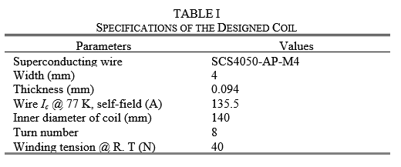
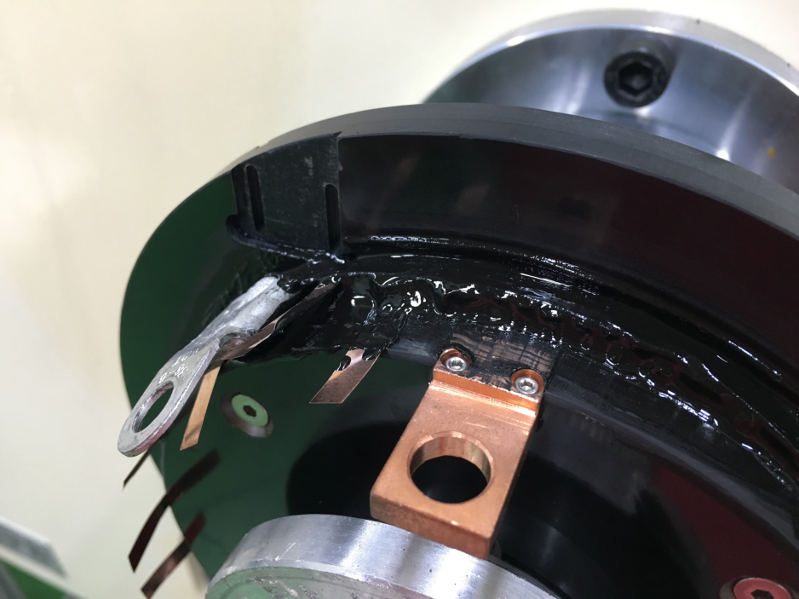
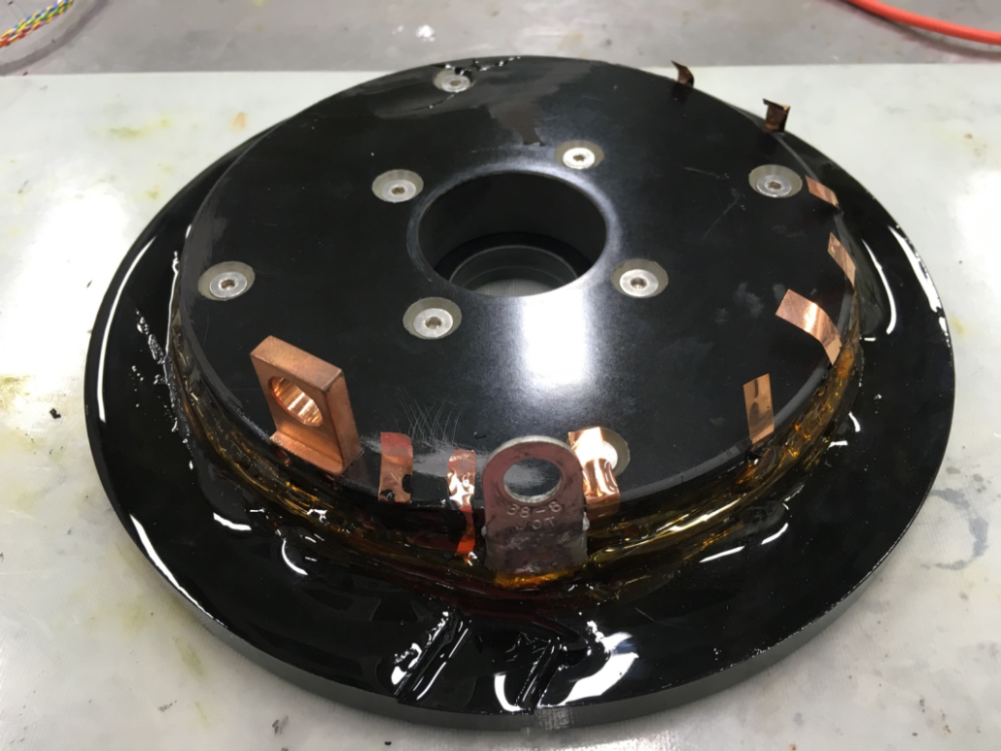
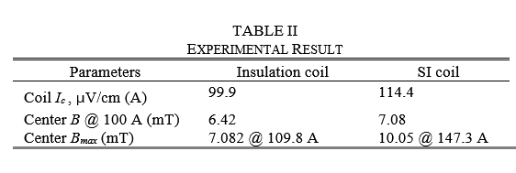


Smart Insulation That Enables Calculation Of
Operating Current Of ReBCO Coil
MT26-Tue-Af-Po2.22-02
Hyung-Wook Kim¹, Young-Sik Jo¹, Seog-Whan Kim¹ and Jin Hur²
Korea Electrotechnology Research Institute, Changwon, South Korea
Incheon National University, South Korea
Background
Conclusion
It is well-known that the first step for developing an application system is calculating the operating current with regards to the rating. In second-generation high-temperature superconducting applications, however, asymmetric wires and other vulnerabilities make it difficult to calculate the operating current.
Therefore, this study proposes a smart insulation (SI) coil as a method to improve the stability of the 2G HTS coil. Based on the high electrical stability of the SI coil com-pared to the insulation coil, this paper also discusses the reliability of the operating current determined within the allowable current density. The electrical stability is verified through coil experiments, and a method to determine the operating current is discussed.
This study proposes a calculation method through experiment and simulation with an 8-turn coil to reduce the analysis variables. However, the proposed method may not be suitable if thermal and mechanical problems are introduced, such as by increasing the number of turns or increasing the width of the wires. However, it is important to note that the SI coil proposed in this study is more electrically stable than conventional insulation coils. Thus, less margin can be applied than in the insulation coil to achieve stability.
Though not mentioned in this paper, when the magnetic field decreased due to current bypass in an extreme transient state through a 100-turn SI racetrack coil test, the magnetic field value was detected and the input power was cut-off, thus successfully protecting the coil. This is one solution to the problem of permanent damage to coils in high-temperature superconducting applications.
In the future, in HTS application system design, data-bases should form the basis of predictable operating cur-rent calculation according to the type of application system and the operating conditions.
Objectives
This study discusses the operating current calculation process of a ReBCO coil based on the high electrical stability and controllability of the SI coil.
THE SMART INSULATION
OVERCURRENT CHARACTERISTICS OF SMART INSULATION COIL
MIT characteristic refers to an instant change in material property from metal to insulator or from insulator to metal due to the change in the resistance under certain conditions.
Among the many materials with an MIT characteristic, vanadium (III) oxide (V₂O₃) was used in this study because its temperature transition range was considered appropriate for the required conditions in this study. V2O3 is a material whose resistivity in a pure singlecrystal state sharply changes by 1/600,000 times at approximately 150–170 K.
Current flow diagram of SI ReBCO coil in (a) steady state and (b) quench state.
The SI coil is quench occurs and the temperature increases above the transition temperature, then the SI gains the electrical conductivity of a metal and turn-to-turn current bypass occurs.
During the initial quench, there is little delay in the magnetic field due to partial current bypass.
Insulation coil
Smart insulation coil
Comparison to B-I curve
CALCULATION OF MAXIMUM OPERATING CURRENT
Measured I_{c}-B curve at the 77 K of SCS4050-AP-M4 by Superpower
Magnetic field distribution at the top surface of a B-radial direction
Flux distribution is calculated by with 2D analytic method. In order to analyze the magnetic field of the magnet using the Biot–Savart’s law, its calculation has been performed by (1), and the Imax of the coil can be estimated based on the Ic-B data.
Normalized curve
Multiplied value to normalized B⊥ and short sample I_{c}
Measured I_{c}-B curve at the 77 K of SCS4050-AP-M4 by Superpower
where , L, R, , , and are the magnetic vector po-tential due to a current I, Length of a HTS coil, radius, ele-ment of , direction vector of r and permeability of free space, respectively.

