Slide 1


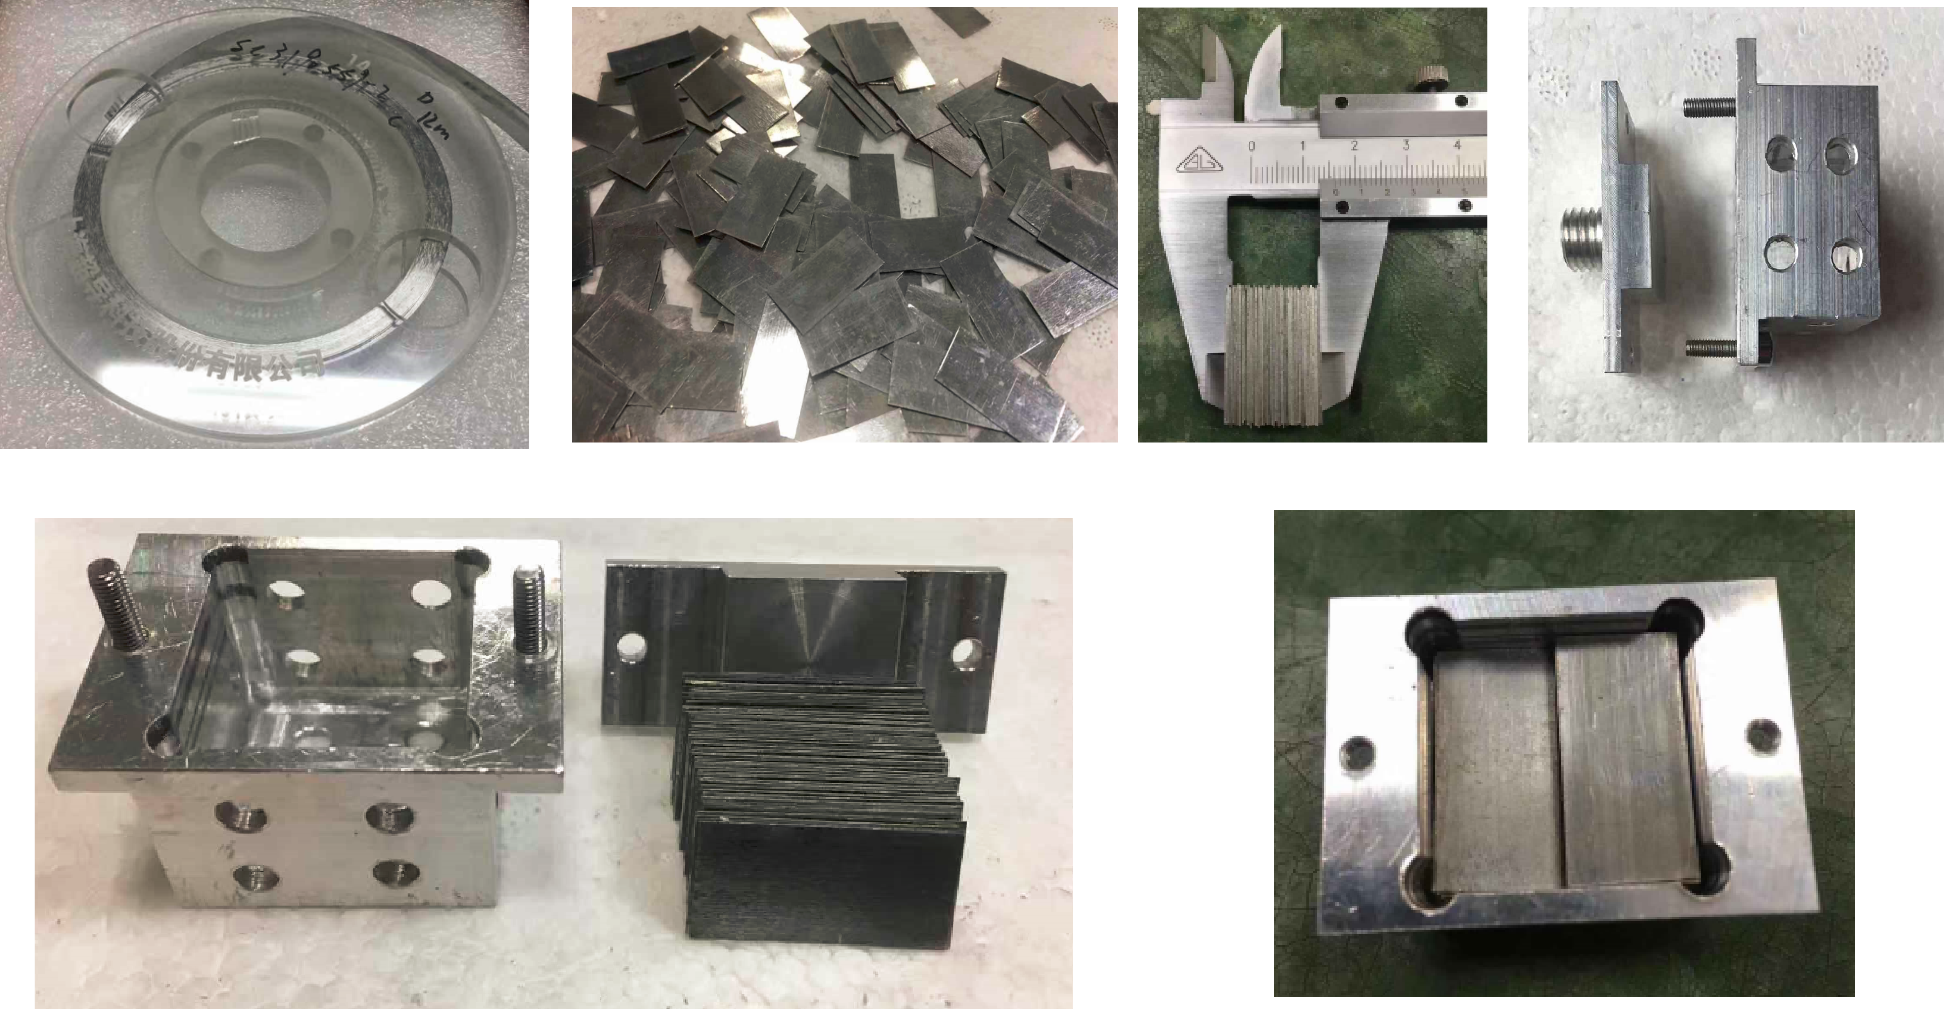
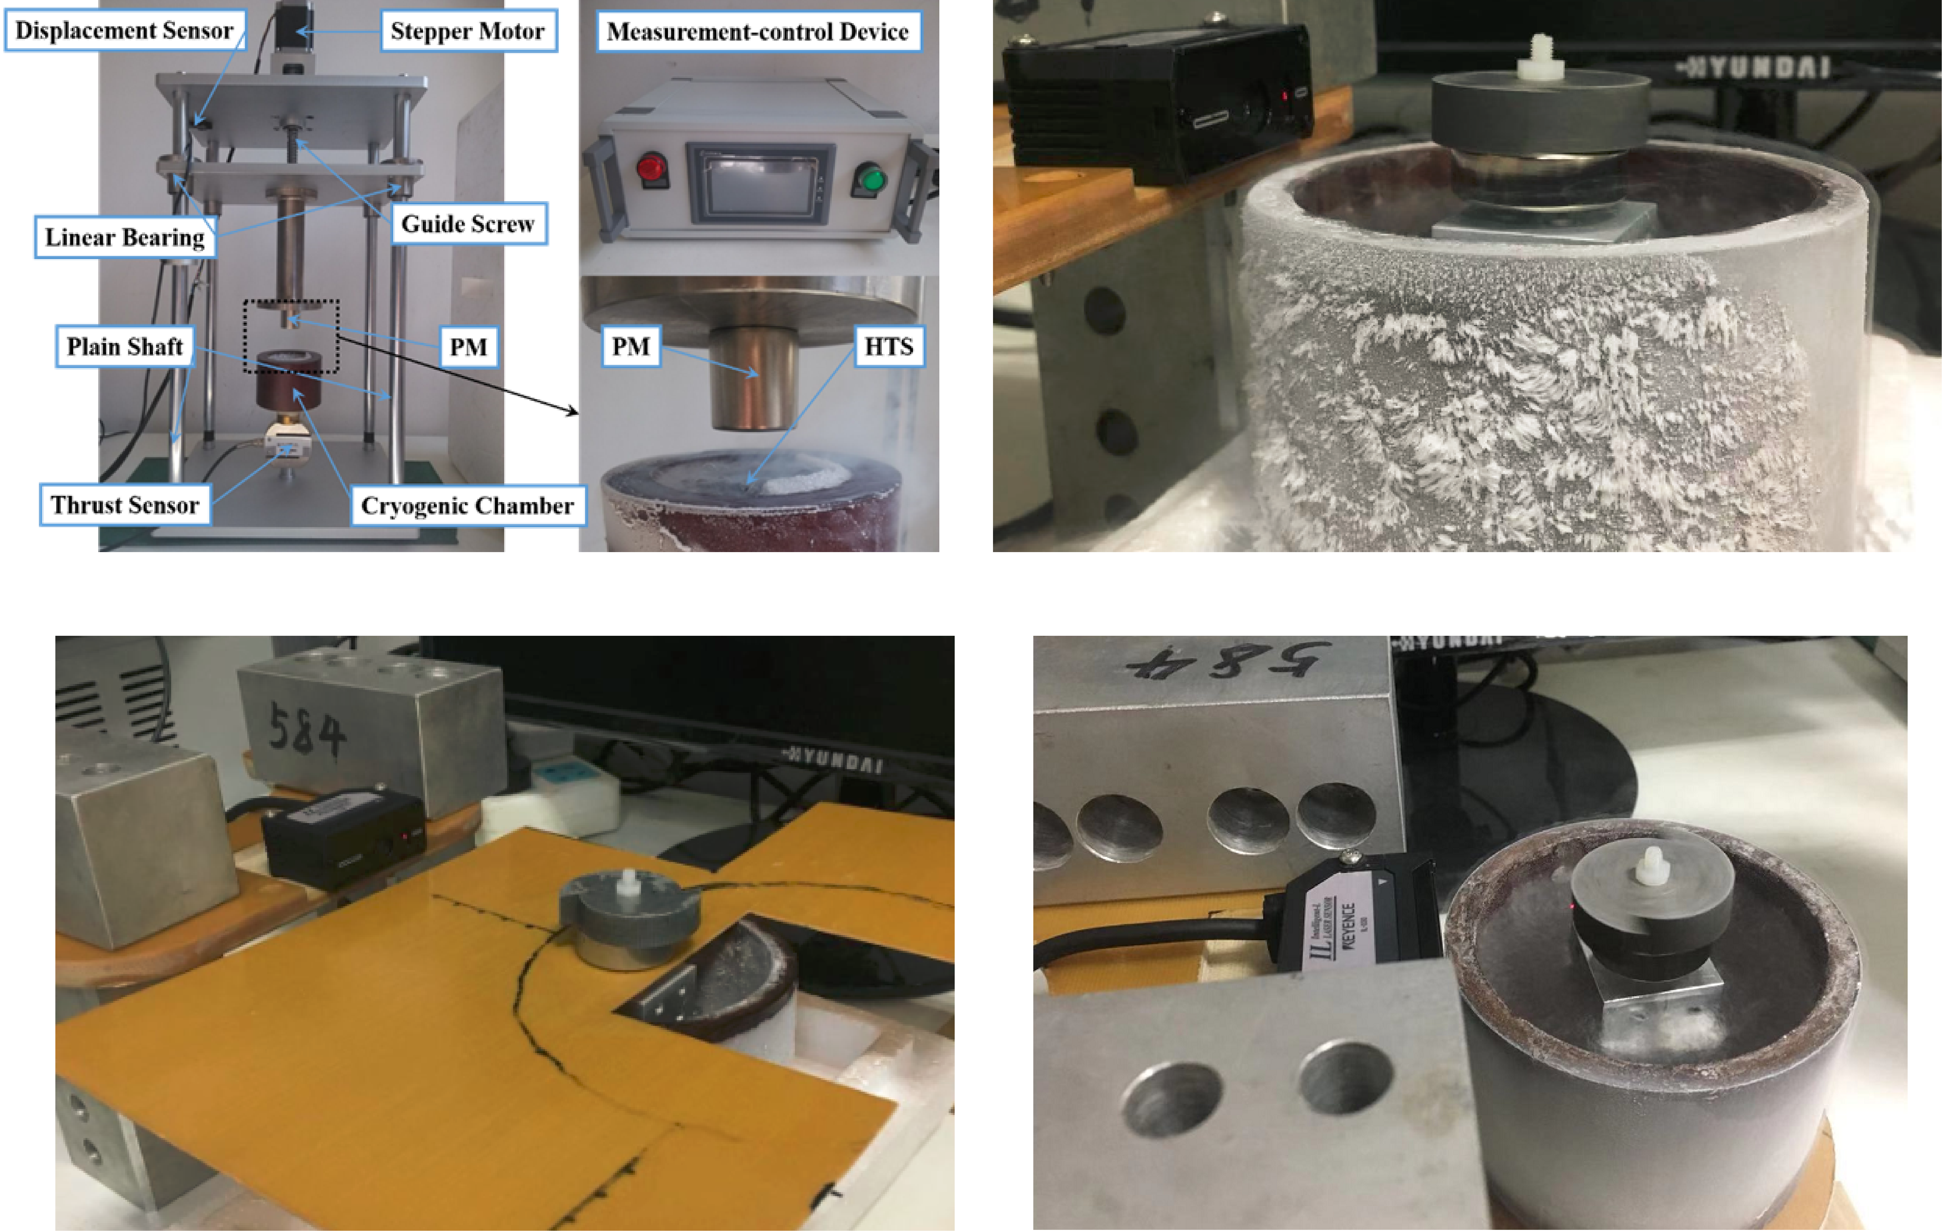
Mon-Mo-Po1.09-01
Modeling and Experimental Analysis of Levitation Characteristics in Superconducting Tape Stack Conductors
Zhaoxin Liu, Wenjiang Yang*, Yu Ji, Rujing Liu, Xiaodong Li, Jiahui Zhu
School of Astronautics, Beihang University, Beijing 100191, China (e-mail: yangwjbuaa@buaa.edu.cn )
Abstract---High temperature superconducting (HTS) taped stacks have broad application in magnetic levitation because of uniform induced current distribution characteristics, good heat dissipation and preferable mechanical properties. Configuration of the stack has a great influence on the uniformity and strength of the trapped magnetic field. In this paper, the influence of four different configuration modules on the magnetic levitation force、stiffness and rotational friction coefficient of tape stack magnets was compared. The module 1 consisted of the superconducting tapes is arranged in a line; the module 2’s tape stack is inclined with an angle; the module 3’s tapes are arranged in the cross array; and the module 4 is the knitted tape stack (KTS). It was observed from the experiment result that the levitation forces of the module 1、3 and 4 gradually improve with the increase of the layer, and the module 2 is an inclined stack, the levitation force is related to the inclination angle. The levitation stiffness of the four superconducting tape stack modules is positive , suggesting HTS tape stack module levitation system can achieve self-stabilizing balance by pinning properties. And order of magnitude of the minimum friction coefficient is 10⁻⁶ . We are unable to measure the coefficient of friction of module 2 because it does not achieve stable magnetic levitation rotation.
Keywords: HTS tape stack modules, stifness, levitation friction coefficient.
1. Experimental Details
2. Experimental measurement result
20 layers
50 layers
30 layers
a
b
c
d
50 layers
80 layers
30 layers
e
a
b
Figure1. The manufacturing process of the superconducting tape stack module. (a) 12mm wide commercial superconducting tape. (b) Cut into pieces. (c) Stacking. (d) Tape stack container. (e) Filling.
10 layers
Figure5.
(a)Levitation rotational friction coefficient of different layers of module 1；
(b)Levitation rotational friction coefficient of different layers of module 3；
(c)Levitation rotational friction coefficient of different layers of module 4.
Figure3. Levitation force measurement results of stacked modules with different stack composition
20 layers
c
a
b
3、Conclusion
Figure 3 shows the variation in the levitation force of four superconducting tape stack modules. It can be seen from the figure that the levitation forces of the module 1、3 and 4 gradually improve with the increase of the layer, and the module 2 is an inclined stack, the levitation force is related to the inclination angle;
Figure4 shows the levitation stiffness of four superconducting tape stack modules. The result shows that the stiffness of the four modules is positive, suggesting HTS tape stack module levitation system can achieve self-stabilizing balance by pinning properties.
Figure 5 shows magnetic levitation rotational friction coefficients of module 1, 3, 4. It can be seen from the figure that order of magnitude of the minimum friction coefficient is 10⁻⁶ . Module 2 cannot achieve stable levitation.
c
d
Figure2. (a) Levitation force measuring device;field cooling magnetization; (b-d)Tape stack magnet levitation rotary friction coefficient measuring device;field cooling magnetization;
Figure4. Levitation stiffness measurement results of stacked modules with different stack composition

