Slide 1




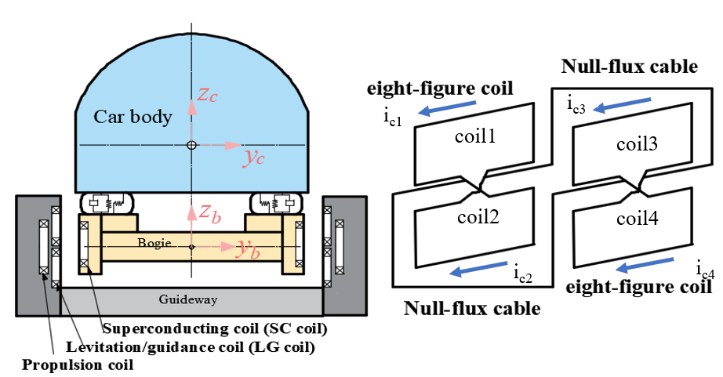
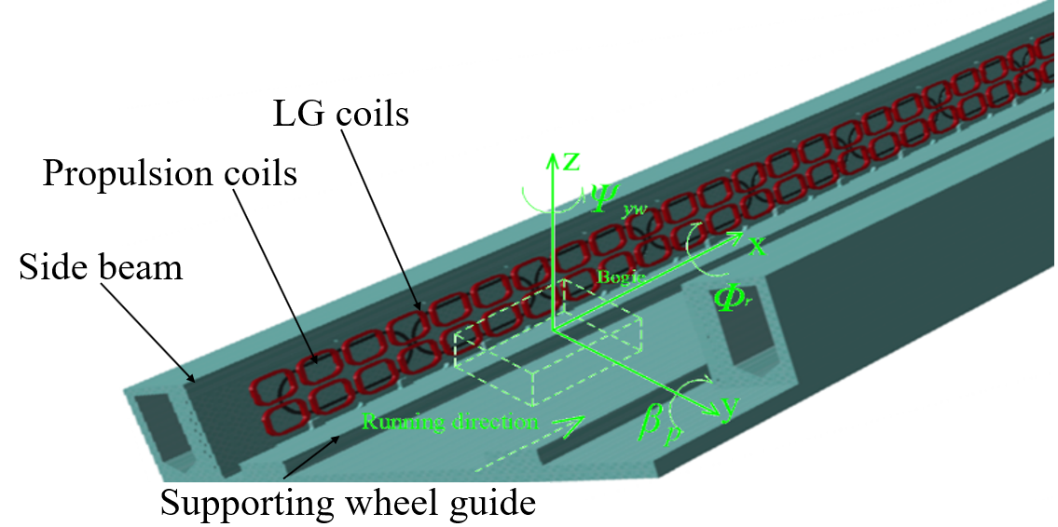
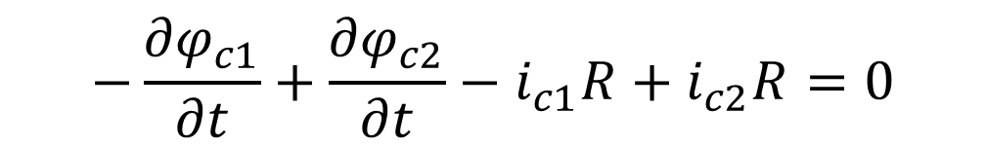
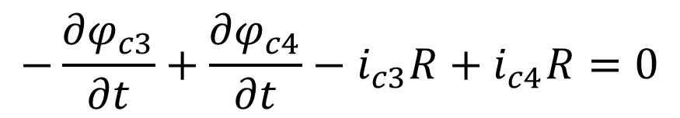
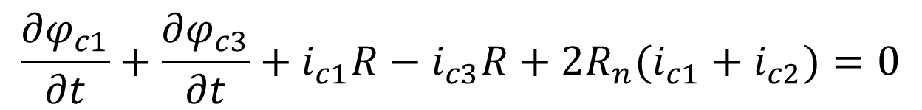
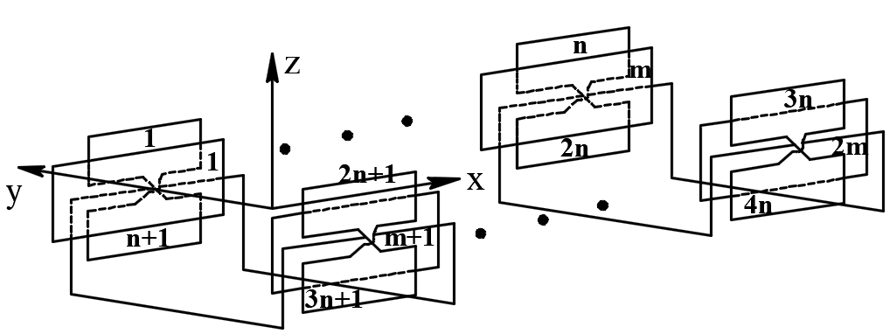
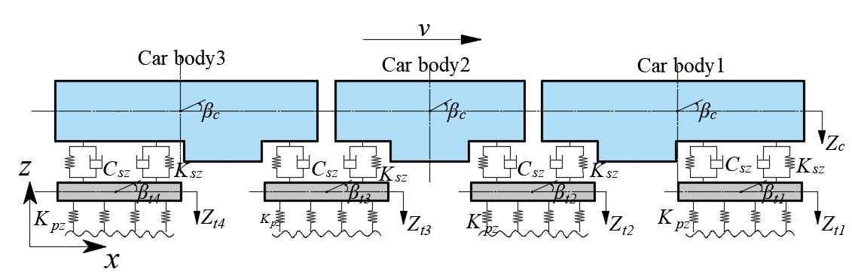
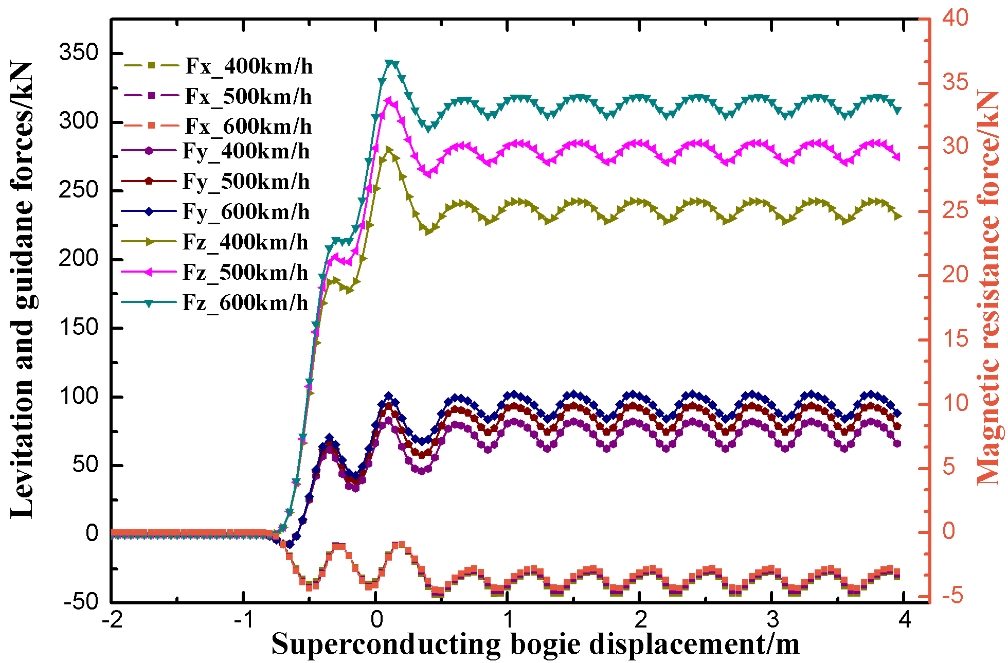
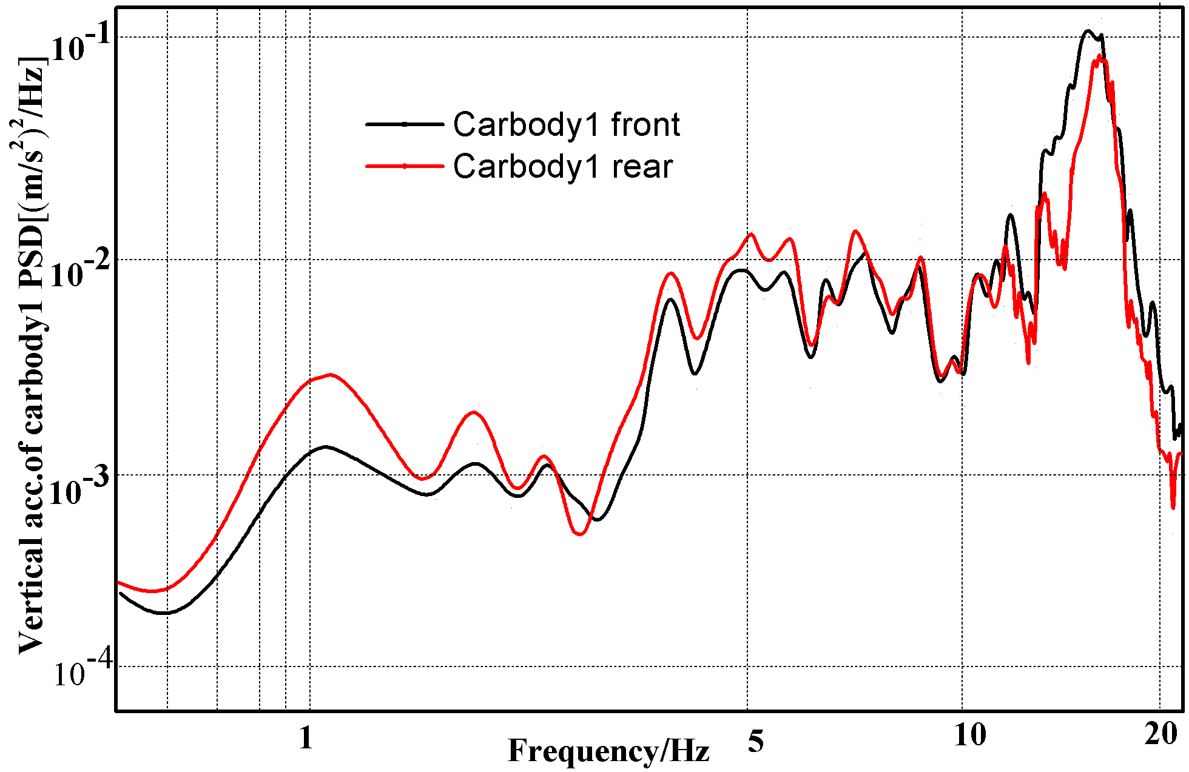
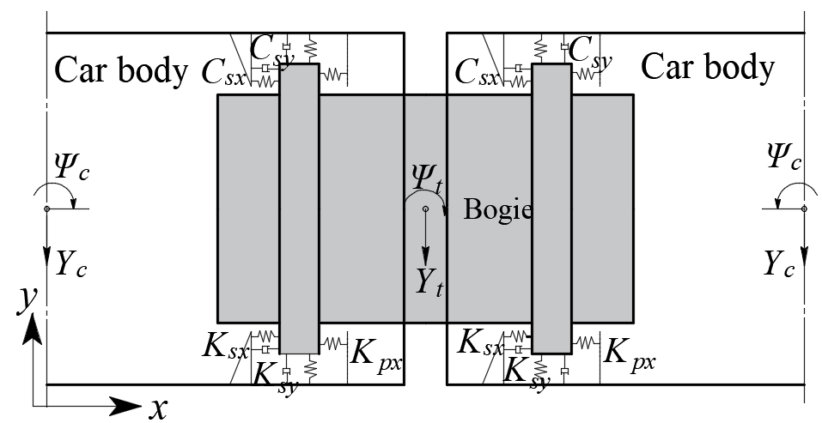
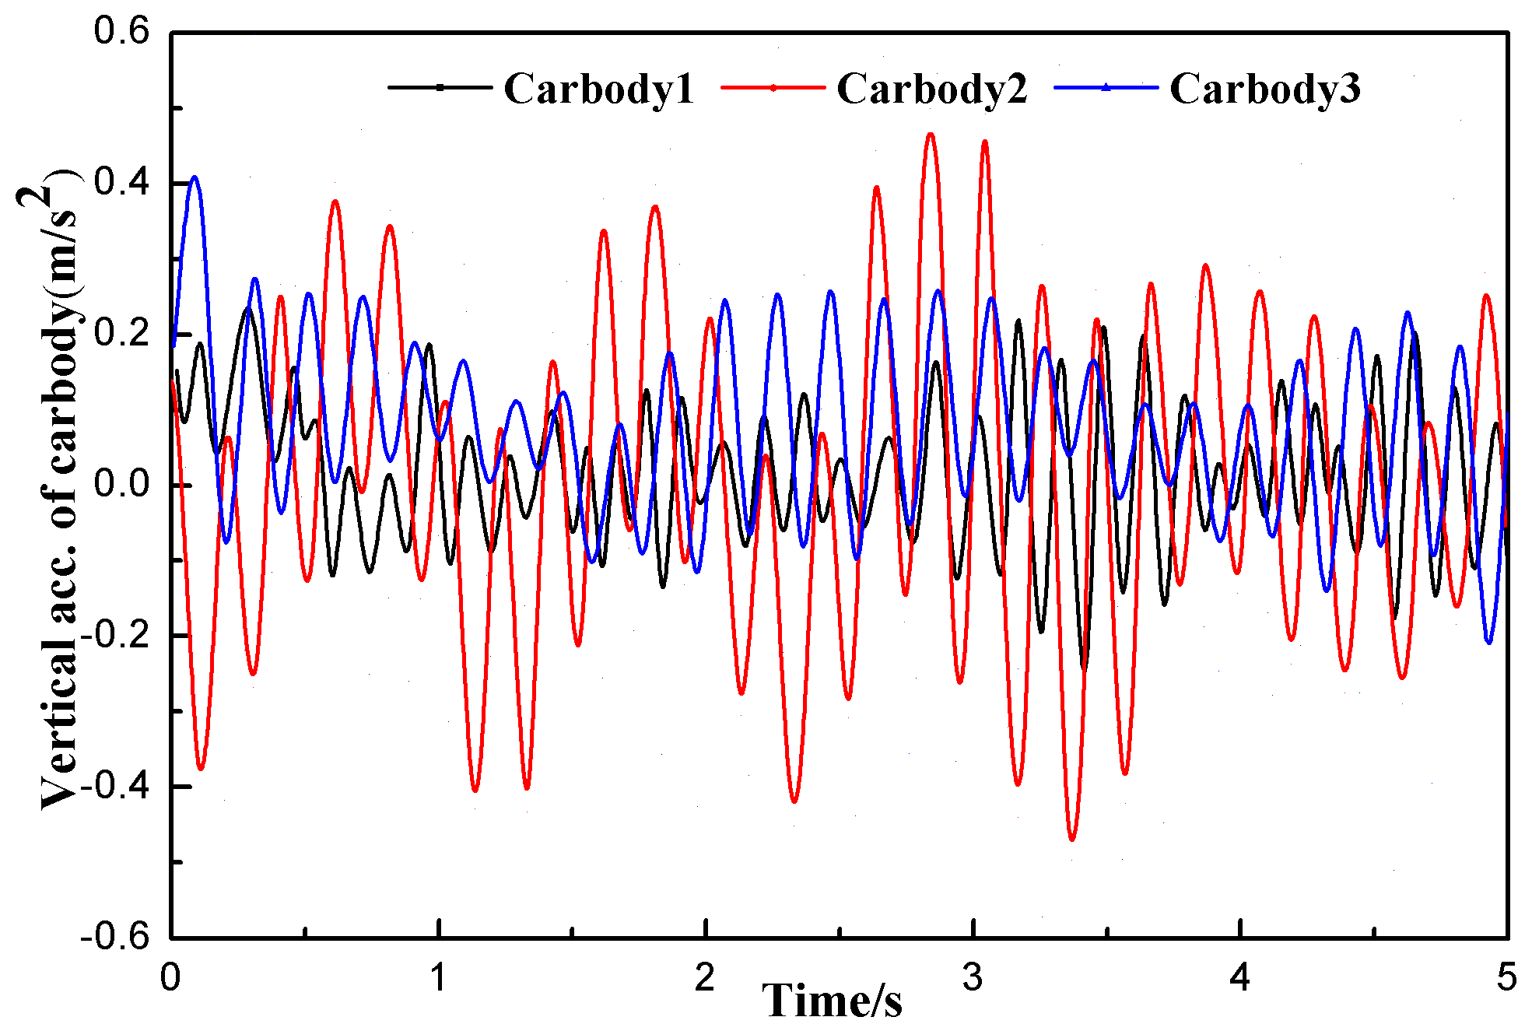
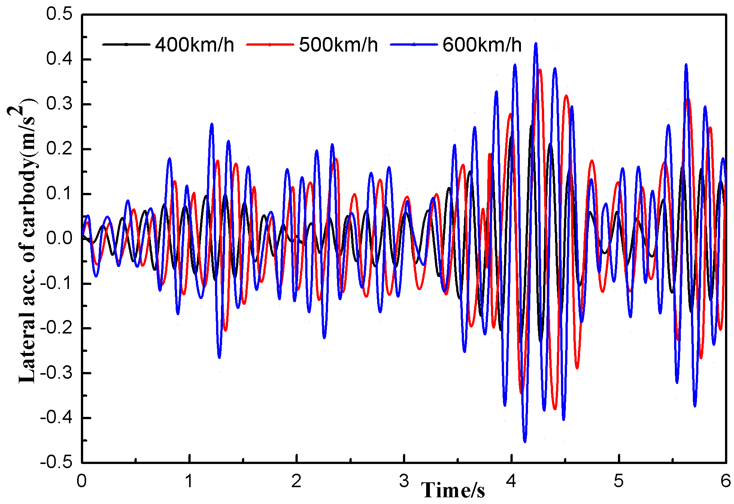
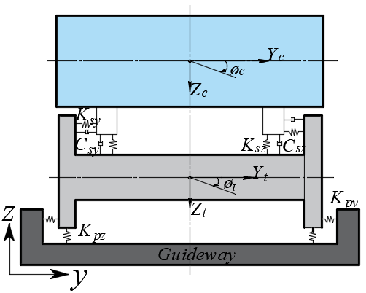
MT26, the International Conference on Magnet Technology, Sept. 22 – 27, 2019, Vancouver, Canada
Thu-Mo-Po4.13-04[100]
Dynamic Response of a Superconducting EDS Train
with Vehicle/Guideway Coupling Dynamics
Zhaoying Yan, Guangtong Ma, Gang Li, Weihai Zhang, Jingsong Zeng,
Chunxing Yao, and Xuliang Song
Applied Superconductivity Lab., State Key Lab. of Traction Power, Southwest Jiaotong University, Chengdu, China
E-mail: gtma@swjtu.edu.cn, swjtu_zyyan@126.com
INTRODUCTION
In the 21st century, the advantages of maglev train are more obvious than that of conventional wheel-rail train, and the requirements are more urgent. Superconducting EDS train also keeps refreshing the speed of Maglev train. Dynamic responses of EDS vehicle/guideway system have important influence on running safety, ride comfort and system costs, which are crucial factors for maglev train commercial application. In electromagnetic suspension lines, this effect becomes particularly significant as the vehicle mass of the maglev train large, the maglev guideway is light and flexible, and the pier is tall and slender. The magnets of the train system and the modular function units of the via
-duct system were not exactly considered in the coupling system in the previous studies. Only partial coupling effects were investigated, and some dynamic characteristics of the coupling system were overlooked. In this paper, a mathematic model of the magnet/guideway and dynamic numerical model of the maglev train with vehicle/guideway coupling dynamics of EDS system are established. The frequency and acceleration responses of the carbody with electromagnetic forces irregularity in different traveling speed are presented, analyzed. The running quality of a superconducting EDS train was evaluated by analyzing the vertical and lateral dynamics characteristics.
MATHMATIC MODEL
Mathematical model of dynamic circuit model,
Analytical method is used to calculate the magnetic resistance Fx, guidance force Fy, and levitation force Fz,,
Fig.1. Superconducting magnetically levitated transportation (Maglev) vehicles have no steel wheels or pantograph, and realize ultra-high-speed running in a state of complete non-contact with the ground. This is enabled by electromagnets known as ground coils, which are usually classified into those used for propulsion and those used for both levitation and guidance, as shown in Fig. 1.
Fig.2. A maglev system can be represented by the dynamic circuit model in which the system energy, power, and forces, as well as other quantities, are expressed in terms of their equivalent circuit parameters. In general, those circuit parameters are functions of a maglev system can be determined on the basic of the solution of the dynamic circuit model.
Where ϕc is ﬂux and ic is current of the LG coil. The subscript 1–4 means the coil number in Fig. R is the resistance of the LG coil.
NUMERICAL MODEL AND RESULTS
(a)
(a)
(b)
(4)
(4)
(b)
(c)
(d)
(c)
Fig. 2
Fig. 4
Fig. 3 The schematic numerical mode of the maglev train and all of the DOFs related to the carbodys, bogies as well as their definitions of the positive directions. (a) The vertical plan of the train system model; (b) The top plan of the train system; (c)The model The cross section plan of the train system model.
Fig.4 (a)The dependence of the null-flux magnetic forces on a magnetic bogie displacement with different velocities, a magnetic bogie can carry more than 30 tons of weight at high speed. (b) Frequency-domain PSD plot of the front and rear ends for carbody1 shows the peak in the range of 6 to 12 Hz can be considered as a combination of the peak corresponding to the secondary suspension and the peak corresponding to the car body pitching motion. (c) and (d) The superconducting EDS train can run by the analysis of the lateral and vertical vibration characteristics over the straight line with favorable riding comfort.
CONCLUSIONS ACKNOWLEDGEMENT
This study focused on vehicle/guideway coupling dynamics of the superconducting EDS train as a train set. The dynamic characteristics of the EDS train are calculated by establishing the magnet/track coupling mathematical model and the coupling dynamic numerical model of the EDS train. Numerical results based on the mathematical model of a null-flux coil suspension system were given. The model can be used to foundation of research the electrical transient and dynamic performance of a maglev system. Through the analysis of the lateral and vertical vibration characteristics of EDS train, it can be known that the superconducting EDS train can steadily run over the straight line at the normal speed of 400 km/h, 500 km/h and also at the higher speed of 600 km/h, with favorable riding comfort.
This work was supported in part by the National Natural Science Foundation of China under Grants 51722706 and 51475389

