Slide 1

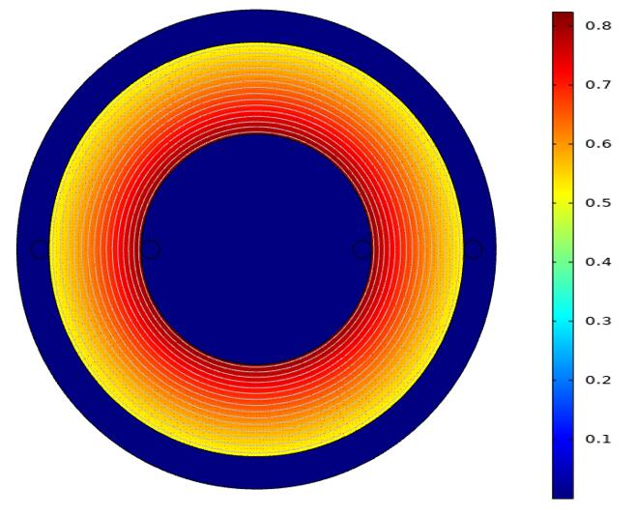
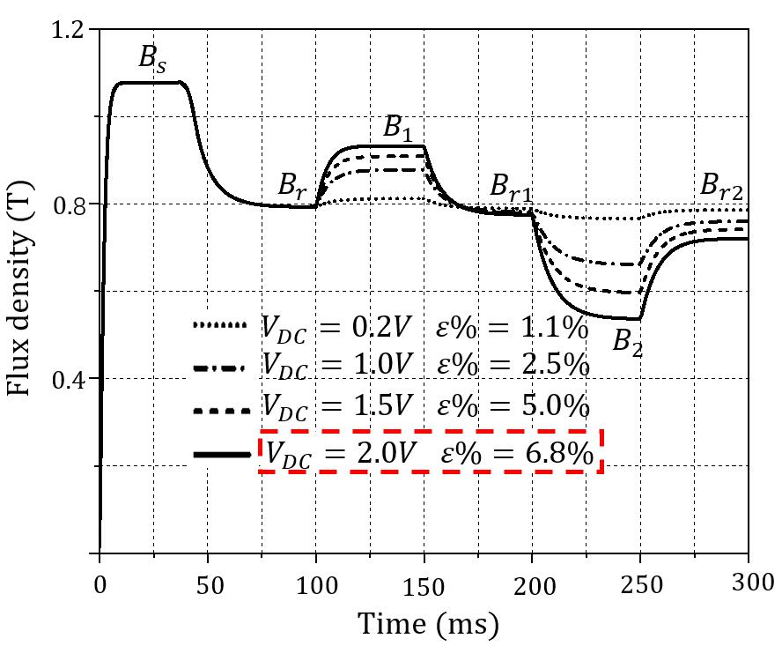
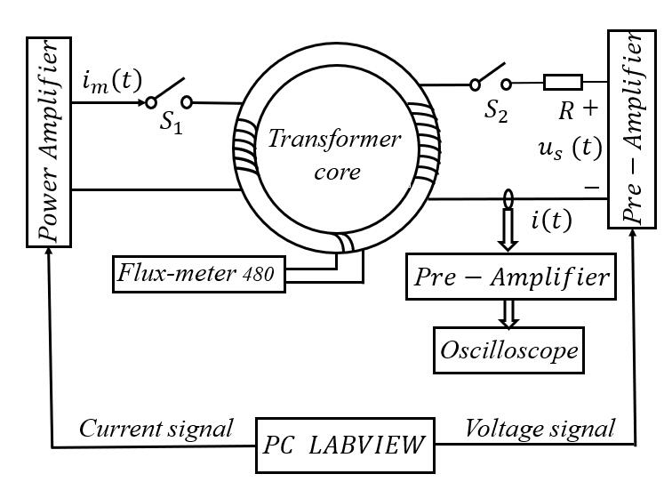
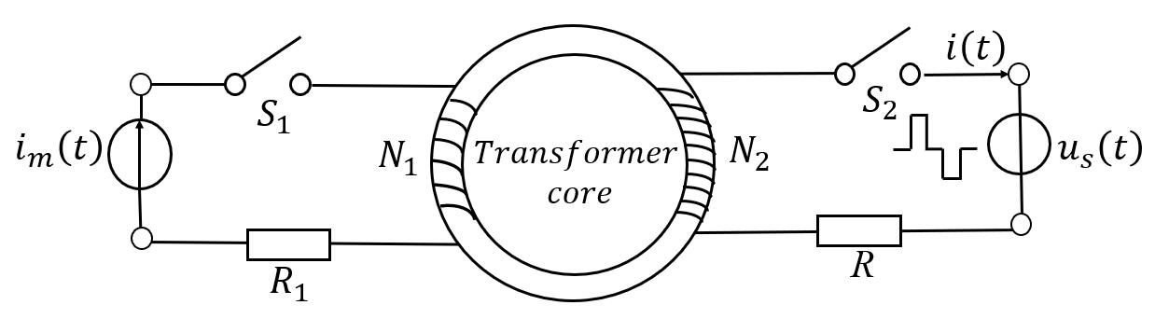
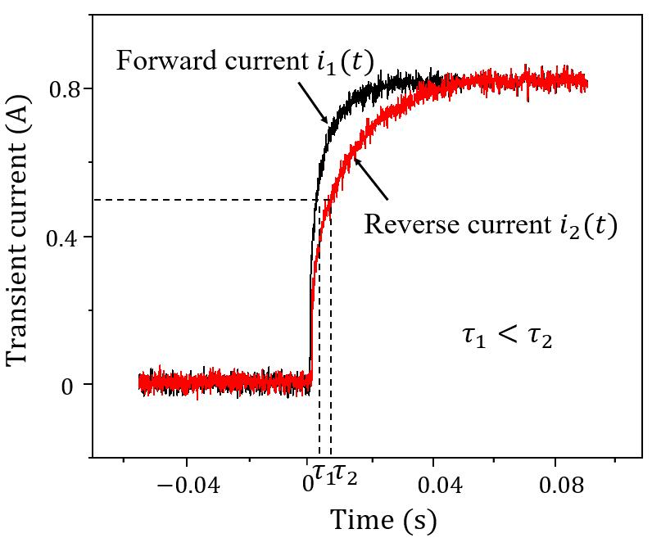
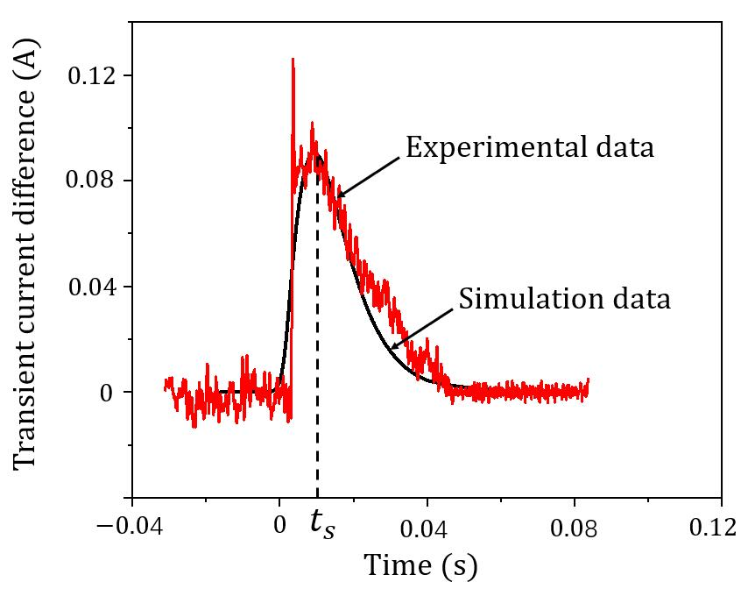
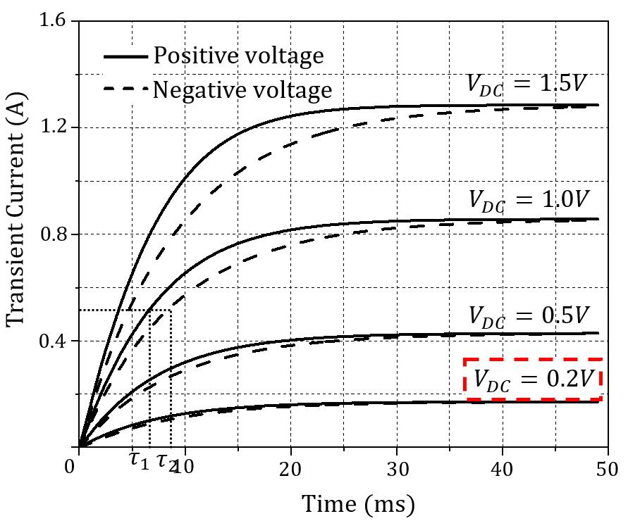
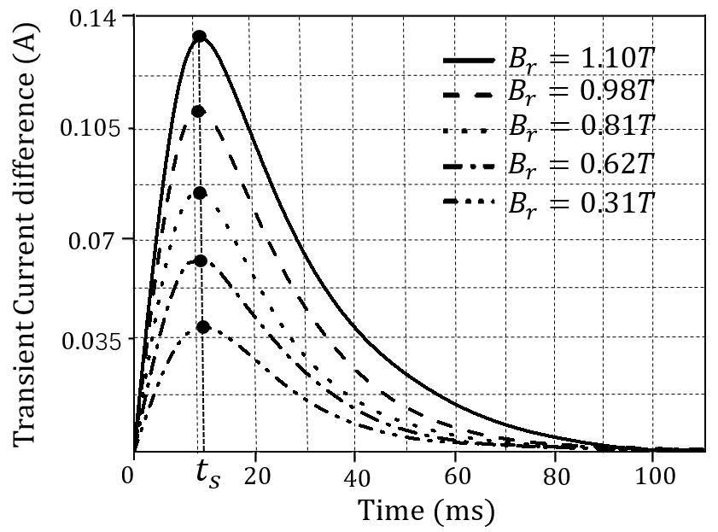
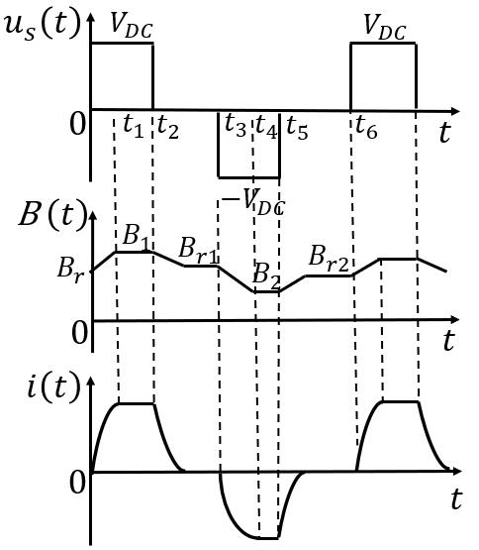
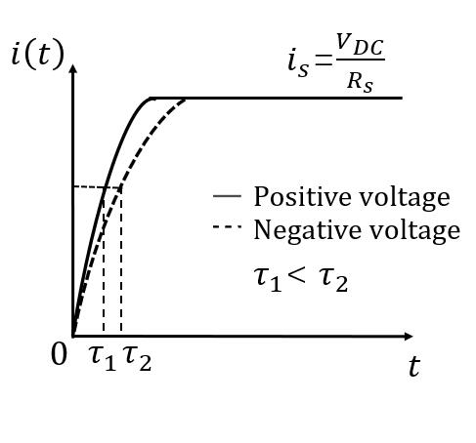
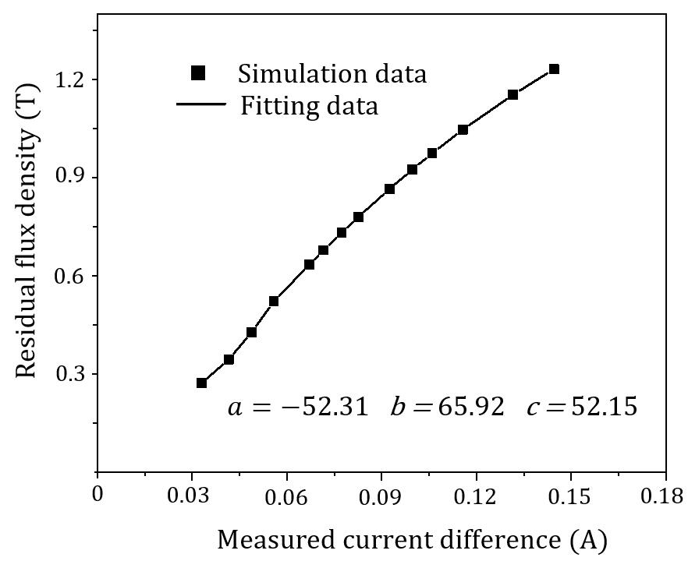
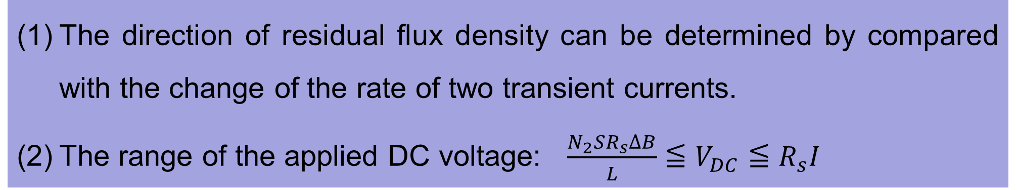
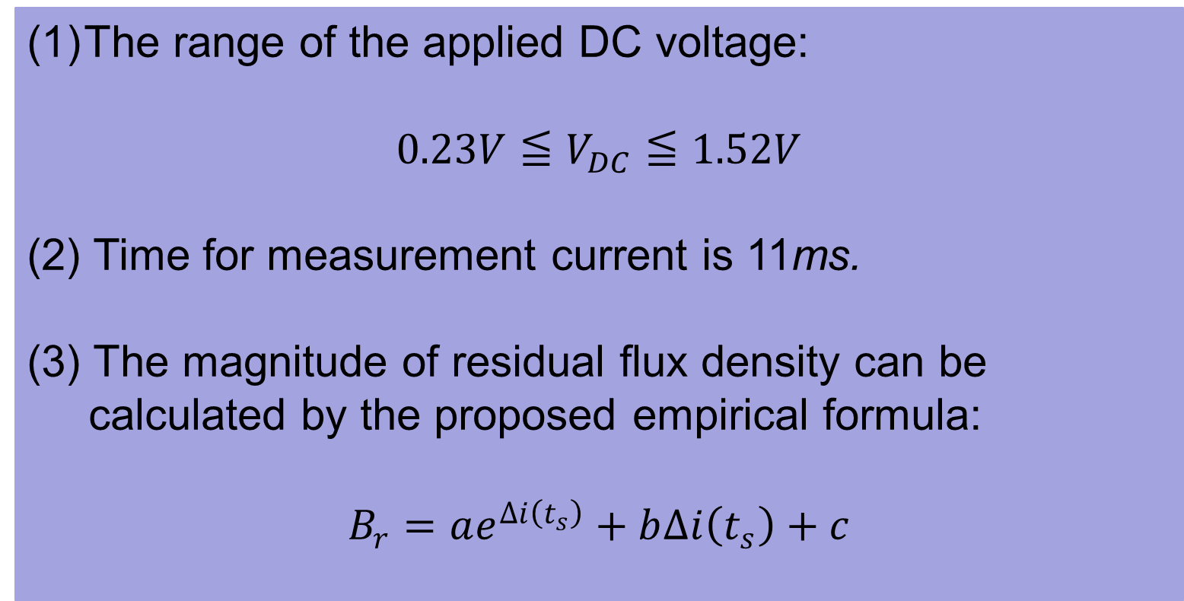
Residual Flux Measurement of the Single-Phase Transformer Based on Transient Current Method
Cailing Huo¹, Youhua Wang^{1*}, Chengcheng Liu¹, and Ziwei Zhao¹
¹State Key Laboratory of Reliability and Intelligence of Electrical Equipment, Hebei University of Technology, Tianjin, 300130, China
Email: 2016020@hebut.deu.cn
23-04
1. INTRODUCTION
3. NUMERICAL SIMULATION ANALYSIS
4. EXPERIMENTAL RESULTS
This paper proposes the transient current for obtaining the residual flux density in the single-phase transformer. Specifically, firstly two DC voltage with the different polarities are applied on the exciting winding sequentially, and then the two corresponding transient response currents will be detected, and based on above information an empirical equation in regarding of the residual flux density and the transient current will be obtained.
To make sure that the applied DC voltage will not affect the former residual flux, the selecting of the DC voltage are also be presented. Both the finite element method and experiment are used to verify the proposed method.
Table 1. Data for Experimental measurement
Measured residual flux density (T) | Calculated residual flux density (T) | Relative error (%)
1.21 | 1.27 | 5.52%
1.15 | 1.09 | -5.20%
1.08 | 1.14 | 5.43%
0.96 | 1.01 | 5.48%
0.89 | 0.84 | -5.67%
0.75 | 0.79 | 5.41%
0.64 | 0.68 | 5.98%
0.52 | 0.49 | -5.27%
2. THE MAIN PRINCIPLE OF PROPOSED METHOD
Fig. 3. The residual flux density distribution of the iron core.
Fig. 4. The variance of residual flux density in the core.
Fig. 8. Structure diagram of experimental system.
Fig. 1. The residual flux measurement principle of the single-phase transformer.
Fig. 9. The waveforms of transient current at different voltage polarities.
Fig. 10. The waveforms of transient current difference between experiment and simulation.
The rate of change of the transient current generated when the magnetic flux density is increased is relatively slower, thus the direction of residual flux density can be determined, and when the measurement time is 11ms, the change of transient current difference is most pronounced and the experimental result is basically the same as the simulation. Moreover, the relative error between measured and calculated residual flux density is less than 6%.
Fig. 5. The waveforms of transient current.
Fig. 6. The waveforms of transient current difference.
The range of the applied DC voltage:
$$0.23V≦V_{DC}≦1.52V$$
(2) Time for measurement current is 11ms.
(3) The magnitude of residual flux density can be
calculated by the proposed empirical formula:
$$B_{r}=ae^{∆i\left(t_{s}\right)}+b∆i\left(t_{s}\right)+c$$
5. CONCLUSION
Fig. 2. The waveforms of source voltage, magnetic flux and transient current.
An new residual flux density measurement method based on transient current is proposed. By comparing the time constant of transient current, the direction of residual flux density can be determined, and by the proposed empirical formula, the magnitude of residual flux density can be accurately measured with an error of less than 6%.
The proposed method provides a basis for selecting the direction and amplitude of demagnetization voltage of a single-phase transformer, and can also be used for the measurement of residual flux of a three-phase transformer.
[1] L. l. Fa, Y. Z. Ming, and L. Liang. “Arrangement optimization of the superconducting pulsed power transformer of inductive pulsed power supply,”. IEEE Trans. App. Supe., vol. 29, no. 2, pp. 1-5, 2019.
[2] W. Q. Ge and Y. H. Wang. “Analysis of the residual flux influence on inrush current and electro-magnetic force in large power transformer,”. IEEE Inst. Eng. Tech., vol.30, pp. 2426-2429, 2019.
[3] W. Q. Ge, Y. H. Wang, and Z. Zhao. “Residual flux in the closed magnetic core of a power transformer,”. IEEE Trans. Appl. Supe, vol. 24, no. 3, pp. 1-4, 2014.
[4] Y. Wang, Z. Liu, and H. Chen. “Research on residual flux prediction of the transformer,”. IEEE Trans. Magn.vol.52, pp. 1-1, 2017.
[5]S. Schubert, Radons, and Günter. “Preisach models of hysteresis driven by markovian input processes,”. Phys. Revi., vol. 96, no. 2, pp. 17-21, 2017.
The direction of residual flux density can be determined by compared with the change of the rate of two transient currents.
The range of the applied DC voltage:$\frac{N_{2}SR_{s}∆B}{L}≦V_{DC}≦R_{s}I$
Fig. 7. The fitting relationship for measurement residual flux density.

