Slide 1


Construction and Power Test of the Superferric Skew Quadrupole for HL-LHC
Marco Statera
INFN Milano - LASA

Slide 2
OUTLINE
Scope: the High Order correctors magnets
Design
Construction and power test
Electrical failure
Second assembly and power test
Conclusions

Slide 3
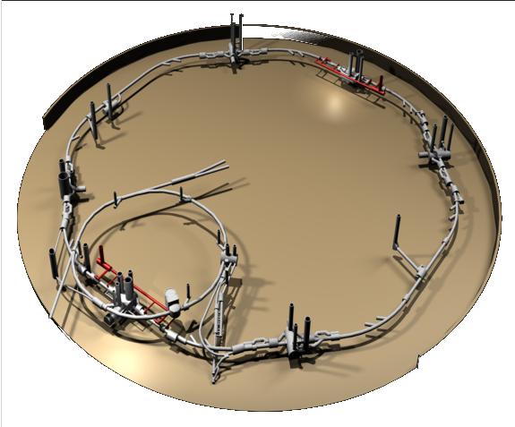
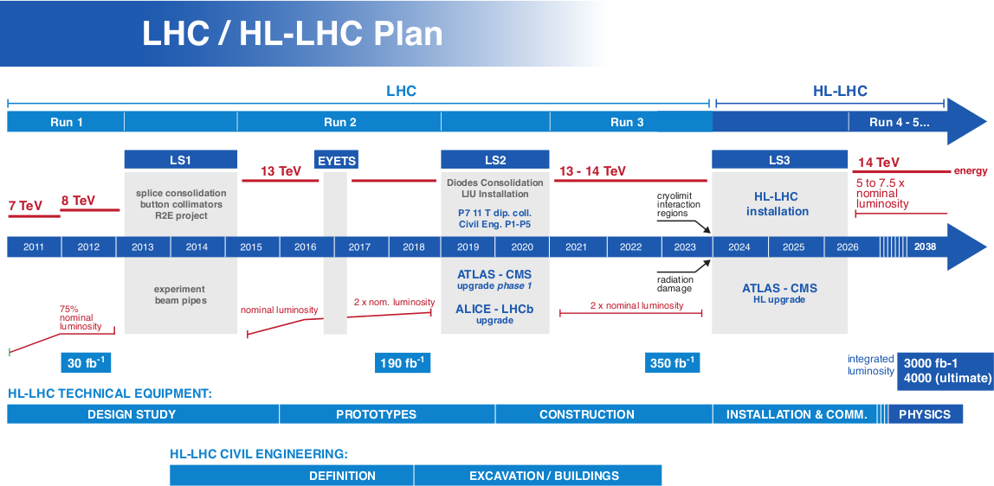
High Luminosity LHC
LHC integrated luminosity 300 fb⁻¹ by 2023
HL LHC
  upgrade interacting regions 2024/26
  3000 fb⁻¹ integrated luminosity by 2038
CERN courtesy

Slide 4
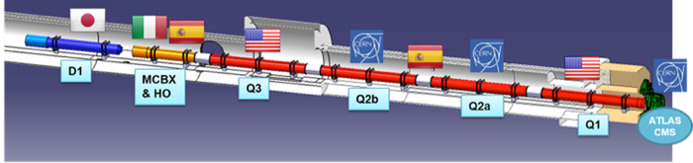
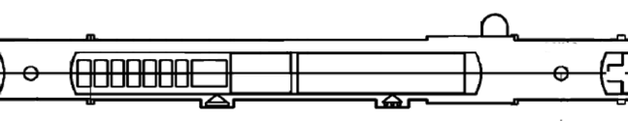
THE LOW BETA SECTION
and the High Order Correctors
73.6 m
IP
b3
b4
b5
b6
a2
by P. Fessia
a3
a4
a5
a6

Slide 5
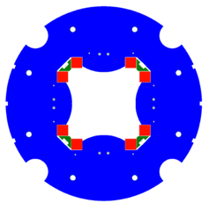
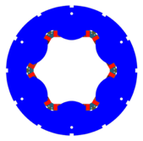
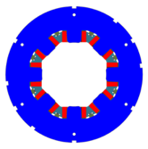
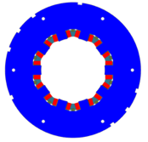
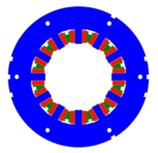
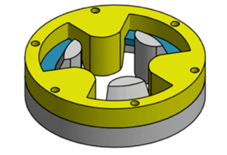
HO CORRECTOR MAGNETS ZOO
MCSXFP1
MCOXFP1
OD460
OD320
a3
b3
a4
b4
a2
Tested 2016
Tested 2017
tested 2019
MgB₂ demonstrator
MCQSXFP1
a5
b5
a6
b6
design construction test
5 protoptypes
54 series magnets
Tested 2018
Tested 2018
MCDXFP1
MCTXFP1
S. Mariotto
Tue-Af-Po2.18-06

Slide 6
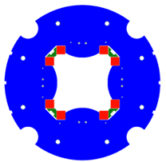
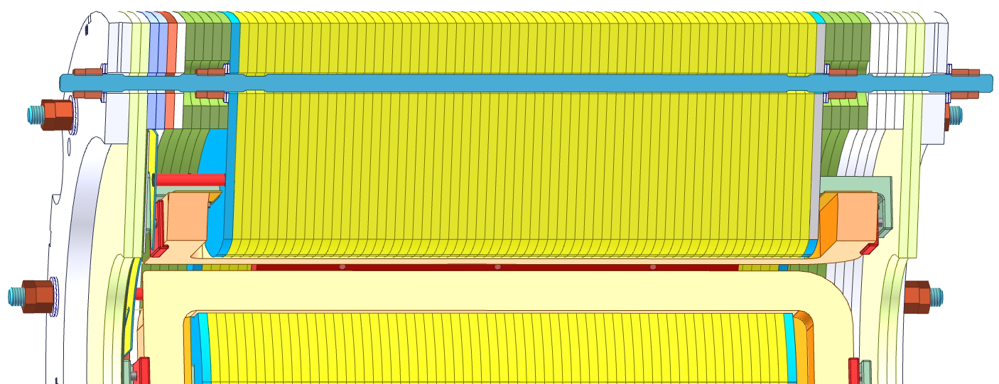
SUPERFERRIC DESIGN
Longitudinal dimension
Quench protection
Small dimension: 84kN series production (6 magnets)
NbTi superconding coils
Racetrack
Insulation by S2 glass reinforced material
Superferric design
Compact and modular
Strong contribution of the iron poles
Field quality influenced by the shape of the poles
constraints
magnet | Ic @ 4.2 K | Margin @4.2 K | Margin @1.9K
4P S | 315.5 A | 42.3 % | 57.1 %
6P | 225.5 A | 53.4 % | >60 %
8P | 230.2 A | 54.4 % | >60 %
10P | 255.7 A | 58.9 % | >60 %
12P N | 232.6 A | 54.9 % | >60 %
12P S | 230.2 A | 54.4 % | >60 %
coils
CuBe rods
pole
Quench protection
No energy extraction (but 4P)
60% margin @ 1.9 K
ARMCO iron
wedges

Slide 7
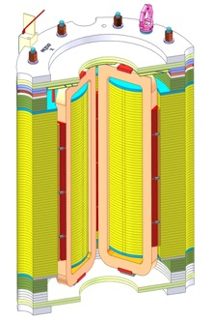
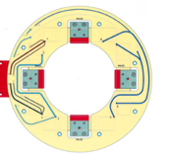
MCQSXFP1
length | 538 mm
integrated field @ In @ r50 mm | 0.700 Tm
magnetic length | 401.1 mm
energy @Inom | 30.8 kJ
harmonics | B6= -30 U at low current B6= 30 U at I_{op} B10= -8 U ÷ -12 U
538 mm
OD 460 mm
I_{nom}= 182 A
COILS
  754 windings
  815 m of Φ 0.7 mm NbTi
connections on a PCB board (Arlon N85)

Slide 8
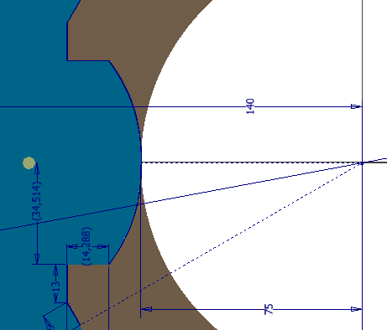
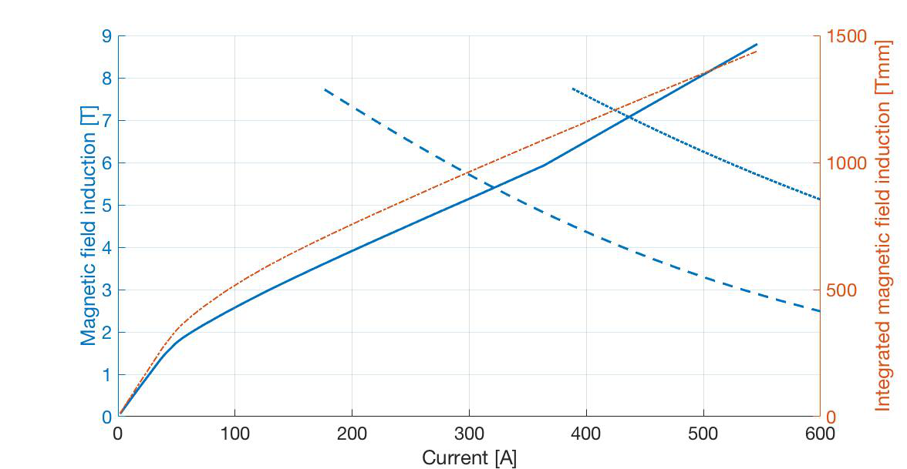
EM DESIGN
modifed ideal pole shape
(wire EDM laminations)
nominal current 174 A - field integral 0.7 Tm
ultimate current 197 A
1.9 K
4.2 K
QUENCH protection
OPERA + QLASA
1.5 Ω dump ressitor
ground in the middle
max temperature 145 K
max voltage 235 V
nominal

Slide 9
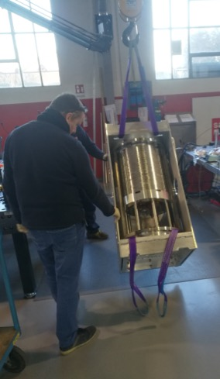
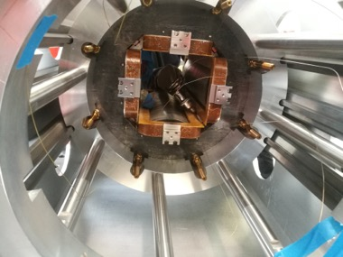
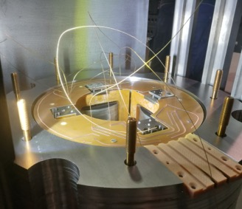
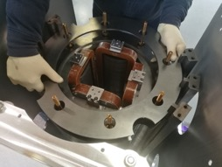
Assembly
wedge
Saes Rial Vacuum
Dec. 2018
pcb
CuBe rod
frame
frame
bridge to connection box
CuBe rod
alignemnt rods

Slide 10
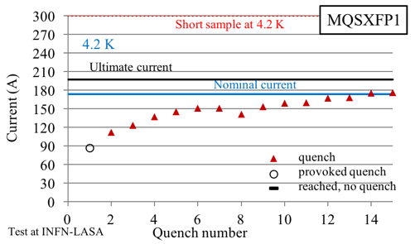
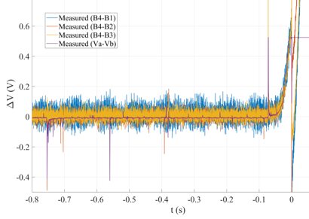
First Cooldown and Energization
Training up to nominal
Electrical problem
precursor
B3
B2
B1
B2
B3
B4
B1
B3
B2
B3
B3
B1
B4
B2
B1
Event n.13 B4
Precursor
Recovered transitions in different coils

Slide 11
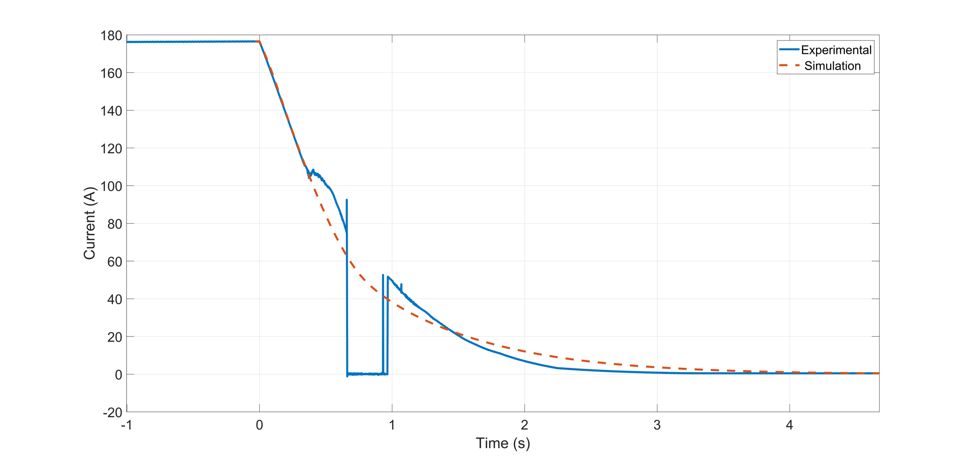
Event n.15
energy extraction
deviation from standard decay
zero measured current

Slide 12
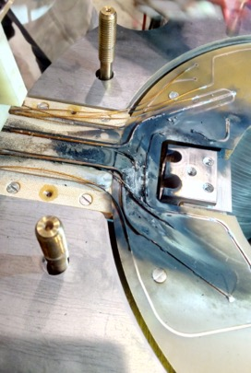
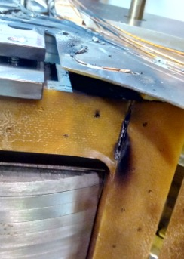
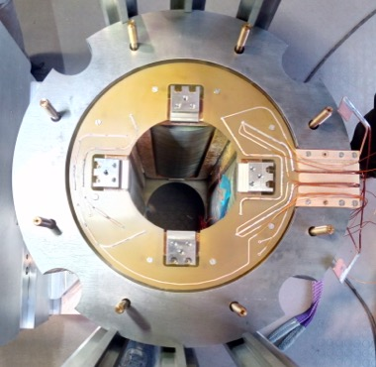
Damaged Coil
bridge
B1
B3

Slide 13
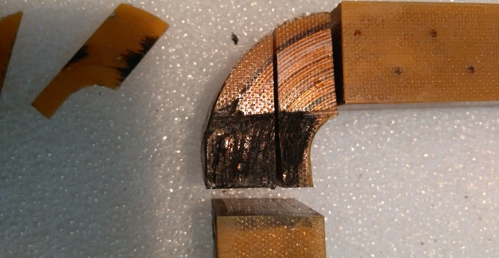
Numerical Model
Discharges between output wire and windings
Inner layers not damaged
Numerical model implemented
in LTSpice, Netlist forma (M. Prioli)
Coil 1 split into two parts:
  Coil 1A: 7 high-field layers bypassed by a short-circuit
  Coil 1B: 19 layers normally in series with the rest of the circuit
Mutual inductance matrix (5 x 5) computed in Opera
(S. Mariotto)
Quench originated in the high-field zone (Coil 1A)
  The resistance is not evenly distributed between coil 1A and coil 1B
  Simulated distribution is 37% for coil 1A and 63% for coil 1B
The short resistance is a variable
  It is initially high (~10 Ω), then decreases due to a local welding (~0 Ω) then increases (~1 Ω)

Slide 14
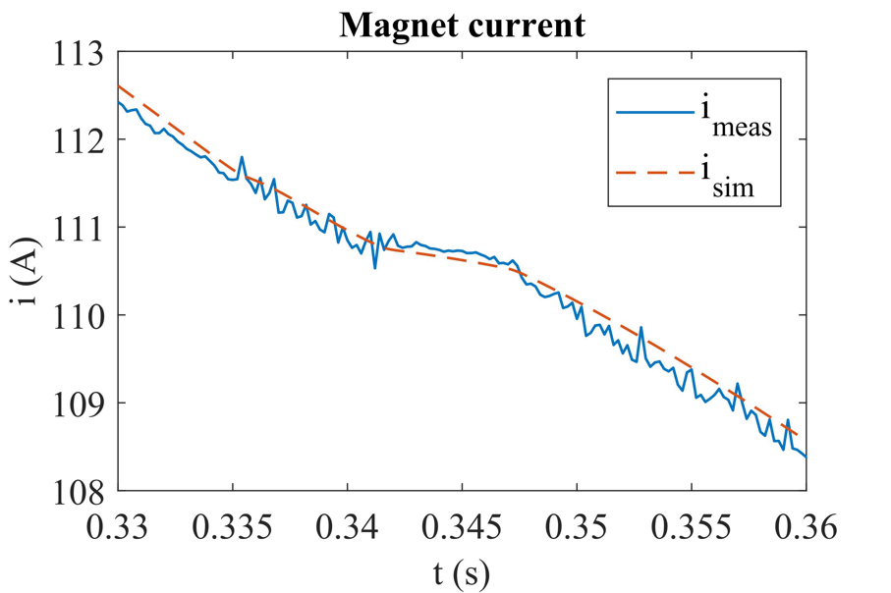
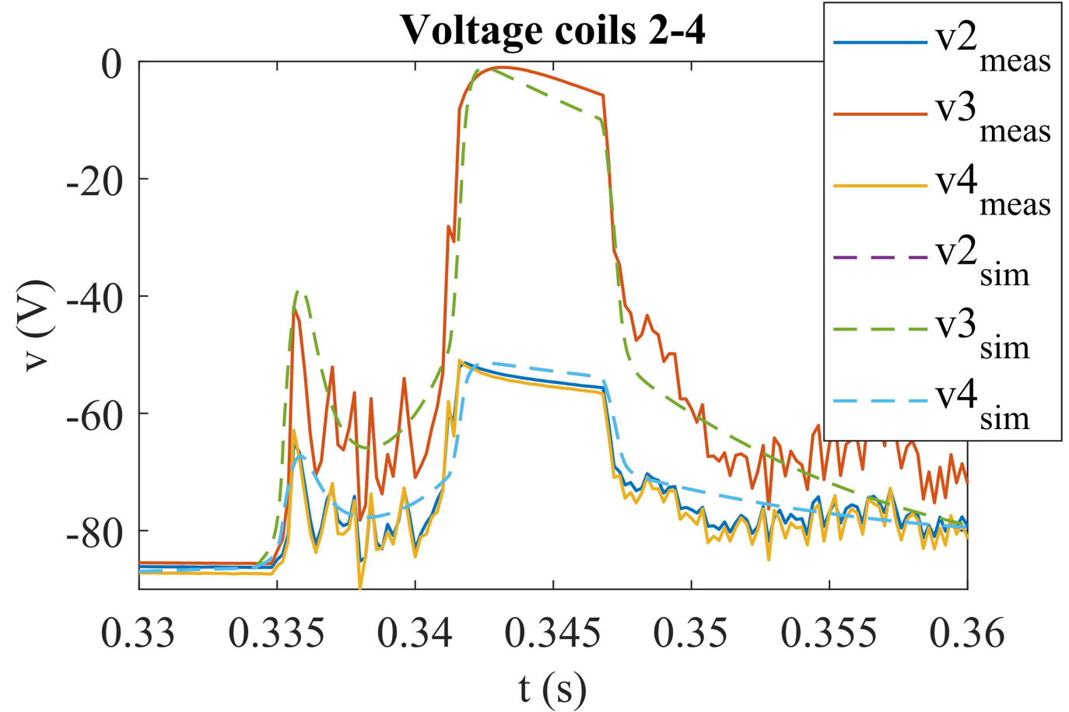
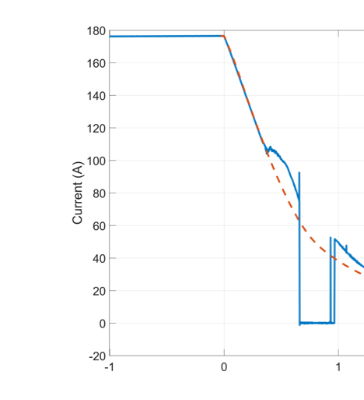
Numerical Model: Results
Current decay deviation
~0 Ω
~10 Ω
~1 Ω
No short

Slide 15
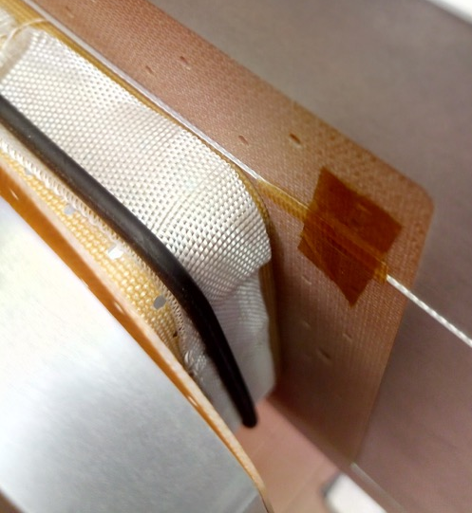
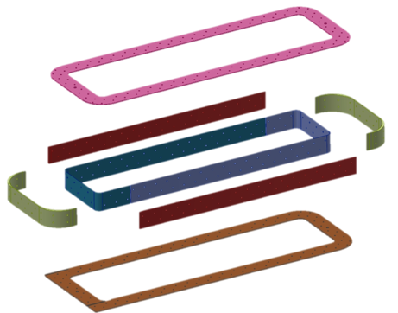
Two New Coils
BTS2 foil
all coils compliant
the 2 new coils installed
Machined from bulk
0.15 mm
sheet
S2 tape
1.0 mm
In & out

Slide 16
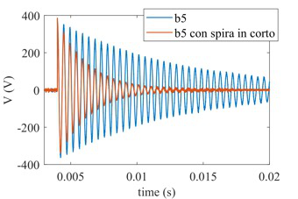
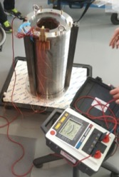
Second Assembly Assessment
Coil
Geometry
HV ground insulation (2,5 kV)
Wire-wire insulation, turns
All coils are compliant
+ shorted winding
Magnet
Laminations’ profiles and slits
Alignment of the assembly
HV ground insulation of the magnet (up to 2 KV)
procedures validated
second assembly
coil replacement

Slide 17
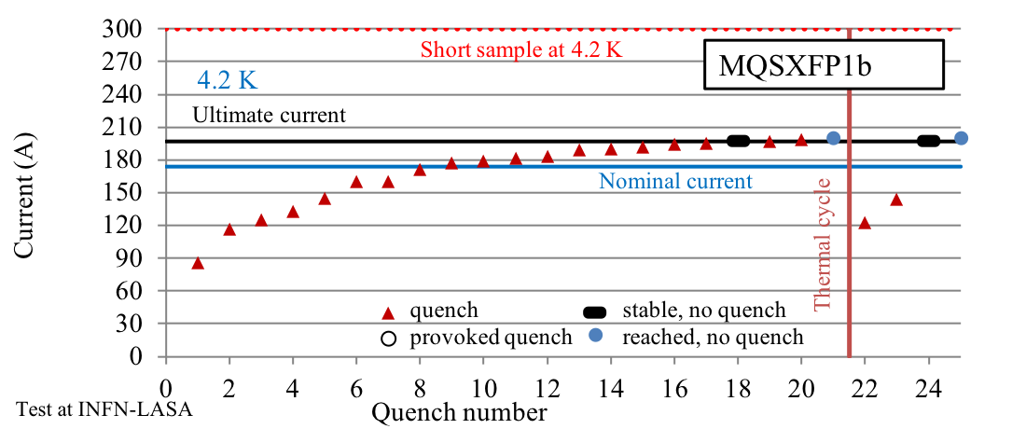
Power Test
Most quenches in new coils
Good stability after reaching 200 A (> I_{ult} 197 A)
Stable 1 h @ ultimate after thermal cycle

Slide 18
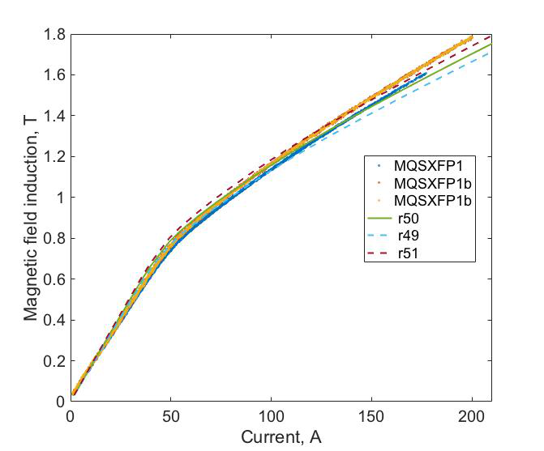
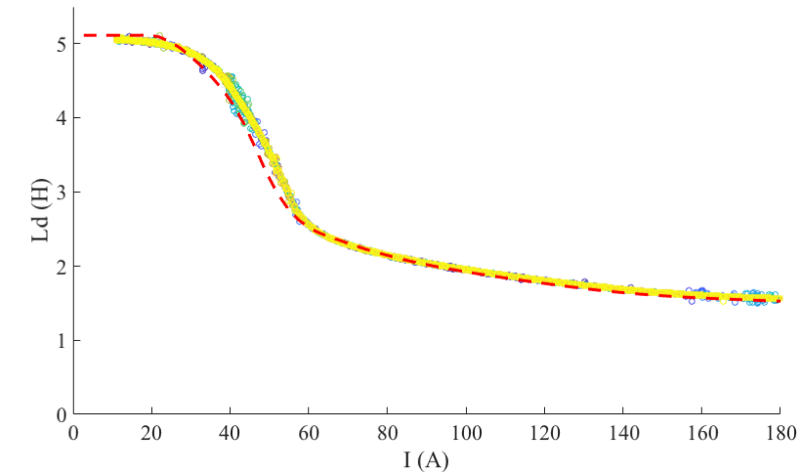
MAGNETIC FIELD AND INDUCTANCE
Single Hall Probe
Dinamic inductance measured during current ramps
several ramps
several ramps
two assembly
Low accuracy positioning
Field quality measurement at LASA in 2019
S. Mariotto

Slide 19
Conclusion
The HL-LHC skew quadrupole corrector magnet was successfully designed and assembled
First power test had an electric failure
  The fault has been identified
  A mitigation was applied even if all the non damaged coils are compliant, also for series production
  New quality test introduced
Second assembly power test showed good results: ultimate current reached, stabiliity test (1 h @ultimate), good quench memory
Procedures validated
All High Order Correctors protoypes tested

Slide 20
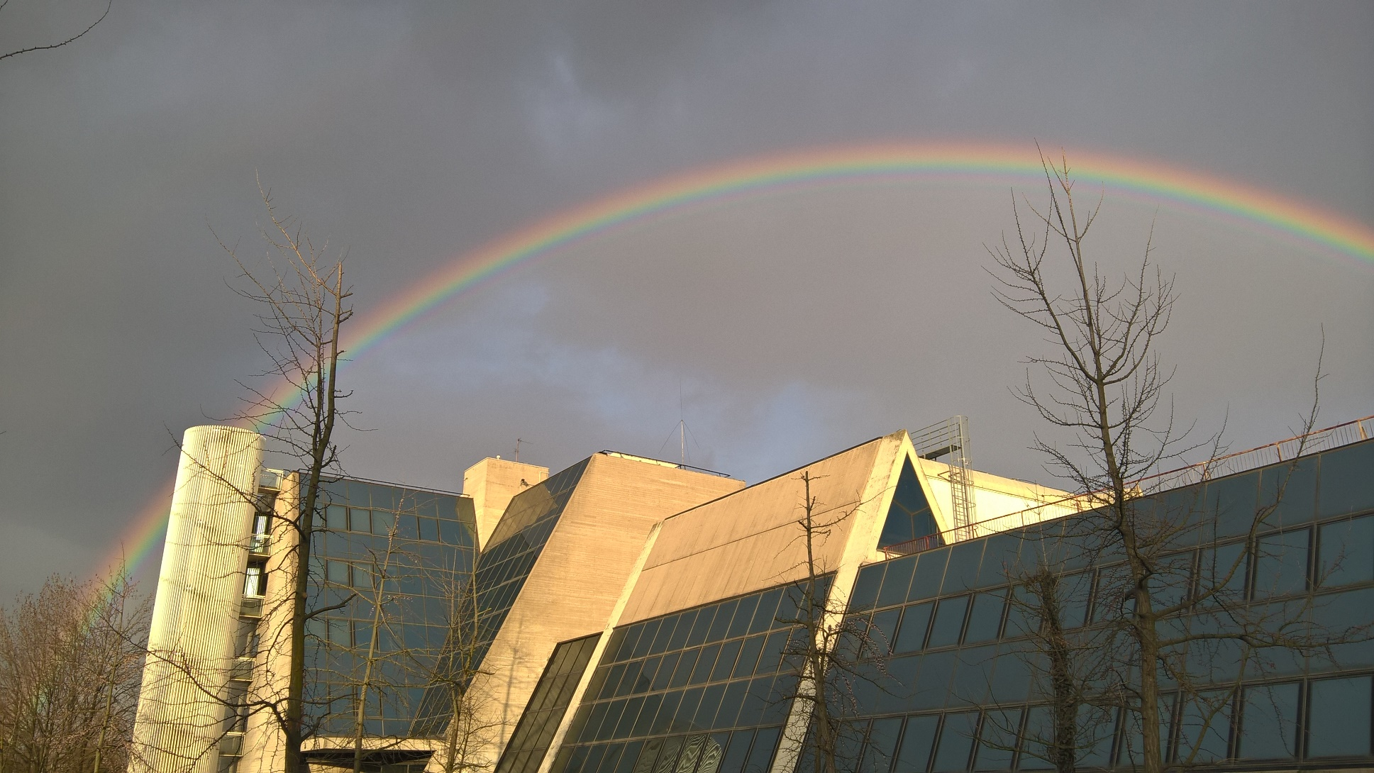



INFN & UNIMI - LASA team
F. Alessandria, G. Bellomo, F. Broggi, S. Mariotto, A. Paccalini, A. Pasini, D. Pedrini, A. Leone, M. Quadrio, M. Prioli, M. Sorbi, M. Statera, M. Todero, C. Uva
CERN A. Musso, E. Todesco
SAES getters M. Campaniello, P. Manini
SAES Rial Vacuum M. Canetti, F. Gangini
RODOFIL A. Zanichelli
THANK YOU
Ph. by G. Fornasier

