Slide 1
Winding and 77K Testing of Non-Insulated Coils for the IBS 25T, 100 mm bore HTS Solenoid
S. Joshi, M. Allen, W. Sampson, R. Gupta
MT-26 Vancouver
26SEPT19

Slide 2
CONTENT
Introduction
No-Insulation
Conductor
Design Specifications
Coil Winding
Coil Testing
Coil Test Results
Summary

Slide 3
INTRODUCTION
The Institute of Basic Science (IBS) in South Korea requires a 25 Tesla, 100 mm bore solenoid for experiments searching for dark matter axions search.
The Superconducting Magnet Division at Brookhaven National Laboratory received a contract to design and build this magnet.
The design is based on no-insulation approach using second generation HTS.
BNL has built 16 of the 28 coils needed; tested 12 (@ 77 K) of the 16 built.
This presentation summarizes the construction and 77 K test results.

Slide 4
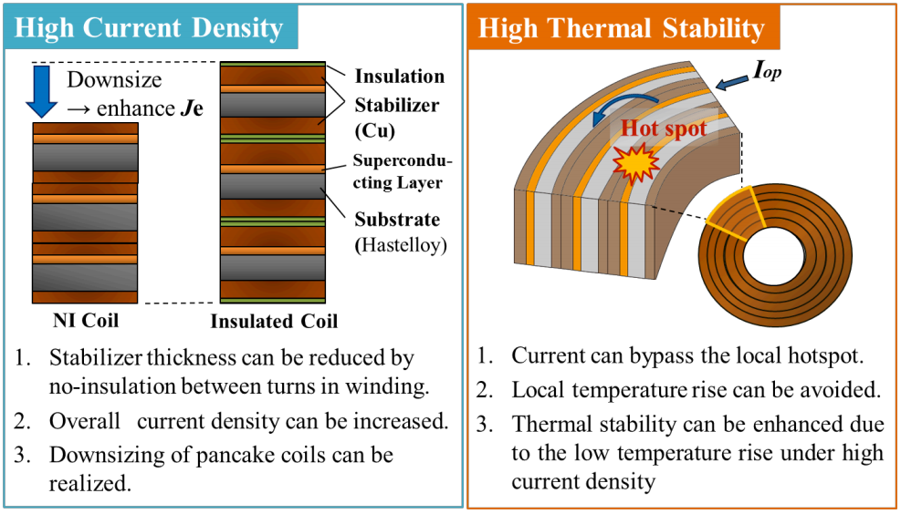
NO-INSULATION
Non-Insulated (HTS) Magnet coils offer:
reliable intrinsic quench protection
the ability to tolerate local defects in the conductor or sudden changes in operation
as compared to HTS coils made with metallic or non-metallic insulation.
Reference:
Wang, T., Noguchi, S., Wang, X., Arakawa, I., Minami, K., Monma, K., … Iwasa, Y. (2015). Analyses of transient behaviors of no-insulation REBCO pancake coils during sudden discharging and overcurrent. IEEE Transactions on Applied Superconductivity. https://doi.org/10.1109/TASC.2015.2393058
Notes:
http://library.psfc.mit.edu/catalog/reports/2010/15ja/15ja045/15ja045_full.pdf

Slide 5
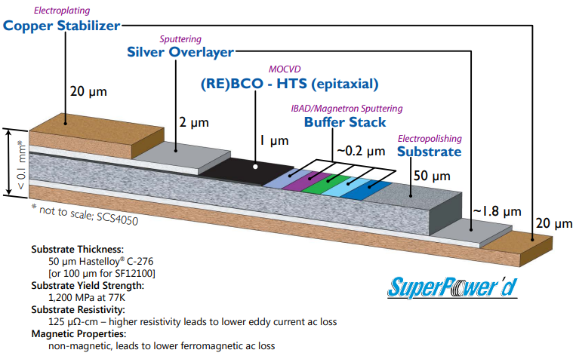
CONDUCTOR
Width of the tape : 2 mm to 12 mm
  12 mm gives larger current, smaller impact of local defect and fewer coils
Choice of substrate: Hastelloy, SS, Ni and others
  Hastelloy for the best mechanical properties
Amount of copper : 20 micron to 100 micron
  20 micron gives the best mechanical properties
Reference:
http://www.superpower-inc.com/system/files/SP_2G+Wire+Spec+Sheet_2014_web_v1_0.pdf

Slide 6
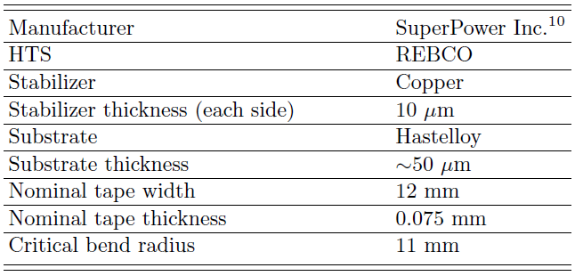
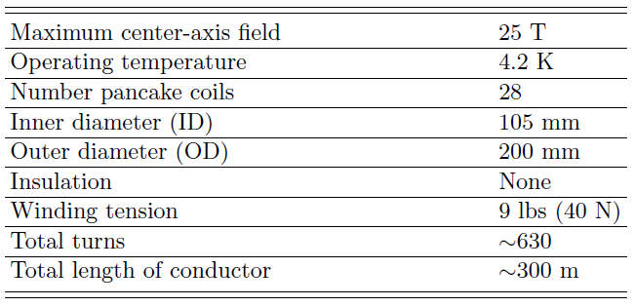
DESIGN SPECIFICATIONS
Conductor Information
Coil Specifications

Slide 7
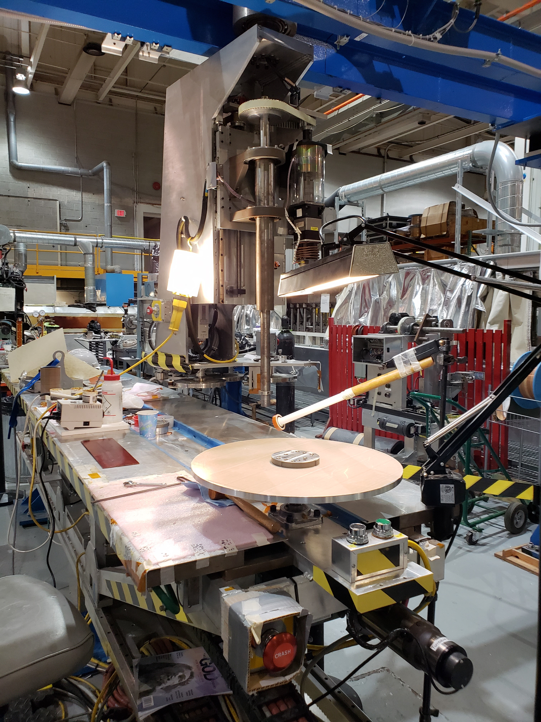
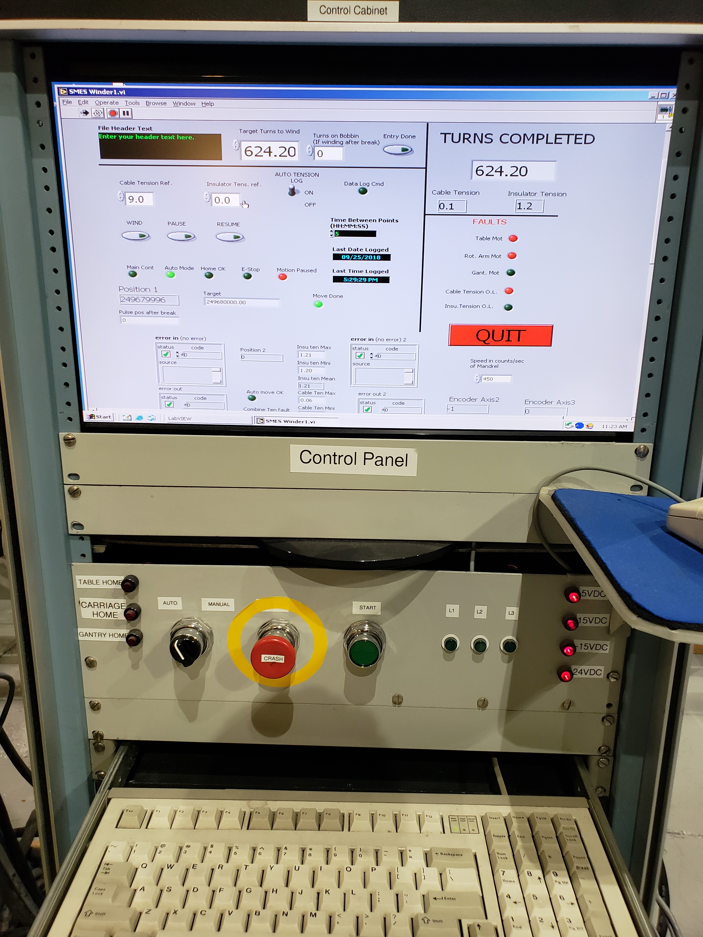
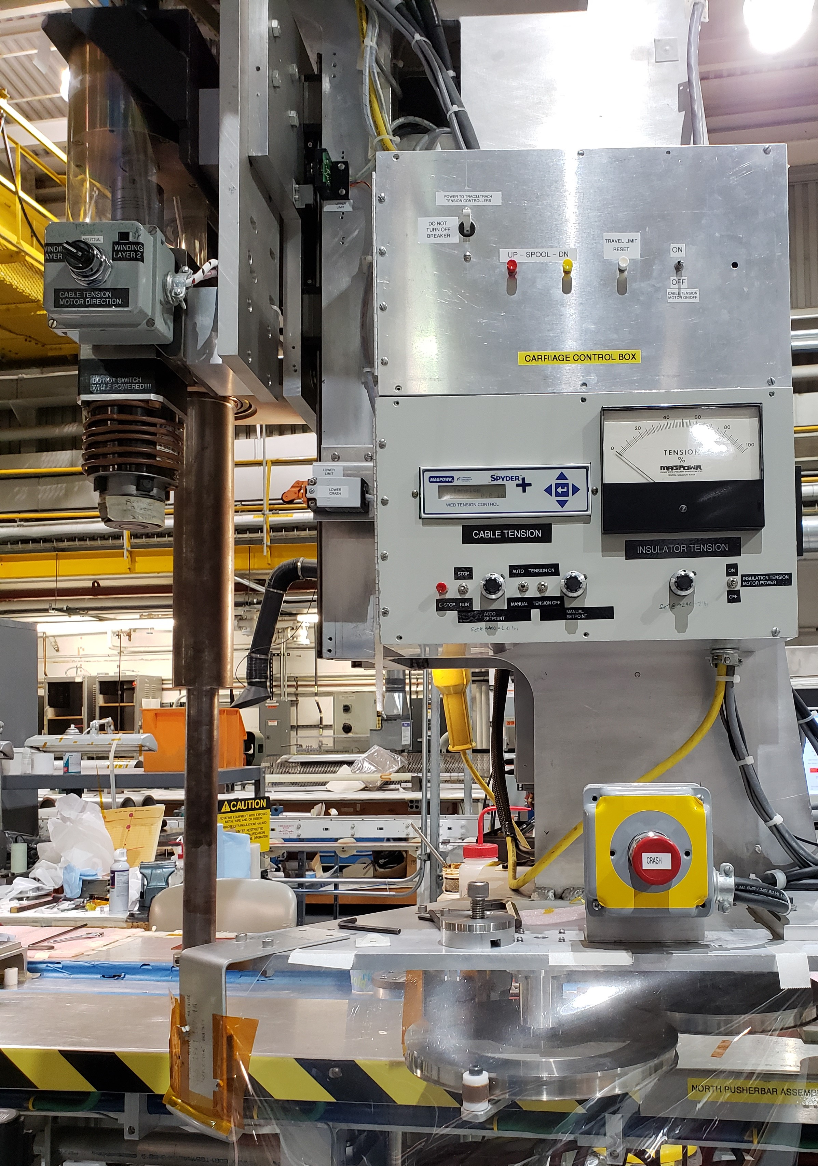
COIL WINDING
Above, left to right: Multi-Axis Coil winding Machine, Designed and Built at BNL; LabView based coil winding machine control program; Coil winding tension control

Slide 8
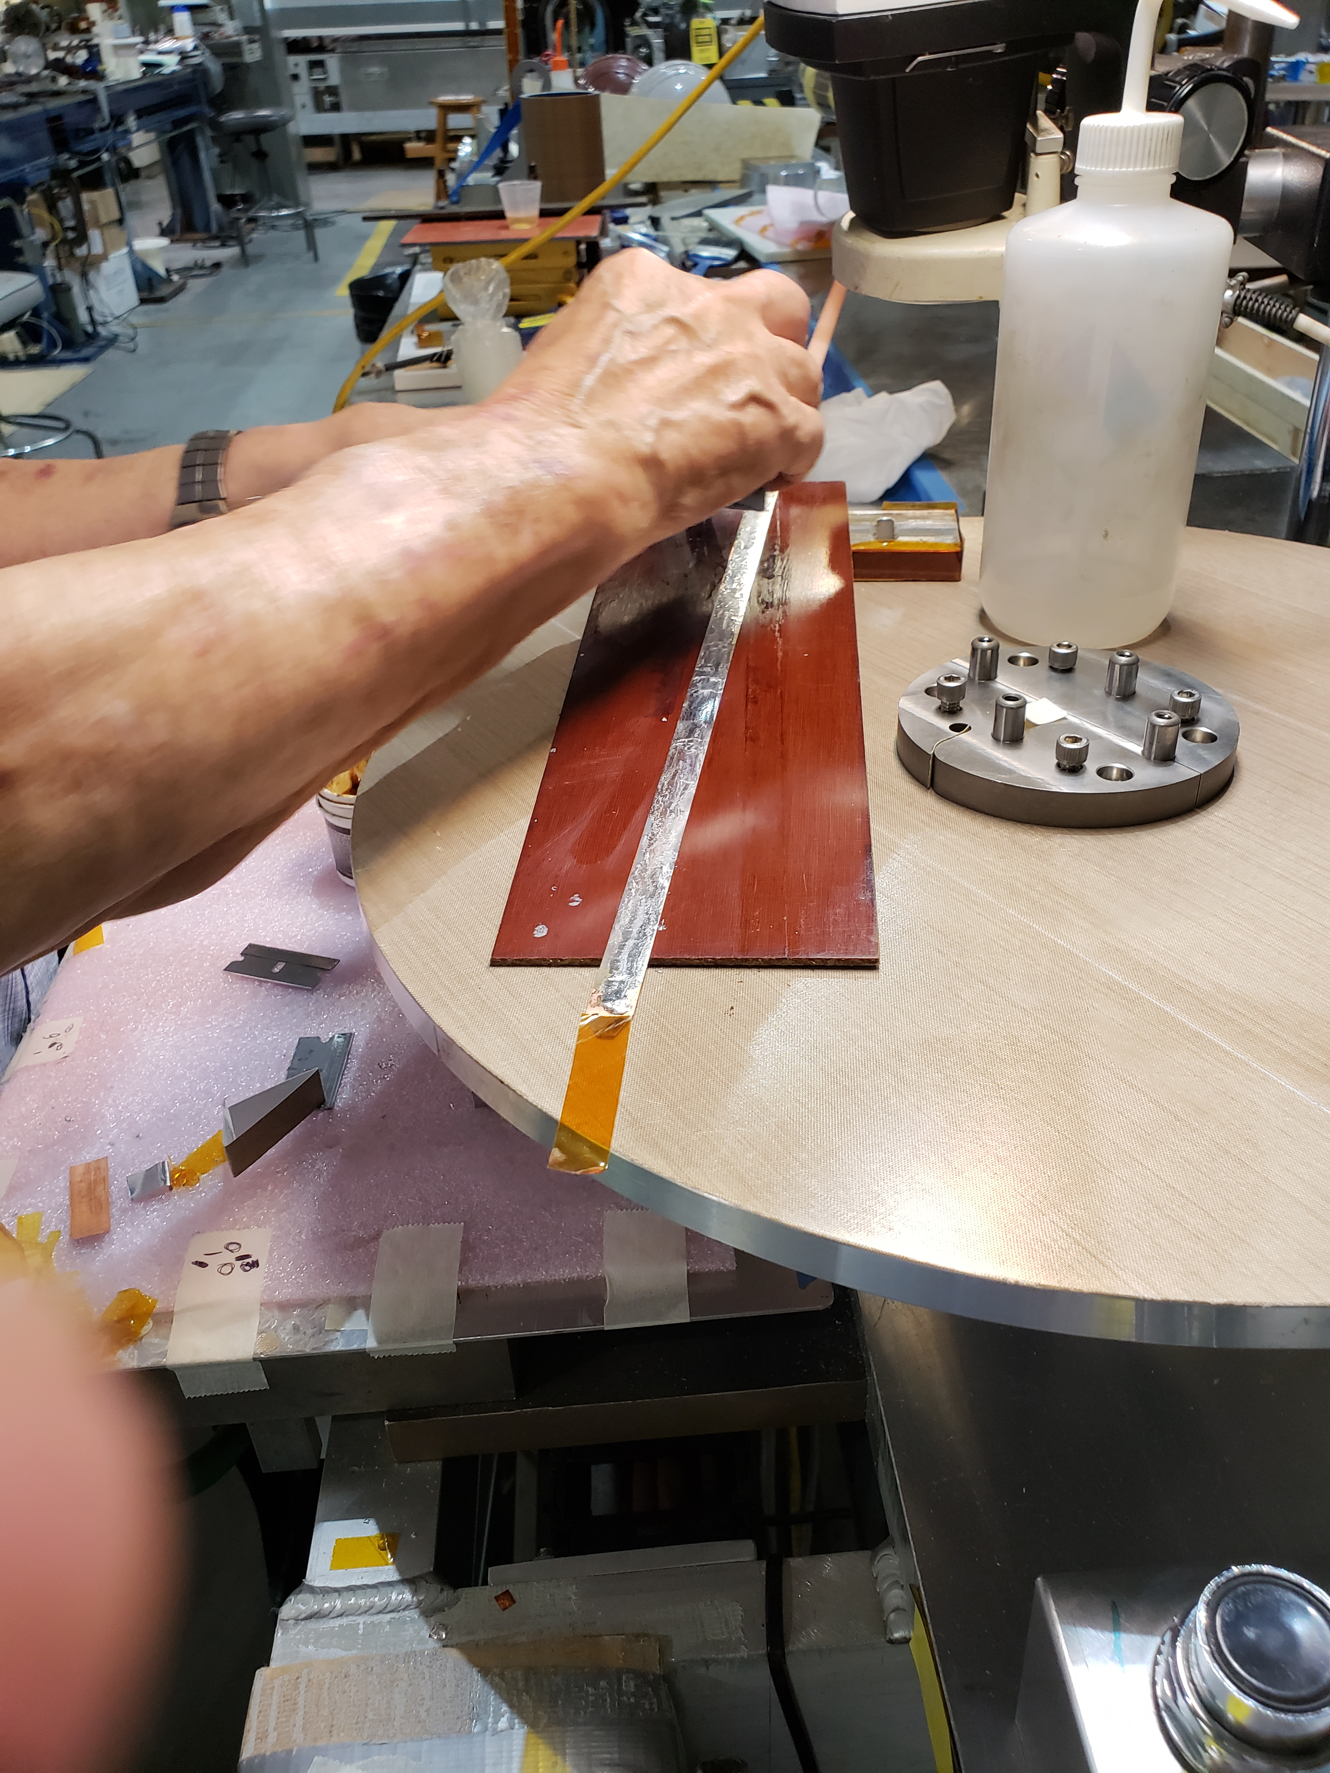
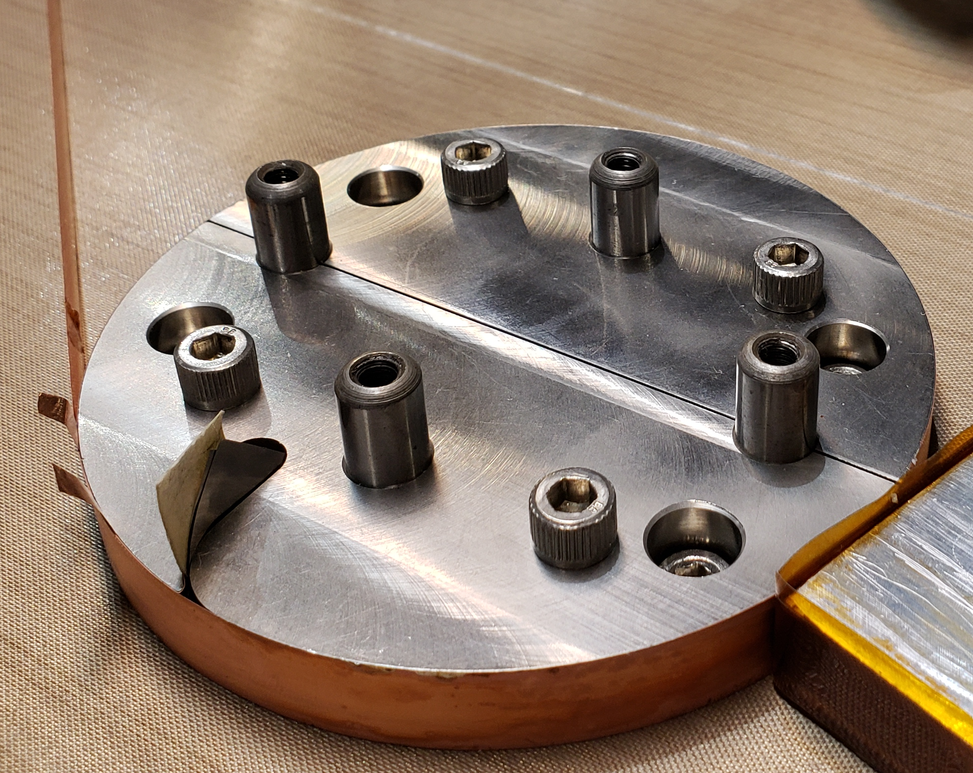
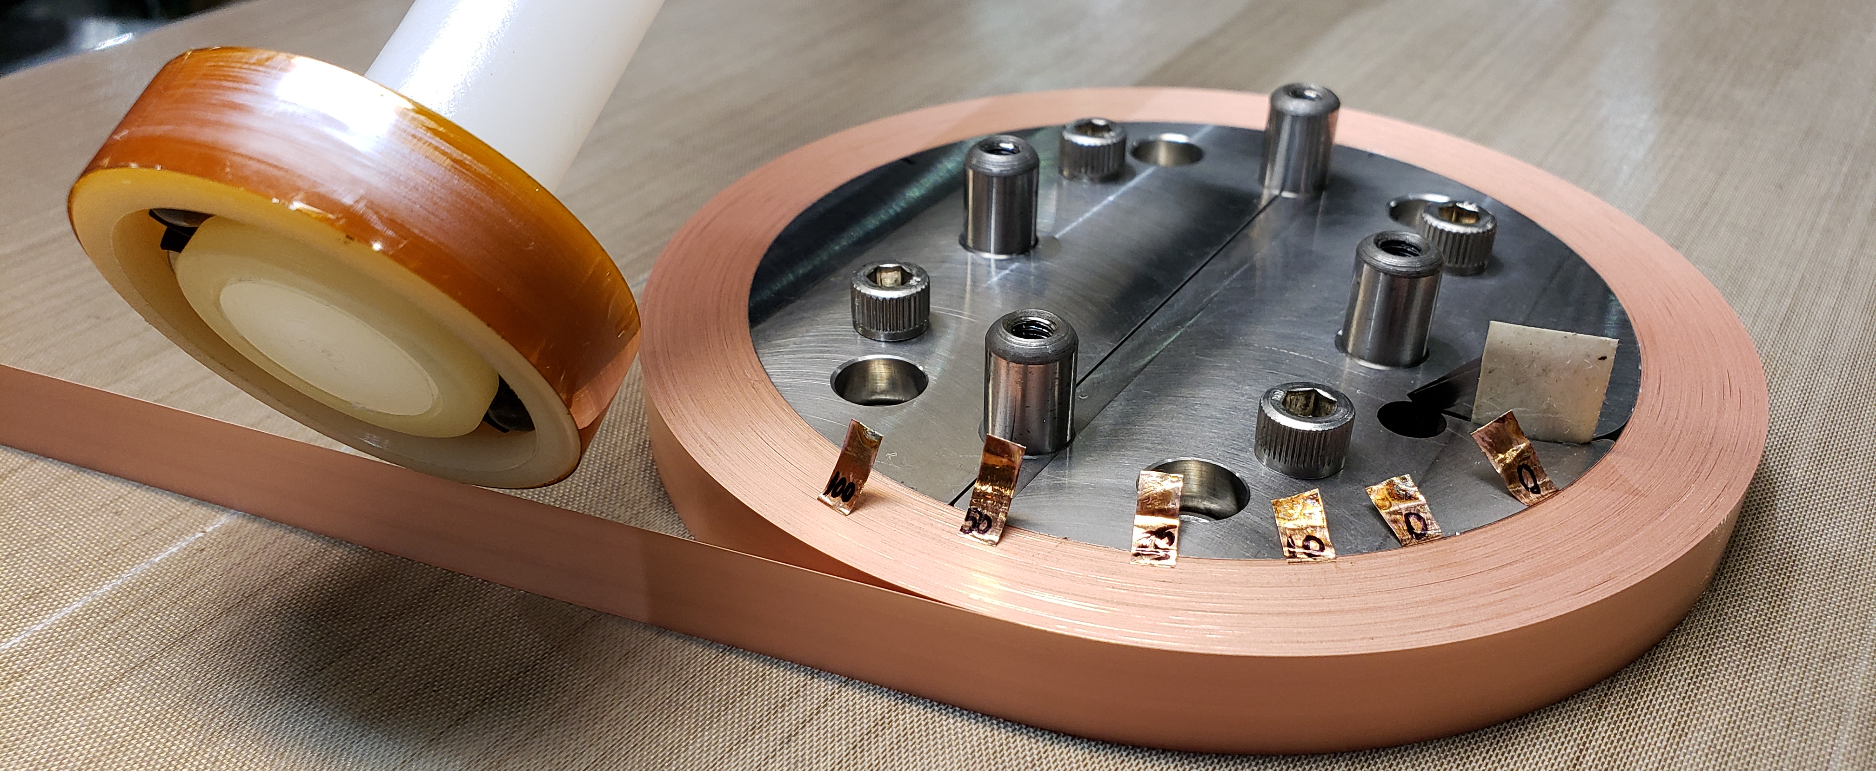
COIL WINDING
Above: Tin first turn for future leads and or coil inter-connections – HTS side FACING bobbin
Above: Solder first turn to itself to secure inner part of coil for reusable bobbin removal
Left: Continue winding, with conductor under 9 lbs of tension, until conductor runs out or splice needs to made to reverse HTS orientation (conductor HTS side has to be FACING AWAY from bobbin on the final turn for future leads and or coil inter-connections)

Slide 9
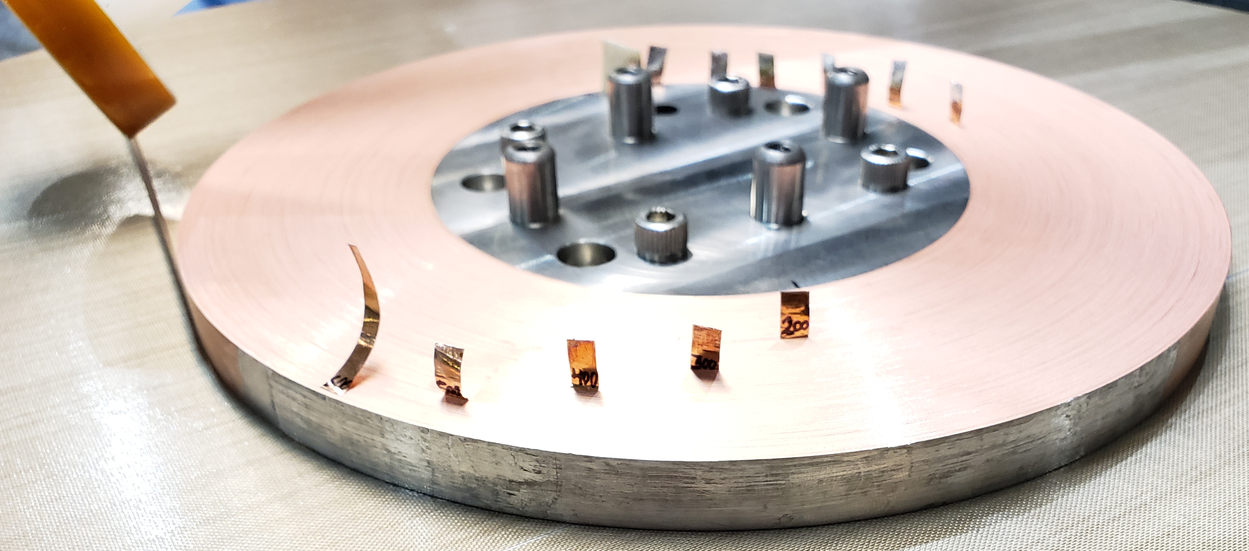
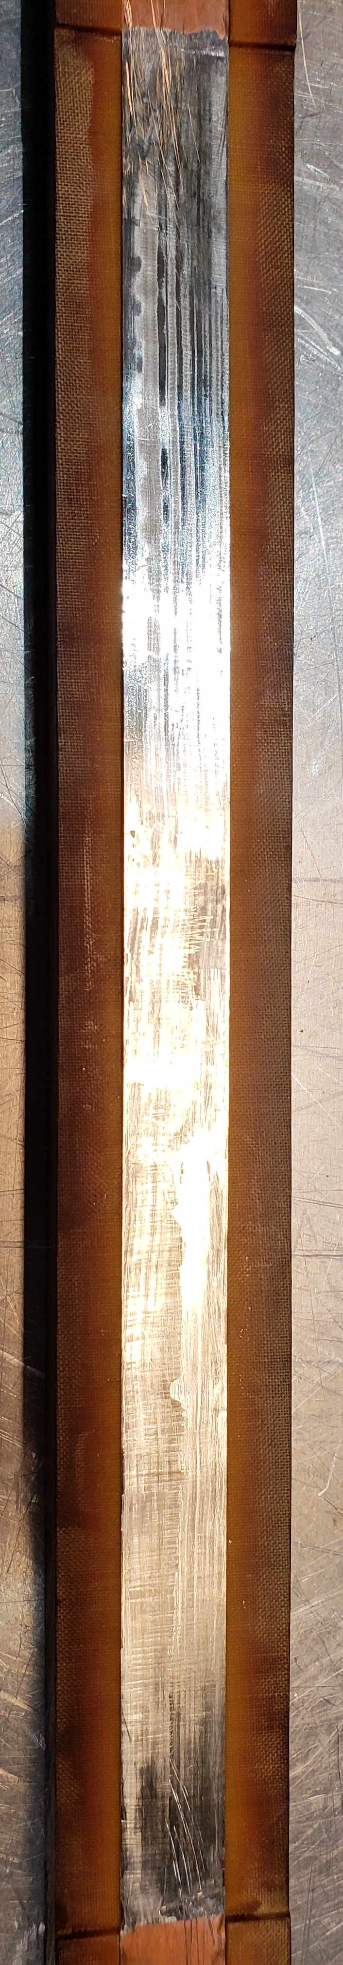
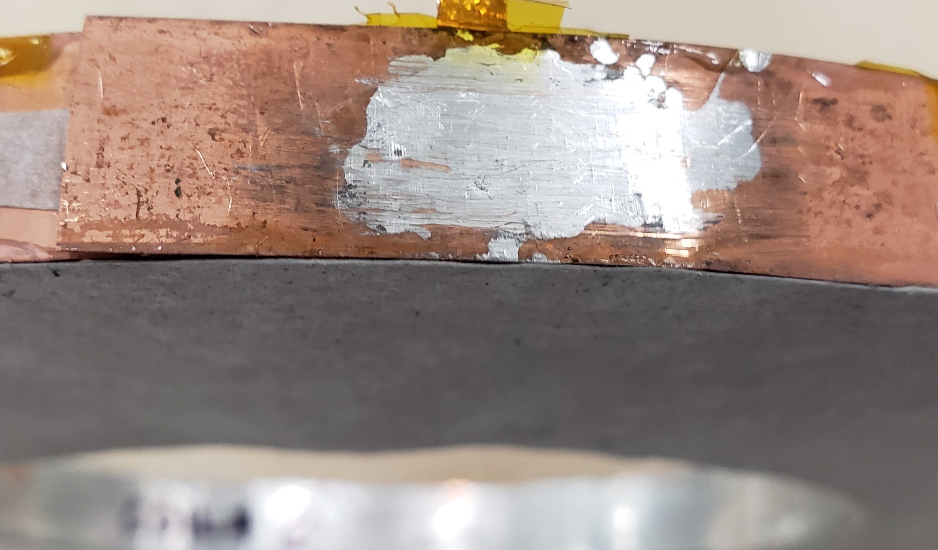
COIL WINDING
Left: Line up conductors together using splicing tool. Splice (~23 cm in length) conductors using Indium solder and scrape away access Indium – minimize the thickness of the splice
Above: Spliced joint being wound into the coil
Left: Continue winding coil until coil O.D equals 200mm (~625-630 turns of 20µm Cu HTS tape). Solder last turn to itself to hold outer part of coil together once conductor is disconnected from spool.

Slide 10
CONTACT RESISTANCE AND TIME CONSTANT
Resistance measurements were taken while Coils 1 and 2 were being wound at intervals of 10, 25, 50, 100, 200, 300, 400, 500, 600, and finished coil.
The resistance of the inner turns decreased, due to compression, as more turns were wound. This signifies better conductor to conductor contact between the turns.

Slide 11
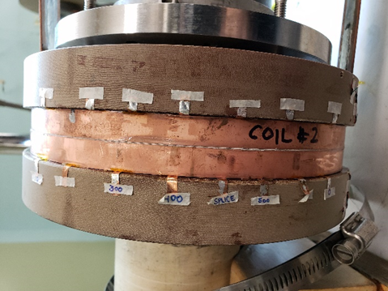
COIL TESTING - SETUP
Coils 1-6 were tested in a Single Pancake configuration;
Coils 7-12 were tested in a Double Pancake configuration.

Slide 12
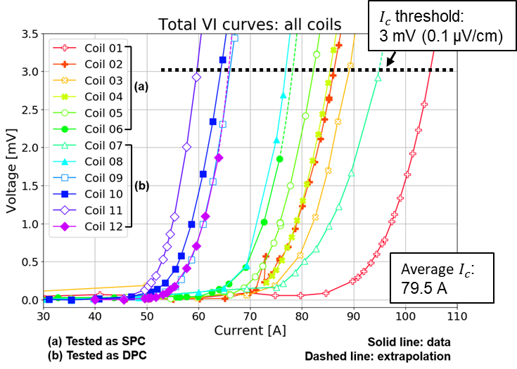
OVERALL LN2 TEST RESULTS FOR TESTED COILS
Significant variation in Coil I_{c} from coil to coil

Slide 13
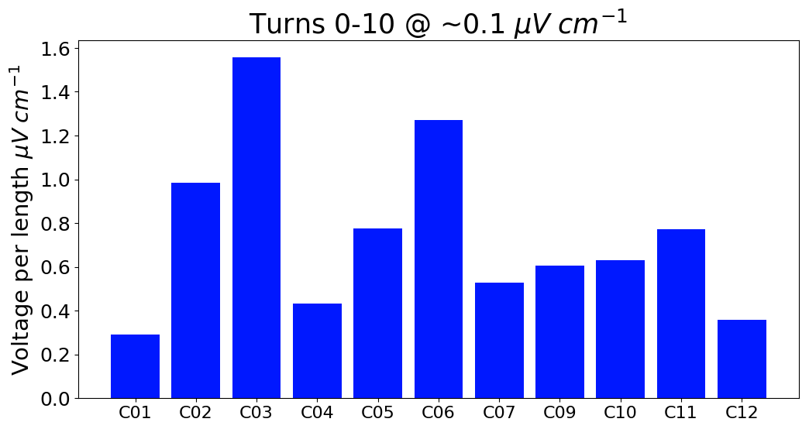
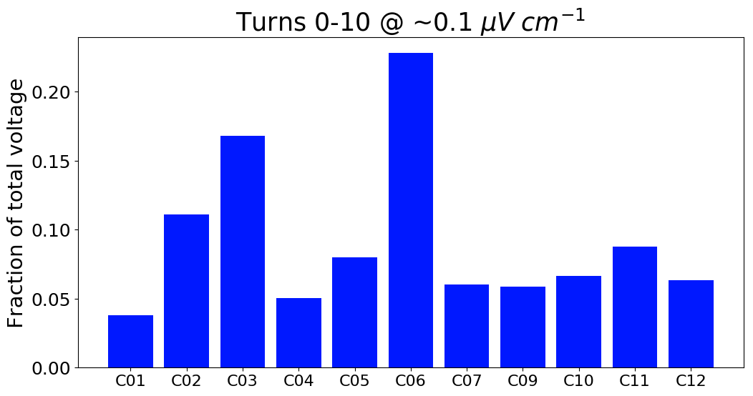
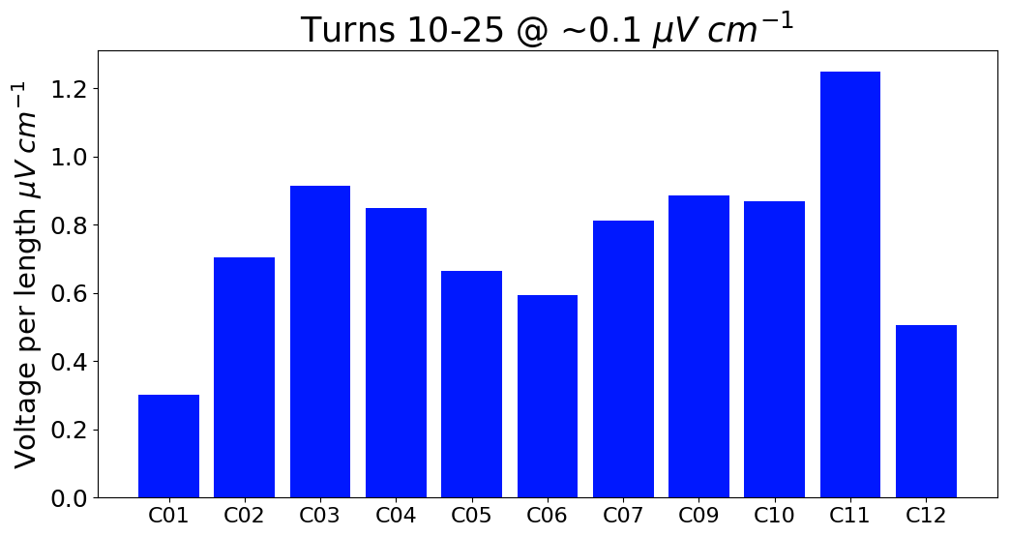
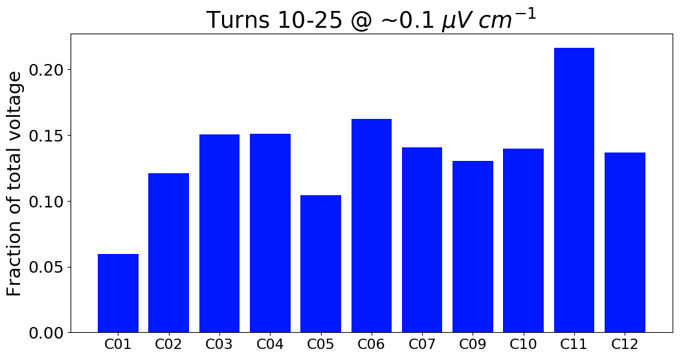
LN2 TEST RESULTS COMPARISON
Variation in voltage distribution observed throughout all coils.
~ 10% of the total coil voltage, on the average, was developing the first 10 turns
~ 15% of the total coil voltage, on the average, was developing between turns 10 and 25

Slide 14
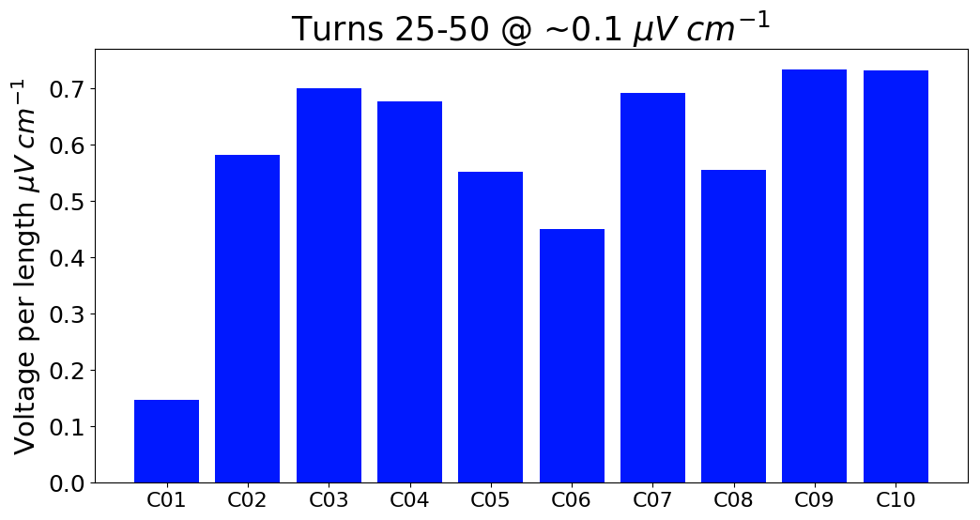
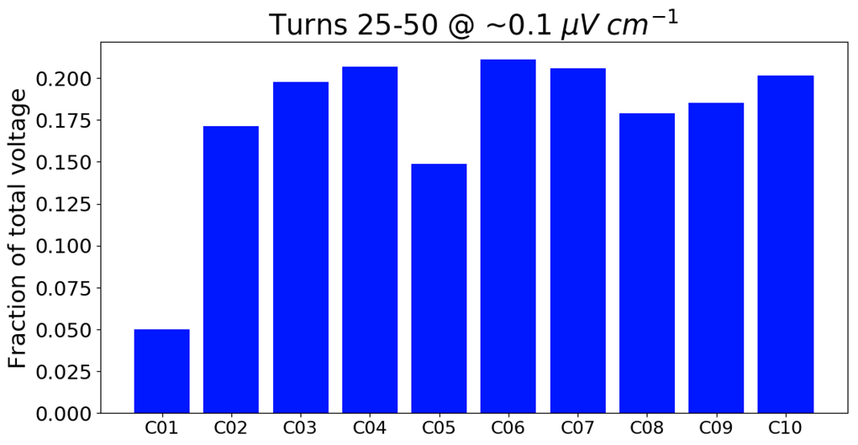
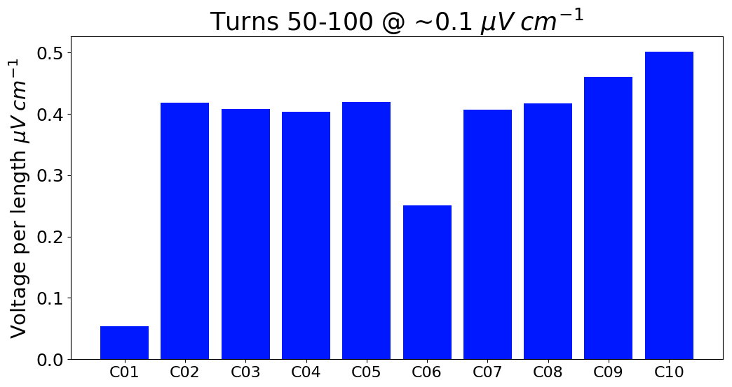
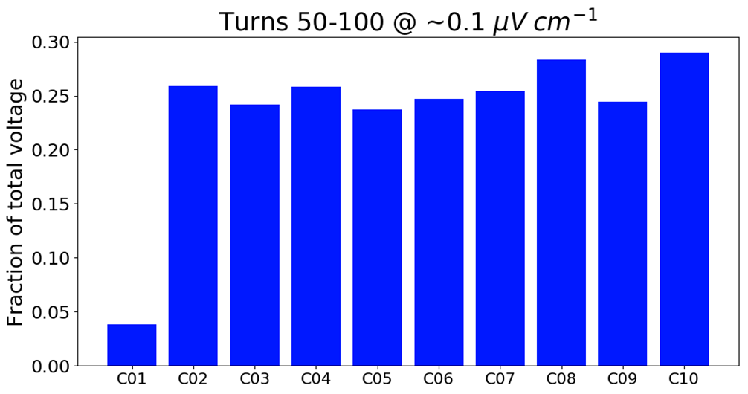
LN2 TEST RESULTS COMPARISON (continued)
Variation in voltage distribution observed throughout all coils.
~ 18% of the total coil voltage, on the average, was developing between turns 25 and 50
~ 25% of the total coil voltage, on the average, was developing between turns 50 and 100

Slide 15
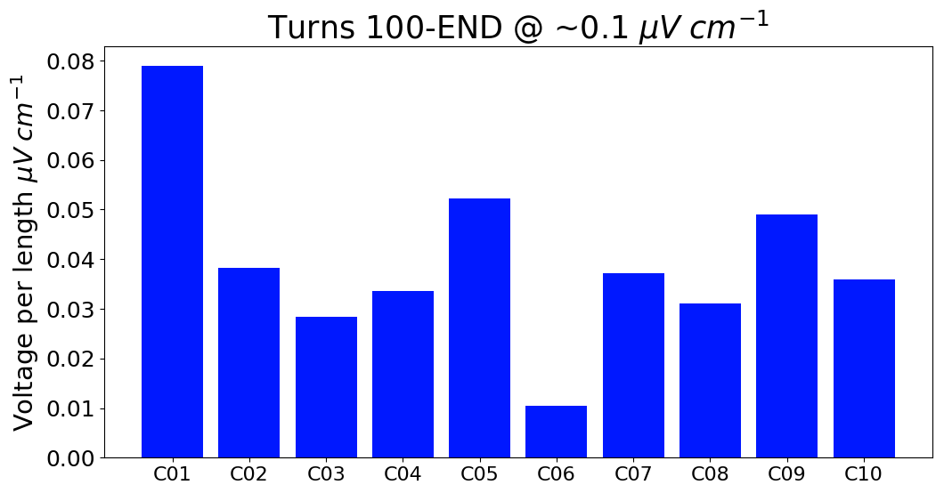
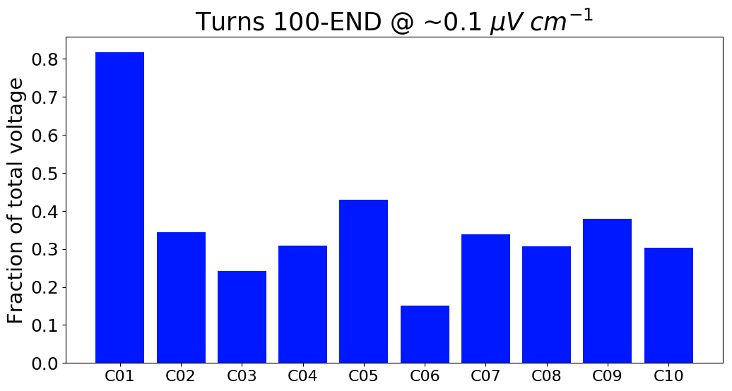
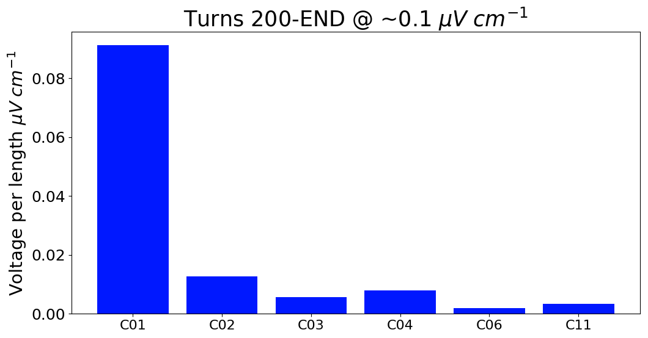
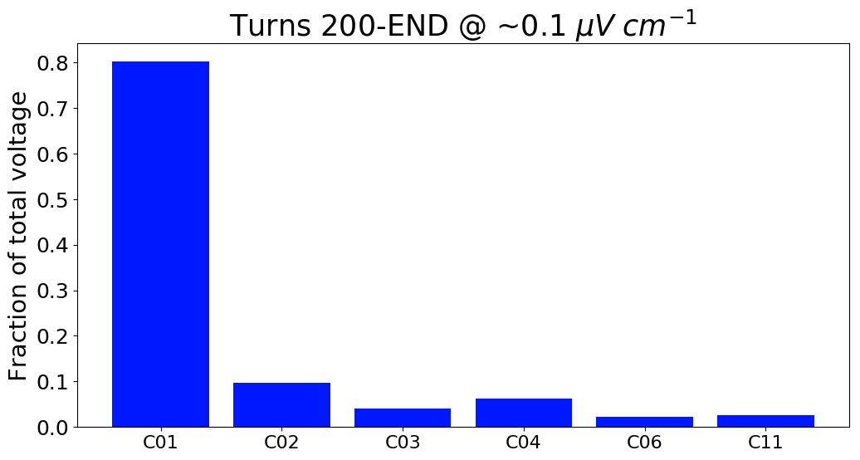
LN2 TEST RESULTS COMPARISON (continued)
Variation in voltage distribution observed throughout all coils.
~ 30% of the total coil voltage, on the average, was developing between turns 100 and the remaining ~520 turns of the coil
Less than 10% of the total coil voltage, on the average, was developing between turns 200 and the remaining ~420 turns of the coil

Slide 16
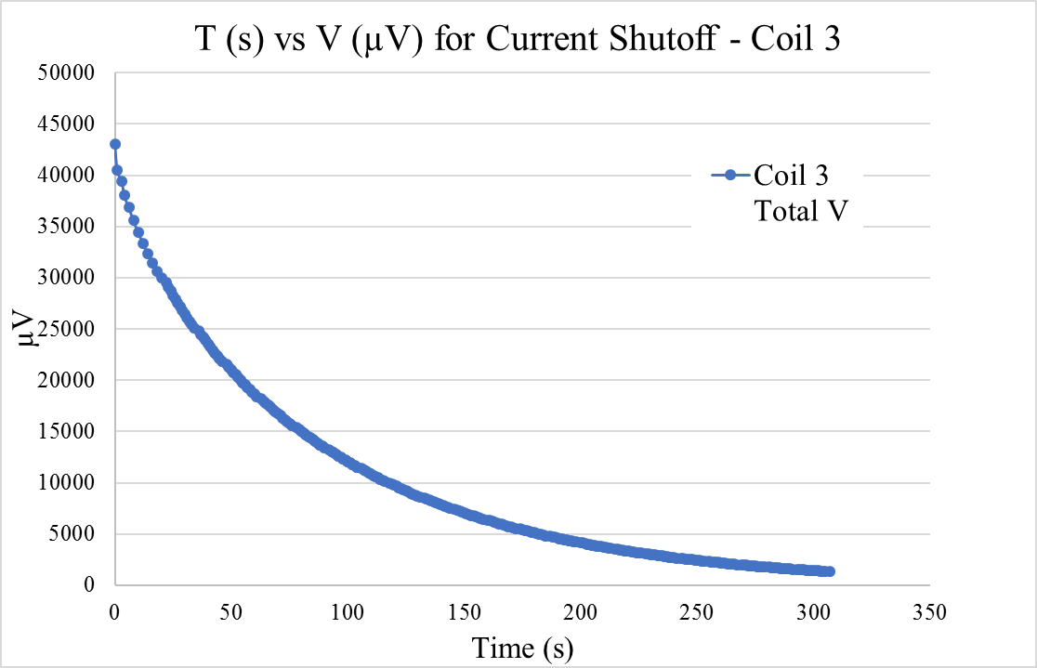
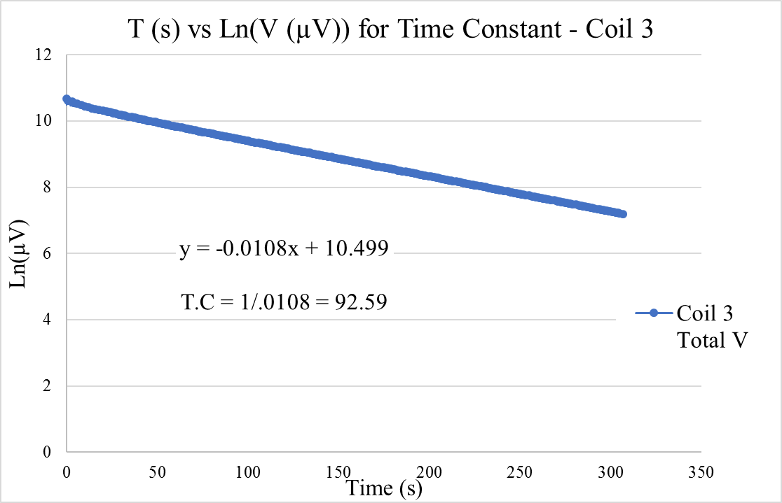
CONTACT RESISTANCE AND TIME CONSTANT
After Coil 3 was ramped up to and stabilized at 50 A (@ 77 K), the power supply was shut off. The time constant of Coil 3 was calculated to be 92.59 seconds. Generally, higher contact resistance results in a smaller time constant.

Slide 17
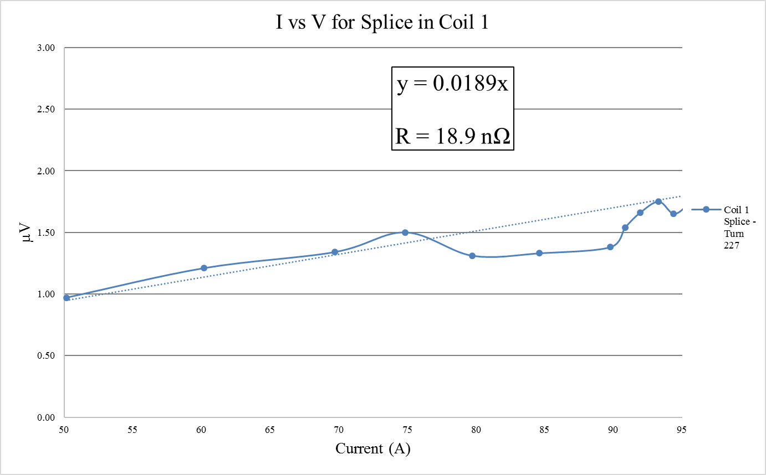
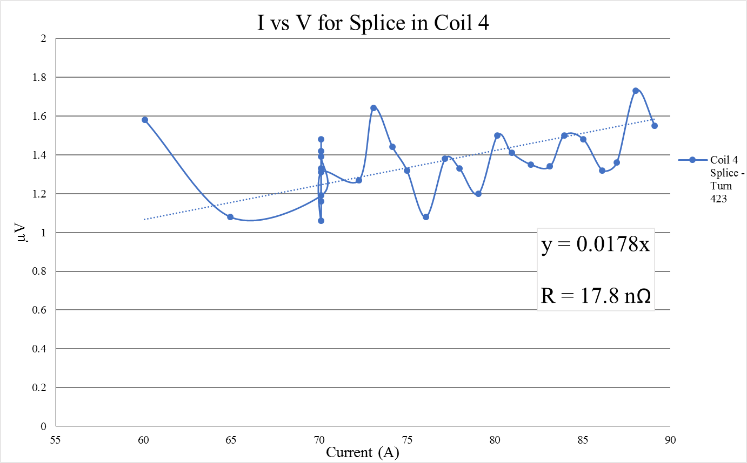
INNER-COIL SPLICE
Above: I vs V curve for the splice in coil 1 @ turn 227. The resistance from the splice averages out to 18.9 nΩ.
Above: I vs V curve for the splice in coil 4 @ turn 423. The resistance from the splice averages out to 17.8 nΩ.

Slide 18
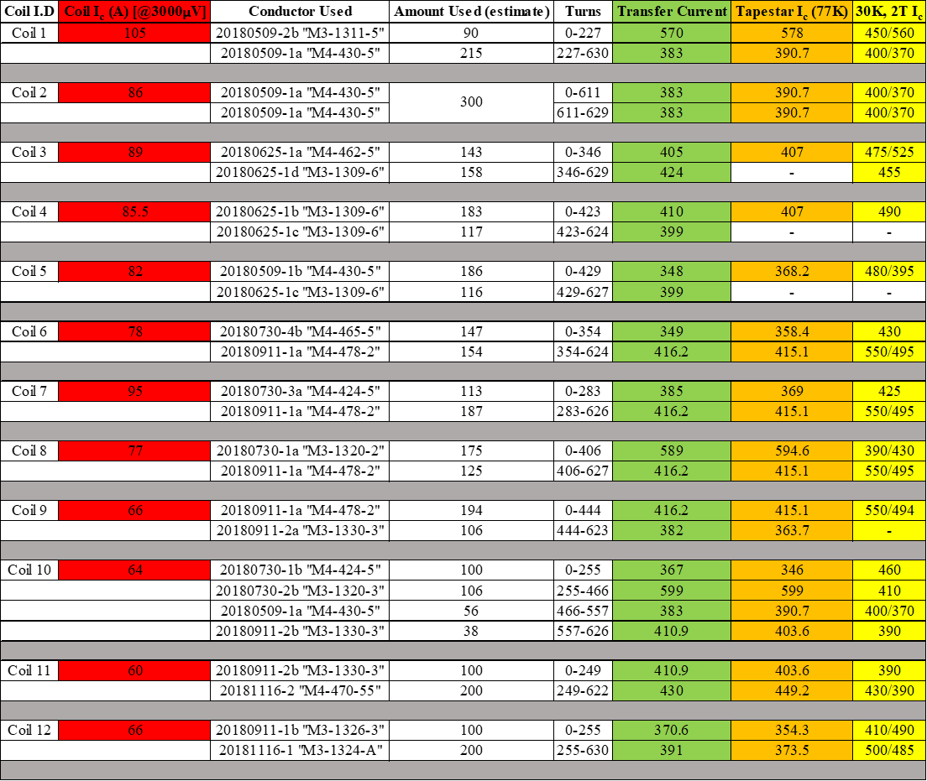
Correlation between Conductor I_{c} and Coil I_{c} at 77 K
There was no obvious or significant correlation between quality of the conductor (defined though Transport, TapeStar, and In-Field (@30K, 2T I_{c} measurements conducted by the manufacturer) and the quality of the coil performance at 77 K (defined by its I_{c} – I_{c} threshold being 3mV as per .1µV/cm industry standard) after winding.

Slide 19
SUMMARY
Winding Techniques, Procedures, and Instrumentations have been optimized for consistency in coil quality.
16 coils have been wound; 12 coils have been tested in LN2.
The 12 tested coils show an average I_{c} of 79.5A @ 77K.
Coil performance varies from coil to coil.
Inner-Coil splices show ~18 - 19 nΩ of resistance at 77K.
Generally, higher contact resistance results in a smaller time constant
Approximately 70% of the coils voltage was developed within the first 100 turns – where the magnetic field is the highest
No significant correlations was found between quality of the conductor (defined though Transport, TapeStar, and In-Field (@30K, 2T I_{c} measurements conducted by the manufacturer) and quality of the coil (defined by its I_{c}) after winding.

