Slide 1


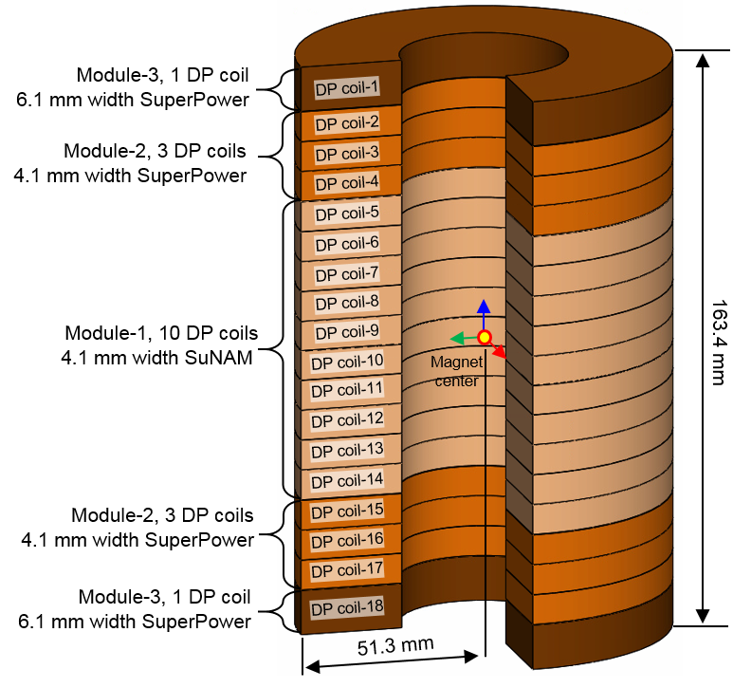
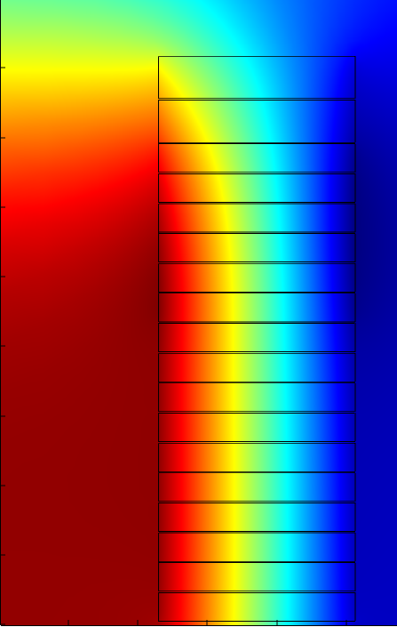
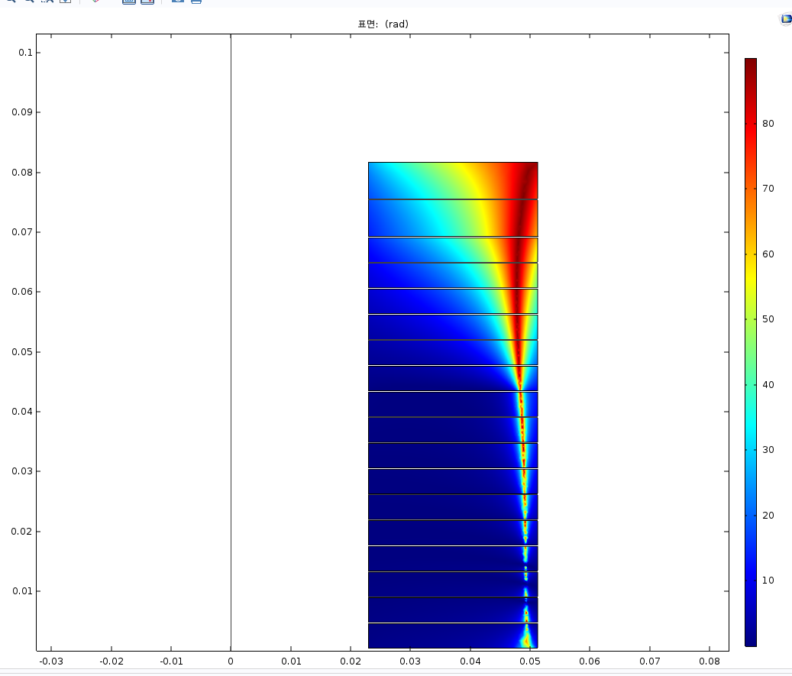
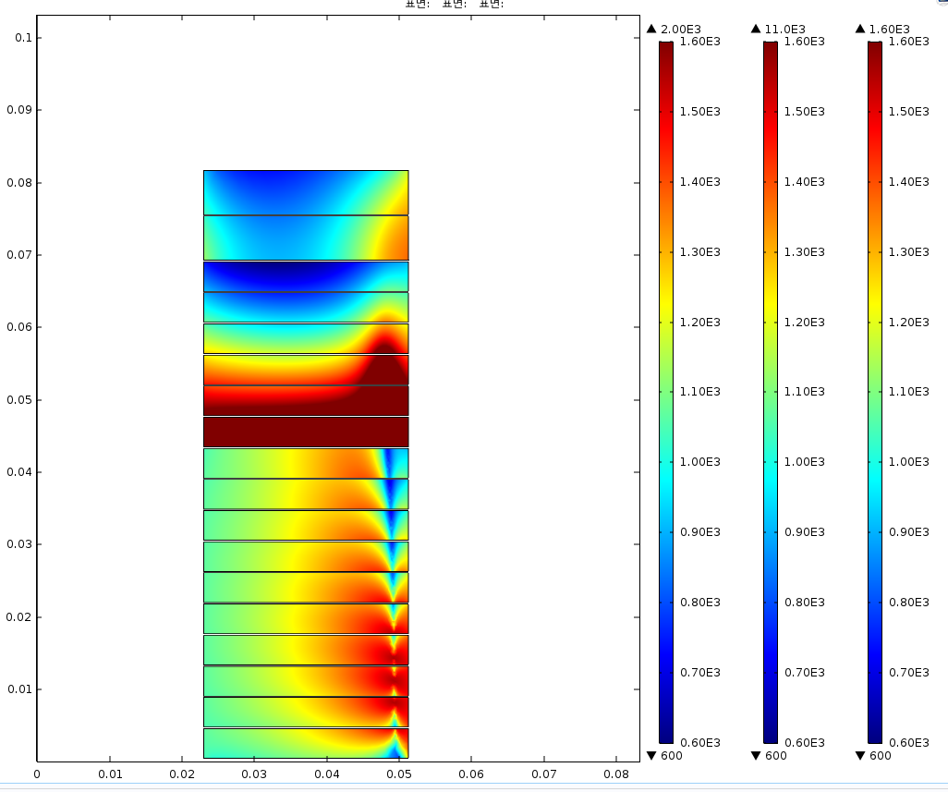
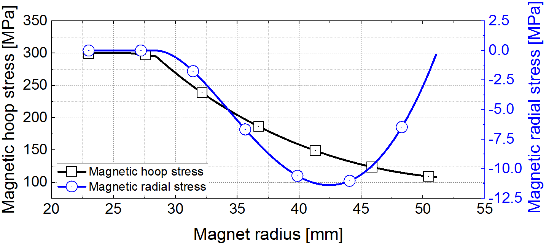
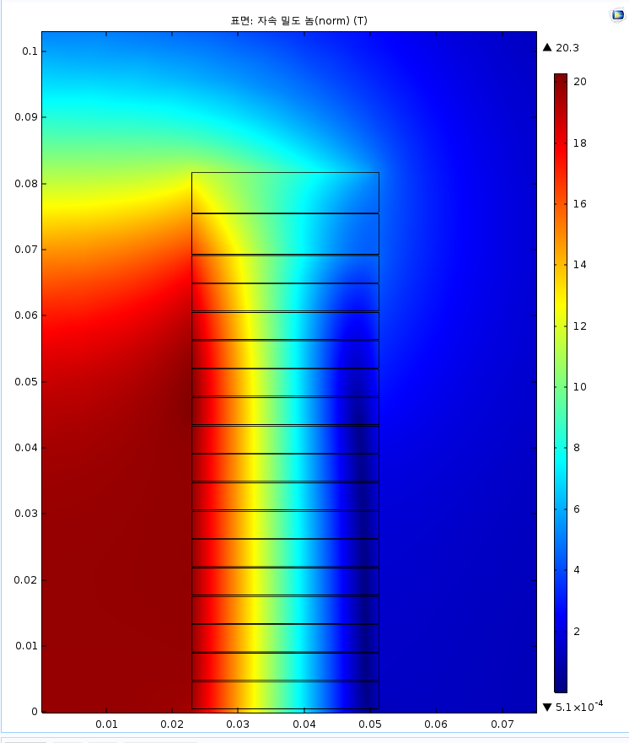
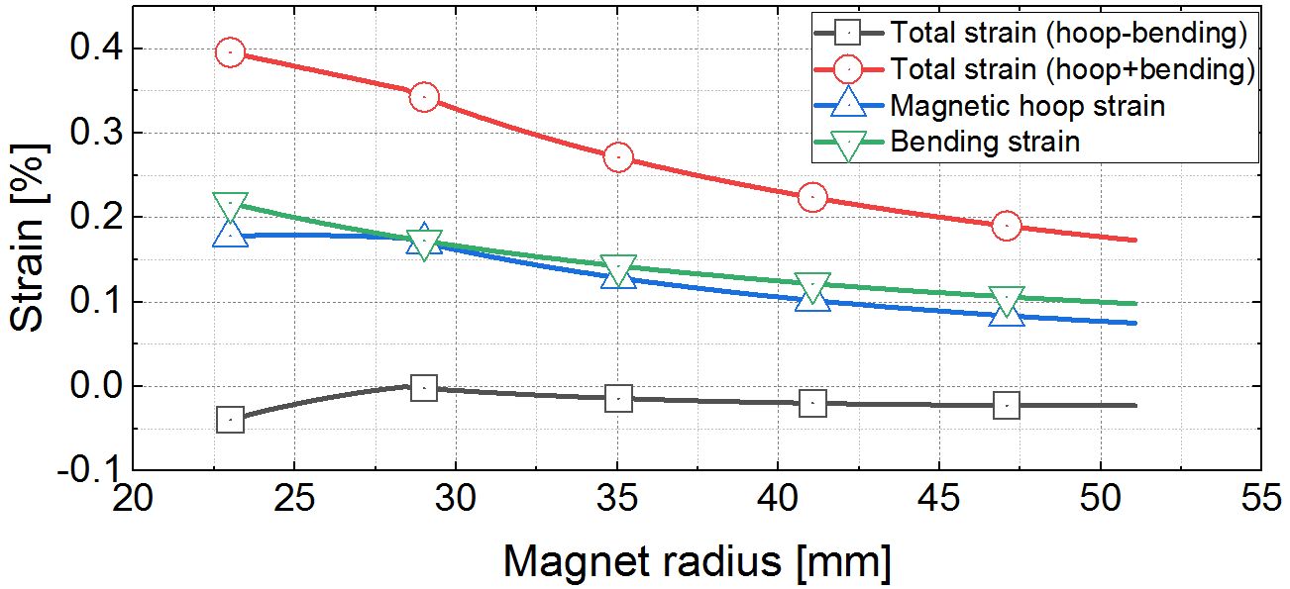
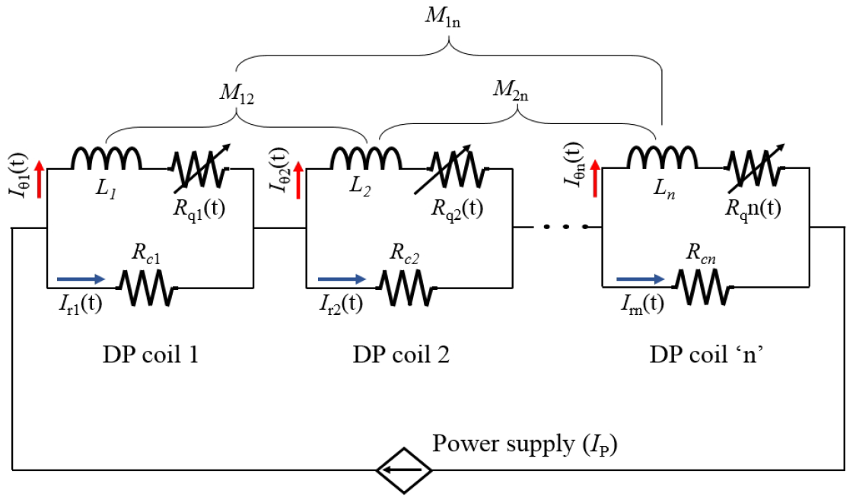
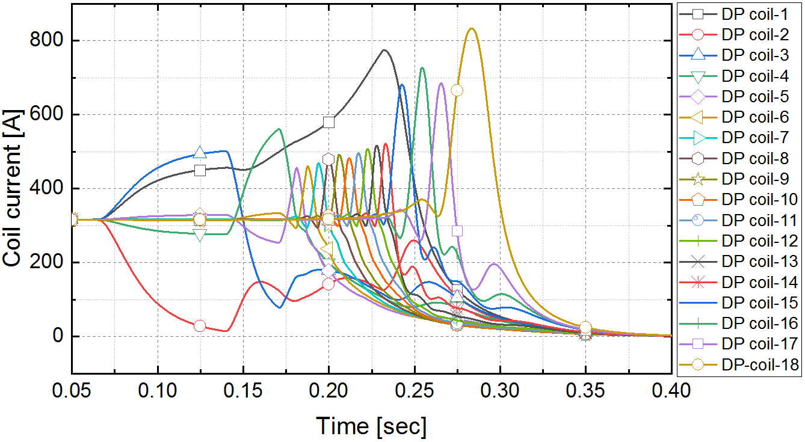
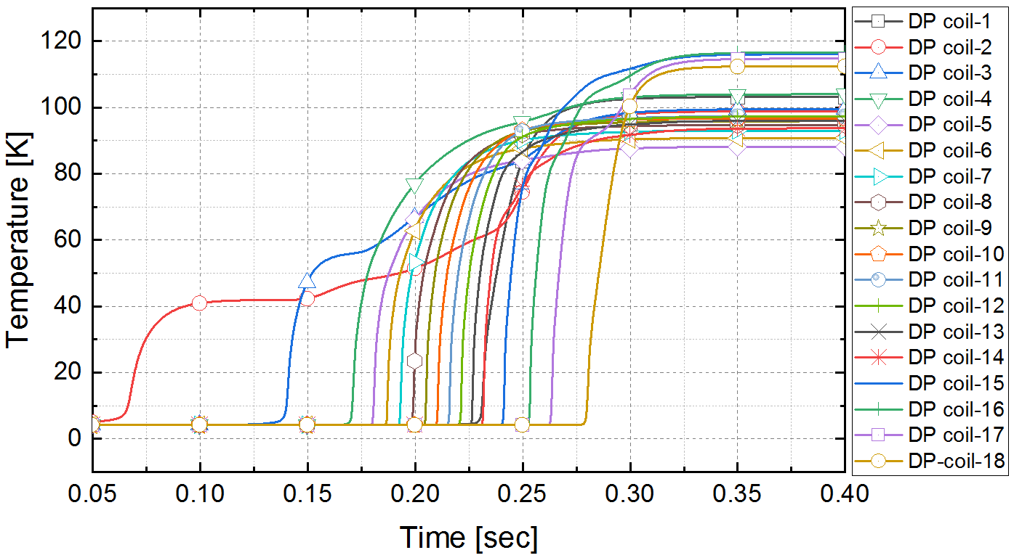
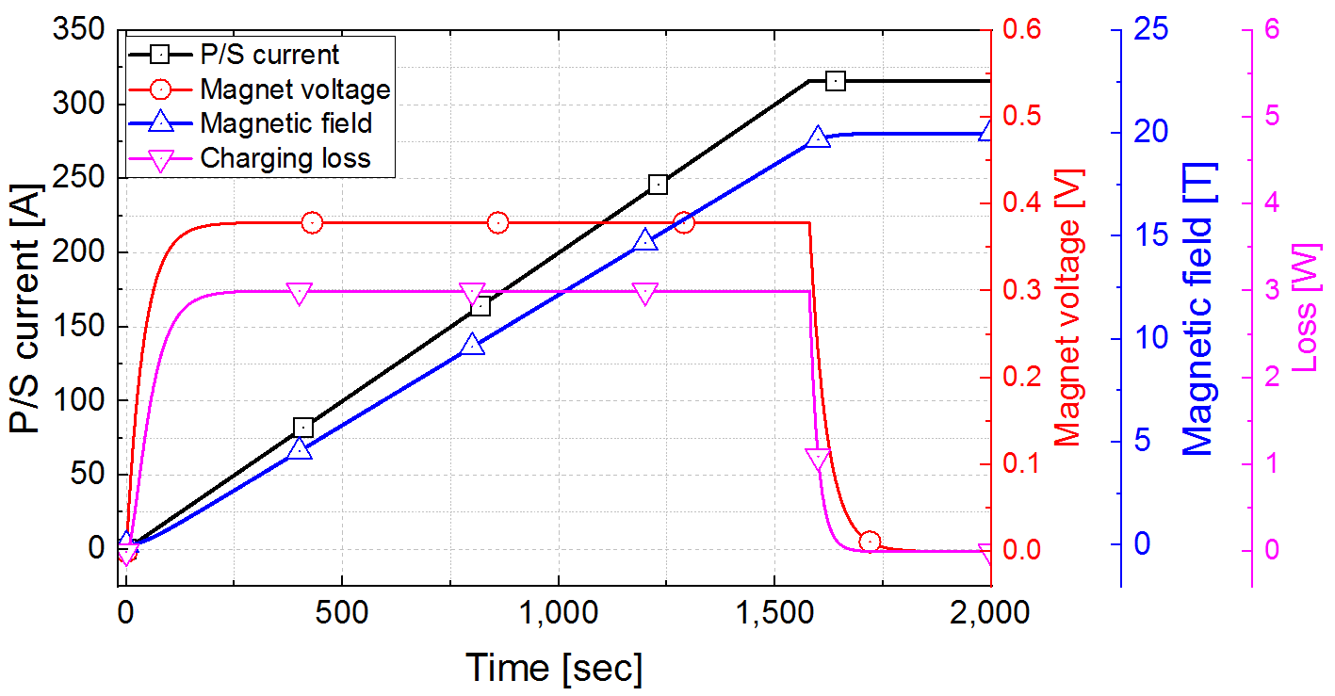
Design and Performance Estimation of a 20 T No-Insulation all-REBCO User Magnet
Kwangmin Kim¹, Kabindra R. Bhattarai^{1,3} ,Kwanglok Kim¹, Hongyu Bai¹, Iain R. Dixon¹, Thomas A. Painter¹, Uijong Bong², David Larbalestier¹ and Seungyong Hahn^{1,2}
¹National High Magnetic Field Laboratory, 1800 East Paul Dirac Drive, Tallahassee, FL 32310, USA
²Department of Electrical and Computer Engineering, Seoul National University, Gwanak-ro 1, Gwanak-gu, Seoul 08826, South Korea
³GE Healthcare, 3001 W Radio Drive, Florence, SC, 29501, USA
Tue-Af-Po2.14-02
1. Introduction
b. Configuration of the NI20T
c. Magnetic Field and Critical Current Distribution
d. Stress and Strain
This paper reports a design and performance estimation of a 20 T no-insulation (NI) high temperature superconductor (HTS) standalone user magnet currently being developed at the National High Magnetic Field Laboratory, hereinafter named ‘NI20T’. It consists of a stack of 18 double pancake coils wound with tapes from two different vendors, SuNAM and SuperPower, in consideration of their complementary in-field critical current and mechanical properties. The inner and outer winding diameters and overall winding height of the magnet are 46 mm, 102.6 mm, and 163.4 mm, respectively. The magnet is designed to generate a center field of 20 T at its nominal operating current of 316 A in a bath of liquid helium at 4.2 K. The inductance and stored energy are 1.89 H and 94.5 kJ, respectively. First, we report key design parameters followed by numerical simulations on: (1) Magnetic field performance, stress analysis; (2) NI charging behaviors and estimation of liquid helium consumption; (3) post-quench behaviors including a local temperature rise.
Estimated critical current (I_{c}) in consideration of B_{norm}, θ, and tape width at 4.2 K.
The minimum I_{c} of modules-1, 2 and 3 are calculated to be 565 A, 436 A and 493 A, respectively.
Force equilibrium and generalized Hook's laws were used.
Since NI20T is expected to be “dry-wound” without using epoxy, the so-called “self-supporting-turn" characteristic of NI20T is also considered in the stress analysis.
(a)
B_{norm}
(b)
(c)
M: module
(a)
z-axis
20.3 T
z-axis
90º
z-axis
Min: 493 A
Min: Minimum I_{c}
18 T
M3
1400 A
80º
Min: 436 A
1300 A
14 T
70º
M2
1100 A
60º
10 T
50º
Min: 565 A
900 A
40º
6 T
30º
M1
700 A
2 T
20º
0 T
0º
10º
400 A
500 A
(b)
2. Magnet design
Magnet center
r-axis
Magnet center
r-axis
Magnet center
r-axis
a. Key Parameters of NI20T
Fig. 1. To-scale drawing of the 20 T NI magnet.
Fig. 2. Magnetic field distribution and critical current estimation of NI20T; (a) normal magnetic field distribution, (b) Field angle (θ) distribution, (c) critical current distribution.
Parameter | Unit | Module-1 | Module-2 | Module-3
REBCO tape
Manufacturer |  | SuNAM | SuperPower
Width; thickness | [mm] | 4.1; 0.12 | 4.1; 0.096 | 6.1; 0.096
Substrate thickness | [mm] | 0.1 | 0.05 | 0.05
Cu stabilizer thickness | [μm] | 7.5 (per side) | 20 (per side) | 20 (per side)
I_{c} at 77 K, self-field | [A] | 150
Equivalent Young’s modulus (E_{r}, E_{h}, E_{z}) | [GPa] | 107; 168; 168 | 72; 130; 130
Equivalent Poisson’s ratio (ν_{rh}, ν_{hz}, ν_{rz}) |  | 0.21; 0.33; 0.21 | 0.18; 0.33; 0.18
Magnet configuration
Inner; outer diameter | [mm] | 46; 102.6
Overall height | [mm] | 163.4
Turns per Pancake |  | 236 | 295
Number of DP coil |  | 10 | 6 | 8
Total conductor per module | [m] | 1,102 | 828 | 276
Estimated R_{c}ª | [mΩ] | 24.7 | 18.9 | 4.1
Operation
Center field, B_{c} | [T] | 20
Operating current, I_{op} | [A] | 316
Operating temperature, T_{op} | [K] | 4.2
Conductor current density, J_{e} | [A/mm²] | 642.3 | 802.8 | 539.6
Inductance, L | [H] | 1.89
Storage energy at I_{op} | [KJ] | 94.4
Estimated time constant, τ | [sec] | 39.6
Performance Estimation of NI20T
a. Charging behaviors
A lumped circuit model was used for charging and quench behavior analysis of the NI20T.
The calculated τ_{c} was 39.6 seconds for NI20T. With a constant ramping rate of dI_{ps}/dt = 0.2 A/sec, the time to reach the target magnetic field after the power supply current reached 316 A is calculated to be ≈3.3 minutes for NI20T.
Fig. 3. Mechanical characteristics on axial midplane of NI20T; (a) magnetic hoop stress and radial stress, (b) overall calculated strains including magnetic and bending strains.
R_{q}: quench resistance
b. Post-quench behaviors
I_{ps} : power supply current
R_{c}: characteristic resistance
L: coil inductance
The quench propagates to all pancake coils in about 0.32 s
During the quench propagation, some DP coils experience overcurrent (Fig. 6). The peak current is calculated to be 830 A in DP18 at t = 0.28 s.
After NI20T is completely discharged, the highest and lowest final temperatures of DP coils of NI20T are calculated to be 117 K (DP coil-16) and 88 K (DP coil-5), respectively.
larger amount of energy is dissipated in the end DP coils.
M: mutual inductance
I_{r}: leak current
Fig. 4. Lumped circuit model for the charging characteristic and the quench simulation of the 20 T NI magnet.
Fig. 5. Charging delay analysis results of NI20T (ramp rate: 0.2 A/sec).
Fig. 6. Azimuthal current pattern of each DP coil during quench; (a) module-1, (b) module-2 and 3.
Fig. 7. Temperature variation of each DP coil during quench; (a) module-1, (b) module-2 and 3.
ªContact surface resistance: R_{ct}=50 μΩ∙cm²
CONTACT INFORMATION: Kwangmin.kim@asc.magnet.fsu.edu
The National High Magnetic Field Laboratory is supported by the National Science Foundation through NSF DMR-1644779 and the state of Florida.
A part of analysis work by U. Bong and S. Hahn was supported by the National Research Foundation of Korea as a part of Mid-Career Research Program (No. 2018R1A2B3009249)

