Slide 1
LS2 vacuum activities within the LHC experimental areas
ATLAS – opening phase overview
Josef Sestak - on behalf of TE-VSC-BVO

Slide 2
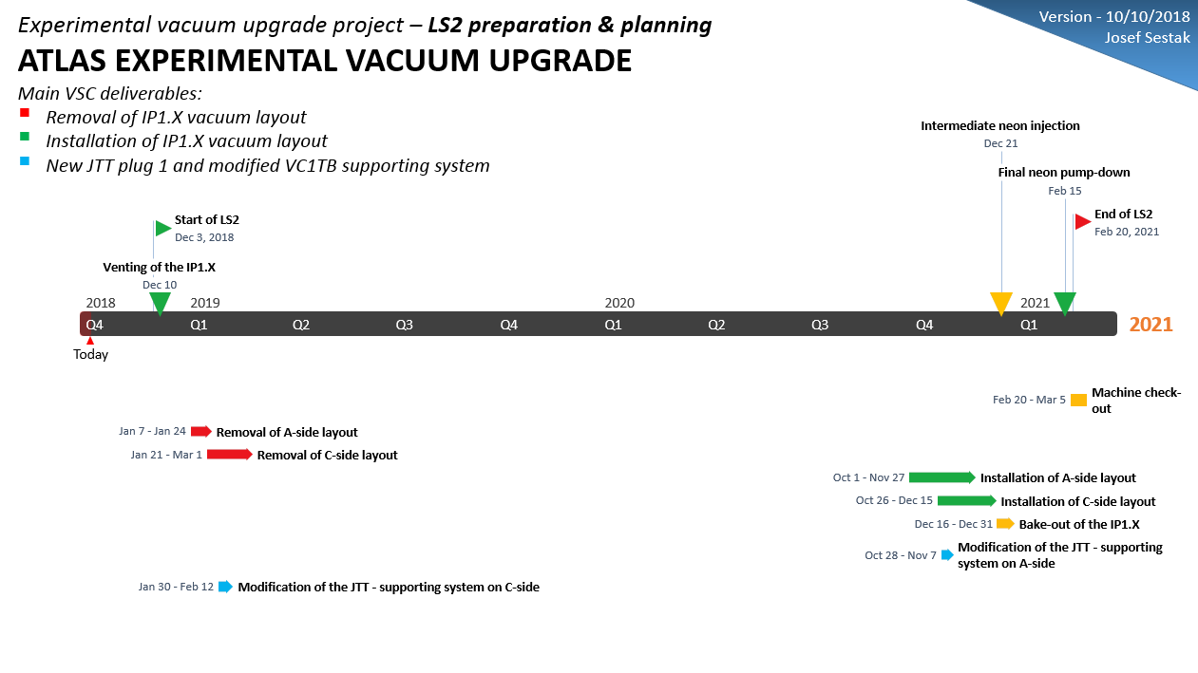
Reference documents:
EDMS 2010266 – General planning for experimental vacuum activities during the LS2
EDMS 1936099 – Master schedule for LS2 (ATLAS)
EDMS 2031011 – Master schedule LS2 baseline (ATLAS)
EDMS 2032085 – LS2 opening schedule

Slide 3
Overview of activities
Opening phase
Venting of the experimental vacuum sector
Partial remove of the vacuum layout
  From ± 3.65 m to ± 19.03 m
    Central chamber stays in place during the LS2.
    Removal up to the TAS chamber.
    VJ chamber with chimney - LHCVC1J_0065
    VT chamber - LHCVC1TB0001
    VA chamber (long-part) – LHCVC1AX0008
    VA chamber (short-part) – LHCVC1AP0001
4 chambers per side – 8 in total

Slide 4
Overview of activities
Opening phase
3. Removal of VT supports
  Including compatibility test of new system.
  If everything is OK we can install as well.
4. Removal of the VA fix-point in the SW
5. Conserve & protect central chamber.
6. Detail inspection of the system
7. NC consolidation

Slide 5
Overview of activities
Closing phase
Replace the VA – C (long-part) “VC1AX” chamber for the spare one (bellow bump).
Install the VA fix-point into the new SW.
Install new VT support system.
Reinstall the vacuum layout
Bake-out & NEG activation
Intermediate neon injection
Final pump-down of the IP1.X
Closing starts by mid 2020 – more likely Q3-Q4 2020

Slide 6
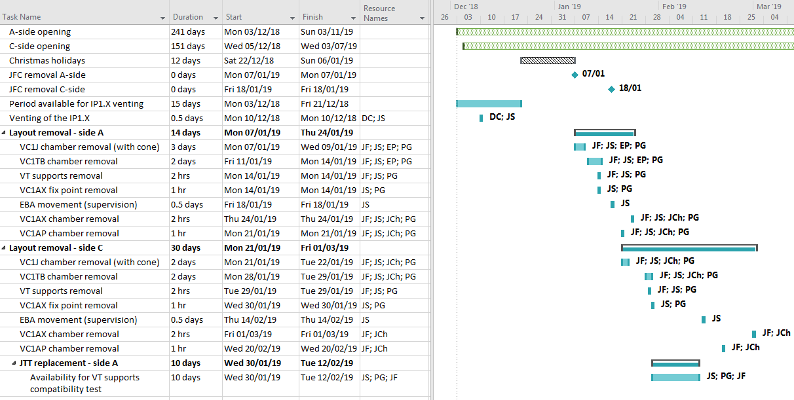
BVO activities planning
Opening phase

