Slide 1
LS2 vacuum activities within the LHC experimental areas
ATLAS – Vacuum layout removal procedure
Josef Sestak - on behalf of TE-VSC-BVO

Slide 2
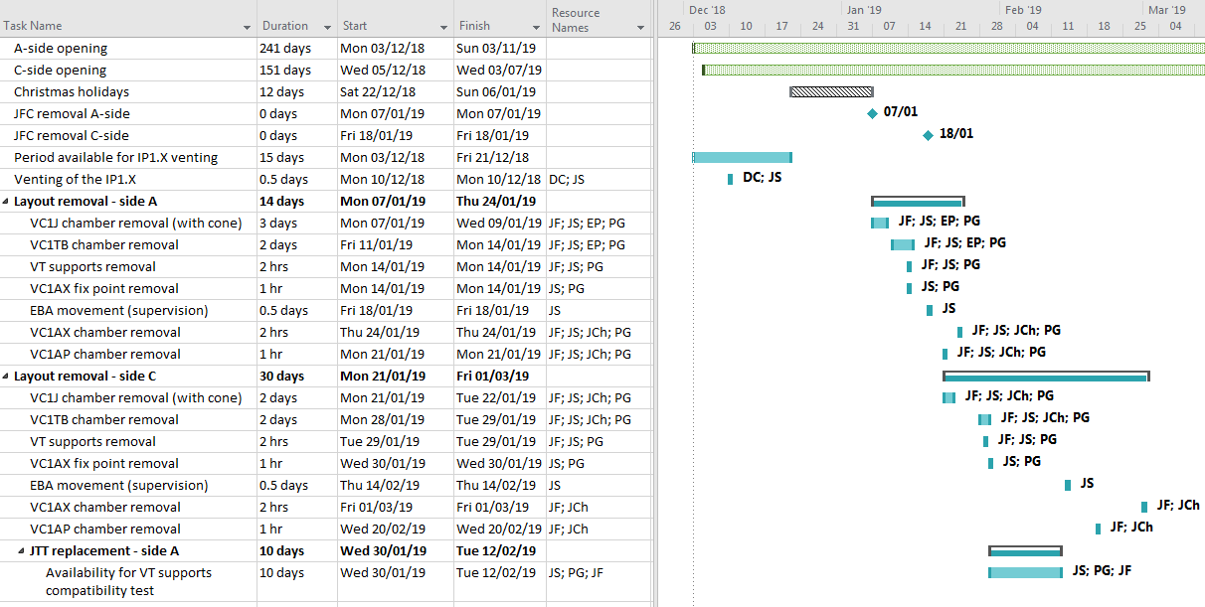
BVO activities planning
Opening phase - removal

Slide 3
Objective for LS2 – removal of IP1.X
From ± 3.65 m to ± 19.03 m
    Central chamber stays in place during the LS2.
    Removal up to the TAS chamber.
    VJ chamber with chimney - LHCVC1J_0065
    VT chamber - LHCVC1TB0001
    VA chamber (long-part) – LHCVC1AX0008
    VA chamber (short-part) – LHCVC1AP0001
Removal of op supports – VT; VA fix-point
Protection of central chamber
Storage of the chambers during the LS2

Slide 4
Objective for LS2 – removal of IP1.X
Reference documents:
2010405 – Removal LS2 (BVO)
1281734 – Removal LS1 (LBV)
1215330 – Removal LS1 (ATLAS)
1344350 – Installation LS1 (LBV)
1437991 – LS1 installation notes (LBV)

Slide 5
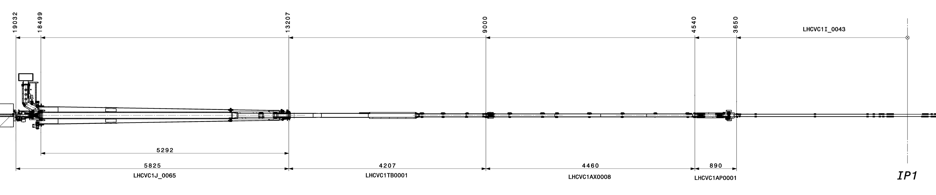
General approach
1st
2nd
4th
3rd

Slide 6
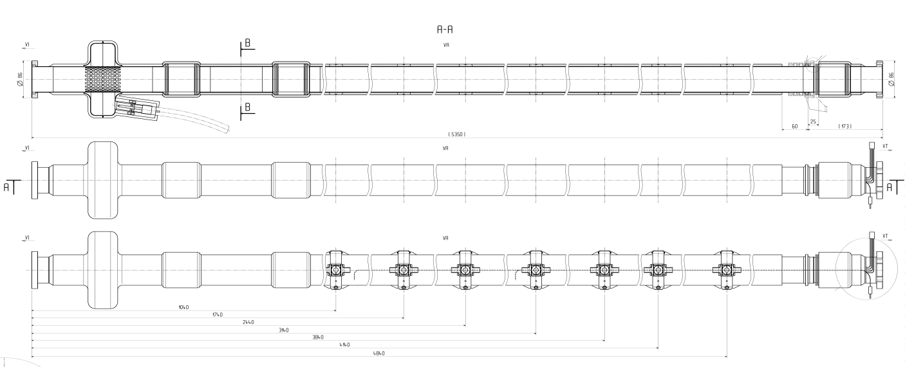
Difference compared to LS1
VC1A chamber – installation phase
VC1AP (short-part)
VC1AX (long-part)
Split design after the LS1

Slide 7
Intervention workflow - list
1. Mutual interface with the experiment.
  Experimental structures constraining the pipe.
  Experimental devices in proximity of the chamber.
2. List the vacuum services connected to the chamber.
3. List of mechanical interfaces (supports and flanges).
4. List of special tooling, boxes and consumables.
  Safe removal of the chamber.
  Protecting the vacuum interfaces on other chambers.
  Protecting the experimental structures & devices.
3. Access configurations.
    For disconnection of the services (cables free).
    For disconnection of the chamber (upstream & downstream flanges access).
    For removal of the chamber (chamber goes out).
And of course our safety + RP

