Slide 1

ISOLDE Technical Report/
LS2 activities
Richard Catherall EN-STI-RBS
ISOLDE Technical Coordinator
83rd ISCC meeting 6th November 2018

Slide 2
Outline
Highlights
LS2 activities
    Frontends
    Nanolab
    Medicis
    HT modulator installation
    Scanner/faraday cup units
    Tape station
  Off-line laboratories
  Available services
    Water, electricity, compressed air, ventilation, vacuum
  Planning
Target area and Class A labs
Experimental Hall (excl. HIE)

Slide 3
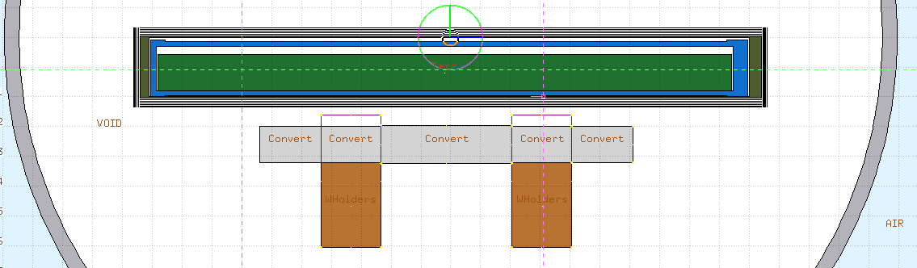
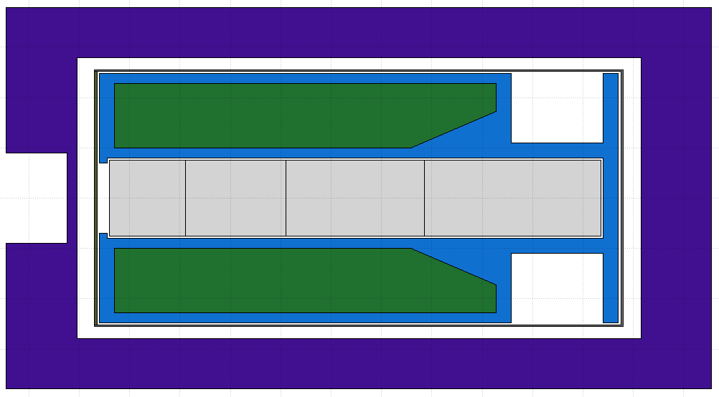
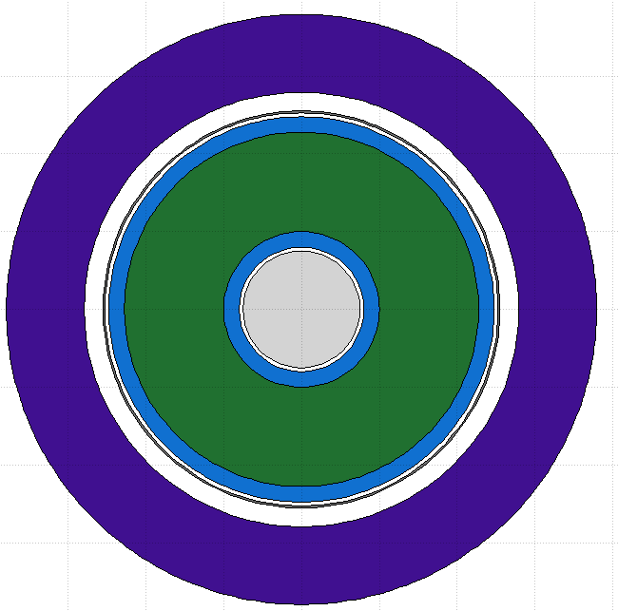
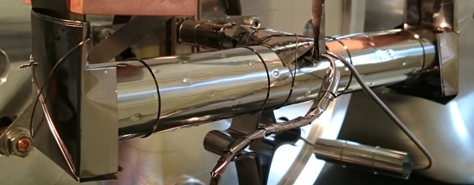
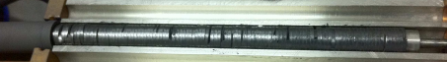
P2n Converter
Converter very close to uranium carbide – high neutron flux!
W converter
ø15 mm (12 mm - standard)
Sliced to mitigate thermal shocks
Operated at 2000 °C
Graphite container
100 mm
p beam
51 mm
Avoid proton scattering
Thermal Shielding
Sigratherm® -
“graphite foam”
0.2 g/cm³
Low thermal conductivity
UC_{x}: new procedure has to be made for annular shape
Standard UC_{x} pellets
J.P.Ramos

Slide 4
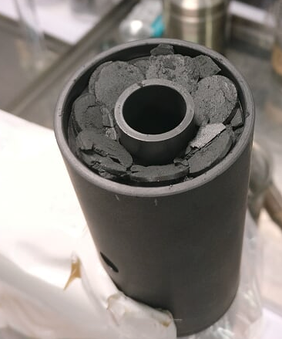
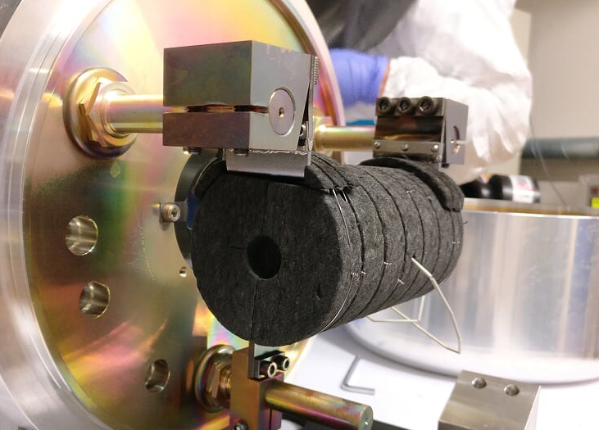
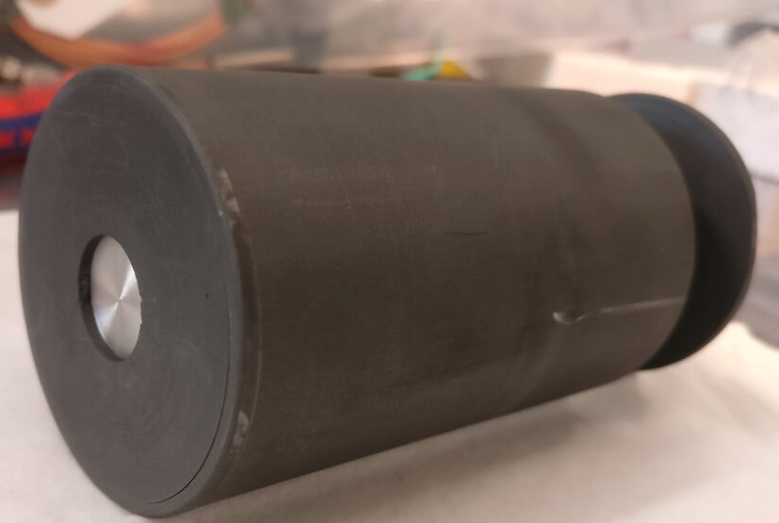
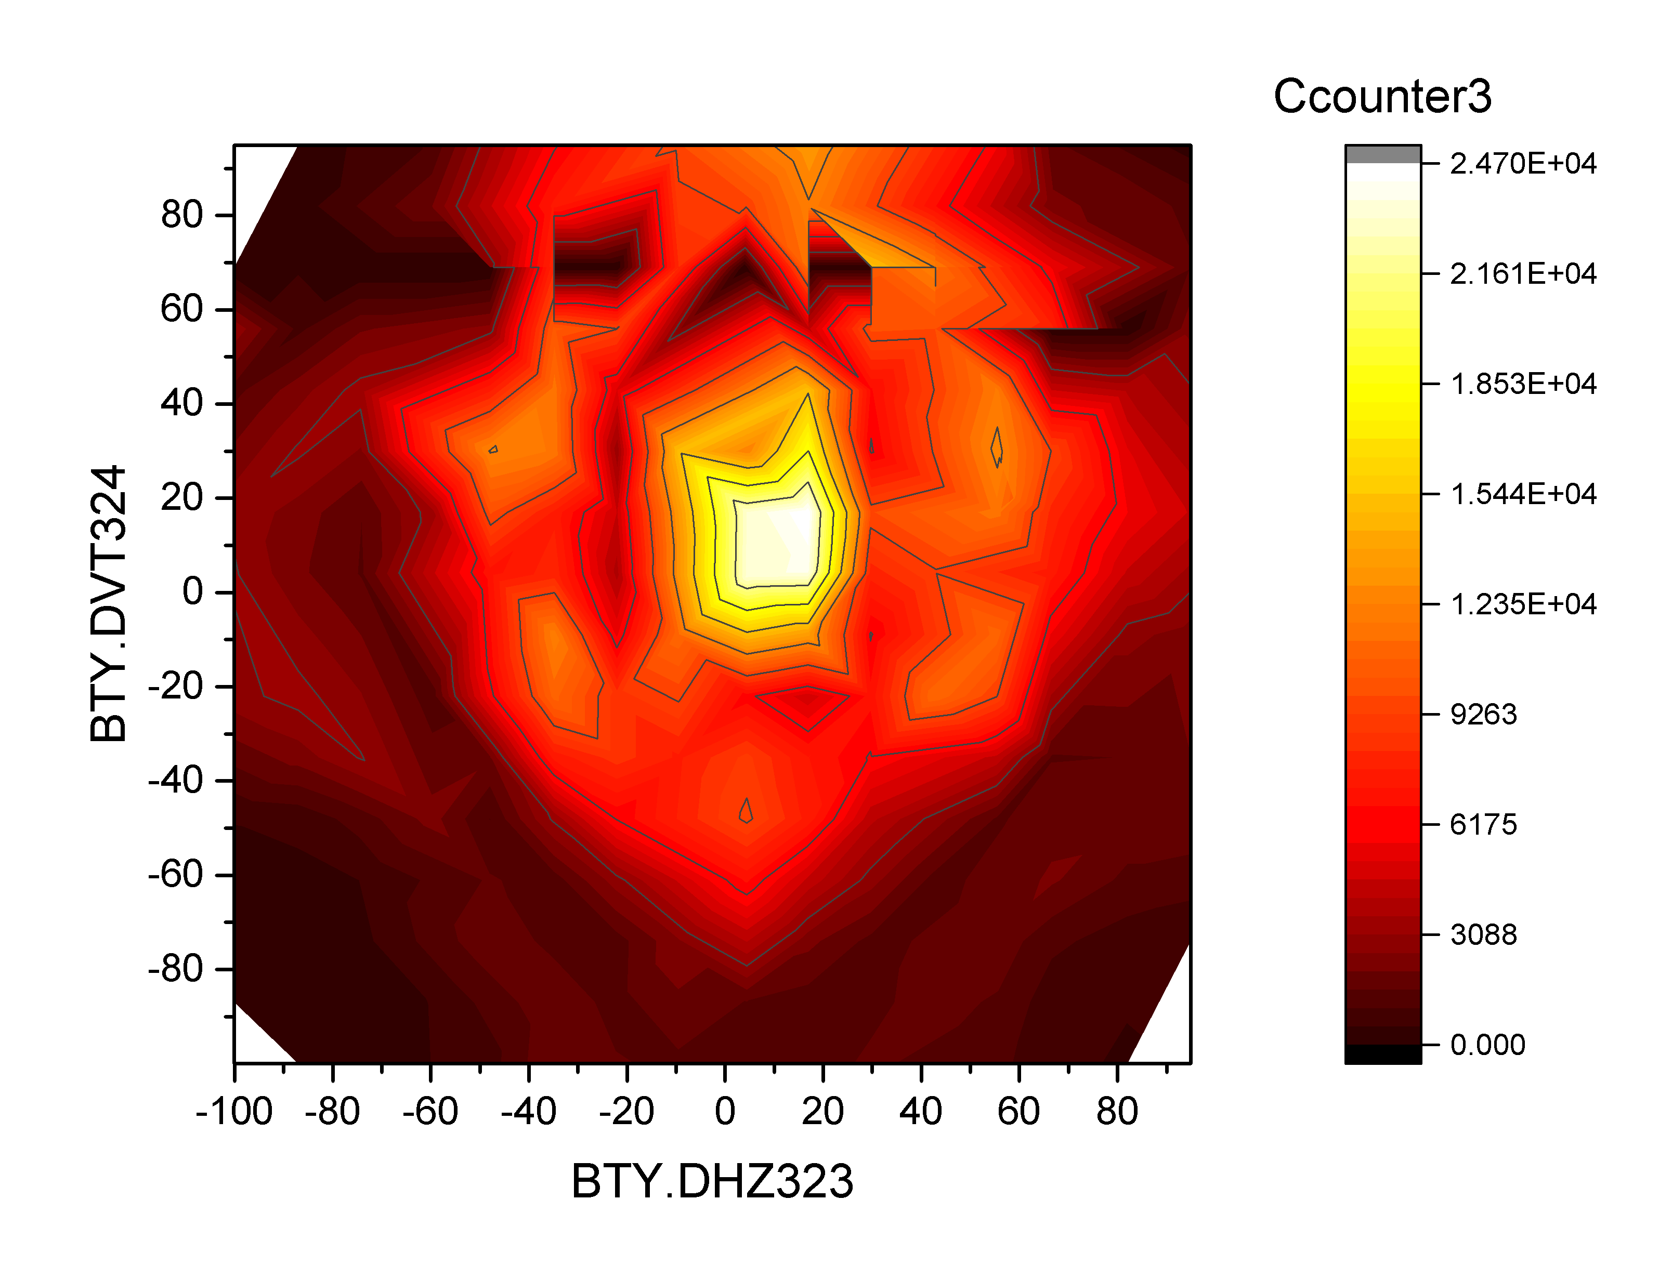
p2nconverter - update
Being tested at ISOLDE!
Rb and Cs isotopes have been measured – T1/2 down to 30 ms seen at the tapestation (>101Rb, >150Cs)!
2nd half of beam time:
Laser beams (Ga, Zn, Ni, In, Te)
Proton scan with 145Cs

Slide 5
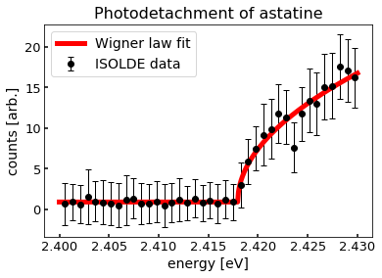
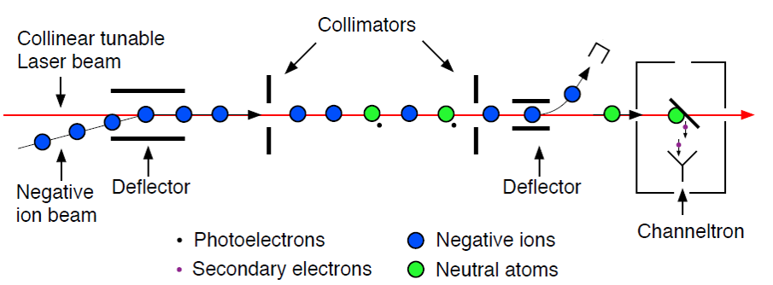
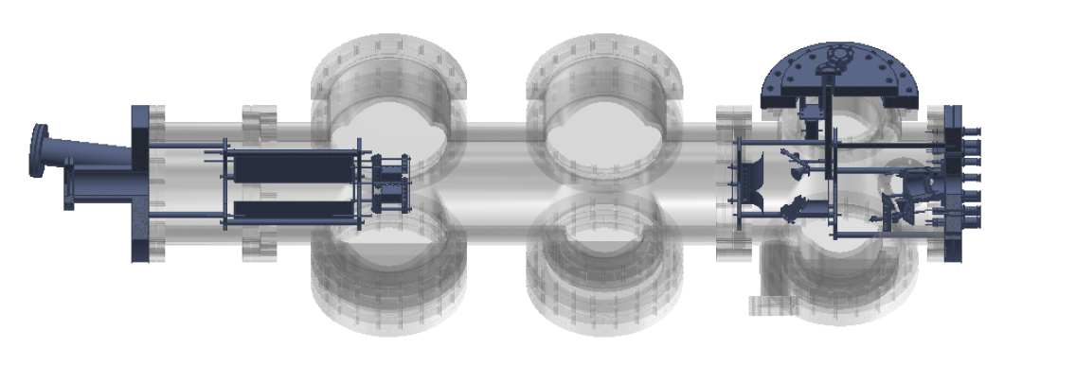

The Electron Affinity of Astatine
At is rarest naturally occurring element on Earth, ca. 70mg in crust, candidate for targeted alpha therapy
Electron Affinity (EA) is the binding energy of the additional electron in a negative ion
  EA required to describe the chemical properties of At
  Benchmark for quantum chemical models
  Predictions for chemistry of superheavy elements, e.g. tennessine (Ts)
  Can be measured by laser photodetachment
Photodetachment threshold spectroscopy:
  Laser and negative ion beam are overlapped
  Detachment cross section is given by the Wigner law
PRELIMINARY
1st ever measurement of the EA of At achieved with the GANDALPH-beamline at ISOLDE
$$σ\left(E\right)∝{(E_{γ}−E_{th})}^{l+\frac{1}{2}}$$
Laser / ion merging
Atom Detector
D.Leimbach, S.Rothe and the IS615 Collaboration

Slide 6


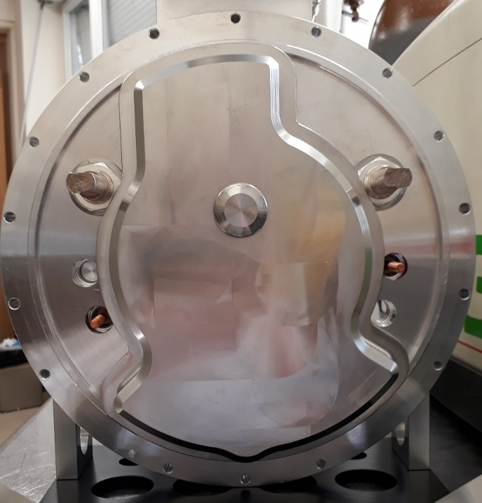
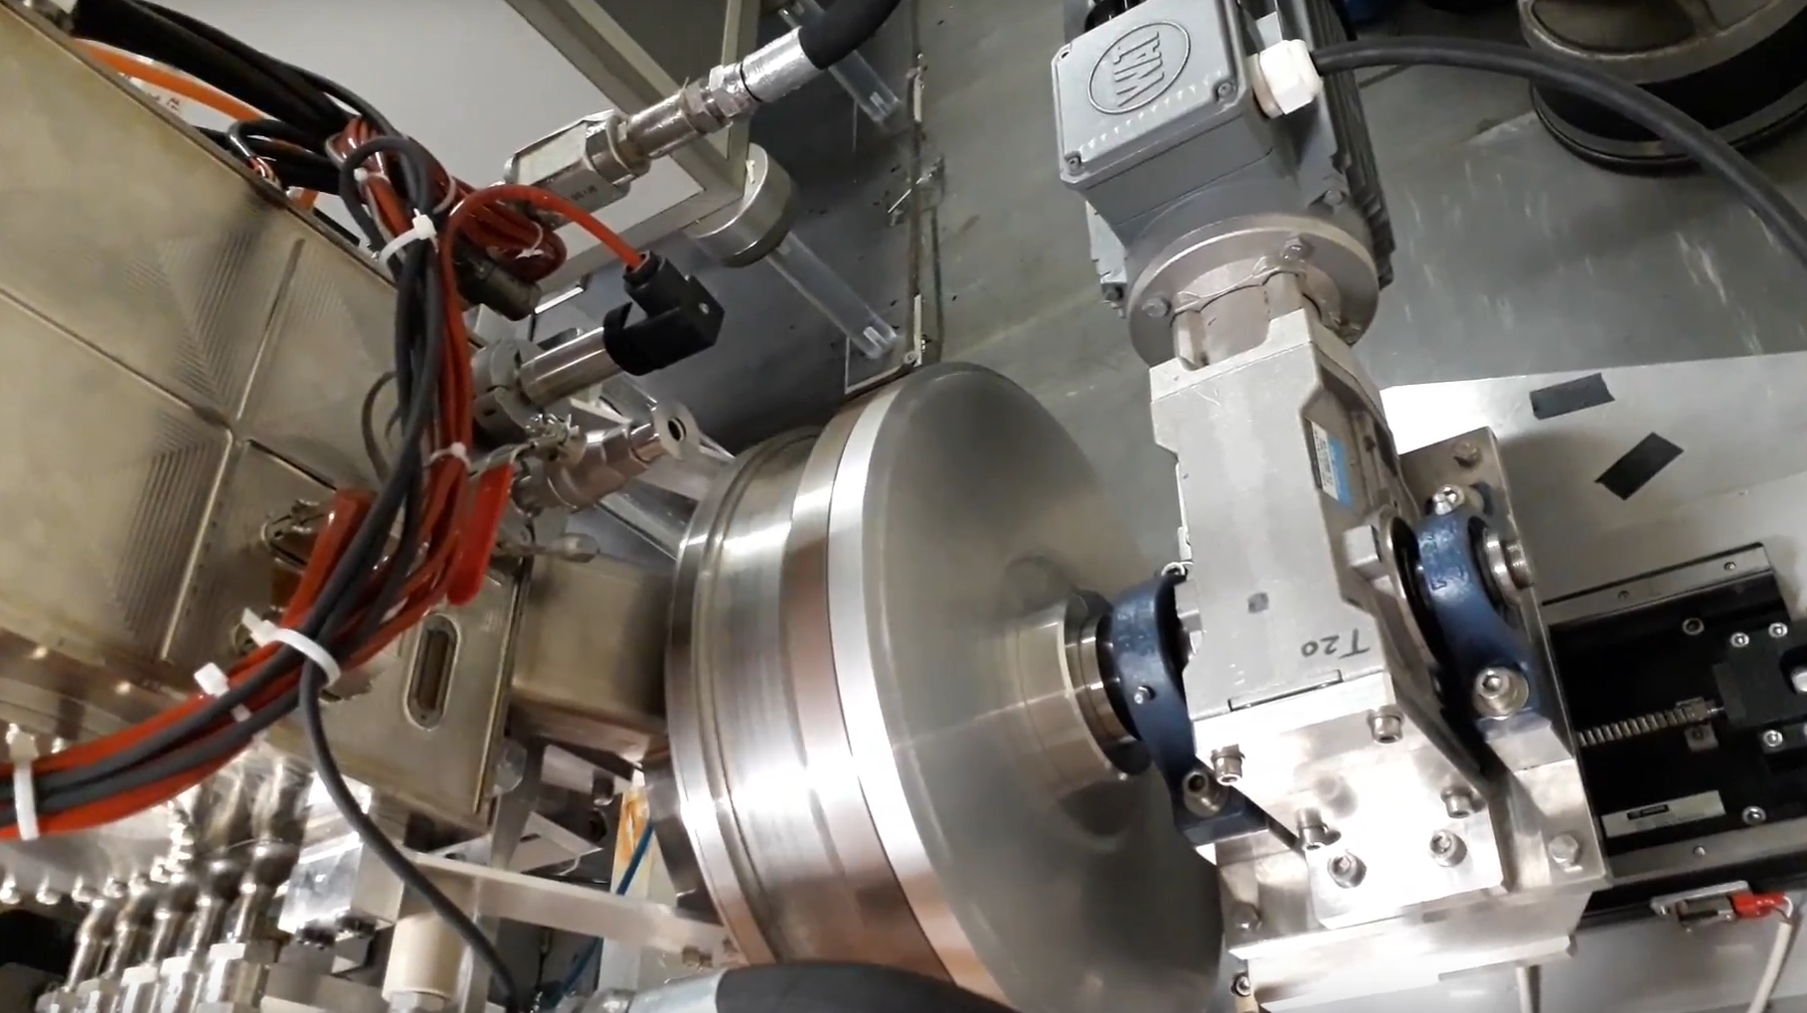
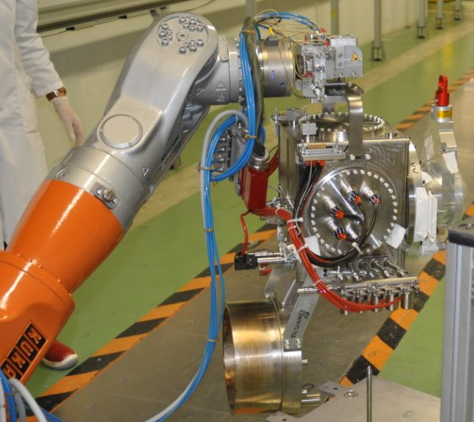
LIEBE: offline commissioning
& prospects for ¹⁰⁰Sn @ HIE-ISOLDE
Successful replacement of the target base
Offline tests with liquid LBE
Successful installation tests on GPS front-end
Unsatisfactory results:
Insufficient heating power
LBE leak → not ready before LS2
→ review & next steps
Article & conferences:
The LIEBE high-power target: Offline commissioning results, F. Boix Pamies et al., HPTW 2018 & EMIS 2018.
Analytical model for release calculations in dynamic liquid ISOL targets, D. Hounbo et al, subm.
Shower formation in a liquid LBE target – An experimental and numerical study of the jetting and dripping regimes, M. Delonca et al, in prep.
Prospects for the production of ¹⁰⁰Sn ISOL beams at HIE-ISOLDE, F. Boix Pamies et al., EMIS 2018.
Ferran Boix Pamies, et al.

Slide 7
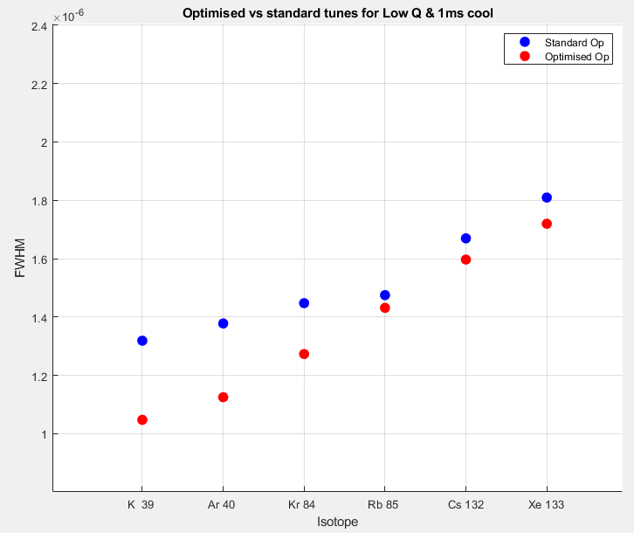
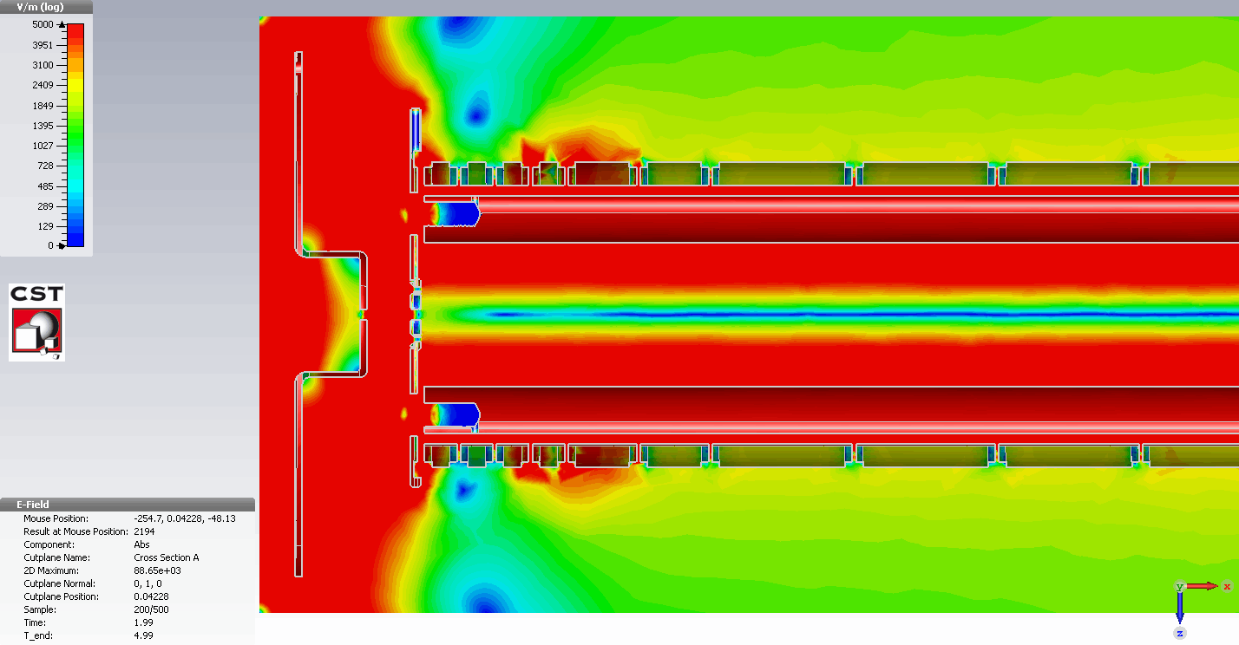
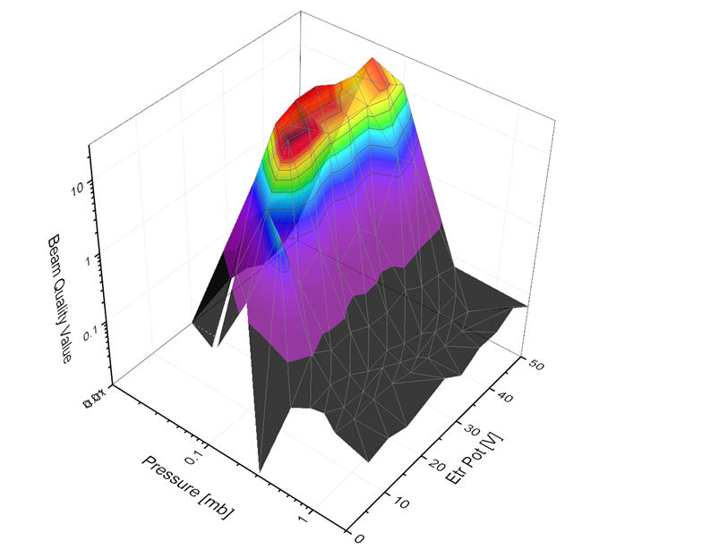
RFQcb ISCOOL
Optimized FWHM values Vs standard operation
Testing campaign :
  New gas injection system – accurate internal buffer gas pressure control
  New bunching techniques – injection chopping
  New TOF detector- accurate 100% efficient in beam detector 10 m downstream of RFQcb
Results have shown:
  Minimum FWHM mass dependent
  Cooling time minimum
  Max Ions per bunch
  Correct operational parameters per isotope
Simulations providing correlate results to measured values !
  Validation of model
Standard operation values
FWHM [us]
Improved bunch width!
New optimized values
Simulated Optimum conditions saddle point matches real data
Bunch Region field map
Stuart Warren et al
TOF detector
Gas injection system

Slide 8
LS2 Activities

Slide 9
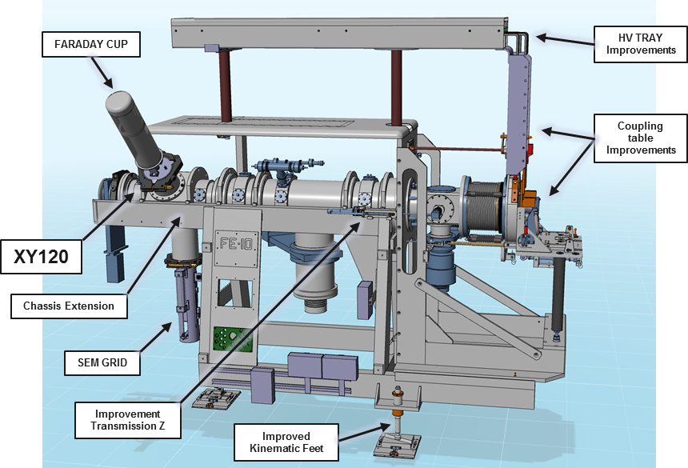
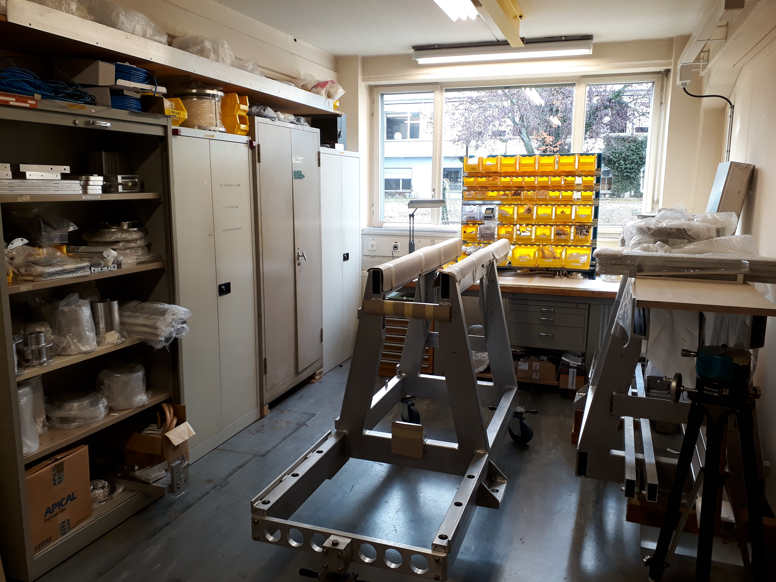
FRONTEND 10 & 11
FRONTEND 10&11 Status November 2018
Manufacturing
  90% of the FRONTEND 10&11 Pieces Received
FE 10&11 Assembly
  Finalization of Assembly preparation
    Surface Treatment
    Cleaning
    Welding
  Assembly to begin the 7th November 2018 in 3/R-035
FRONTEND 10&11 Testing
  FRONTEND testing to begin in January 2019 on OFFLINE 2
Installation in the Target Area May 2019
  Preliminary transport tests beginning on the 9th November 2018 with EN/HE to improve the ease of installation.
James Cruikshank

Slide 10
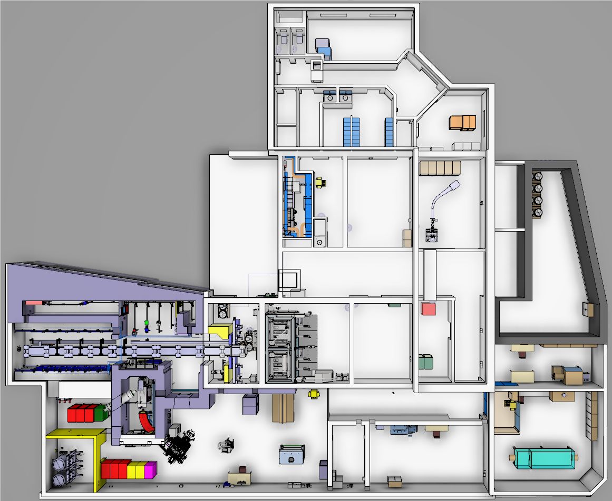





Layout of the Class A Extension (nano-lab)
Produce actinide nano materials targets by having a laboratory equipped for Uranium Nano target production
Provide a safe working environment for the manipulation of actinide nano-materials - confinement
Having a specific laboratory equipped for the validation of the oxidation process (target dismantling)
Move the buffer area and increase its capacity
Existing Building
New Extension
E.Fontaine & R.Catherall 27/04/2018

Slide 11
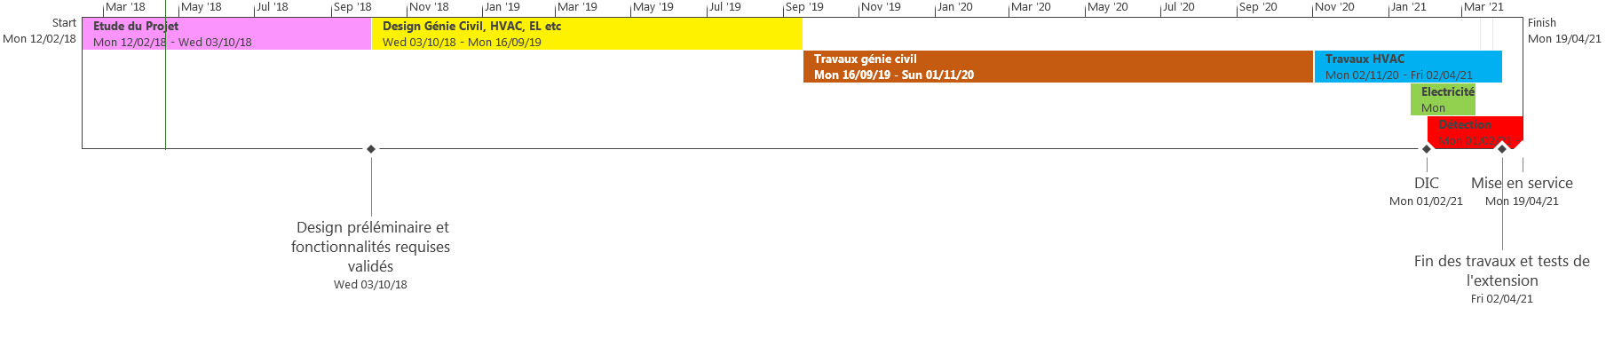
Nano-lab Preliminary Schedule
LS2
Mon 12/11/18 - Mon 11/01/21
Today
Key Dates :
    Launch of the design in October 2018
    Beginning of LS2 in November 2018 until January 2021
    Beginning of civil engineering works in September 2019
    Installation of the remaining infrastructure from November 2020 to the end of March 2021
    Commissioning of the extension April 2021
E.Fontaine & R.Catherall 27/04/2018

Slide 12
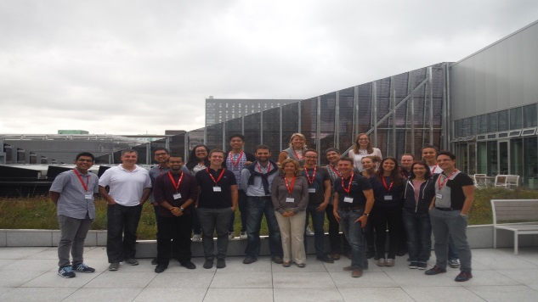

MEDICIS
Newly appointed MEDICIS run coordinator : J. P. Ramos
Final conference 30st April-4th May 2019, Erice
(1st Flyer to be dispatched in November)
2nd MEDICIS Board took place 3rd October - 3rd Board planned Feb/March 2019
MEDICIS is planned to operate at a 1-2 weeks/months level throughout LS2, with some interruptions (YETS, services upgrades, etc ).
Non-medical projects (as approved by INTC/Research Board could be scheduled in the facility (eg isotope collections), provided it does not collide with the medical program

Slide 13
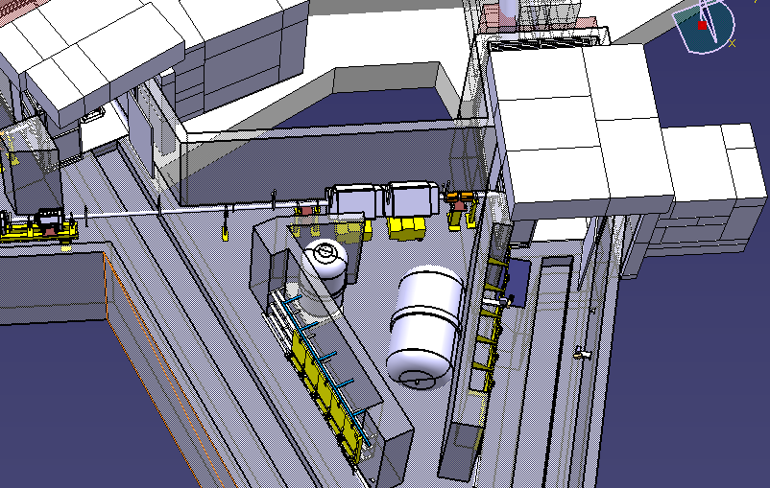
Other target area activities
Cameras
  Revise and consolidate the current camera situation
    Shield telescopic camera
Safety requalification of gas storage tanks
  Never been tested
  Request by HSE to test or do visual inspection to continue to operate at > atm pressures
    If not can only operate up to 1000 mbar Bar instead of 2800 mbar (absolute)
    Volume of tanks 3m3 and 5 m3
Robot/Montrac maintenance and testing

Slide 14
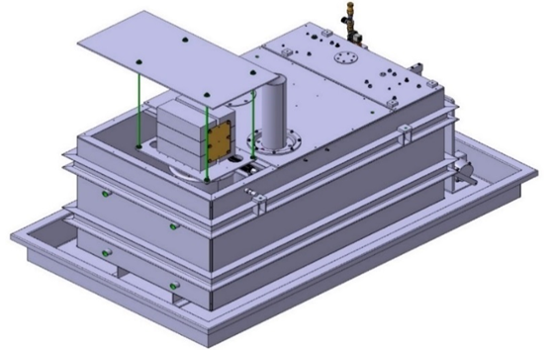
HT Modulator
A second HT modulator (for the GPS) is planned to be installed during LS2
However the negative power supply will only be installed during the 2021-2022 YETS
  No negative beams available until 2022.
HT (kV) | 1E13ppp | 2E13ppp | 3E13ppp
30 | 350 | 370 | 370
40 | 400 | 480 | 550
50 | 530 | 650 | 750
55 | - | - | 870
60 | 620 | 780 | 980
Recovery time (µs) of HT (+/-0.6V) with protons on convertor

Slide 15
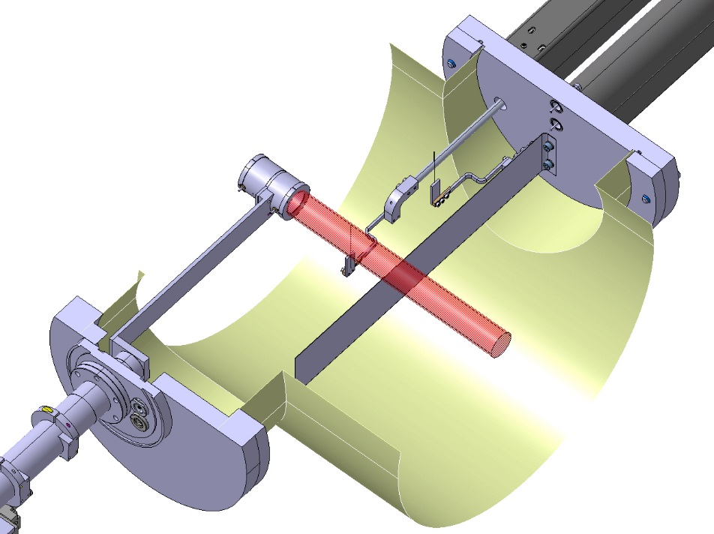
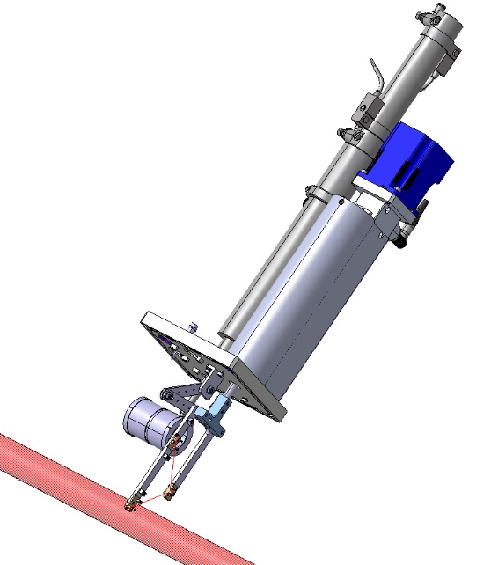
Beam diagnostics
  BE-BI group to procure 20 FC/scanner units for low energy beam lines by Q1 2019
    Need to prioritize which scanners are to be exchanged
  Also new scanner units for the separators are under procurement
  To be installed in Q2 – Q4 in 2019
 | Total | REX | HIE | Low Energy
FC | 64 | 8 | 23 | 32
Scanners | 46 | 0 | 18 | 27
New HRS scanner/FC design
New “standard” scanner/FC design

Slide 16
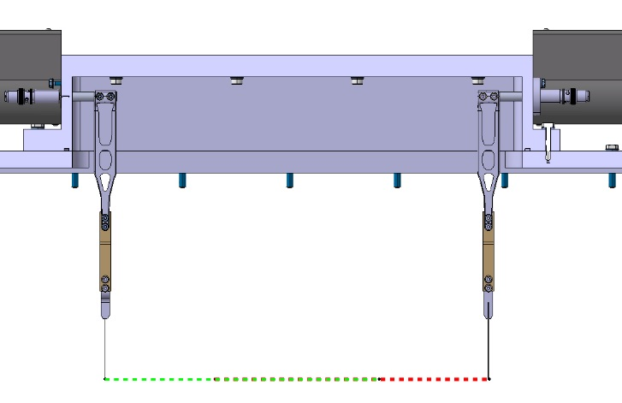
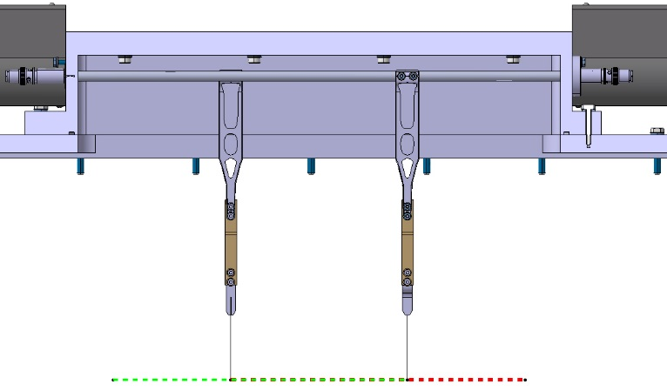
GPS Scanner: Specification Changes
Magnetically coupled push-pulls: 250 mm stroke
+ 70 mm/needle: Extra 140 mm to be allocated
Maximum useful overlap is 147 mm
with central beam = 21Ne
Max. useful range of combined scanners
300 mm (mass range ± 10%)
No need for beam instrumentation at extreme edges when using mass ranges ±15%
T. Giles
More combined distance
+ Covers different mass ranges
More overlap between two needles
+ Redundancy in case of failure of one needle, more versatile instrument
 | Combined range | Overlap
Current | 300 mm | 60 mm
New | 350 mm | 150 mm
350 mm
150 mm
Ana Miarnau Marin BE-BI

Slide 17
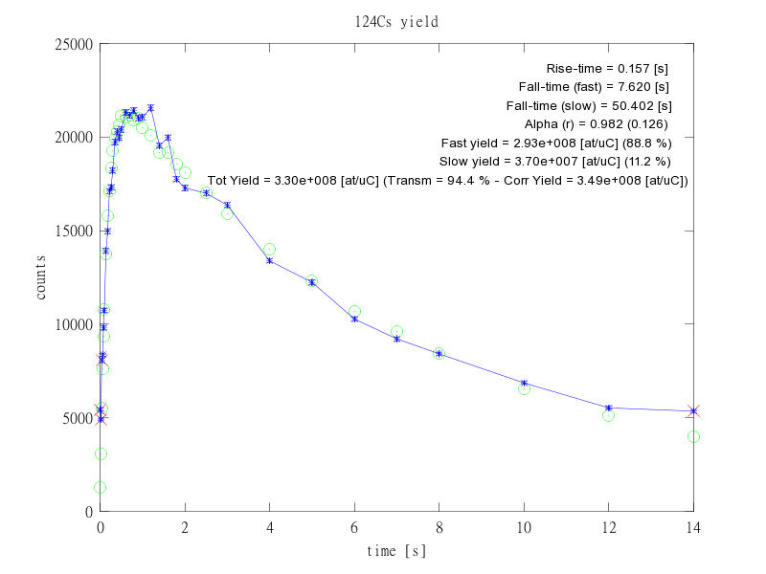
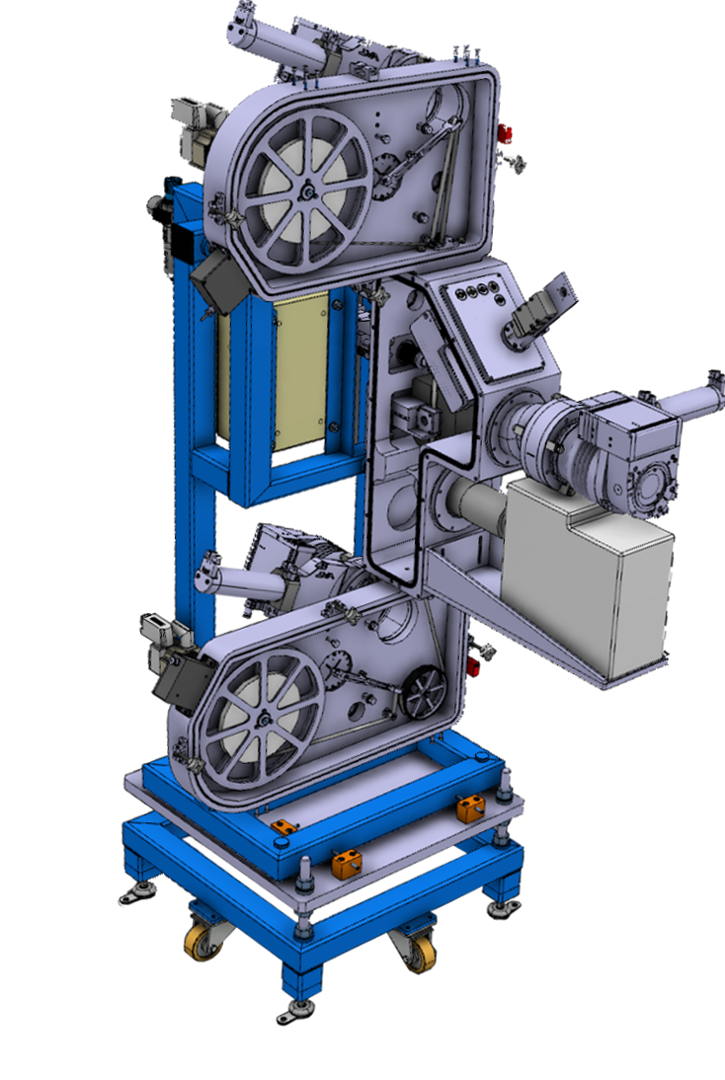
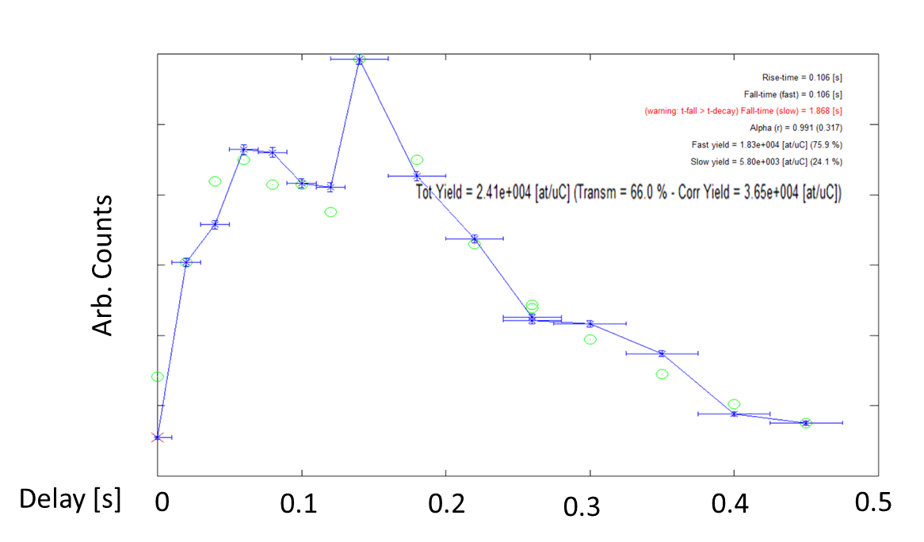
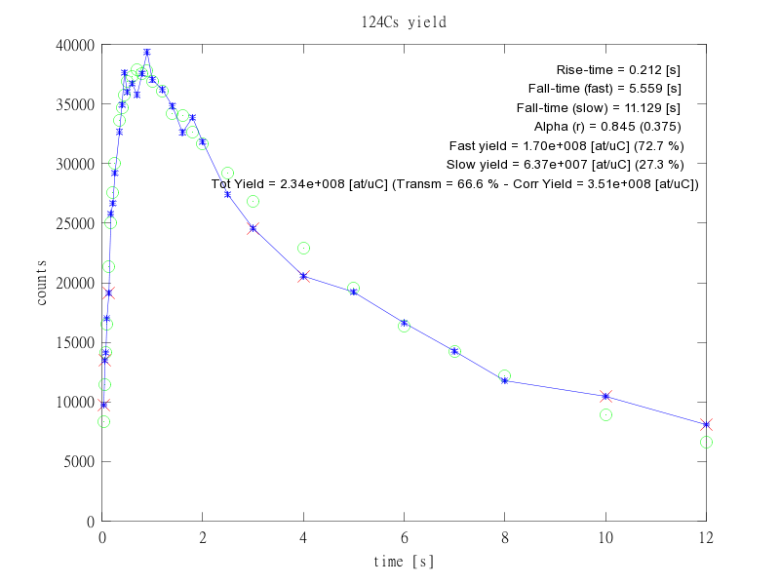
New Fast Tapestation
Commissioning underway:
  Release curves 134 Cs - identical measured values old and new tape station.
  Beta detectors improved for 2x10⁶ counts/seconds rates
  Short lived isotope (²¹Mg, T_{1/2} =122 ms) yield measured for the first time!
OLD tape station 134 Cs
21Mg yield
  Mechanical controls tested
  Timing sequence tested
  Beam instruments installed and operational
  RIB commissioning continuing
  Installation in CA0 planned for 2019
NEW tape station 134 Cs
Stuart Warren et al

Slide 18
ISOLDE Hall: Separator upgrades
Mechanical slits on HRS
  Revise the mechanics (EN-STI-RBS)
Replacement of flexible compressed air lines
  5 yearly preventive maintenance
Installation of Fast Tape Station in CA0 beam line
Target and ion source gas system to be refurbished
  Mechanical parts and leak reparation
Beam gate controls in ICR
Beam diagnostics
N2 supply line for experiments
CRIS platform integration and installation?
Installation of second HT modulator

Slide 19
Vacuum
Maintenance of turbopumps and replacement of oil of primary pumps
Consolidation of turbopumps (replacement of 6 TMPs)
Repair leak in tank 1 of exhaust system.
Replace profibus full range gauges by compact full range gauges in experimental hall
Replace REX roughing pump
Consolidation of compressed air system and installation of reservoirs to better protect the vacuum system against power cuts.
Support FE installation
Interventions planned for May/June 2020

Slide 20
Water
Machine | Circuits | Stop | Start
ISOLDE | Cryo-primary | 18/12/2018 | 01/04/20
 | BTY magnet cooling | 18/12/2018 | 28/02/21
 | Hall (incl. Separators, REXEBIS and REXTRAP) | 18/12/2018 | 28/02/19
 | HIE-ISOLDE (HEBT lines + triplets REX + RF B. 199 | 18/12/2018 | 01/05/20
 | Target cooling | 10/12/18 | …31/07/20
 | Mixed water cooling (Ampli RF bldg. 170 + REX cavities | 18/12/2018 30/09/19 | 31/07/19 01/05/20

Slide 21
Electricity
Cut of 18kV power to ISOLDE
  3rd April 2019
  UIAC-19701
  Groupe Trane UHF1-0101
  EWD15*80 (Armoire CV local 197/R-401
  EBD12*80 : Hvac bâtiment 508/R-006
  Tableaux machines : ERD11*80, EXD32*80, ERD5*80 ERD2*80, EXD12*80, EXD16*80
  Armoire UIA0-00045 CLIM REX ISOLDE
  Ventilation hall 170 local 170/3-401 (Passerelle sur bâtiment 197)
  UIAC-00094 Bâtiment 179/1-023
Punctual stops throughout 2019 with prior notice
Stops already announced:
19/12/2018 06:00 to 06:30
Weekend du 20/01/2019 AUG tests PS/Booster

Slide 22
Ventilation and compressed air
Ventilation
  4 weeks stop of ventilation systems throughout ISOLDE
  Dates
Cooling maintenance
  4 weeks during the stop of the cryo-compressor
  Proposed dates January and February 2019
Compressed air will be operational throughout LS2

Slide 23
Off-line Facilities
Offline 1
Vacuum System
Beam Instrumentation
Purchase of residual gas analyser
Control software: upgrade and development of new modules
Target production Labs
Additional leak detector
Install second fume hood in chemical lab
Add demineralized water supply
Investigating options for save nanomaterial handling
Optimization target production and documentation using INFOR EAM
Off-line beam development
Set up of the ion source test stand
Long-term ion source performance measurement
Benchmarking of ion source simulations
Design of infrastructure to investigate molecular ion beams
Preparations for in-LIST laser spectroscopy, general LIST development
Continuation of the ToF-LIS project
Negative ion source – new materials and geometries
FEBIAD: Simulation driven optimization. Benchmark of codes at offline.
Sebastian Rothe

Slide 24
Planning

