Slide 1
Operating the LHC with Beam
(on behalf of the LHC team)
December 18, 2009

Slide 2
Milestones
Date | Day | Achieved
Nov 20 | 1 | Each beam circulating. Key beam instrumentation working.
Nov 23 | 4 | First collisions at 450 GeV. First ramp (reached 560 GeV).
Nov 26 | 7 | Magnetic cycling established (reproducibility).
Nov 27 | 8 | Energy matching.
Nov 29 | 10 | Ramp to 1.18 TeV.
Nov 30 | 11 | Experiment solenoids on.
Dec 04 | 15 | Aperture measurement campaign finished. LHCb and ALICE dipoles on.
Dec 05 | 16 | Machine protection (Injection, Beam dump, Collimators) ready for safe operation with pilots.
Dec 06 | 17 | First collisions with STABLE BEAMS, 4 on 4 pilots at 450 GeV, rates around 1Hz.
Dec 08 | 19 | Ramp colliding bunches to 1.18 TeV
Dec 11 | 22 | Collisions with STABLE BEAMS, 4 on 4 at 450 GeV, > 10¹⁰ per bunch, rates around 10Hz.
Dec 13 | 24 | Ramp 2 bunches per beam to 1.18 TeV. Collisions for 90mins.
Dec 14 | 25 | Collisions with STABLE BEAMS, 16 on 16 at 450 GeV, > 10¹⁰ per bunch, rates around 50Hz.
Dec 16 | 27 | Ramp 4 on 4 to 1.18 TeV. Squeeze to 7 m.

Slide 3
Corrector polarity checks
Beam 1
Beam 2:
 | total | checked | ok |  | checked ok? | % checked
L1 | 39 | 32 | 32 |  | TRUE | 82.05%
R1 | 38 | 30 | 30 |  | TRUE | 78.95%
L2 | 40 | 33 | 33 |  | TRUE | 82.50%
R2 | 37 | 29 | 29 |  | TRUE | 78.38%
L3 | 31 | 31 | 29 |  | FALSE | 100.00%
R3 | 39 | 0 | 0 |  | TRUE | 0.00%
L4 | 30 | 29 | 29 |  | TRUE | 96.67%
R4 | 33 | 28 | 28 |  | TRUE | 84.85%
L5 | 39 | 32 | 32 |  | TRUE | 82.05%
R5 | 38 | 31 | 31 |  | TRUE | 81.58%
L6 | 29 | 29 | 29 |  | TRUE | 100.00%
R6 | 28 | 28 | 28 |  | TRUE | 100.00%
L7 | 31 | 31 | 29 |  | FALSE | 100.00%
R7 | 30 | 28 | 28 |  | TRUE | 93.33%
L8 | 40 | 34 | 34 |  | TRUE | 85.00%
R8 | 40 | 32 | 32 |  | TRUE | 80.00%
 | 562 | 457 | 453 |  | FALSE | 81.32%
 | total | checked | ok |  | checked ok? | % checked
L1 | 39 | 32 | 32 |  | TRUE | 82.05%
R1 | 38 | 30 | 30 |  | TRUE | 78.95%
L2 | 40 | 31 | 31 |  | TRUE | 77.50%
R2 | 37 | 31 | 31 |  | TRUE | 83.78%
L3 | 31 | 31 | 31 |  | TRUE | 100.00%
R3 | 30 | 29 | 29 |  | TRUE | 96.67%
L4 | 30 | 29 | 29 |  | TRUE | 96.67%
R4 | 29 | 27 | 27 |  | TRUE | 93.10%
L5 | 39 | 32 | 32 |  | TRUE | 82.05%
R5 | 38 | 32 | 32 |  | TRUE | 84.21%
L6 | 29 | 29 | 29 |  | TRUE | 100.00%
R6 | 28 | 28 | 28 |  | TRUE | 100.00%
L7 | 31 | 16 | 16 |  | TRUE | 51.61%
R7 | 30 | 15 | 15 |  | TRUE | 50.00%
L8 | 40 | 0 | 0 |  | TRUE | 0.00%
R8 | 40 | 0 | 0 |  | TRUE | 0.00%
 | 549 | 392 | 392 |  | TRUE | 71.40%

Slide 4
BPM polarity checks
 | checked | ok | % ok
Beam 1 | 1076 | 1050 | 97.58%
Beam 2 | 1076 | 1058 | 98.33%

Slide 5
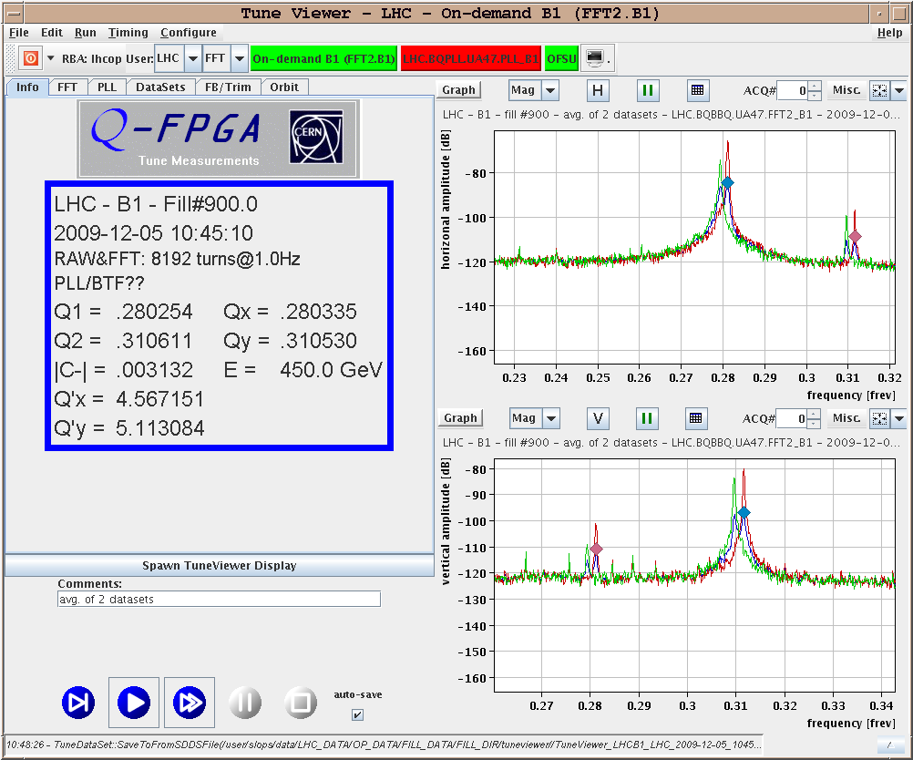
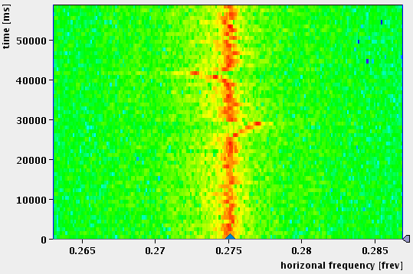
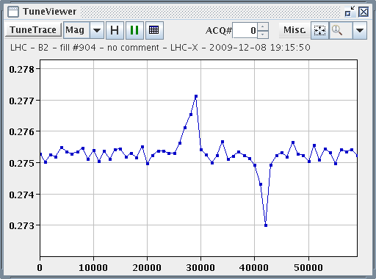
Q Q’ C and Q loop
The work horse (Ralph S)

Slide 6
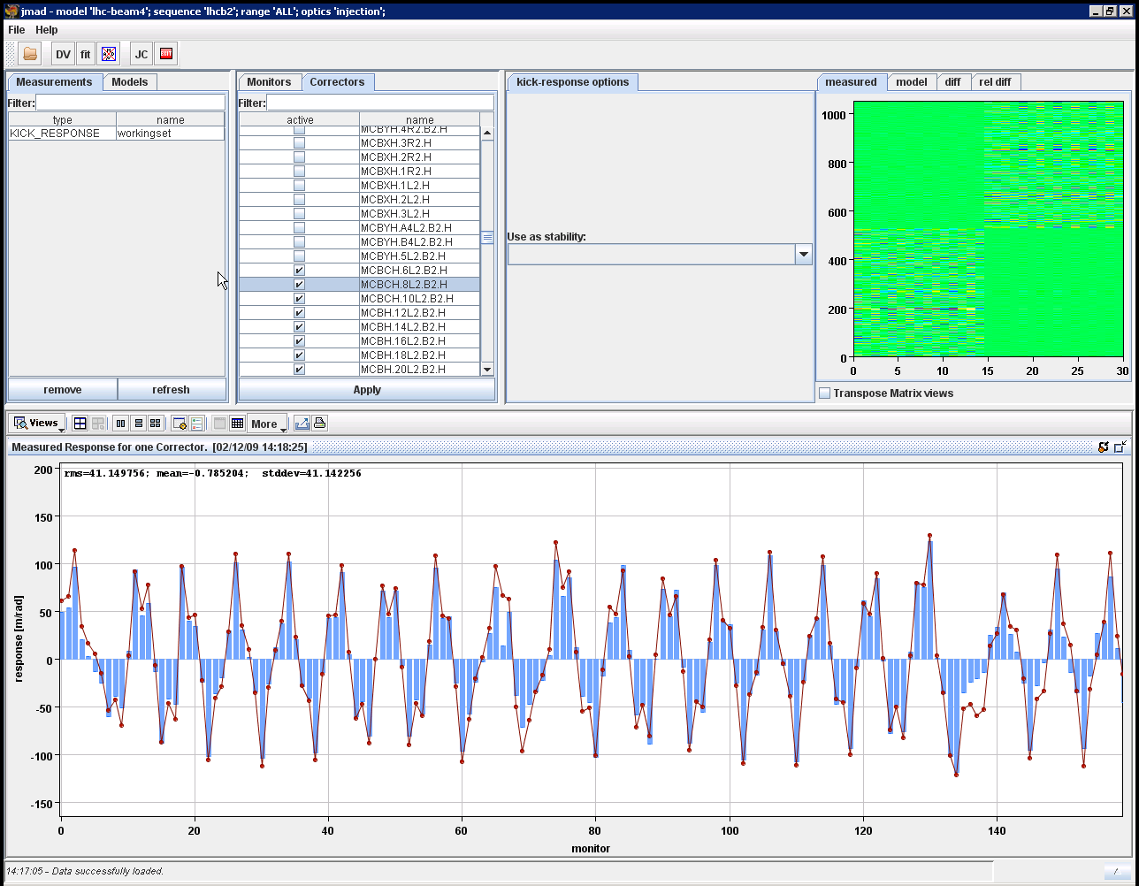
Optics Checks (2nd Dec)
B2 Measured and Calculated response for 1 Corrector

Slide 7
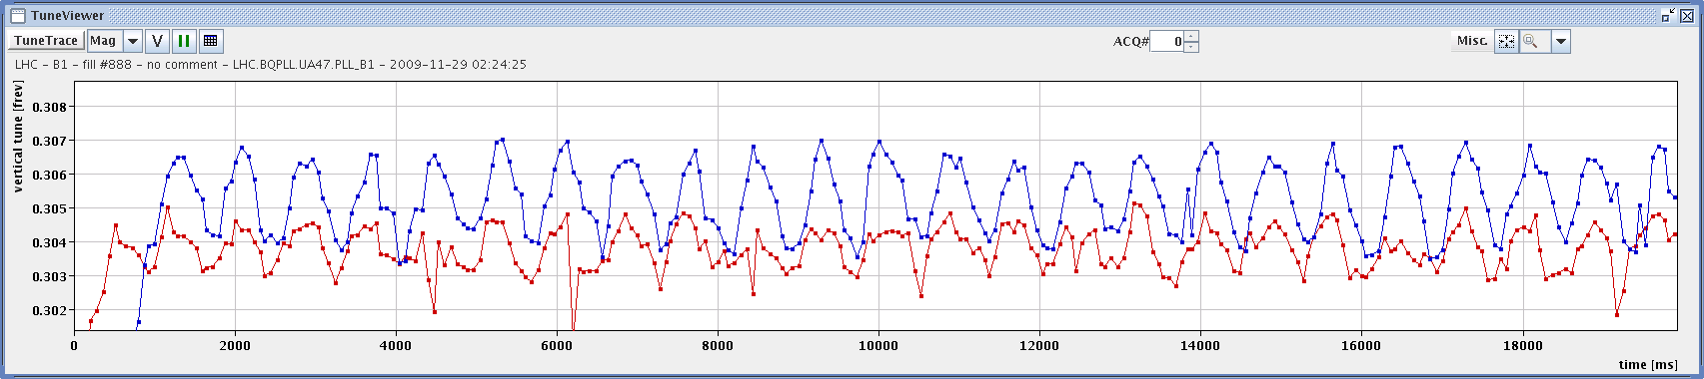
Chromaticity Measurement and Correction
measured Q_{v}’ = 15 using dp/p=1e-4 @2.5 Hz radial modulation, damper amplitude 1e-3
with dQ_{v}’ = -10 trim
'blue' trace before and 'red' after trim

Slide 8
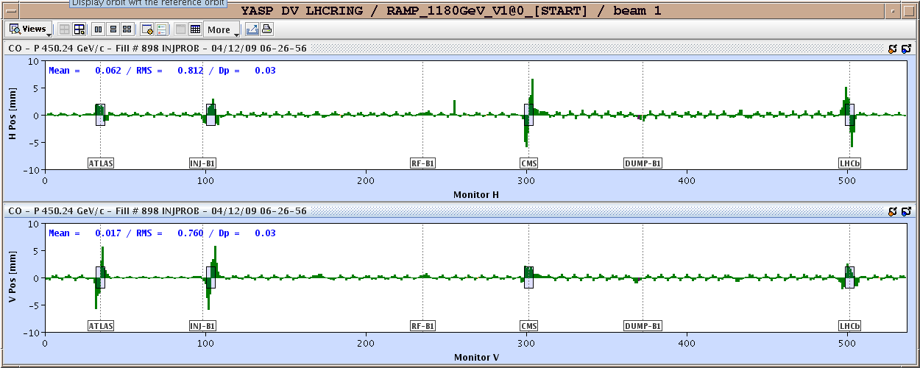
Separation bumps and crossing angle.

Slide 9
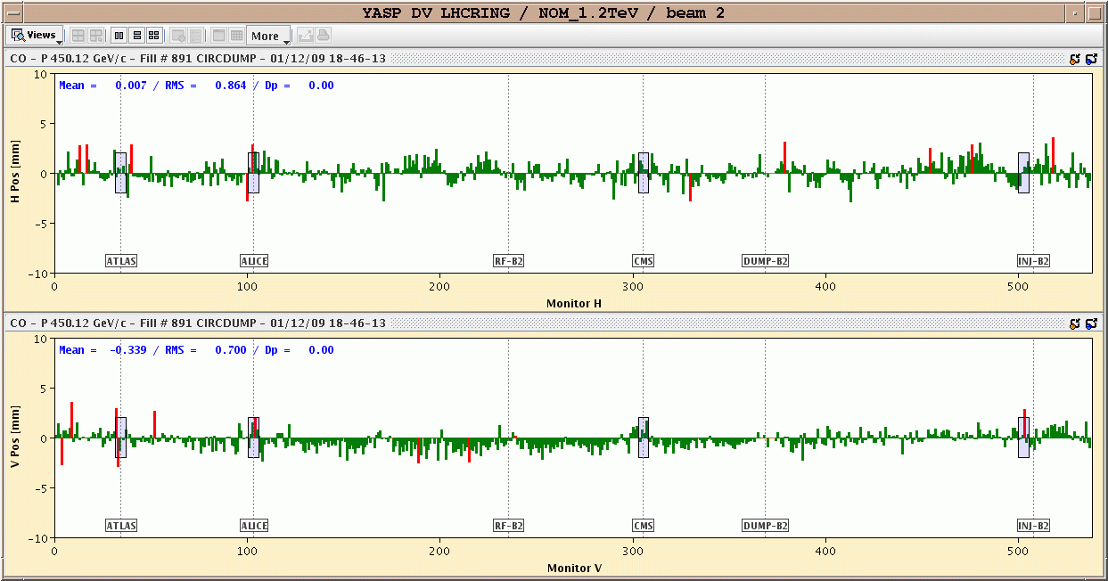
Orbits – golden “Santa Klaus”

Slide 10
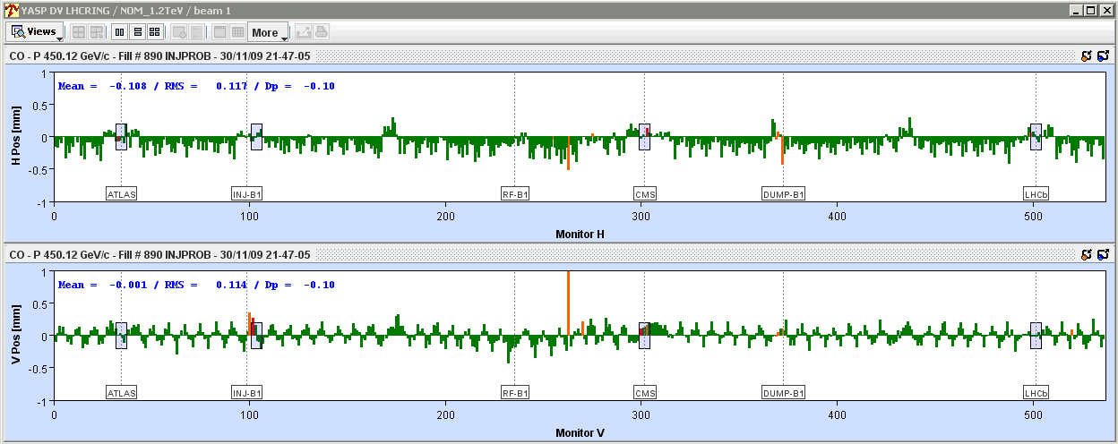
CMS solenoid ramp up
Orbit difference CMS ON – CMS OFF
dp/p error change by ~ 0.1 per mill…
?? CMS solenoid changes the beam energy??

Slide 11
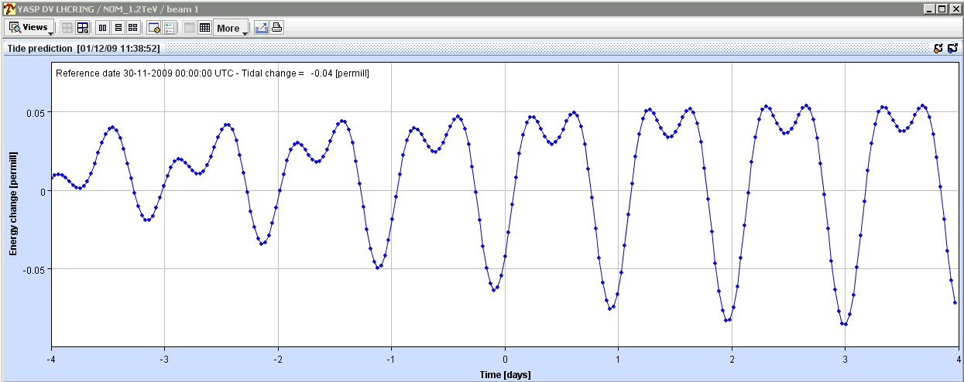
NO! But Earth tides do!
Joerg
Ramp up coincided with large tidal change – good agreement !
Tidal swing corresponds to ~ 15 Hz.
LHC measures influence of tidal forces 10 days after 1st Beam!

Slide 12
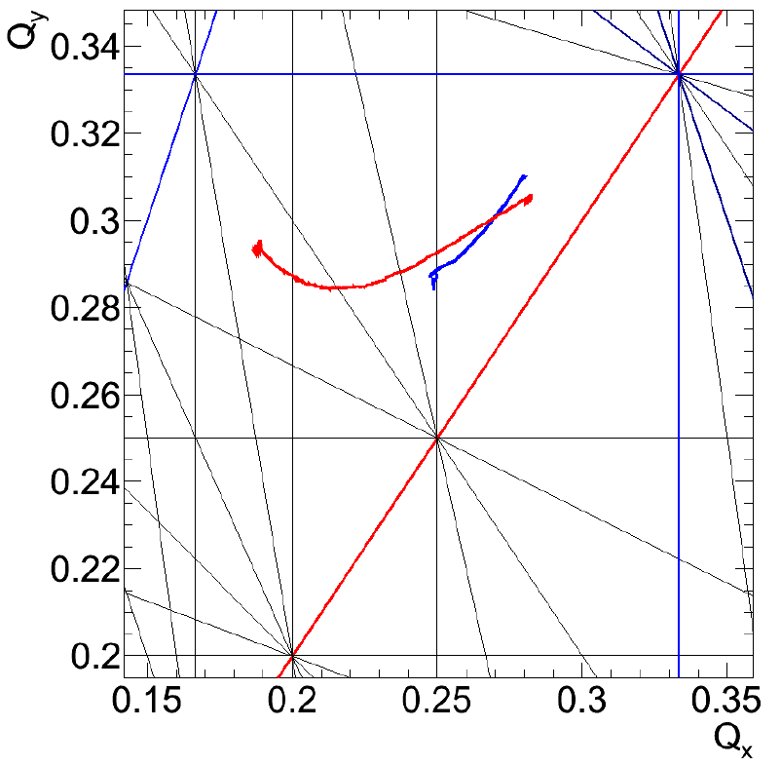
Third Ramp to 1.18 TeV
Tune variations during ramp
Beam 1
Beam 2

Slide 13
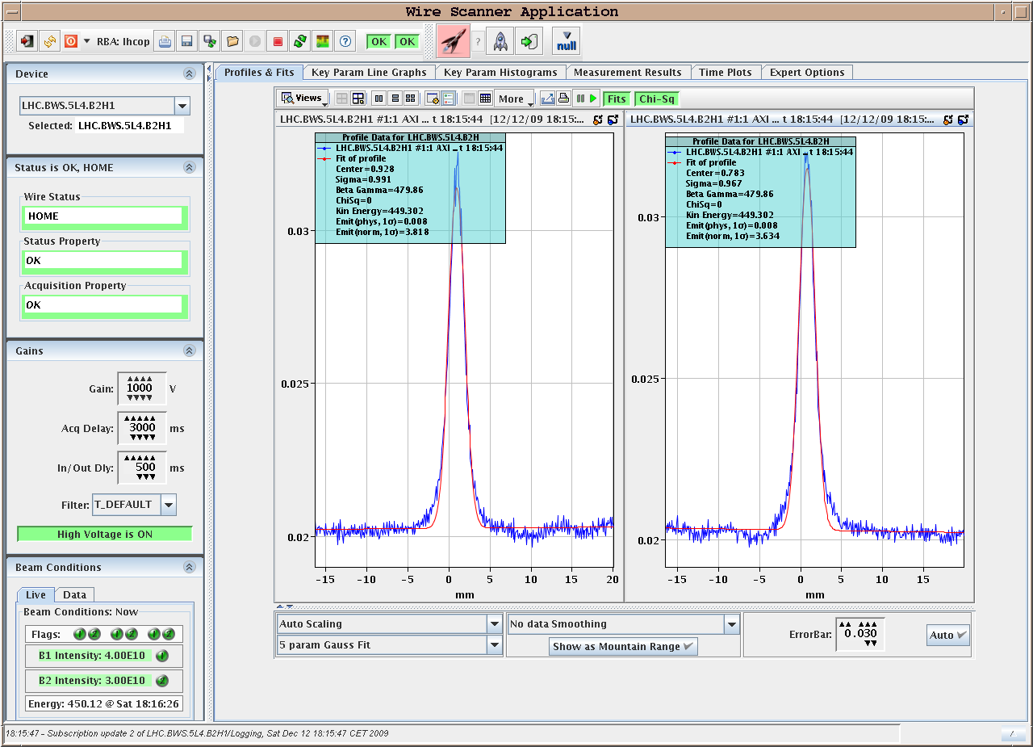
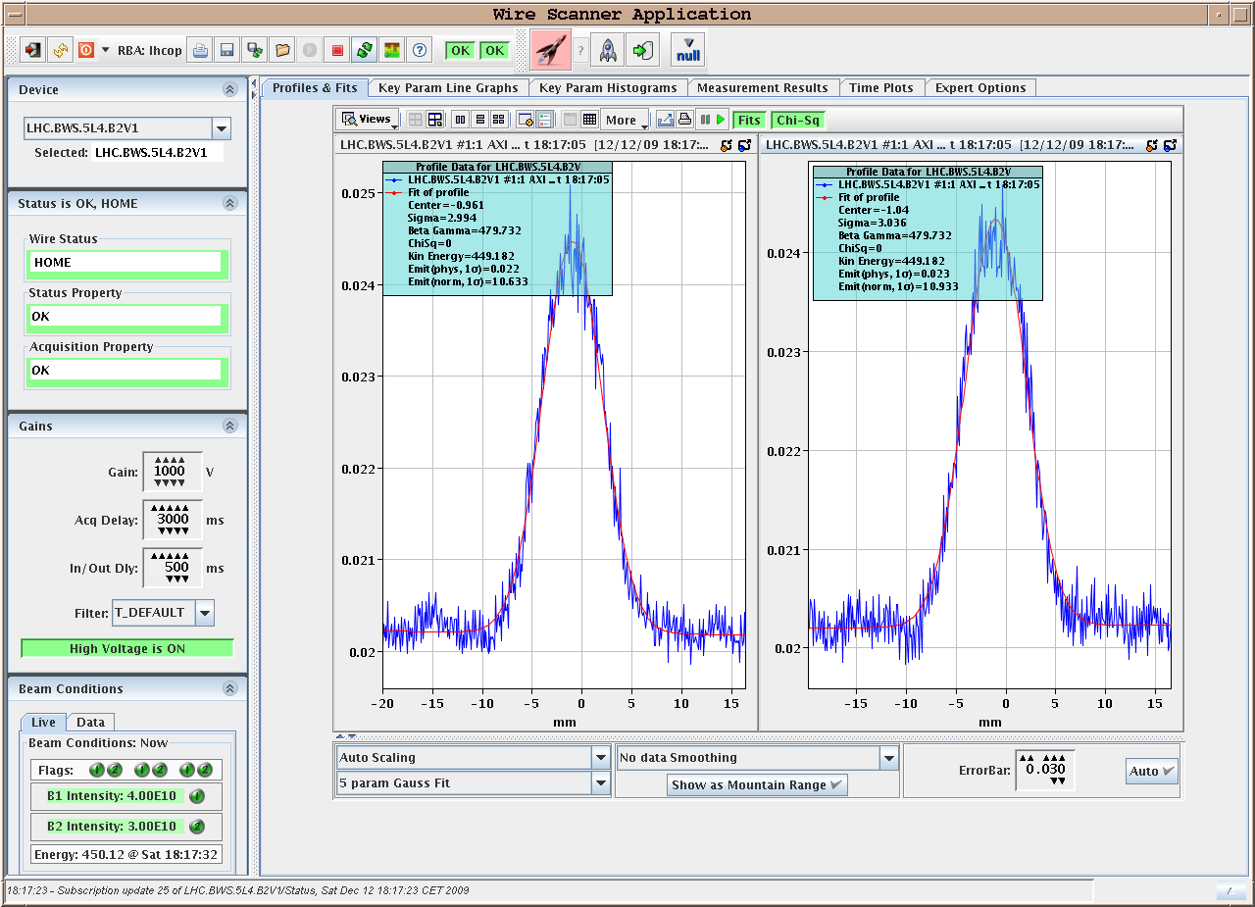
13.12.2009: Wire Scans During STABLE Beams
Beam2 horizontal: Beam2 vertical
Comparing beam size from wire with synchrotron light monitor
Wire: σ_{x} = 0.98mm σ_{y} = 3.0mm
BSRT: σ_{x} = 1.10mm, σ_{y} = 2.7mm ➔ ca factor 2 between σ_{y} and σ_{x}

Slide 14
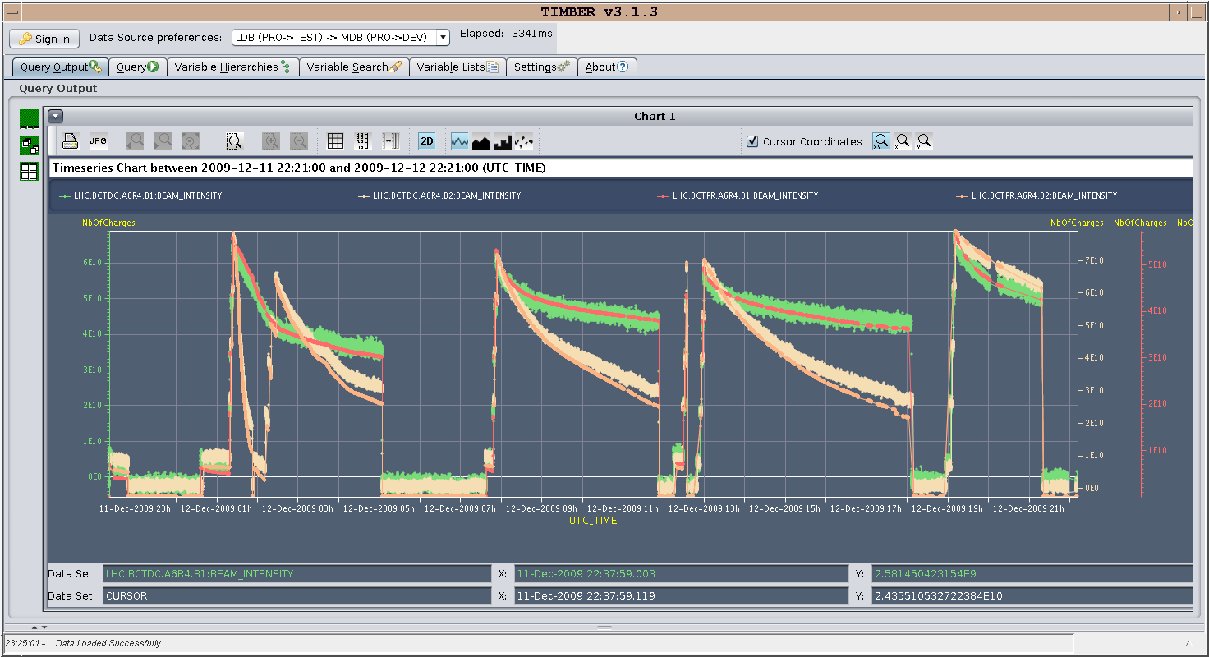
13.12.2009: 24 hours running - currents

Slide 15
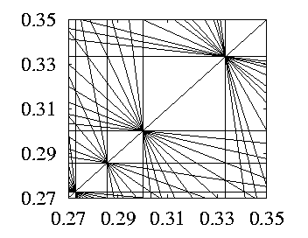
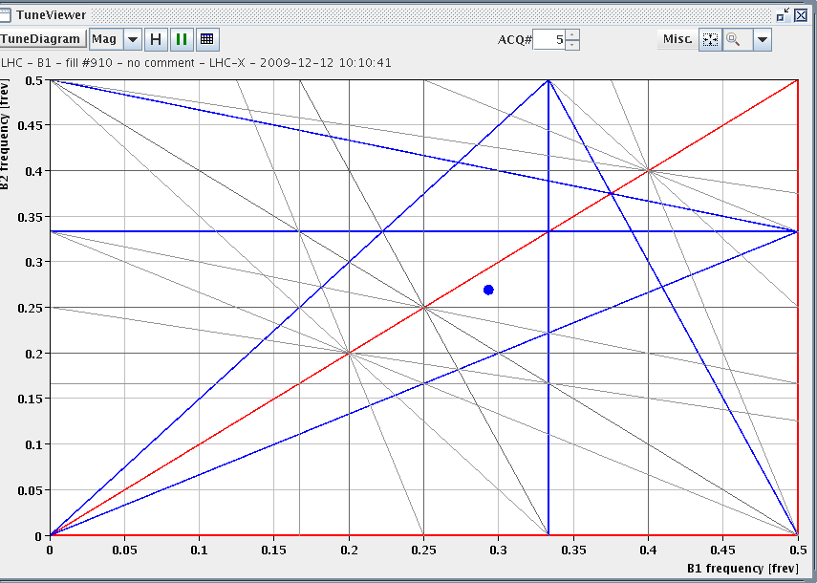
13.12.2009: Tune Adjustments for Beam2
Oliver
B1: Q_{x} = 0.293, Q_{y} = 0.269; lifetime = 26h
B2: Q_{x} = 0.297, Q_{y} = 0.267; lifetime = 5h
B1: Q_{x} = 0.293, Q_{y} = 0.269; lifetime = 25h
B2: Q_{x} = 0.312, Q_{y} = 0.305; lifetime = 12h
1/3
3/10
3/11
2/7

Slide 16
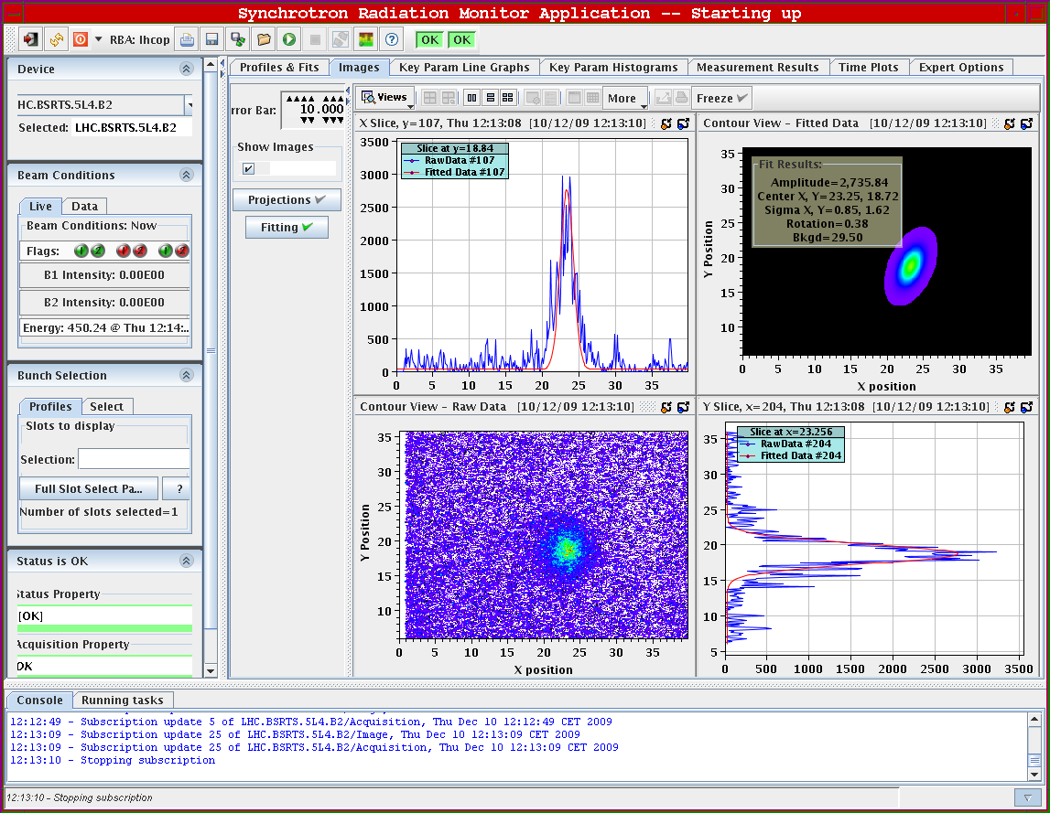
BSRT on beam 2
Thibault/Allan

Slide 17
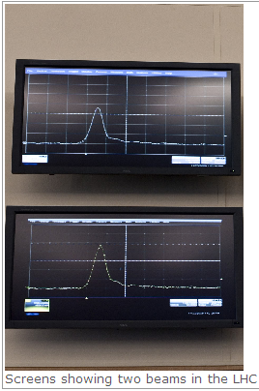
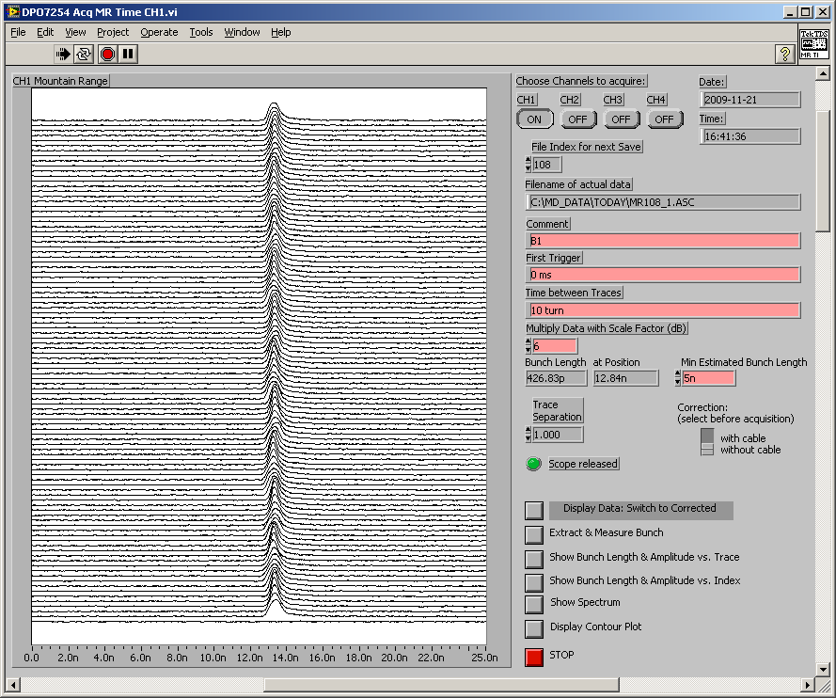
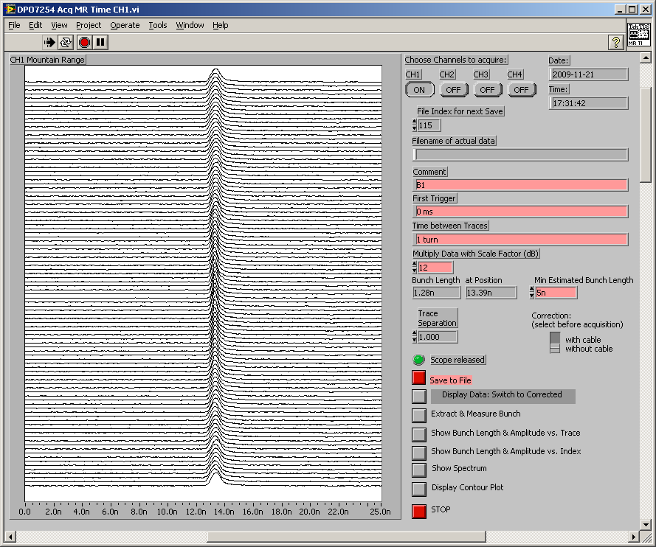
The “RF guys” (Ed and his merry men)
Phase loop Off
Phase Loop On

Slide 18
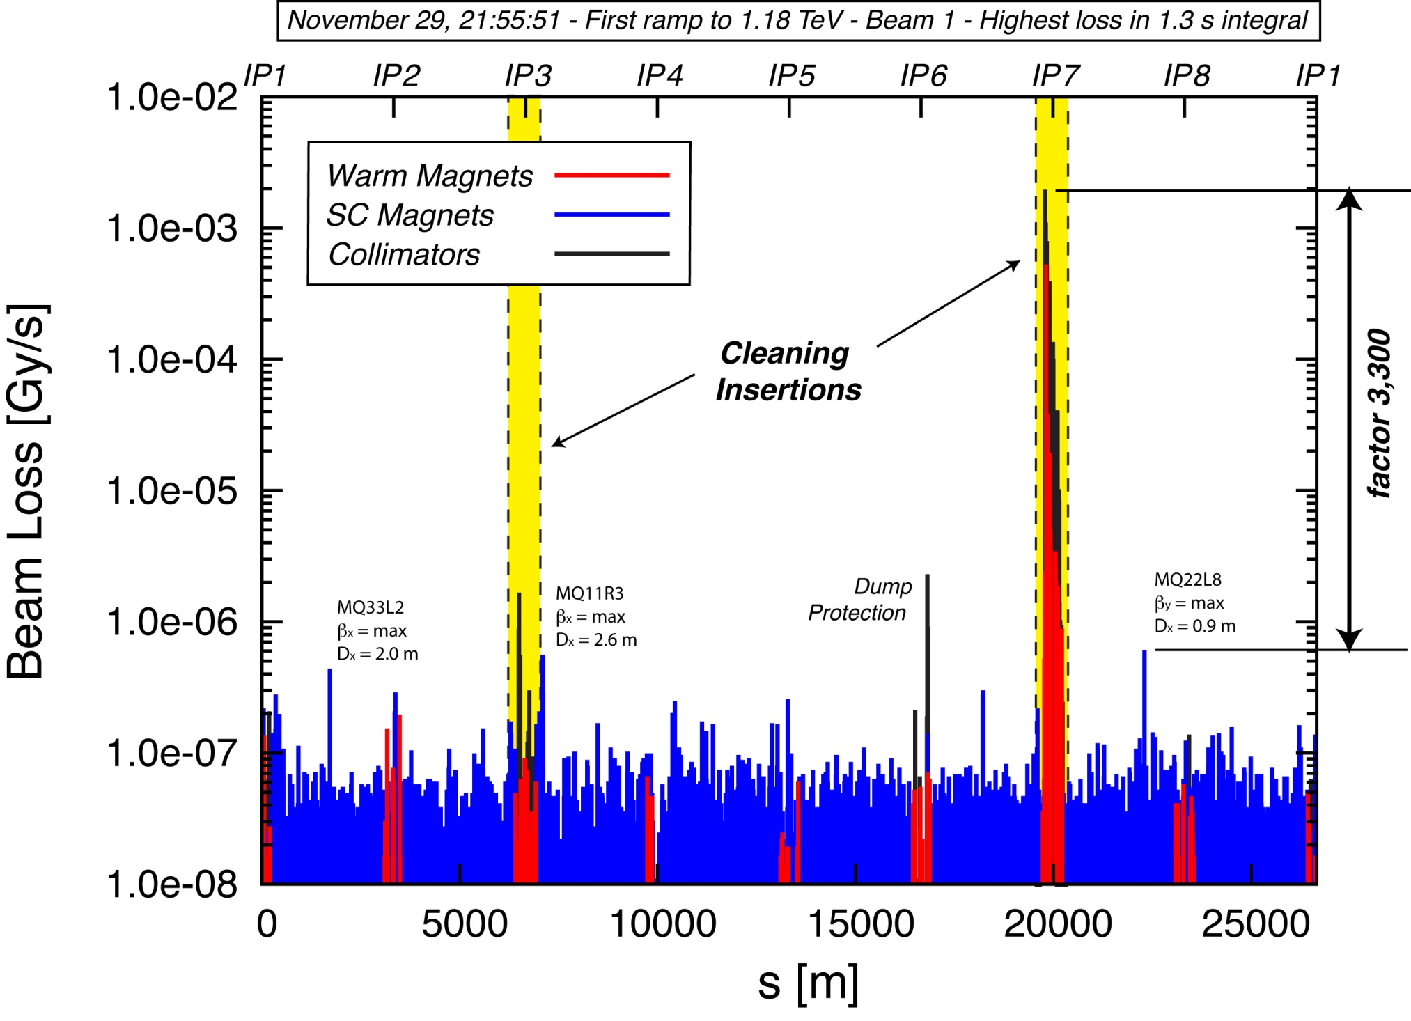
Collimation after beam based set up
Ralph A
Efficiency: > 99.9%

Slide 19
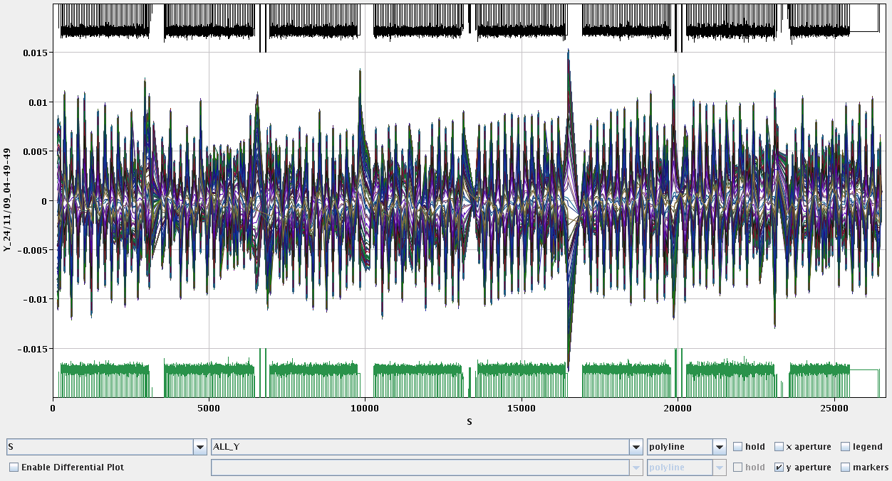
Aperture checks with free oscillation

Slide 20
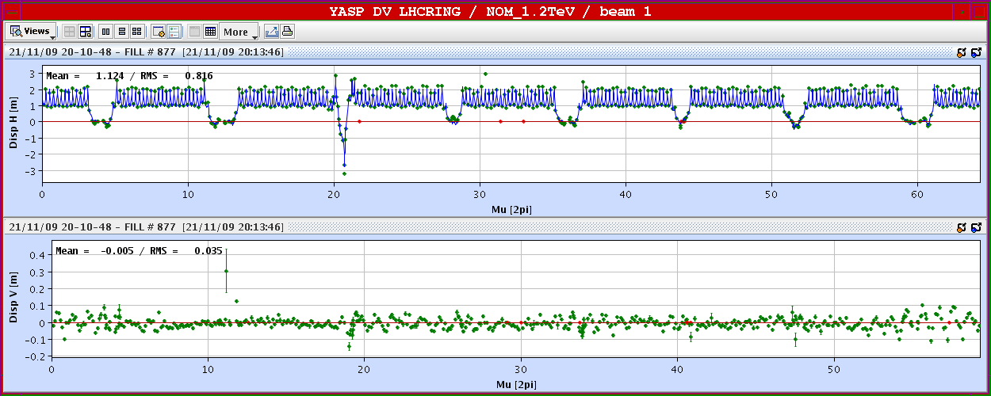
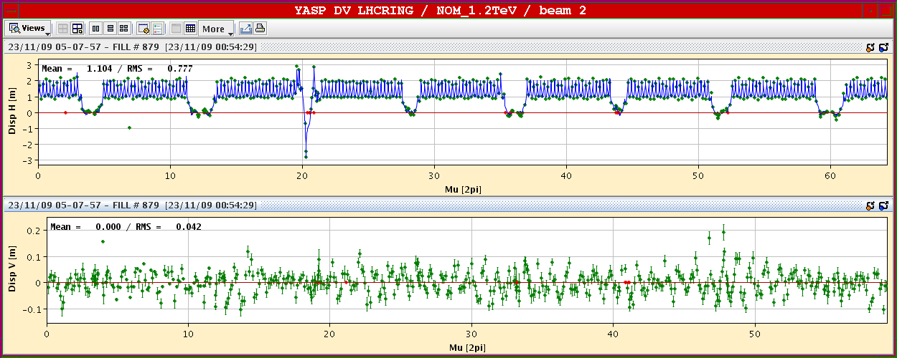
Dispersion…WoW

Slide 21
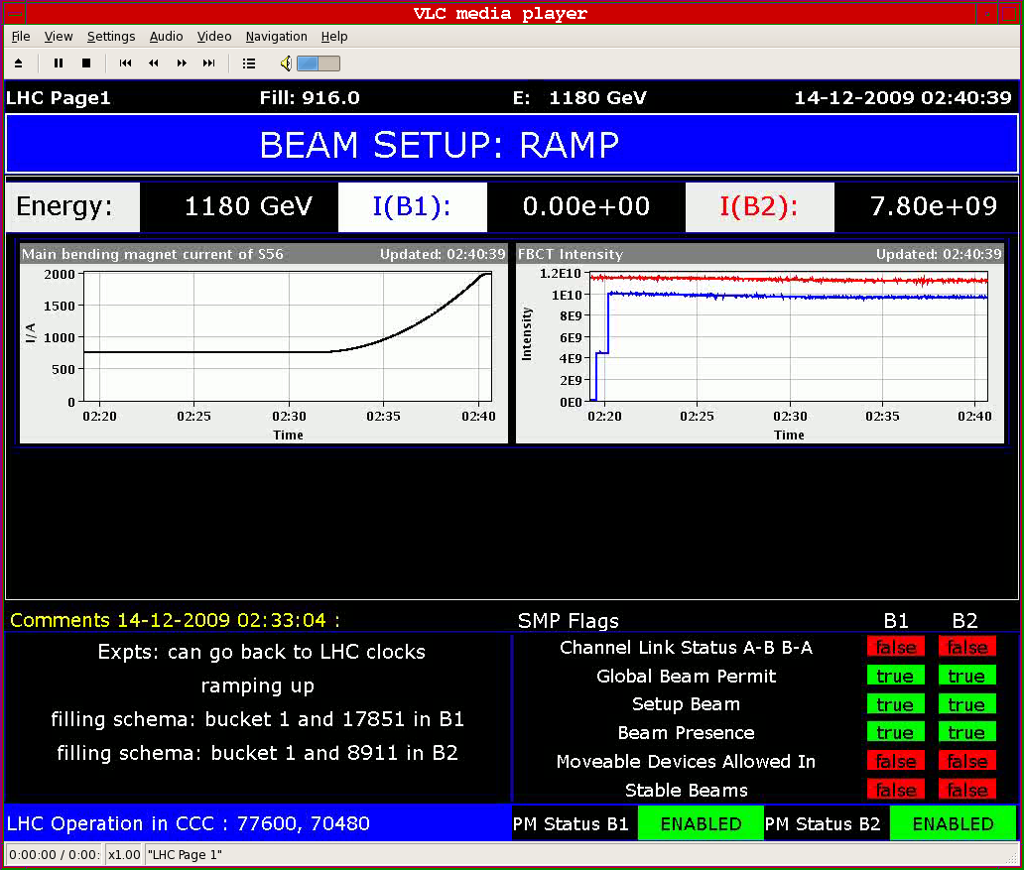
Ramp 2 on 2 to 1.18 TeV

Slide 22
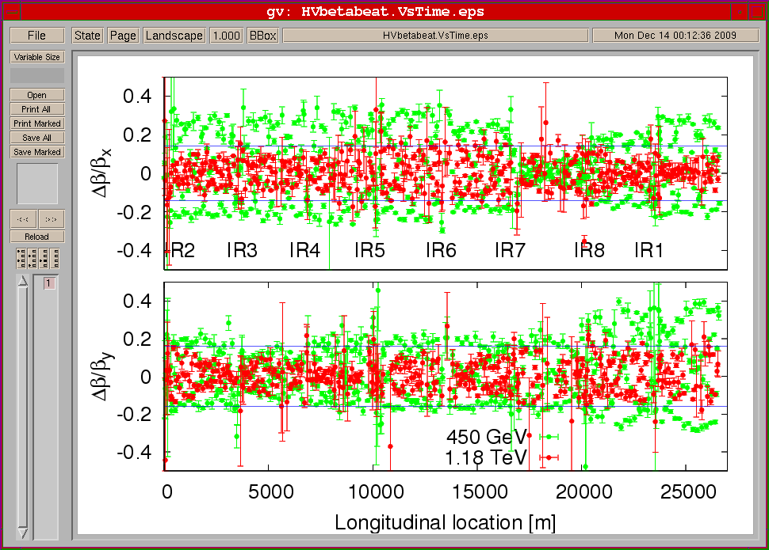
Beta-beat comparison 450 GeV and 1.18 TeV

Slide 23
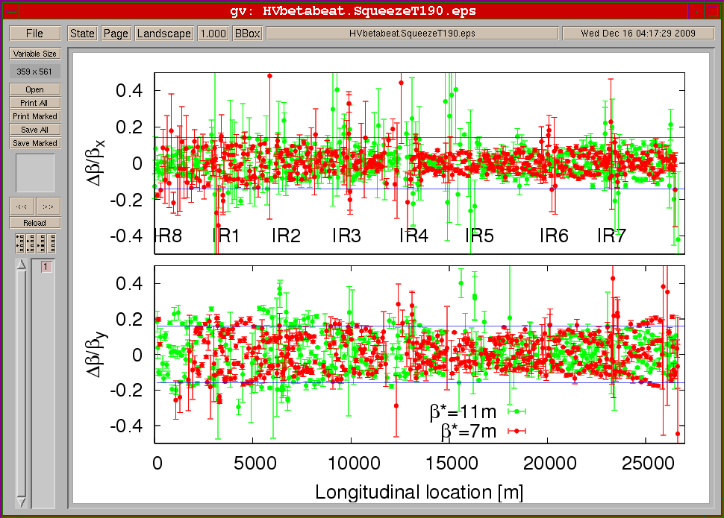
Beta-beat comparison 11m and 7m

Slide 24
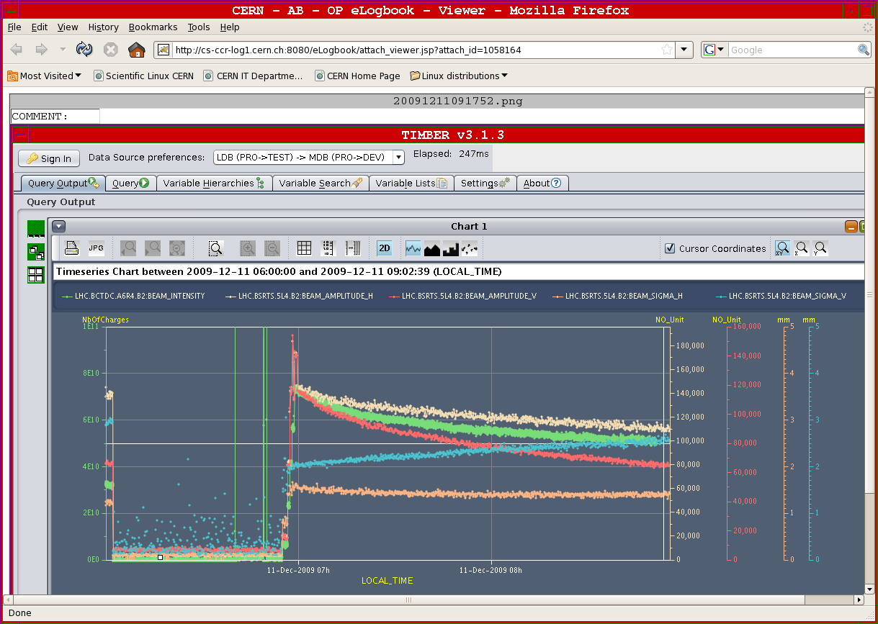
Food for thought – V blow up of beam 2

Slide 25
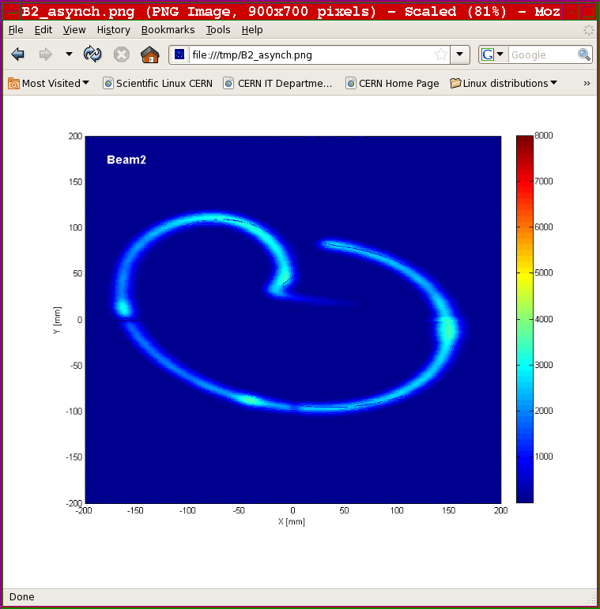
debunched

Slide 26
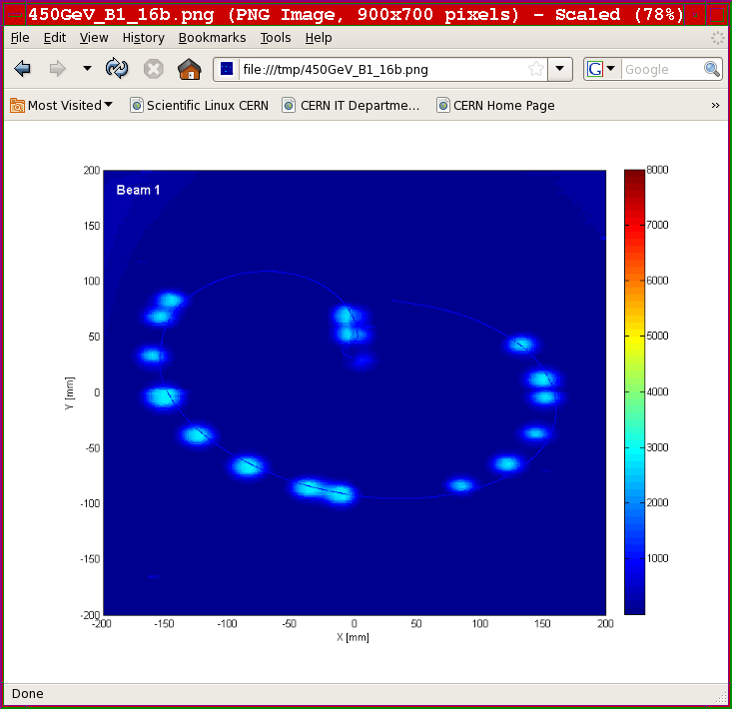
Brennan and Verena (with baby soon to come)
16 bunches

Slide 27
System commissioning
Everyone
Plenty of systems worked as needed on day 1
Planning was adjusted on a daily basis for critical systems
  Beam Instrumentation
  Acceleration (RF)
  Injection
  Extraction
  Collimation
  Kick response campaign
  Aperture measurement campaign
  Optics measurements
  Machine protection
  Collisions
  Ramp
  Squeeze
and don’t forget
Magnets
Power supplies
Cryo
vacuum
Controls
Electrical distribution
Cooling
Access
nQPS
…
…

Slide 28
Beam commissioning strategy
Mike’s cunning plan
Energy | Safe | Very Safe
450 | 1 e12 | 1 e11
1 TeV | 2.5 e11 | 2.5 e10
3.5 TeV | 3.0 e10 | probe
Global machine checkout
Essential 450 GeV commissioning
Trial ramps
Machine protection commissioning 1
Experiments’ magnets at 450 GeV
All has been accomplished! +
Xmas
450 GeV collisions
Ramp commissioning to 1.2 TeV
System/beam commissioning
Machine protection commissioning 2
2010
3.5 TeV beam & first collisions
Full machine protection qualification
System/beam commissioning
Pilot physics

Slide 29
Summary
LHC is back!
26 days of highly successful beam commissioning due to
  meticulous planning
  High availability of all accelerator and detector components

Slide 30
In conclusion
It has been a truly remarkable 24 days. Things have moved so quickly that it has been hard to keep up with the progress.
Many firsts for the LHC and the detectors
On the longer time scale, it has been a fantastic effort, with five impressive phases:
1) repair; 2) consolidation; 3) hardware commissioning; 4) preparation for beam; and 5) beam operation.
The final phase has been highly visible, and widely reported throughout the world, but would not have been possible without the other phases.
From the CERN management, we would like to express our sincere thanks and congratulations to all of you who have done such a great job in bringing the LHC BACK!

Slide 31

I wish you
A good rest
a great Christmas with your families
A very happy new year
And please come back in 2010 fully recharged for the next phase

Slide 32

While waiting for Questions…
A little black Christmas humour

