Slide 1

Highlights from TWEPP 2018 conference

Slide 2
Outline
Brief overview about the conference
Summary of some presentations
  The BRAVE FPGAs: overview and status of the European radiation-hardened FPGAs for space
  Evaluating the NanoXplore 65nm SRAM based RadHard FPGA for CERN applications
  Technology and challenges for extreme ultraviolet lithography
  The CMS High Granularity Calorimeter for HL-LHC
  SAMPIC-based systems for precise timing detectors: implementation and performance
  The proton timing system of the TOTEM experiment
  Radiation tolerance enhancement of silicon photonics for HEP applications
  Next generation of radiation tolerant Single-Mode Optical Links for Accelerator InstrumentationFPGAs for space
Additional topics

Slide 3
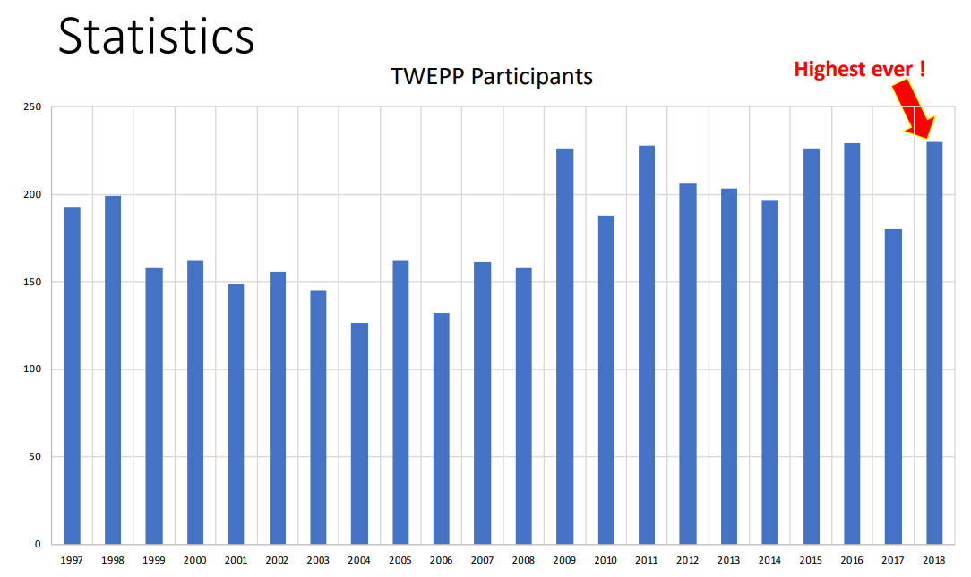
Conference overview
General information:
Hold annually since 1995
Covers “all aspects of electronics for particle physics experiments, and accelerator instrumentation of general interest to users”
Particular focus on LHC experiments
Purpose:
Present results and original concepts for electronic research and development relevant to experiments as well as accelerator and beam instrumentation at future facilities
Review the status of electronics for the LHC experiments
Identify and encourage common efforts for the development
of electronics
Promote information exchange and collaboration in the
relevant engineering and physics communities.
Practical information:
Website : https://indico.cern.ch/event/697988
Papers will be published in “Proceedings of Science”:
htpss://pos.sissa.it
Duration : 4.5 days with plenary + 2 parallel sessions + 2 tutorials
183 paper submissions, 60 oral presentations & 100 posters

Slide 4
The BRAVE FPGAs: overview and status of the European radiation-hardened FPGAs for space. (1/5)
David Merodio Codinachs (ESA) – no slides or paper will be available
Project collaboration between ESA, CNES with industrial partners (NanoXplore and STMicrolelectronics) to develop a range of rad-hard, SRAM-based and ITAR and EAR-free (= no dependant of US regulations) FPGAs.
Important project for ESA since there ~200 FPGAs per satellite.
BRAVE = Big Re-programmable Array for Versatile Environments
3 rad-hard device families are planned: with increasing fabric size and number of logic resources.
NG-Medium | NG-Large | NG-Ultra
STMicroelectronics' rad-hard 65 nm process (STM C65) | STM C65 | 28 nm FD-SOI process
2 packages currently available: a 625-pin, 29×29 mm LGA, and a 352-pin, 48×48 mm MQFP | packaged in a 1752-pin LGA/CGA | packaged in a 1752-pin LGA/CGA
35k LUTs, 2.8 Mb of embedded RAM | 140k LUTs, 10.1 Mb of embedded RAM, | 600k LUTs, 32 Mb of embedded RAM
4x PLL, 13 I/O banks 1x 430 Mbps SpaceWire CODEC and 112 DSP blocks 16 SW PHY | 24x 6.25 Gbps high-speed serial links 1x 400 Mbps SpaceWire interface Embedded DSP blocks A rad-hard ARM Cortex-R5x core 24 I/O banks. | The target logic and DSP performance is 500 and 800 MHz respectively 1 Gbps differential I/O 12.5 Gbps SERDES links 600 MHz quad-core ARM R52.
Already available | First parts available in Q3 of this year | First parts available towards the end of 2020
 |  | Slightly less total dose tolerance than the large (>50kRad )
Notes:
Purpose: Provide to the Space Industry a High-capacity, high performance radiation hardened reprogrammable European FPGA
Why FPGAs ? FPGA unlimited re-programmability extra advantage: enable re-configurable and adaptive systems; and also reduces impacts in the (frequent) event of unexpected design changes or modification.
FPGAs cost advantages: shorter development times, simpler, less expensive design and manufacturing phases than ASICs.
CNES = Centre National d’etudes spatiales
ITAR = International Traffic of Arms Regulations
EAR = Export Administration Regulations
FD-SOI = Fully Depleted Silicon On Insulator, also known as ultra-thin or extremely thin silicon-on-insulator (ET-SOI), is an alternative to bulk silicon as a substrate for building CMOS devices. SOI wafers have a shallow layer of epitaxial silicon grown on top of an oxide layer that acts as an insulator. The top silicon layer is fully depleted, that is, it doesn’t have any intrinsic charge carriers, which has a number of advantages when building deep submicron devices.
Nano xplore is in charge of the design, verify and bring up (validation) + FPGA tools (mapping, place & route, etc)
STMicroelectronics: manufacturing the silicons, packaging, evaluation & qualification. It also provides RadHard block library.
Alpha customers: Airbus Defence & Space and Thales Alenia Space.
Nanoxplore relatively young company, was created in 2010.
28 nm FD-SOI process which enables ultra-low power features

Slide 5
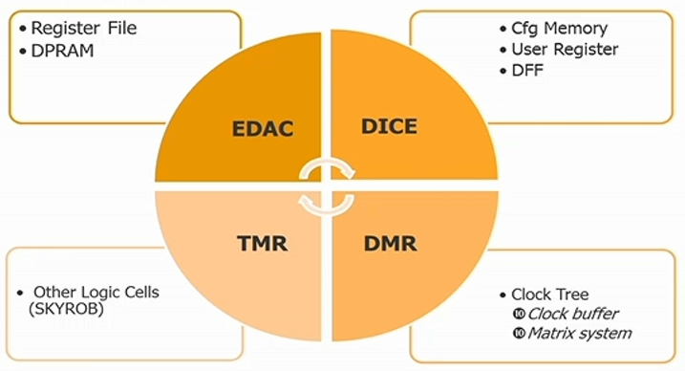
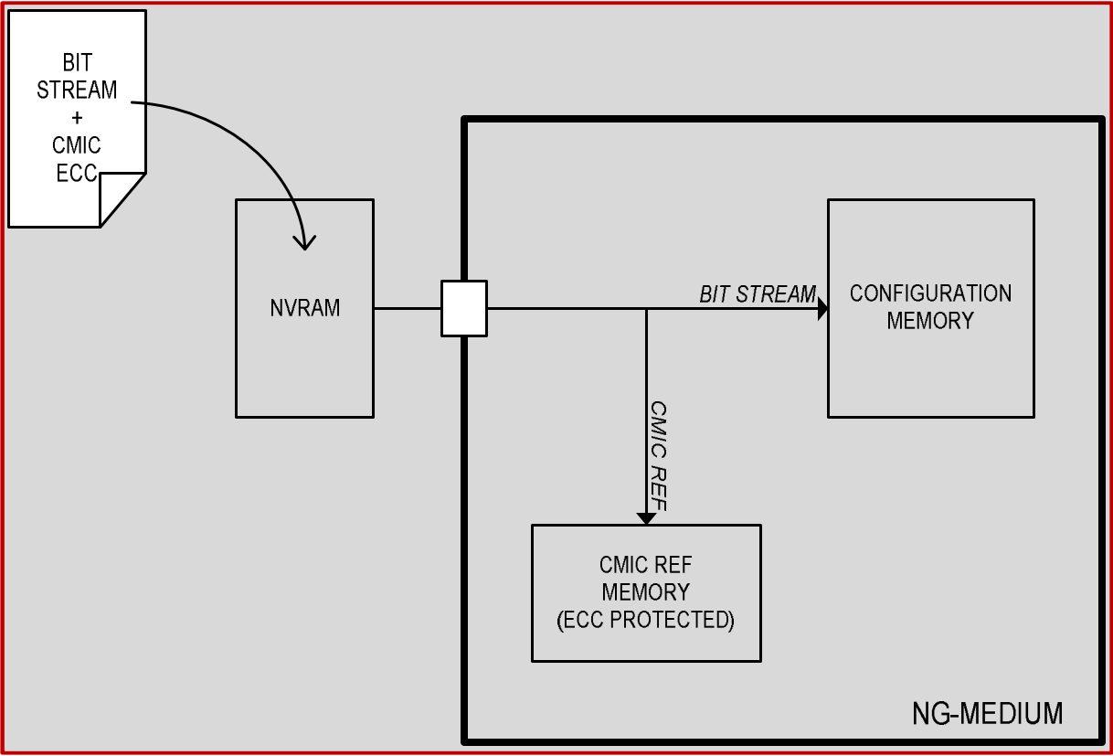
The BRAVE FPGAs: overview and status of the European radiation-hardened FPGAs for space. (2/5)
Radiation Hardened by Design (RHBD) and simulated TFIT software
TID >300 krads TID
No SEL for LETth > 60 MeV cm⁻²/mg
SER / device.day : 1.7e-4 (GEO).
Diff. harden techniques : TMR for logic cells, DMR for clock tree, DICE for configuration Memory and EDAC for register file + embedded Configuration Memory Integrity Check (CMIC)
CMIC (Configuration Memory Integrity Check) :
On initialization, a bit stream reference is saved into a memory protected by ECC.
CMIC can be periodically activated (period can be set by the user
between 5.3ms-65days):
1. Reads the configuration data (~4ms)
2. Calculates the signature
3. Compares the result with the signature of the CMIC reference.
4. If mismatch is detected it can correct it.
Note: Tested up to 300krads TID (ESA qualifies up to 100krads).
Notes:
- Configuration Memory Cells are built with dedicated RH layout to guarantee a very low probability of soft-errors,
- User Register and DFF are also built with RH layout,
- Register files and Embedded Dual-Port RAM are protected with ECC.
- Clock tree has double redundancy
- Remaining critical logic blocks are triplicated.
ECC or EDAC-protected memory : error correcting memory. It maintains a memory system immune to single –bit errors, even if 1 or more bits actually stored have been flipped to the wrong state. Used in critical systems where data corruption cannot be tolerated such as scientific or financial computing.
An ECC-capable memory controller can detect and correct errors of a single bit per "word", and detect (but not correct) errors of two bits per word. Single Error Correction and Dual Error Detection (SECDED)
Every memory word contains some additional bits that will be used for the SECDEC process.
TMR : Triple modular redundancy : Mitigates SETs and SEUs.
DMR : Dual memory redundancy. Allows to detect but not to correct the issues.
DICE : Dual interlock storage cell. Consists of 8 interlocked inverters.
LETth: linear energy transfer threshold. The LET_{th} is defined as the minimum LET to cause a single-event effect at a particle fluence of 10⁷ ions/cm².
SER : Soft Error rate
SER (GEO) = 1.7e-4 / device.day * 500 devices ~ 0.085 errors/day -> 1 error every 11.7 days !!!
How does GEO radiation spectrum compares with LHC?
CMIC ~ configuration memory scrubber controller.
The CMIC does not need to access the external NVRAM when performing checks and repairs at run time. When a faulty bit is detected, the repair process is launched automatically and a notification signal is generated. This signal can be used by external means to manage this situation at system level.

Slide 6
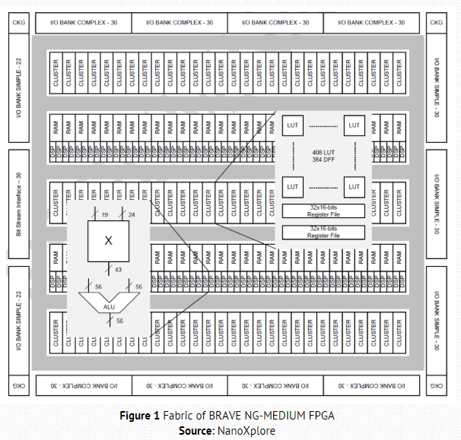
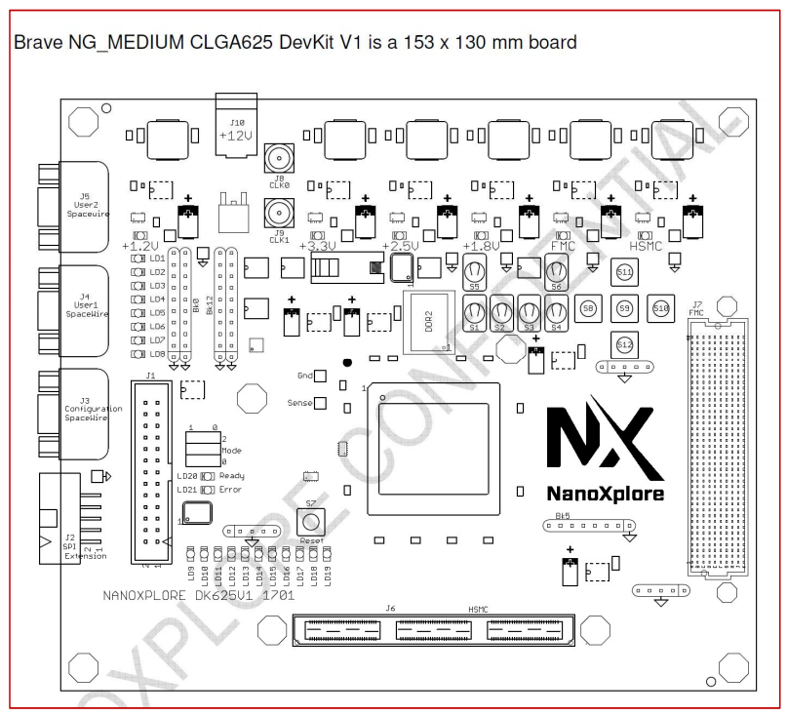
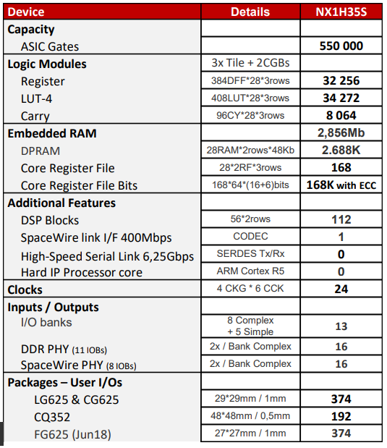
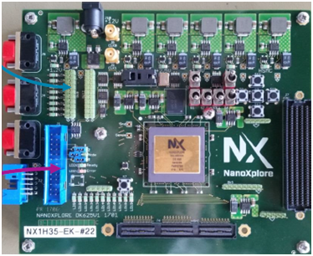
The BRAVE FPGAs: overview and status of the European radiation-hardened FPGAs for space. (3/5)
NG-medium specs
Evaluation board for NG-medium available. To be used interactively through JTAG or standalone from an EEPROM board (Atmel Dump Model EEPROM or a standard SPI EEPROM).
(NG-medium Eval kit ~3.2k€)
Performance :
Logic : 200 Mhz
DSP : 333MHz
I/O : 800 Mbps
Notes:
LUTs are 4-inputs
SpaceWire : Communication protocol used by ESA.
Recommended Space FPGA Configuration Memory : 3D-PLUS Serial NOR Flash TMR’ed 128Mb / 3DFS128M01VS2728

Slide 7
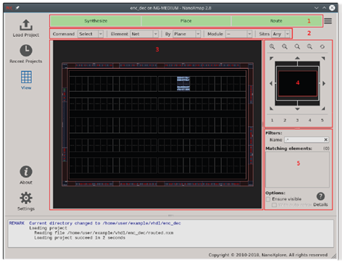
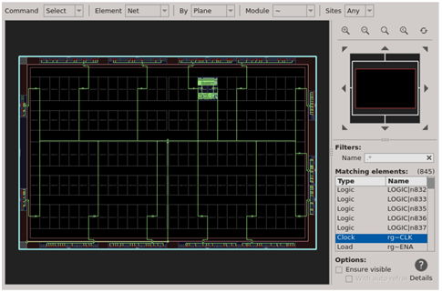
The BRAVE FPGAs: overview and status of the European radiation-hardened FPGAs for space. (4/5)
NanoXmap: Tool for synthesis, mapping and P&R. Available now free-of-charge against SW Licence Agreement (SLA).
NanoXPytohn: Python wrappers scripts for making the different steps: synthesis, P&R, etc.
They provide an embedded logic analyser IP core (VHDL)
Notes:
Development for these FPGAs is done with NanoXmap or NanoXpython. NanoXmap is a minimalistic GUI, while NanoXpython is a set of scripts for making the synthesis, place and route and showing the reports resulting from the different steps.
They provide Embedded Logic Analyser IP core (VHDL)

Slide 8
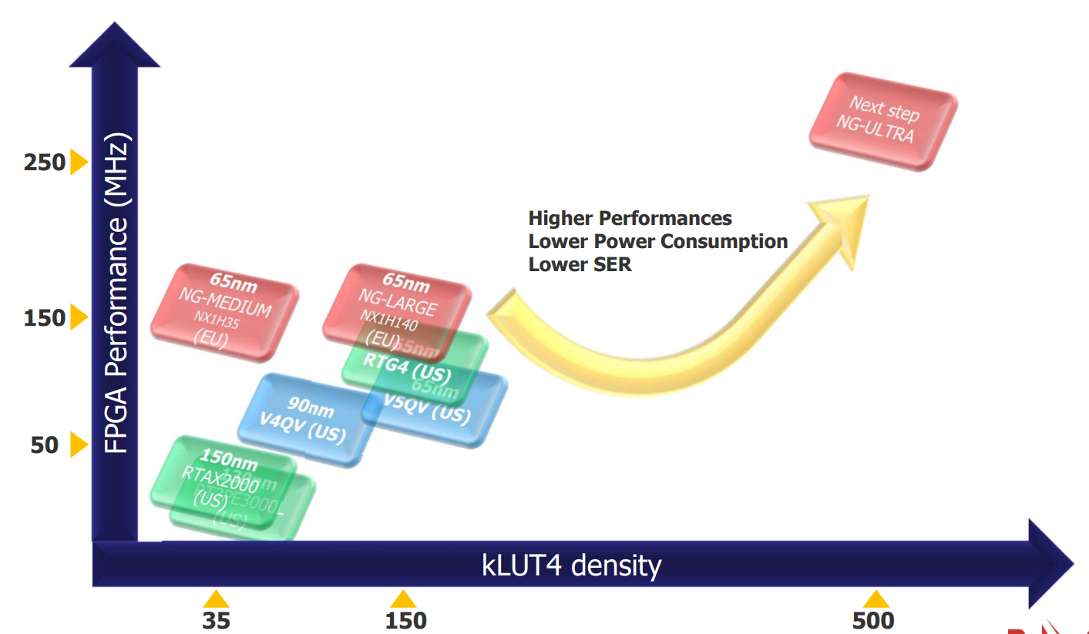
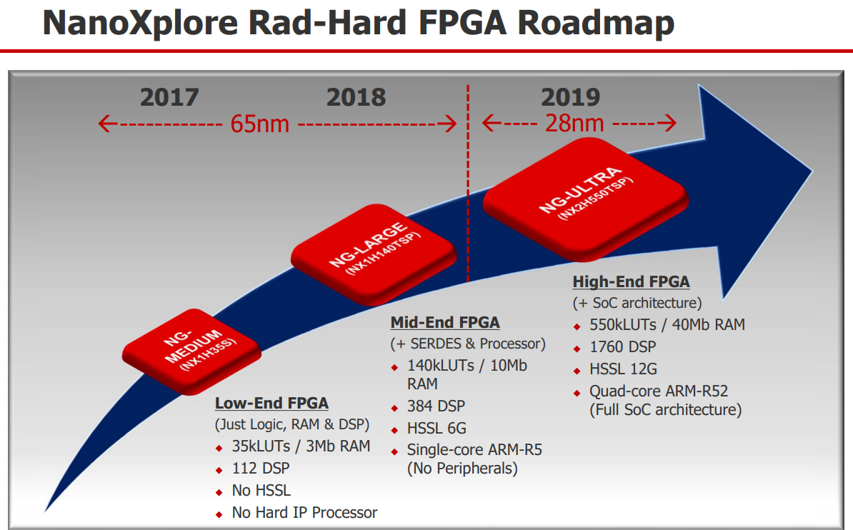
The BRAVE FPGAs: overview and status of the European radiation-hardened FPGAs for space. (5/5)
8
Microsemi: RTAX2000, Antifuse, 150nm, ~35k LUT4, 50MHz.
RT Proasic3 : Flash, 130nm, ~35k LUT4, more configurable, ~50 MHz
Xilinx : V4QV, RadTolerant, 90nm, obliged to triplicate, so similar ressources to previous after triplication.
Xilinx : V5QV , 65nm, ~60-80k€
Microsemi : RTG4, ~150k LUT4, ~150MHz, 60-70k€ (space qualified)
NanoXplore : NG-medium, RHBD 65nm, ~35k LUT4, 150MHz
NanoXplore : Future NG-Large, RHBD 65nm, 140k LUT4
NanoXplore : Future NG-Ultra, RHBD 28nm.
1
2
3
6
7
4
5
5
2
4
Current
market
6
3
1
7
8

Slide 9
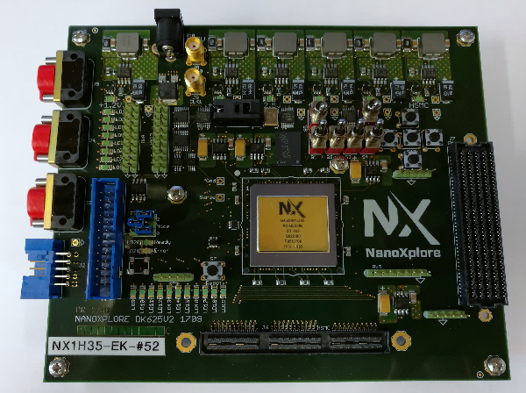
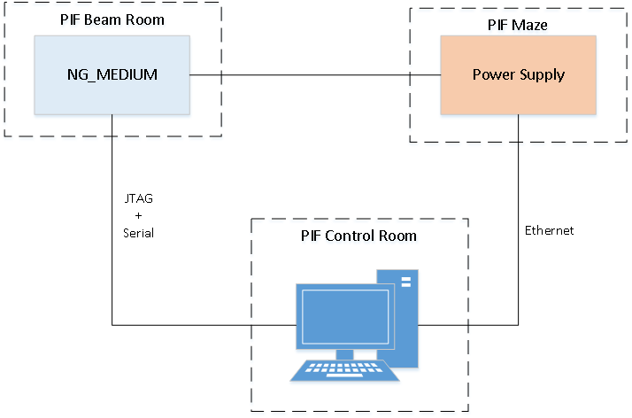
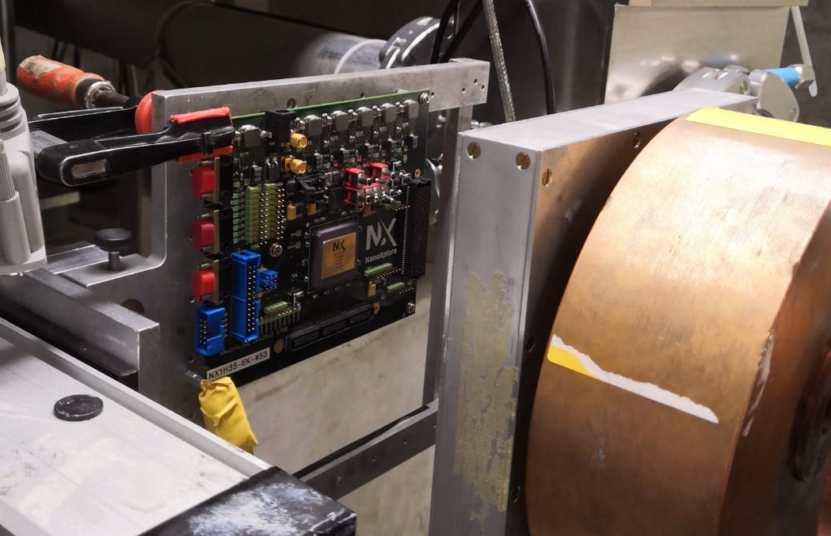
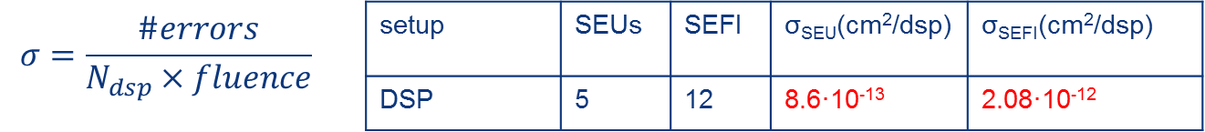
Evaluating the NanoXplore 65nm SRAM based RadHard FPGA for CERN applications. (1/2)
Salvatore Danzeca (CERN)
FPGAs are needed in CERN regions affected by radiation
COTS FPGAs are divided in 2 families:
SRAM | FLASH
TID immunity (>1kGy for most COTS) | TID is limiting the lifetime of the FPGA
Configuration Memory very sensitive to SEUs | Configuration Memory SEU immune
NanoXplore FPGAs seems a good
Compromise, since memory cells have been Rad-hardened
Irradiations test at PSI:
1st test - CRAM cells. Disable CMIC → Program FPGA → Irradiate → Check.
No SEUs observed in 2 runs up to 1.72x10¹¹ p
2nd test - DSP blocks: 32x 24-bit x 24-bit multiplication of 2 fixed numbers →Check @clk →
Update error counters → tx. counters every second.
3 runs of 1.72x10¹¹ p
NG-medium evaluation board
Notes:
SEFI = Single-Event Functional Interrupt

Slide 10
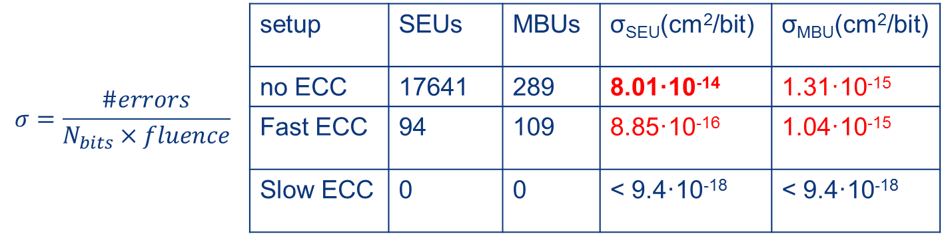
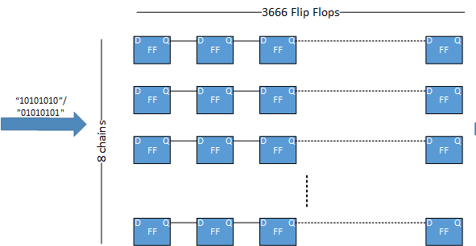
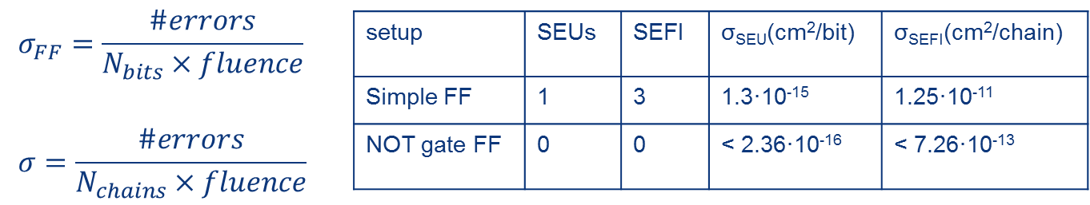
Evaluating the NanoXplore 65nm SRAM based RadHard FPGA for CERN applications. (2/2)
3rd test – BRAM in 3 diff. config. Modes : No ECC (6 runs), Fast ECC (3 runs) and Slow ECC (3 runs).
@ every Run: Write into the memory → Irradiate up to 3x10¹⁰ p → Read back and tx. wrong data
4th test – FF : 2 setups:
8 chains of 3072 flip-flops initialized with an alternating pattern. → 4 runs up to 3x10¹⁰ p
8 inversors interfered between every flip-flop column. (More sensitive to SETs) → 1 run up to 1.72x10¹⁰ p
@ every Run: Results check at every clock → tx. to a computer.
*
*
* All in the 1st run
Notes:
ECC implemented as Single Error Correction, Double Error Detection (SECDED)
In ECC Fast: If a single bit error is found, it will be automatically detected and corrected at the RAM output port. However, the internal memory array remains corrupt. If a double bit error is detected, it can’t be corrected
In ECC Slow = Read Repair Mode (RRM). If a single bit error is found, it will be automatically detected and corrected at the RAM output port, and the memory content is automatically updated with the corrected value. If a double bit error is detected, it can’t be corrected. In this mode, the internal RAM block works a frequency that is double of the user’s clock. The maximum user’s clock frequency is then reduced by a factor of 2, approximately.
Custom memory instantiation of 32 blocks (out of 56) using library component without automatic inference
Setup #1 -> Without EDAC uses 6144 x 8 bits per block
Setup #2 -> With EDAC Fast ECC 2048 x 18 bits per block
Setup #3 -> With EDAC Slow ECC 2048 x 18 bits per block
MBU = Multiple Bit Upset -> Several memory bits upset by passage of the same particle

Slide 11
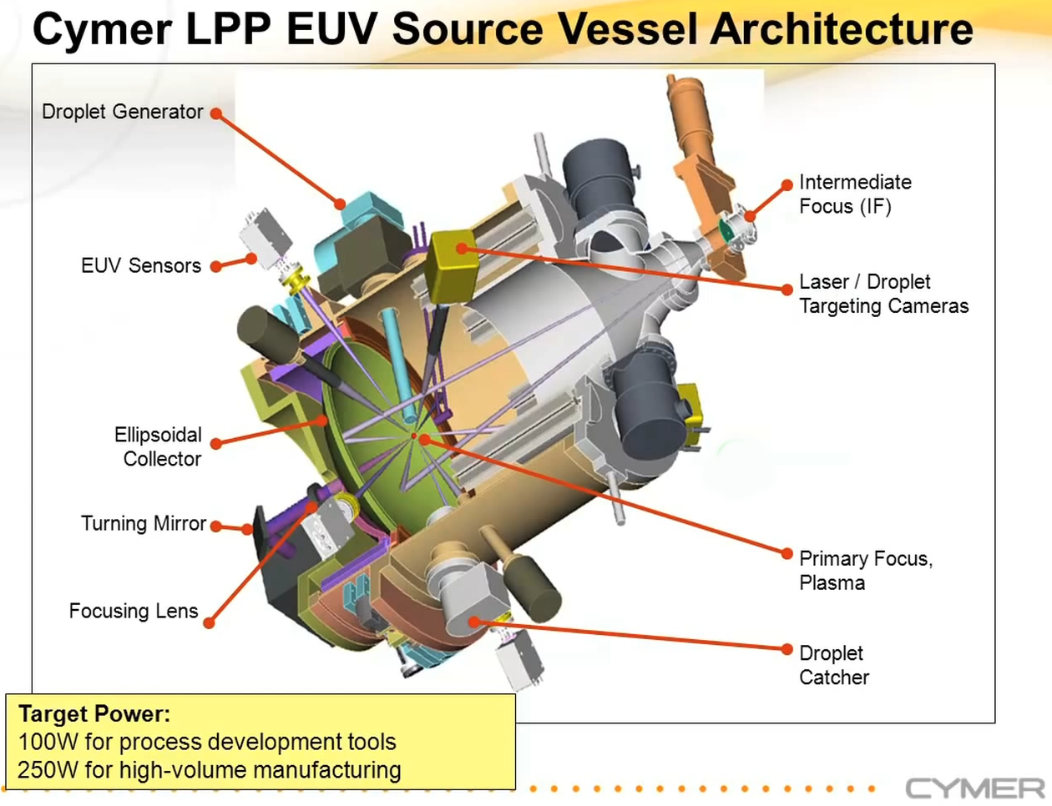
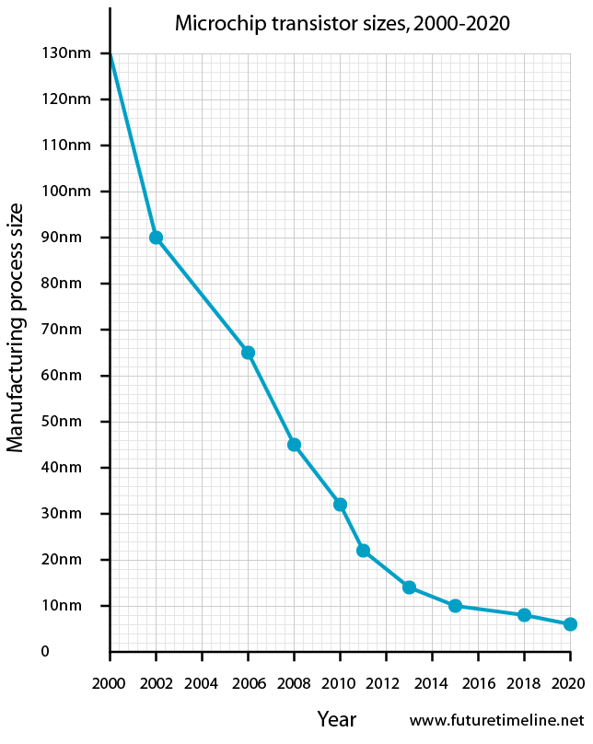
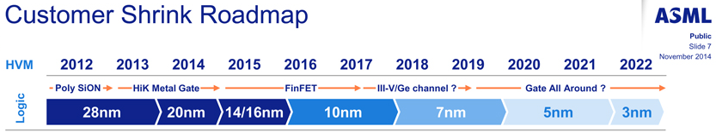
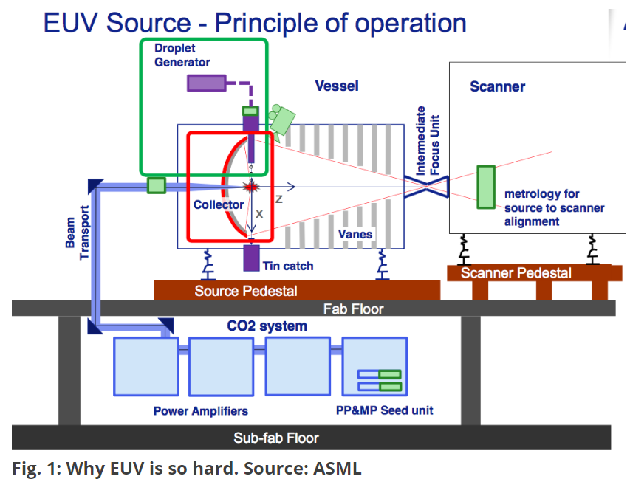
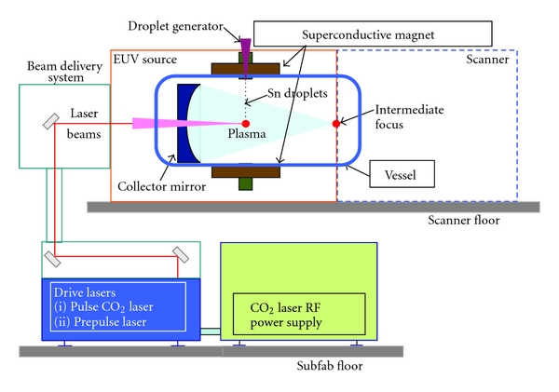
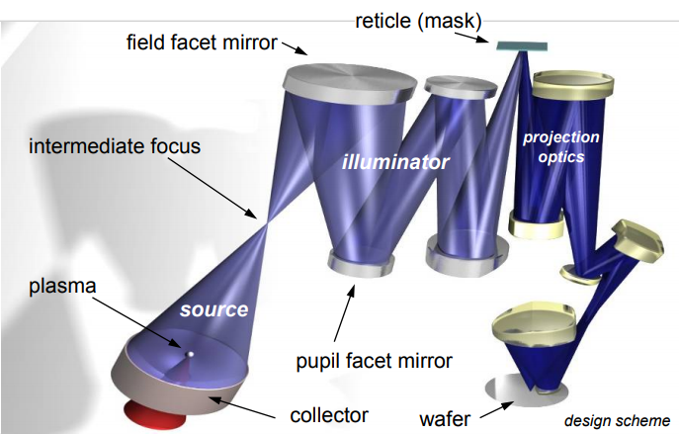
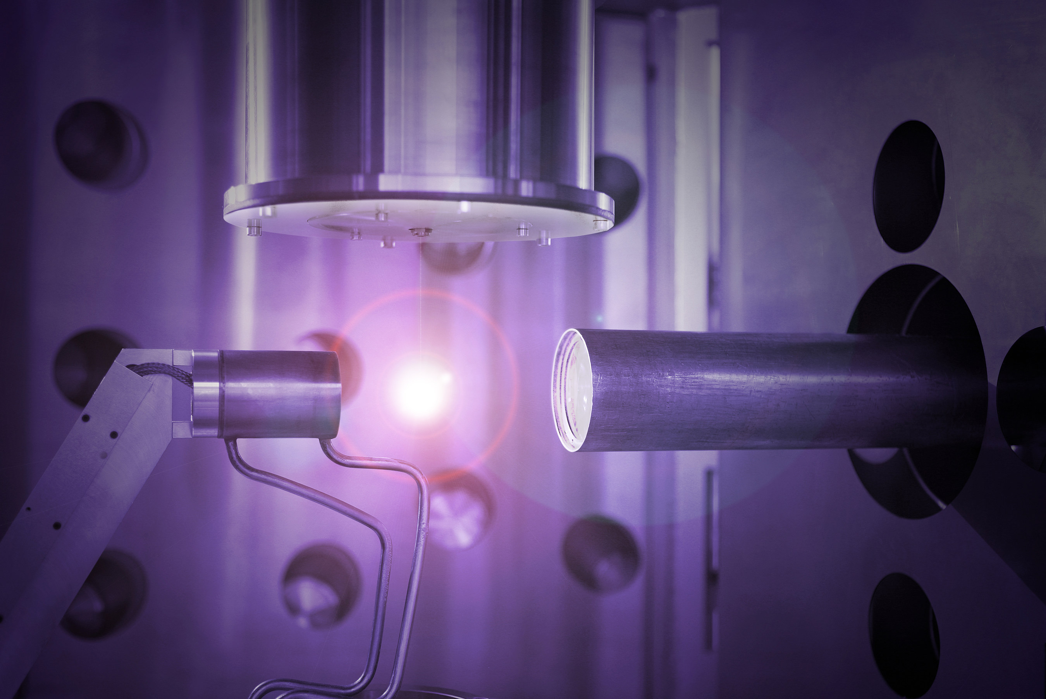
Technology and challenges for extreme ultraviolet lithography. (1/3)
Van Der Zande Wim (ASML) – no slides neither paper will be available
Presentation of main techniques used to solve the challenges to obtain EUV lithography at 7nm.
CO₂ laser hits small Sn droplets (~30um diameter) x2 at ~50kHz. This creates a ionized gas plasma and a 13.5 nm radiation is then produced and collected by a special ~0.5 meter mirror in order to selectively reflect and direct the 13.5nm light to the Intermediate Focus (IF) position at the entrance to the scanner system.
Since EUV light with 13.5 nm wavelength can be absorbed by almost any matter, EUV lithography has to be done in vacuum.
Lenses cannot be used with EUV, instead, specialized multilayer mirrors are used. Even those, absorb ~30% of the light, so the laser
should be very powerful.
Every chip in the wafer is scan individually and the system should produce 125 wafers/hours. For a 7 nm node there is an on-product overlay requirement of 3.5 nm, so scanners have to support an overlay budget of 2.5 nm (<10 silicon atoms!!) and this with acceleration ~100m/s².
Notes:
Moore's law : doubling the transistor density every 2 years. Some people are predicting the imminent end of Moore’s law…
Currently : 7nm in 2018, predictions ~5nm by 2020, 3nm by 2022… (1nm ~ size 4 silicon atoms)
Miniaturization is slowing down, since shrinking the size of transistors lead to a huge increase in the manufacturing complexity. Therefore, economy benefit of shrinking is decreasing.
ASML is one of the leaders in the market of lithography machines.
275 wafers per hour with sub-10nm processutilizes extreme ultraviolet wavelength of 13.5 nm.
laser produced plasma (LPP) EUV sources. The LPP technology applies CO₂ laser to small tin droplets (which are around 30 microns in diameter), creating ionized gas plasma at electron temperatures of several tens of electron volts. The 13.5 nm radiation is then collected by a special ~0.5 meter mirror coated with several layers of molybdenum (Mo) and silicon (Si), in order to selectively reflect the maximum possible amount of 13.5 nm EUV light and direct it to the Intermediate Focus (IF) position at the entrance to the scanner system.
125 wafers/hours => ~2 wafers/minute =>
conversion efficiency (CE) ~ determines how much of the laser power gets turned into EUV light. CE in ASML’s power source is roughly 5%.
CO2 laser hits small tin droplets (~30um diameter). This creates a ionized gas plasma. The 13.5 nm radiation is then
collected by a special ~0.5 meter mirror coated with several layers of molybdenum (Mo) and silicon (Si), in order to
selectively reflect the maximum possible amount of 13.5 nm EUV light and direct it to the Intermediate Focus (IF) position
at the entrance to the scanner system.
Since EUV light with 13.5 nm wavelength can be absorbed by almost any matter, EUV lithography has to be done in vacuum.
Lenses cannot be used with EUV, instead, specialized multilayer mirrors are used. Even those, absorb ~30% of the light.
Mirrors are incredibly precise: if they were of the size of Germany, the biggest mountain on them will be about 1mm!!!

Slide 12


Slide 13
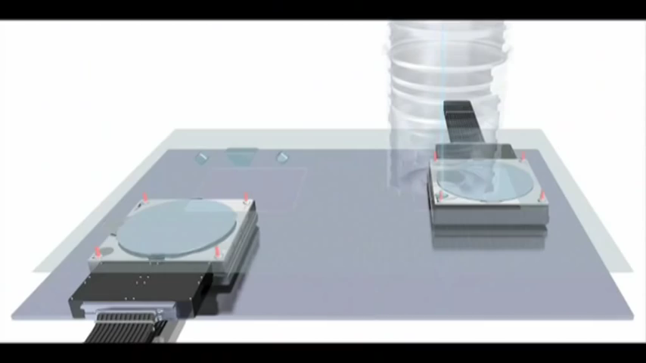

Slide 14
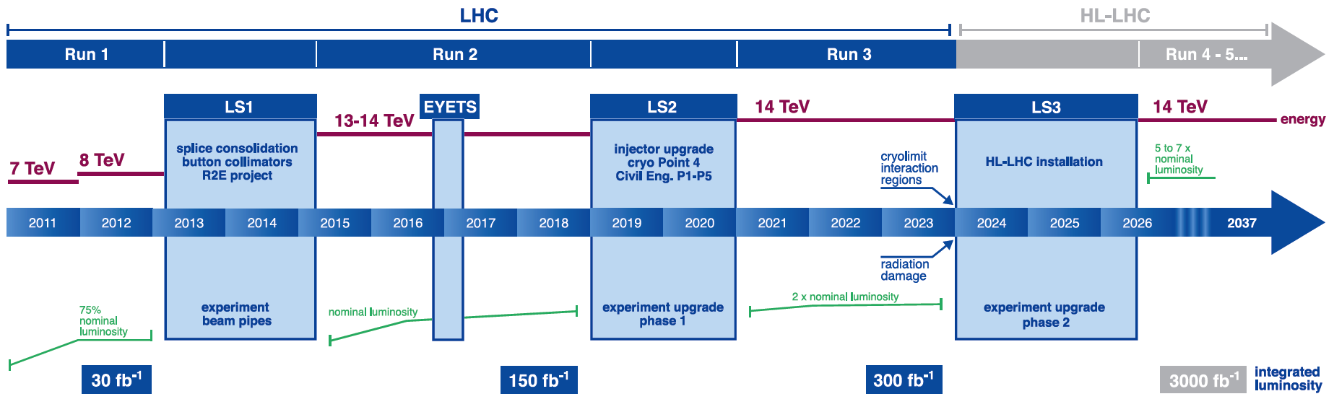
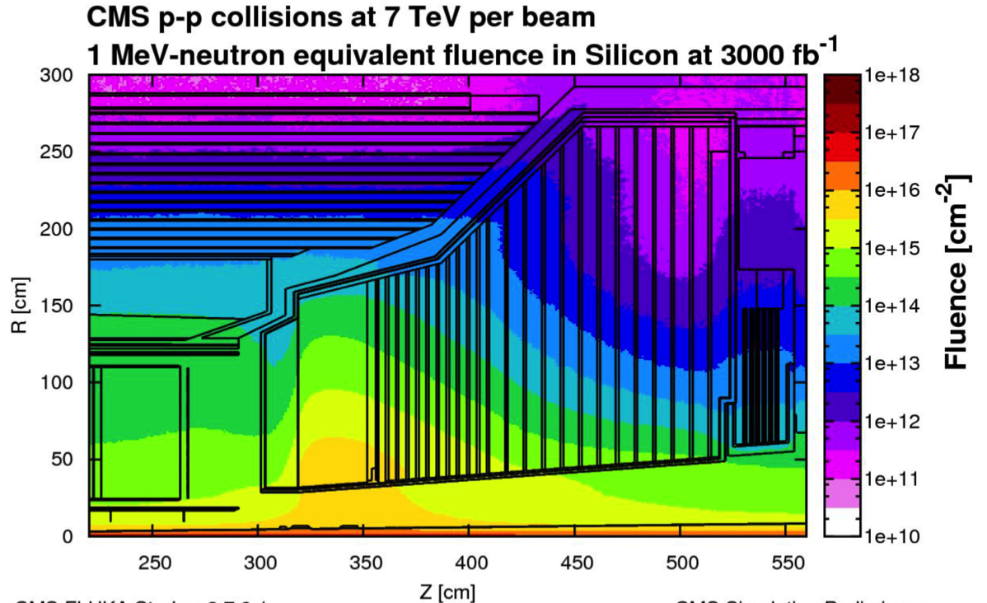
The CMS High Granularity Calorimeter for HL-LHC. (1/7)
David Barney (CERN, EP-CMX)
HL-LHC:
L = 5x10³⁴cm⁻²s⁻¹ and pileup 140, with potential for 50% higher L & pileup
Good jet identification and measurement: crucial for HL-LHC
Existing CMS endcap calorimeters cannot cope with the expected radiation or pileup @ HL-LHC
CMS @ HL-LHC:
~10¹⁶ 1 MeV n_{eq} cm⁻² @ 3ab⁻¹
in forward calorimeters,
with pileup ~200
And up to 2 MGy absorbed dose

Slide 15
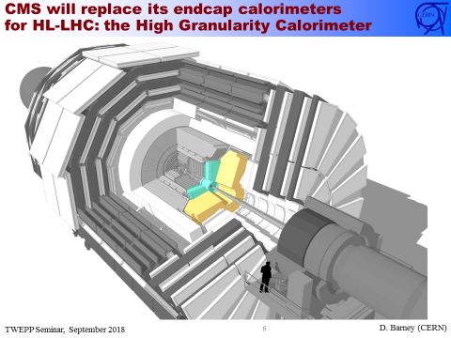
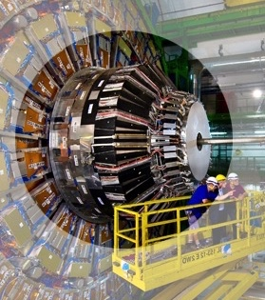
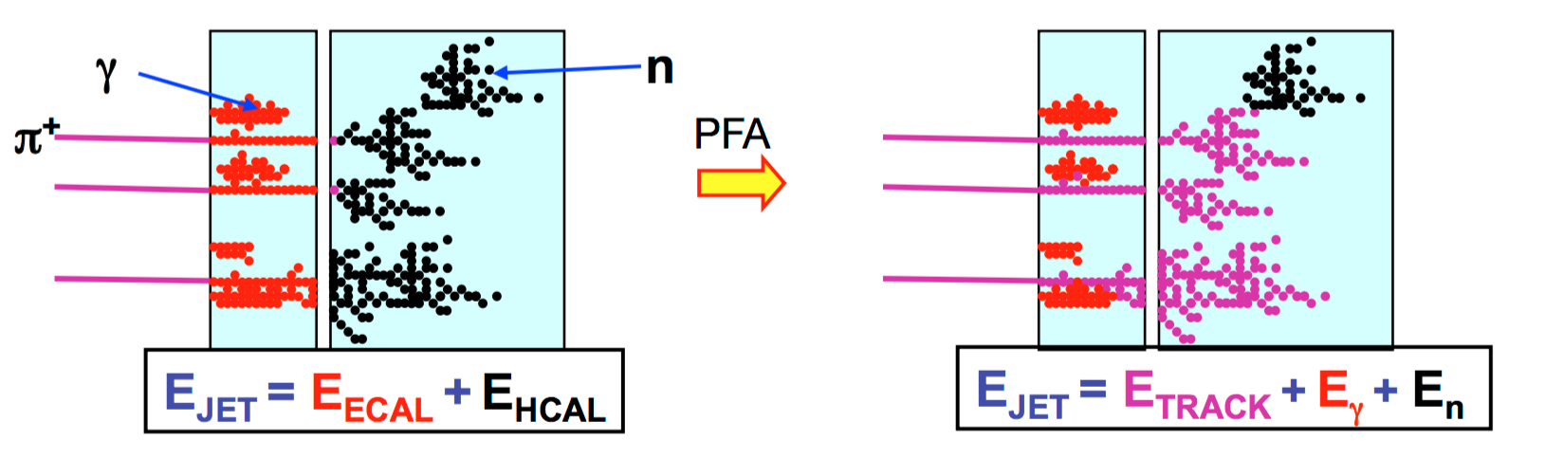
The CMS High Granularity Calorimeter for HL-LHC. (2/7)
Present CMS endcap calorimeters
HGCAL design
Precise reconstruction of each particle within the jet:
Particle Flow Algorithms and imaging calorimeters
e.g. CALICE detectors for linear colliders (CLIC, ILC),
CMS HGCAL
Granularity is more important than energy resolution
Concept: remove complete endcap calo. system and replace with HGCAL
Notes:
Previous ECAL :
Lead tungstate crystal is made primarily of metal and is heavier than stainless steel, but with a touch of oxygen in this crystalline form it is highly transparent and “ scintillates ” when electrons and photons pass through it. This means it produces light in proportion to the particle’s energy. These high-density crystals produce light in fast, short, well-defined photon bursts that allow for a precise, fast and fairly compact detector.
Previous HCAL:
The HCAL is a sampling calorimeter [see explanation below] meaning it finds a particle’s position, energy and arrival time using alternating layers of “absorber” and fluorescent “scintillator” materials that produce a rapid light pulse when the particle passes through. Special optic fibres collect up this light and feed it into readout boxes where photodetectors amplify the signal. When the amount of light in a given region is summed up over many layers of tiles in depth, called a “tower”, this total amount of light is a measure of a particle’s energy.

Slide 16
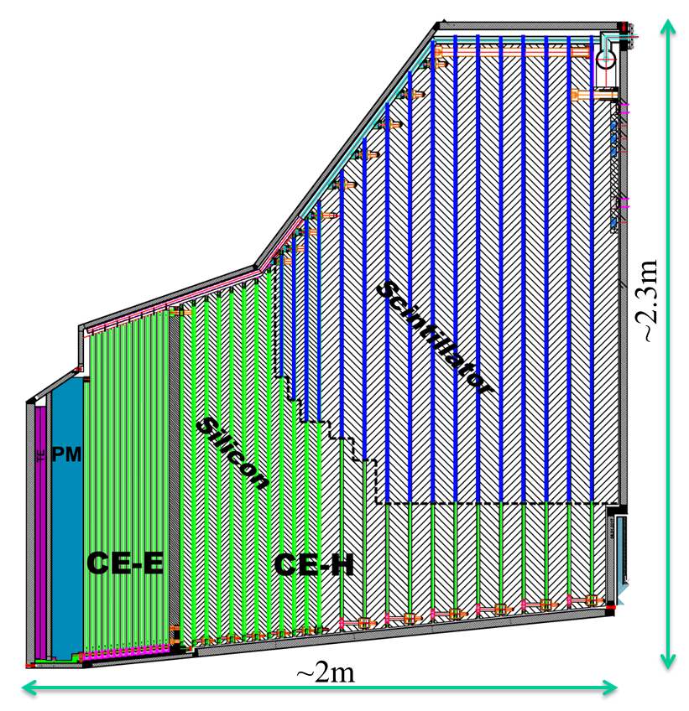
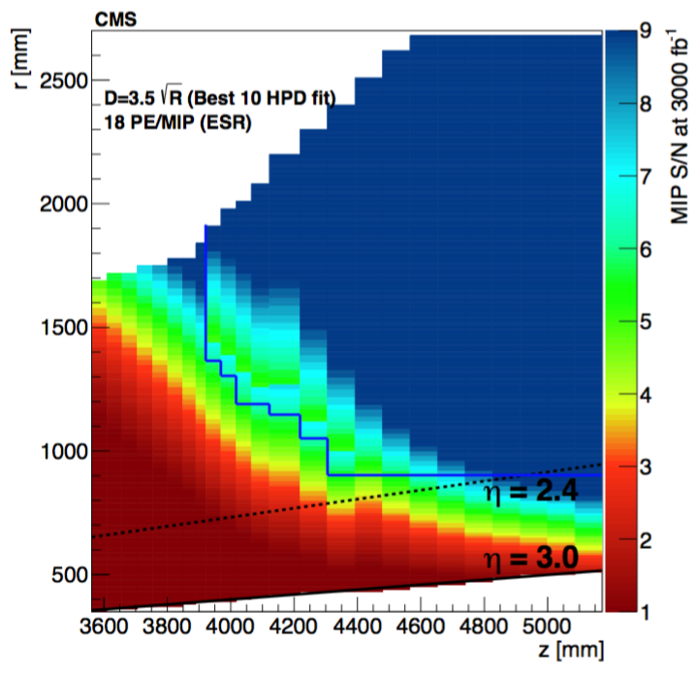
The CMS High Granularity Calorimeter for HL-LHC. (3/7)
Active Elements:
Hexagonal modules based on Si sensors
in CE-E and high-radiation regions of CE-H
Scintillating tiles with SiPM readout in
low-radiation regions of CE-H
Scintillator
Silicon
Full system maintained at -30ºC
~600m² of silicon sensors
~500m² of scintillators
6M Si channels, 0.5 or 1.1 cm² cell size
  Data readout from all layers
  Trigger readout from alternate layers
  in CE-E and all layers in CE-H
~27000 Si modules
~110 kW per endcap

Slide 17
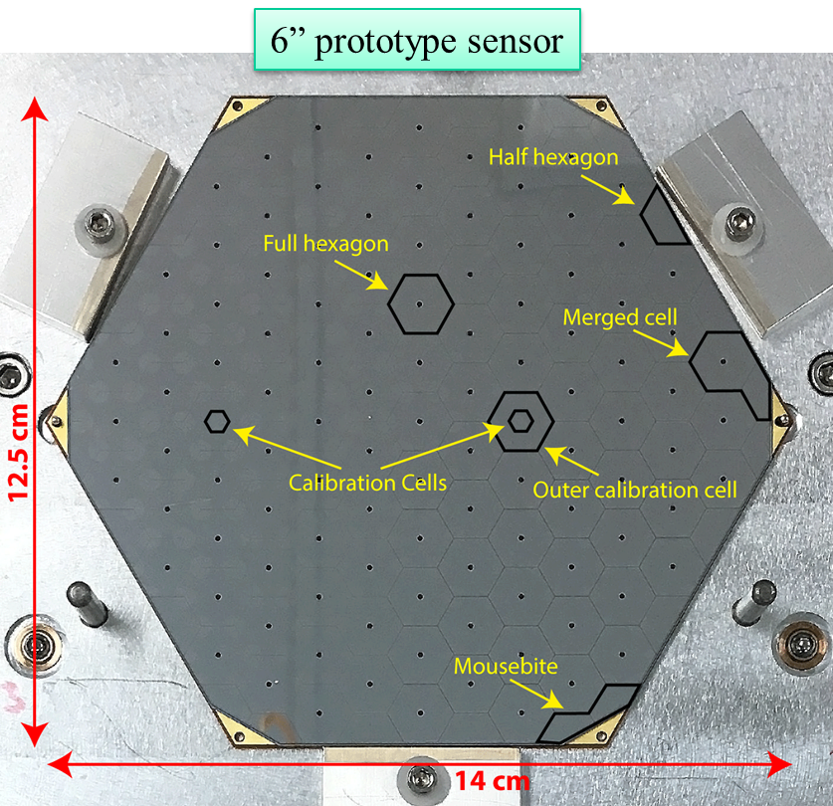
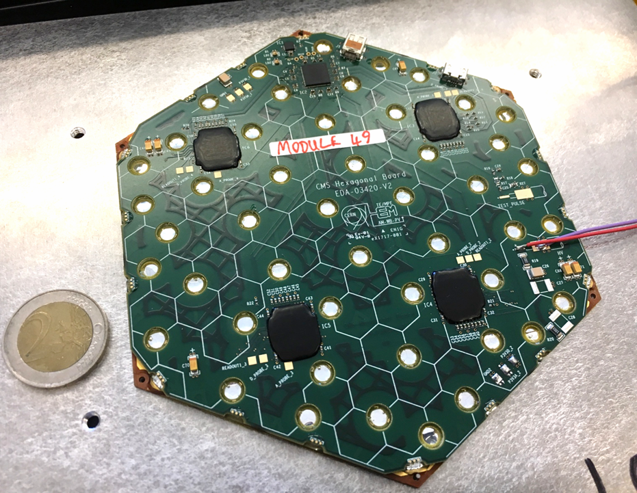
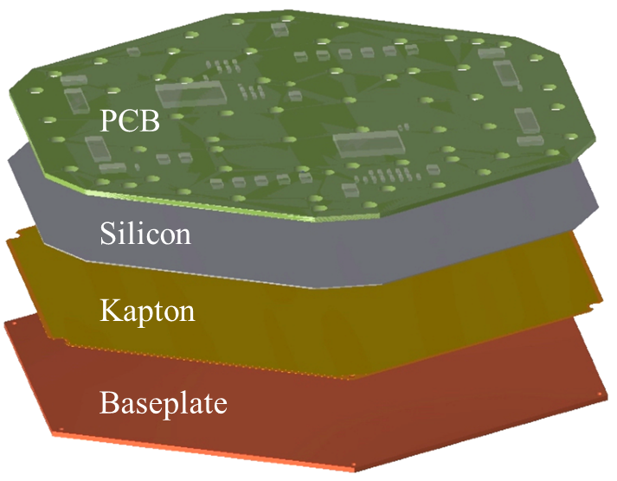
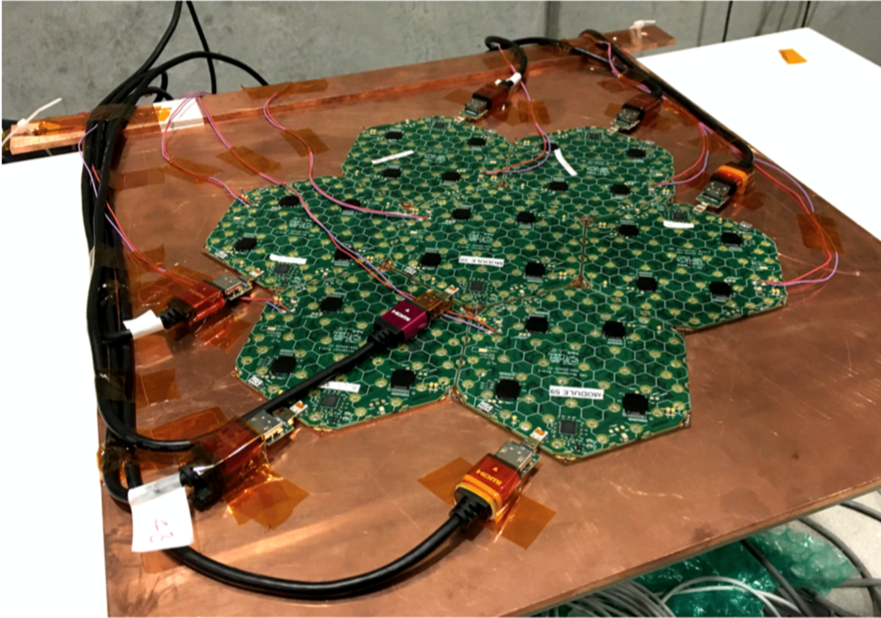
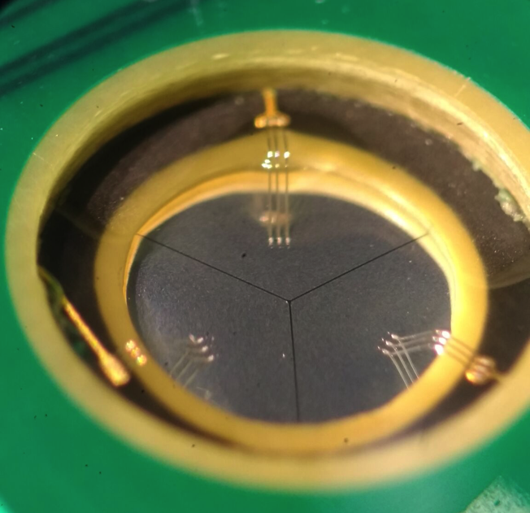
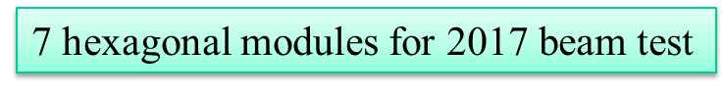
The CMS High Granularity Calorimeter for HL-LHC. (4/7)
Wire bonding from PCB to silicon through holes

Slide 18
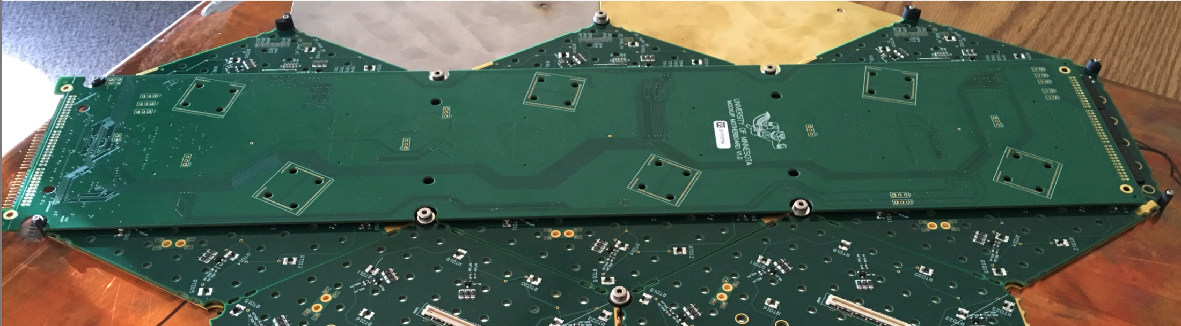
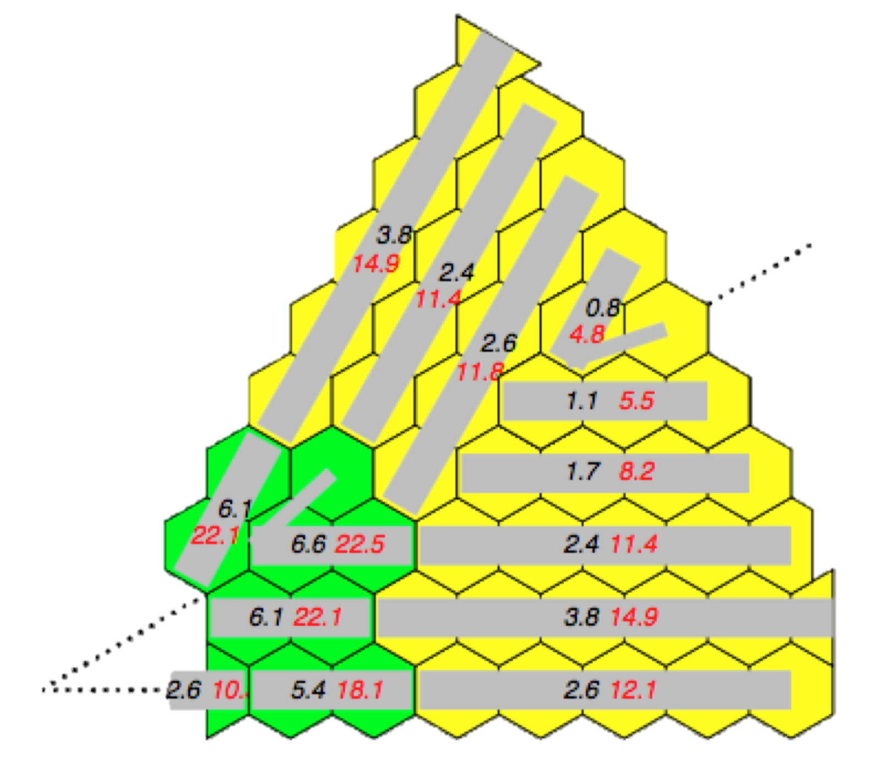
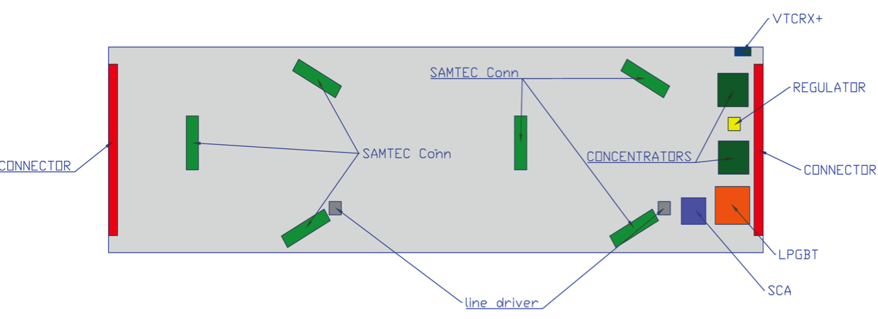
The CMS High Granularity Calorimeter for HL-LHC. (5/7)
3 modules connected to a single “motherboard” providing power, data concentrator and optical links

Slide 19
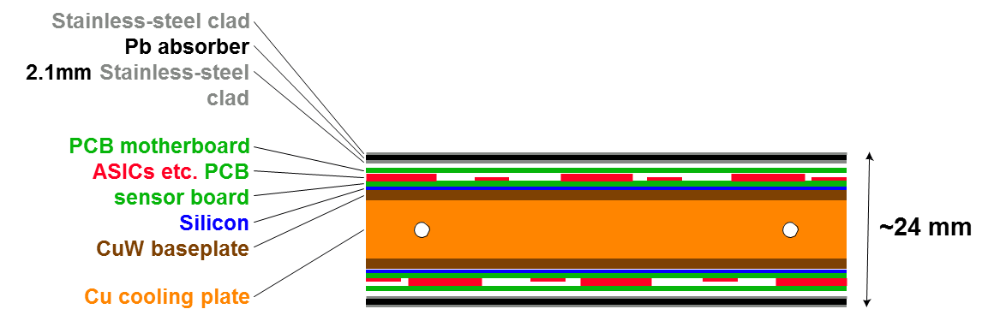
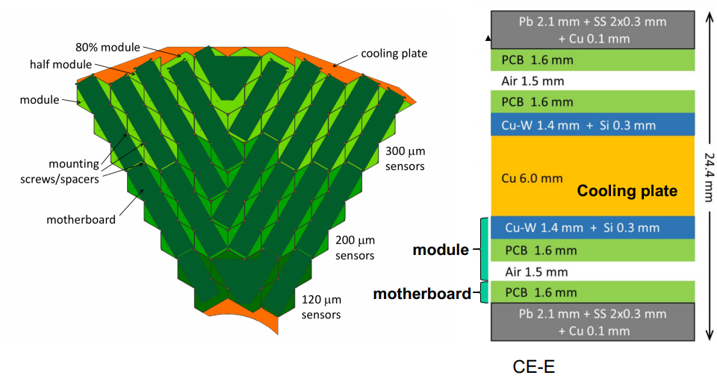
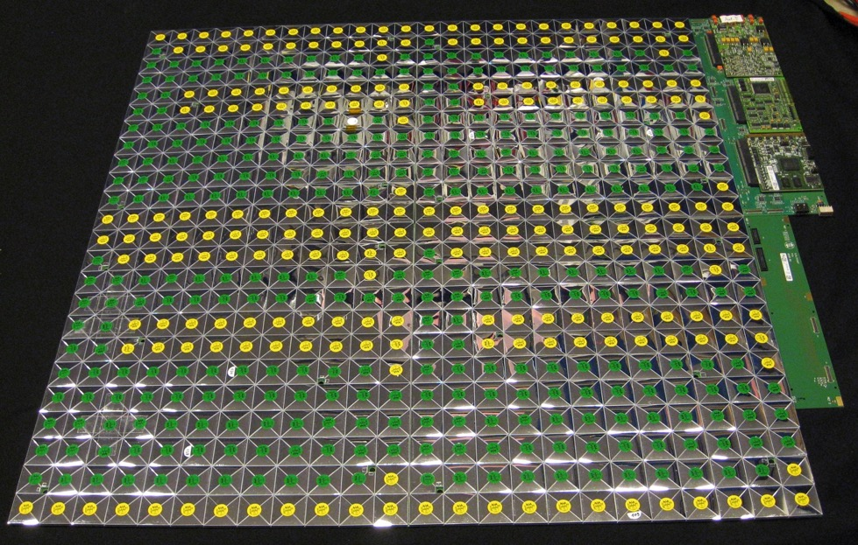
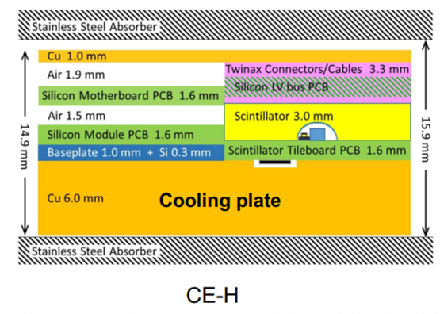
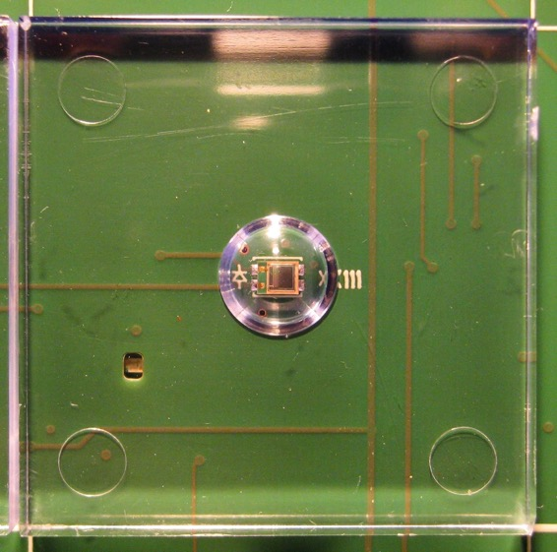
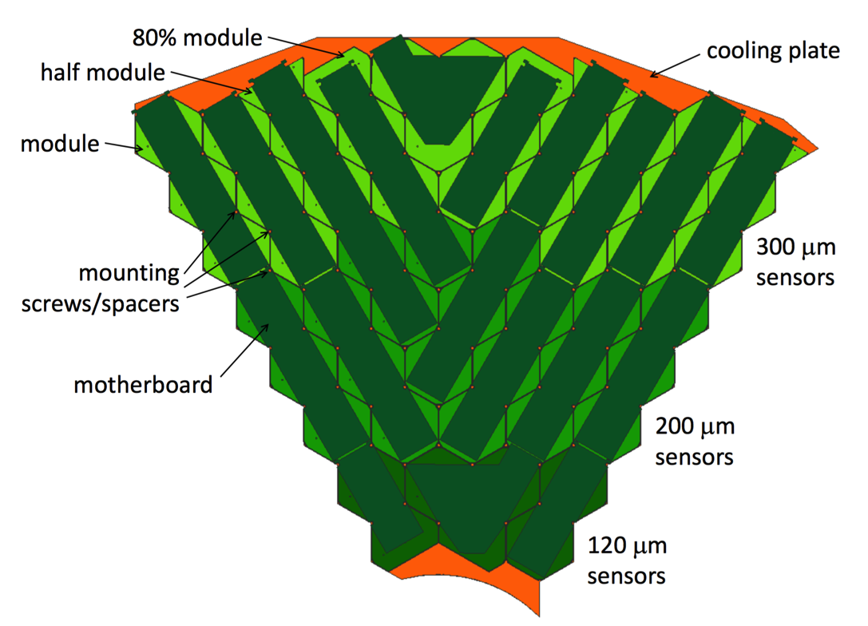

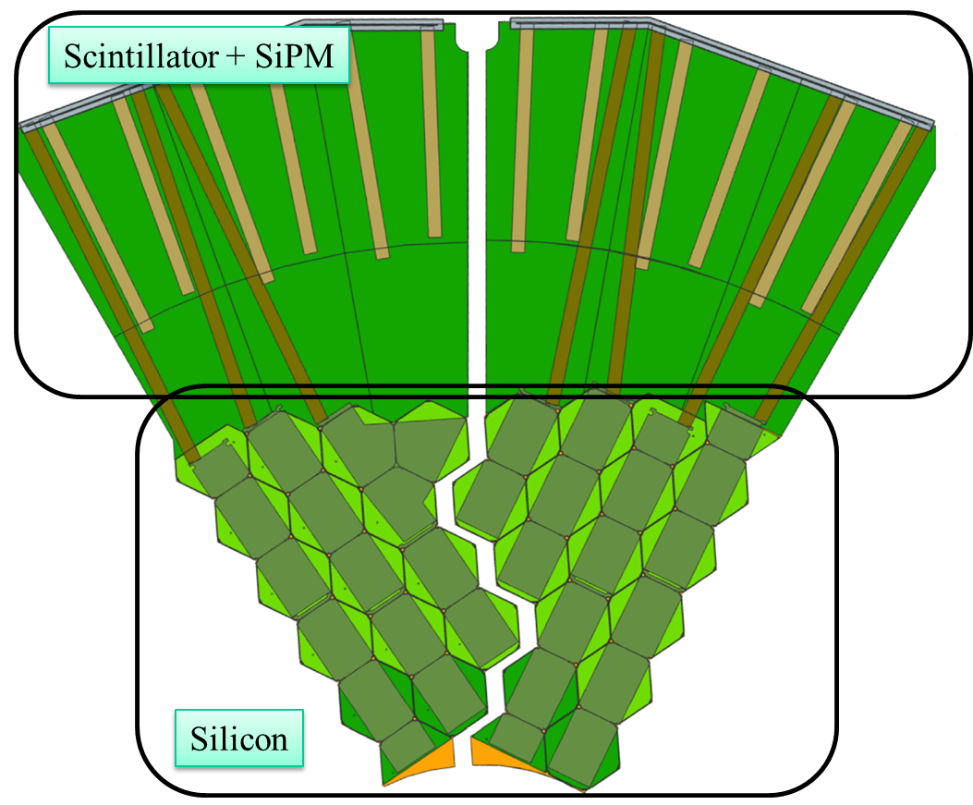

The CMS High Granularity Calorimeter for HL-LHC. (6/7)

Slide 20
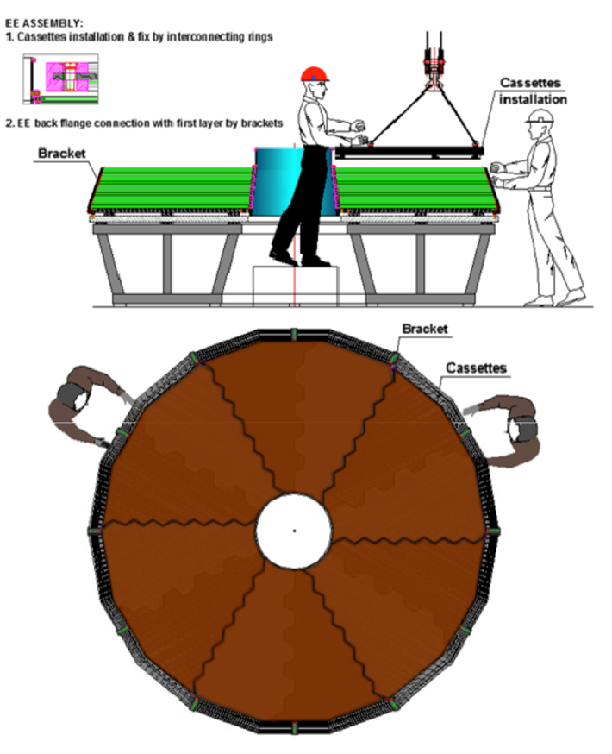


The CMS High Granularity Calorimeter for HL-LHC. (7/7)

Slide 21

SAMPIC-based systems for precise timing detectors: implementation and performance. (1/2)
Jihane Maalmi (CNRS/LAL Orsay)
SAMPIC : SAMpler for PICosecond time.
Based on the concept of “Waveform TDC” (WTDC).
SAMPIC is designed to digitize a short signal or only a small part of a longer one
(eg. rising edge) to extract timing information.
Time information is obtained combining 3 acquired time stamps:
Coarse → Counter → few ns step
Medium → DLL locked on the clk to define region of interest → ~100ps step
Fine → Digital algorithms applied on samples of the waveform → few ps
TDC
Discriminator is used only for triggering, not for timing → no jitter added on measurement, low power
Digitized waveform available to extract other parameters (Q, amplitude,…)
One Common 12-bit Gray Counter (FClk up to 160MHz) for Coarse Timestamping.
One Common servo-controlled 64-cell DLL : (from 1 to 10 GHz) used for medium precision timing & analog sampling
16 independent WTDC channels each with :
  1 discriminator for self triggering
  Registers to store the timestamps
  64-cell deep SCA analog memory
  One 11-bit ADC/ cell (Total : 64 x 16 = 1024 on-chip ADCs)
One common 1.3 GHz oscillator + counter used as time base for all the Wilkinson ADCs.
Read-Out interface
Waveform continuously recorded (circular buffer), then stopped on trigger
Main limitation is the dead time of conversion once the channel is triggered.
Only the triggered channels are in dead time.
Notes:
SAMPIC is designed to digitize a short signal or only a small part of a longer one (eg rising edge) to extract the timing.
Tested with PMTs, MCPPMTs, APDs, SiPMs, fast Silicon Detectors, Diamonds.
ps timing resolution can be reached by sampling signals with ultra-fast digitizers => this generates a huge local data rate at the ADC output (>>10Gbps) => expensive, complex and power consuming electronics.
Ultrafast analog memories using Switched Capacitor Arrays (SCA) can solve this problem under certain conditions/scenarios but their readout dead-time may be a limitation.
TDCs, used for timing measurement, reduce drastically the dataflow, but do not provide information on waveform .
Classical TDCs are based on DLLs, which usually are limited by stability of calibration. Additionally, another limitation is that they require a digital input, and therefore require an extra discriminator (Anal => Dig). The discriminator introduces jitter and suffers from residual time walk (=dependency of timing with signal amplitude). Typical TDC resolution are in the order of 20ps.
Digital algorithms used => Constant Fraction Discriminator (CFD) and Cross-Correlation (CC)

Slide 22




SAMPIC-based systems for precise timing detectors: implementation and performance. (2/2)
Several trigger modes programmable for each channel:
External
“Central” trigger (only OR in V1)
Edge selection
Enable/disable
Internal/external threshold
Posttrig (0,1,2 elementary delays)
Fast Global Enable for common deadtime
TRIGGER
RAMP ADC
@ Trigger: simultaneous digitization of all the cells of all the triggered ch.
Ramp slope is tunable: speed/precision tradeoff => 1.6µs for 11bits down to 100ns for 7 bits => main contribution to the Dead Time
Module with several mezzanines (32/64/256-channels) + software and C libraries available
Notes:
Channels can be combined through triggering methods to increase slightly memory depth.
3dB input BW of ADC: 1.6 GHz
ADC precision : configurable between 7-11 bits (trade-off time vs resolution)
Input dynamic range: 1V
Timing precision: 15ps RMS before calibration and <5ps after calibration.
Ex: Measuring time between 2 pulses with 2.5ns distance, 1ns FWHM after TINL correction : ~3.5ps
Maybe interesting for some particular application that can withstand the dead time of a few us and so little number of samples.

Slide 23



The proton timing system of the TOTEM experiment (1/2)
Edoardo Bossini (CERN)
On each arm:
• 4 tracking RP equipped with TOTEM strip detectors (210 and 220 m from the IP)
• 2 timing RP equipped with UFSD and readout with the SAMPIC chip
Reconstruction of primary vertex, they require to measure the p-p TOF in the two arms with a resolution of ~50ps
Notes:
Ultrafast Silicon Detector (UFSD), based on LGAD technology.
The SAMPIC is a 16 channel ASIC which can perform a fast sampling of the input signal, up to 8.4 GSa/s.

Slide 24


The proton timing system of the TOTEM experiment (2/2)
SAMPIC:
16 channel/chip
Up to 64 sample/hit @ 10 GSa/s
1.5 GHz bandwidth
8-11 bit resolution
0.25-1.6 µs channel dead time
Notes:
Ultrafast Silicon Detector (UFSD), based on LGAD technology.
The SAMPIC is a 16 channel ASIC which can perform a fast sampling of the input signal, up to 8.4 GSa/s.

Slide 25


Charact. of the 65nm pixel readout ASIC with on-chip quick transverse momentum discrimination capabilities. Davide Ceresa (CERN)
Phase-II upgrade of CMS Outer Tracker requirements:
• Increase granularity → Introduction of a pixelated sensor
• Increase radiation tolerance → Radiation tolerance up to 100 Mrad
• Participate in the L1 trigger → Quick and on-chip particle discrimination
• Improve trigger performance → Higher trigger rate and longer latency
• Reduction of material budget → Power density < 100 mW/cm2
Notes:
Phase II -> After LS3.

Slide 26





Radiation tolerance enhancement of silicon photonics for HEP applications. (1/3)
Andrea Kraxner (CERN, EP-ESE)
Laser based transceivers reach their limit after HL-LHC and no optical links possible so far at the innermost pixel
detectors and parts of the endcap calorimeter.
Notes:
Silicon photonics is the study and application of photonic systems which use silicon as an optical medium.
Silicon photonic devices can be made using existing semiconductor fabrication techniques, and because silicon is already used as the substrate for most integrated circuits, it is possible to create hybrid devices in which the optical and electronic components are integrated onto a single microchip.
It is being actively researched by many electronics manufacturers including IBM and Intel, as well as by academic research groups, as a means for keeping on track with Moore's Law, by using optical interconnects to provide faster data transfer both between and within microchips.
Silicon is transparent to infrared light with wavelengths above about 1.1 micrometres. Silicon also has a very high refractive index, of about 3.5. The tight optical confinement provided by this high index allows for microscopic optical waveguides, which may have cross-sectional dimensions of only a few hundred nanometers. Single mode propagation can be achieved, thus (like single-mode optical fiber) eliminating the problem of modal dispersion.

Slide 27




Radiation tolerance enhancement of silicon photonics for HEP applications. (2/3)
Proposal for a Silicon Photonics optical Transmitter

Slide 28


Radiation tolerance enhancement of silicon photonics for HEP applications. (3/3)
Very resistant against displacement damage BUT strong degradation due to ionization
No degradation up to 3 MGy →
Compensation of irradiation effect during irradiation
Notes:
Conclusions and future work
• A very efficient annealing method for MZMs was introduced by applying a forward bias to the devices during or after irradiation
• By performing re-irradiation tests of recovered devices a complete recovery was proven
• SiGe photodiodes used in standard SiPh processes showed no significant degradation due to displacement damage or TID
• Due to the quite high power consumption of MZMs, Ring Modulators should be investigated as power saving alternatives : similar design -> similar behavior to radiation?
• Development of first transmitter and receiver prototype to test system

Slide 29




Next generation of radiation tolerant Single-Mode Optical Links for Accelerator Instrumentation. (1/2)
Carmelo Scarcella (CERN, EP-ESE)
BE-BI roadmap for project requiring RH HS optical links
Single-mode Versatile Link Transceiver
VTRx
Front-End pluggable module
Receiver:
• COTS InGaAs Photodiode
• Transimpedance amplifier GBTIA v3
Transmitter:
• COTS Edge emitter DFB laser
• Laser driver GBLD v4.2
TOSA Displacement damage test :
SM TOSAs exposed to neutron beam at UC Louvain facility
Irradiation with fluence up to 5 x 10¹⁴ n/cm² 20 MeV neutrons
Output optical power decreases due to threshold current rising
Best in class with optical power drop of 40 % at 40 mA bias current
Notes:
TOSA : transmitter optical sub-assembly. It consists of a laser diode, optical interface, monitor photodiode, metal and/or plastic housing, and electrical interface.
ROSA : receiver optical sub-assembly. It consists of a photodiode, optical interface, metal and/or plastic housing, and electrical interface.
BOSA : Bidirectional Optical Sub-Assemblies. It consists of a TOSA, a ROSA and a WDM filter so that it can use bidirectional technology to support two wavelengths on each fiber.
TOSA TID test: Irradiated with Gamma rays (Cobalt-60) to 10 kGy -> No induced loss due to darkening of passive optical components
Next steps:
Displacement damage characterization of CWDM TOSAs
Radiation tolerance validation of WDM MUX and DEMUX
Defining final link architecture
Moving towards parts procurement and production

Slide 30


Next generation of radiation tolerant Single-Mode Optical Links for Accelerator Instrumentation. (2/2)
Notes:
OMA = Optical Modulation Amplitude of a signal is an important parameter that is used in specifying the performance of optical links used in digital communication systems.
The OMA directly influences the system bit error ratio (BER). With an appropriate point of reference (such as average power), OMA can be directly related to extinction ratio (re).
OMA = P1 – P0
Pavg=(P1+P0) / 2
re = P1/P0
OMA and extinction ratio by themselves are relative quantities, since they only specify the difference or ratio of the power levels. In order to derive an absolute quantity from the OMA or extinction ratio, we must have an additional point of reference (e, such as PAVG, P1, or P0).
In eyediagrams, Pavg = half the eye heigh.
P1 and P0 are the high and low levels of the eye.

Slide 31


System level serial powering studies of RD53A chip
A. Pradas (ITAINNOVA)
Serial powering is the baseline choice for CMS and ATLAS detectors for HL-LHC era.
It is based on a Shunt-LDO.
The total current across each module is always constant, independently of the load current → constant power consumption → minimum current head-room is needed
A current source is used to feed each serial chain
Each Chip has 2 SLDO regulators : 1 for analog domain + 1 for digital
The paper presents measurements and simulations about the impact of different parasitics (inductance of PCB tracks, wire-bonds to IC), transient propagations among Cis, etc.
Notes:
Atlas and CMS readout chip (ROC), must be supplied with significant current levels ( ~2A per chip).
Studies have shown that a serial power distribution system is the only feasible scheme to supply the pixel detector with the required power within an acceptable material budget and power cable losses.
Serial powering topology has never been used in any high-energy physics experiment, and so it is being exhaustively simulated and tested using different prototypes.

Slide 32



Nuclear structure research and applications with Radioactive Ion Beams at ISOLDE/CERN.
Riccardo Prof. dr. Raabe (KU Leuven) – no slides or paper will be available
Presented several lines of research of the Institute for Nuclear and Radiation Physics at the KU Leuven, at ISOLDE.
ISOLDE = Isotope mass Separator On-Line Device. Largest range of radioactive beams available worldwide.
COLLAPS is the COLlinear LAser SPectroscopy beam line located at ISOLDE. Powerful tool to measure ground state properties (nuclear spins, magnetic moments, quadrupole moments and mean-square charge radii, etc) of short-lived isotopes far from stability, the so-called exotic nuclei. Laser light with a very precise wavelength is used to induce electron-transitions in atoms or ions.
MEDICIS (Medical Isotopes Collected from ISOLDE) : Production and shipping of radioisotopes to clinical and research
centers to enable researchers to devise and test unconventional radioisotopes with a view to developing new cancer
treatments.
Notes:
COLLAPS: hyperfine splitting (HFS) or isotope shifts (IS), the nuclear spins, moments and charge radii can be extracted.

Slide 33
Others…
Implementing the High Precision Timing IP for Xilinx Ultrascale FPGA’s (E. Mendes, CERN)
Interesting recipes to setup the GTH transceivers for Kintex Ultrascale so that they start with fixed-phase after link start-up.
https://gitlab.cern.ch/HPTD/tx_phase_aligner
Introduction to the LpGBT-FPGA (J.M. Mendez, CERN)
The new FPGA IP implements the encoding/decoding schemes supported by the front-end ASIC, meaning that it can be configured using two decoding schemes and two line rates (10.24 or 5.12Gbps). The LpGBT-FPGA is not anymore given as a generic module that can be implemented in one block. It is now proposed as a set of modules with implementation example and reference notes to help the user in designing its own system. The “Mgt” block is not included in the LpGBT-FPGA folder as it is device and user dependant. However, reference notes are provided to show the typical / recommended configuration for different FPGAs.
http://lpgbt-fpga.web.cern.ch/doc/html/
Fast Inference of Deep Neural Networks in FPGAs for Particle Physics (J. Duarte, Fermilab)
Implementation of machine learning methods (neural network models) into FPGA to identify b-quark jets, Higgs candidates, etc. They develop hsl4ml translates ML models from common open-source software packages into RTL abstraction for FPGAs using High-Level Synthesis (HLS) tools. (arXiv:1804.06913, hls-fpga-machine-learning.github.io/hls4ml)
2 tutorials:
  SERDES Design in Advanced CMOS Technologies (MIROMICO)
  lpGBT, a user's perspective (Paulo Moreira, CERN)

Slide 34
Thank you

