Slide 1
CERN and Tape Carousel
HEPiX Tape BoF, Fall 2018
Germán Cancio – CERN IT/ST

Slide 2
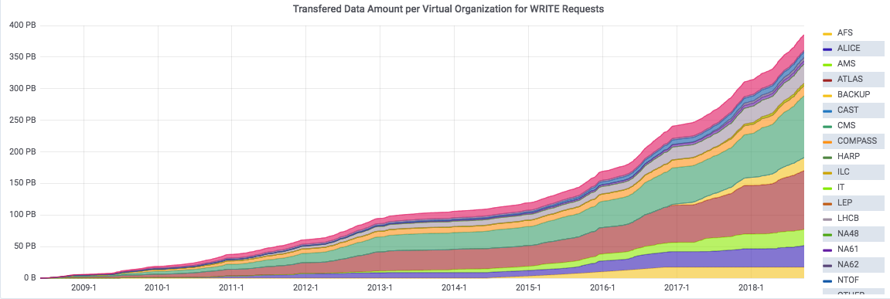
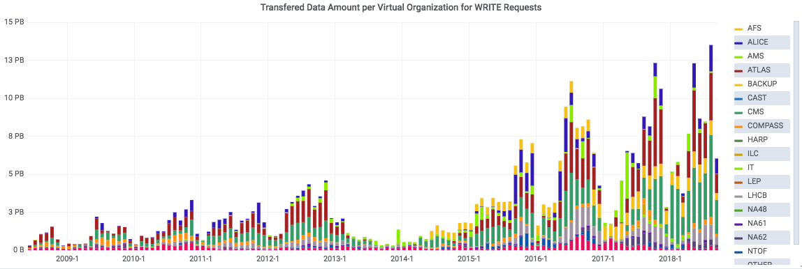
CERN Archive current numbers
Total data to CASTOR tape, 2008-2018
Data:
300 PB physics data – CASTOR
Tape libraries:
IBM TS3500/4500 (5)
Oracle SL8500 (4)
Tape drives (~100):
TS1150/55 + T10000D + LTO8
Capacity:
~35 000 tapes
~70 000 slots (up to ~800PB)
Monthly data to CASTOR tape, 2008-2018

Slide 3
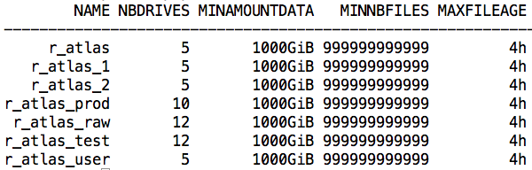
CASTOR mechanisms – writing to tape
Data is structured in “file classes” and “tape pools”
  A file belongs to a file class that goes to a tape pool
  Keep e.g. AOD separated from RAW
Data is written as quasi-FIFO to tape
  De-facto random scheduling from disk cache to tape, but within short lifespan (hours)
Maximum number of drives per tape pool for writing -> control throughput and collocation spread
  Overbooking total #drives, but hard dedications of drives to VO’s possible
“Intelligent traffic light” policies
  Do not mount a tape before thresholds are reached (volume, #files, age)
  Allows to increase #files / volume per mount
Small files not a problem -> “immediate / buffered file marks” -> using MTWEOFI which we prototyped in Linux kernel…

Slide 4
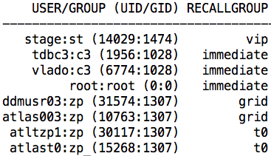
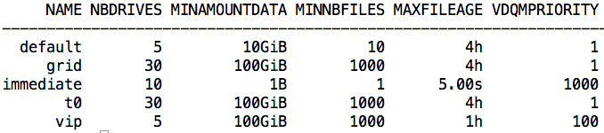
CASTOR mechanisms – reading from tape
Writing has always priority
Priorities and maximum number of drives for reading
  based on user/group, not on file class+tape pool
  Overbooking total #drives, but hard dedications of drives to VO’s possible
“Intelligent traffic light” policies
  Do not mount a tape before thresholds are reached (volume, #files, age)
Small files are a problem.. read positioning in general is a growing problem
  Capacity of tapes increasing faster than avg file sizes -> more files / tape, less parallelism reading
  The bigger the files, the better as less positioning operations required!
  Support for Recommended Access Order (RAO) – enterprise tape only
  LTO equivalent (cf my presentation this morning) will be implemented for CTA (future CASTOR replacement)

Slide 5
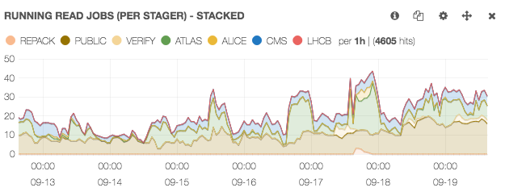
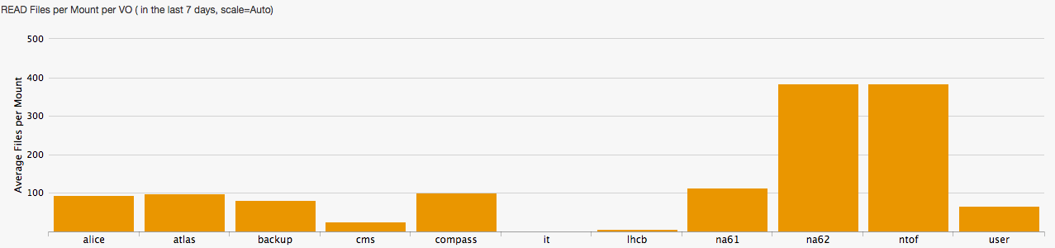
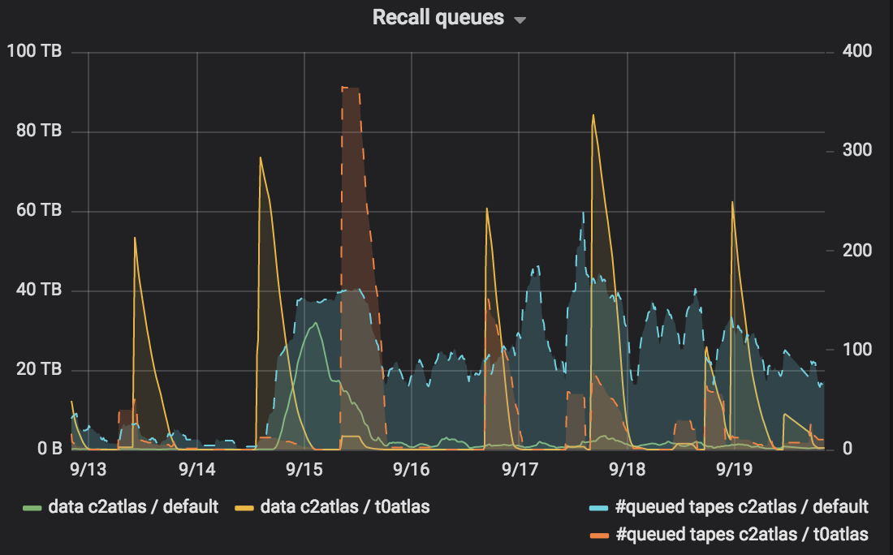
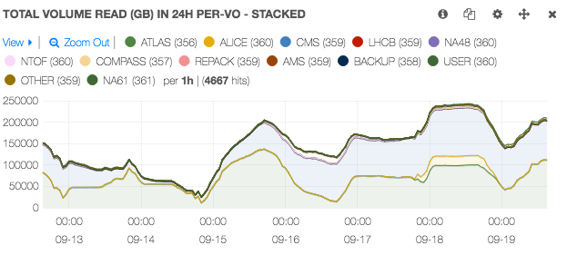
A typical ATLAS recall week… as seen from CASTOR
Files per read mount per VO

Slide 6
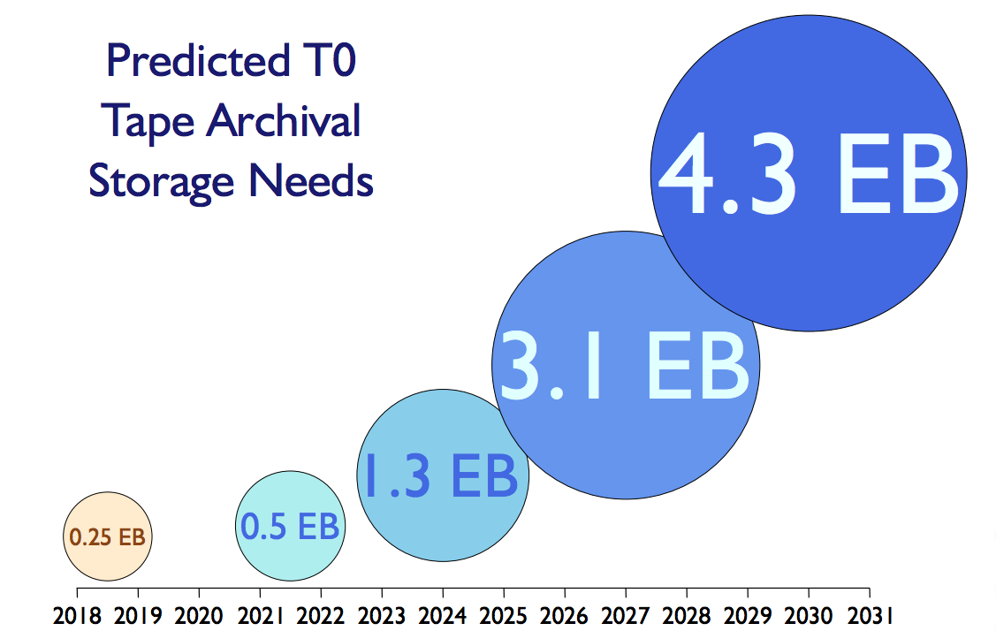
Changing Use Cases for Archival Storage
Scaling up for Run 3 and HL–LHC

Slide 7
Best of two worlds: from CASTOR to EOS+CTA
CASTOR: tape layer rewritten recently but stager design dating from early 2000s
  New functionality difficult to add; maintenance concerns
Many duplications and overlaps with EOS
  Access protocols
  Authentication / Authorisation
  Disk pool management
  File Catalogue
CERN Tape Archive (CTA) offers the “Best of Both Worlds”: EOS and CASTOR tape
  User interface, file access and disk pool management from EOS
  Tape system management from CASTOR
  New scalable, robust queuing system to link the two
  CTA focused on tape access and staging - optimising drive usage and performance - rather than on providing HSM
  Efficiency enhancements eg. library / drive / tape access optimisations
CTA design principles
  Simplicity
  Scalability
  Performance

Slide 8
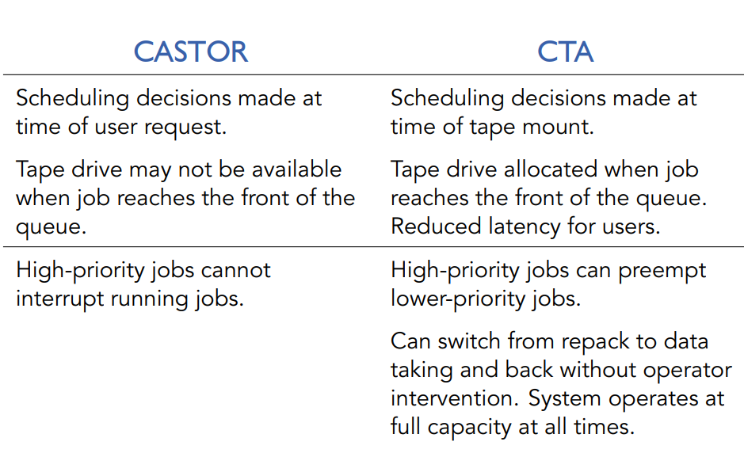
CTA vs CASTOR

