Slide 1
1st Meeting IAC – MEDICIS Promed final conference
Agenda:
Introduction on MEDICIS-Promed
Final conference
IAC input
LOC Committee – 07-Dec 2018

Slide 2
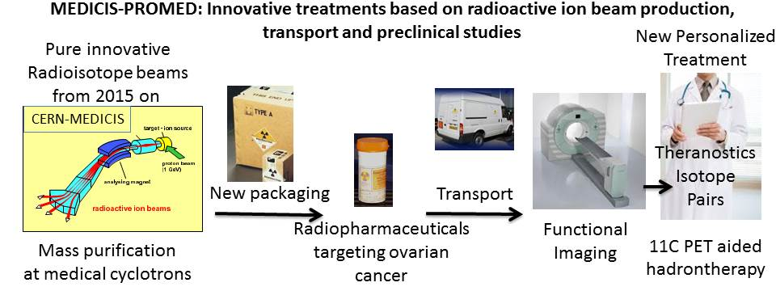

Overview of MEDICIS-Promed (1st Apr 2015 - 30st March 2019)
Medical coordination : PhD, MD J. Prior, CHUV

Slide 3
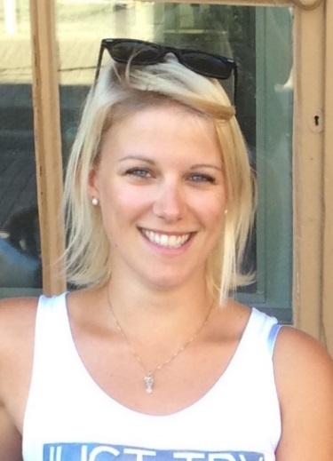
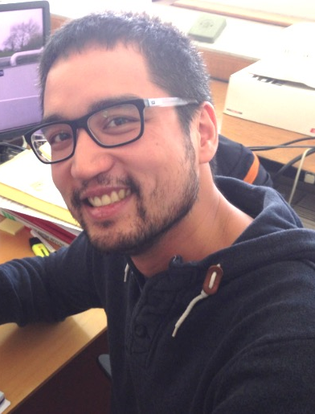
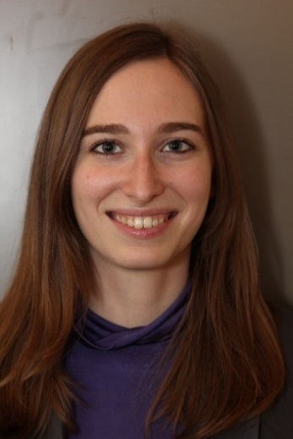
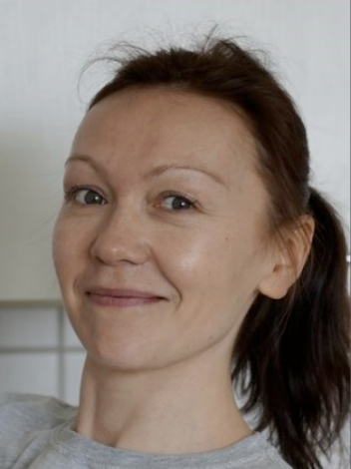
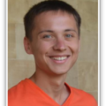



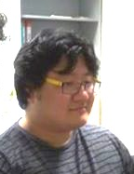
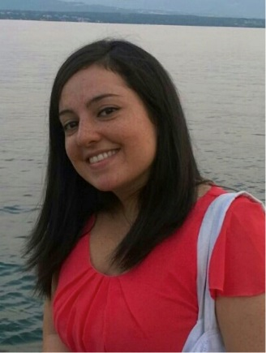
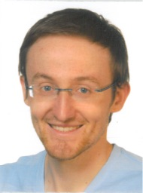

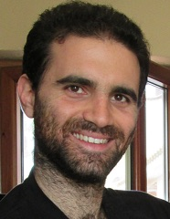
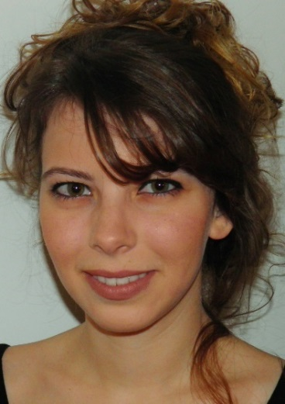
Students in the network
1 | Ringvall-Moberg | Annie | SWE | CERN | EU | Academic | 01.06.2016 | 29.03.2019 | 7 | University of Gothenburg June 2016
2 | Vuong | Nhât-Tân | CH | CERN | EU | Academic | 01.01.2016 | 01.01.2019 | 12 | EPFL May 2016
3 | Pitters | Johanna | AT | CERN | EU | Academic | 01.10.2015 | 01.10.2018 | 15 | TU Vienna October 2016
4 | Nazarova | Marina | RU | UNIMAN | UK | Academic | 12.11.2015 | 12.11.2018 | 13.5 | UNIMAN November 2015
5 | GADELSHIN | Vadim | RU | JGU Mainz | DE | Academic | 15.01.2016 | 15.01.2019 | 11.5 | JGU Mainz August 2016
6 | FORMENTO | Roberto | IT | AAA | FR | Non-academic | 08.02.2016 | 08.02.2019 | 11 | Uni. Nantes May 2016
7 | CHOWDHURY | Sanjib | IN | C2TN | PT | Academic | 01.01.2016 | 01.01.2019 | 12 | IST January 2016
8 | D'ONOFRIO | Alice | FR | C2TN | PT | Academic | 02.11.2015 | 02.11.2018 | 14 | IST February 2016
9 | CHOI | KyungDon | KR | CNAO | IT | Academic | 12.11.2015 | 12.11.2018 | 13.5 | Uni. Pavia October 2016
10 | MAIETTA | Maddalena | IT | LEMER PAX | FR | Non-academic | 20.10.2015 | 20.10.2018 | 14.5 | Uni. Nantes January 2016
11 | STEGEMANN | Simon | DE | KULeuven | BE | Academic | 01.06.2016 | 29.03.2019 | 7 | KULeuven June 2016
12* | LITVINENKO | Alexandra | RU | UNIGE/HUG | CH | Academic | 01.12.2016 | 29.03.2019* | 1 | UNIGE 2017
13* | CICONE | Francesco | IT | CHUV | CH | Academic | 15.10.2015 | 15.10.2018* | 14.5 | UNIL November 2015
14* | PRIONISTI | Ioanna | GR | UNIGE/HUG | CH | Academic | 01.01.2017 | 29.03.2019* | 0 | UNIGE 2017
15* | FAM | Thhe Kyong | UA | EPFL | CH | Academic | 01.08.2015 | 01.08.2018* | 17 | EPFL August 2015
Karateev Grigory RU 21.03.2017

Slide 4
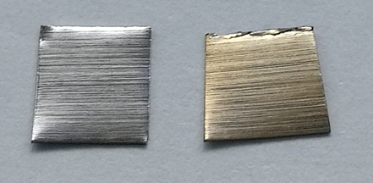

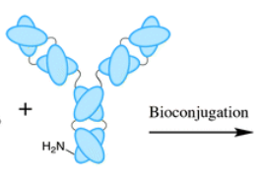
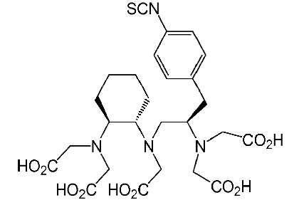
Some results from R&D projects
120MBq Auger ¹⁶⁵Tm >99%
Produced/delivered in 24hr
From MEDICIS
Target
Graphene coated Tantalum targets
Comparison of
in-beam PET with fragment 12C (11C, 15O)
and direct 11C use
¹¹¹In-CHX-A’’-DTPA-FcTEM1
and
¹⁵²Tb-CHX-A’’-DTPA-FcTEM1

Slide 5
Final Conference
Final conference 30st April-4th May 2019, Erice
(1st Flyer distributed)

Slide 8
Input From IAC
Distribution of the conference announcement
Program of the conference : thematic days, cross disciplinary by essence
Mix of network presentations and regular conference
Invited talks: covering the scientific topics : this is an urgent topics !
Conference web site under construction : indico link to be sent
Abstract submission : format, review, etc
AOB, next meeting

