Slide 1

Inside GOC
Soichi Hayashi
Software Engineer

Slide 2
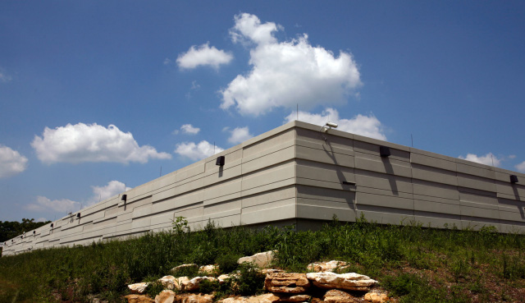
Hardware
VM Hosts
  Production (B-town & Indi)
  Dev & ITB (B-town)
LDAP Server (389)
Internal.grid.iu.edu
  VM Install scripts / data
  Service soft-backup
IU Services
  SVN, Footprint, etc..

Slide 3
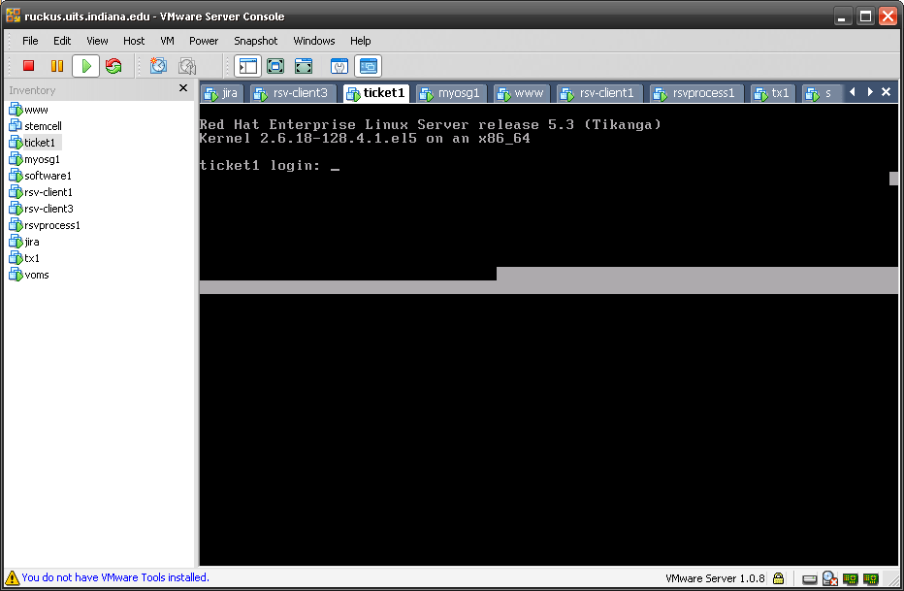
1 Service = 1 machine

Slide 4
Backup
Soft Backup (/usr/local/backup @internal)
  MySQL Replication
  All transitory files are periodically synced
  Key configuration files are also synced
Hard Backup
  TSM backup system running on internal

Slide 5
VM
Most services are redundant (DNS RR-ed)
  Wget access secondary service if one is failing
  Load balancing / “Higher” failure tolerance
  No HA at this point
“Stemcell”
  Default GOC node with DHCP, LDAP, etc
  Master Install Script
    Service Install Scripts
      Download files / configs, then run install script
      Pulls softback data from internal.grid

Slide 6
Install Script
Installs everything to setup a certain GOC service
Updated when service machine is updated

Slide 7
Software Development
Nothing fancy.. Really… (sorry!)
PHP/Python for POC, Java for production
  MyOSG (PHP, MySQL, Java, Google Chart, Python, jQuery)
  OIM (Java, MySQL, DivRep)
  GOC Ticket (PHP, SOAP, MySQL, jQuery)
  Others stuff in scripting languages

Slide 8
DivRep Framework
Simple user interface framework for Java
Easy to learn, easy to implement
  In academic environment, not everyone is software engineer
  Minimizes the required knowledge
  Build stuff using what they know
    Basic Java, Basic HTML, Bit of Servlet
  Secret is in “Replacing Content”
    Sacrifices bit of responsiveness for
    Greatly simplified development / testing
DivRep Framework
DivRep Components
MyOSG / OIM Application

Slide 9
Contact
hayashis@indiana.edu

