Slide 1
Usage of Volatile Pools in Belle-II
Dr. Silvio Pardi
INFN-Napoli
DOMA / ACCESS Meeting
CERN -27/12/2018

Slide 2

SCoRES Project
Goal of the activity is to setup and test an HTTP Caching system and investigate how to integrate it in the HEP computing model. Pilot experiment is Belle II.
Activities are carrying on in the context of a project funded by GARR within a National call consisting in a 2Year fellowship.
Davide Michelino - project fellowship
Silvio Pardi – Project Tutor for INFN-Napoli

Slide 3
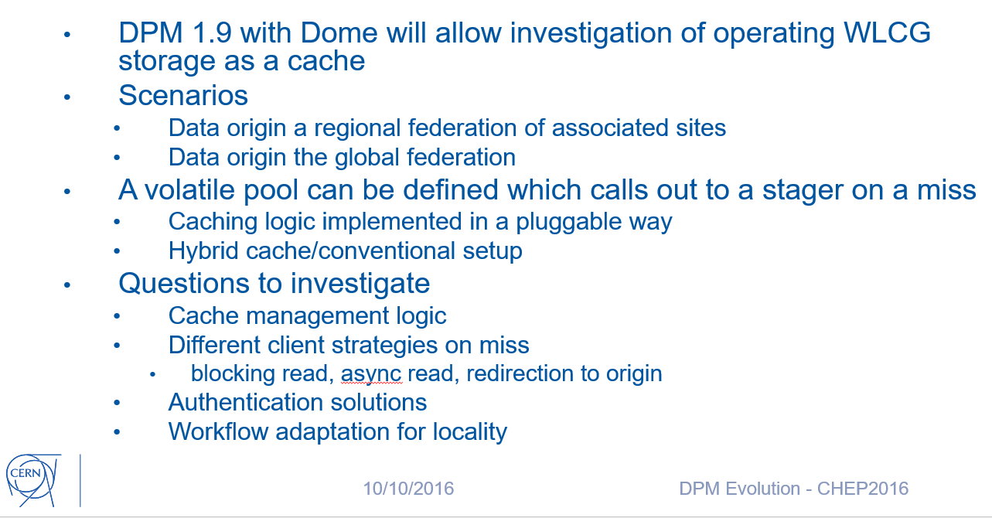
Caching laboratory with DPM
CHEP 2016
We are trying to answer at
these questions

Slide 4
Concept of DPM Volatile Pool
A Volatile Pool is a special storage area in a DPM system that can download files from external sources when clients ask for them.
Two main scripts configurable by the system admin:
A script running on DPM head node that manages the stat operations
A script running in Disk Nodes responsible to get file from external sources

Slide 5
File Stat in a Volatile Pool
Data Grid
Or Any external resources
HEAD NODE
Disk Node
File is there
Stat a File
No
Script simulate file metadata
Yes
Send file information

Slide 6
File Get in a Volatile Pool
Data Grid
Or Any external resources
File
download
HEAD NODE
DISK NODE
File is there
Get a File
Script
To retrieve file
File ready
File Sender
No
Yes
Sent File to the Client

Slide 7
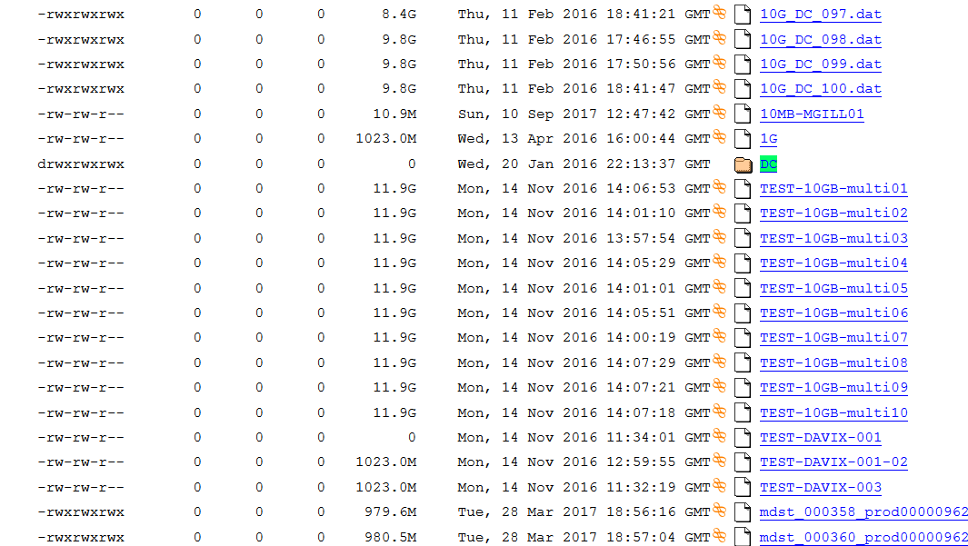
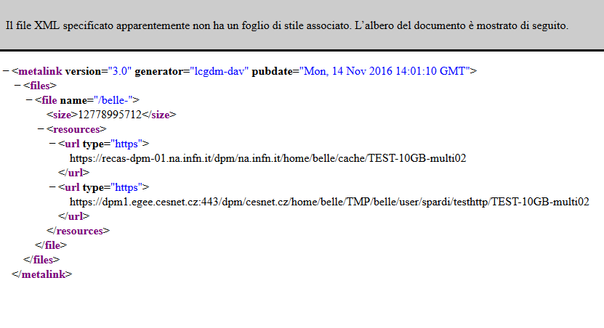
Dynafed + Volatile Pool
What happen if we aggregate a set of standard http endpoints with a DPM Volatile Pool?
When Dynafed stats a file, it receive always a positive answer from the Volatile Pool.
So that the metalink representing a file in Dynafed, will included always at least two links: the real URL, and the corresponding virtual copy in the cache (even if the latter does not exist yet)
Moreover thanks to the GeoPlugin, Dynafed prioritize the cache copy if the Volatile Pool is local to the Client or close to it.
This combination allow to create a cache system
Cache
Real File

Slide 8
FileA
FileB
FileA
FileD
$
HTTP dCache
HTTP dCache
Cloud Storage
FileC
FileB
HTTP DPM
HTTP STORM
DYNAFED FEDERATOR
$$$
FileD
HTTP CACHE
FileA
FileA
Cloud Storage
HTTP STORM

Slide 9
FileA
FileB
FileD
$
$
HTTP dCache
HTTP dCache
CACHING POPULAR FILES
Cloud Storage
FileC
FileC
FileC
FileB
HTTP DPM
HTTP DPM
HTTP STORM
DYNAFED FEDERATOR
DYNAFED FEDERATOR
$$$
HTTP CACHE
FileD
HTTP CACHE
FileC ?
FileC ?
FileA
Cloud Storage
HTTP STORM

Slide 10
FileA
FileB
FileD
$
$
HTTP dCache
HTTP dCache
CACHING POPULAR FILES
Cloud Storage
FileC
FileC
FileC
FileB
HTTP DPM
HTTP DPM
HTTP STORM
DYNAFED FEDERATOR
DYNAFED FEDERATOR
$$$
HTTP CACHE
FileD
HTTP CACHE
FileC ?
FileC ?
FileA
Cloud Storage
HTTP STORM

Slide 11
FileA
FileB
FileD
$
$
HTTP dCache
HTTP dCache
CACHING POPULAR FILES
Cloud Storage
FileC
FileC
FileC
FileB
HTTP DPM
HTTP DPM
HTTP STORM
DYNAFED FEDERATOR
DYNAFED FEDERATOR
FileC
$$$
HTTP CACHE
FileD
HTTP CACHE
FileC ?
FileC ?
FileA
Cloud Storage
HTTP STORM

Slide 12
FileA
FileB
FileD
$
$
HTTP dCache
HTTP dCache
CACHING POPULAR FILES
Cloud Storage
FileC
FileC
FileC
FileB
HTTP DPM
HTTP DPM
HTTP STORM
DYNAFED FEDERATOR
DYNAFED FEDERATOR
$$$
FileC
HTTP CACHE
FileD
HTTP CACHE
FileC ?
FileC ?
FileC DOWLOAD
FileA
Cloud Storage
HTTP STORM

Slide 13
FileA
FileB
FileD
$
$
HTTP dCache
HTTP dCache
CACHING POPULAR FILES
Cloud Storage
FileC
FileC
FileC
FileB
HTTP DPM
HTTP DPM
HTTP STORM
DYNAFED FEDERATOR
DYNAFED FEDERATOR
$$$
FileC
HTTP CACHE
FileD
HTTP CACHE
FileC ?
FileC ?
FileC DOWLOAD
FileA
Cloud Storage
HTTP STORM

Slide 14
FileA
FileB
FileD
$
$
HTTP dCache
HTTP dCache
CACHING POPULAR FILES
Cloud Storage
FileC
FileC
FileC
FileB
HTTP DPM
HTTP DPM
HTTP STORM
DYNAFED FEDERATOR
DYNAFED FEDERATOR
FileC DOWLOAD
FileC ?
$$$
FileC
HTTP CACHE
FileD
HTTP CACHE
FileC ?
FileC ?
FileC DOWLOAD
FileA
Cloud Storage
HTTP STORM

Slide 15
FileA
FileB
FileD
$
$
HTTP dCache
HTTP dCache
CACHING POPULAR FILES
Cloud Storage
FileC
FileC
FileC
FileC
FileC
FileB
HTTP DPM
HTTP DPM
HTTP STORM
DYNAFED FEDERATOR
DYNAFED FEDERATOR
FileC DOWLOAD
FileC ?
$$$
FileC
HTTP CACHE
FileD
HTTP CACHE
FileC ?
FileC ?
FileC DOWLOAD
FileA
Cloud Storage
HTTP STORM

Slide 16
FileA
FileB
FileD
$
$
HTTP dCache
HTTP dCache
CACHING POPULAR FILES
Cloud Storage
FileC
FileC
FileC
FileC
FileC
FileC DOWLOAD
FileB
HTTP DPM
HTTP DPM
HTTP STORM
DYNAFED FEDERATOR
FileC DOWLOAD
DYNAFED FEDERATOR
FileC DOWLOAD
FileC ?
$$$
FileC
HTTP CACHE
FileD
HTTP CACHE
FileC ?
FileC ?
FileC DOWLOAD
FileA
Cloud Storage
HTTP STORM

Slide 17
FileA
FileB
FileD
$
$
HTTP dCache
HTTP dCache
CACHING POPULAR FILES
Cloud Storage
FileC
FileC
FileC
FileC
FileC
FileC DOWLOAD
FileB
HTTP DPM
HTTP DPM
HTTP STORM
DYNAFED FEDERATOR
FileC DOWLOAD
DYNAFED FEDERATOR
FileC DOWLOAD
FileC ?
$$$
FileC
HTTP CACHE
FileD
HTTP CACHE
FileC ?
FileC ?
FileC DOWLOAD
FileA
Cloud Storage
HTTP STORM

Slide 18
FileA
FileB
FileD
$
$
HTTP dCache
HTTP dCache
CACHING POPULAR FILES
Cloud Storage
FileC
FileC
FileC
FileC
FileC
FileB
HTTP DPM
HTTP DPM
HTTP STORM
DYNAFED FEDERATOR
DYNAFED FEDERATOR
FileC DOWLOAD
FileC ?
$$$
FileC
HTTP CACHE
FileD
HTTP CACHE
FileC ?
FileC ?
FileA
Cloud Storage
HTTP STORM

Slide 19
FileA
FileB
FileD
$
$
HTTP dCache
HTTP dCache
CACHING POPULAR FILES
FileC DOWLOAD
Cloud Storage
FileC
FileC
FileC DOWLOAD
FileC
FileC
FileC
FileB
HTTP DPM
HTTP DPM
HTTP STORM
DYNAFED FEDERATOR
DYNAFED FEDERATOR
FileC DOWLOAD
FileC ?
FileC DOWLOAD
$$$
FileC
HTTP CACHE
FileD
HTTP CACHE
FileC ?
FileC ?
FileA
Cloud Storage
HTTP STORM

Slide 20
The testbed
10Gb/s LAN
SOFTWARE VERSION
dpm-1.10.x
dynafed-1.3.1-2
davix-0.6.6-1
User Interface
DYNAFED
10Gb/s LAN
20Gb/s WAN
DPMHEAD NODE
…
KEK Storage
CESNET Storage
DPMDISK1
DPMDISK2
pool-recas
pool-cache
Private Cloud storage S3

Slide 21
Dynafed Server for Belle II
# | STORGE NAME | HOSTNAME | TYPE
1 | DESY-DE | dcache-belle-webdav.desy.de | DCACHE
2 | GRIDKA-SE | f01-075-140-e.gridka.de | DCACHE
3 | NTU-SE | bgrid3.phys.ntu.edu.tw | DCACHE
4 | SIGNET-SE | dcache.ijs.si | DCACHE
5 | UVic-SE | charon01.westgrid.ca | DCACHE
6 | BNL-SE | dcbldoor01.sdcc.bnl.gov | DCACHE
7 | Adelaide-SE | coepp-dpm-01.ersa.edu.au | DPM
8 | CESNET-SE | dpm1.egee.cesnet.cz | DPM
9 | CYFRONNET-SE | dpm.cyf-kr.edu.pl | DPM
10 | Frascati-SE | atlasse.lnf.infn.it | DPM
11 | HEPHY-SE | hephyse.oeaw.ac.at | DPM
12 | Melbourne-SE | b2se.mel.coepp.org.au | DPM
13 | Napoli-SE | belle-dpm-01.na.infn.it | DPM
14 | ULAKBIM-SE | torik1.ulakbim.gov.tr | DPM
15 | IPHC-SE | sbgse1.in2p3.fr | DPM
16 | CNAF-SE | ds-202-11-01.cr.cnaf.infn.it | STORM
17 | ROMA3-SE | storm-01.roma3.infn.it | STORM
18 | KEK-SE | Kek-se03.cc.kek.jp | STORM
19 | McGill-SE | gridftp02.clumeq.mcgill.ca | STORM
Testing Dynafed server in Napoli since Feb 2016
In January 2018 we installed the new
new version of Dynafed on CENTOS-7
https://dynafed-belle.na.infn.it/myfed
19 Storages ( about 75%)
Proxy generated by a robot certificate
Version on SL6 Still available
https://dynafed01.na.infn.it/myfed/

Slide 22
Cache Implementation via DOME
Script on the Head Node:
The implemented script recognizes if the requested path is a file or a directory then reply to the client consequently. The plugin retrieve as well the size of the real copy of the file.
Script on the Disk Node:
When a file is not in the cache, the disk node download the requested file from the datagrid by resolving the location via Dynafed. (Using Robot Certificate registerd in the VO)

Slide 23
Client Behaviour
If the file is not in cache or not ready yet, the client receives a 202 Message that ask for waiting.
Davix or gfal clients will retry after a n-seconds (retry_delay) up to max_retry.
Then the file will be downloaded from the volatile pool

Slide 24
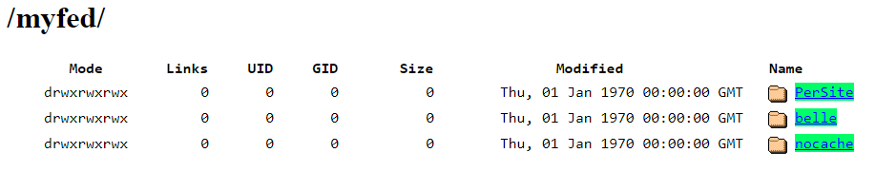
Federation Views
With Dynafed is possible to create multiple views by aggregating storage paths in different manner. Two new views as been added
myfed/PerSite/ Shows the file systems of each storage separately (without aggregation)
myfed/belle/ Aggregation of all the directory /DATA/belle and /TMP/belle/ + VOLATILE POOL
myfed/nocache/ Aggregation of all the directory /DATA/belle and /TMP/belle/ + WITHOUT VOLATILE POOL

Slide 25
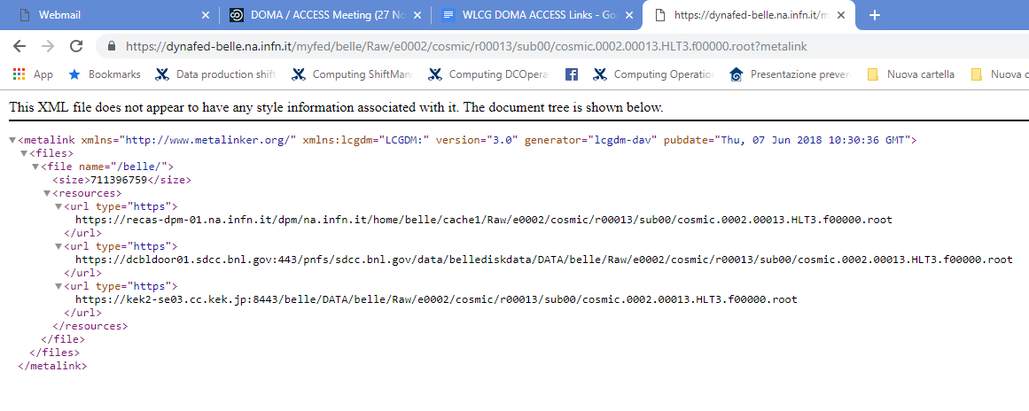
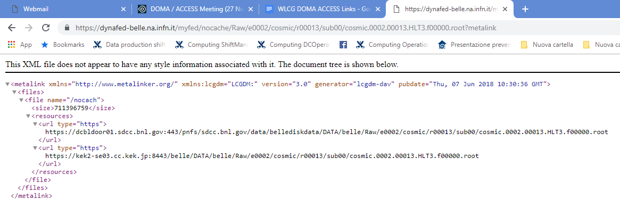
Exa
VOLATILE POLL
FIRST IN THE LIST
RAW DATA FILE - METALINK IN THE FULL VIEW
RAW DATA FILE - METALINK IN NOCACHE VIEW

Slide 26
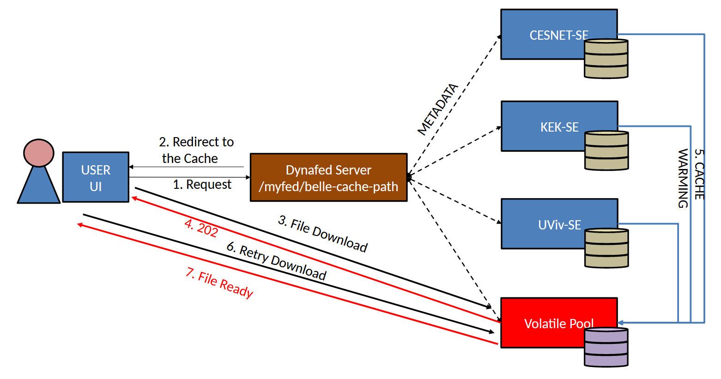
Implementation Detail
Napoli
Napoli

Slide 27
File Download Test 1GB from a UI in Napoli
Mbit/s (Higher is better)

Slide 28
Local job reading file through dynafed
basf2 B2A602-BestCandidateSelection.py -i dav://dynafed-belle.na.infn.it/myfed/belle/MC/mdst_000028_prod00003102_task00000028.root
USER INTERFACE IN NAPOLI – PHYSICAL COPY AT KEK

Slide 29
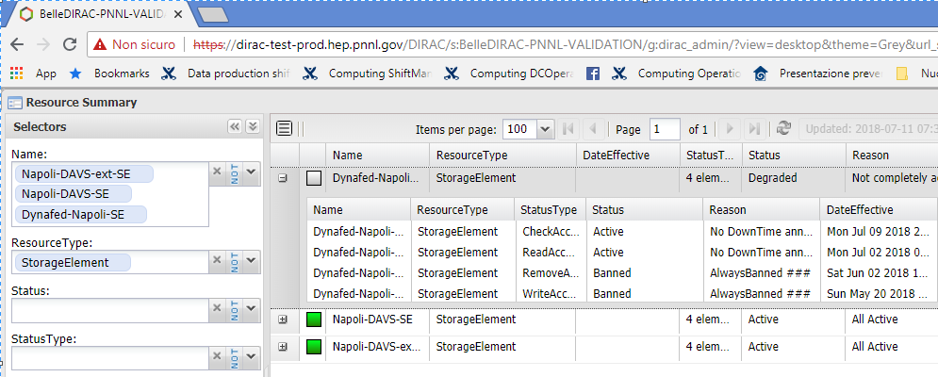
How to use this object?
  Using the DIRAC Validation server of Belle II we are investigating different approaches:
  Register the Volatile Pool among SEs (in that case we loss the benefit of dynafed)
  Register dynafed as a Storage (In that case DIRAC loss the control in writing)
  Make a special configuration for the HTTP endpoints registered in DIRAC in order to be used directly in writing and through Dynafed in reading.

Slide 30
How to use this object?
Ongoing test are focussed on three main use-cases:
DAVS protocol in DIRAC
DAVS + Dynafed + DIRAC
DAVS + Dynafed + DPM Volatile Pool (Cache) + DIRAC

Slide 31
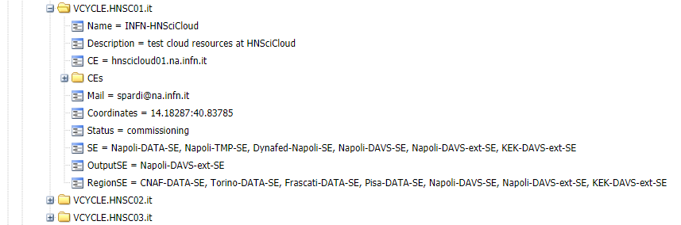
How to use this object?
The site VCYCLE.HNSC01.it in PNNL DIRAC has been configured to use the testing http endpoint, included dynafed
We created a set of datasets locally with basf2 then we copied and registered it on KEK-DAVS-SE storage via gb2_ds_put command.

Slide 32
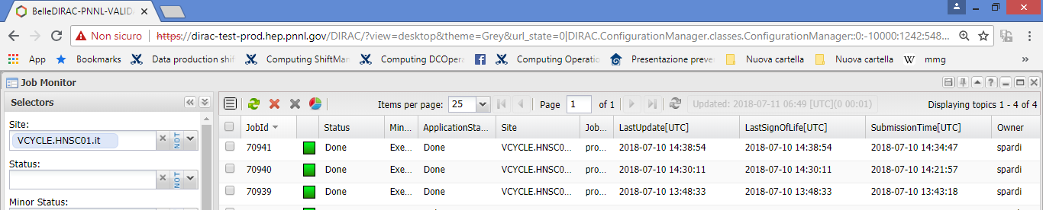
How to use this object?
  Submit jobs to DIRAC via gbasf2, taking advantage from the cache.
  Early results:
  In a protected environment, we replicated datasets to KEK-DAVS-SE and then we ran a set of simple analysis on HNSC resources, reading files from the http storage via Dynafed, using the volatile pool feature as well, experiencing the caching effect.

Slide 33
Current Status and ongoing activities
  Up to now we mainly focussed on creating a working testbed, overcoming the issues and investigating how to introduce the cache element in the belle II computing model.
  Last part 3 months of the SCoRES project will be dedicated in doing performance and resilience tests that should be ready by the end of February 2018 together with the characterization of the testbed.

Slide 34
Additional Initiatives
  The ATLAS Team at INFN-Napoli is working with similar technologies in the context of ATLAS using Volatile Pool in combination with RUCIO. Preliminary results have been presented at CHEP18, more detailed and results will be presented soon.
  There are currently a set of new initiatives submitted in different context in Italy to support activities related this topic:
  Included a research project named “HTTP in Physics (HTTPhy)” submitted within the national call PRIN 2017 (result expected by the end of the year).
  I.Bi.S.Co. (Infrastructure for Big Data and Scientific Computing) is a new proposal submitted by several Italian institutions (including INFN and University Federico II) in the contest of the National CALL for datacenter extension.

Slide 35
  Thank you

Slide 36
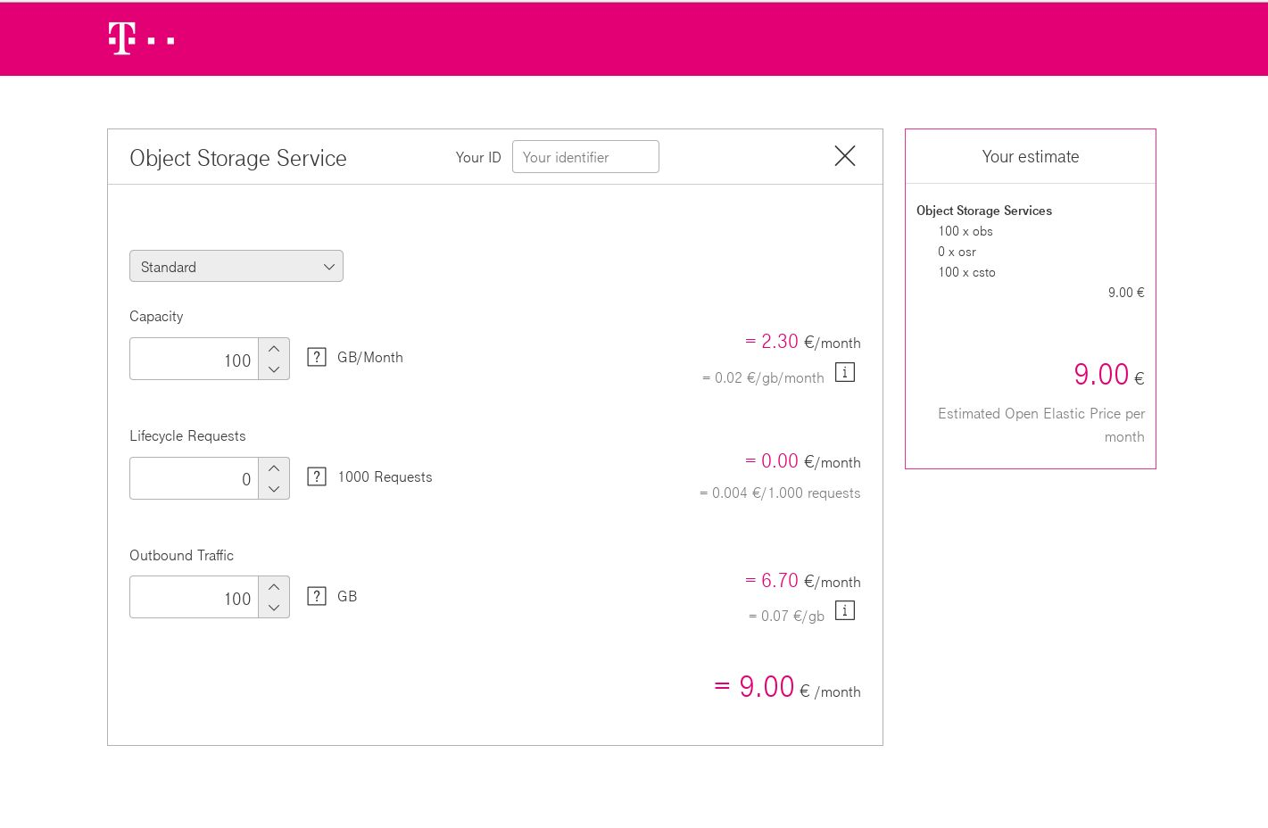
USE CASE Cloud Access
  In the context of HNSC project we had the opportunity to simulate the cost of data access with a cloud storage.
  Copy 100GB of data from an S3 bucket may cost up to 6.7 Euro
  (Cloud T-system in Germania)

Slide 37
FileA
FileB
FileA
FileD
$
HTTP dCache
HTTP dCache
Cloud Storage
FileC
HTTP DPM
FileB
HTTP STORM
DYNAFED FEDERATOR
FileD
$$$
HTTP CACHE
FileD
FileA
FileA
Cloud Storage
HTTP STORM

Slide 38
FileA
FileB
FileA
FileD
$
HTTP dCache
HTTP dCache
Cloud Storage
FileC
HTTP DPM
FileB
HTTP STORM
DYNAFED FEDERATOR
FileD
$$$
HTTP CACHE
FileD
FileA
FileA
Cloud Storage
HTTP STORM

Slide 39
FileA
FileB
FileA
FileD
$
HTTP dCache
HTTP dCache
Cloud Storage
$
FileC
HTTP DPM
FileD DOWLOAD
FileB
HTTP STORM
DYNAFED FEDERATOR
FileD
FileD
FileD DOWLOAD
$$$
HTTP CACHE
FileD
FileA
FileA
Cloud Storage
HTTP STORM

Slide 40
FileA
FileB
FileA
FileD
$
HTTP dCache
HTTP dCache
Cloud Storage
FileC
HTTP DPM
FileB
HTTP STORM
DYNAFED FEDERATOR
1
2
FileD
FileD
FileD DOWLOAD
$$$
HTTP CACHE
FileD DOWLOAD
4
FileD DOWLOAD
FileD
FileA
FileA
Cloud Storage
HTTP STORM

Slide 41
USE CASE Cloud Access
  To manage this use-case we developed two filter plugins for Dynafed able to prioritize replicas in a different way rather than the geographical distance between client and storage:
  Price Plugin: Which allows to associate an arbitrary weight to storages
  Default Plugin: Which allows to set an endpoint as default storage for the host of a network
    The combined usage of those two plugins allows to design new scenarios

Slide 42
USE CASE Cloud Access
Configurazione PRICE Plugin
recas-dpm-01.na.infn.it 0.20 (CACHE)
dcache-belle-webdav.desy.de 0.40
kek2-se03.cc.kek.jp 0.50
dcache.ijs.si 0.50
charon01.westgrid.ca 0.50
dpm1.egee.cesnet.cz 0.50
davide.obs.otc.t-systems.com 0.80
Configurazione Default Plugin
131.169.168 recas-dpm-01.na.infn.it ( DESY Network )
79.23. kek2-se03.cc.kek.jp
 | Total Size (GB) | Plugin | Costo I accesso | Costo II accesso | Costo III acceso
CLOUD | 100 | GeoIP | 6,7 € | 6,7 € | 6,7 €
SCORES-CACHE | 100 | GeoIP+Price/Default | 6,7 € | 0 | 0

Slide 43
FileA
FileB
FileA
FileD
FileA DOWLOAD
$
HTTP dCache
HTTP dCache
Cloud Storage
FileA ?
FileC ?
FileA ?
FileC
FileC DOWLOAD
FileB
HTTP DPM
HTTP STORM
DYNAFED FEDERATOR
FileC
FileD ?
$$$
FileD
HTTP CACHE
FileC ?
FileD DOWLOAD
FileC DOWLOAD
FileA
FileA
Cloud Storage
HTTP STORM

Slide 44
Preliminary Tests Details (File Download)
As preliminary test, we download from a User Interface in Napoli a set of Belle II files, stored in CESNET, KEK and UVic . Each file set is downloaded three times as follow:
File Download using the direct link to the remote storage
File Download using Dynafed with Cold cache
File Download using Dynafed with Warm cache
Tests have been performed using files of different size: 50MB, 1GB

Slide 45
Dynafed and Cache: Model and implementation
Application
gbasf2
WebDav Client
Federation
Dynafed
Dynafed
Cache
DPM Volatile Pool
Xcache?
Storages
Belle II Https
Endpoints
Belle II Https
Endpoints
Test this model in Belle II require two steps:
Implement the caching system
Study how to use HTTP/DAV in the application workflow

Slide 46
FileB
FileA
COST EFFECTIVE REPLICA SELETCION
FileD
FileD
$
$
HTTP dCache
HTTP dCache
Cloud Storage
Cloud Storage
FileC DOWLOAD
FileC
FileB
HTTP DPM
HTTP STORM
DYNAFED FEDERATOR
DYNAFED FEDERATOR
FileD ?
FileD ?
$$$
FileD
$$$
HTTP CACHE
FileD
HTTP CACHE
FileD
FileA
Cloud Storage
HTTP STORM
Cloud Storage

Slide 47
FileA
FileB
FileA
FileD
DOWNLOAD DATA FROM THE CLOSEST SERVER
(GEOPLUGIN FEATURE)
FileA DOWLOAD
$
HTTP dCache
FileA DOWLOAD
HTTP dCache
HTTP dCache
Cloud Storage
FileC DOWLOAD
FileA ?
FileB ?
FileA ?
FileC
FileD DOWLOAD
FileB
HTTP DPM
HTTP STORM
DYNAFED FEDERATOR
DYNAFED FEDERATOR
FileC
FileD ?
$$$
FileD
HTTP CACHE
FileC ?
FileC DOWLOAD
FileA
FileA
HTTP STORM
Cloud Storage
HTTP STORM

Slide 48
FileB
FileA
FileB
FileD
$
$
HTTP dCache
FileA DOWLOAD
HTTP dCache
FAILOVER: RESILIENCE TO STORAGE FALUTS
HTTP dCache
Cloud Storage
FileC DOWLOAD
FileC DOWLOAD
FileB ?
FileA ?
FileB ?
FileC
FileB
FileD DOWLOAD
FileB
HTTP DPM
HTTP STORM
HTTP STORM
DYNAFED FEDERATOR
DYNAFED FEDERATOR
FileC
FileD ?
$$$
FileD
HTTP CACHE
FileC ?
FileC DOWLOAD
FileA
Cloud Storage
HTTP STORM

Slide 49
FileA
FileB
FileD
$
FileA DOWLOAD
$
HTTP dCache
HTTP dCache
CACHING POPULAR FILES
Cloud Storage
FileC DOWLOAD
FileA ?
FileC ?
FileC
FileC
FileC
FileD DOWLOAD
FileB
HTTP DPM
HTTP DPM
HTTP STORM
DYNAFED FEDERATOR
FileC DOWLOAD
DYNAFED FEDERATOR
FileC DOWLOAD
FileC
FileC
FileD ?
$$$
HTTP CACHE
FileD
HTTP CACHE
FileC ?
FileC ?
FileC DOWLOAD
FileB DOWLOAD
FileA
Cloud Storage
HTTP STORM

Slide 50
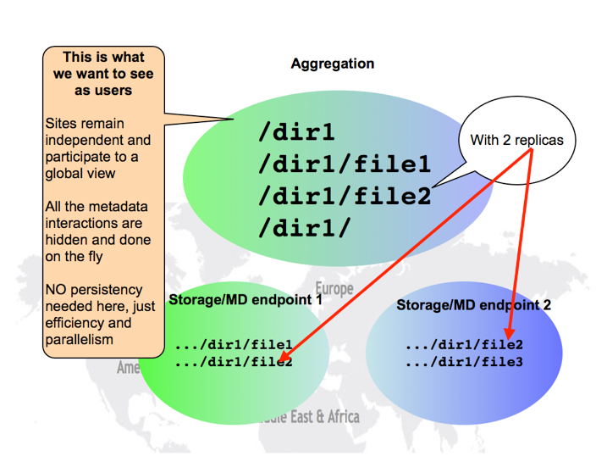
DYNAFED
Dynamic Federations system.
It can aggregate namespaces of different type of storages
HTTP/Webdav Storage
S3 storage
NFS
LFC
Others
Storage aggregation is made on the fly
File metadata are cached on the Dynafed machine.
For the client point of view, Dynafed works as a redirector:
When a client ask for a file to it will be redirect the one of the available replicas.

Slide 51
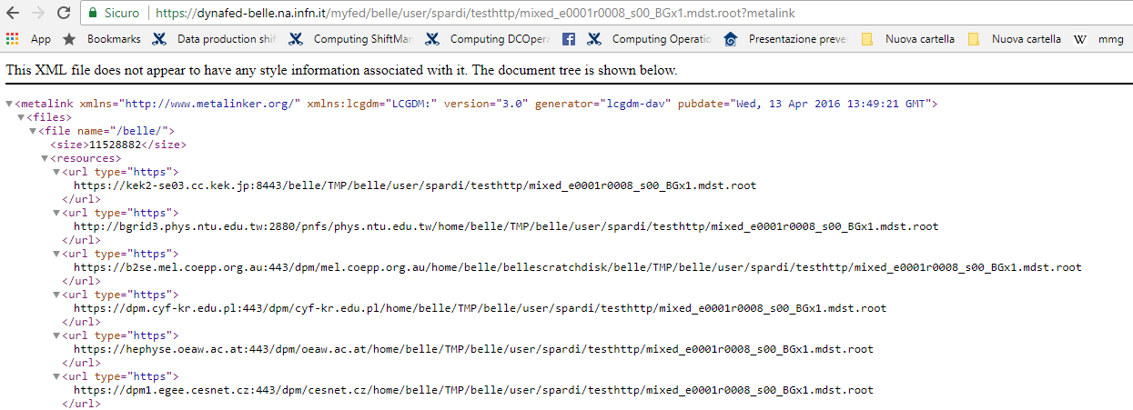
Dynafed file representation: Metalink

Slide 52
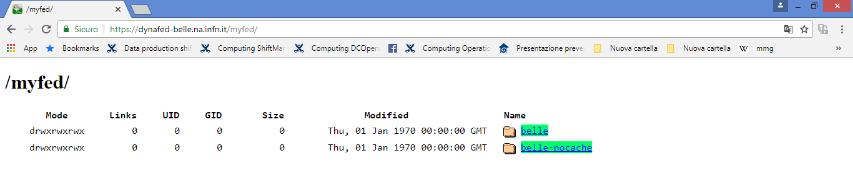

Slide 53
Dynafed and Cache: Model and implementation
Application
gbasf2
WebDav Client
Federation
Dynafed
Xrootd federation? Rucio?
Cache
DPM Volatile Pool
Xcache ??
Storages
Belle II Https
Endpoints
Belle II Https
Endpoints
Two challenges: User HTTP in the application workflow and implement a caching system

