Slide 1
Understanding Disk needs at the HL-LHC for CMS
Frank Würthwein
SDSC/UCSD
DOMA Access
November 20th 2018

Slide 2
Disclaimer !!!
The ideas presented herein are NOT necessarily representing current thinking in CMS.
They are nothing more than rumblings of an individual to stimulate discussions.
However, those rumblings are informed by many discussions with a long list of colleagues from within CMS. Too long to list them all here, as I would undoubtedly forget to mention some people.

Slide 3
Start with Data Formats and their expected use
Data Tier | Data
RAW [MB] | 7.4
AOD [MB] | 2.0
MiniAOD [kB] | 200
NanoAOD [kB] | 4
Primary Processing:
RAW -> AOD -> Mini -> Nano
Processing Assumptions:
Courtesy David Lange
Present Model of CMS
HL-LHC resource planning
Data formats span x1000 in size per event.
Files in large data formats are touched at most twice a year.

Slide 4
May 2018 Tape Estimate
Use Tape estimates as guidance of
size of the total available data.
Dominated by RAW and AOD
Another way of looking at it:
80+160 Billion events/year (Data+MC) = 240B events/year
7.4MB x 8e10 ~ 6e11 MB ~ 0.5 Exabytes/year of RAW
2.0MB x 2.4e11 ~ 5e11 MB ~ 0.5 Exabytes/year of AOD
0.2MB x 2.4e11 ~ 0.5e11 MB ~ 50 Petabytes/year of Mini
0.004MB x 2.4e11 ~ 0.01e11 MB ~ 1 Petabyte/year of Nano
The data that is accessed 1-2 times per year is x1000 larger
than the data that dominates data analysis use !!!

Slide 5
Caching Objectives
Want to define a working set of data that is accessible from all CPU anywhere.
  We think this requires regional caches where region is defined by maximum RTT within the region to avoid latency that significantly deteriorates CPU/wall time for analysis.
    This requires continued detailed measurement of latency dependence of user analysis on the production system.
  This requires an understanding of the time evolution of the working set. And the resulting tape recall bandwidth.
Want to reduce administrative effort of supporting storage infrastructure for analysis.

Slide 6
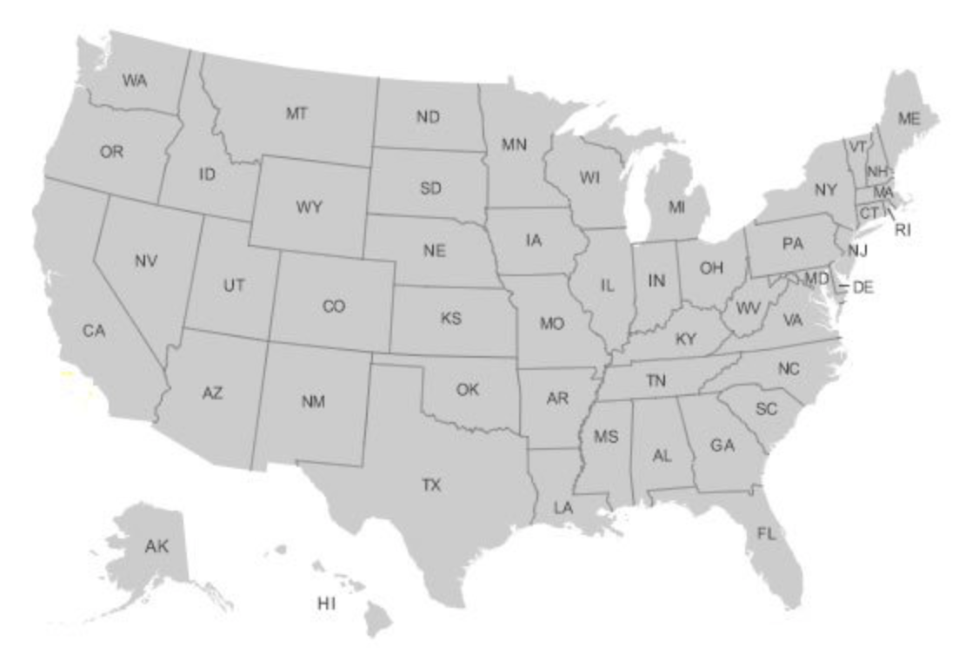
Straw Proposal for optimizing US T2 disk space usage
The geography makes for two obvious cache collaborations.
UNL maybe close enough to Midwest.
Florida and MIT unlikely to be close enough.
550 miles
~ 4 caches total in US CMS

Slide 7
Equivalent Distances in EU
500 Miles is an interesting
distance for merging caches !!!
Good goal to set for IO stack to be sufficiently
latency tolerant to lose less than 10% in CPU time
for access distances of ~500 Miles (RTT UNL-Purdue).

Slide 8
Gains from regional caches
T2s at Caltech, UCSD, UNL, … today use HDFS with replica = 2.
  Disk failures are a major operational concern as it can lead to data corruption.
Xrootd caches are run as JBODs
  Disk failures in caches are of no concern.
There is an immediate x4 increase in useable disk space for
cache deployment across 2 sites in SoCal (or elsewhere).

Slide 9
Caching Model
One high quality disk copy of the “working set” for all analysis in the Americas.
  As the working set changes over time, we recall data from tape.
    Need to measure the global analysis working set !!!
    Need to measure data lifetime and transients to estimate tape recall needs.
Each T2 has zero redundancy disks inside caches.
T2s are grouped into regional caches within distances that have less than 10% degradation of CPU/Wall due to access latencies.
  Need to understand latency tolerance for analysis

Slide 10
Summary & Conclusions
Need to distinguish 4 storage uses
  Cheapest possible Archive
  Golden disk copy (likely to be most expensive storage)
  Caches with zero redundancy
  Buffers for processing campaigns
    Single vs distributed buffers requires understanding of latency tolerance of processing applications.
Need to measure/estimate
  Working set for analysis globally
  Tape recall needs for processing buffers
  Tape recall needs for golden disk copy
  Latency tolerance of analysis applications

