Slide 1
Investigation of multipole components in MCBRD
M. Koratzinos
18/9/2018

Slide 2
The issue
When measuring the field quality at warm of MCBRD, a large component of B3 was seen
The measurement was confirmed by two methods, so I will assume it is real
Although this component is still within specification, it would be nice to understand why it is there

Slide 3
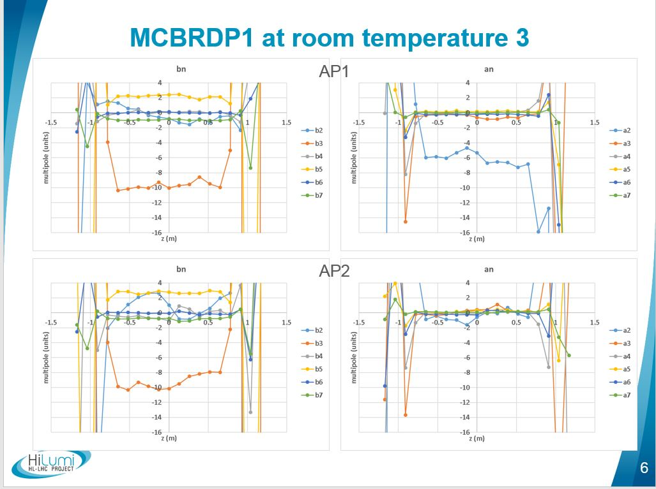
Effect seen at both apertures
“allowed multipoles are larger than expected but field quality is within specifications”

Slide 4
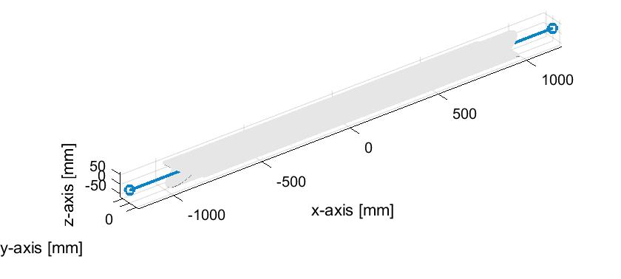
…but first, look at the ideal case
CCT design: it has the virtue of excellent field quality
How does the field look like?

Slide 5
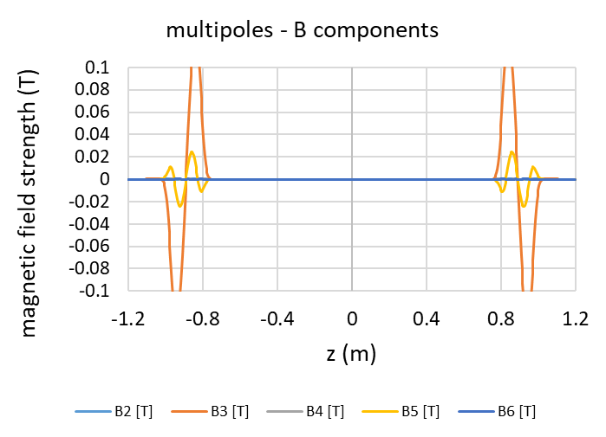
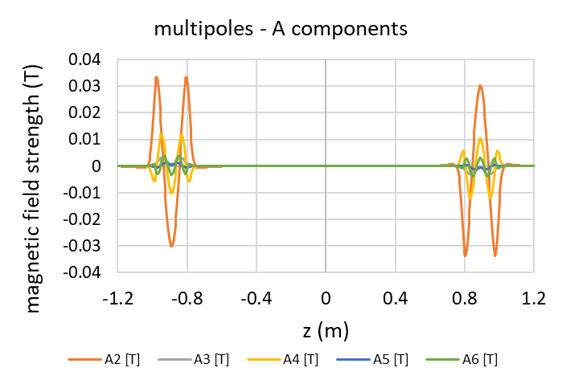
Field quality with ideal positioning of both coils
Small effects at the edges that cancel out when integrating

Slide 6
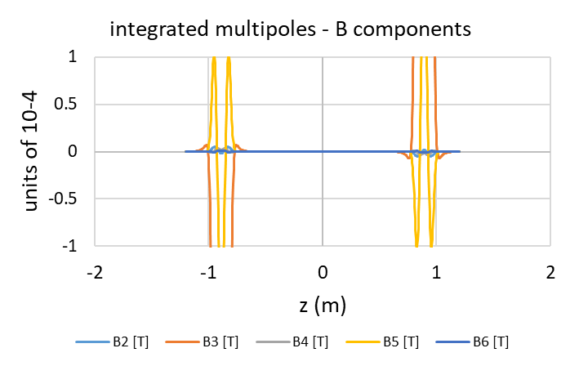
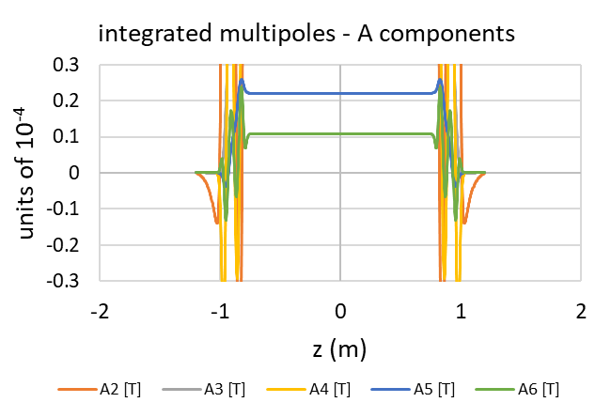
And if we integrate…
This is for infinitely thin wires

Slide 7
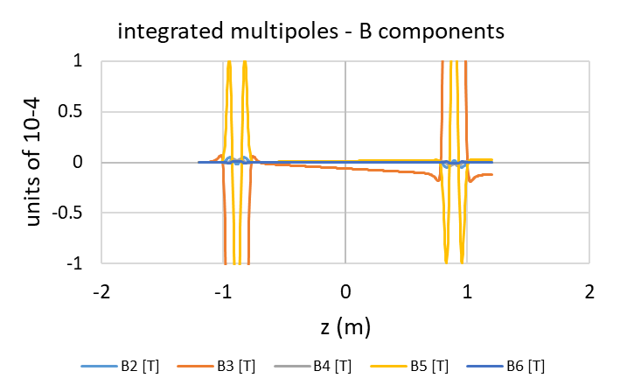

Now, the into account the fact that the cable is 2mm wide
This introduces a minute B3 component

Slide 8
Now, calculate the effect of misalignment
Translation in x, y, z of the inner wrt the outer coil
Rotation wrt all angles
Simplifications: No iron, no cross talk, standalone magnet in air

Slide 9
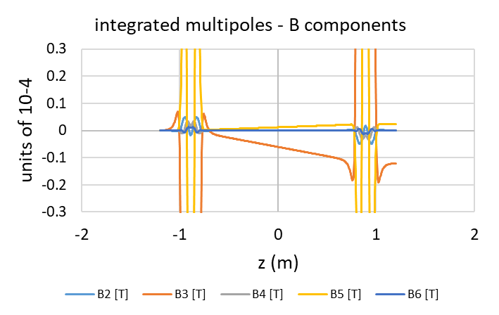
Reference

Slide 10
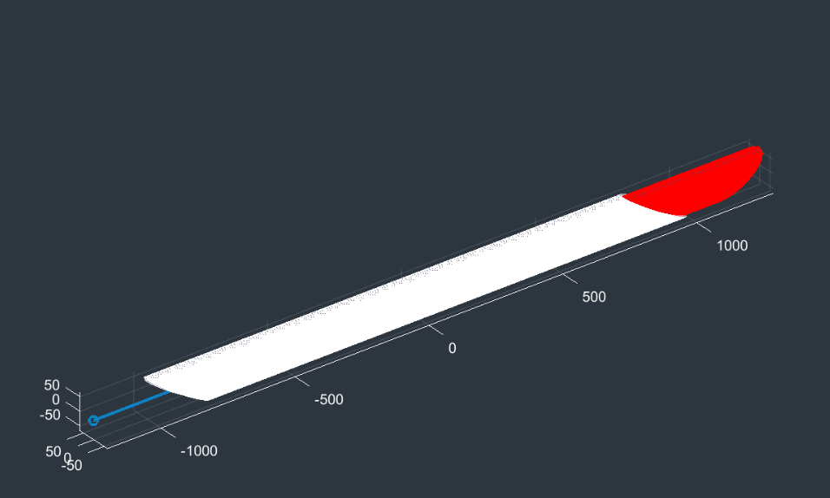
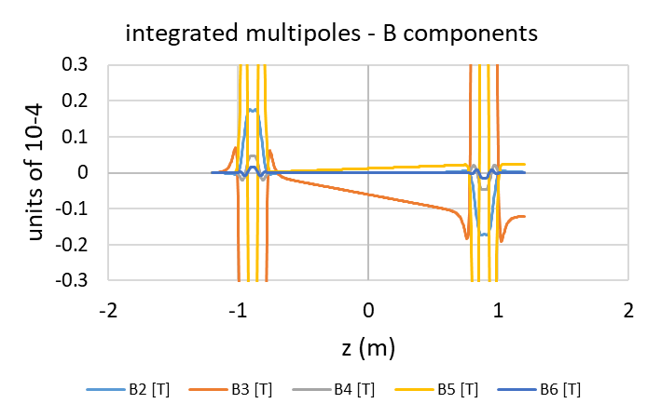
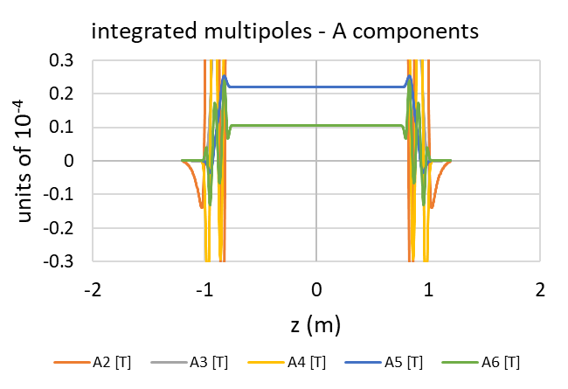
Misalignment along the beam
By 3mm – no effect

Slide 11
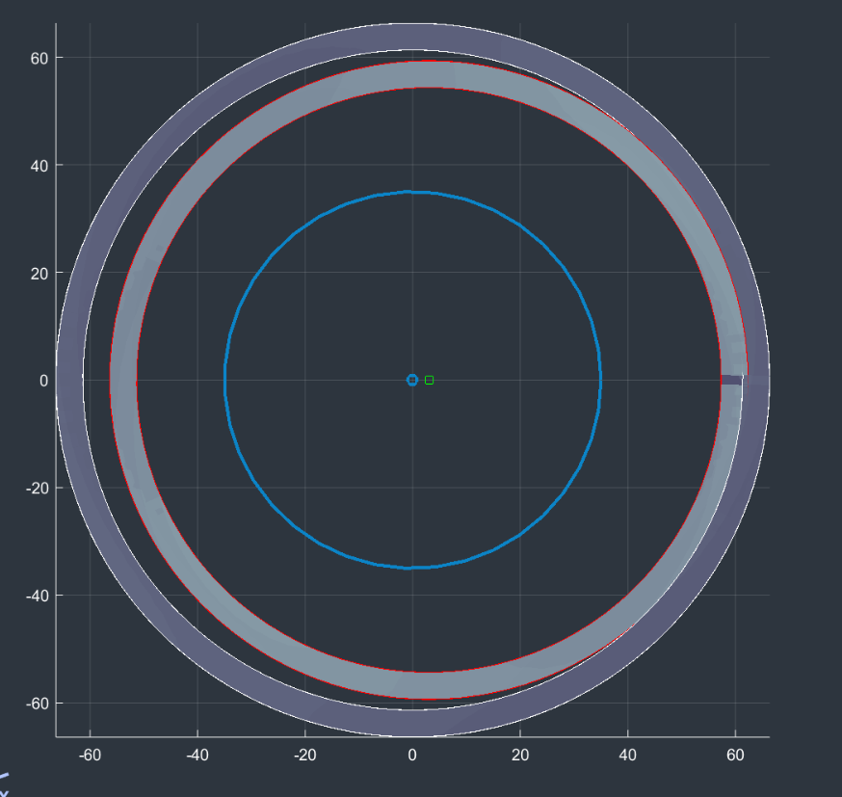

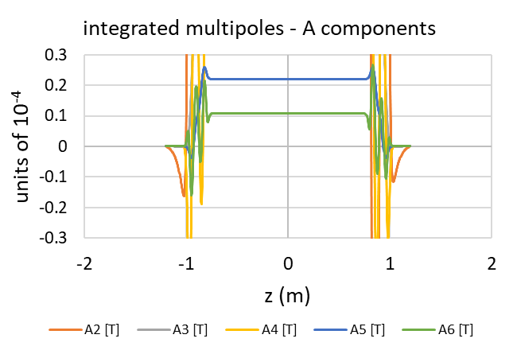
Misalignment horizontally
By 200um – no effect

Slide 12
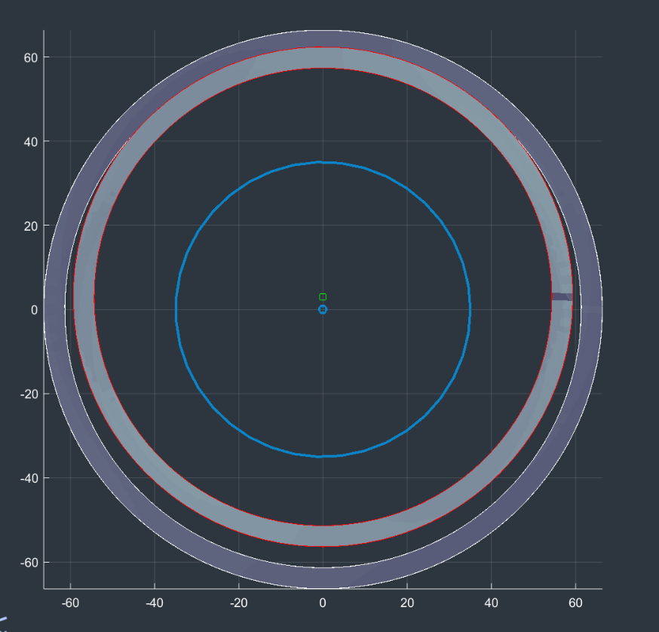
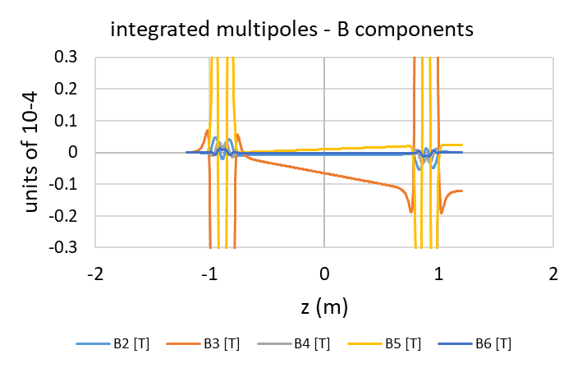
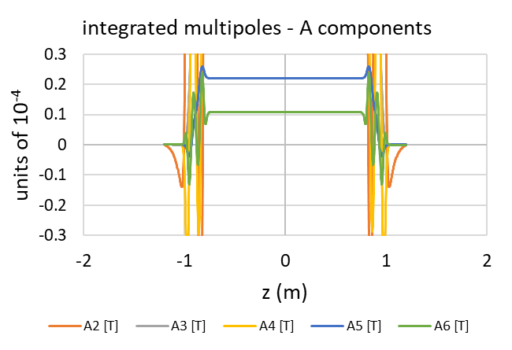
Misalignment vertically
By 200um – no effect

Slide 13
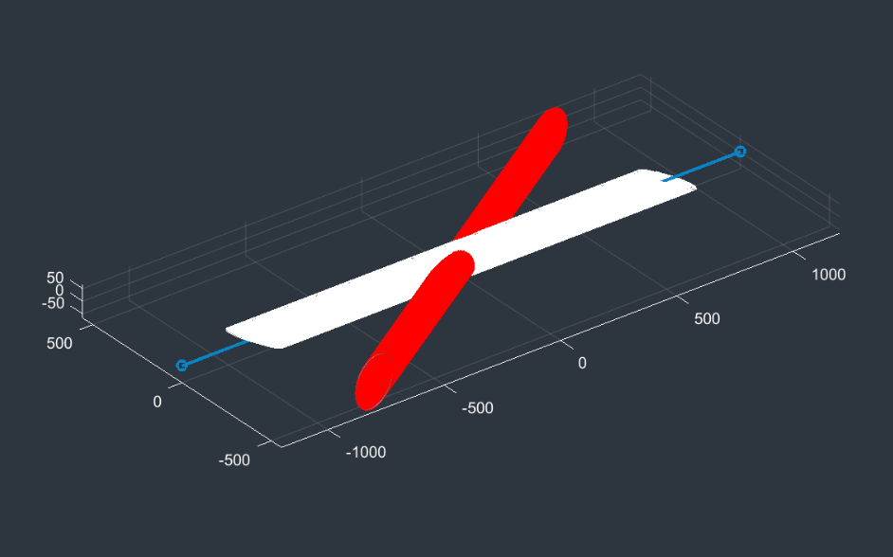
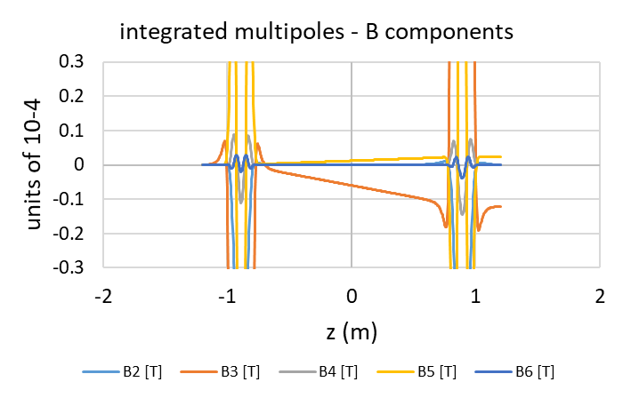
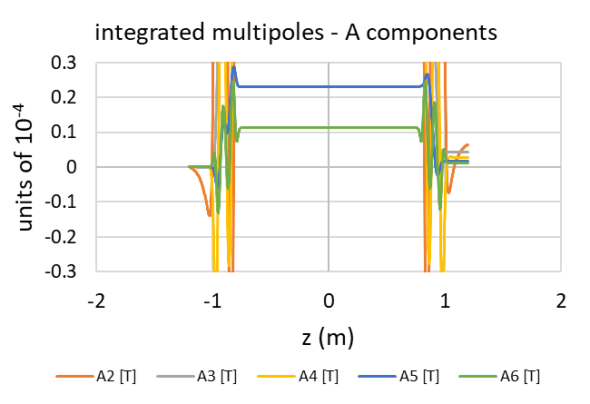
Twist horizontally
By 1mrad – no effect

Slide 14
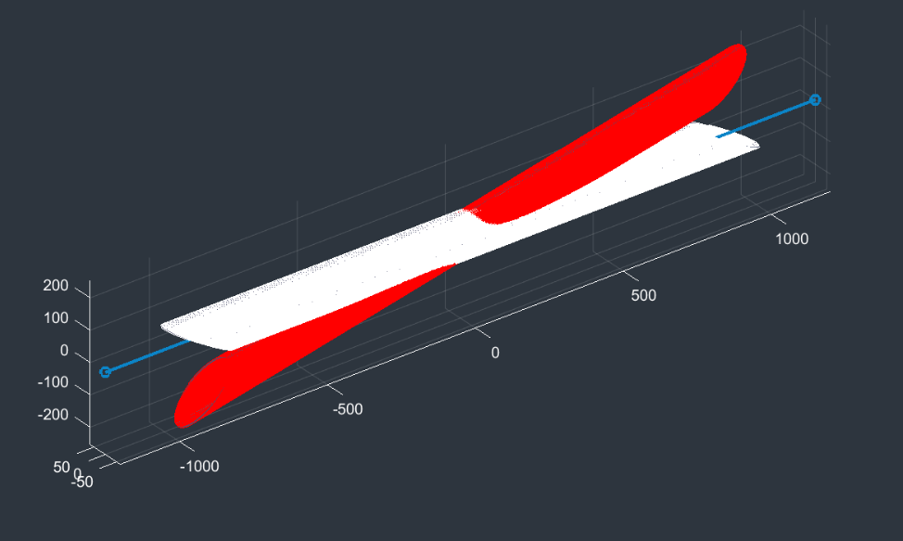


Twist vertically
By 1mrad – no effect

Slide 15
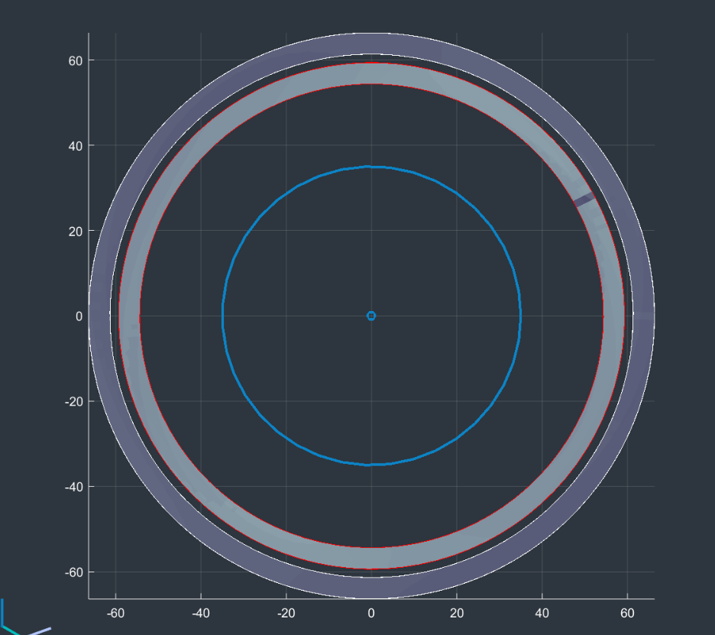
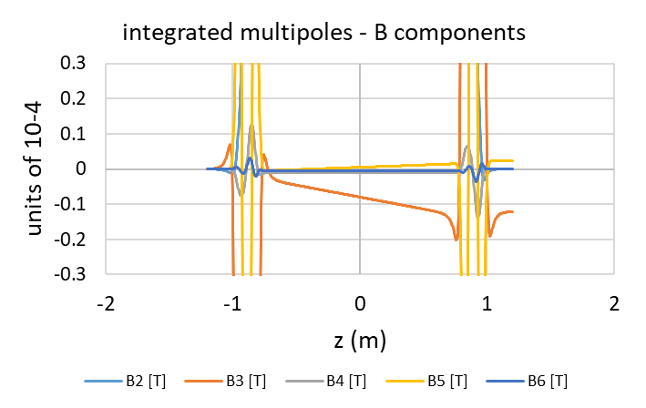
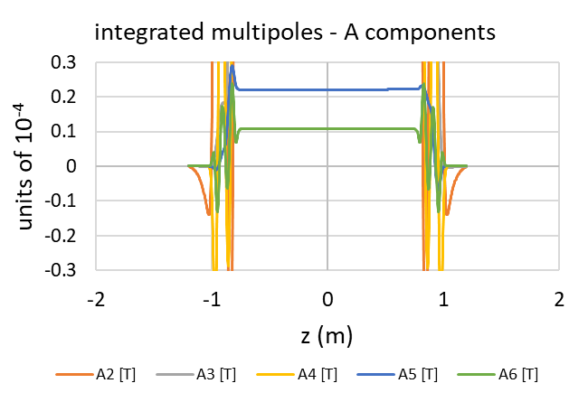
Rotate along beam
By 10mrad – no effect

Slide 16
recap
The CCT design is very forgiving when it comes to mechanical tolerances (when we talk about the integral of the multipoles)
So where does the 10 unit B3 component come from?

Slide 17
Possible culprits:
Some error creeping in from the electrical design till the manufacturing process
  I was unable to test this
I will offer one more possible explanation…

Slide 18
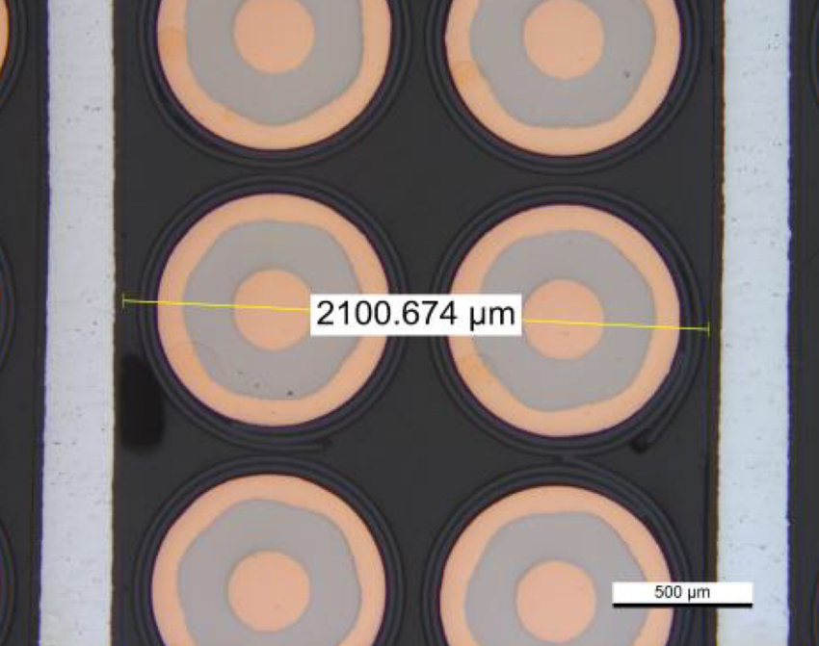
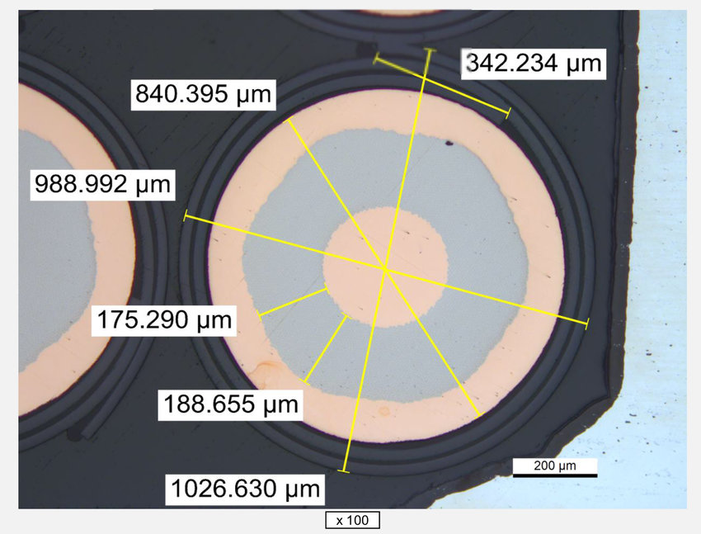
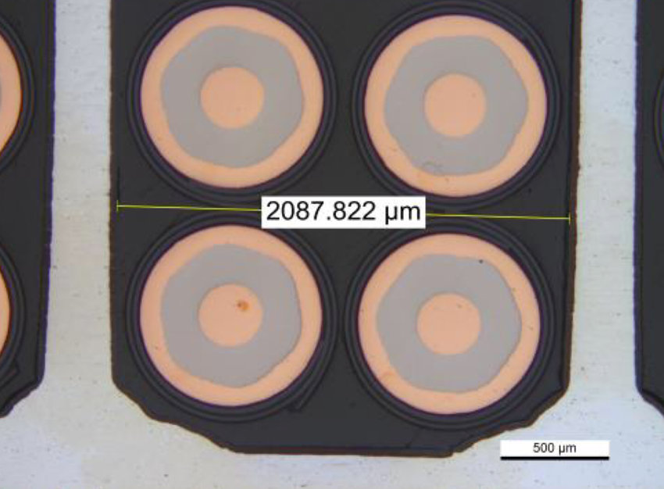
Groove size vs cable size
2100 μm vs 2 × 990 μm: there is an empty space of ±60 μm

Slide 19
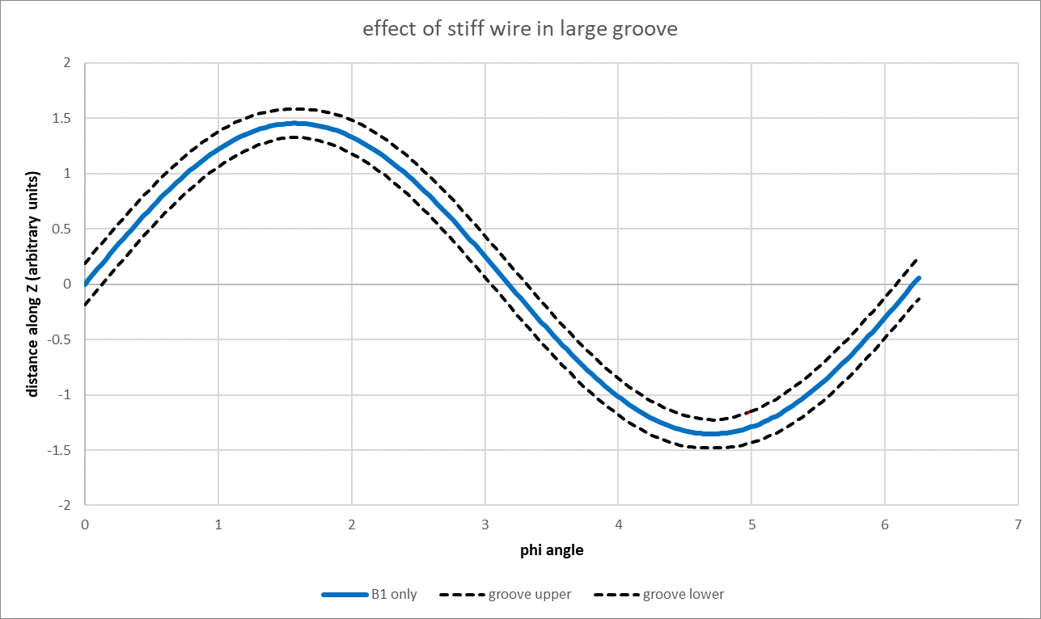
Slot around ideal position – B1 (dipole) case

Slide 20
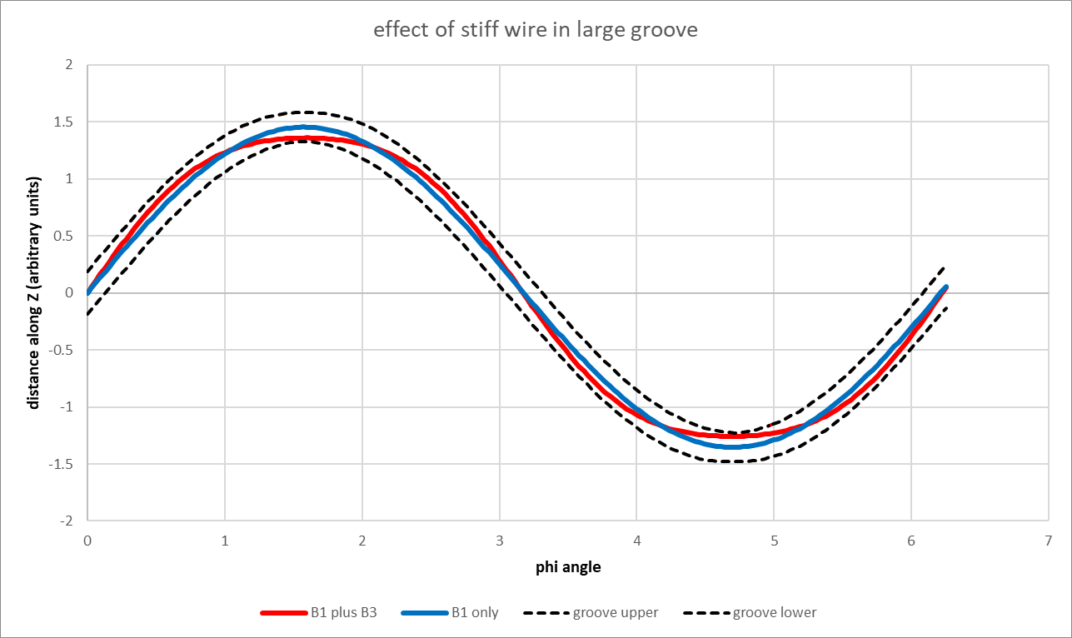
Positioning of a stiff wire in a larger groove

Slide 21
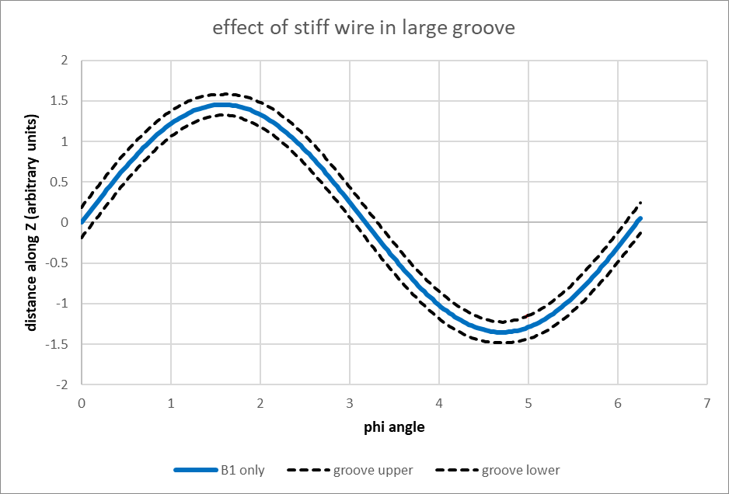
…or is it like this

Slide 22
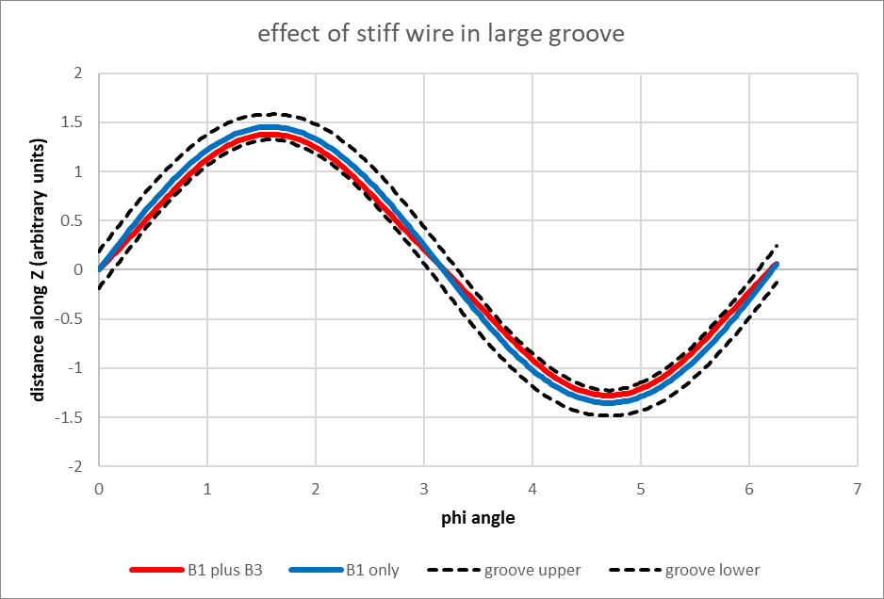
…or is it like this

Slide 23
What does this have to do with B3?
Actually, I have cheated. I do not (yet) have the a model for the position of a stiff wire inside a groove. What you saw in the previous slides is the addition of a B3 component to the existing B1 component
In the first plot, a B3 component of the same sign as the B1 component was added
In the second plot, a B3 and B5 component of the opposite sign were added
In both cases, the result is that around the bend the wire sits in the lowest allowed region of the groove
Question is: how many microns of wiggle do we need to get 10 units of B3?
Use Jeroen’s field program

Slide 24
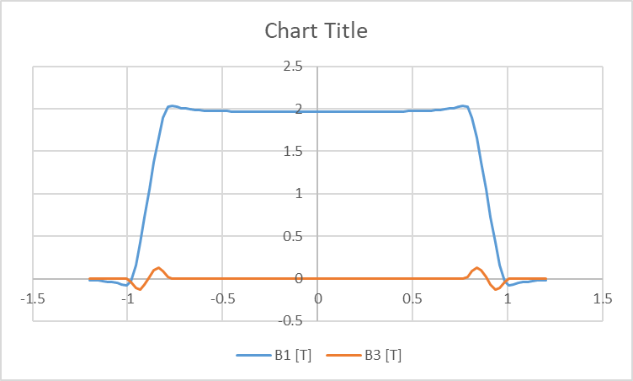
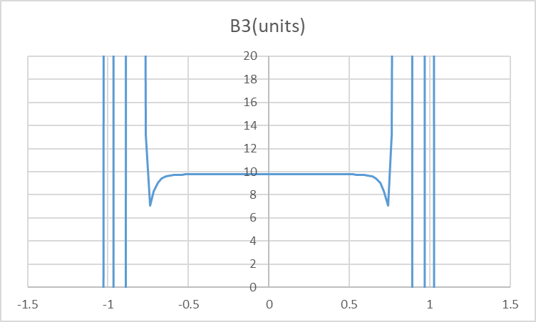
Model used
Inner radius of inner cable: 54.35; cable size 2X5mm; outer cable inner radius: 61.35
Strength of B1: maximum (60 degrees)
Strength of B3: 1/200th of maximum (0.3 degrees)

Slide 25
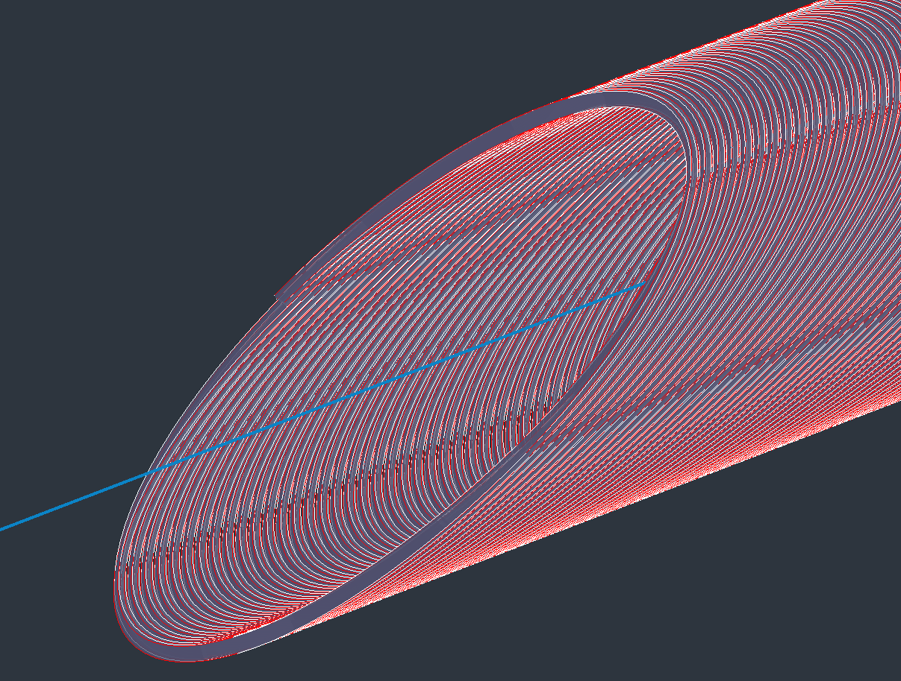
Effect on position of cable
Superposition of two coils: one with only B1, the second with B1 and B3 compomennts

Slide 26
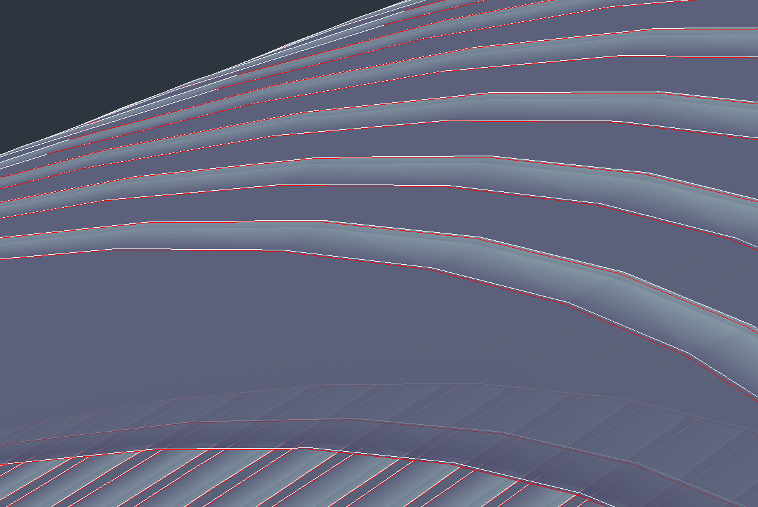
No B3 component
With 10 units of B3

Slide 27
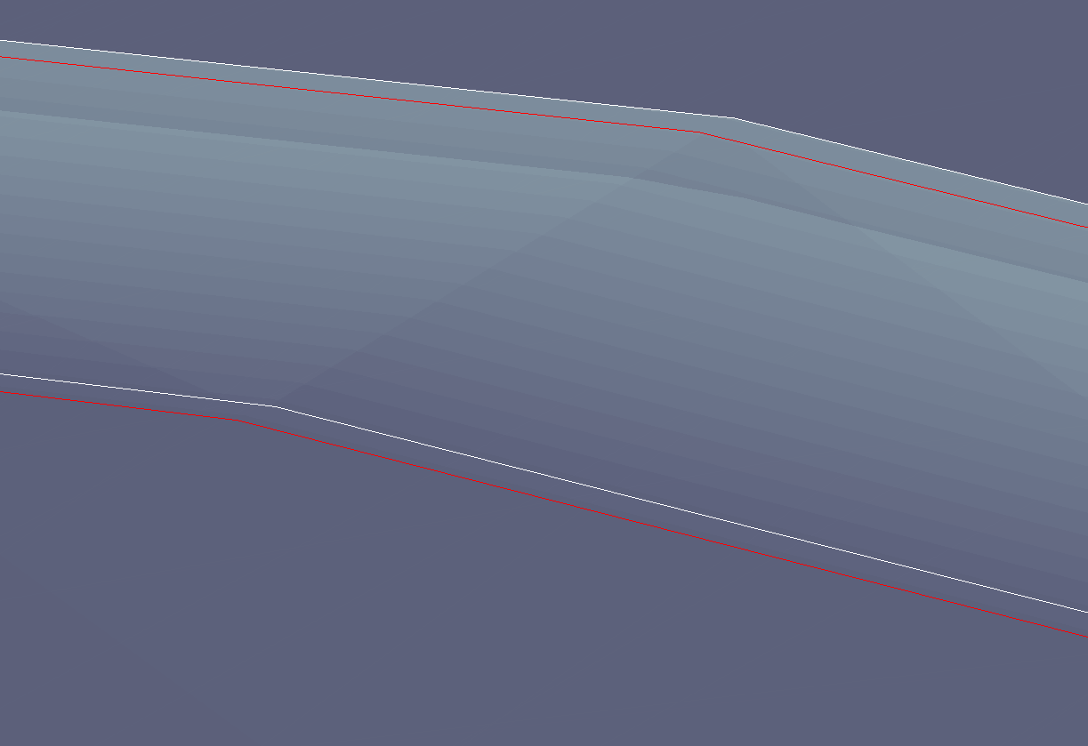
Old position
New position
Cable moved by 50-60 um (for 10 units of B3)

Slide 28
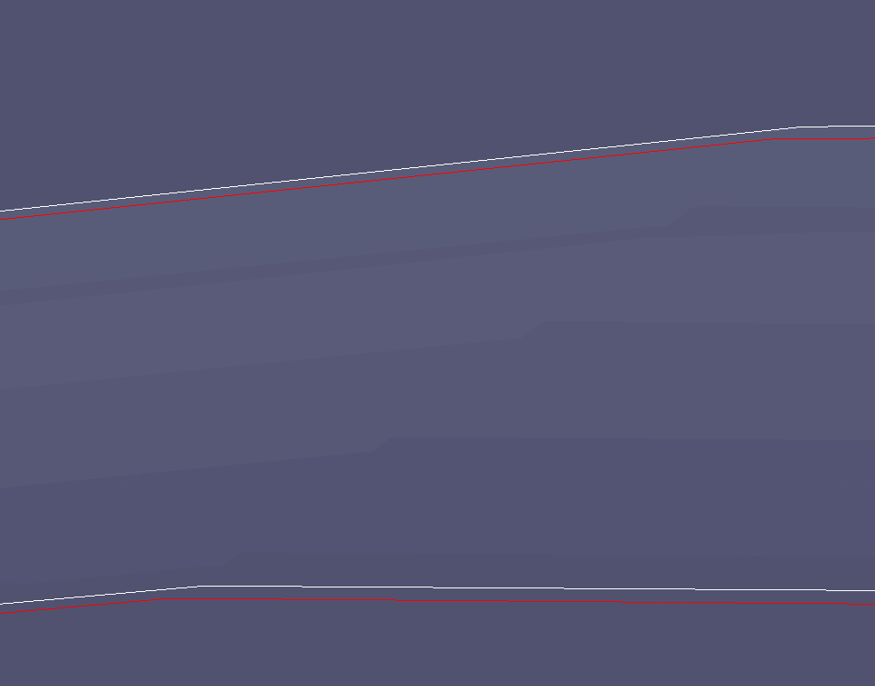
Max. displacement of cable and B3 component
50 um movement
10 units of B3

Slide 29
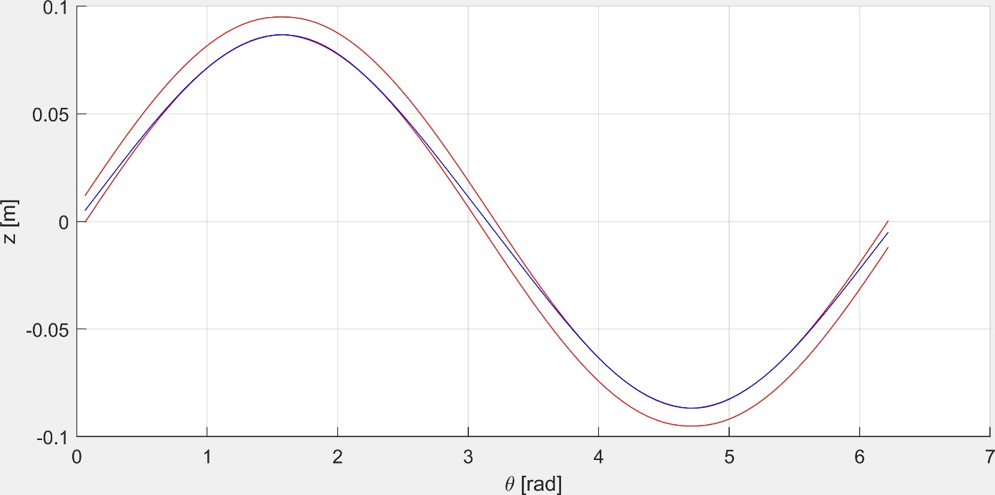
Model of a stiff wire in a groove
Work just started… modeling of the wire inside the groove, minimizing the potential energy of the wire
Following is a sneak preview of this work (that even gives the correct strength of B3 (10 units in a groove of 2.1 mm where the wire width is 2X1mm)
Jeroen van Nugteren

Slide 30
Possible mitigation strategies
Introduce a -10 units of B3 component
Tighter fitting cable in slot
Tension during winding ?? – this still has a few question marks until we understand the model well.

Slide 31
What about the 6 units of A2 found in one of the two apertures?
Best theory is that one of the apertures is not centered wrt to the iron yoke, but I have not tested it

Slide 32
Conclusions
I found a possible explanation for the large B3 component: it could be the combination of a stiff wire and a larger groove than the cable dimensions
The numbers match: B3 component magnitude is what is expected by the size of the groove (2100um) and he size of the cables (2X990um)

Slide 33
End

