Slide 1
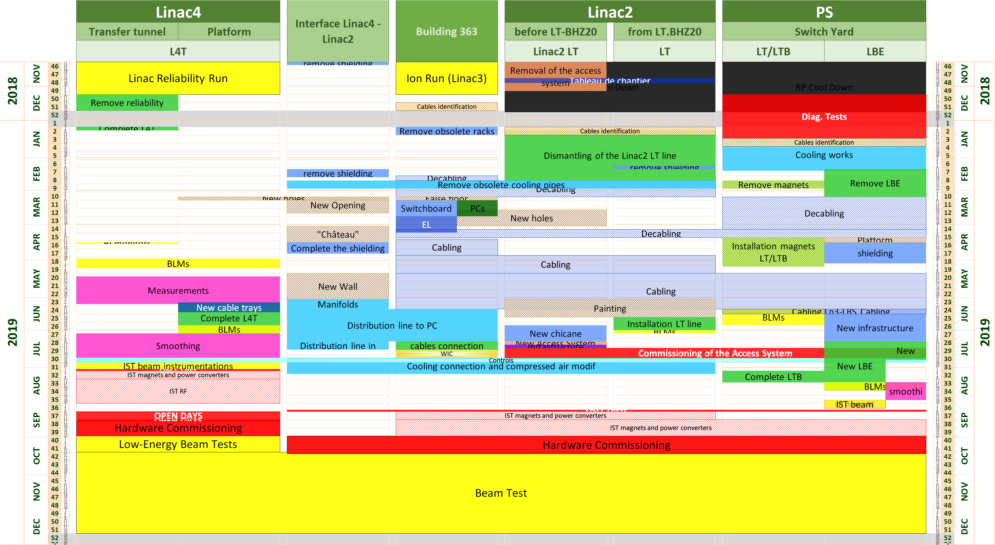
LIU-PLI
Linac4 Connection Schedule
Stop L4 end of week49
Wait for the end of Ion run in b.363
Open Days
Commissioning before beam test

Slide 2
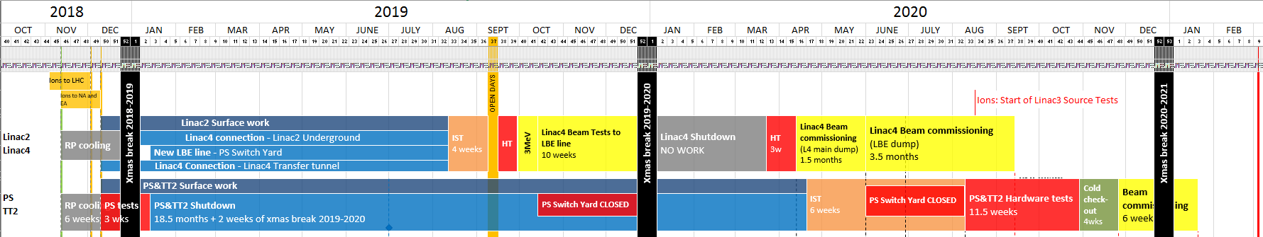
LIU-PLI
LS2 Master Schedule v.1.3 IN WORK
NO WORK
IST Period
with and without access
Beam Tests Period
without access
HC Period
without access
Low Energy Beam Test Period
with or without access
HC Period
without access
IST Period
To be defined in detailed with BE-OP

