Slide 1
LBE Run September – December 2019
–
Detailed Planning

Slide 2
Motivation
Crucial to assure that various beams for Run 3 can be provided within required specifications from Day 1
Long transfer line >150 m mostly composed of new equipment, matching of horizontal and vertical dispersion, line verified for 160 MeV beam energy, prove reaching range of required energy spread
Reach good beam quality before 2020 commissioning – assure that there are no show-stoppers and solve remaining issues
  For many parameter tests the LBE line is essential (debuncher commissioning, longitudinal painting, transverse performance at PSB entrance) and could not be worked on before
  If issues would be discovered by then, needs time (e.g. a couple of months for LLRF firmware upgrades)
  Cannot delay beam commissioning of downstream machines

Slide 3
Some expected changes before LBE line run
HW changes:
  Completion end of line L4T and connection with LT line
  Modifications LT/LTB lines in Linac2/PS tunnel
  Renewal LBE line
  Magnets, power supplies, BI, vacuum, dump, WIC, BIS to commission
Important decabling/cabling campaign mainly in PS → associated risks
Controls changes:
  CO requests 1-2 weeks mid-end June (for source controls) and 1 week in September (re-validation, new timings infrastructure, OASIS etc.)
New operational applications
Linac4 changes: still to be finalised with new Linac4 LS2 facility coordinator
  RF: filters to shorten transients, set up cavities for 600 us pulse length, PIMS11/12 + debuncher with energy ramping, solve cavity tuner spikes etc.
  BI: exchange Semgrids, laser emittance meter, repair of BSM1, new motor controllers for WS
  Source: new source? Autopilot? Modifications of source RF power supply
Commissioning of debuncher and longitudinal painting

Slide 4
Introductory remarks
Intense work with main actors to provide a detailed and aggressive daily planning after LS2 days
  Depends on outcome/follow-ups from the reliability run
  Could depend on the source strategy (caesiation periods, optimising beam with potential new volume source etc.)
  Performance of LLRF filters, debuncher, controls etc.
  Input from principal equipment groups included, but not yet complete picture (WIC commissioning duration/organisation etc.)
Unforeseen issues always happen and will require some internal planning flexibility

Slide 5
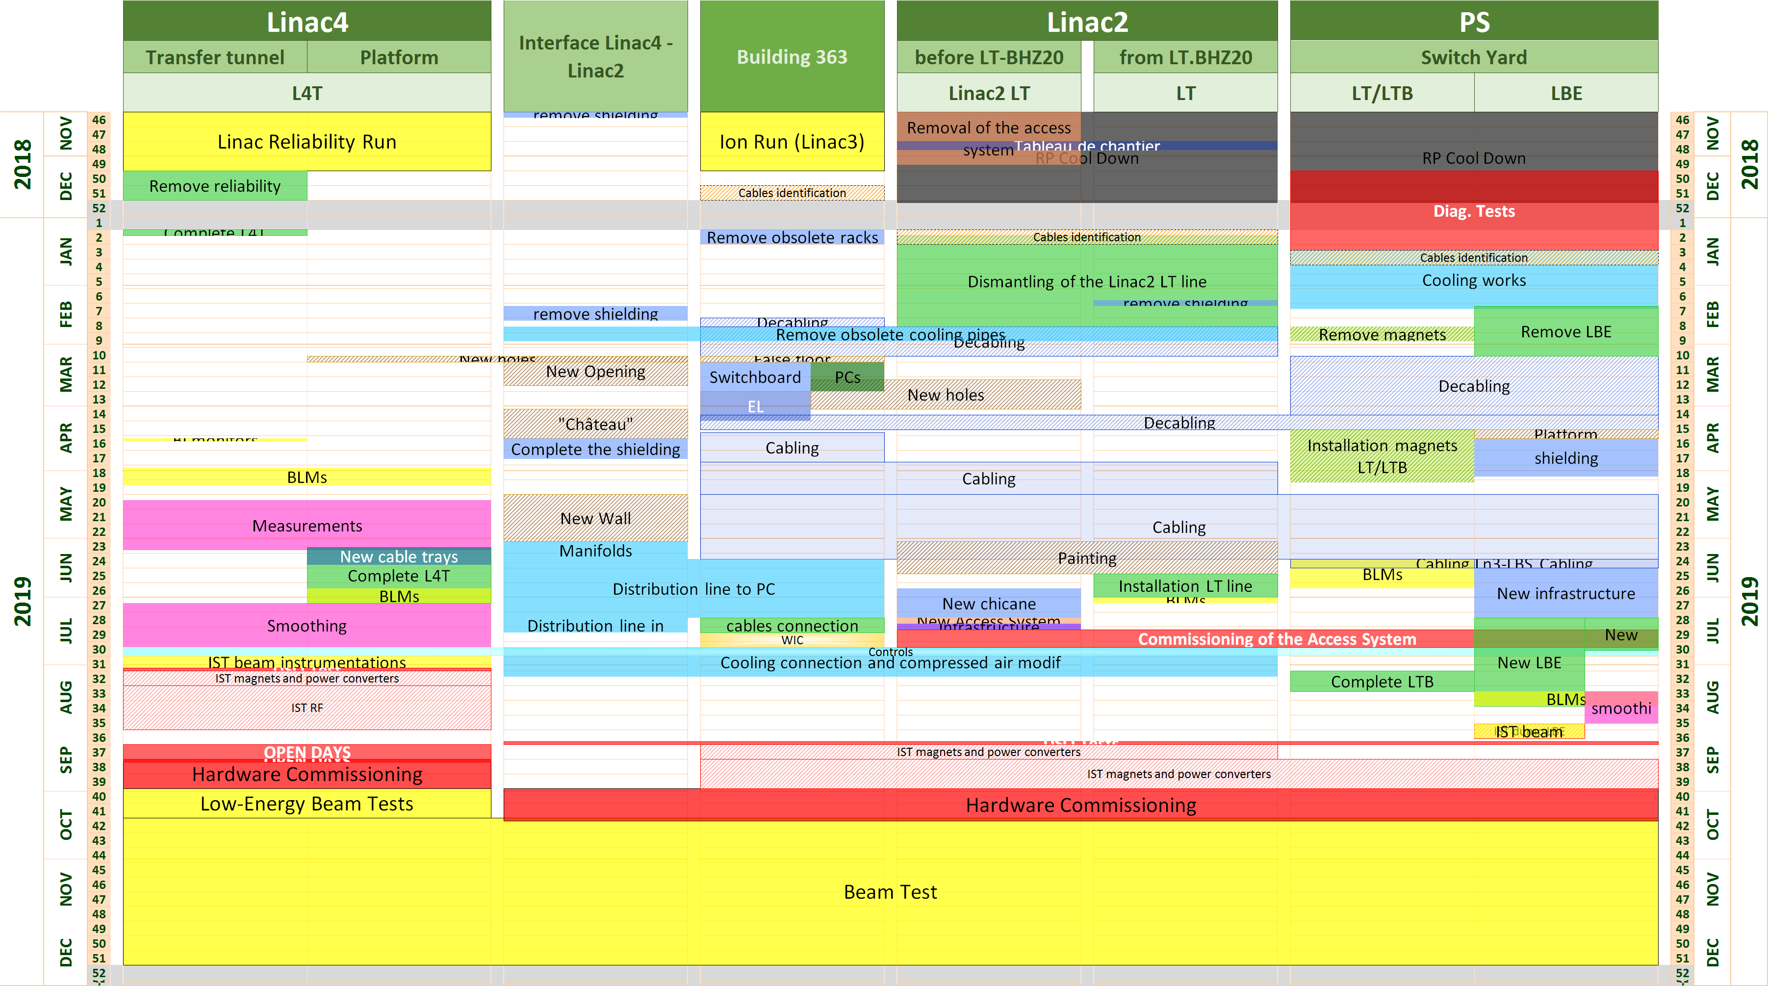
LS2 Schedule (see Julie’s presentation)
Risk of decabling/cabling activities, controls changes, additional week to set up RF for 600 us
long pulse and magnet polarity checks + WIC commissioning → mitigation through IST periods
compatible with Open Days and EN-ACE planning (tbc for Switchyard)

Slide 6
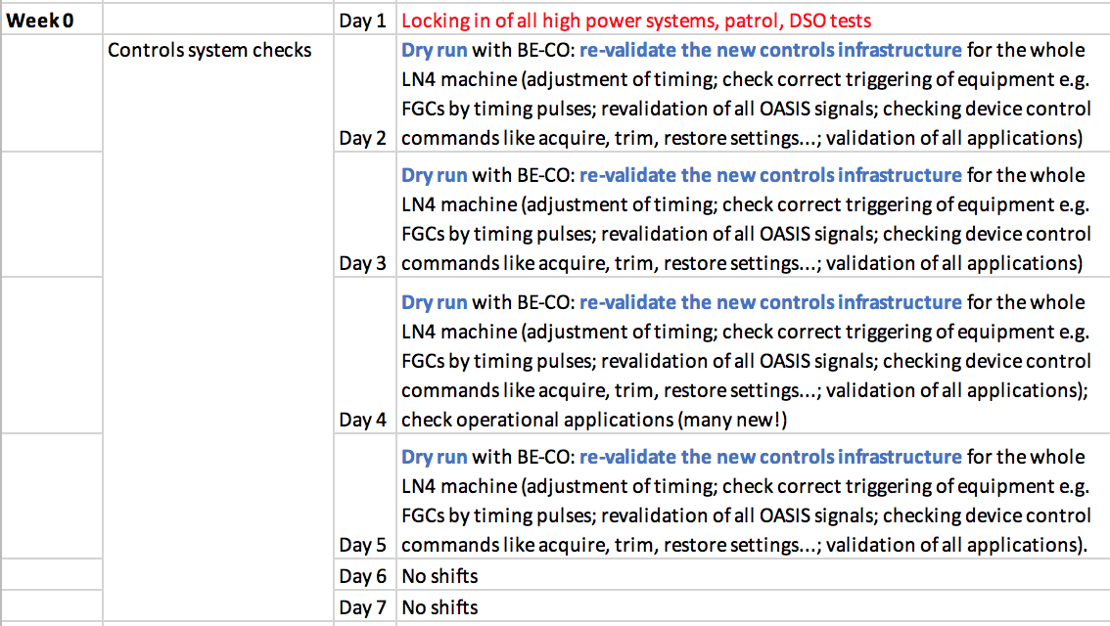
Linac4 IST – week 0 (19-23 Aug)
Have to stop Linac4 1 week before Open Days; ~2 days after Open Days for recovery, lock-in of equipment, patrol, beam permit, source restart…
IST can be arranged in August; no issues with co-activity; request is for 3 weeks (first week only CO + OP to assure controls infrastructure is available; new request by BE-CO)
Not considered
by previous
planning…

Slide 7
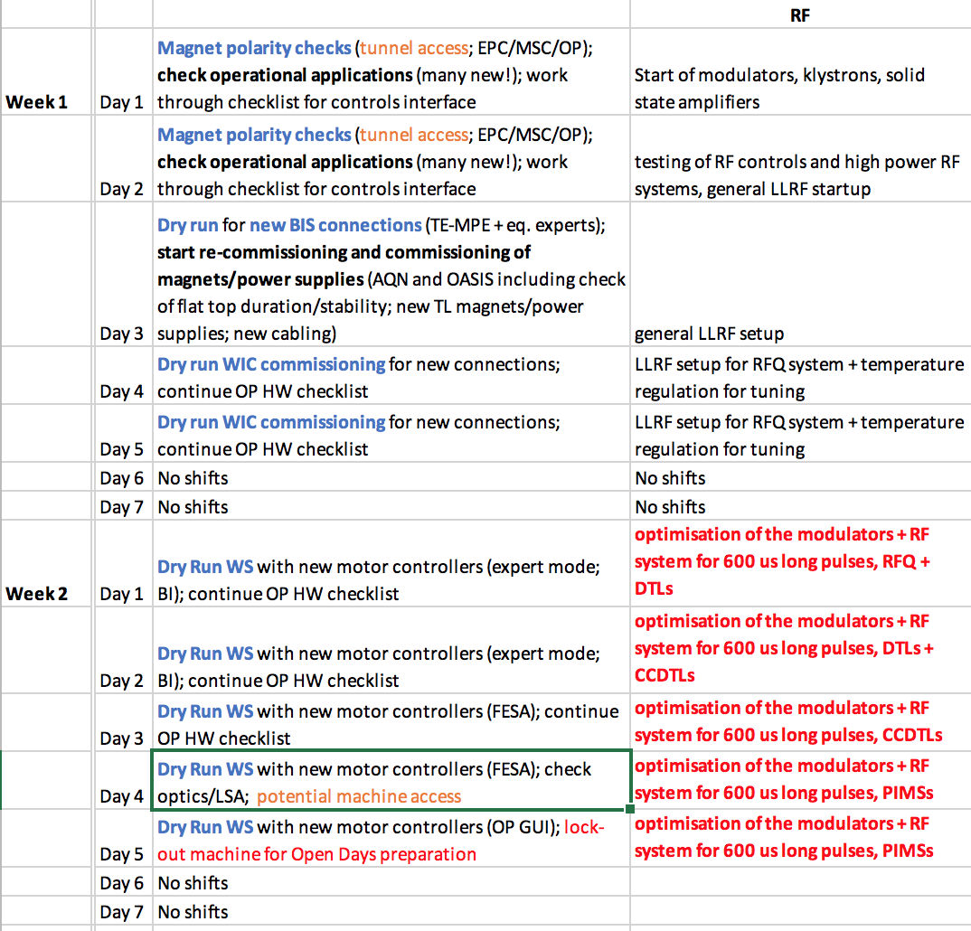
Linac4 IST – weeks 1+2 (26 Aug-6 Sep)
not testable in previous Linac4 runs
Not considered by previous planning; cannot be implemented during this run…

Slide 8
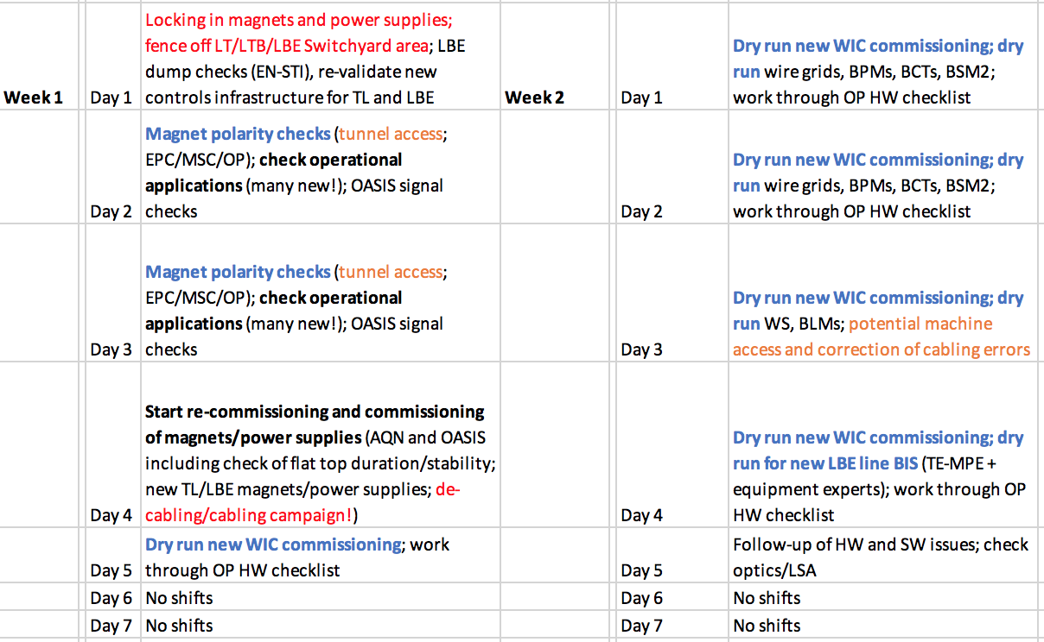
Linac2 and Switchyard IST – 2 weeks (16-29 Sep)
Could in principle start IST in Linac2 area 1 week earlier
Risk mitigation due to important de-cabling/cabling campaign
New magnets/power supplies/WIC/BIS/LBE line…

Slide 9
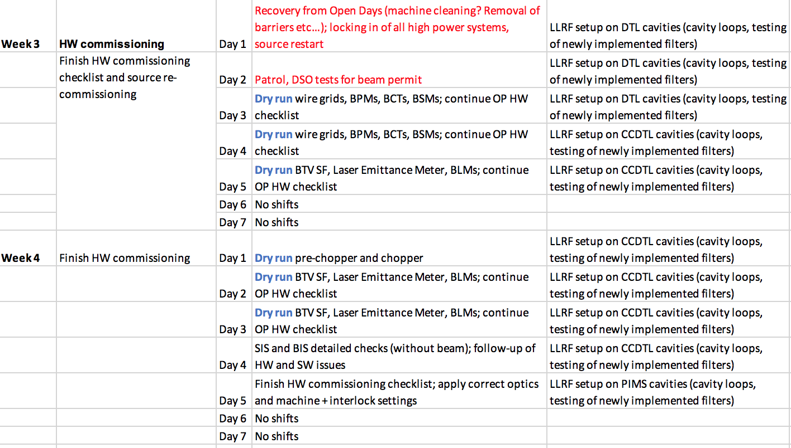
Global HW commissioning – 1.5 weeks (16-29 Sep)
Starts after Open Days RF

Slide 10
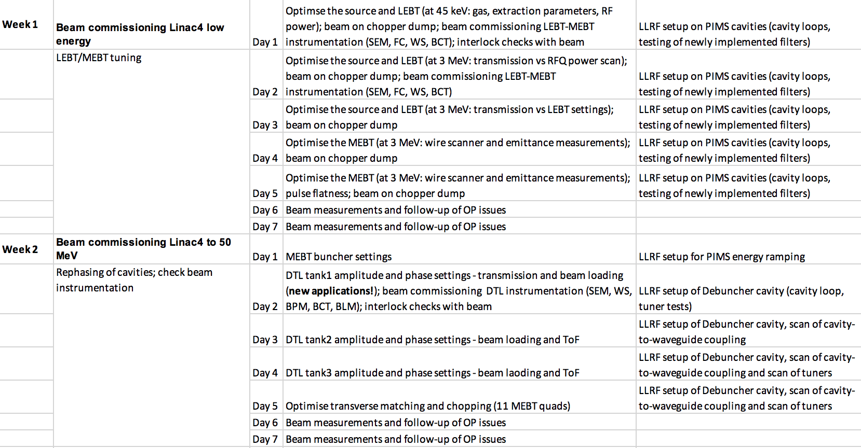
Beam commissioning – weeks 1+2 (30 Sep-13 Oct)
During this period TLs and LBE HW commissioning could continue in parallel

Slide 11
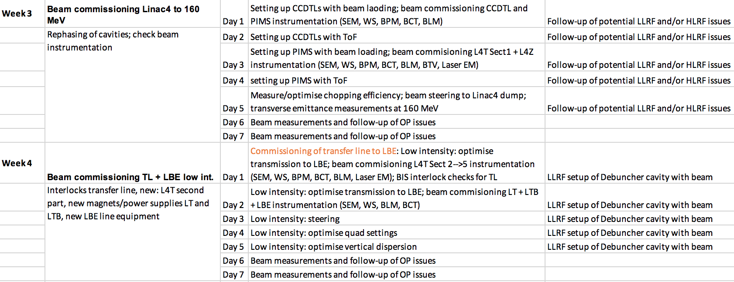
Beam commissioning – weeks 3+4 (14-27 Oct)

Slide 12
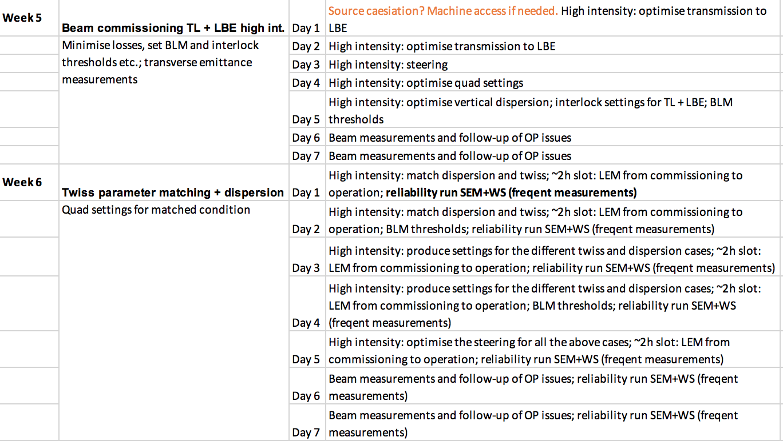
Beam commissioning – weeks 5+6 (28 Oct-10 Nov)

Slide 13
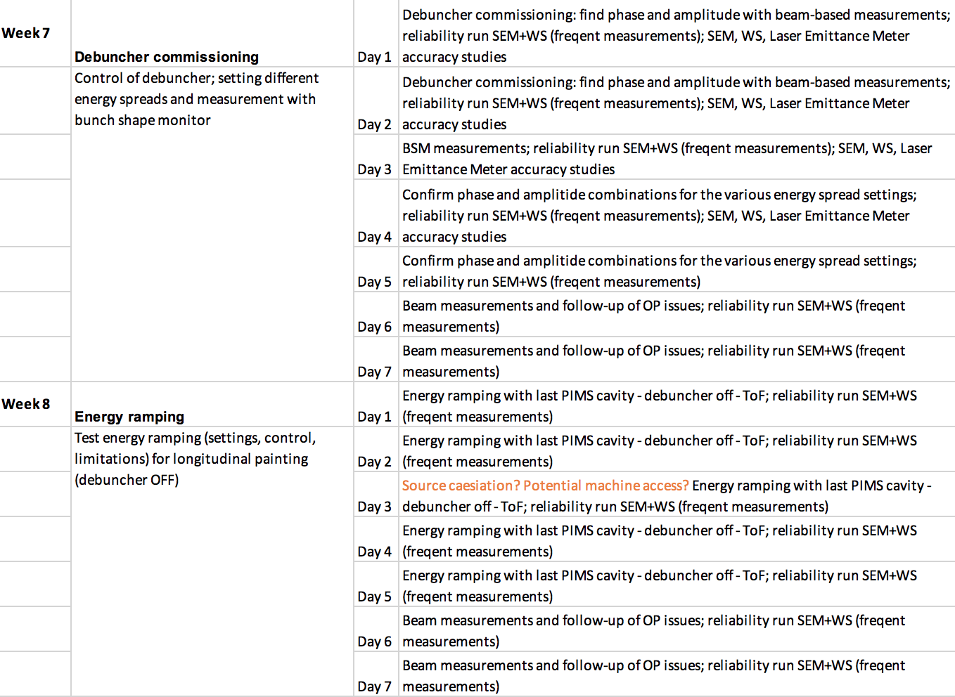
Beam commissioning – weeks 7+8 (11-24 Nov)
Joint setup ABP, RF, OP; week 8 BI data analysis and performance review

Slide 14
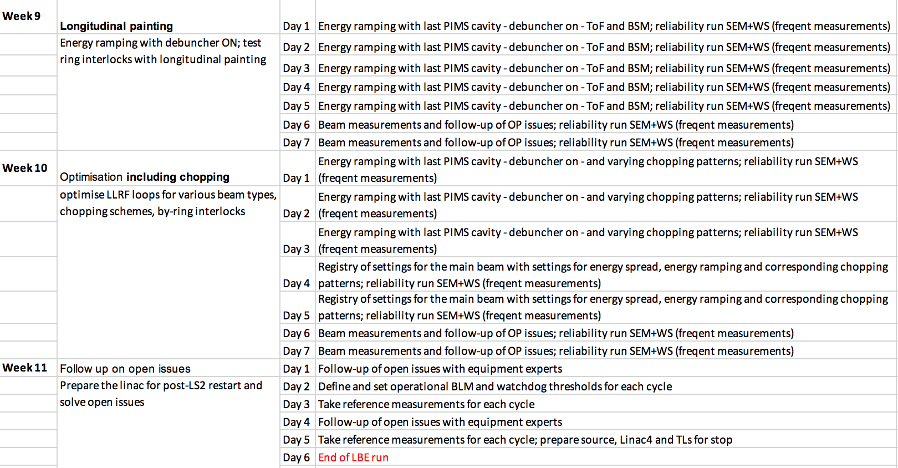
Beam commissioning – weeks 9+10+11 (25 Nov-13 Dec)
Depending on BI performance analysis, start BI system revalidation

Slide 15
Summary
Delayed LBE run planning compatible with the modified Linac4 connection planning; fits with Open Days constraints; IST periods maximise chances for a successful LBE line run (still tbc with Fernando for the Switchyard part)
Out of the 11 weeks of beam commissioning, 3 weeks are needed for re-commissioning the linac, 0.5 weeks for wrap-up, and 7.5 weeks correspond to previously non-testable/adjustable features
Sufficient time for LBE line run essential to test all that was impossible to be tested before
We might discover important issues that need some time to be cured before first beam to the PSB
What cannot be done during the LBE run will have to be reported to the Linac4 restart in 2020 – enough time for potential modifications?
Presented planning is very dense – could only be compressed through descoping, moving the problem to 2020 commissioning

